Slide 1


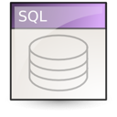



Databases for Developers
DBMS Fundamental Concepts

Slide 2

Relational Databases
Database models
Hierarchical (tree)
Network / graph
Relational (table)
Object-oriented
Relational databases
Represent a bunch of tables together with the relationships between them
Rely on a strong mathematical foundation: the relational algebra

Slide 3
Relational Database Management System (RDBMS)
Relational Database Management Systems (RDBMS) manage data stored in tables
RDBMS systems typically implement
Creating / altering / deleting tables and relationships between them (database schema)
Adding, changing, deleting, searching and retrieving of data stored in the tables
Support for the SQL language
Transaction management (optional)

Slide 4
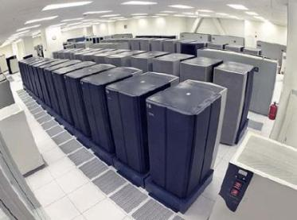

RDBMS Systems
RDBMS systems are also known as:
Database management servers
Or just database servers
Popular RDBMS servers:
Microsoft SQL Server
Oracle Database
MySQL
IBM DB2
PostgreSQL
SQLite

Slide 5
Relational Schema
Relational schema of a DB is the collection of:
The schemas of all tables
Relationships between the tables
Any other database objects (e.g. constraints)
The relational schema describes the structure of the database
Doesn't contain data, but metadata
Relational schemas are graphically displayed in Entity / Relationship diagrams (E/R Diagrams)

Slide 6
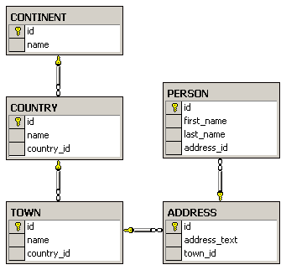
E/R Diagrams – Examples
The diagram is created with Microsoft SQL Server Management Studio

Slide 7

Tools for E/R Design
Data modeling tools allow building E/R diagrams, generate / import DB schemas:
SQL Server Management Studio
MySQL Workbench
Oracle JDeveloper
Microsoft Visio
CASE Studio
Computer Associates ERwin
IBM Rational Rose

Slide 8
Communicating with the DB
SQL statement is
sent to the DB server
SELECT Name
FROM Departments
Database
Name
Engineering
Sales
Marketing
…
The result is returned
(usually as a record set)

Slide 9
The SQL Language
SQL (Structured Query Language)
Standardized declarative language for manipulation of relational databases
SQL-99 is currently in use in most databases
http://en.wikipedia.org/wiki/SQL#Standardization
SQL language supports:
Creating, altering, deleting tables and other objects in the database
Searching, retrieving, inserting, modifying and deleting table data (rows)

Slide 10




Transactions
Begin / Commit / Rollback Transactions in SQL Server

Slide 11
What Is Concurrency Control?
Pessimistic concurrency (default in SQL Server)
Locks table data at each data modification
Concurrent users are blocked until the lock is released
Optimistic concurrency (default in MySQL)
No locks are performed when data is being read or changed
Concurrent users don’t see the changes until they are committed / rolled-back
Supported with SNAPSHOT isolation in SQL Server

Slide 12
Transactions
Transactions are a sequence of database operations which are executed as a single unit:
Either all of them execute successfully
Or none of them is executed at all
Example:
A bank transfer from one account into another (withdrawal + deposit)
If either the withdrawal or the deposit fails the entire operation should be cancelled

Slide 13
DB Transactions Lifecycle
Read
Write
Durable starting state
Sequence of reads and writes
Durable,
consistent,
ending state
Write
Commit
Rollback
Notes:
Two possible outcomes of the transaction: It completes successfully (as agreed by unanimous vote of all its participants) or it fails and rolls back to the state before the transaction started
Durable: if the transaction didn’t occur, this state would persist
Analogy: A contract negotiation either results in a successful signed contract, or it fails. There is no intermediate. Similarly, once it is signed, it exists as a whole, it cannot be broken into pieces. It is also durable, lasting as long as specified within the contract.

Slide 14
Transactions Behavior
Transactions guarantee the consistency and the integrity of the database
All changes in a transaction are temporary
Changes become final when COMMIT is successfully executed
At any time all changes done in the transaction can be canceled by executing ROLLBACK
All operations are executed as a single unit
Either all of them pass or none of them

Slide 15
Transactions: Example
Withdraw $100
Transfer $100
Read current balance
New balance = current - $100
Write new balance
Dispense cash
Read savings
New savings = current - $100
Read checking
New checking = current + $100
Write savings
Write checking
15

Slide 16


Transactions Properties
Modern DBMS servers have built-in transaction support
Implement “ACID” transactions
E.g. MS SQL Server, Oracle, MySQL, …
ACID means:
Atomicity
Consistency
Isolation
Durability
16

Slide 17
Transactions and SQL
Start a transaction
BEGIN TRANSACTION
Some RDBMS use implicit start, e.g. Oracle
Ending a transaction
COMMIT
Complete a successful transaction and persist all changes made
ROLLBACK
“Undo” changes from an aborted transaction
May be done automatically when failure occurs
17

Slide 18
The Implicit Transactions Option
What is implicit transactions mode?
Automatically start a new transaction after each commit or rollback
Nested transactions are not allowed
Transaction must be explicitly completed with COMMIT or ROLLBACK TRANSACTION
By default, IMPLICIT_TRANSACITONS setting is switched off
SET IMPLICIT_TRANSACTIONS ON

Slide 19


Triggers

Slide 20

Stored Procedures
Stored procedures (database-level procedures)
Consist of SQL-like code stored in the database
Code executed inside the database server
Much faster than an external code
Data is locally accessible
Can accept parameters
Can return results
Single value
Record sets

Slide 21
What Are Triggers?
Triggers are very much like stored procedures
Called in case of specific event
We do not call triggers explicitly
Triggers are attached to a table
Triggers are fired when a certain SQL statement is executed against the contents of the table
E.g. when a new row is inserted in given table

Slide 22
Types of Triggers
There are two types of triggers
After triggers
Instead-of triggers
After triggers
Fired when the SQL operation has completed and just before committing to the database
Instead-of triggers
Replace the actual database operations

Slide 23
After Triggers
Also known as "for-triggers" or just "triggers"
Defined by the keyword FOR
CREATE TRIGGER tr_TownsUpdate ON Towns FOR UPDATE
AS
IF (EXISTS(SELECT * FROM inserted WHERE Name IS NULL) OR
EXISTS(SELECT * FROM inserted WHERE LEN(Name) = 0))
BEGIN
RAISERROR('Town name cannot be empty.', 16, 1)
ROLLBACK TRAN
RETURN
END
GO
UPDATE Towns SET Name='' WHERE TownId=1
This will cause and error

Slide 24
Instead Of Triggers
Defined by using INSTEAD OF
CREATE TABLE Accounts(
Username varchar(10) NOT NULL PRIMARY KEY,
[Password] varchar(20) NOT NULL,
Active CHAR NOT NULL DEFAULT 'Y')
GO
CREATE TRIGGER tr_AccountsDelete ON Accounts
INSTEAD OF DELETE
AS
UPDATE a SET Active = 'N'
FROM Accounts a JOIN DELETED d
ON d.Username = a.Username
WHERE a.Active = 'Y'
GO

Slide 25

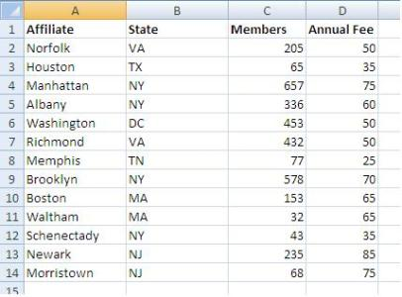

MS SQL Server
Overview

Slide 26
What is Microsoft SQL Server?
MS SQL Server is a Relational Database Management System (RDBMS) from Microsoft
The main language supported in SQL Server is Transact SQL (T-SQL), an extension of SQL
Powerful, trustworthy, easy-to-use DB server
The most recent version is SQL Server 2014
Works only on Windows systems
A free distribution exists (SQL Server Express)
http://www.microsoft.com/express/database/

Slide 27


Types of SQL Server Databases
System Databases
master
model
tempdb
msdb
distribution
pubs
Northwind
…
User Databases

Slide 28
SQL Server Databases
Each SQL Server database consists of two files:
.mdf file
Contains the core data in the database
Schema, tables data, and other database objects
.ldf file
Transaction log – keeps track of transactions
You need both these files to use the database

Slide 29
Connecting to SQL Server
Connecting to SQL Server requires
The name of the server (e.g. localhost)
The name of the DB instance (e.g. SQLEXPRESS)
The name of the database (e.g. Northwind)
Username / password (if using SQL Server authentication)
Types of authentication in SQL Server
Windows (by using a Windows user credentials)
Mixed (both Windows and SQL Server)

Slide 30
SQL Server Management Studio (SSMS)
SQL Server Management Studio (SSMS) is a powerful graphical DB management tool
Administrate databases (create, modify, backup / restore DB)
Create and modify E/R diagrams
View / modify table data and other DB objects
Execute SQL queries
Free and easy to use tool
Works with all SQL Server versions

Slide 31
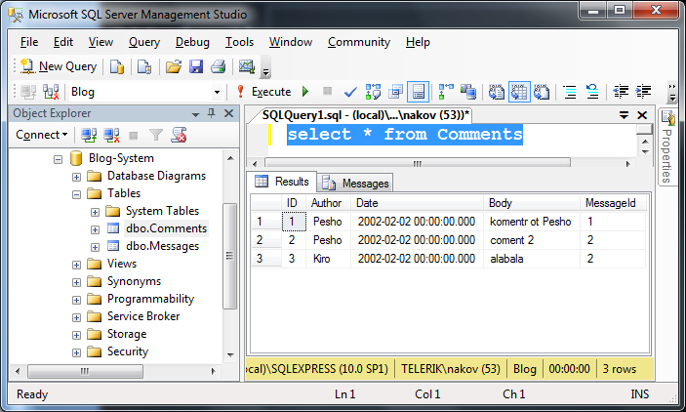
Executing SQL – Screenshot

Slide 32
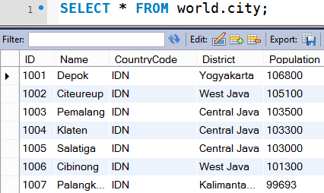

MySQL Server
Overview

Slide 33
What is MySQL?
MySQL Database Server
MySQL is open-source DB server (RDBMS)
World's most-popular open-source database
Mostly used to power web sites and small apps
Supports concurrency, transactions (full ACID)
Stored procedures, views, triggers, partitioning
Support clustering and replication
Free and paid editions
Community Server, Enterprise, Cluster CGE

Slide 34
MySQL Storage Engines
MyISAM
Fast, non-transactional → unreliable, forget it!
InnoDB
Fully ACID transactional, highly reliable
Recommended for most applications
Memory
Ultra-fast, non-persistent
CSV
Stores the data in CSV (text) files

Slide 35
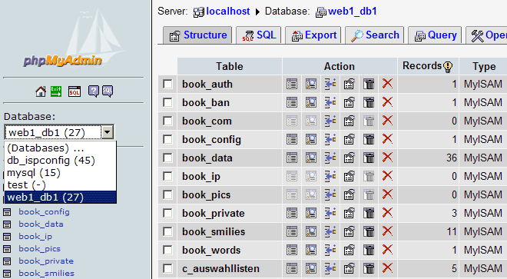
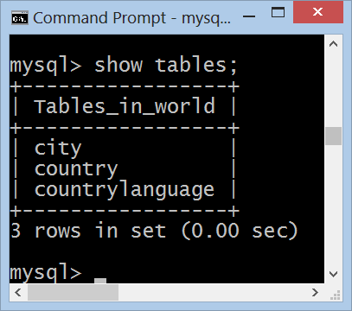
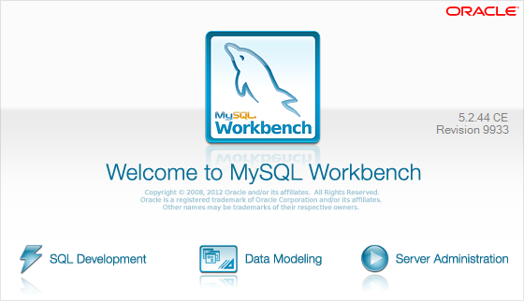

MySQL Administration Tools
The Console Client, MySQL Workbench, phpMyAdmin

Slide 36
Authentication and Login
MySQL uses traditional username / password authentication
The administrator's user is: root
The default password is specified during the installation process
Connecting through the console client
mysql –u root -p
use world;
select * from city limit 100;

Slide 37
MySQL Workbench
MySQL Workbench is free open-source GUI administration tool for MySQL
Execute SQL queries
Browse / edit table data
Create / modify relational schema
DB design (E/R diagrams)
Forward / reverse engineering
Visualize query plan

Slide 38
phpMyAdmin Tool
phpMyAdmin Tool
Web-based open-source MySQL admin tool

