Slide 1
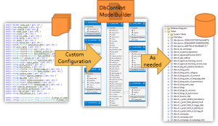
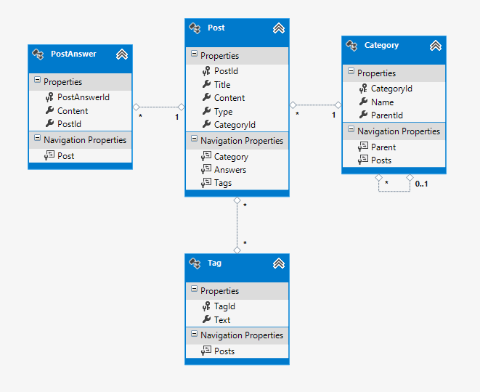
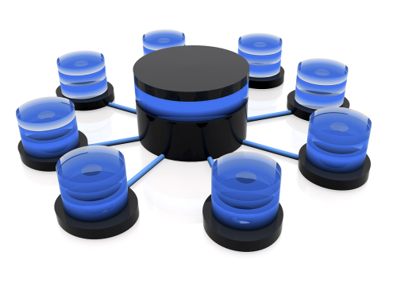


Entity Framework Code First

Slide 2
ORM Technologies
Object-Relational Mapping (ORM) is a programming technique for automatic mapping and converting data
Between relational database tables and object-oriented classes and objects
ORM creates a "virtual object database"
Which can be used from within the programming language, e.g. C# or Java
ORM frameworks automate the ORM process
A.k.a. object-relational persistence frameworks

Slide 3
ORM Frameworks
ORM frameworks typically provide the following functionality:
Creating object model by database schema
Creating database schema by object model
Querying data by object-oriented API
Data manipulation operations
CRUD – create, retrieve, update, delete
ORM frameworks automatically generate SQL to perform the requested data operations

Slide 4
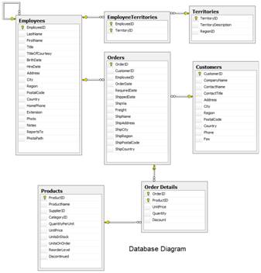
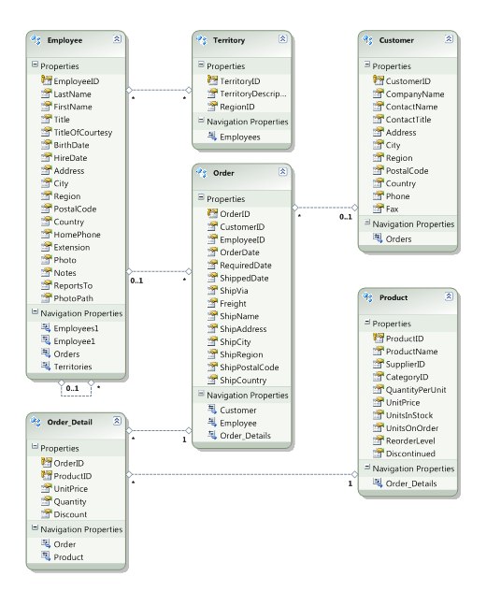




ORM Mapping – Example
Database and Entities mapping diagrams for a subset of the Northwind database
Relational database schema
ORM Entities (C# Classes)
ORM
Framework

Slide 5
ORM Advantages
Object-relational mapping advantages
Developer productivity
Writing less code
Abstract from differences between object and relational world
Complexity hidden within ORM
Manageability of the CRUD operations for complex relationships
Easier maintainability

Slide 6
ORM Frameworks in .NET
Built-in ORM tools in .NET Framework and VS
Entity Framework (LINQ-to-Entities)
LINQ-to-SQL
Both combine entity class mappings and code generation, SQL is generated at runtime
Third party ORM tools
NHibernate – the old daddy of ORM
Telerik OpenAccess ORM

Slide 7


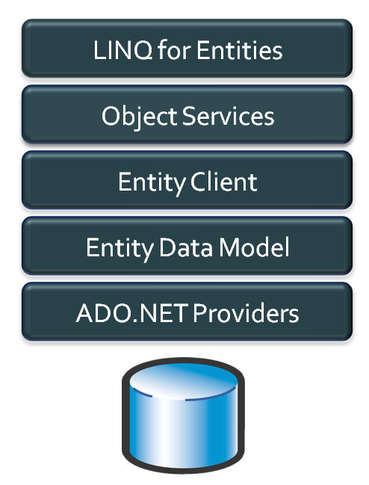
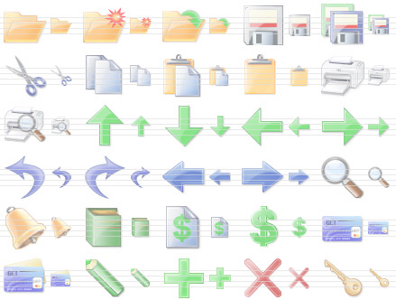
Entity Framework
Object Relation Persistence Framework

Slide 8
Overview of EF
Entity Framework (EF) is a standard ORM framework, part of .NET
Provides a run-time infrastructure for managing SQL-based database data as .NET objects
The relational database schema is mapped to an object model (classes and associations)
Visual Studio has built-in tools for generating Entity Framework SQL data mappings
Data mappings consist of C# classes and XML
A standard data manipulation API is provided

Slide 9
Entity Framework Features
Maps tables, views, stored procedures and functions as .NET objects
Provides LINQ-based data queries
Executed as SQL SELECTs on the database server (parameterized queries)
Built-in CRUD operations – Create/Read/Update/Delete
Creating or deleting the database schema
Tracks changes to in-memory objects

Slide 10
Entity Framework Features (2)
Works with any relational database with valid Entity Framework provider
Work with a visual model, database or with your own classes
Has very good default behavior
Very flexible for more granular control
Open source – independent release cycle
entityframework.codeplex.com
github.com/aspnet/EntityFramework

Slide 11
EF Components
The DbContext class
DbContext holds the database connection and the entity classes
Provides LINQ-based data access
Implements identity tracking, change tracking, and API for CRUD operations
Entity classes
Each database table is typically mapped to a single entity class (C# class)

Slide 12
EF Components (2)
Associations (Relationship Management)
An association is a primary key / foreign key based relationship between two entity classes
Allows navigation from one entity to another, e.g. Student.Courses
Concurrency control
Entity Framework uses optimistic concurrency control (no locking by default)
Provides automatic concurrency conflict detection and means for conflicts resolution

Slide 13
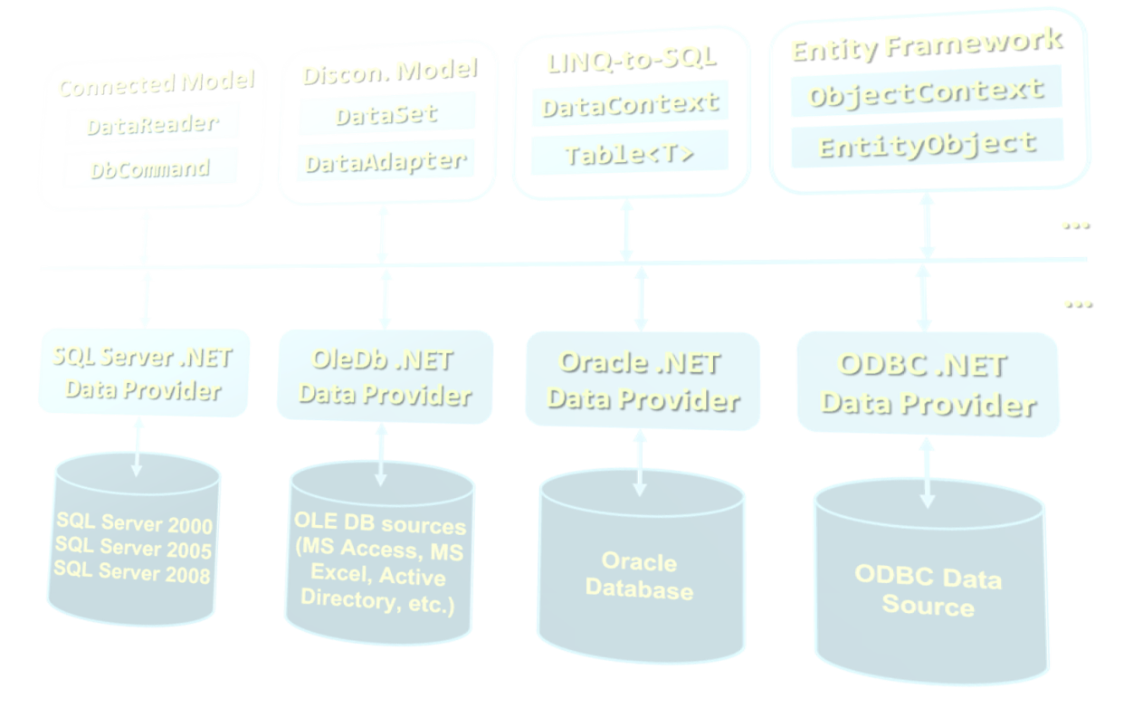

ADO.NET Architecture

Slide 14
What Is ADO.NET?
ADO.NET is a standard .NET class library for accessing databases, processing data and XML
A program model for working with data in .NET
Supports connected, disconnected and ORM data access models
Excellent integration with LINQ, XML and WCF
Allows executing SQL in RDBMS systems
DB connections, data readers, DB commands
Allows accessing data in the ORM approach
LINQ-to-SQL and ADO.NET Entity Framework

Slide 15
Namespaces In ADO.NET
System.Data
ADO.NET core classes
System.Data.Common
Common classes for all ADO.NET technologies
System.Data.Linq
LINQ-to-SQL framework classes
System.Data.Entity
Entity Framework classes
System.Xml
XML processing classes

Slide 16
Connecting to Non-Microsoft Databases
ADO.NET supports accessing various databases via their Data Providers:
OLE DB – supported internally in ADO.NET
Access any OLE DB-compliant data source
E.g. MS Access, MS Excel, MS Project, MS Exchange, Windows Active Directory, text files
Oracle – supported internally in ADO.NET
MySQL – third party extension
PostgreSQL – third party extension

Slide 17
Components of ADO.NET
Connected Model
Disconn. Model
LINQ-to-SQL
Entity Framework
DataReader
DataSet
DataContext
ObjectContext
DbCommand
DataAdapter
Table<T>
EntityObject
ADO.NET
Programming Model
…
…
SQL Server .NET Data Provider
OleDb .NET Data Provider
Oracle .NET Data Provider
ODBC .NET Data Provider

Slide 18

ADO.NET: LINQ-to-SQL
LINQ-to-SQL is ORM framework for SQL Server
Create object models mapping the database
Open a data context
Retrieve data with LINQ / modify the tables in the data context
Persist the data context changes into the DB
Connection is auto-closed
Table
Table
Table
DataContext
SqlConnection
Database

Slide 19
ADO.NET: Entity Framework
Entity Framework is generic ORM framework
Create entity data model mapping the database
Open an object context
Retrieve data with LINQ / modify the tables in the object context
Persist the object context changes into the DB
Connection is auto-closed
Entity
Entity
Entity
ObjectContext
EntityClient
Data Provider
SqlConnection
Database

Slide 20

Code First Main Parts
Domain classes, DbContext and DbSets

Slide 21
Modeling Workflow
Entity Framework supports three types of modeling workflow:
Database first
Create models as database tables
Use Management Studio or native SQL queries
Model first
Create models using visual EF designer in VS
Code first
Write models and combine them in DbContext

Slide 22
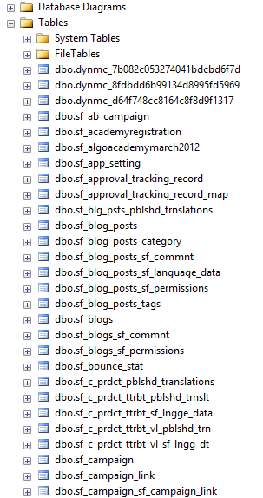
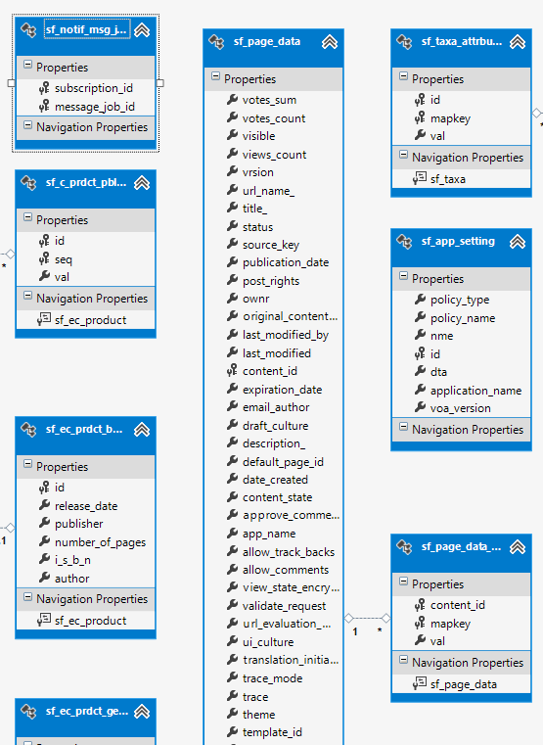
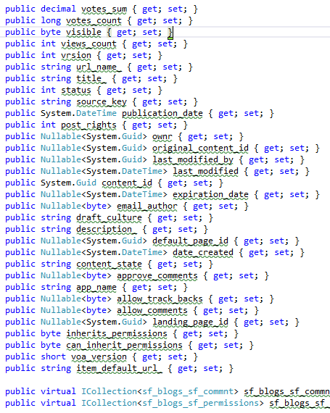
Database First Modeling Workflow
Create models as database tables and then generate code (models) from them

Slide 23
Model First Modeling Workflow

Slide 24
Code First Modeling Workflow
Domain classes
DbContext ModelBuilder
Custom Configuration
As needed

Slide 25
Why Use Code First?
Write code without having to define mappings in XML or create database models
Define objects in POCO
Reuse these models and their attributes
No base classes required
Enables database persistence with no configuration
Can use automatic migrations
Can use Data Annotations (Key, Required, etc.)

Slide 26
Domain Classes (Models)
Bunch of normal C# classes (POCO)
May contain navigation properties
Recommended to be in a separate class library
Primary key
public class PostAnswer
{
public int PostAnswerId { get; set; }
public string Content { get; set; }
public int PostId { get; set; }
public virtual Post Post { get; set; }
}
Foreign key
Virtual for lazy loading
Navigation property

Slide 27
DbContext Example
using System.Data.Entity;
using CodeFirst.Models;
public class ForumContext : DbContext
{
public DbSet<Category> Categories { get; set; }
public DbSet<Post> Posts { get; set; }
public DbSet<PostAnswer> PostAnswers { get; set; }
public DbSet<Tag> Tags { get; set; }
}

Slide 28
Database Connection Workflow
Connection String Available?
Database Exists?
Use Database
Build String (SQL Server Express or Create Local DB)
Create Database

Slide 29

Using Code First Migrations

Slide 30
Database Migration Strategies
CreateDatabaseIfNotExists (default)
DropCreateDatabaseIfModelChanges
We loose all the data when change the model
DropCreateDatabaseAlways
Great for automated integration testing
MigrateDatabaseToLatestVersion
This option uses our migrations
We can implement IDatabaseInitializer if we want custom migration strategy

Slide 31
Use Code First Migrations
First, enable code first migrations
Second, we need to tell to Entity Framework to use our migrations with code (or app.config)
We can configure automatic migration
Database.SetInitializer( new MigrateDatabaseToLatestVersion
<ForumContext, Configuration>());
This will allow us to delete or change properties
public Configuration()
{
this.AutomaticMigrationsEnabled = true;
this.AutomaticMigrationDataLossAllowed = true;
}

Slide 32
Seeding the Database
During a migration we can seed the database with some data using the Seed method
This method will be run every time (since EF 5)
protected override void Seed(ForumContext context)
{
/* This method will be called after migrating to
the latest version. You can use the
DbSet<T>.AddOrUpdate() helper extension method
to avoid creating duplicate seed data. E.g. */
context.Tags.AddOrUpdate(new Tag { Text = "срок" });
context.Tags.AddOrUpdate(new Tag { Text = "форум" });
}

Slide 33
Data Annotations
There is a bunch of data annotation attributes in System.ComponentModel.DataAnnotations
[Key] – specifies the primary key of the table
For validation: [StringLength], [MaxLength], [MinLength], [Required]
Schema: [Column], [Table], [ComplexType], [ConcurrencyCheck], [Timestamp], [ComplexType], [InverseProperty], [ForeignKey], [DatabaseGenerated], [NotMapped], [Index]
In EF 6 we will be able to add custom attributes by using custom conventions

Slide 34
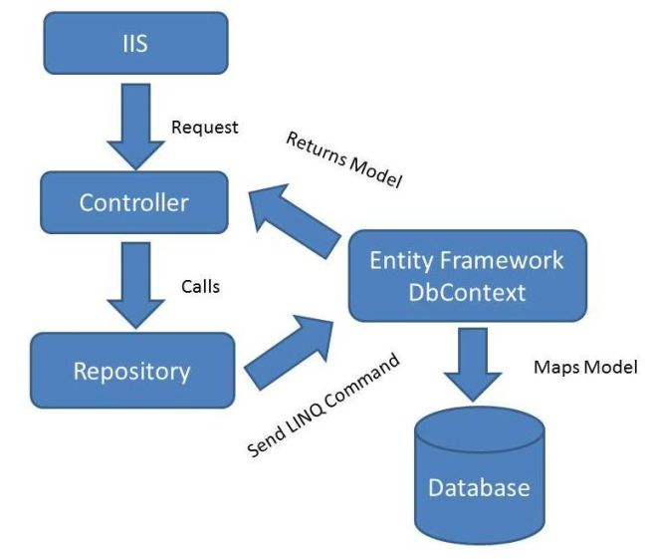
Repository Pattern

Slide 35


Reading Data with Entity Framework

Slide 36
The DbContext Class
The DbContext class is generated by the Visual Studio designer
DbContext provides:
Methods for accessing entities (object sets) and creating new entities (Add() methods)
Ability to manipulate database data though entity classes (read, modify, delete, insert)
Easily navigate through the table relationships
Executing LINQ queries as native SQL queries
Create the DB schema in the database server

Slide 37
Using DbContext Class
First create instance of the DbContext:
In the constructor you can pass a database connection string and mapping source
DbContext properties
Connection – the SqlConnection to be used
CommandTimeout – timeout for database SQL commands execution
All entity classes (tables) are listed as properties
e.g. IDbSet<Order> Orders { get; }
NorthwindEntities northwind = new NorthwindEntities();

Slide 38
Reading Data with LINQ Query
Executing LINQ-to-Entities query over EF entity:
Customers property in the DbContext:
using (var context = new NorthwindEntities())
{
var customers =
from c in context.Customers
where c.City == "London"
select c;
}
The query will be executes as SQL command in the database
public partial class NorthwindEntities : DbContext
{
public ObjectSet<Customer> Customers
{
get { … }
}
}

Slide 39
Reading Data with LINQ Query
We can also use extension methods (fluent API) for constructing the query
Find element by id
This is called
projection
using (var context = new NorthwindEntities())
{
var customerPhoness = context.Customers
.Select(c => c.Phone)
.Where(c => c.City == "London")
.ToList();
}
ToList() method executes the query
using (var context = new NorthwindEntities())
{
var customer = context.Customers.Find(2);
Console.WriteLine(customer.ContactTitle);
}

Slide 40
Incorrect Use of ToList()
In EF invoking ToList() executes the underlying SQL query in the database
Transforms IQueryable<T> to List<T>
Invoke ToList() as late as possible, after all filtering, joins and groupings
Avoid such code:
This will cause all order details to come from the database and to be filtered later in the memory
List<Order_Detail> orderItemsFromTokyo =
northwindEntities.Order_Details.ToList().
Where(od => od.Product.Supplier.City == "Tokyo").ToList();

Slide 41


Create, Update, Delete using Entity Framework

Slide 42
Creating New Data
To create a new database row use the method Add(…) of the corresponding collection:
// Create new order object
Order order = new Order()
{
OrderDate = DateTime.Now, ShipName = "Titanic",
ShippedDate = new DateTime(1912, 4, 15),
ShipCity = "Bottom Of The Ocean"
};
// Mark the object for inserting
context.Orders.Add(order);
context.SaveChanges();
This will execute an SQL INSERT
SaveChanges() method call is required to post the SQL commands to the database

Slide 43
Updating Existing Data
DbContext allows modifying entity properties and persisting them in the database
Just load an entity, modify it and call SaveChanges()
The DbContext automatically tracks all changes made on its entity objects
Order order = northwindEntities.Orders.First();
order.OrderDate = DateTime.Now;
context.SaveChanges();
This will execute an SQL UPDATE
This will execute an SQL SELECT to load the first order

Slide 44
Deleting Existing Data
Delete is done by Remove() on the specified entity collection
SaveChanges() method performs the delete action in the database
Order order = northwindEntities.Orders.First();
// Mark the entity for deleting on the next save
northwindEntities.Orders.Remove(order);
northwindEntities.SaveChanges();
This will execute an SQL DELETE command

Slide 45
Deleting Entities
Deleting entities (slower):
Executes SELECT + DELETE commands
Deleting entities with native SQL (faster):
Executes a single DELETE command
NorthwindEntities northwindEntities = new NorthwindEntities();
var category = northwindEntities.Categories.Find(46);
northwindEntities.Categories.Remove(category);
northwindEntities.SaveChanges();
NorthwindEntities northwindEntities = new NorthwindEntities();
northwindEntities.Database.ExecuteSqlCommand(
"DELETE FROM Categories WHERE CategoryID = {0}", 46);

Slide 46




Using Transactions in ADO.NET

Slide 47
Using Transactions
Working with transactions in ADO.NET
Beginning a transaction:
Including a command in a given transaction:
Committing / aborting a transaction:
SqlTransaction trans =
dbConnection.BeginTransaction();
sqlCommand.Transaction = trans;
trans.Commit();
trans.Rollback();

Slide 48
Using Transactions in Entity Framework

Slide 49
Transactions in Entity Framework (EF)
In EF ObjectContext.SaveChanges() always operates in a transaction
Either all changes are persisted, or none of them
Enable optimistic concurrency control by ConcurrencyMode=Fixed for certain property
OptimisticConcurrencyException is thrown when the changes cannot be persisted
Conflicts can be resolved by ObjectContext. Refresh(StoreWins / ClientWins)
You still can use TransactionScope in EF

Slide 50
Transactions in EF – Example
NorthwindEntities context = new NorthwindEntities();
// Add a valid new category
Category newCategory = new Category() {
CategoryName = "New Category",
Description = "New category, just for testing"
};
context.Categories.AddObject(newCategory);
// Add an invalid new category
Category newCategoryLongName = new Category() {
CategoryName = "New Category Loooooooong Name",
};
context.Categories.AddObject(newCategoryLongName);
// The entire transaction will fail due to
// insertion failure for the second category
context.SaveChanges();

