Slide 1



NoSQL Databases
NoSQL Concepts

Slide 2


Relational vs. NoSQL Databases
Relational databases
Data stored as table rows
Relationships between related rows
Single entity spans multiple tables
RDBMS systems are very mature, rock solid
NoSQL databases
Data stored as documents
Single entity (document) is a single record
Documents do not have a fixed structure

Slide 3
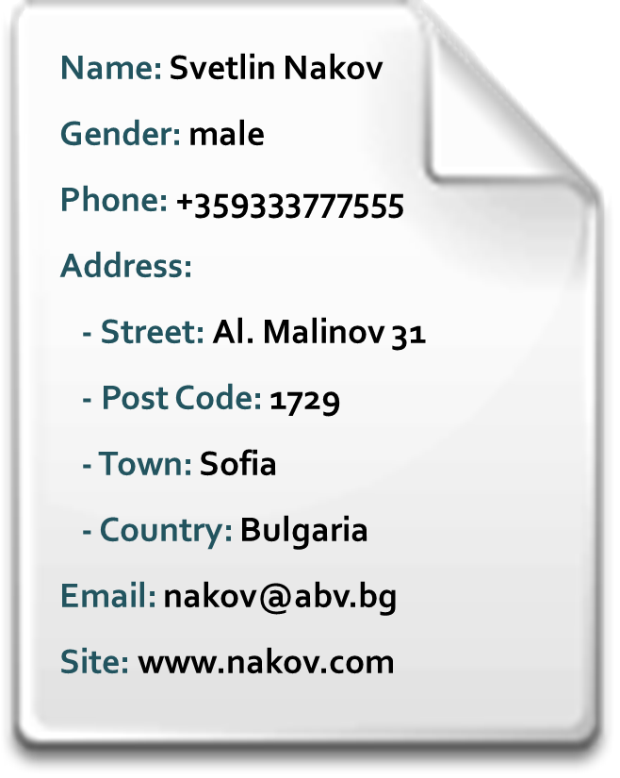

Non-Relational Data Models
Document model
Set of documents, e.g. JSON strings
Key-value model
Set of key-value pairs
Hierarchical key-value
Hierarchy of key-value pairs
Wide-column model
Key-value model with schema
Object model
Set of OOP-style objects

Slide 4

What is NoSQL Database?
NoSQL (non-relational) databases
Use document-based model (non-relational)
Schema-free document storage
Still support CRUD operations (create, read, update, delete)
Still support indexing and querying
Still supports concurrency and transactions
Highly optimized for append / retrieve
Great performance and scalability
NoSQL == “No SQL” or “Not Only SQL”?

Slide 5

Relational vs. NoSQL Models
Relational Model
Document Model
Name | Svetlin Nakov
Gender | male
Phone | +359333777555
Email | nakov@abv.bg
Site | www.nakov.com
Name: Svetlin Nakov
Gender: male
Phone: +359333777555
Address:
- Street: Al. Malinov 31
- Post Code: 1729
- Town: Sofia
- Country: Bulgaria
Email: nakov@abv.bg
Site: www.nakov.com
*
1
Street | Al. Malinov 31
Post Code | 1729
*
1
Town | Sofia
*
1
Country | Bulgaria

Slide 6




NoSQL Database Systems
Redis
Ultra-fast in-memory data structures server
MongoDB
Mature and powerful JSON-document database
CouchDB
JSON-based document database with REST API
Cassandra
Distributed wide-column database
DB Ranking: http://db-engines.com/en/ranking

Slide 7
MongoDB Structure
How is the data structured in MongoDB

Slide 8
MongoDB
MongoDB is an open-source document store database
Save JSON-style objects with dynamic schemas
Support for indices
Has document-based queries
CRUD operations

Slide 9
Using MongoDB
Download MongoDB from the official web site:
https://www.mongodb.org/downloads
Installers for all major platforms
When installed, MongoDB needs a driver to be usable with a specific platform
One for .NET, another for Node.JS, etc…
To install the MongoDB driver for .NET run in Visual Studio's Package Manager Console
Install-Package mongocsharpdriver

Slide 10
MongoDB Structure
A MongoDB instance can have many databases
A database can have many collections
A collection can have many documents
MongoDB Instance
Database
Database
Collection
Collection
Collection
Document
Database
Collection
Collection
Document
Document
Collection
Collection
Database

Slide 11
MongoDB Documents
Documents in MongoDB are JSON objects
Name: Databases
Students: 250
Titles:
- Intro to SQL
- NoSQL databases
- Entity Framework
Evaluation:
- Homework: 10
- Exam: 60
- Teamwork: 20
- Attendance: 10
{"name": "Databases",
"students": 250,
"titles": [
"Intro to SQL",
"NoSQL databases",
"Entity Framework"
],
"evaluation": {
"homework": 10,
"exam": 60,
"teamwork": 20,
"attendance": 10
}

Slide 12
Connecting to MongoDB with .NET and C#
The C# driver for MongoDB provides a .NET SDK for working with MongoDB
Init a MongoClient with a connection string
MongoClient client = new MongoClient("mongodb://localhost);
Host the MongoDB instance
MongoServer server = client.GetServer();
Connect to a database
If the db does not exists, it will be createad
MongoDatabase db = server.GetDatabase("logger");
Work with the database

Slide 13
The .NET MongoDB SDK
The .NET driver provides a SDK to work with MongoDB databases
Supports CRUD operations
create, read, update and delete
Can create indexes
Provides LINQ-like functionality
That is executed over the database using the native query commands
Does not have transactions
Still has atomicity on single document

Slide 14
CRUD Over MongoDB with .NET
A collection must be created/fetched
Before performing any operations
var logsCollection = db.GetCollection<Log>("logs");
All operations are done over this collection:
Fetch documents
Update
logsCollection.FindAll();
logs.FindOneById(id);
logsCollection.Update(
query, update);
Insert
Remove
logsCollection.Insert(log);
logs.Remove(removeQuery);

Slide 15
LINQ-to-MongoDB
The MongoDB C# driver supports part of LINQ over MongoDB collections
Only LINQ queries that can be translated to an equivalent MongoDB query are supported
Others throw runtime exception and the error message will indicate which part of the query wasn’t supported
var logs =
from log in db.GetCollection<Log>("Logs").AsQueryable<Log>()
where log.LogType.Type == "ticket" &&
log.LogType.State == "pending"
select log;

Slide 16

Redis
Ultra-Fast Data Structures Server

Slide 17
What is Redis?
Redis is
Ultra-fast in-memory key-value data store
Powerful data structures server
Open-source software: http://redis.io
Redis stores data structures:
Strings
Lists
Hash tables
Sets / sorted sets

Slide 18
Working with Redis and .NET
Install the Redis Client of ServiceStack.Net
Free and intuitive to use
Run in VS console
Then:
Install-Package ServiceStack.Redis
var redis = new RedisClient(host);
var redisLogs = redis.As<Log>();
redisLogs.Store(newTodo);
redisLogs.GetAll()
.Print();

Slide 19
Redis Persistence
Redis runs in the memory
That is the reason to be that fast
Redis saves the data on the disk at a given period
By default:
save 900 1 // 1 key for 900 seconds
save 300 10 //10 keys for 300 seconds
save 60 10000 // 10000 keys for 60 seconds

Slide 20
The JSON Data Format
What is JSON?

Slide 21
The JSON Data Format
JSON (JavaScript Object Notation) is a lightweight data format
Human and machine-readable
Based on the way to create objects in JS
Platform independent – can be used with any programming language

Slide 22

JSON Rules
The JSON data format follows the rules of object creation in JavaScript
Strings, numbers and Booleans are valid JSON
"this is string and is valid JSON"
Arrays are valid JSON
[5, 'string', true]
Objects are valid JSON
{
"firstname": "Doncho",
"lastname": "Minkov",
"occupation": "Technical trainer"
}

Slide 23
Built-in JSON Serializers
.NET has built-in JSON serializer:
The JavaScriptSerializer class, contained in System.Web.Extensions assembly
JavaScriptSerializer has parsing from object to JSON string and vice versa:
var place = new Place(…);
var serializer = new JavaScriptSerializer();
var jsonPlace = serializer.Serialize(place);
var objPlace = serializer.Deserialize<place>(jsonPlace);

Slide 24
JavaScriptSerializer Features
JavaScript serializer has nice features:
Serializing objects to JSON and vice versa
Correct parsing of dictionaries:
Is parsed to
digits = new Dictionary<string, int>
{
{ "one", 1},
{ "two", 2},
…
};
{
"one": 1, "two": 2,
"three": 3,
"four": 4,
…
}

Slide 25
JSON.NET
JavaScriptSerializer is good
But JSON.NET is better
JSON.NET:
Has better performance
Supports LINQ-to-JSON
Has an out-of-the-box support for parsing between JSON and XML

Slide 26
Installing JSON.NET
To install JSON.NET run in the Package Manager Console:
$ Install-Package Newtonsoft.Json
Has two primary methods:
Serialize an object:
var serializedPlace =
JsonConvert.SerializeObject(place);
Deserialize an object:
var deserializedPlace =
JsonConvert.DeserializeObject<Place>(serializedPlace);

Slide 27
JSON.NET Features
JSON.NET can be configured to:
Indent the output JSON string
To convert JSON to anonymous types
To control the casing and properties to parse
To skip errors
JSON.NET also supports:
LINQ-to-JSON
Direct parse between XML and JSON

Slide 28
Configuring JSON.NET
To indent the output string use Formattingg.Indented:
JsonConvert.SerializeObject(place, Formatting.Indented);
Deserializing to anonymous types:
var json = @"{ 'firstName': 'Doncho',"
'lastName': 'Minkov', 'occupation': 'Technical Trainer' }";
var template = new
{
FirstName = "",
Lastname = "",
Occupation = ""
};
var person =
JsonConvert.DeserializeAnonymousType(json, template);
Should provide a template
Should provide a template

Slide 29
JSON.NET Parsing of Objects
By default JSON.NET takes each Property/Field from the public interface of a class and parses it as is
This can be controlled using attributes:
Tells the converter to parse "Username" to "user"
public class User
{
[JsonProperty("user")]
public string Username{get;set;}
[JsonIgnore]
public string Password{get;set;}
}
Tells the converter to skip the property "Password"

Slide 30
LINQ-to-JSON
JSON.NET has a support for LINQ-to-JSON
var jsonObj = JObject.Parse(json);
Console.WriteLine("Places in {0}:", jsonObj["name"]);
jsonObj["places"].Select(
pl =>
string.Format("{0}) {1} ({2})",
index++,
pl["name"],
string.Join(", ",
pl["categories"].Select(
cat => cat["name"]))))
.Print();

