Slide 1
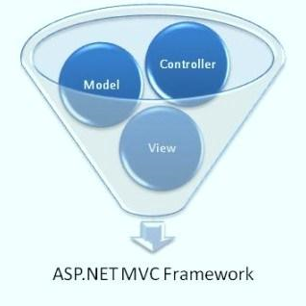



Introduction to ASP.NET MVC

Slide 2
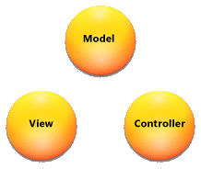
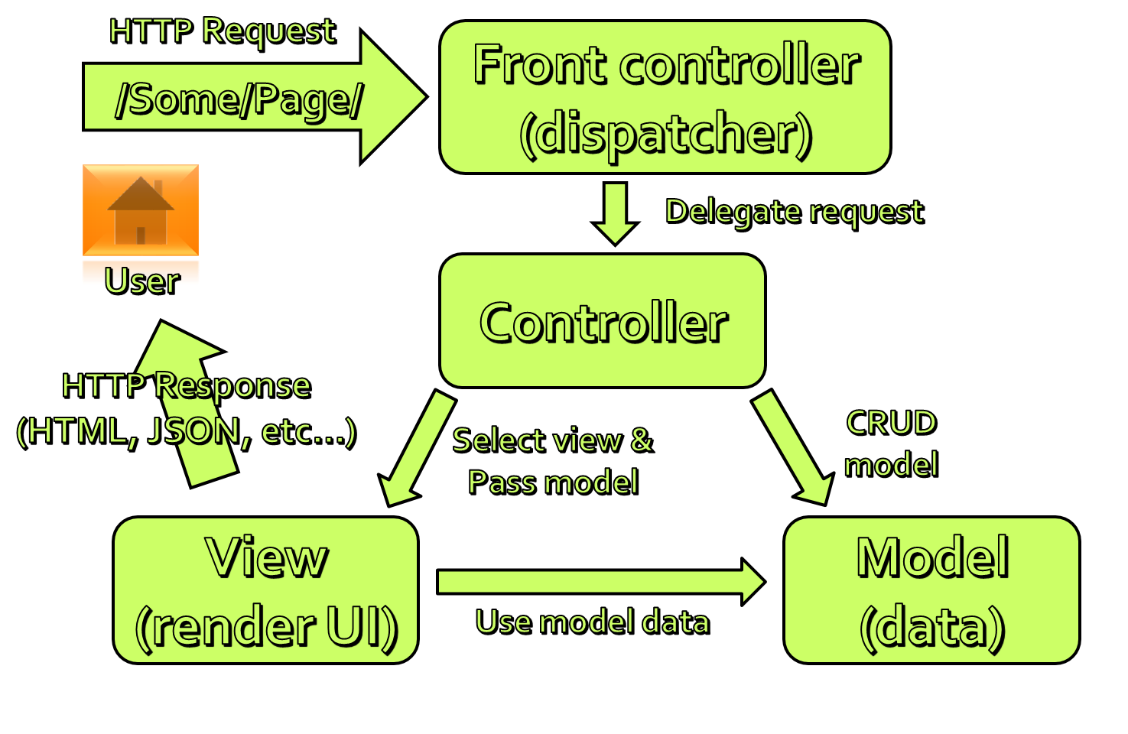
The MVC Pattern

Slide 3
The MVC Pattern
Model–view–controller (MVC) is a software architecture pattern
Originally formulated in the late 1970_{s} by Trygve Reenskaug as part of the Smalltalk
Code reusability and separation of concerns
Originally developed for desktop, then adapted for internet applications

Slide 4
MVC Steps
Incoming request routed to Controller
For web: HTTP request
Controller processes request and creates presentation Model
Controller also selects appropriate result (view)
Model is passed to View
View transforms Model into appropriate output format (HTML)
Response is rendered (HTTP Response)

Slide 5
The MVC Pattern for Web
HTTP Request
/Some/Page/
Front controller (dispatcher)
Delegate request
User
Controller
HTTP Response
CRUD model
Select view & pass data
View
(render UI)
Model (data)
Use model data

Slide 6
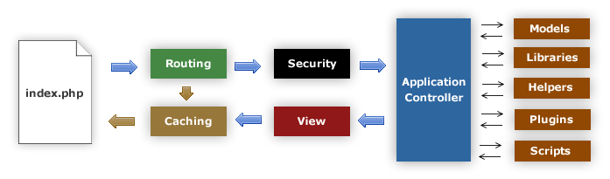
MVC Frameworks
CakePHP (PHP)
CodeIgniter (PHP)
Spring (Java)
Perl: Catalyst, Dancer
Python: Django, Flask, Grok
Ruby: Ruby on Rails, Camping, Nitro, Sinatra
JavaScript: AngularJS, JavaScriptMVC, Spine
ASP.NET MVC (.NET Framework)

Slide 7
ASP.NET MVC

Slide 8
ASP.NET History
Classic ASP introduced in late 1990's
ASP.NET 1.0 – 2002 (Web Forms)
ASP.NET 3.5 – 2008 (First version of MVC)
Two more versions in next two years
ASP.NET 4 – 2010 (VS 2010, MVC 2.0, Razor)
ASP.NET 4.5 (First version of Web API, VS 2012)
February 2013 – SignalR
Autumn 2013 – VS 2013, One ASP.NET, MVC 5
ASP.NET vNext – 2014, Roslyn, Platform ind.

Slide 9
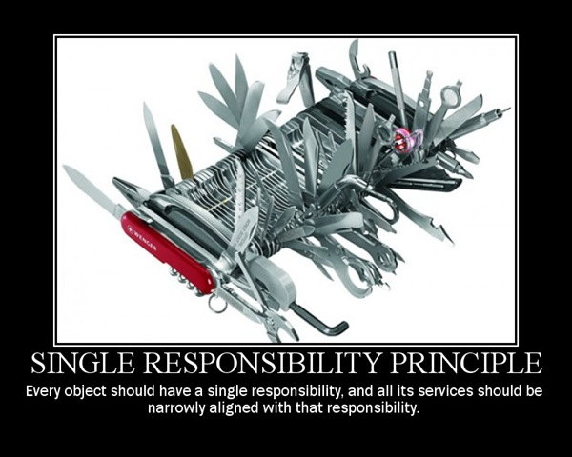
Separation of Concerns
Each component has one responsibility
SRP – Single Responsibility Principle
DRY – Don’t Repeat Yourself
More easily testable
TDD – Test-driven development
Helps with concurrent development
Performing tasks concurrently
One developer works on views
Another works on controllers

Slide 10
Clean URLs
REST-like
/products/update
/blog/posts/2013/01/28/mvc-is-cool
Friendlier to humans
/product.aspx?catId=123 or post.php?id=123
Becomes /products/chocolate/
Friendlier to web crawlers
Search engine optimization (SEO)

Slide 11
MVC Pattern in ASP.NET MVC
HTTP Request
Web server
ASP.NET MVC Routing engine
/Users/Ivo/
Select controller and invoke action (method)
User
Controller
(C# class)
HTTP Response
(HTML, File, JSON, …)
Select view & pass data (model)
CRUD model
View engine
(Razor)
Model (POCO)
Use model data

Slide 12
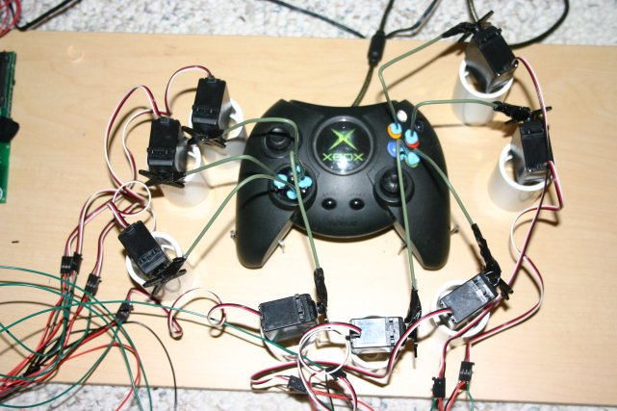
Controllers and Actions
The brain of the application

Slide 13
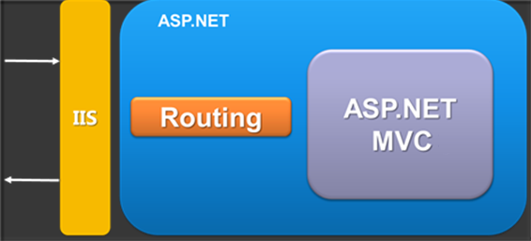
ASP.NET MVC Routing
Mapping between patterns and a combination of controller + action + parameters
Routes are defined as a global list of routes
System.Web.Routing.RouteTable.Routes
Something similar to Apache mod_rewrite
Greedy algorithm
the first match wins

Slide 14
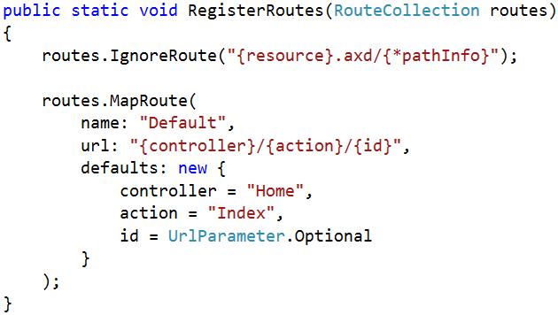
Routing Examples
http://localhost/Products/ById/3
Controller: Products
Action: ById
Id: 3

Slide 15
Controllers
The core component of the MVC pattern
All the controllers should be available in a folder by name Controllers
Controller naming standard should be "nameController" (convention)
Routers instantiate controllers in every request
All requests are mapped to a specific action
Every controller should inherit Controller class
Access to Request (context) and HttpContext

Slide 16
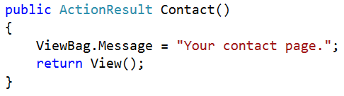
Actions
Actions are the ultimate request destination
Public controller methods
Non-static
No return value restrictions
Actions typically return an ActionResult

Slide 17
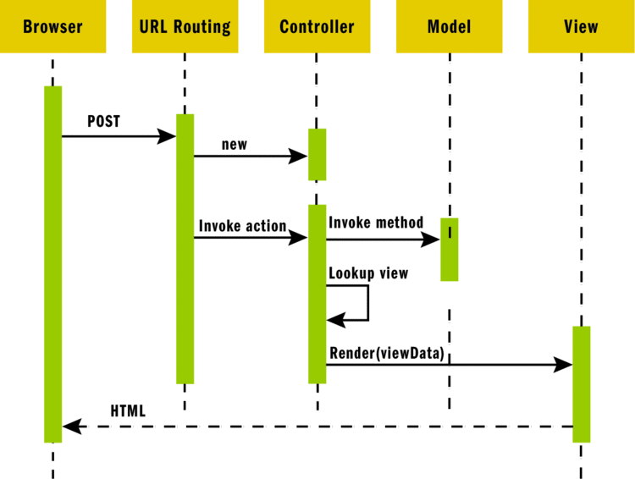
ASP.NET MVC Request

Slide 18
Action Results
Controller action response to a browser request
Inherits from the base ActionResult class
Different results types:
Name | Framework Behavior | Producing Method
ContentResult | Returns a string literal | Content
EmptyResult | No response
FileContentResult FilePathResult FileStreamResult | Return the contents of a file | File

Slide 19
Action Results (2)
Name | Framework Behavior | Producing Method
HttpUnauthorizedResult | Returns an HTTP 403 status
JavaScriptResult | Returns a script to execute | JavaScript
JsonResult | Returns data in JSON format | Json
RedirectResult | Redirects the client to a new URL | Redirect / RedirectPermanent
RedirectToRouteResult | Redirect to another action, or another controller’s action | RedirectToRoute / RedirectToAction
ViewResult PartialViewResult | Response is the responsibility of a view engine | View / PartialView

Slide 20
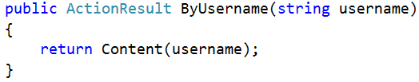
Action Parameters
ASP.NET MVC maps the data from the HTTP request to action parameters in few ways:
Routing engine can pass parameters to actions
http://localhost/Users/NikolayIT
Routing pattern: Users/{username}
URL query string can contains parameters
/Users/ByUsername?username=NikolayIT
HTTP post data can also contain parameters

Slide 21
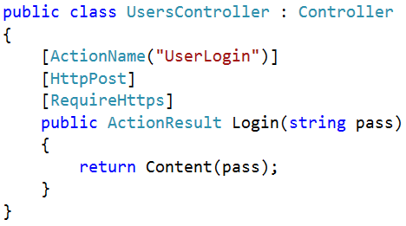
Action Selectors
ActionName(string name)
AcceptVerbs
HttpPost
HttpGet
HttpDelete
HttpOptions
…
NonAction
RequireHttps
ChildActionOnly – Only for Html.Action()

Slide 22
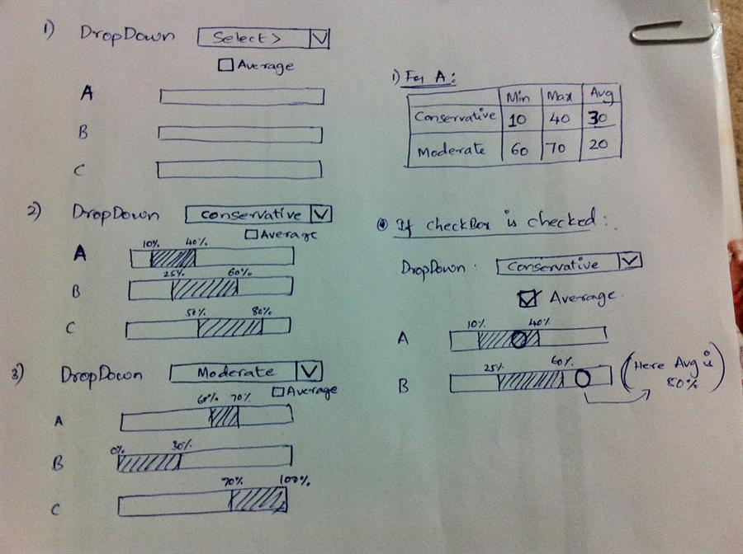
Razor Views

Slide 23
Views
HTML templates of the application
A lot of view engines available
View engines execute code and provide HTML
Provide a lot of helpers to easily generate HTML
The most popular is Razor and WebForms
We can pass data to views through ViewBag, ViewData and Model (strongly-typed views)
Views support master pages (layout views)
Other views can be rendered (partial views)

Slide 24
Pass Data to a View
With ViewBag (dynamic type):
Action: ViewBag.Message = "Hello World!";
View: @ViewBag.Message
Strongly-typed views:
Action: return View(model);
View: @model ModelDataType;
With ViewData (dictionary)
ViewData["message"] = "Hello World!";
View: @ViewData["message"]

Slide 25
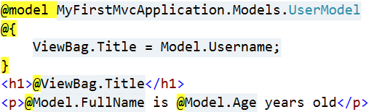

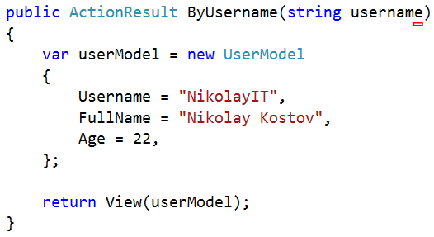
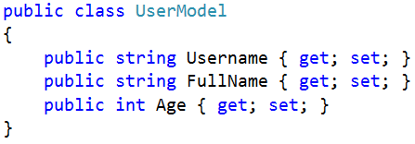
How it works?
ByUsername.cshtml
HTML Output
Template
+
Data
=
Generated Output
UsersController.cs
UserModel.cs

Slide 26
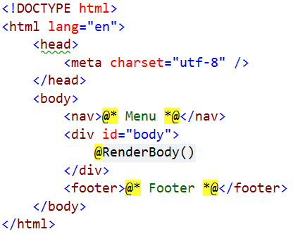
Layout
Define a common site template
Similar to ASP.NET master pages (but better!)
Razor view engine renders content inside-out
First view is redered, then layout
@RenderBody() – indicate where we want the views based on this layout to “fill in” their core content at that location in the HTML

Slide 27
Views and Layouts
Views don't need to specify layout since their default layout is set in their _ViewStart file:
~/Views/_ViewStart.cshtml (code for all views)
Each view can specify custom layout pages
Views without layout:
@{
Layout = "~/Views/Shared/_UncommonLayout.cshtml";
}
@{
Layout = null;
}

Slide 28
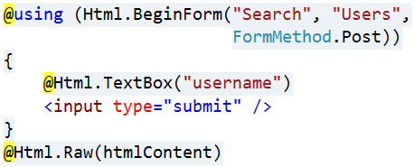
View Helpers
Each view inherits WebViewPage
ViewPage has a property named Html
Html property has methods that return string and can be used to generate HTML
Create inputs
Create links
Create forms
Other helper properties are also available
Ajax, Url, custom helpers

Slide 29
HTML Helpers
Method | Type | Description
BeginForm, BeginRouteForm | Form | Returns an internal object that represents an HTML form that the system uses to render the <form> tag
EndForm | Form | A void method, closes the pending </form> tag
CheckBox, CheckBoxFor | Input | Returns the HTML string for a check box input element
Hidden, HiddenFor | Input | Returns the HTML string for a hidden input element
Password, PasswordFor | Input | Returns the HTML string for a password input element
RadioButton, RadioButtonFor | Input | Returns the HTML string for a radio button input element
TextBox, TextBoxFor | Input | Returns the HTML string for a text input element
Label, LabelFor | Label | Returns the HTML string for an HTML label element

Slide 30
HTML Helpers (2)
Method | Type | Description
ActionLink, RouteLink | Link | Returns the HTML string for an HTML link
DropDownList, DropDownListFor | List | Returns the HTML string for a drop-down list
ListBox, ListBoxFor | List | Returns the HTML string for a list box
TextArea, TextAreaFor | TextArea | Returns the HTML string for a text area
Partial | Partial | Returns the HTML string incorporated in the specified user control
RenderPartial | Partial | Writes the HTML string incorporated in the specified user control to the output stream
ValidationMessage, ValidationMessageFor | Validation | Returns the HTML string for a validation message
ValidationSummary | Validation | Returns the HTML string for a validation summary message

Slide 31
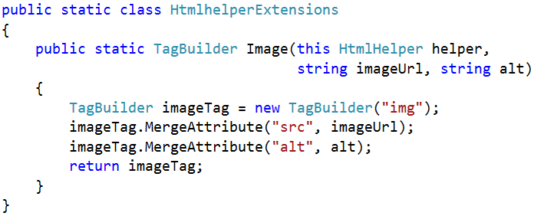

Custom Helpers
Write extension methods for the HtmlHelper
Return string or override ToString method
TagBuilder manages closing tags and attributes
Add namespace in web.config (if needed)

Slide 32
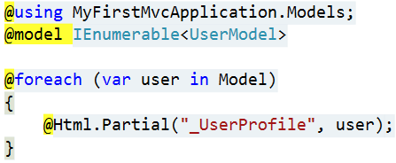
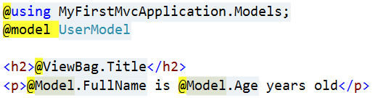
Partial Views
Partial views render portions of a page
Reuse pieces of a view
Html helpers – Partial, RenderPartial and Action
Razor partial views are still .cshtml files
Sub-request
Located in the same folder as other views or in Shared folder

Slide 33
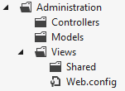
Areas
Some applications can have a large number of controllers
ASP.NET MVC lets us partition Web applications into smaller units (areas)
An area is effectively an MVC structure inside an application
Example: large e-commerce application
Main store, users
Blog, forum
Administration

