Slide 1



ASP.NET 5
(formerly ASP.NET vNext) Lean .NET stack for building modern web apps

Slide 2
Introduction to VS 2015
New features for team working
Improved code refactoring (using "Roslyn")
Performance debugging
Cross-platform mobile development
Dependency graph
Grunt and Bower package managers for web
Unity and Xamarin support

Slide 3
Web Projects
The "brand new" ASP.NET 5
Rebuild from ground up
Request pipeline light and fast
Cross-platform
And many more
Visual Studio 2015 Support
Bower, NPM, Grunt support out of the box

Slide 4



Mobile Projects
Cross-Platform C# Apps
Using Xamarin
Cross-Platform JS/TS Apps
Using Apache Cordova
Cross-Platform C++ Apps
Using Visual C++

Slide 5

Game Projects
Unity tools for Visual Studio
Download from https://visualstudiogallery.msdn.microsoft.com/8d26236e-4a64-4d64-8486-7df95156aba9
Allows opening, developing and debugging of Unity 2D/3D projects

Slide 6





ASP.NET vNext
JS* everywhere
node.js build tools
NPM - Node Package Manager
Gulp/Grunt - Tasks runner
Bower - frontend JS pkg manager

Slide 7
Flexible, Cross-Platform
In the past, the .NET Framework was delivered as a single, all-encompassing installation
Features were added but rarely removed
The size of the framework continually grew
ASP.NET 5 can be run on
Full .NET CLR – 200 MB, update everything
Best for backward compatibility
Core CLR (cloud-optimized runtime) – 11 MB
Include only those features that you need
Cross-Platform CLR – Not ready, yet. Use Mono.

Slide 8
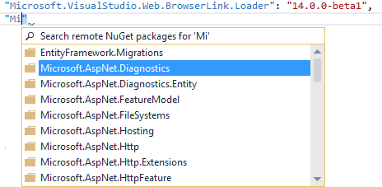
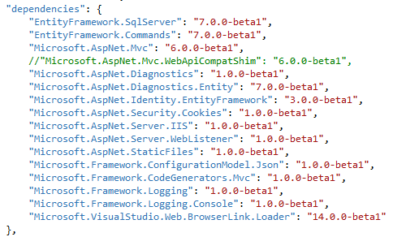
Package Management
ASP.NET 5 introduces a new, lightweight way to manage dependencies in your projects
No more assembly references
Instead referencing NuGet packages
project.json file

Slide 9
Grunt and Bower in ASP.NET 5
Visual Studio 2015 is integrating with Bower
Similar to NuGet for client side packages
JS libraries and CSS packages
Integrating with Grunt
Provide build tasks for client-side purposes
Similar to MS Build for the client side
Compile LESS, SASS
Bundling
Minification, etc.

Slide 10
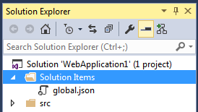
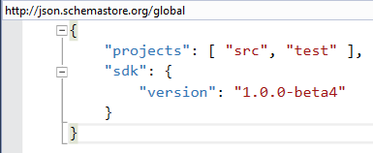
ASP.NET 5 Solution Items
Project info
Solution level settings
Project to project references

Slide 11
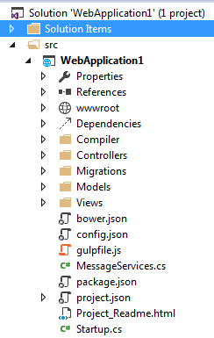
MVC 6 Template
Solution layout
New folders
wwwroot
Can rename
Dependencies
Compiler

Slide 12
MVC 6 Root files
JSON configurations + CSharp
Bower: JS + CSS frameworks
Config: settings, connections
Gulpfile: client build tasks
MessageService: 2 factor auth email
Package: package versions
Project: dependencies, secrets, commands, frameworks, excludes, scripts
Startup: initialization code

Slide 13
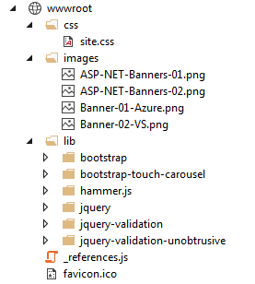
MVC 6 wwwroot
Static files
Styles
Images
Lib
JavaScript frameworks
CSS frameworks
Favicon
Can rename

Slide 14
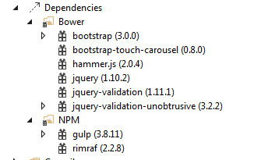
MVC 6 Dependencies
JS build tools
Bower
Client frameworks
NPM
Node package manager

Slide 15
Web API in ASP.NET MVC 6
MVC, Web API, and Web Pages are merged into a single framework called MVC 6
This merging removes duplication
In ASP.NET MVC 5 there are overlapping features with different implementations
MVC routing – System.Web.Mvc.Routing
WebAPI routing – System.Web.Http.Routing
Currently only MVC and WebAPI are unified
Web Pages will be added in a later release

Slide 16
Entity Framework 7
New platforms (in addition to .NET)
Windows Phone, Windows Store
ASP.NET 5 (.NET core)
Mac and Linux
New data stores (in addition to relational)
Non-relational data stores
Not a magic abstraction but option to use common EF functionality in all data stores
SQL Server, SQLite, Azure Table Storage, Redis, In Memory (for testing)
https://github.com/aspnet/EntityFramework

