Slide 1
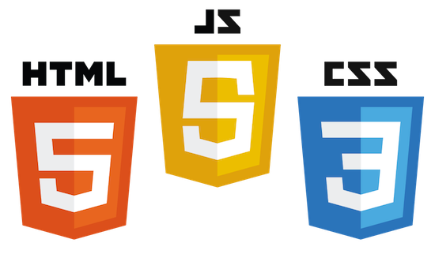

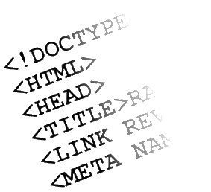

Web Front-end Track
Track Overview
Web Front-end Track
Telerik Software Academy
http://academy.telerik.com

Slide 2
Web Front-end Track
Introduction

Slide 3
Table of Contents
The Elements of a Web Page
HTML Basics
CSS Basics

Slide 4
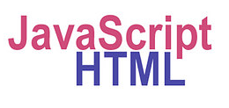
The Elements of a Web Page
A Web page consists of:
HTML markup
CSS rules
JavaScript code
JS libraries
Images
Other resources
Fonts, audio, video, Flash, Silverlight, etc…

Slide 5

The Elements of a Web Page: HTML Markup
The HTML is used to define the content of a Web page
Not the layout
Not the decorations
HTML's role is to present the information in a meaningful manner
Like a paper document
Define headers, paragraphs, textboxes, etc…
Not define size, color and/or positioning

Slide 6
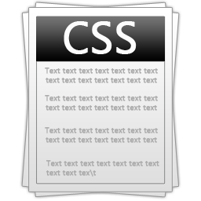
The Elements of a Web Page: CSS Rules
Cascading Style Sheets (CSS) is the way to make a Web page look pretty
Define styling rules
Fonts, colors, positioning, etc.
Define the layout of the elements
Define the presentation
The CSS files are attached to a web page and the browser applies these styles to elements

Slide 7

The Elements of a Web Page: JavaScript Code
JavaScript is the programming language for the Web
Makes the Web pages dynamic
Dynamically adding / removing HTML elements, applying styles, etc.
Modern JavaScript UI libraries provide UI components like dialog boxes, grids, tabs, etc.
Like CSS the JavaScript files are attached to a web page

Slide 8





The Elements of a Web Page: Other Resources
Other resources are needed for a Web page to run properly
Images, fonts (glyph icons), audio, video files
Flash / Silverlight / ActiveX objects

Slide 9

HTML – Past, Present, Future
1991 – HTML first mentioned – Tim Berners-Lee – HTML tags
1993 – HTML (first public version, published at IETF)
1993 – HTML 2 draft
1995 – HTML 2 – W3C
1995 – HTML 3 draft
1997 – HTML 3.2 – “Wilbur”
1997 – HTML 4 – ”Cougar” – CSS
1999 – HTML 4.01 (final)
2000 – XHTML draft
2001 – XHTML (final)
2008 – HTML5 / XHTML5 draft
2011 – feature complete HTML5
http://en.wikipedia.org/wiki/HTML5#Plan_2014

Slide 10
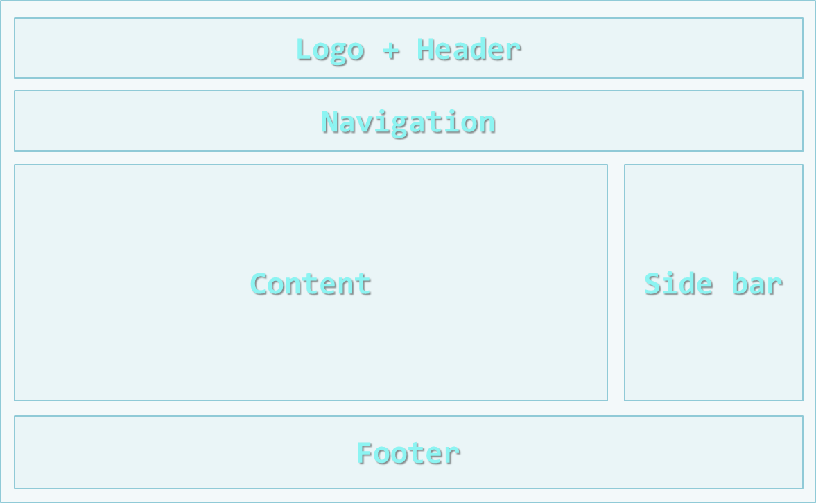
The Structure of a Web Page
A sample layout structure of a Web Page

Slide 11
The "HTML 4 and Before" Way
Using divs with IDs
The IDs are needed for styling
<html>
<head> … </head>
<body>
<div id="header"> … </div>
<div id="navigation"> … </div>
<div id="sidebar"> … </div>
<div id="content"> … </div>
<div id="footer"> … </div>
</body>
</html>

Slide 12
The HTML 5 Way
In HTML 5 there are semantic tags for layout
<nav>, <header>, <footer>, <section>
Work only on newer browsers
<html>
<head> … </head>
<body>
<header> … </header>
<nav> … </nav>
<aside> … </aside>
<section> … </section>
<footer> … </footer>
</body>
</html>

Slide 13
CSS3 box-sizing
Determine whether you want an element to render it's borders and padding within its specified width, or outside of it.
Possible values:
box-sizing: content-box (default) box width: 288px + 10px padding + 1px border on each side = 300px
box-sizing: border-box box width: 300px, including padding and borders

Slide 14
Display
display controls the display of the element and the way it is rendered and if breaks should be placed before and after the element
display values:
inline: no breaks are placed before or after (<span> is an inline element)
height and width depend on the content
block: breaks are placed before AND after the element (<div> is a block element)
height and width may not depend on the size of the content

Slide 15
Display Values
display values:
none: element is hidden and its dimensions are not used to calculate the surrounding elements rendering
differs from visibility: hidden!
inline-block: no breaks are placed before and after (like inline)
height and width can be applied (like block)
table, table-row, table-cell: the elements are arranged in a table-like layout

Slide 16
Display Values
display values:
flex: used for new fangled layout methods like Flexbox
grid: two-dimensional grid-based layout system that aims to do nothing less than completely change the way we design grid-based user interfaces

Slide 17
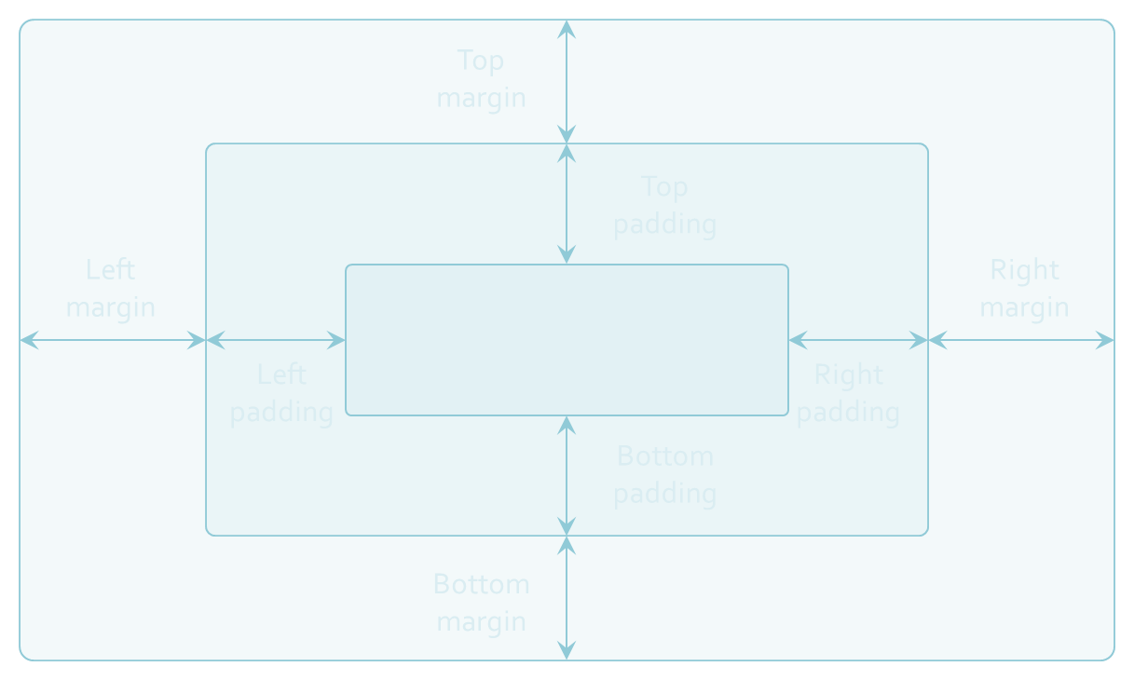
Margins and Paddings

Slide 18
Margin and Padding: Short Rules
margin: 5px;
Sets all four sides to have margin of 5 px;
margin: 10px 20px;
top and bottom to 10px, left and right to 20px;
margin: 5px 3px 8px;
top 5px, left/right 3px, bottom 8px
margin: 1px 3px 5px 7px;
top, right, bottom, left (clockwise from top)
Same for padding

Slide 19
Positioning
position: defines the positioning of the element in the page content flow
The value is one of:
static (default)
relative – relative position according to where the element would appear with static position
absolute – relative to the first parent element that has a position other than static
fixed – relative to the browser window, but ignores page scrolling

Slide 20
Preprocessors Overview
A preprocessor is a program that processes its input data to produce output that is used as input to another program
Sass, Less, Stylus are preprocessors for CSS
CoffeeScript, TypeScript are preprocessors for JavaScript
Jade, Ejs are preprocessors for HTML

Slide 21
Selector Nesting
SASS introduces selector nesting
body {
font: normal 16px arial;
color: #fff;
background-color: #011b63;
h1 {
font-size: 2.3em;
font-weight: bold;
}
}
body {
font: normal 16px arial;
color: #fff;
background-color: #011b63;
}
body h1 {
font-size: 2.3em;
font-weight: bold;
}
Parses to

Slide 22
Object Types in JavaScript
Only six value types in JavaScript
undefined, null, object, number, string, boolean
Four object types
Object, number, string and boolean
String, boolean and number are primitive types
Object is the only reference type
Arrays, dates, HTML elements are of type object

Slide 23
Functions in JavaScript
Functions are small named snippets of code
Can be invoked using their identifier (name)
Functions can take parameters
Parameters can be of any type
Each function gets two special objects
arguments contains all passed arguments
this contains information about the context
Different depending of the way the function is used
Function can return a result of any type
undefined is returned if no return statement

Slide 24
Function Object
Functions are objects and they can be used as objects
Can be passed as arguments to functions
Can be stored in an array
Can be assigned to variable
Can be returned by another function
var arr = [3, 2, 1, 3, 4, 5, 1, 2, 3, 4, 5, 7, 9];
function orderBy(x, y) { return x - y; }
arr.sort(orderBy);
//better to be done using anonymous function
//arr.sort(function(x, y){return x - y;});

Slide 25
Function Declaration
Function declarations use the function operator to create a function object
Function declarations are loaded first
No matter where they appear
This allows using a function before it is defined
printMsg("Hello");
function printMsg(msg){
console.log("Message: " + msg);
}

Slide 26
Function Expression
Function expressions are just function objects assigned to variables
Loaded where they are defined
They cannot be used before hand
The name of function expressions is optional
If the name is missing the function is anonymous
var printMsg = function (msg){
console.log("Message: " + msg);
}
printMsg("Hello");

Slide 27
Function Expression vs. Function Declaration
Function declarations are loaded first, while function expressions are loaded when reached
i.e. function declarations can be used before they are declared, while expressions cannot
Function declarations can be overridden
Imagine two function declarations in the same scope have the same name
Which will be the one to execute?

Slide 28
Function Expression vs. Function Declaration (2)
Function declarations can be overridden
Result in unexpected behavior
if(true){
function printMsg(msg) {
console.log("Message (from if): " + msg);
}
}
else{
function printMsg(msg) {
console.log("Message (from else): " + msg);
}
}
printMsg("message");
logs (from if) only in Firefox
logs (from else) in Opera, IE and Chrome

Slide 29
Function Expression vs. Function Declaration (3)
Easy to fix using function expression:
Works well on all browsers
if(true){
var printMsg = function (msg) {
console.log("--from if");
console.log(msg);
}
}
else{
var printMsg = function (msg) {
console.log("--from else");
console.log(msg);
}
}
printMsg("message");
//Everywhere output ("--from if");

Slide 30
Function Properties
Each function is an object
Created with declaration, expression or constructor
Functions have properties:
function.length
The count of parameters the function expects
The arguments object is not counted
function.name
Identifier of the function
Returns an empty string if anonymous

Slide 31
Function Methods
Functions have methods as well
function.toString()
Returns the code of the functions as a string
function.call(obj, args)
Calls the function over the obj with args
function.apply(obj, arrayOfArgs)
Applies the function over obj using the arrayOfArgs as arguments
Basically call and apply to the same
One gets args, the other gets array of args

Slide 32
Call and Apply
function.apply(obj, arrayOfargs) applies the function over an specified object, with specified array of arguments
Each function has a special object this
function.call(obj,arg1,arg2…) calls the function over an specified object, with specified arguments
Apply and call do the same with difference in the way they receive arguments

Slide 33
Call and Apply
function.apply(obj, arrayOfargs) applies the function over an specified object, with specified array of arguments
Each function has a special object this
By invoking apply, obj is assigned to this
var numbers = […];
var max = Math.max.apply (null, numbers);
function printMsg(msg){
console.log("Message: " + msg);
}
printMsg.apply(null, ["Important message"]);
//here this is null, since it is not used anywhere in //the function
//more about this in OOP

Slide 34
Scope
Scope is a place where variables are defined and can be accessed
JavaScript has only two types of scopes
Global scope and function scope
The global scope is the same for a web page
Function scope is different for every function
Everything outside of a function scope is inside of the global scope
if(true){
var sum = 1+2;
}
console.log(sum);
The scope of the if is the global scope. sum is accessible from everywhere
The scope of the if is the global scope. sum is accessible from everywhere

Slide 35
Immediately Invoked Function Expressions
Functions in JavaScript can be invoked immediately after they are defined
Can be anonymous
Don't pollute the global scope
Handle objects with the same identifier
Used with Closures
IIFE must be always an expression
Otherwise the browsers don't know what to do with the declaration

Slide 36
Closures
Closures are a special kind of objects
They combine a function and the context of this function
function outer(x){
function inner(y){
return x + " " + y;
}
return inner;
}
var f1 = outer(5);
console.log(f1(7)); //outputs 5 7
//in the context of f1, x has value 5
var f2 = outer("Peter");
console.log(f2("Petrov")); //outputs Peter Petrov
//in the context of f2, x has value "Peter"
inner() forms a closure. It holds a reference to x

Slide 37
Classical OOP
JavaScript uses functions to create objects
It has no definition for class or constructor
Functions play the role of object constructors
Create/initiate object by calling the function with new
function Person(){}
var gosho = new Person(); //instance of Person
var maria = new Person(); //instance of Person

Slide 38
The prototype Object
JavaScript is prototype-oriented programming language
Every object has a hidden property prototype
Its kind of its parent object
Prototypes have properties available to all their children
The object type is the parent of all objects
Every object inherits object
All objects has toString() method

Slide 39
Attaching Methods
Yet there are performance differences when attaching methods
Creating a method is a slow operation
Attaching methods inside the function constructor is very slow
Better attach them to the prototype
function Person(name,age){
this.name = name;
this.age = age;
}
Person.prototype.sayHello = function(){
console.log("My name is " + this.name + " and I am " +
this.age + "-years old");
}

Slide 40
this in Function Scope
When executed over a function, without the new operator
this refers to the parent scope
function Person(name) {
this.name = name;
this.getName = function getPersonName() {
return this.name;
}
}
var p = new Person("Gosho");
var getName = p.getName;
console.log(p.getName()); //Gosho
console.log(getName()); //undefined
Here this means the Person object
Here this means its parent scope (window)

Slide 41
Function Constructors
JavaScript cannot limit function to be used only as constructors
That is because JavaScript was not mean this way
function Person(name) {
var self = this;
self.name = name;
self.getName = function getPersonName() {
return self.name;
}
}
var p = Person("Peter");
What will be the value of this?

Slide 42
Inheritance
Since JavaScript is prototype-oriented programing language, inheritance is done through prototypes
To implement inheritance set the prototype of an object to its parent
Need to set the correct constructor
function Person(name, age){
this.name = name; this.age = age; }
function Student(name, age, grade){
this.name = name; this.age = age; this.grade = grade;}
Student.prototype = new Person();
Student.prototype.constructor = Student;
var isStudentPerson = new Student() instanceof Person;
Repeating code Not quite good right?
Repeating code Not quite good right?

Slide 43
Inheritance Using parent Constructors
Yet this is not fully-usable inheritance
The parent constructor is not reused
Yes, but how?
Remember call and apply?
Person is just a function, so it has them
function Person(name, age){
this.name = name; this.age = age; }
function Student(name, age, grade){
Person.apply(this, arguments); //Person.call(this, name, age);
this.grade = grade;}
Student.prototype = new Person();
Student.prototype.constructor = Student;

Slide 44
XMLHttpRequest
XMLHttpRequest is a JavaScript object, that provides a way to retrieve a resource by URL
Designed by Microsoft, adopted by Mozilla, Apple and Google
Nowadays standardized in the W3C
XHR can retrieve resources both synchronously and asynchronously
The data can be of any format, not strictly XML
JSON, HTML or just plain text

Slide 45
AJAX
AJAX is acronym of Asynchronous JavaScript and XML
Technique for background loading of dynamic content and data from the server side
Allows dynamic client-side changes
Two styles of AJAX
Partial page rendering – loading of HTML fragment and showing it in a <div> (AHAH)
JSON service – loading JSON object and client-side processing it with JavaScript / jQuery

Slide 46
AJAX
Technically, AJAX is a group of technologies working together
HTML & CSS for presentation
The DOM for data display & interaction
XML (or JSON) for data interchange
XMLHttpRequest for async communication
JavaScript to use the above

Slide 47
AJAX
AJAX uses HTTP
Requests have headers – GET, POST, HEAD, etc.
Requests have bodies – XML, JSON or plain text
The request must target a resource with a URI
The resource must understand the request
Server-side logic
Requests get a HTTP Response
Header with a body

Slide 48
Callback-oriented Programming
Callback function
A function pointer passed to another function
The other function can call the passed one
The other function can give arguments
Examples of callbacks:
Event handlers are sort-of callbacks
setTimeout and setInterval take a callback argument
Some OOP patterns use callbacks for _super

Slide 49
Callback-oriented Programming (2)
Callback-oriented programming
Functions get passed to each other
Each functions calls the passed ones
To continue the work
To process values
Inversion of control principle ("don't call us, we'll call you")
Problems:
"Return" values by passing to other functions
Heavily nested functions are hard to understand
Errors and exceptions are a nightmare to process

Slide 50
Promises
A promise is an object which represents an eventual (future) value
Methods "promise" they will return a value
Correct or representing an error
A Promises can be in one of three states:
Fulfilled (resolved, succeded)
Rejected (an error happened)
Pending (unfulfilled yet, still being computed)

Slide 51
What is a JavaScript Library
A JavaScript library is pre-written code that aims to facilitate and /or jump start development, especially AJAX based tasks
A JS library:
Works around browser differences
Abstracts common work
Introduces means to simplify JS development

Slide 52
jQuery
Created 2006 by John Resig
Initially just selectors
Have become one of the most powerful and used js libraries in the web
Features
DOM query, traversal, manip, animations, Ajax, utility, plugins…

Slide 53
Knockout.js
Knockout is a framework that offers a MVVM design of an JavaScript application:
Model holding the app data
ViewModel with the behavior of the app
View that binds to the ViewModel
Primary features:
Data binding
Templating
Observable objects

Slide 54
Web Front-end Track
http://academy.telerik.com

