Slide 1

Using Elasticsearch
Lionel Nguyen

Slide 2
Table of Contents
Elasticsearch
Inverted Index
Query DSL
Distributed
Ecosystem

Slide 3
Elasticsearch
Search & Analytics Engine
Open source, Lucene based
Schema free
RESTful API, JSON over HTTP
Real-time
Distributed
Scales massively
High availability
Multi tenancy

Slide 4
Lucene & Elasticsearch
Lucene:
Provides most of the search “technology” behind search, plus some non-search but important capabilities (e.g. dates & numbers)
But it’s just a toolkit/library/framework
Elasticsearch
Adds everything else needed to have a search platform / server / NoSQL solution
Add some more of its own search technology too

Slide 5
Glossary
RDBMS (MySQL, Postgres, …) | Elasticsearch
Database | Indice
Table | Type
Row | Document
Column | Field
Primary Key | _id
Schema | Mapping
Relational | Nested
SQL | Query DSL
B* Tree Index | Inverted Index

Slide 6
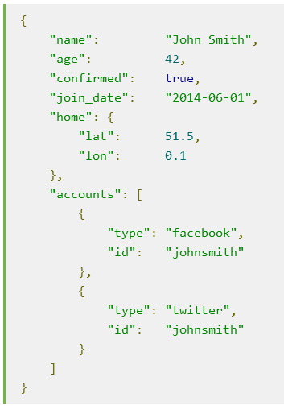
Document
_index: Where the document lives
_type: The class of object that the document represents
_id: The unique identifier for the document
Elasticsearch will auto generate id if not specified

Slide 7
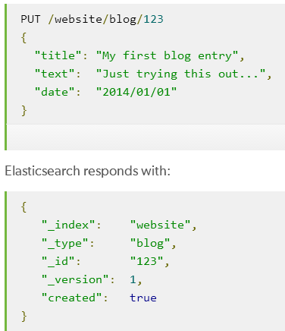
Creating a Document

Slide 8
Inverted Index
How data is indexed

Slide 9
WHERE content LIKE "%brown%fox"
{
"title": "Quick brown rabbits",
"content": "Brown rabbits are commonly seen"
}
{
"title": "Keeping pets healthy",
"content": "My quick brown fox eats rabbits on a regular basis"
}

Slide 10
How data is indexed
Inverted Index
Separate words / terms
Sort unique terms
List docs containing terms
Normalize terms

Slide 11
field: content
Term | Doc 1 | Doc 2
a
are
basis
brown
commonly
eats
fox
my
on
quick
rabbits
regular
seen
sorted list of unique terms

Slide 12
field: content
Term | Doc 1 | Doc 2
a
are
basis
brown
commonly
eats
fox
my
on
quick
rabbits
regular
seen

Slide 13
field: content
Term | Doc 1 | Doc 2
a
are
basis
brown
commonly
eats
fox
my
on
quick
rabbits
regular
seen

Slide 14
Query DSL
Flexible, powerful query language

Slide 15
Full-text Queries
SELECT * FROM jxm_farm
… WHERE message LIKE '%this is a test%'
POST /jxm_farm/_search
{ "query": { "match_all": {} } }
{
"query": {
"match": {
"message": "this is a test"
}
}
}

Slide 16
Term Queries
… WHERE role_id CONTAINS '12345’
… WHERE role_id IN ['12345', '13579’]
… WHERE log_date >= '2018-12-01'
AND log_date < '2018-12-10'
{ "term": { "role_id": "12345" } }
{ "terms": { "role_id": [ "12345", "13579" ] } }
{ "range": { "log_date": {
"gte": "2018-12-01", "lt": "2018-12-10"
} } }

Slide 17
Compound query
A query that matches documents matching boolean combinations of other queries.
{
"bool": {
"must": {
"term": { "user": "kimchy" }
},
"must_not": {
"range": { "age": { "gte": 10, "lte": 20 } }
},
"should": [
{ "term": { "tag": "wow" } },
{ "term": { "tag": "elasticsearch" } }
],
"minimum_should_match": 1,
"boost": 1.0
}
}

Slide 18
Query DSL
Full-text
match
match_all
Term level
term
terms
range
exists
Compound
bool
must
must_not
should
Joining
nested
has_child
has_parent

Slide 19
Aggregations
Allows real time data analytics
{
"query": {
"bool": {
"must": {
"range": {
"age": { "gte": "2018-12-01", "lte": "2018-12-10" }
}
}
}
},
"aggs": {
"farm_level_agg": {
"terms": { "field": "farm_level" }
}
}
}

Slide 20
Nested Aggregations
More powerful queries
{
"aggs": {
"daily_login_agg": {
"range": {
"field": "m_numlogindays",
"ranges": [
{"to": 3} , {"from": 3, "to": 5}, {"from": 5}
]
},
"aggs": {
"churn_rate_stats_agg": {
"range": {
"field": "churnlevel",
"ranges": [{"to": 3}, {"from": 3}]
}
}
}
}
}
}

Slide 21
Update document
Delete document
POST /jxm_farm/farm/12345/_update
{ "doc": { "killed_date": "2018-12-15" } }
DELETE /jxm_farm/farm/13579

Slide 22
Distributed
Highly Available

Slide 23
CAP Theorem
Three properties of a (distributed computer) system:
Consistency (all copies have same value)
Availability (system can run even if parts have failed) Via replication.
Partitions (network can break into two or more parts, each with active systems that can’t talk to other parts)

Slide 24
Glossary
Node: an instance of Elasticsearch
Shard: single Lucene instance
Replica: copy of shard
Increase fail over
Increase performance

Slide 25
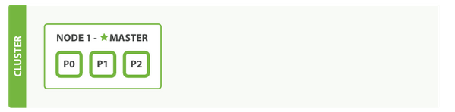
A Single Node Cluster with An Index
All 3 Primary Shards allocated to Node1
No replication Nodes
A single node means single point of failure
Health of the Cluster: Yellow

Slide 26
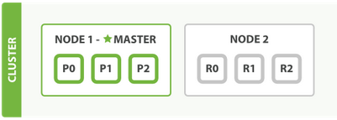
Add Failover
Add one Node to cluster by configuring the cluster name.
3 replica shards have been allocated.
Cluster Health : Green.
Now 6 Shards. There is redundancy

Slide 27
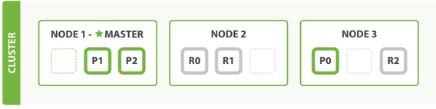
Scale horizontally
A 3 node cluster
One shard each from Node 1 and Node 2 have moved to Node 3
Better performance as hardware resources (CPU,RAM, I/O) are shared

Slide 28
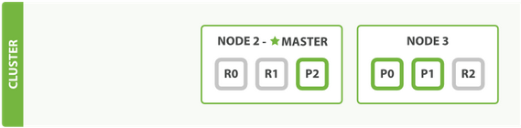
Coping with Node Failure
Kill Master Node
Elect a New Master (Node 2)
Primary Shard 1 and 2 were lost
Cluster Health : Red
Node 2 & 3 have Replicas of these shards, which are now promoted as primaries
Cluster Health: Yellow

Slide 29
Ecosystem

Slide 30
Elasticsearch with Spark
./spark-2.1.1-bin-hadoop2.7/bin/spark-shell --packages org.elasticsearch:elasticsearch-spark-20_2.11:5.4.3
import org.elasticsearch.spark.sql._ case class Person(ID:Int, name:String, age:Int, numFriends:Int)
def mapper(line:String): Person = { val fields = line.split(',’) val person:Person = Person(fields(0).toInt, fields(1),
fields(2).toInt, fields(3).toInt)
return person
}
import spark.implicits._ val lines = spark.sparkContext.textFile("fakefriends.csv")
val people = lines.map(mapper).toDF()
people.saveToEs("spark/people")

Slide 31
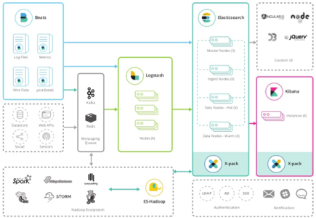
Ecosystem - The Big Picture

Slide 32
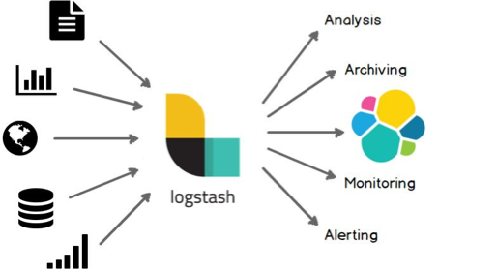
Logstash

Slide 33
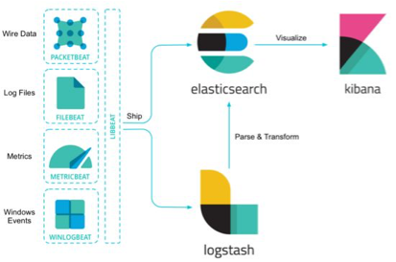
Beats

Slide 34
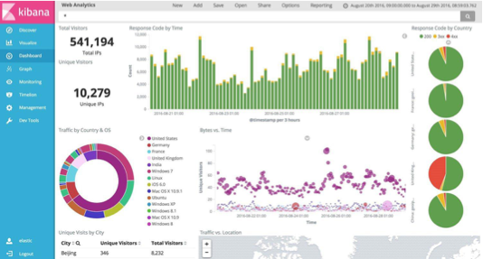
Kibana

Slide 35
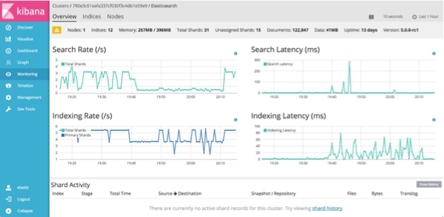
Monitoring

Slide 36
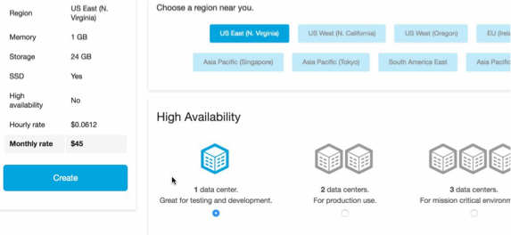
Elastic Cloud

