Slide 1
Machine Learning

Slide 2
Learning and Machine Learning?
An AI centric viewpoint: ML is about getting computers to do the types of things people are good at.
When people say “AI” they almost always mean “ML.”

Slide 3
What is ML about?
Easy for a computer: (42384 ∗ 3421.82)^{1/3}
Easy for a child:
speech recognition
object recognition
question/answering (“what color is the sky?”)
Computers are designed to execute mathematically precise computational primitives (and they have become much faster!).
The algorithmic and statistical thinking (and techniques) for how we train computers to get better at these more ’easy-for-human’ tasks.

Slide 4
Today, ML is begin used for:
Video and image processing
Speech and language processing
Search engines
Robot control
Medical and health analysis
not just “AI-ish” problems: sensor networks, traffic navigation, medical imaging, computational biology, finance

Slide 5
Outline
Problem formulations: classification, regression
Techniques: decision trees, nearest neighbors, perceptron, linear models, probabilistic models, neural networks, kernel methods, clustering
“Meta-techniques”: ensembles, expectation-maximization
Understanding ML: limits of learning, practical issues, bias & fairness
Recurring themes: (stochastic) gradient descent, the “scope” of ML, overfitting

Slide 6
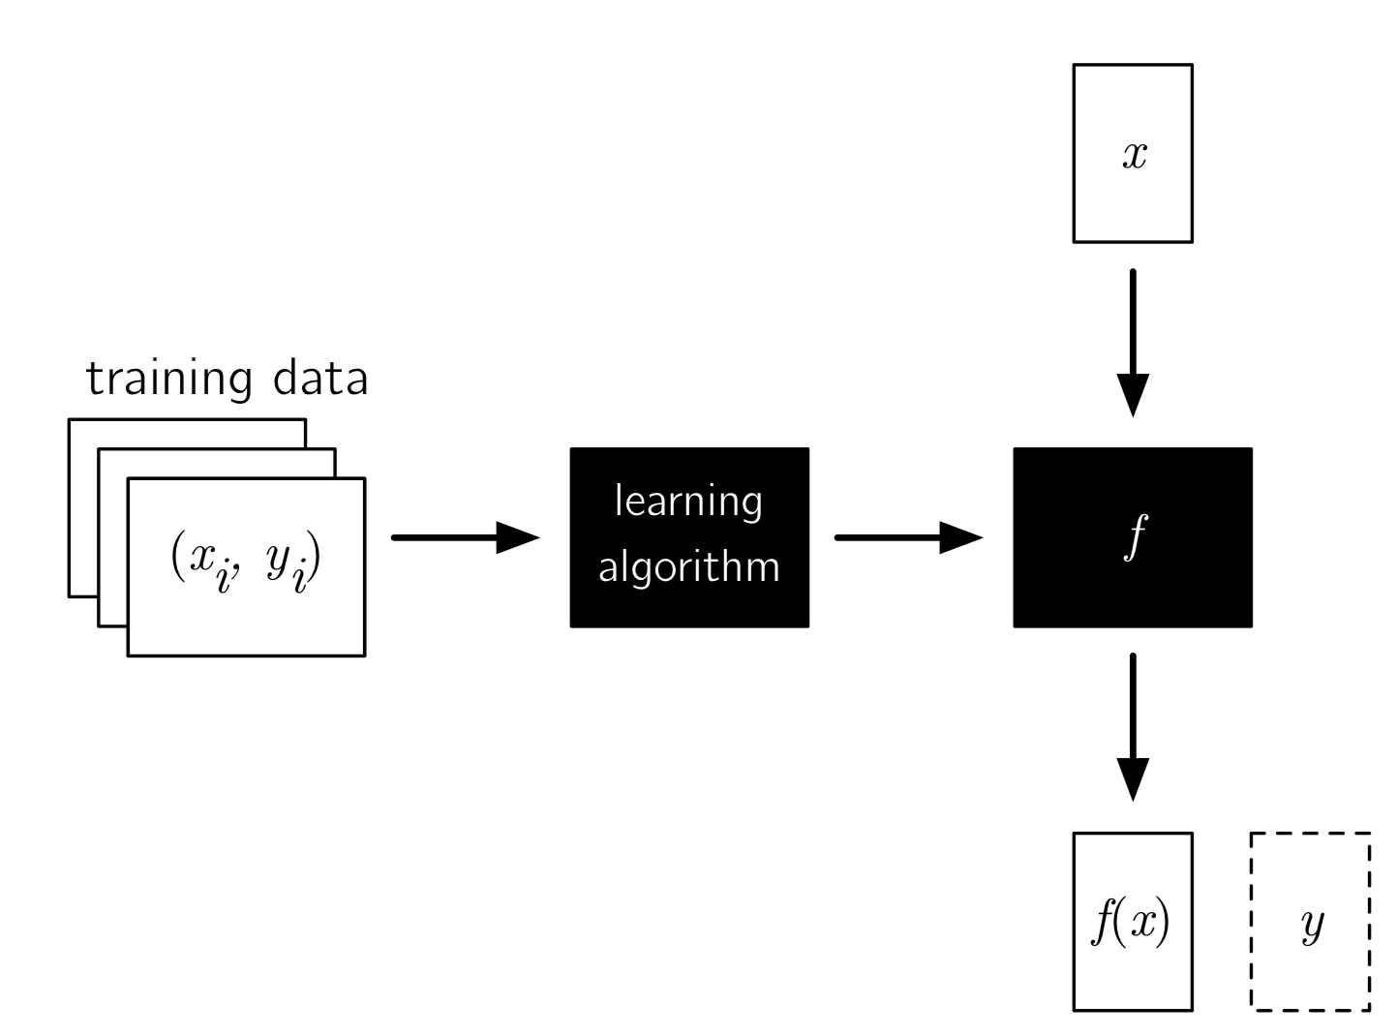
“Inductive” Supervised Machine Learning
Training: a learning algorithm takes a set of example input-output pairs, {(x1,y1),...(xN,yN)}, and returns a function f (the ’hypothesis’); the goal is for f(x) to recover the true label y, for each example, and on future examples
Testing: we check how well f predicts on a set of test examples, {(x′1, y1′ ), . . . (x′M , yM′ )}, by measuring how well f(x′) matches y.

Slide 7
Inputs and Output
x can be pretty much anything we can represent
To start, we’ll think of x as a vector (really, a “tuple”) of features, where each feature φ(x) maps the instance into some set. Sometimes Φ(x) denotes the tuple (the “vector” of all the features).
y can be
a real value (regression)
a label (classification)
an ordering (ranking)
a vector (multivariate regression)
a sequence/tree/graph (structured prediction)
...

