Slide 1
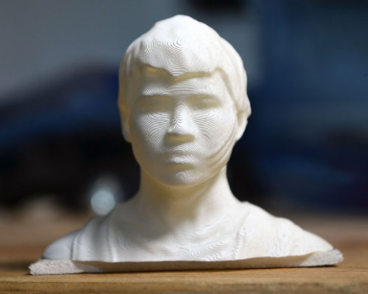
Binary CSE 120 Winter 2019
Instructor: Teaching Assistants:
Justin Hsia Ann Shan, Eunia Lee, Pei Lee Yap, Sam Wolfson, Travis McGaha
3D-printed heads let hackers – and cops – unlock your phone
“You can even 3D-print a life-size replica of a human head — and not just for Hollywood. Forbes reporter Thomas Brewster commissioned a 3D-printed model of his own head to test the face unlocking systems on a range of phones — four Android models and an iPhone X.
“It’s no secret that biometrics — your fingerprints and your face — aren’t protected under the Fifth Amendment. That means police can’t compel you to give up your passcode, but they can forcibly depress your fingerprint to unlock your phone, or hold it to your face while you’re looking at it.”
https://techcrunch.com/2018/12/16/3d-printed-heads-unlock- cops-hackers/

Slide 2
Administrivia
Assignments:
Symbolic Lightbot (checkoff) due tonight (1/11)
Lightbot Functions (submit) due Monday (1/14)
Make sure you read the specifications carefully!

Slide 3
Lecture Outline
Decimal, Binary, and Hexadecimal
Binary Worksheet
Binary Encoding

Slide 4
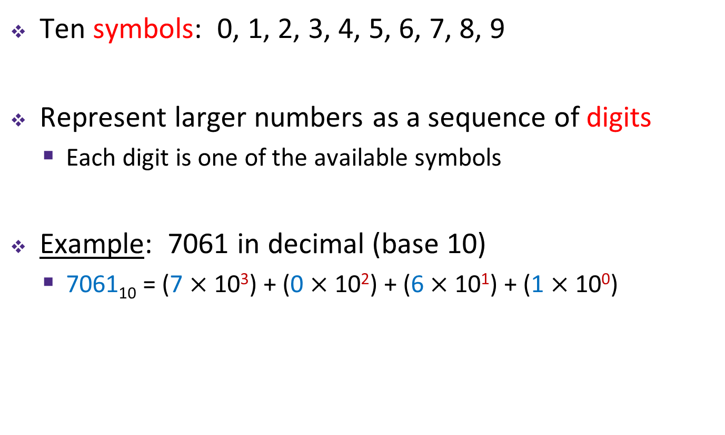
Decimal Numbering System
Ten symbols: 0, 1, 2, 3, 4, 5, 6, 7, 8, 9
Represent larger numbers as a sequence of digits
Each digit is one of the available symbols
Example: 7061 in decimal (base 10)
7061₁₀ = (7 $×$ 10³) + (0 $×$ 10²) + (6 $×$ 10¹) + (1 $×$ 10⁰)
Notes:
Ones digit, Tens digit, Hundreds digit, etc.

Slide 5
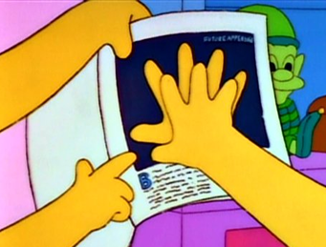
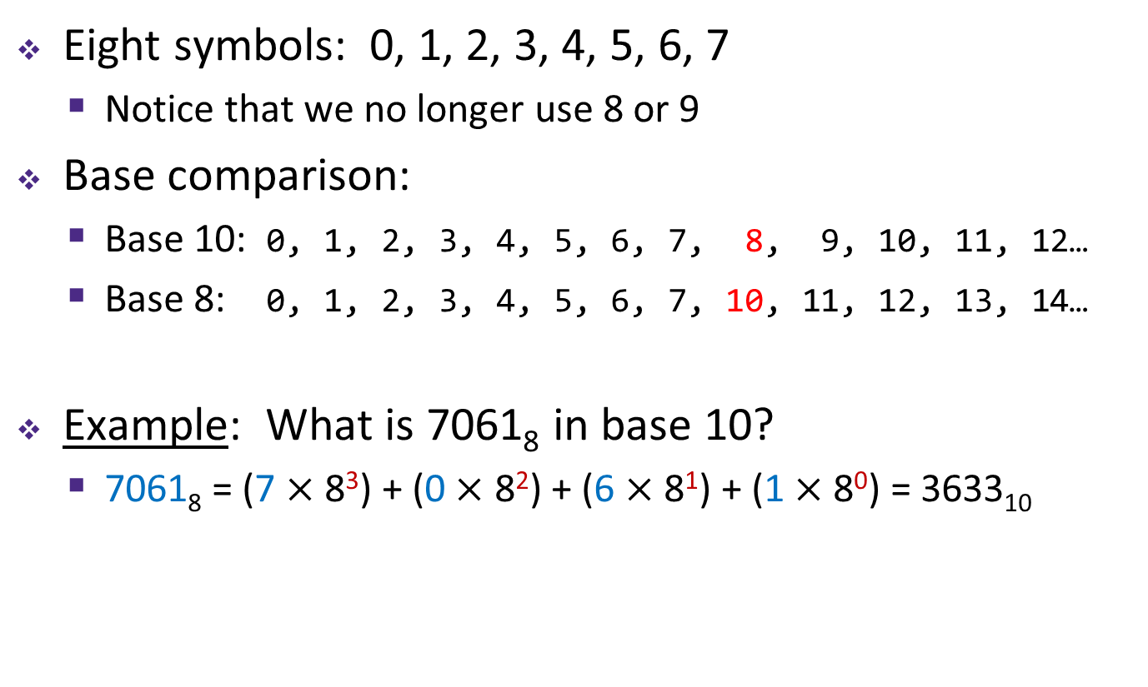
Octal Numbering System
Eight symbols: 0, 1, 2, 3, 4, 5, 6, 7
Notice that we no longer use 8 or 9
Base comparison:
Base 10: 0, 1, 2, 3, 4, 5, 6, 7, 8, 9, 10, 11, 12…
Base 8: 0, 1, 2, 3, 4, 5, 6, 7, 10, 11, 12, 13, 14…
Example: What is 7061₈ in base 10?
7061₈ = (7 $×$ 8³) + (0 $×$ 8²) + (6 $×$ 8¹) + (1 $×$ 8⁰) = 3633₁₀

Slide 6
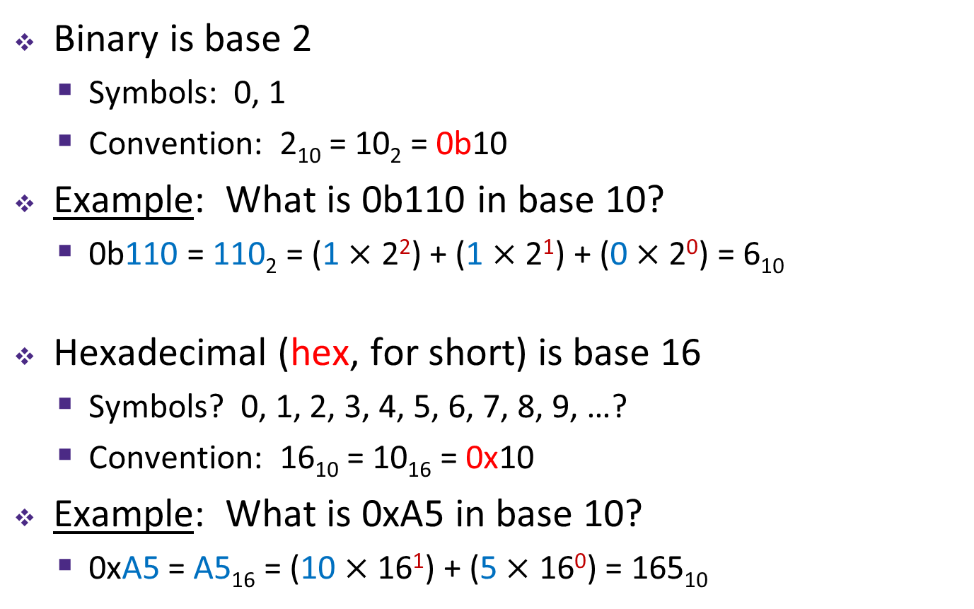
Binary and Hexadecimal
Binary is base 2
Symbols: 0, 1
Convention: 2₁₀ = 10₂ = 0b10
Example: What is 0b110 in base 10?
0b110 = 110₂ = (1 $×$ 2²) + (1 $×$ 2¹) + (0 $×$ 2⁰) = 6₁₀
Hexadecimal (hex, for short) is base 16
Symbols? 0, 1, 2, 3, 4, 5, 6, 7, 8, 9, …?
Convention: 16₁₀ = 10₁₆ = 0x10
Example: What is 0xA5 in base 10?
0xA5 = A5₁₆ = (10 $×$ 16¹) + (5 $×$ 16⁰) = 165₁₀
9, A, B, C, D, E, F

Slide 7
Aside: Why Base 2?
Electronic implementation
Easy to store with bi-stable elements
Reliably transmitted on noisy and inaccurate wires
Other bases possible, but not yet viable:
DNA data storage (base 4: A, C, G, T) is a hot topic
Quantum computing
0
1
0
3.3V
2.8V
0.5V
0.0V
Notes:
adenine (A), cytosine (C), guanine (G), or thymine (T)

Slide 8
Base Comparison
Why does all of this matter?
Humans think about numbers in base 10, but computers “think” about numbers in base 2
Binary encoding is what allows computers to do all of the amazing things that they do!
Base 10 | Base 2 | Base 16
0 | 0000 | 0
1 | 0001 | 1
2 | 0010 | 2
3 | 0011 | 3
4 | 0100 | 4
5 | 0101 | 5
6 | 0110 | 6
7 | 0111 | 7
8 | 1000 | 8
9 | 1001 | 9
10 | 1010 | A
11 | 1011 | B
12 | 1100 | C
13 | 1101 | D
14 | 1110 | E
15 | 1111 | F

Slide 9
Lecture Outline
Decimal, Binary, and Hexadecimal
Binary Worksheet
Binary Encoding
Hints: 2⁰ = 1 2¹ = 2 2² = 4 2³ = 8 2⁴ = 16 2⁵ = 32 2⁶ = 64 2⁷ = 128 2⁸ = 256 2⁹ = 512 2¹⁰ = 1024

Slide 10
Lecture Outline
Decimal, Binary, and Hexadecimal
Binary Worksheet
Binary Encoding

Slide 11
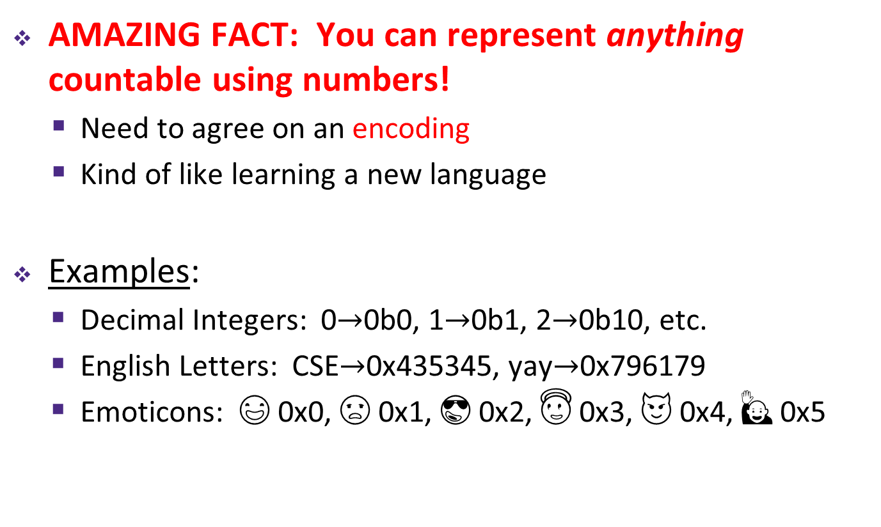
Numerical Encoding
AMAZING FACT: You can represent anything countable using numbers!
Need to agree on an encoding
Kind of like learning a new language
Examples:
Decimal Integers: 0$→$0b0, 1$→$0b1, 2$→$0b10, etc.
English Letters: CSE$→$0x435345, yay$→$0x796179
Emoticons: 😃 0x0, 😞 0x1, 😎 0x2, 😇 0x3, 😈 0x4, 🙋 0x5
Notes:
Base 2 is too hard for humans to read, so we use base 16 as a convenient way to hold what is effectively binary data in our brains.

Slide 12
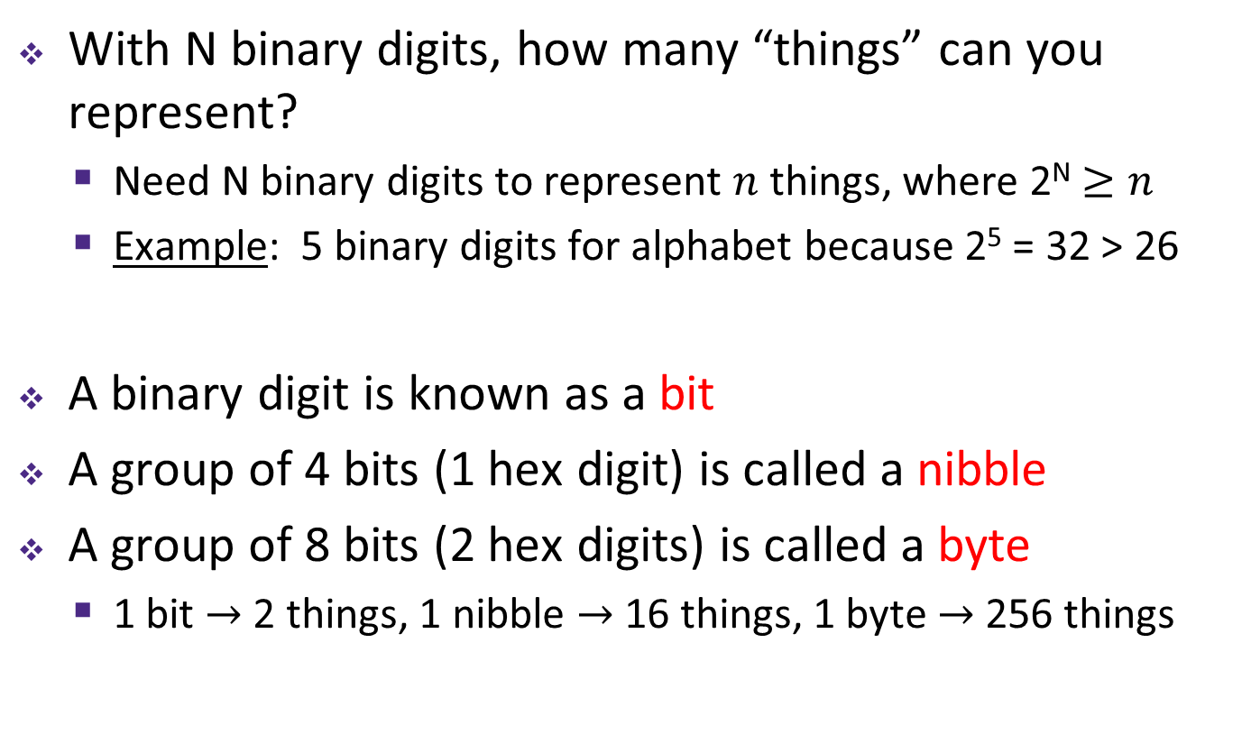
Binary Encoding
With N binary digits, how many “things” can you represent?
Need N binary digits to represent $n$ things, where 2^{N} $≥n$
Example: 5 binary digits for alphabet because 2⁵ = 32 > 26
A binary digit is known as a bit
A group of 4 bits (1 hex digit) is called a nibble
A group of 8 bits (2 hex digits) is called a byte
1 bit $→$ 2 things, 1 nibble $→$ 16 things, 1 byte $→$ 256 things

Slide 13

So What’s It Mean?
A sequence of bits can have many meanings!
Consider the hex sequence 0x4E6F21
Common interpretations include:
The decimal number 5140257
The characters “No!”
The background color of this slide
The real number 7.203034 $×$ 10⁻³⁹
It is up to the program/programmer to decide how to interpret the sequence of bits

Slide 14
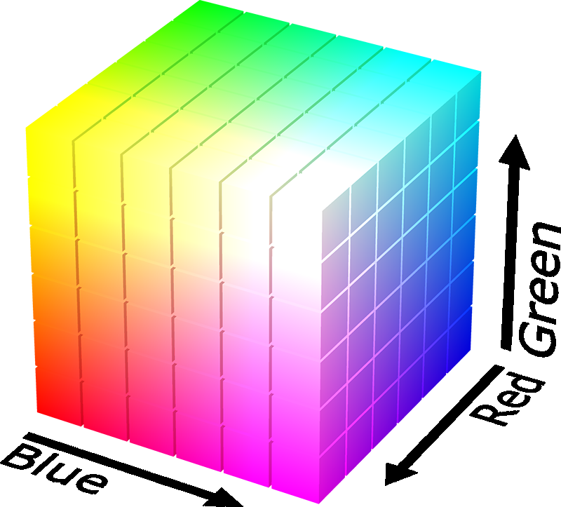
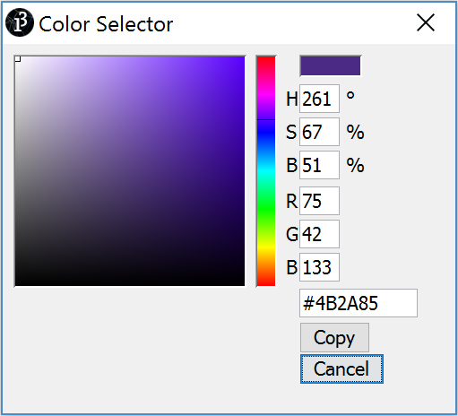

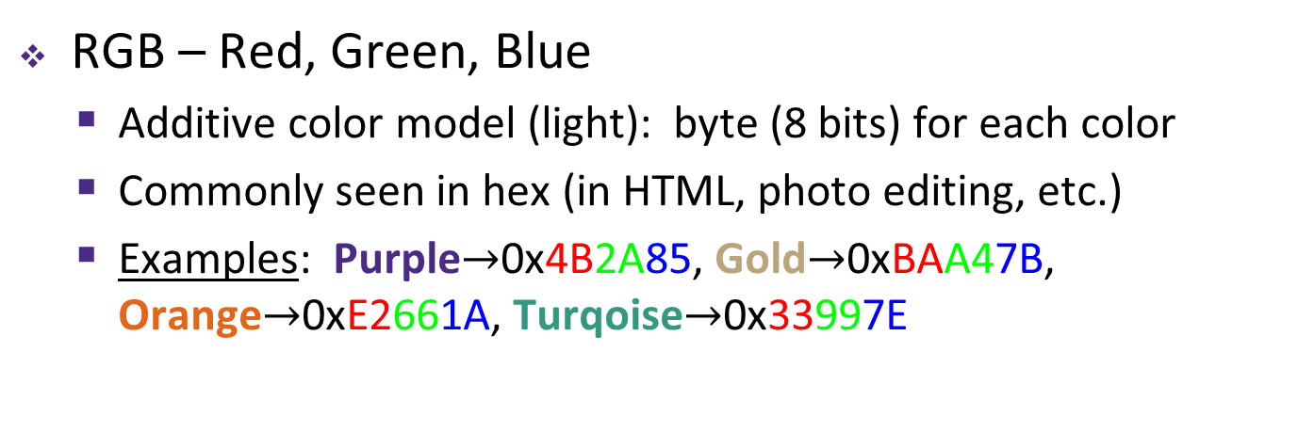
Binary Encoding – Colors
RGB – Red, Green, Blue
Additive color model (light): byte (8 bits) for each color
Commonly seen in hex (in HTML, photo editing, etc.)
Examples: Purple$→$0x4B2A85, Gold$→$0xBAA47B, Orange$→$0xE2661A, Turqoise$→$0x33997E

Slide 15
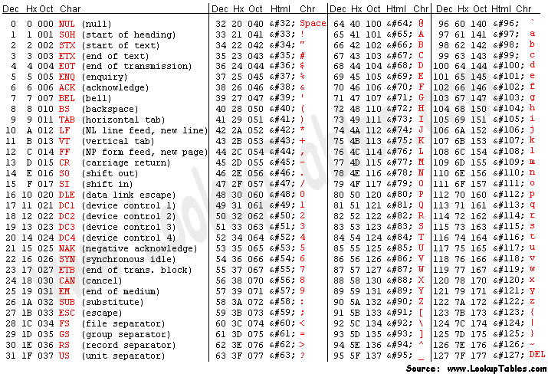
Binary Encoding – Characters/Text
ASCII Encoding (www.asciitable.com)
American Standard Code for Information Interchange

Slide 16
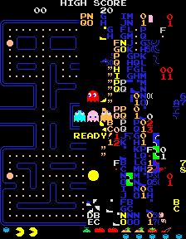
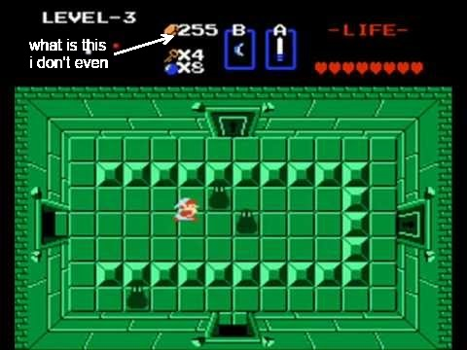
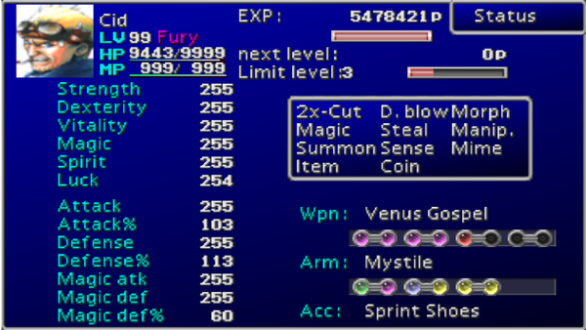
Binary Encoding – Video Games
As programs run, in-game data is stored somewhere
In many old games, stats would go to a maximum of 255
Pacman “kill screen”
http://www.numberphile.com/videos/255.html

Slide 17
Binary Encoding – Files and Programs
At the lowest level, all digital data is stored as bits!
Layers of abstraction keep everything comprehensible
Data/files are groups of bits interpreted by program
Program is actually groups of bits being interpreted by your CPU
Computer Memory Demo
Can try to open files using a text editor
From vim: %!xxd

Slide 18
Summary
Humans think about numbers in decimal; computers think about numbers in binary
Base conversion to go between them
Hexadecimal is more human-readable than binary
All information on a computer is binary
Binary encoding can represent anything!
Computer/program needs to know how to interpret the bits

Slide 19
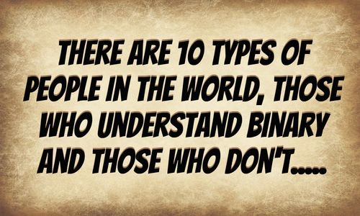
Summary

