Slide 1
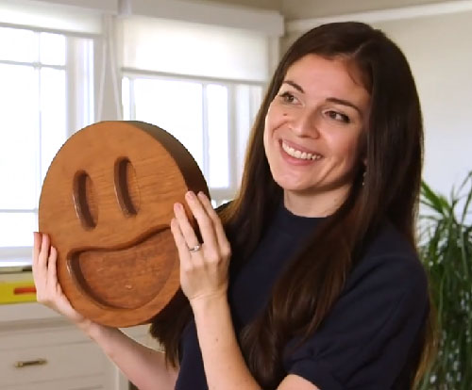
Processing and Drawing CSE 120 Winter 2019
Instructor: Teaching Assistants:
Justin Hsia Ann Shan, Eunia Lee, Pei Lee Yap, Sam Wolfson, Travis McGaha
There are now 2,823 emoji. Meet the former Apple intern who helped design the original 500
“The latest Apple software update, iOS12.1, added 157 new emoji to the ever-growing library. This brings the total number to 2,823, which includes all the variations for elements like skin tone and gender. It may be hard to imagine a world before these little icons, but it was only a decade ago that they got their start.
“Meet Angela Guzman, a former Apple design intern who worked with her mentor Raymond Sepulveda to create about 500 of the original emoji, … including the happy poop, the colorful hearts and a seemingly endless variety of facial expressions.”
https://www.cnbc.com/2018/12/27/this-former-apple-intern- helped-design-the-original-500-emoji.html

Slide 2
Administrivia
Assignments:
Lightbot Functions [hw] due today before 11:59 pm (1/14)
Taijitu [lab] due by end of Thursday (1/17)
“Big Ideas” lecture this week: Algorithms
Reading due before lab on Thursday (1/17)
Register on Piazza (7 of you still haven’t)
Grading and Grades
Reading Check 1 and Personal Values scores released
Assignment have rubrics on Canvas
Final grades will be curved, but not to a strict curve

Slide 3
Processing
Our programming language for this course
Text-based language that is good for visuals and interaction
Try to focus on ideas and techniques, not the specific commands
No language is perfect – Processing has its fair share of quirks and deficiencies ☹
It is both a programming environment (where you type) and a programming language
You are writing Java code, but they have made a lot of things easier

Slide 4
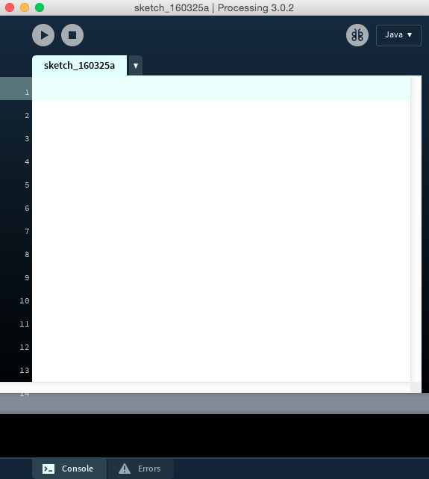
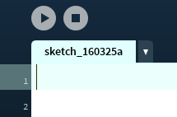
The Processing Coding Environment
Notes:
Open Processing (make sure it’s on Java mode).

Slide 5

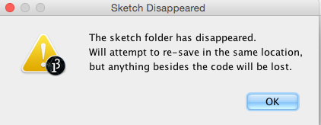
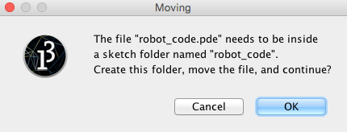
Aside: Processing Files
Processing files have extension .pde
File names cannot contain dashes (-)
To run a Processing file, it must be in a folder of the same name
If it’s not, then Processing will create the folder for you

Slide 6
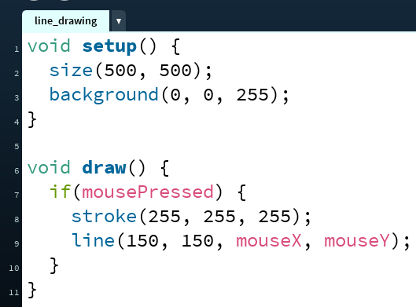
Text-Based Programming Basics
semi-colon indicates end
of statement
case-sensitive
mouseX ≠ mousex
Other helpful environment features:
Parentheses matching
Error messages
There is color coding

Slide 7
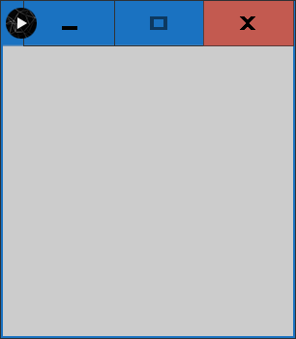
The Drawing Canvas
Defines the space on which you can draw
size(width, height);
Anything drawn off of the canvas won’t be visible
Notes:
Type: size(500,500);
Click Run
Change to: size(500,800);
Ask: “Will this canvas be tall or wide?” – tall
Click Run
Change back to: size(500,500);

Slide 8
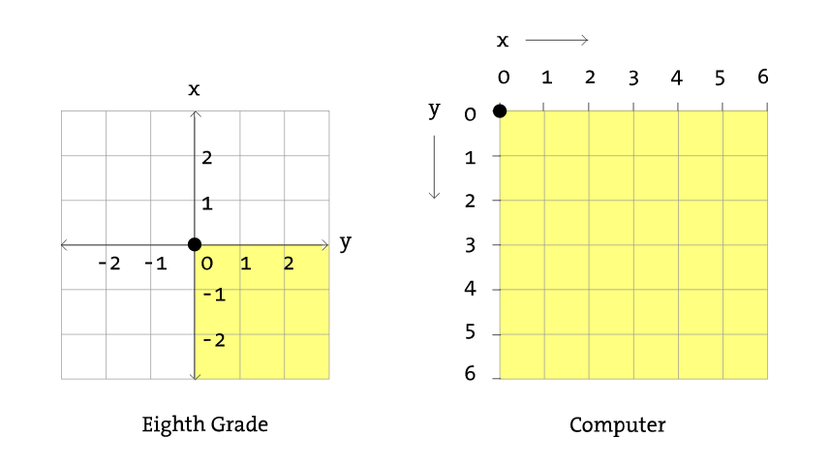
Coordinate System
Math
Processing
y
x

Slide 9
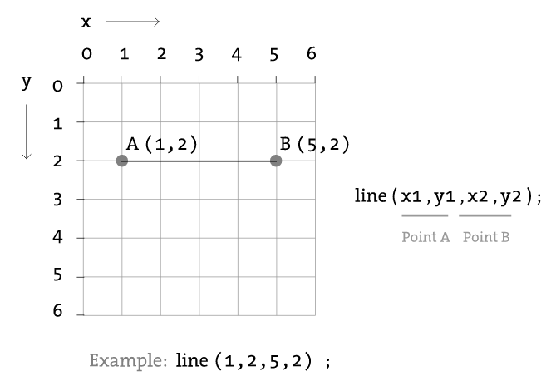
Drawing: Line
Notes:
Add to bottom of code: line(30,60,150,60);
Click Run
Add to bottom of code: line(300,300,100,100);
Ask: “Will this show up above or below the first line?” – below
Click Run
Ask: “Does the ordering of the points matter?” – no
Change last line: line(100, 100, 300, 300);
Click Run

Slide 10
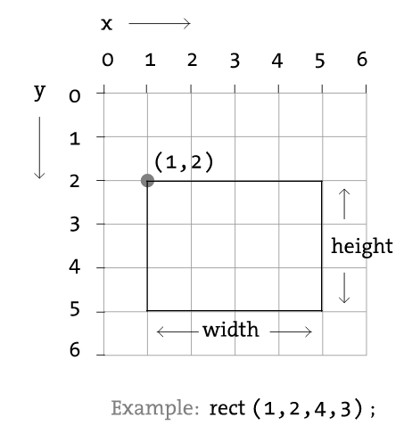
Drawing: Rectangle
Default mode is CORNER
Notes:
In CORNER: rect( x, y, width, height );
Add to bottom of code: rect(100, 250, 175, 125);
Click Run
Ask: “Why does this look this way?” – rect on top of the line because statement happened after
Ask: “Turns out that there isn’t a square function. Why not?” – square is just a special case of a rectangle
Change last line: rect(100, 250, 125, 125);
Click Run

Slide 11
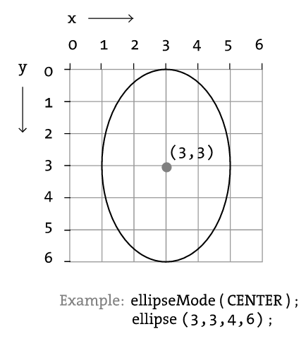
Drawing: Ellipse/Circle
Default mode is CENTER
Notes:
In CENTER: ellipse( x, y, width, height );
Add to bottom of code: ellipse(100, 250, 125, 125);
Click Run
Ask: “How do I get the circle in the same place as the square?” – add half the height and width to x and y
Adjust position of circle.
Click Run
Ask: “What if I wanted to get rid of the circle?” – could delete, but mention comments
Comment out the ellipse
Click Run

Slide 12
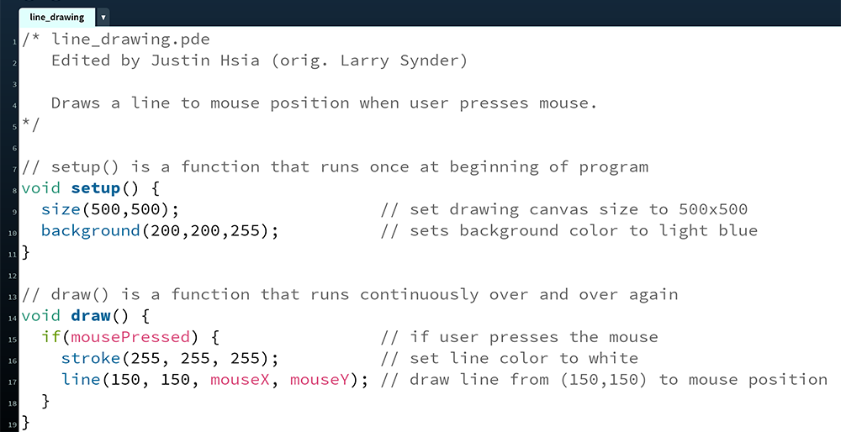
Comments Are Critical!!!

Slide 13
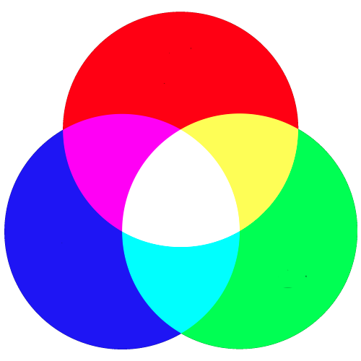
Understanding Color
In electronic systems, color specified using the RGB color model
Red, Green, Blue
Each pixel on your screen is made up of 3 tiny lights, one red, one green, one blue
Specify the intensity of each light using an integer between 0 and 255
0 is completely off
255 is highest intensity

Slide 14
Guess the Color
color( R, G, B);
color(255, 0, 0);
color( 0, 255, 0);
color( 0, 0, 255);
color( 0, 0, 0);
color(255, 255, 255);
color(255, 255, 0);
color(255, 0, 255);
color( 0, 255, 255);

Slide 15
Guess the Color
color( R, G, B);
color(255, 0, 0); // red
color( 0, 255, 0); // green
color( 0, 0, 255); // blue
color( 0, 0, 0); // black
color(255, 255, 255); // white
color(255, 255, 0); // yellow
color(255, 0, 255); // magenta
color( 0, 255, 255); // cyan

Slide 16
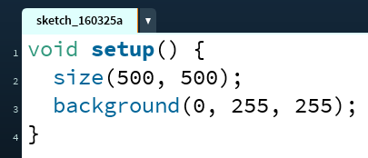
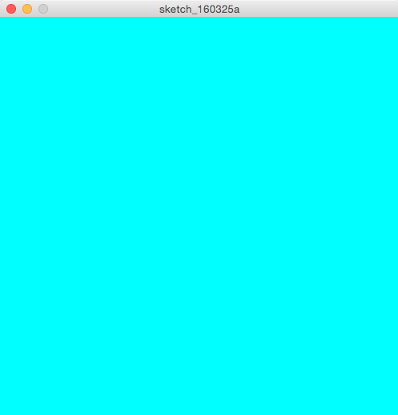
Color Functions
background(R, G, B);
Covers the entire drawing canvas with the specified color
Will draw over anything that was previously drawn
Notes:
Add to bottom of code: background(0, 255, 255);
Click Run
Ask: “Oh no! What happened?” – drawing canvas was covered with background color after other shapes were drawn
Move background() statement to top of code
Change statement to background(255, 255, 255);

Slide 17
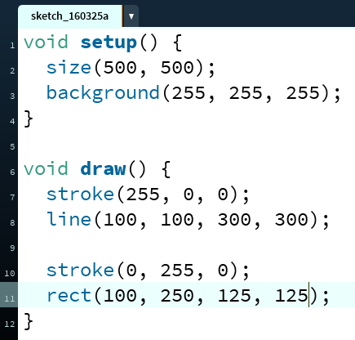
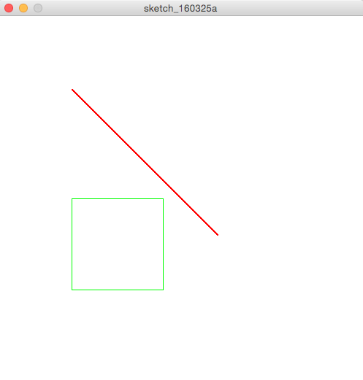
Color Functions
stroke(R, G, B);
Sets the color of the stroke of a line or line around a shape
Can change line size using strokeWeight(#);
Notes:
Add before 1st line(): stroke(255, 0, 0);
Click Run
Add before 1st line(): strokeWeight(5);
Click Run
Ask: “What if we only wanted the diagonal line to be red?” – move stroke() below 1st line, add stroke() before rect()
Make those changes, Click Run

Slide 18
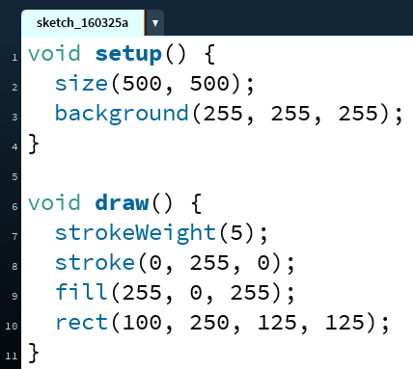
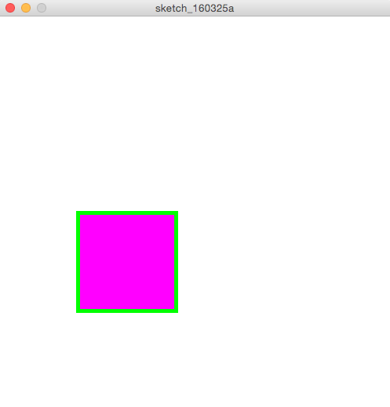
Color Functions
fill(R, G, B);
Sets the inside color of a shape (note: you cannot fill a line)
Notes:
Add before rect(): fill(255, 0, 255);
Click Run

Slide 19
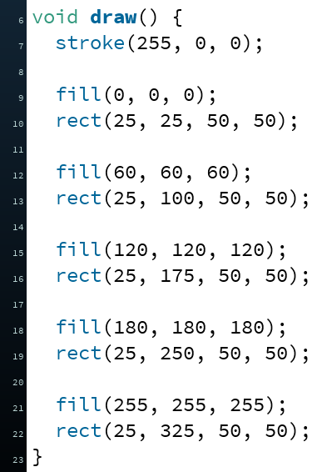
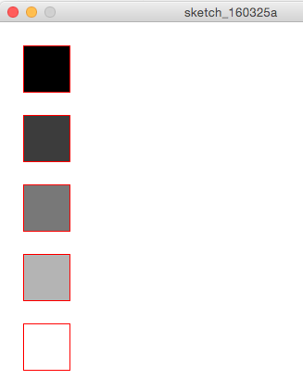
Color: “Grays"
When the values for RGB are all the same, then the color will be white, black, or some shade of gray

Slide 20
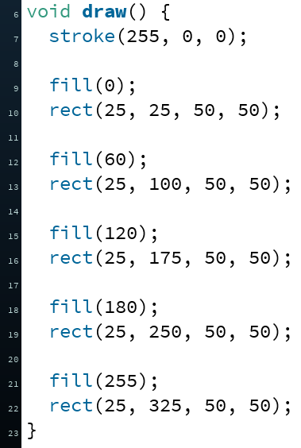
Color: “Grays"
When the values for RGB are all the same, then the color will be white, black, or some shade of gray
For brevity, can specify just a single number instead

Slide 21
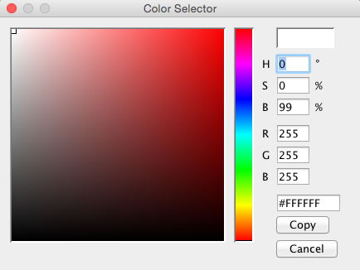
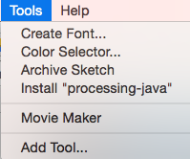
Processing’s Color Selector

Slide 22
The Color “State” of Your Program
Recall that programs are executed sequentially (i.e. instruction-by-instruction)
stroke() and fill() apply to all subsequent drawing statements
Until a later call overrides
Hidden color “state” that knows the current values of stroke(), strokeWeight(), and fill()
In complex programs, can be difficult to keep track of
Early rule of thumb: always explicitly set colors before each drawing element

Slide 23

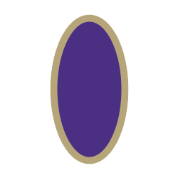


Practice Question
Which of the following drawings corresponds to the Processing code below?
Vote at http://PollEv.com/justinh
strokeWeight(10);
stroke(75, 47, 131); // UW purple
fill(183, 165, 122); // UW gold
ellipse(100, 100, 100, 200);
A. B. C. D.

Slide 24
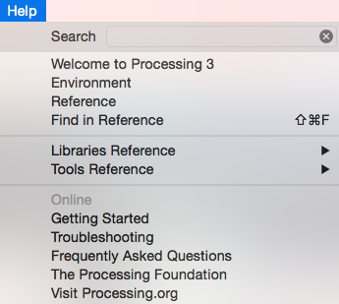
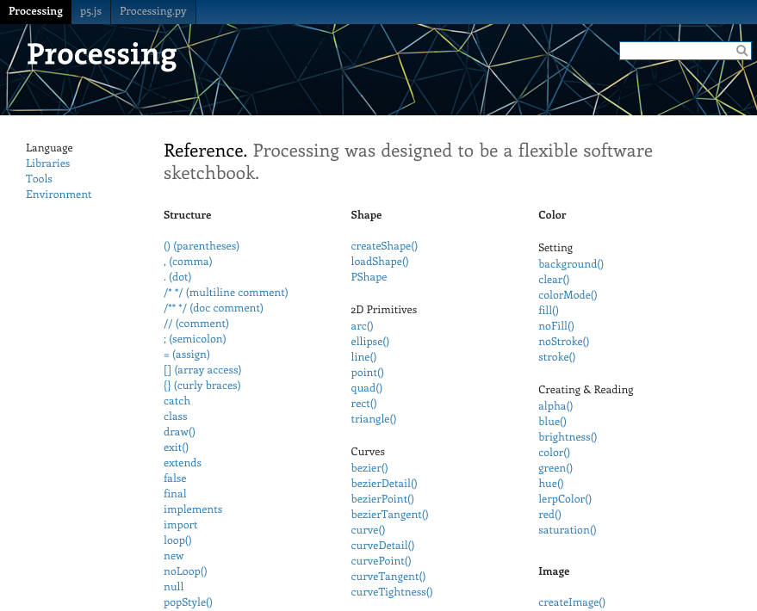
The Processing Reference

Slide 25
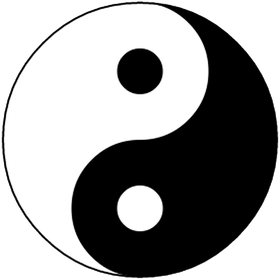
Activity: Taijitu
How do you build a complex drawing out of these simple shapes?

