Slide 1

Variables & Datatypes CSE 120 Winter 2019
Instructor: Teaching Assistants:
Justin Hsia Ann Shan, Eunia Lee, Pei Lee Yap, Sam Wolfson, Travis McGaha
Feds Can't Force You To Unlock Your iPhone With Finger Or Face, Judge Rules
“Judge Westmore declared that the government did not have the right, even with a warrant, to force suspects to incriminate themselves by unlocking their devices with their biological features. Previously, courts had decided biometric features, unlike passcodes, were not ‘testimonial.’ That was because a suspect would have to willingly and verbally give up a passcode, which is not the case with biometrics.
“The magistrate judge decision could, of course, be overturned by a district court judge, as happened in Illinois in 2017 with a similar ruling.”
https://www.forbes.com/sites/thomasbrewster/2019/01/14/ feds-cant-force-you-to-unlock-your-iphone-with-finger-or-face- judge-rules/

Slide 2
Administrivia
Assignments:
Taijitu [checkoff] due Thursday (1/17)
Reading Check 2 due Thursday by 3:30 pm (1/17)
Logo Design due Friday (1/18)

Slide 3
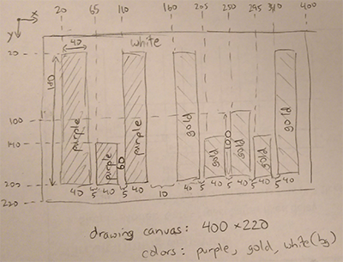
Homework: Logo Design

Slide 4
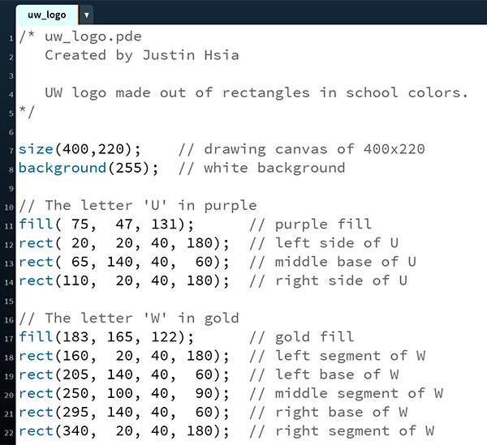
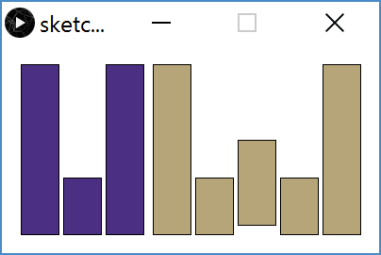
Homework: Logo Design

Slide 5
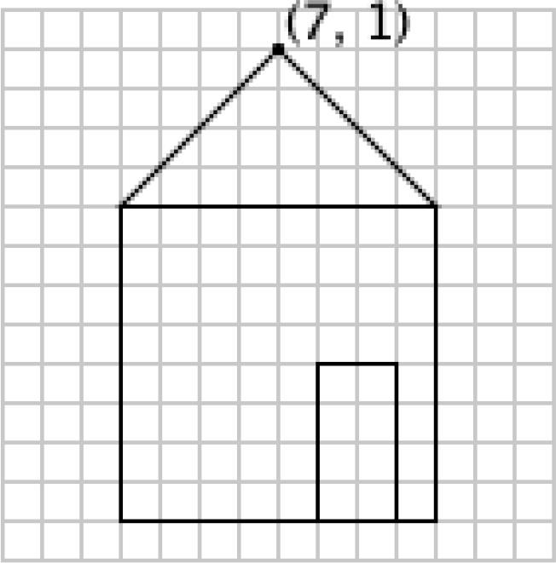
Drawing a House
One solution from worksheet:
triangle(7,1, 3,5, 11,5); rect(3, 5, 8, 8); rect(8, 9, 2, 4);
What if we wanted to move the house?

Slide 6
Variables
Piece of your program that holds the value of something
Every variable must be given a name and a data type
The values of these variables can change (i.e. vary) during the execution of your program
Warning: Not like a variable in Algebra (i.e. an unknown)
Assignment/Write: give a variable a specific value
e.g. x = 12;

Slide 7
Variables
Piece of your program that holds the value of something
Every variable must be given a name and a data type
The values of these variables can change (i.e. vary) during the execution of your program
Warning: Not like a variable in Algebra (i.e. an unknown)
Read: use the current value of a variable
e.g. ellipse(x+1, 50, 20, 20);

Slide 8

Datatypes
int integers (e.g. 12 or -3)
float decimal/real numbers (e.g. 3.14)
color RGB (e.g. color(0))
char characters (e.g. 'J')
boolean true or false (e.g. true)
Many more exist and can be found in the Processing Reference:

Slide 9

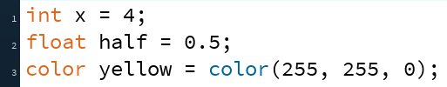
Declarations
We declare a variable by telling Processing the variable’s datatype, followed by the variable’s name:
You can also give a variable a starting value (initialization) in the same line as the declaration:

Slide 10
Variable Manipulation
Executed sequentially, just like other statements
For variable assignments, compute right-hand side first, then store result in variable
Example: int x = 4; x = x + 1;
Read the current value of x (4) for the right-hand side
Add 1 to the current value of x
Store the result (5) back into x

Slide 11
Drawing a House with Variables
Initial solution:
triangle(7,1, 3,5, 11,5); rect(3, 5, 8, 8); rect(8, 9, 2, 4);
What properties might be useful to store in variables?

Slide 12
Variable Rules & Guidelines
Variable naming rules:
Variables are case-sensitive (e.g. myx vs. myX)
Numbers allowed, but not at beginning (e.g. k9 vs. 9k)
Generally avoid symbols other than underscore (e.g. my_x)
Variable names are meaningless to computers, but meaningful to humans
Choosing informative names improves readability and reduces confusion
In this class, most of our variables will be declared and initialized at the very top of our programs

Slide 13
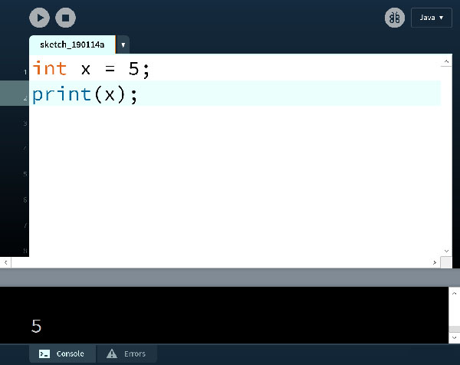
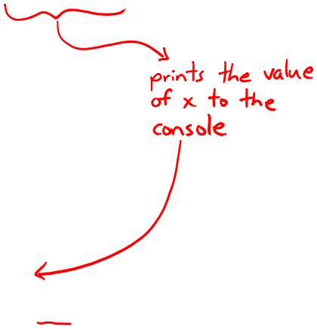
Variable Worksheet
New functions: print(), println()

Slide 14
System Variables
Special variables that hold values related to the state of the program, often related to user input
You don’t need to declare these variables
These variables will update automatically as the program runs
Colored pink/magenta-ish in the Processing environment
Examples: width and height hold the value of the width and height of the drawing canvas, respectively
Notes:
size(300,500);
println(width);
println(height);

Slide 15
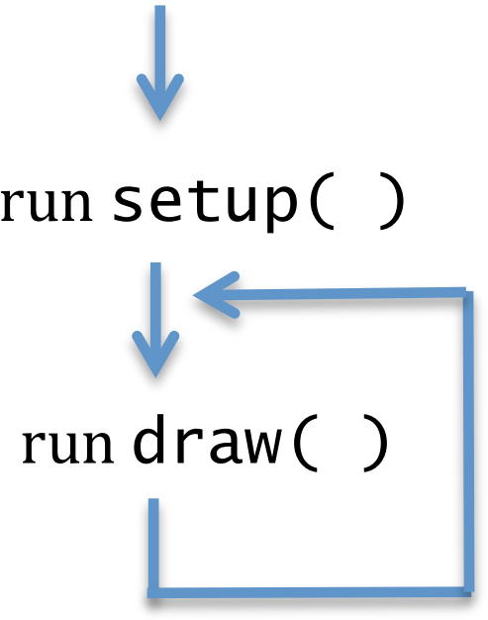
Active Mode in Processing
We enter active mode by creating the functions setup() and draw() in our program
setup() automatically executes once at the start
draw() executes infinitely afterwards
Each time draw() executes, it is called a new frame

Slide 16
Drawing and Frames
System variable frameCount returns the number of frames since the start of the program
Starts at 0 in setup()
frameRate() changes the desired number of frame updates there are per second
Larger argument is faster
Default is frameRate(60)
noLoop() stops draw() from being continuously executed
Can restart using loop()

Slide 17
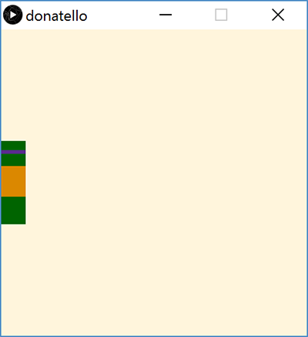
Motion with Variables
Create your drawing
Introduce a variable
Substitute values in your drawing with expressions that use the new variable
Change the variable value in-between frames
Use background() to cover old frames

Slide 18
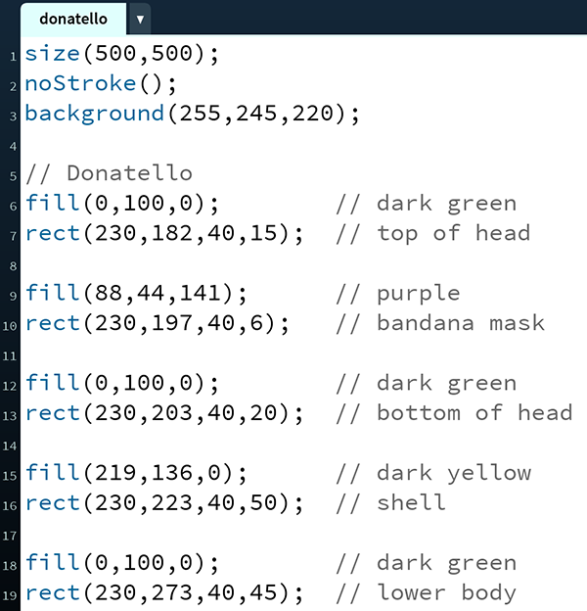
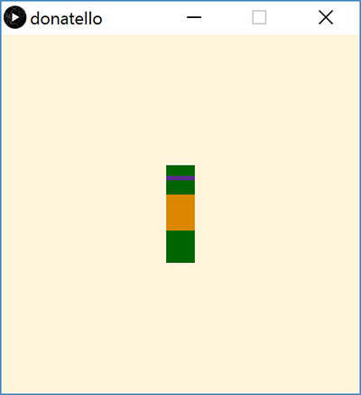
TMNT: Donatello

Slide 19
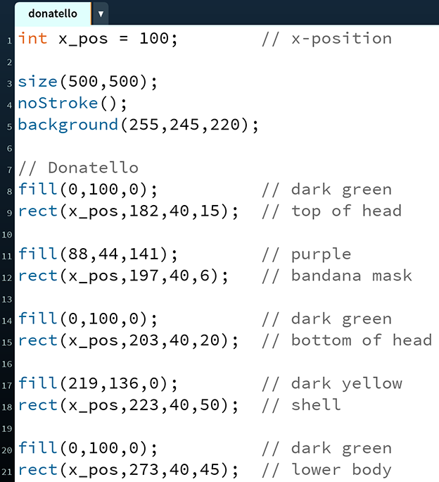
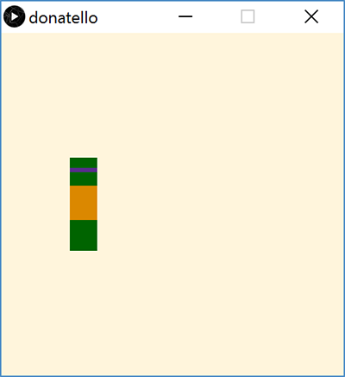
Donatello with a Variable

Slide 20
Stopping Motion
Stop Donatello from running off the right side of the screen:
x_pos = min(x_pos + 1, width-40);
Stop Donatello from running off the left side of the screen:
x_pos = max(x_pos - 1, 0);
Notes:
In draw(), change x_pos: x_pos = min(x_pos + 1, 460);
In draw(), change x_pos: x_pos = min(x_pos - 1, 0);

Slide 21
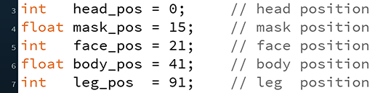
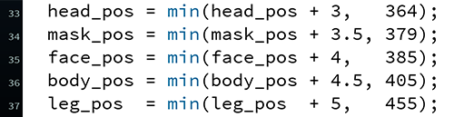
Falling Into Place
Introduce variables for each body segment:
Update each variable at different speeds:

Slide 22
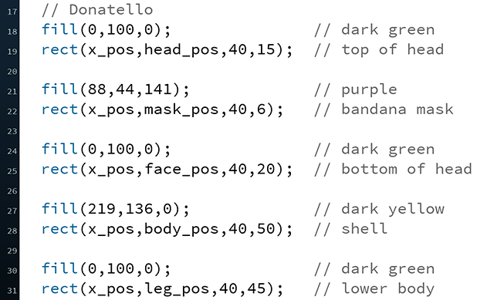
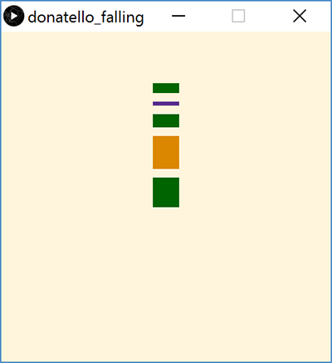
Falling Into Place
Update y-positions of drawing based on new variables:

Slide 23
Summary
Variables are named quantities that can vary during the execution of a program
Datatypes specific different forms of data
e.g. int, float, color, Boolean
Variable declarations specify a variable datatype and name to the program
Generally occur at top of program
Active mode uses setup() and draw()
Motion can be introduced by changing the values of variables used in drawing commands in-between frames
min() and max() functions can be used to limit or stop change in a variable value

Slide 24
Variable Practice
int x = 1; int y = 2; int z = 3; x = x + 1; y = y - 1; z = z + 2;
int x = 7; int y = 2; int z = 0; x = x + 3; y = y – 2; z = x + y;
int x = -1; int y = 0; int z = 5; x = x + z; y = y – x; z = x + z;
x | y | z
x | y | z
x | y | z

