Slide 1

Algorithms CSE 120 Winter 2019
Instructor: Teaching Assistants:
Justin Hsia Ann Shan, Eunia Lee, Pei Lee Yap, Sam Wolfson, Travis McGaha
Beijing to Judge Every Resident Based on Behavior by End of 2020
“China’s plan to judge each of its 1.3 billion people based on their social behavior is moving a step closer to reality, with Beijing set to adopt a lifelong points program by 2021 that assigns personalized ratings for each resident.
“The tracking of individual behavior in China has become easier as economic life moves online, with apps such as Tencent’s WeChat and Ant Financial’s Alipay a central node for making payments, getting loans and organizing transport. Accounts are generally linked to mobile phone numbers, which in turn require government IDs.”
https://www.bloomberg.com/news/articles/2018-11-21/ beijing-to-judge-every-resident-based-on-behavior-by-end- of-2020

Slide 2
Administrivia
Monday (1/21) is a holiday – no class!
No office hours, either
Assignments:
Logo Design [submit] is due tonight (1/18)
Lego Family [submit] due on Wednesday (1/23)
Make sure you read the rubric before submitting!

Slide 3
Lego Family
Create an abstracted family/group of characters
Can’t use the Simpsons or Teenage Mutant Ninja Turtles
Be careful with level of detail vs. time you want to spend
Add motion to get them to come together

Slide 4
Definition
An algorithm is “any well-defined computational procedure that takes some value, or set of values, as input and produces some value, or set of values, as output.” “An algorithm is thus a sequence of computational steps that transform the input into the output.”
From textbook Introduction to Algorithms (link)
Algorithm
(well-defined computational procedure)
Inputs
Outputs

Slide 5
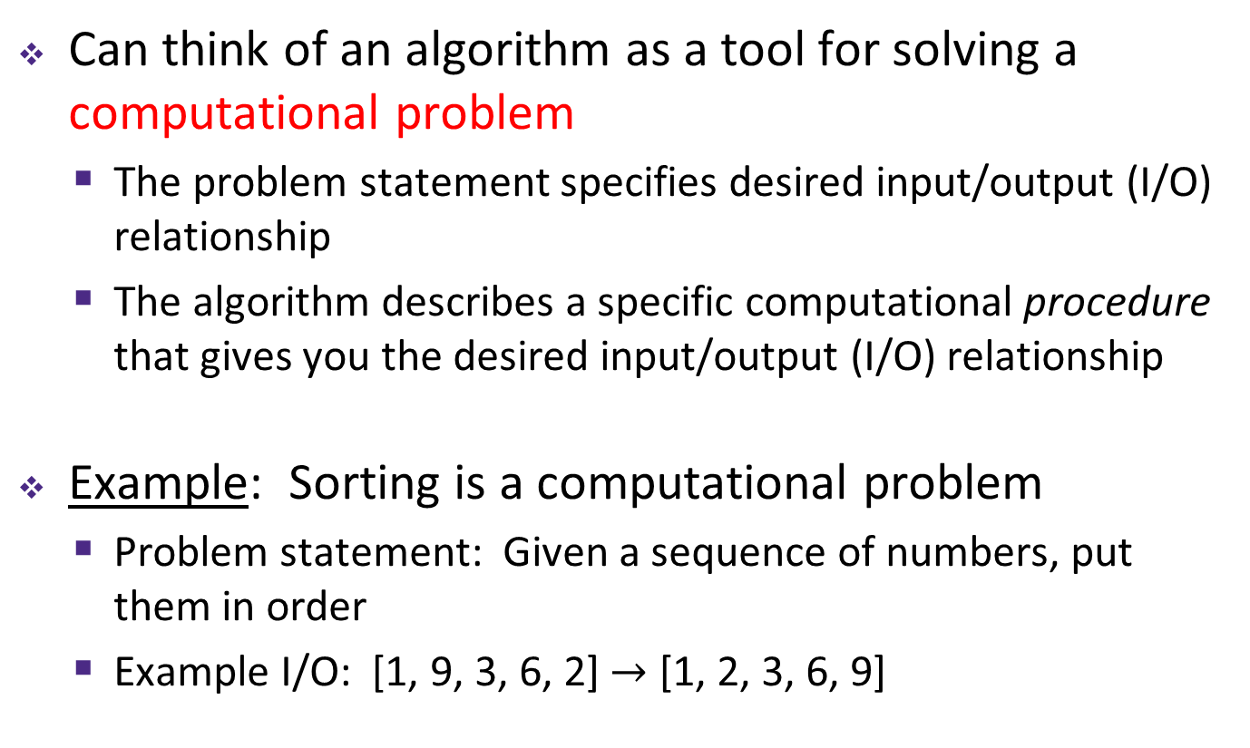
Computational Problems
Can think of an algorithm as a tool for solving a computational problem
The problem statement specifies desired input/output (I/O) relationship
The algorithm describes a specific computational procedure that gives you the desired input/output (I/O) relationship
Example: Sorting is a computational problem
Problem statement: Given a sequence of numbers, put them in order
Example I/O: [1, 9, 3, 6, 2] $→$ [1, 2, 3, 6, 9]

Slide 6
Early Algorithms
The concept of algorithms pre-dates computers
Dances, ceremonies, recipes, and building instructions are all conceptually similar to algorithms
Mathematical algorithms go way back:
Babylonians defined many fundamental procedures ~3600 years ago, more formal algorithms in Ancient Greece
Al-Khwarizmi laid out many algorithms for computation using decimal numbers
You implicitly use hundreds of numerical algorithms!
Nature runs algorithms (e.g. genes and development)
Notes:
https://en.wikipedia.org/wiki/Muhammad_ibn_Musa_al-Khwarizmi

Slide 7
Properties of Algorithms
Algorithms can be combined to make new algorithms
It helps to know standard algorithms
Building from correct algorithms helps ensure correctness
There are many algorithms to solve the same computational problem
Developing a new algorithm to solve a problem can lead to insight about the problem

Slide 8
Algorithms You’ve Seen
Create a Taijitu from rectangles and ellipses
Converting a binary number to decimal
Make a character move into place on the screen
… and many more!

Slide 9
An Algorithm You’ve Seen Before
Multiplying two numbers:
Another multiplication algorithm?
Common core “box” method:
2
23
x 7
161
20 + 3_
7
140
21
140+21=161

Slide 10
More Famous Algorithms
PageRank algorithm
Google’s measure of the “reputation” of web pages
EdgeRank algorithm
Facebook’s method for determining what to show on your News Feed
Luhn algorithm
Credit card number validation
Deflate
Lossless data compression
RSA Encryption
Encrypt (secure) data for transmission

Slide 11
Peanut Butter Jelly Time!
On a piece of paper, write out an “algorithm” for making a peanut butter and jelly (PB&J) sandwich
bread (in a bag), jar of peanut butter, jar of jam, knife
A TA will collect a few for me to test out!

Slide 12
Be Specific!
A programmer’s spouse says, “Run to the store and pick up a loaf of bread. If they have eggs, get a dozen.”
What happens?
The programmer comes home with 12 loaves of bread!
Algorithms need to be expressed in an unambiguous way for all participants

Slide 13
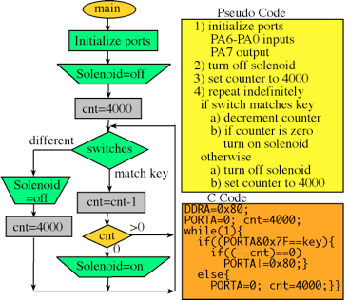
Ways to Express Algorithms
Many ways to specify an algorithm:
Natural Language (e.g. English, 中國) or Pseudocode
Easy for humans to understand, but can be ambiguous or vague
Visual and text-based programming languages (e.g. Scratch, Processing)
Have an exact meaning with no ambiguity
Can be run on a computer
Other information-conveying ways
e.g. flowcharts or pictures

Slide 14
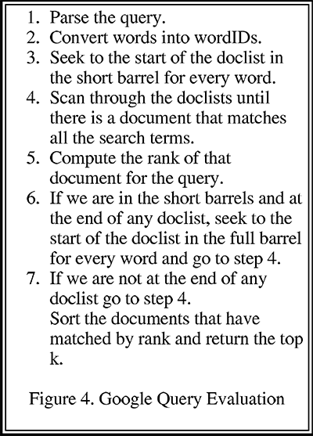
Google Query
From Larry Page and Sergey Brin’s research paper The Anatomy of a Large-Scale Hypertextual Web Search Engine

Slide 15







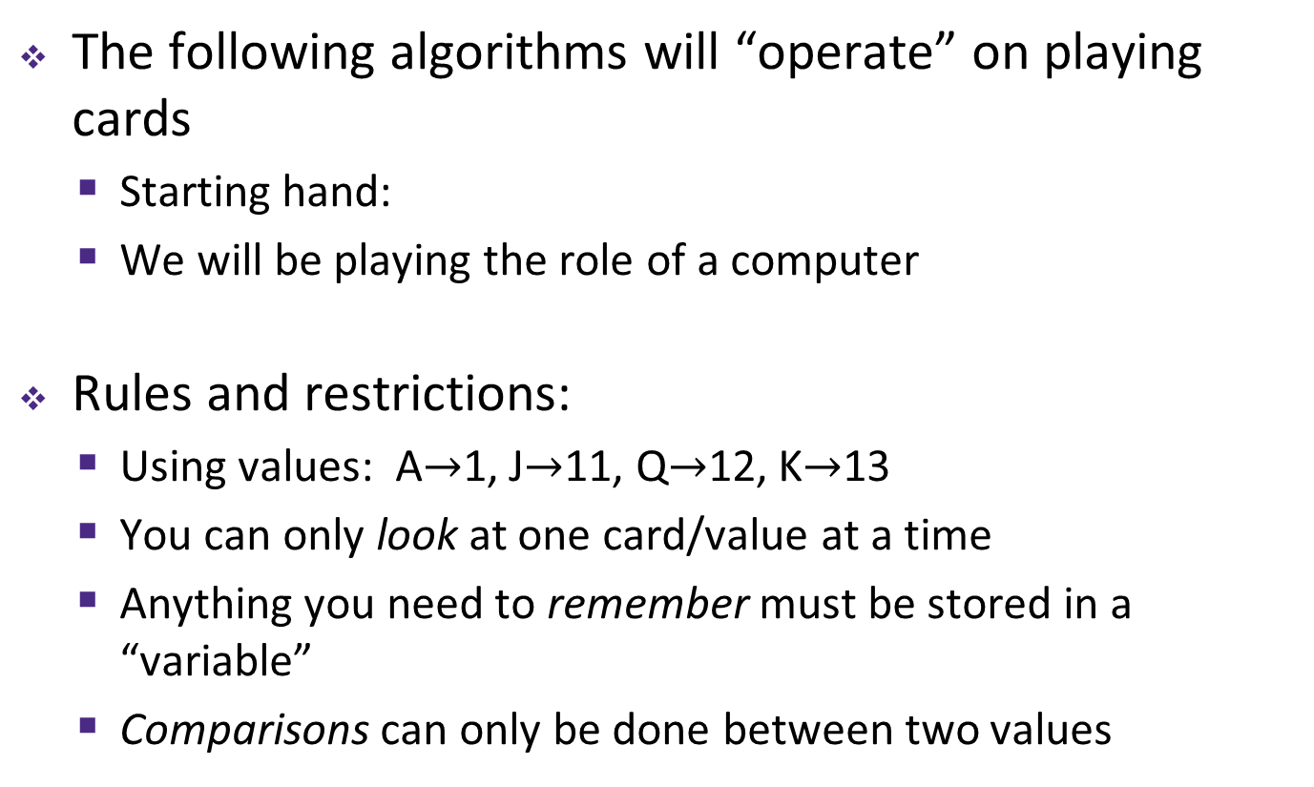
Specifying Algorithms Practice
The following algorithms will “operate” on playing cards
Starting hand:
We will be playing the role of a computer
Rules and restrictions:
Using values: A$→$1, J$→$11, Q$→$12, K$→$13
You can only look at one card/value at a time
Anything you need to remember must be stored in a “variable”
Comparisons can only be done between two values

Slide 16
1) Search an Unordered List
Input: , desired card
Output: Yes if desired number is in the list, No otherwise
Algorithm:
Check each card starting from the left
If card is the one you’re looking for, then report Yes
If a different card, then move on (don’t report)
If done with numbers, then report No

Slide 17
2) Sort an Unordered List (version 1)
Input:
Output: The same list, but now in numerical order
Algorithm:
Starting from the left, compare two adjacent cards and swap them if they are not in order. Move one card over and repeat until you reach the end of the list.
Repeat until list is ordered.
This algorithm is called Bubble Sort

Slide 18
3) Find the Smallest Number in a List
Input:
Output: The index/position of the smallest number (5 in this case, since Ace is in the 5th position)
Algorithm:
Look at the first card and write down (or remember) the card value and the index 1.
Check the rest of the cards 1-by-1: if card value is smaller, then write (or remember) the new value and index.

Slide 19
4) Sort an Unordered List (version 2)
Input:
Output: The same list, but now in numerical order
Algorithm:
Find the smallest number (algorithm 3) and move it to the front of the list.
Repeat this entire procedure, but for the rest of the list.
This algorithm is called Selection Sort
Notes:
https://visualgo.net/bn/sorting

Slide 20
5) Find Median of a List
Note: This is an actual job interview question!
Problem: Given a list of numbers (odd length, no repeats), return the median
Example: { should output 6
Algorithm:
Sort the list (algorithm 2 or 4).
Take the number in the middle index (N+1)/2.

Slide 21
Sorting
Sorting is a mind-bogglingly common task
Still difficult because it depends on (1) how many things you are sorting and (2) the initial ordering
We showed some simple sorting algorithms, but there are a lot more clever ones
https://visualgo.net/bn/sorting
https://www.toptal.com/developers/sorting-algorithms

Slide 22
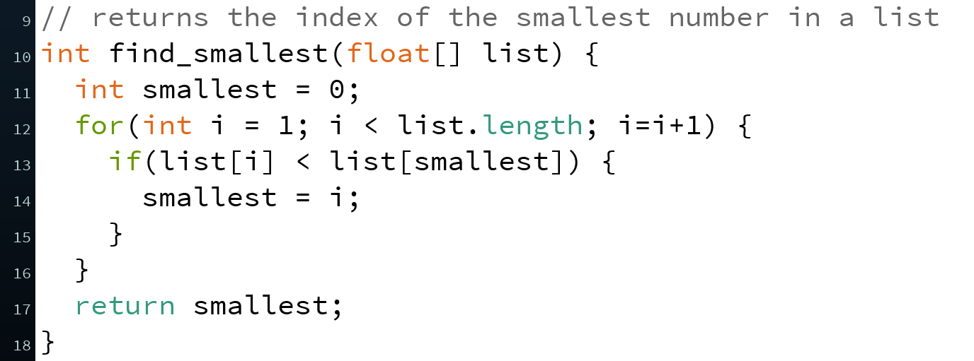
Implementations
If we specify an algorithm using code in a programming language, we say that the code implements the algorithm
A function or program that can be run on a computer
Example: Find index of smallest in list
Algorithm 3 of demo
Pseudocode/natural language
Function in Processing
Implementation

Slide 23
Which Language to Use?
Different languages are better suited for expressing different algorithms
Some languages are designed for specific domains, and are better for expressing algorithms in those domains
e.g. Unix shell scripts, SQL, HTML
https://en.wikipedia.org/wiki/Domain-specific_language
Language choice can affect things like efficiency, portability, clarity, or readability
Clarity and readability are VERY important considerations
Doesn’t affect existence of algorithmic solution

Slide 24
Conceptual Question
I hand you a cooking recipe with no name – is this equivalent to a computational problem, algorithm, or implementation?
What can and can’t I do with just the recipe?
Vote at http://PollEv.com/justinh
Computational Problem
Algorithm
Implementation

Slide 25
Summary
A computational problem is a problem statement with desired I/O relationship
An algorithm describes a computational procedure that satisfies/solves a computational problem
An implementation is an algorithm written out in a programming language (unambiguous, executable)
Properties of algorithms:
Can be combined to make new algorithms
Knowledge of existing algorithms & correctness help
There are many algorithms to solve the same computational problem

