Slide 1

Functions in Processing CSE 120 Winter 2019
Instructor: Teaching Assistants:
Justin Hsia Ann Shan, Eunia Lee, Pei Lee Yap, Sam Wolfson, Travis McGaha
Amazon scraps secret AI recruiting tool that showed bias against women
“[Amazon’s] machine-learning specialists uncovered a big problem: their new recruiting engine did not like women. The team had been building computer programs since 2014 to review job applicants’ resumes with the aim of mechanizing the search for top talent.”
“But by 2015, the company realized its new system was not rating candidates for software developer jobs and other technical posts in a gender-neutral way. That is because Amazon’s computer models were trained to vet applicants by observing patterns in resumes submitted to the company over a 10-year period. Most came from men, a reflection of male dominance across the industry.”
https://www.reuters.com/article/us-amazon-com-jobs- automation-insight/amazon-scraps-secret-ai-recruiting-tool- that-showed-bias-against-women-idUSKCN1MK08G

Slide 2
Administrivia
Assignments:
Lego Family [submit] due tonight (1/23)
Website Setup [checkoff] due tomorrow (1/24)
Reading Check 3 due tomorrow @ 3:30 pm (1/24)
Editing your portfolio from home
Download and install Cyberduck & VS Code
Re-do Steps 3 & 4 from the website setup
Make sure to take advantage of office hours and Piazza!

Slide 3
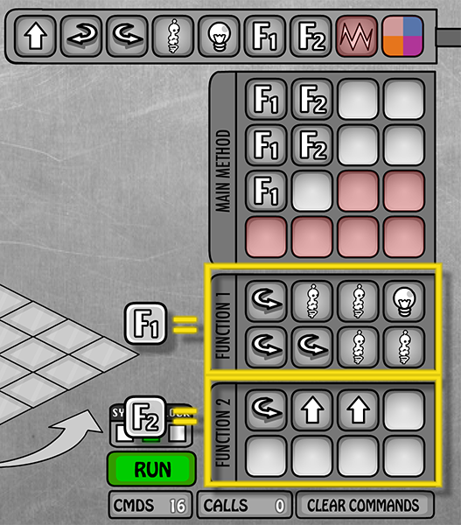
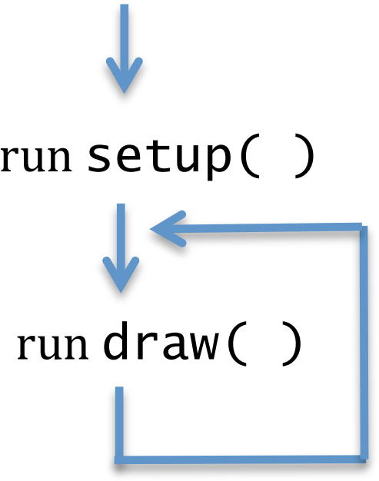
Functions (So Far)
Used for abstraction
Detail Removal: subtasks with intuitive names
Generalization: don’t repeat code
Lightbot:
Processing:
line(), rect(), …
min(), max()

Slide 4
Program Execution with Functions
Functions “break” the normal sequential execution model
When function is called, begin execution of function code
When end of function is reached, jump back to where function was called from
The keyword associated with this is return
Analogy: Song lyrics with a repeated chorus
Example: Survivor – Eye of the Tiger
Verse 1, Verse 2, Chorus, Verse 3, CHORUS, Verse 4, CHORUS, Outro

Slide 5

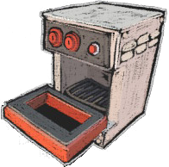



Data Passing with Functions
It takes in zero or more inputs, completes some task(s), and then returns a value
Functions can do more in Processing than in Lightbot!
Analogy: An Oven
Analogy: Song lyrics with that change slightly
Parameterized Example: Old MacDonald
Chorus(cow,moo), Chorus(pig,oink), Chorus(duck,quack)
Inputs
Output

Slide 6
House-Drawing Function
void setup() {
size(500, 500);
}
void draw() {
drawHouse(70, 10);
}
void drawHouse(int x, int y) {
triangle(x, y, x-40, y+40, x+40, y+40); // roof
rect(x-40, y+40, 80, 80); // walls
rect(x+10, y+80, 20, 40); // door
return;
}

Slide 7
Return Type
return type
What the function sends back to whoever called it
Can be any of the datatypes: int, float, color, etc.
If not returning anything, then we use void
void drawHouse(int x, int y) {
triangle(x, y, x-40, y+40, x+40, y+40); // roof
rect(x-40, y+40, 80, 80); // walls
rect(x+10, y+80, 20, 40); // door
return;
}

Slide 8
Function Name
function name
Does not matter to computer, but does to humans
Should describe what the function does
Subject to same naming constraints as variables
No two functions (or variables) can have the same name
void drawHouse(int x, int y) {
triangle(x, y, x-40, y+40, x+40, y+40); // roof
rect(x-40, y+40, 80, 80); // walls
rect(x+10, y+80, 20, 40); // door
return;
}

Slide 9
Parameters
parameters
Required part of every function definition
Must be surrounded by parentheses
If no parameters, parentheses are left empty
Datatype and name for every parameter must be specified
Separate parameters with commas
void drawHouse(int x, int y) {
triangle(x, y, x-40, y+40, x+40, y+40); // roof
rect(x-40, y+40, 80, 80); // walls
rect(x+10, y+80, 20, 40); // door
return;
}

Slide 10
Function Body
body
Body is enclosed in curly braces {}
Parameters are variables that are used inside the body
Body of a function is indented for better readability
Processing uses two spaces by default
Can use Edit → “Auto Format” to clean yours up automatically
void drawHouse(int x, int y) {
triangle(x, y, x-40, y+40, x+40, y+40); // roof
rect(x-40, y+40, 80, 80); // walls
rect(x+10, y+80, 20, 40); // door
return;
}

Slide 11
Lightbot Functions
Lightbot functions had a different syntax, but similar parts:
F.turn_around() Right, Right.
function name
parameters
body
F.turn_around() Right, Right.

Slide 12
Functions Worksheet
Make sure you explain why you see what you see!
void setup() {
size(500, 500);
}
void draw() {
drawHouse(70, 10);
}
void drawHouse(int x, int y) {
triangle(x, y, x-40, y+40, x+40, y+40); // roof
rect(x-40, y+40, 80, 80); // walls
rect(x+10, y+80, 20, 40); // door
return;
}
function call
function name
return type
parameters
body

Slide 13
Donatello as a Function
// draw Donatello
void drawDon() {
fill(0, 100, 0); // dark green
rect(x_pos, 182, 40, 15); // top of head
fill(88,44,141); // purple
rect(x_pos, 197, 40, 6); // bandana mask
fill(0, 100, 0); // dark green
rect(x_pos, 203, 40, 20); // bottom of head
fill(219, 136, 0); // dark yellow
rect(x_pos, 223, 40, 50); // shell
fill(0, 100, 0); // dark green
rect(x_pos, 273, 40, 45); // lower body
}
Notes:
What’s wrong with this code? What happens if we call donatello() twice?

Slide 14
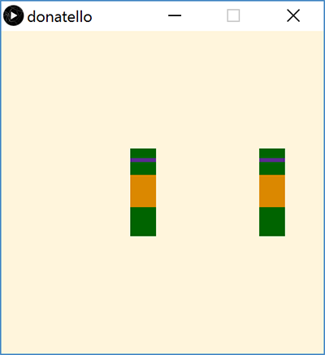
Donatello Function Parameterized
Can now call drawDon() function with different arguments (stored in parameter x_don):
We can also add parameter color mask to draw the other Teenage Mutant Ninja Turtles!
// draw Donatello
void drawDon(int x_don) {
fill(0, 100, 0); // dark green
rect(x_don,182,40,15); // top of head
...
void draw() {
background(255, 245, 220);
drawDon(200);
drawDon(400);
}

Slide 15
Parameters vs. Arguments
Implicit parameter/variable initialization with argument values
// draw TMNT with parameters
void draw() {
background(255, 245, 220);
drawTurtle(200, color(88, 44, 141)); // donatello
drawTurtle(400, color(255, 0, 0)); // raphael
}
// parameterized ninja turtle drawing function
void drawTurtle(int x, color mask) {
fill(0, 100, 0); // dark green
rect(x, 182, 40, 15); // top of head
fill(mask); // apply mask color
rect(x, 197, 40, 6); // bandana mask
...
arguments
parameters

Slide 16
Parameters vs. Arguments
When you define a function, you specify the parameters
Parameters are internal variables/boxes for functions
Use parameters for values that you want to be different on different calls to this function
When you call a function, you pass arguments
The order of the arguments must match the order of the parameters
We define a function once, but can call it as many times as we want (and in different ways)!

Slide 17
Solving Problems
Understand the problem
What is the problem description?
What is specified and what is unspecified?
What has been given to you (e.g. starter code)?
Break the task down into less complex subtasks
Example: Make a function that draws a row of five mice with their ears touching/overlapping. The mice should all be the same color except for the middle one, which should be red.

Slide 18
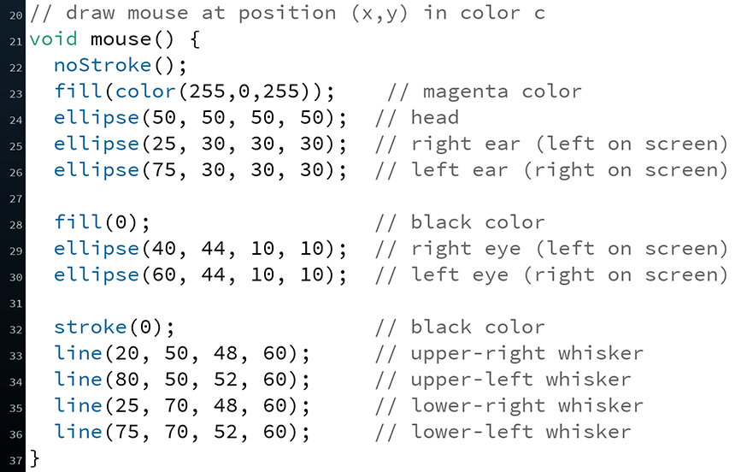

Parameter Example

Slide 19
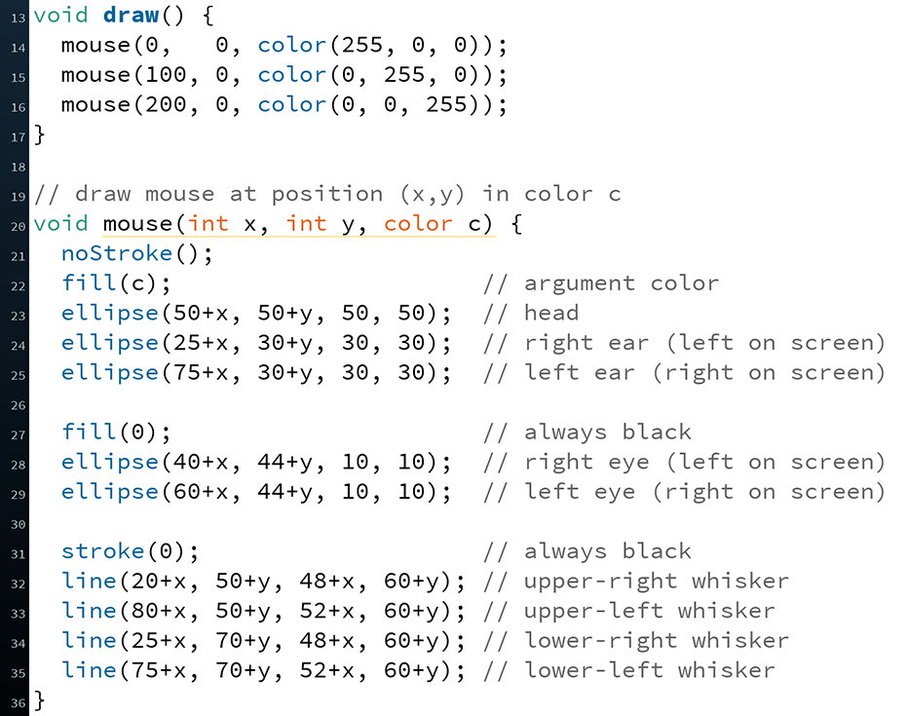

Parameter Example

Slide 20

Looking Forward
Portfolio
Don’t forget to add Taijitu, Logo Design, and Lego Family!
Animal Functions
Start in lab on Thursday, due Monday (1/28)
Design your own animal (like the frog shown here)
Example from CSE120 Wi18 student

Slide 21

Parameters Analogy
Executing a program is like walking down a hallway
Calling a function is like stepping into a room
Step back into the hallway after you are done with the task in that room
Parameters are boxes (our variable analogy) bolted to floor of room – can use while you’re there, but can’t leave room with them
Arguments are the values you place in boxes when you enter the room

