Slide 1
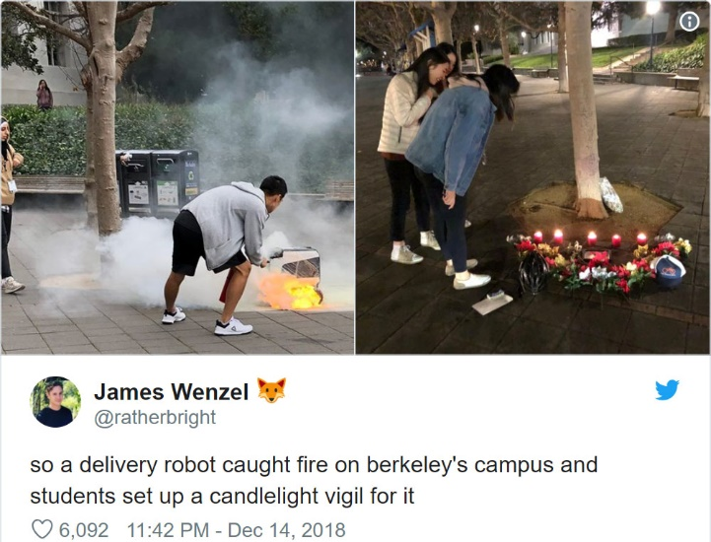
Expressions & Conditionals CSE 120 Winter 2019
Instructor: Teaching Assistants:
Justin Hsia Ann Shan, Eunia Lee, Pei Lee Yap, Sam Wolfson, Travis McGaha
Delivery Robot Engulfed in Flames, Honored on Campus With Candlelight Vigil
“The University of California, Berkeley, lost a beloved member of their campus last week, when a delivery robot was engulfed in flames outside the student union.
“The courier rovers started delivering food to students about two years ago. The service seems to have been operating relatively smoothly until… a Kiwibot spontaneously combusted while on the job.
“After an investigation, the company revealed … ‘a defective battery was put in place of a functioning one. This caused an exceedingly rare occurrence of the battery experiencing thermal runaway.’ ”
https://gizmodo.com/delivery-robot-engulfed-in-flames- honored-on-campus-wi-1831145871

Slide 2
Administrivia
Assignments:
Animal Functions due tonight (1/28)
Reading Check 4 due Thursday @ 3:30 (1/31)
Jumping Monster due Friday (2/1)
“Big Ideas” this week: Digital Distribution

Slide 3
Outline
Expressions & Operators
Conditionals
if
else
else if

Slide 4
Expressions
“An expression is a combination of one or more values, constants, variables, operators, and functions that the programming language interprets and computes to produce another value.”
https://en.wikipedia.org/wiki/Expression_(computer_science)
Expressions are evaluated and resulting value is used
Assignment: x = x + 1;
Assignment: x_pos = min(x_pos + 3, 460);
Argument: ellipse(50+x, 50+y, 50, 50);
Argument: drawMouse(rowX+4*50,rowY,rowC);

Slide 5
Operators
Built-in “functions” in Processing that use special symbols:
Multiplicative: * / %
Additive: + -
Relational: < > <= >=
Equality: == !=
Logical: && || !
Operators can only be used with certain data types and return certain data types
Multiplicative/Additive: give numbers, get number
Relational: give numbers, get Boolean
Logical: give Boolean, get Boolean
Equality: give same type, get Boolean

Slide 6
Operators
Built-in “functions” in Processing that use special symbols:
Multiplicative: * / %
Additive: + -
Relational: < > <= >=
Equality: == !=
Logical: && || !
Logical operators use Boolean values (true, false)
AND (&&)
OR (||)
NOT (!)
x | y | x && y
false | false
false | true
true | false
true | true
x | y | x || y
false | false
false | true
true | false
true | true
x | !x
false
true

Slide 7
Operators
Built-in “functions” in Processing that use special symbols:
Multiplicative: * / %
Additive: + -
Relational: < > <= >=
Equality: == !=
Logical: && || !
In expressions, use parentheses for evaluation ordering and readability
e.g. x + (y * z) is the same as x + y * z, but easier to read

Slide 8
Modulus Operator: %
x % y is read as “x mod y” and returns the remainder after y divides x
For short, we say “mod” instead of modulus
Example Uses:
Parity: Number n is even if n%2 == 0
Leap Year: Year year is a leap year if year%4 == 0
Chinese Zodiac: year1 and year2 are the same animal if year1%12 == year2%12

Slide 9
Conditionals Worksheet
Work just on Page 1 (Questions 1-6)
Operators:
Arithmetic: + - * / %
Relational: < > <= >=
Equality: == !=
Logical: && || !
Data Types:
Arithmetic: give numbers, get number
Relational: give numbers, get Boolean
Logical: give Boolean, get Boolean
Equality: give same type, get Boolean

Slide 10
Modulus Example in Processing
Use mod to “wrap around”
Replace min/max function to “connect” edges of drawing canvas
x_pos = min(x_pos + 3, 460);
x_pos = (x_pos + 3) % 460;

Slide 11
Control Flow
The order in which instructions are executed
We typically say that a program is executed in sequence from top to bottom, but that’s not always the case:
Function calls and return calls
Conditional/branching statements
Loops
Curly braces {} are used to group statements
Help parse control flow
Remember to use indentation!

Slide 12
Outline
Expressions & Operators
Conditionals
if
else
else if

Slide 13
If-Statements
Sometimes you don’t want to execute every instruction
Situationally-dependent
Conditionals give the programmer the ability to make decisions
The next instruction executed depends on a specified condition
The condition must evaluate to a boolean (i.e. true or false)
Sometimes referred to as “branching”
This generally lines up well with natural language intuition

Slide 14
If-Statements
Start
Basic form:
if(condition) {
// "then"
// statements
}
Example conditions:
Variable: if( done == true )
Variable: if( done )
Expression: if( x_pos > 460 )
Expression: if( x_pos > 100 && y_pos > 100 )
Condition?
False
True
“Then”
Statements
End

Slide 15
If-Statements
Start
With else clause:
if(condition) {
// "then"
// statements
} else {
// "otherwise"
// statements
}
Condition?
False
True
“Then”
Statements
“Otherwise”
Statements
End

Slide 16
If-Statements
Start
With else if clause:
if(cond1) {
// "then"
// statements
} else if(cond2) {
// "otherwise if"
// statements
}
Cond1?
False
Cond2?
False
True
True
“Then”
Statements
“Otherwise if”
Statements
End

Slide 17
If-Statements
Notice that conditionals always go from Start to End
Choose one of many branches
A conditional must have a single if, as many else if as desired, and at most one else
Can nest and combine in interesting ways:
if(cond1) {
if(cond2) {
// statement1
} else {
// statement2
}
}
if(cond1 && cond2) {
// statement1
} else if(cond1) { // statement2
}

Slide 18
Practice Question
Which value of x will get the following code to print out "Maybe"?
1
3
5
7
We’re lost…
Think for a minute, then discuss with your neighbor(s)
Vote at http://PollEv.com/justinh
if (x == 5) {
print("Yes");
} else if ((x >= 6) || (x < 2)) {
print("No");
} else {
print("Maybe");
}

Slide 19
Conditionals Worksheet
Work on Page 2 (Questions 7-9)
if(cond1) {
// "then"
} else if(cond2) {
// "otherwise if"
} else {
// "else"
}
Start
Cond1?
False
Cond2?
False
True
True
“Then”
Statements
“Otherwise if”
Statements
“Else”
Statements
End

Slide 20
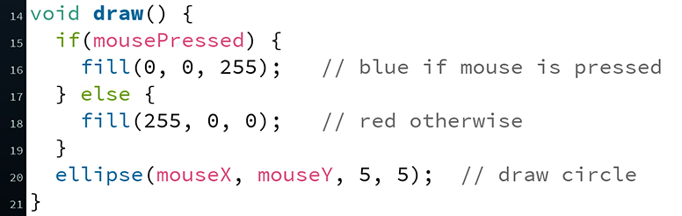
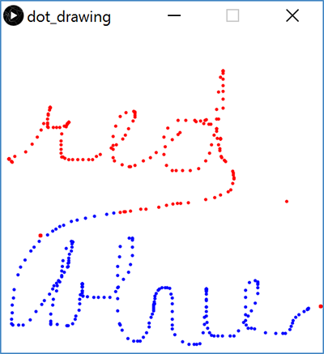
Processing Demo: Drawing Dots

Slide 21
Jumping Monster
Using expressions and conditionals in conjunction with variables and user input (Wed) to control what is drawn as well as motion:

