Slide 1

Basic Input and Output CSE 120 Winter 2019
Instructor: Teaching Assistants:
Justin Hsia Ann Shan, Eunia Lee, Pei Lee Yap, Sam Wolfson, Travis McGaha
Facebook to integrate WhatsApp, Instagram and Messenger
“Until now, WhatsApp, Instagram and Messenger have been run as separate and competing products. Integrating the messaging parts might simplify Facebook's work. It wouldn't need to develop competing versions of new features, such as Stories, which all three apps have added with inconsistent results.
“Cross-platform messaging may also lead the way for businesses on one platform to message potential customers on another. And it might make it easier for Facebook to share data across the three platforms, to help its targeted advertising efforts.”
https://www.bbc.com/news/technology-47001460

Slide 2
Administrivia
Assignments:
Reading Check 4 due tomorrow @ 3:30 pm (1/31)
Jumping Monster due Friday (2/1)
“Big Idea” this week: Digital Distribution
Upcoming: Creativity Project, Midterm (2/11)

Slide 3
Jumping Monster
Using expressions and conditionals in conjunction with variables and user input (today) to control what is drawn as well as motion:

Slide 4
Lecture Outline
Other Useful Processing Tools
User Input and Output
Mouse (input)
Keyboard (input)
Text (output)

Slide 5
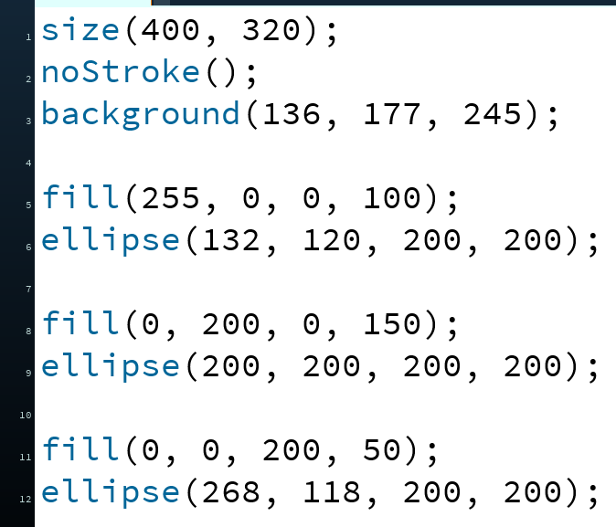

Transparency/Opacity
You can add a 4th argument to a color!
This also applies to the fill() and stroke() functions
This argument also takes an integer between 0–255
0 is fully transparent (invisible)
255 is fully opaque (the default)

Slide 6
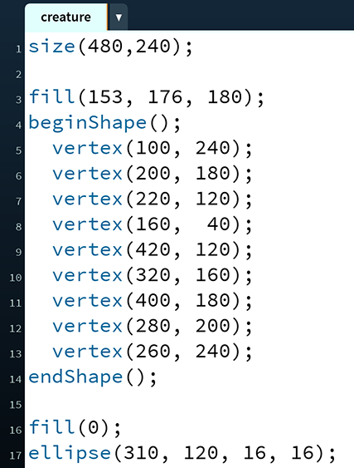
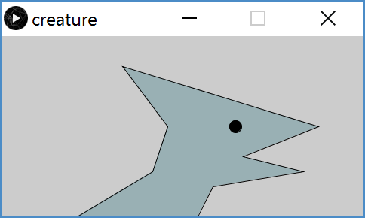
Custom Shapes
Define vertices between beginShape() and endShape()
If planning to reuse, best to create in a separate function

Slide 7
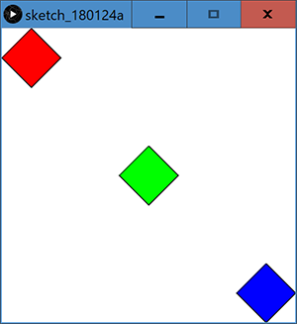
Functions Practice: Diamond
h
(x,y)
Fill in the code to produce:
w
_____ diamond( ______________________________ ) {
beginShape();
vertex( ______, ______ );
vertex( ______, ______ );
vertex( ______, ______ );
vertex( ______, ______ );
vertex( ______, ______ );
endShape();
}
void draw() {
}

Slide 8
Lecture Outline
Other Useful Processing Tricks
User Input and Output *
Mouse
Keyboard
Text
* We will look at a subset of the available Processing commands. For a full list, see the Processing Reference.

Slide 9
Reminder: System Variables
Special variables that hold values related to the state of the program, often related to user input
You don’t need to declare these variables
These variables will update automatically as the program runs
Colored pink/magenta-ish in the Processing environment
We’ve used some of these already:
width, height, frameCount
We’ll see a lot more today

Slide 10
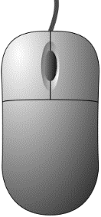

The Mouse
System variables:
mouseX – x-coordinate of mouse in current frame
mouseY – y-coordinate of mouse in current frame
pmouseX – x-coordinate of mouse in previous frame
pmouseY – y-coordinate of mouse in previous frame
mousePressed – is a button currently being pressed?
Built-in functions:
mousePressed() – called very time a button is pressed
mouseReleased() – called every time a button is released

Slide 11
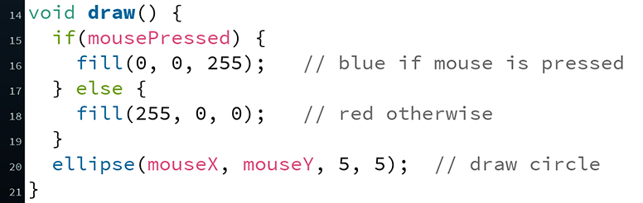
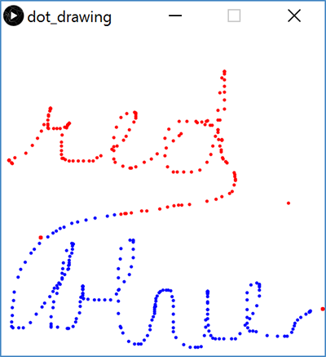
Example: Drawing Dots

Slide 12
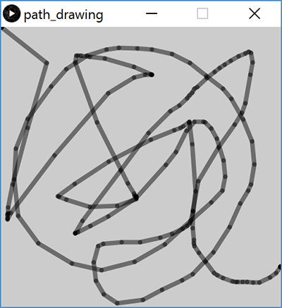
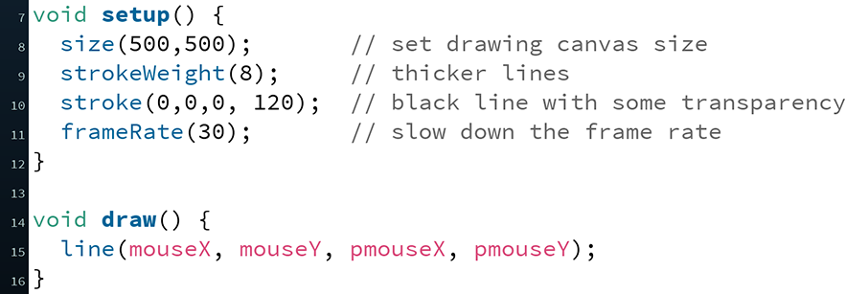
Example: Path Drawing
We just wrote a dot-drawing program
We can additionally use pmouseX and pmouseY to create a path-drawing program

Slide 13
Hovering Over a Rectangle
(x,y)
h
w
if(mouseX >= x)
if(mouseX <= x + w)

Slide 14
Hovering Over a Rectangle
(x,y)
h
w
if(mouseY >= y)
if(mouseY <= y + h)

Slide 15
Hovering Over a Rectangle
(x,y)
h
w
if( (mouseX >= x) &&
(mouseX <= x + w) && (mouseY >= y) && (mouseY <= y + h) )

Slide 16
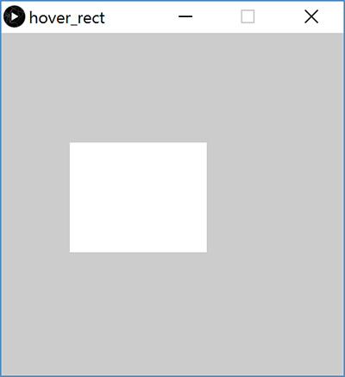
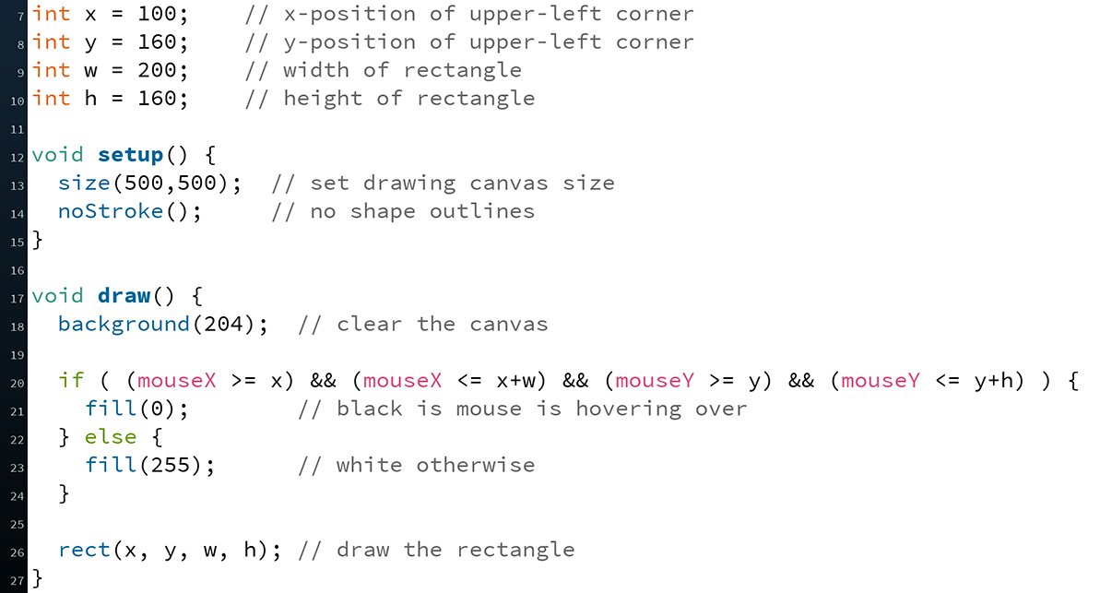
Hovering Over a Rectangle

Slide 17
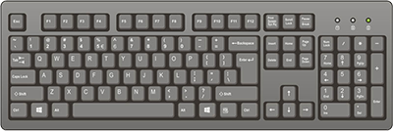
The Keyboard
System variables:
key – stores the ASCII value of the last key press
keyCode – stores codes for non-ASCII keys (e.g. UP, LEFT)
keyPressed – is any key currently being pressed?
Built-in functions:
keyPressed() – called every time a key is pressed
New datatype: char
Stores a single character (really just a number)
Should be surrounded by single quotes
e.g. char letter = 'a';

Slide 18
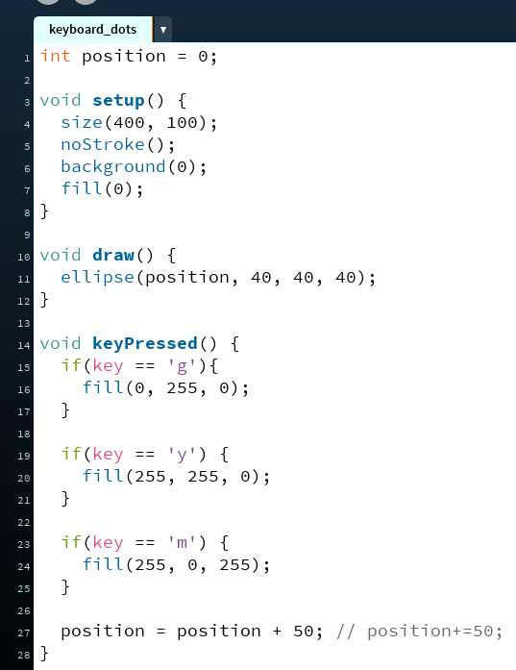
Example: What does this code do?

Slide 19
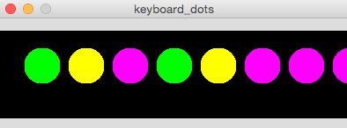
Example: Keyboard Dots

Slide 20
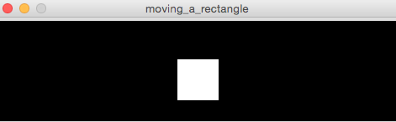
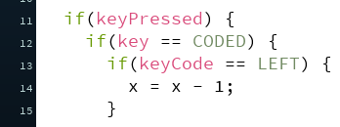
Example: Moving a Rectangle
Note: non-character keys, such as the arrow keys (UP, DOWN, LEFT, RIGHT) are coded keys

Slide 21
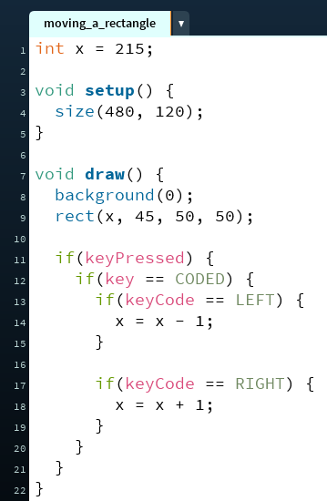
Example: Moving a Rectangle

Slide 22
Text Output
println(yourText);
Prints yourText to the console, which is the black area below your Processing code
Useful for debugging
text(yourText, x, y);
Prints yourText on the drawing canvas, starting with the bottom-left corner at coordinate (x,y)
Change the size of your text using textSize(size);
yourText should be between double quotes
We will talk more about the datatype String later

Slide 23
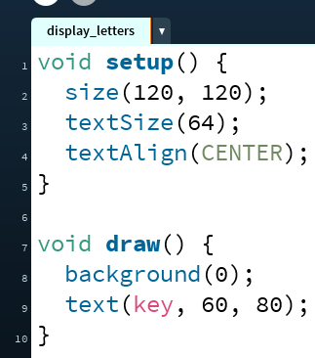

Example: Displaying Typed Keys

Slide 24
Looking Forward
Next week is the Creativity Assignment
In pairs, you will be asked to brainstorm TWO Processing projects of your choice
You will implement and submit ONE of your two projects
The point is to use the tools available to you to make something fun and creative!
Planning document due Tuesday (2/5)
Actual programs due next Friday (2/8)
Portfolio Update 1 is due Wednesday (2/6)
Taijitu, Logo Design, Lego Family, Animal Functions
Ask your TAs for assistance if you encounter problems!

