Slide 1

Algorithmic Complexity I CSE 120 Spring 2017
Instructor: Teaching Assistants:
Justin Hsia Anupam Gupta, Braydon Hall, Eugene Oh, Savanna Yee
Why UPS drivers don’t turn left and you probably shouldn’t either
UPS solves versions of the vehicle routing problem. In these mathematical problems, you are given a set of points and the distances between them, and you have to find the best route(s) to travel through all of them.
UPS have designed their vehicle routing software to eliminate as many left-hand turns as possible. Typically, only 10% of the turns are left turns. As a result, the company claims it uses 10m gallons less fuel, emits 20,000 tonnes less carbon dioxide and delivers 350,000 more packages every year.
https://theconversation.com/why-ups-drivers- dont-turn-left-and-you-probably-shouldnt-either- 71432

Slide 2
Administrivia
Assignments:
Binary Practice (4/21)
Creativity Assignment (4/24)
Midterm in class on Wednesday, 4/26
1 sheet of notes (2-sided, letter, handwritten)
Fill-in-the-blank(s), short answer questions, maybe simple drawing
Questions will cover lectures, assignments, and readings
Midterm Review sheet will be released tonight (4/19), will be covered in lab next week (4/25)

Slide 3
Outline
Algorithm Analysis: The Basics
Comparing Algorithms
Orders of Growth

Slide 4
Algorithm Correctness
An algorithm is considered correct if for every input, it reports the correct output and doesn’t run forever or cause an error
Incorrect algorithms may run forever, crash, or not return the correct answer
But they could still be useful!
e.g. an approximation algorithm
Showing correctness
Mathematical proofs for algorithms
Empirical verification of implementations
Notes:
Mathematical formal methods are needed to prove the GENERAL correctness of algorithm, like does it solve the problem, like does it actually finish.
Empirical methods are used to test a concrete implementation of an algorithm on concrete data

Slide 5
Algorithm Analysis
One commonly used criterion for analyzing algorithms is computation time
How long does the algorithm take to run and finish its task?
Can be used to compare different algorithms for the same computational problem
How to measure this time?
Counting in my head
Stopwatch
Within your program

Slide 6
Aside: Computation Time
Computers take time to complete their tasks
Under the hood, it’s sort of like a bunch of buckets of water filling up – you have to wait for water to reach the top of a bucket for a single computation to complete
Buckets take about a billionth of a second to fill (~ 1 nanosecond)
There are billions of them on a single chip!
A CPU can generally only execute one instruction at a time

Slide 7
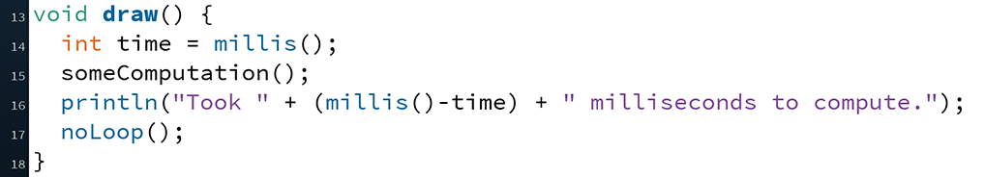
Timing in Processing
The function millis() returns the number of milliseconds since starting your program (as an int)
To start timing, call and store the value in a variable
Call again after your computation and subtract the values

Slide 8
Outline
Algorithm Analysis: The Basics
Comparing Algorithms
Orders of Growth

Slide 9
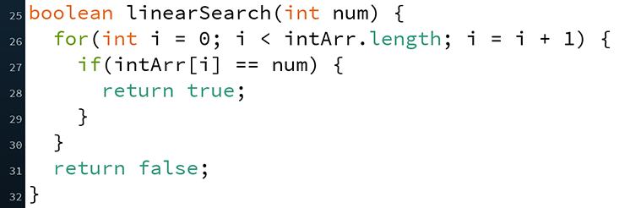
Algorithm: Searching A Sorted Array
Input: Numbers in a sorted array, desired number
Output: If desired number is in the array (true/false)
Algorithm 1:
Check each index starting from 0 for desired number
If equal, then report true
If not equal, then move to next index
If at end of array, then report false
Called Linear Search (also works for unsorted array)

Slide 10
Algorithm: Searching A Sorted Array
Input: Numbers in a sorted array, desired number
Output: If desired number is in the array (true/false)
Algorithm 2:
Check “middle” index for desired number
If equal, then report true
If less than desired number, check halfway forwards next
If greater than desired number, check halfway backwards next
If no halfway point left, then report false
Called Binary Search
http://www.cs.armstrong.edu/liang/animation/web/BinarySearch.html

Slide 11
Peer Instruction Question
On average, which algorithm would take less time to complete a search?
Vote at http://PollEv.com/justinh
Algorithm 1 (Linear Search)
Algorithm 2 (Binary Search)
They’d take about the same amount of time

Slide 12
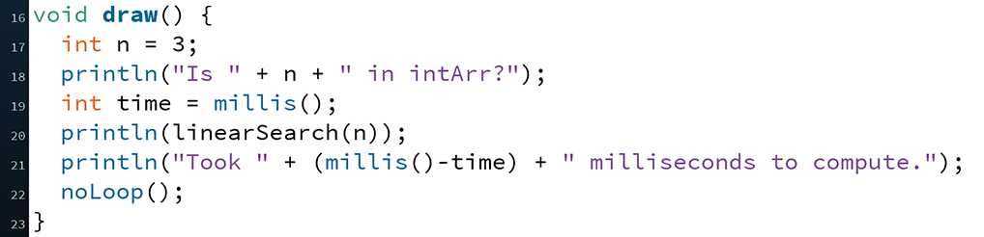
Measuring Linear Search
Let’s time Linear Search:
One issue: our algorithm seems to be too fast to measure!
How can we fix this?

Slide 13
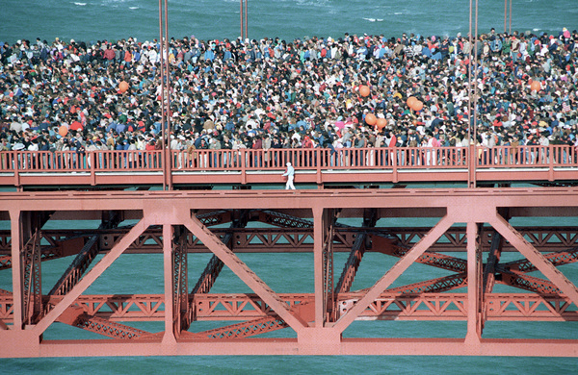
Best Case vs. Worst Case vs. Average Case
We were measuring close to the best case!
Didn’t matter how long our array was
Could measure average case instead
Run many times on random numbers and average results
Instead, we’ll do worst case analysis. Why?
Nice to know the most time we’d ever spend
Worst case happens often
Average case is often similar to worst case
Notes:
Golden Gate Bridge bent by people celebrating its 50th anniversary party.
http://www.nytimes.com/1987/05/26/us/golden-gate-crowd-made-bridge-bend.html

Slide 14
Example of Worst Case in Action
Many web servers out there run something called “The Apache HTTP Server” (or just Apache for short)
When a user enters a particular URL, Apache delivers the correct files from the server to the person on the internet
An old version of Apache had a bug where if you entered a URL with tons of consecutive slashes, it could take hours to complete the request
e.g. http://someurl.com/////////////////////
Bottom line: an algorithm is often judged by its worst case behavior

Slide 15
What is the Worst Case?
Discuss with your neighbor (no voting):
Assume intArr.length is 1000000 and intArr[i] = i;
What is a worst case argument for num for Linear Search?
What is a worst case argument for num for Binary Search?
1
500000
1000000
1000001
Something else

Slide 16
Timing Experiments
Let’s try running Linear Search on a worst case argument value
Results: 54, 31, 53, 34
Now let’s run Binary Search on a worst case argument value
Results: 0, 0, 0, 0

Slide 17
Runtime Intuition
Does it seem reasonable that the runtimes were inconsistent?
Some reasons:
Your computer isn’t just running Processing – there’s a lot of other stuff running (e.g. operating system, web browser)
The computer hardware does lots of fancy stuff to avoid slowdown due to physical limitations
These may not work as well each execution based on other stuff going on in your computer at the time

Slide 18
Empirical Analysis Conclusion
We’ve shown that Binary Search is seemingly much faster than Linear Search
Similar to having two sprinters race each other
Limitations:
Different computers may have different runtimes
Same computer may have different runtime on same input
Need to implement the algorithm in order to run it
Goal: come up with a “universal algorithmic classifier”
Analogous to coming up with a metric to compare all athletes (or fighters)

Slide 19
Outline
Algorithm Analysis: The Basics
Comparing Algorithms
Orders of Growth

Slide 20
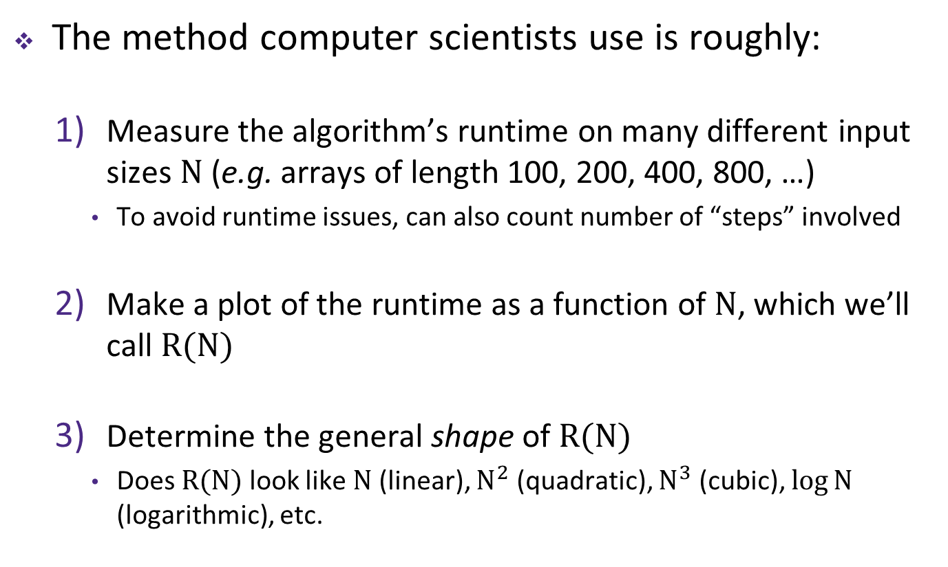
Characterizing Algorithms
The method computer scientists use is roughly:
Measure the algorithm’s runtime on many different input sizes $N$ (e.g. arrays of length 100, 200, 400, 800, …)
To avoid runtime issues, can also count number of “steps” involved
Make a plot of the runtime as a function of $N$, which we’ll call $R(N)$
Determine the general shape of $R(N)$
Does $R(N)$ look like $N$ (linear), $N^{2}$ (quadratic), $N^{3}$ (cubic), $\log{N}$ (logarithmic), etc.

Slide 21
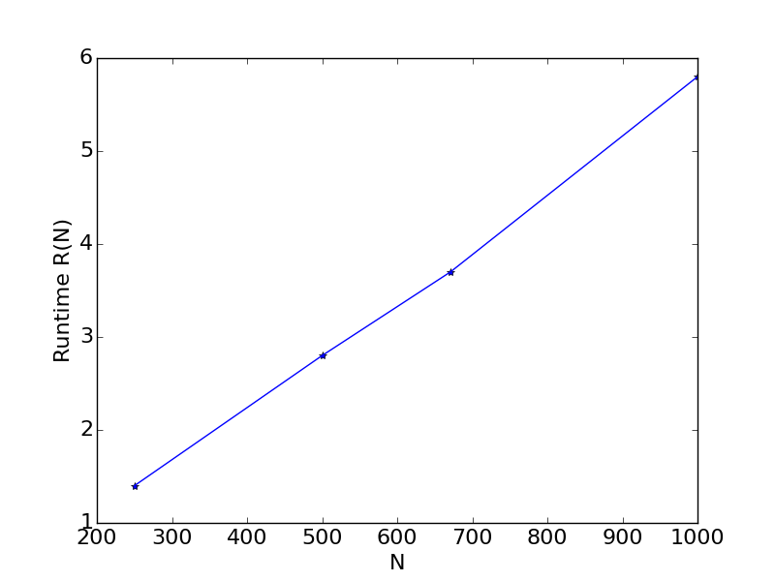

Linear Search
As the name implies, Linear Search is linear
If you double $N$, then $R(N)$ should roughly double
$N$ (input size) | $R(N)$ (time)
250 items | 1.4 sec
500 items | 2.8 sec
671 items | 3.8 sec
1000 items | 5.7 sec

Slide 22
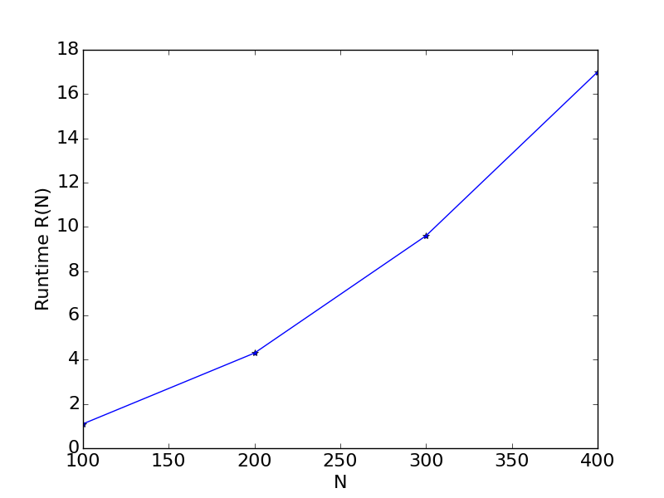

Peer Instruction Question
Algorithm for: do any pairs in array sum to zero?
Which function does $R\left(N\right)$ look like?
Vote at http://PollEv.com/justinh
$sqrt\left(N\right)$
$log\left(N\right)$
$N$
$N^{2}$
$2^{N}$
$N$ (input size) | $R(N)$ (time)
100 items | 1.1 seconds
200 items | 4.3 seconds
300 items | 9.6 seconds
400 items | 17.0 seconds

Slide 23
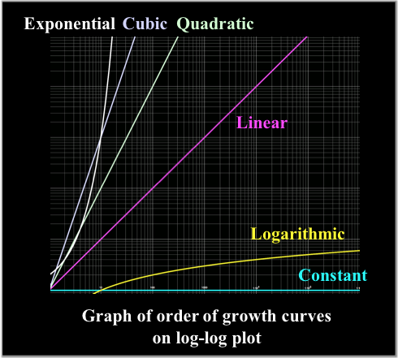

Orders of Growth
The order of growth of $R\left(N\right)$ is its general shape:
Constant $1$
Logarithmic $\log{N}$
Linear $N$
Quadratic $N^{2}$
Cubic $N^{3}$
Exponential $2^{N}$
Factorial $N!$

Slide 24

Orders of Growth
The order of growth of $R\left(N\right)$ is its general shape:
Use dominant term
e.g. $10N^{2}+4\log{N}$ is quadratic

Slide 25
Binary Search
What order of growth is Binary Search?
Analyze using number of “steps” in worst case
$N$ (input size) | Indices to Check
1 items
2 items
4 items
8 items
16 items

Slide 26
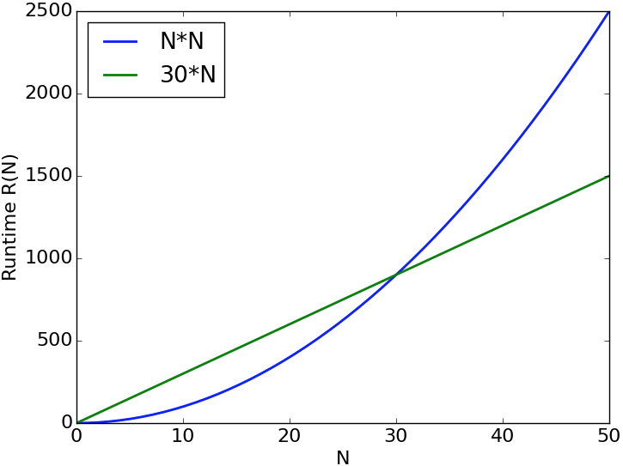
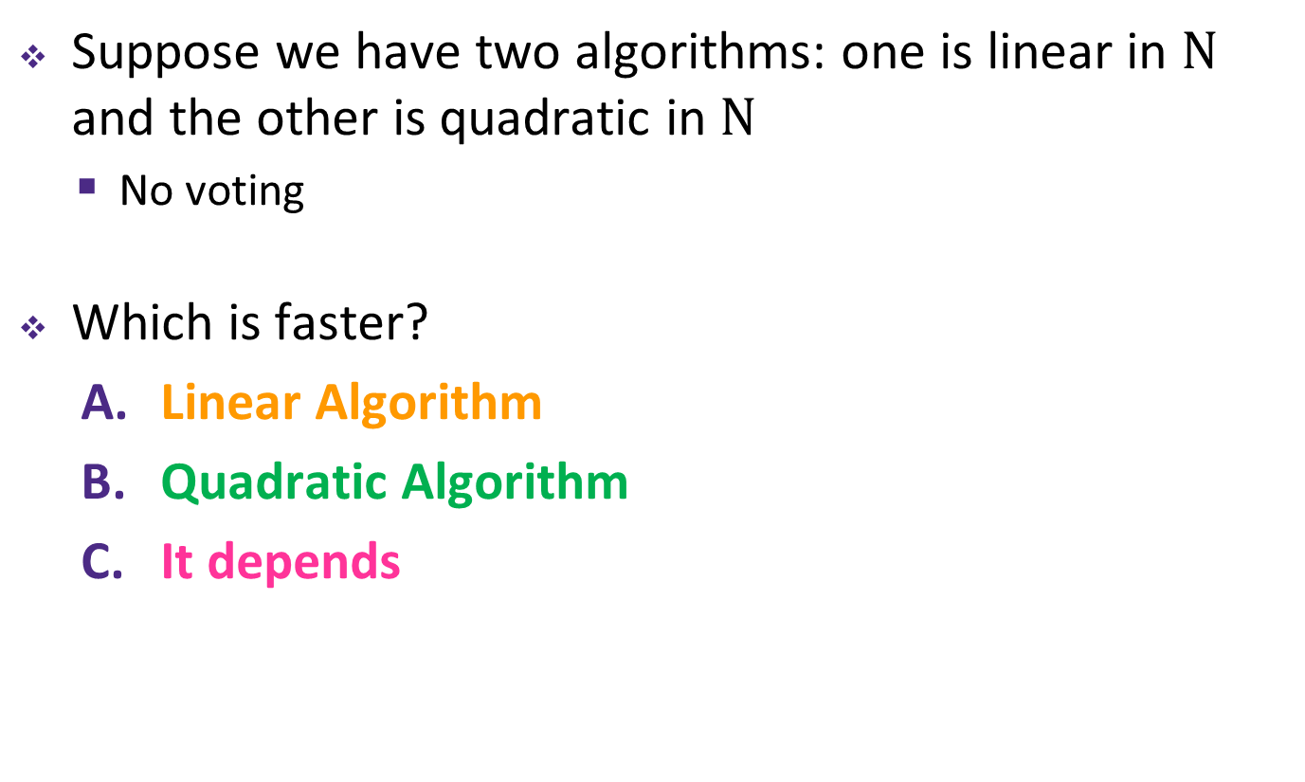
Which is Faster?
Suppose we have two algorithms: one is linear in $N$ and the other is quadratic in $N$
No voting
Which is faster?
Linear Algorithm
Quadratic Algorithm
It depends

Slide 27
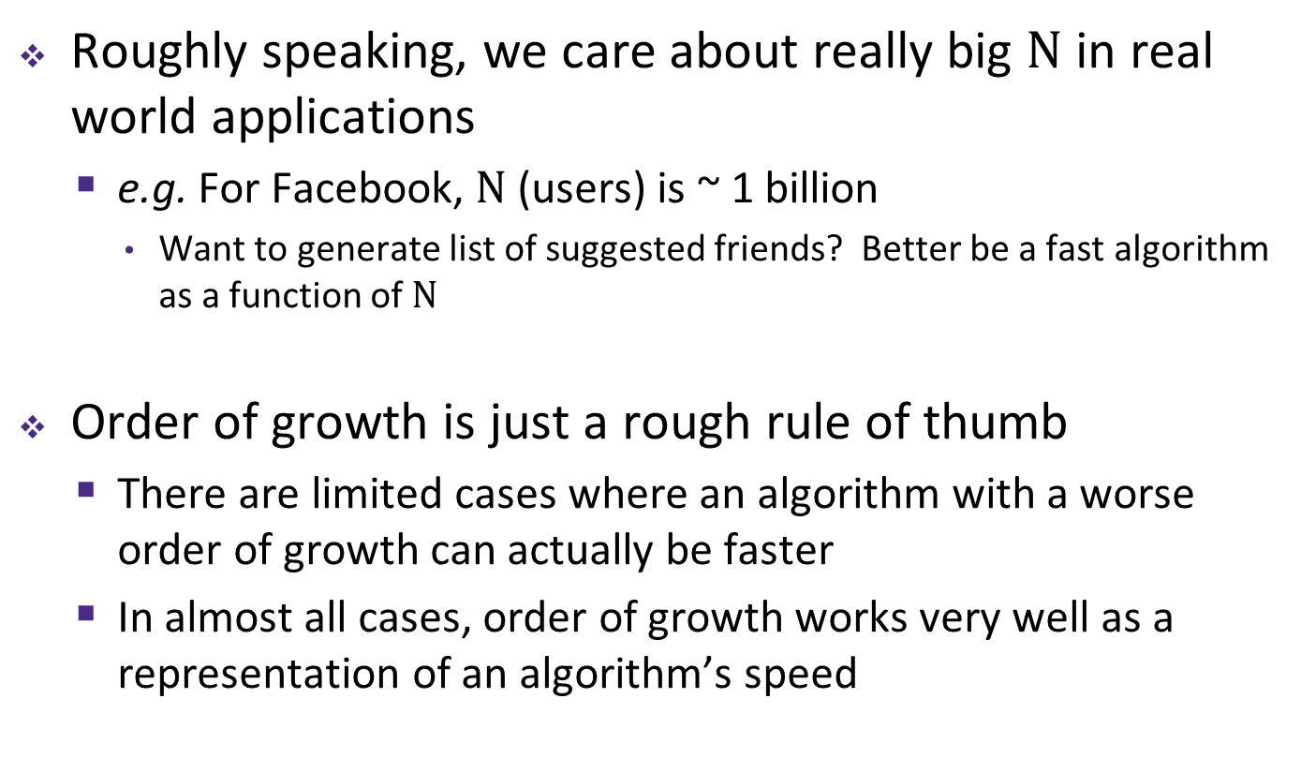
The Reason Order of Growth Matters
Roughly speaking, we care about really big $N$ in real world applications
e.g. For Facebook, $N$ (users) is ~ 1 billion
Want to generate list of suggested friends? Better be a fast algorithm as a function of $N$
Order of growth is just a rough rule of thumb
There are limited cases where an algorithm with a worse order of growth can actually be faster
In almost all cases, order of growth works very well as a representation of an algorithm’s speed

Slide 28
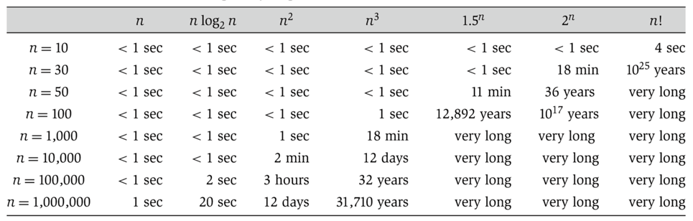

Orders of Growth Comparison
The numbers below are rough estimates for a “typical” algorithm on a “typical” computer – provides a qualitative difference between the orders of growth
Linearithmic
Linear
Quadratic
Cubic
Exponential
Exponential
Factorial

