Slide 1
Loops & Nested Loops CSE 120 Winter 2019
Instructor: Teaching Assistants:
Justin Hsia Ann Shan, Eunia Lee, Pei Lee Yap, Sam Wolfson, Travis McGaha
❄️☃️ SNOW LECTURE – SNOW DAY ☃️❄️

Slide 2
Outline
Loops
while-loop
for-loop
Nested Loops

Slide 3
Looping
Sometimes we want to do the same (or similar) things over and over again
Looping saves us time from writing out all of the instructions
Loops control a sequence of repetitions

Slide 4
While-Loop
Start
Basic form:
while(condition) {
// loop
// body
}
Repeat loop body until condition is false
Must make sure to update conditional variable(s) in loop body, otherwise you cause an infinite loop
draw() is basically a while(true) loop
Condition?
True
Loop Body
False
End

Slide 5
While-Loop Example [Demo]
Row of six animals:
Using a while-loop:
void drawRow() {
??? // draw six mice
}
void drawMouse(float x, float y, color c) {
... // drawing commands
}
void drawRow() {
int count = 0;
while (count < 6) {
drawMouse(80*count, 20, color(150));
count = count + 1;
}
}
Notes:
mouse_loop.pde

Slide 6
While-Loop
Start
More general form:
// init cond var(s)
while(condition) {
// loop body
// update var(s)
}
This occurs so commonly that we create a separate syntax for it!
Initialize Var(s)
Update Var(s)
Condition?
True
Loop Body
False
End

Slide 7
For-Loop
Start
for(init; cond; update){
// loop body
}
First runs init expression(s)
Then checks cond
If true, runs loop body followed by update statement(s)
Initialize Var(s)
Update Var(s)
Condition?
True
Loop Body
False
End

Slide 8

For-Loop Example
Without loop:
line( 20, 40, 80, 80);
line( 80, 40, 140, 80);
line(140, 40, 200, 80);
line(200, 40, 260, 80);
line(260, 40, 320, 80);
line(320, 40, 380, 80);
line(380, 40, 440, 80);
With loop:
for (int i = 20; i < 400; i = i + 60) {
line(i, 40, i + 60, 80);
}

Slide 9
Understanding the For-Loop
Choice of variable name(s) is not critical
Represent the value(s) that vary between different executions of the loop body
Think of as temporary variable(s)
If variable i is declared in the initialization statement, then it only exists within this loop
initialization
for (int i = 20; i < 400; i = i + 60) {
line(i, 40, i + 60, 80);
}

Slide 10
Understanding the For-Loop
Condition evaluated before the loop body and must evaluate to true or false
Reminder: > greater than < less than >= greater than or equal to >= less than or equal to == equal to != not equal to
condition
for (int i = 20; i < 400; i = i + 60) {
line(i, 40, i + 60, 80);
}

Slide 11
Understanding the For-Loop
Update is an assignment that is executed after the loop body
Loop body is enclosed by curly braces {} and should be indented for readability
update
for (int i = 20; i < 400; i = i + 60) {
line(i, 40, i + 60, 80);
}
loop body

Slide 12
Loops Worksheet
Start
While-loop:
while(condition) {
// loop body
}
For-loop:
for(init; cond; update){
// loop body
}
Condition?
True
Loop Body
False
End
Start
Initialize Var(s)
Update Var(s)
Condition?
Loop Body
True
False
End

Slide 13
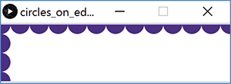
Processing Demo: Circles on Canvas Edge

Slide 14
Processing Demo: Circles on Canvas Edge
size(720, 120); // canvas size
background(255); // white background
noStroke(); // no outline on circles
fill(75, 47, 131); // UW purple
int diam = 40;
// loop for circles along the top edge
for (int x = 0; x <= width; x = x+diam) {
ellipse(x, 0, diam, diam);
}
// loop for circles along the left edge
for (int y = 0; y <= height; y = y+diam) {
ellipse(0, y, diam, diam);
}

Slide 15
Outline
Loops
while-loop
for-loop
Nested Loops

Slide 16
Nested Loops
Generally a for-loop has a single loop variable that changes with each iteration
What if you need/want more things to change?
Can nest loops – i.e. put a loop inside of another loop

Slide 17
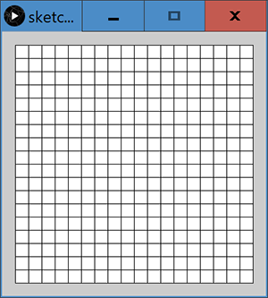
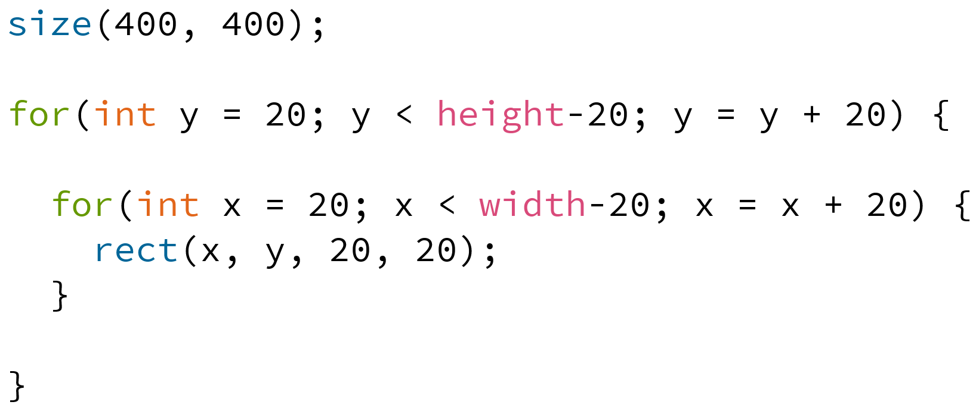
Example: Rectangle Grid

