Slide 1

Arrays CSE 120 Winter 2019
Instructor: Teaching Assistants:
Justin Hsia Ann Shan, Eunia Lee, Pei Lee Yap, Sam Wolfson, Travis McGaha
Navigation Apps With Millions of Downloads Exposed as Just Google Maps With Bonus Ads
“One of the purported benefits of modern day app stores is to make it easier for companies to review and ensure that the software you download isn’t harmful or malicious.
“[T]he 19 apps he tested were navigation apps with over 1 million installs each, totaling a combined install base of more than 50 million. Sadly, despite claims that these apps can help users map their routes or include tools such as a compass or speedometer, every single app ended up relying on Google Maps or its related API to perform the real work.”
https://gizmodo.com/navigation-apps-with-millions-of- downloads-exposed-as-j-1831869725

Slide 2
Administrivia
Assignments:
Portfolio Update 1 due tonight (2/6)
Creativity Assignment (2/9) – deadline pushed back to Sat
We will try to give you feedback on your proposals tonight
Midterm in class on Monday, 2/11
1 sheet of notes (2-sided, letter, handwritten)
Fill-in-the-blank(s), short answer questions, maybe simple drawing
Living Computers Museum “field trip” upcoming

Slide 3
Loops Worksheet
Start
While-loop:
while(condition) {
// loop body
}
For-loop:
for(init; cond; update){
// loop body
}
Condition?
True
Loop Body
False
End
Start
Initialize Var(s)
Update Var(s)
Condition?
Loop Body
True
False
End

Slide 4
Outline
For-Loop Review
Arrays
Arrays and Loops

Slide 5

Example: Line Gradient
size(400, 400);
background(255);
strokeWeight(5);
for (int i = 0; i < 400; i = i + 8) {
stroke(i);
line(i, 0, i, 400);
}

Slide 6

Exercise: Circle Loop
Consecutive concentric circles differ in diameter by 10:
size(400, 400);
noFill();
for(int d = 450; ________; ________ ) {
ellipse( ______, ______, _____, _____ );
}

Slide 7

Example: Looping with User Interaction?
Draw lines from left side of screen to the horizontal position of the mouse

Slide 8
Example: Draw Lines to mouseX
void setup() {
size(400, 400);
strokeWeight(4);
}
void draw() {
background(204);
for (int i = 10; i < mouseX; i = i + 8) {
line(i, 10, i, 390);
}
}

Slide 9
Outline
For-Loop Review
Arrays
Arrays and Loops

Slide 10
Arrays
“Structures” that store many values of the same datatype
Can think of as a group of related variables
Arrays store large amounts of data that you can access using a single name
Accessing arrays with loops is very convenient
Analogy: creating a street with lots of houses on it; can access houses via house numbers

Slide 11
Arrays Terminology
“Structures” that store many values of the same datatype
Element: a single value in the array
Index: a number that specifies the location of a particular element of the array
Start from 0
Length: total number of elements in the array
Example:
Index: | 0 | 1 | 2 | 3 | 4
Value: | 12 | 49 | -2 | 5 | 17
length of 5
“element 0”
“element 4”

Slide 12
Declaring Arrays in Processing
Declaration: type[] name
Warning: an array variable is NOT an array!
Examples:
int[] myNums declares an array variable for arrays of integers
float[] myData
color[] rainbow
Could represent the colors of the rainbow in order
boolean[] correct
Could represent correctness on a multiple choice test

Slide 13
Creating Arrays in Processing
Creation: new type[num]
Remember that actual indices are from 0 to num-1
Default value for all elements is “zero-equivalent” (0, 0.0, false, black)
Examples:
int[] intArr = new int[5];
intArr associated with int array {0, 0, 0, 0, 0}
boolean[] quiz = new boolean[3];
quiz associated with boolean array {false, false, false}
new float[7];
Creates a float array, but you can’t use it because you didn’t associate it with an array variable!

Slide 14
Initializing Arrays in Processing
Initialization: {elem0, elem1, …, elemN}
The "curly brace" notation can be used to create an array with specified/initialized element values
Don’t confuse this usage of {} with that for a code block
Examples:
int[] intArr = {12, 49, -2, 5, 17};
Create a new array with specified values and associate it with the array variable intArr
intArr = {1, 2, 3, 4};
Discards the old array and associates the array variable intArr with this new array!

Slide 15
Using Arrays in Processing
Use element: name[index]
In expression, uses value of that index of the array
In assignment, modifies value of that index of the array
Get length: name.length
Example:
int[] intArr = {12, 49, -2, 5, 17};
println(intArr[0]); // prints 12 to console
intArr[2] = intArr.length; // changes -2 to 5
Index: | 0 | 1 | 2 | 3 | 4
Value: | 12 | 49 | -2 | 5 | 17

Slide 16
Arrays and Loops
Arrays are very convenient to use with loops!
Loops usually change numerical value in loop variable (e.g. Update: i = i + 1)
You access array element values using a numerical value (e.g. intArr[i])
Loops provide an easy way to perform the same/similar action on all/many elements of an array
Examples:
Read each array value to use in a drawing command
Sum up the numbers in an array

Slide 17
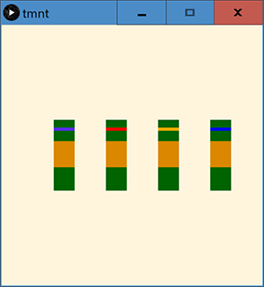
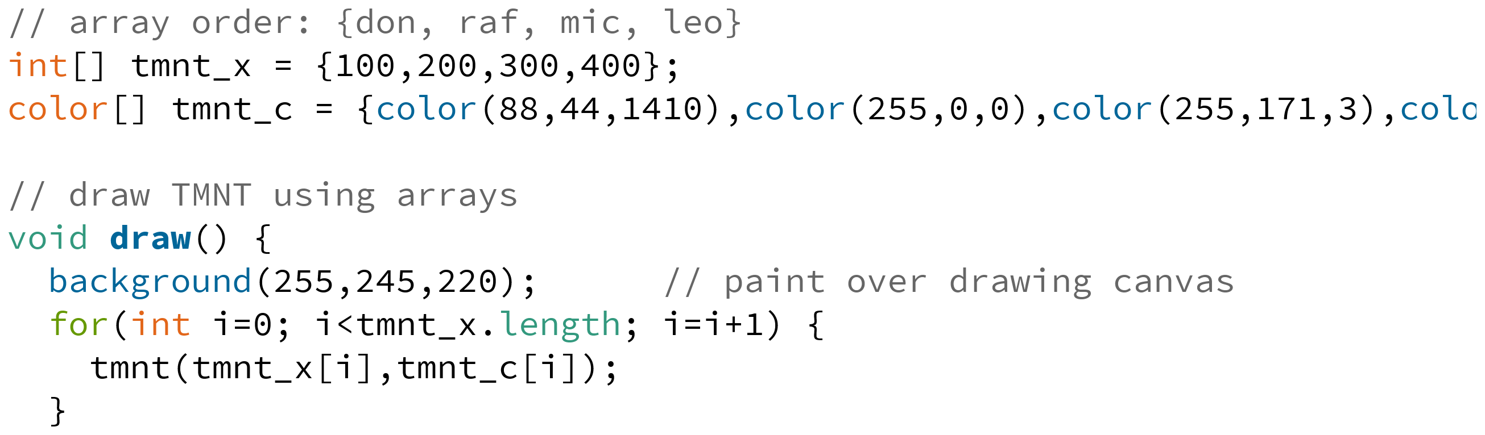
Example: TMNT

Slide 18
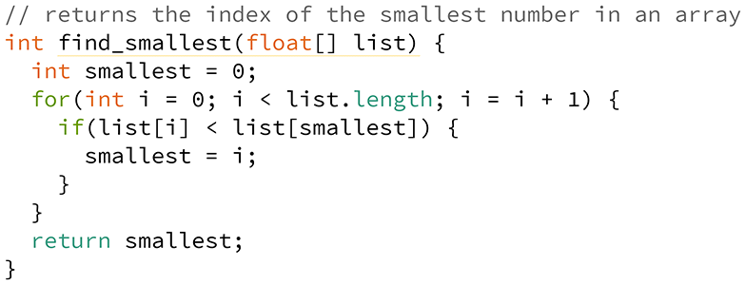
Example: Index of Smallest Number
Algorithm:
Keep track of the index of the smallest number seen so far
Start with index 0
Check each element 1-by-1; if number is smaller, then update the smallest index

Slide 19
Arrays Visual Demo
0
1
2
3
4
1) int[] ar;
2) ar = new int[4];
3) ar[1] = 1;
4) ar[3] = ar[1] + 1;
5) if (ar[2] < ar[1]) {
ar[2] = 4;
}
6) ar[0] = ar[1] + ar[3];
7) ar[4] = 0;

Slide 20
Arrays Visual Demo
0
1
2
3
4
Demo Notes:
Array creation only gives you as many buckets as you request
Creation of array automatically initializes it
When WRITING, replace ball in bucket
When READING, take ball of same color (leave current one in bucket)
Trying to use an invalid index (off either end) will result in an ArrayIndexOutOfBoundsException

Slide 21
Arrays Worksheet
Attach buckets to velcro when array is created
Creation of array automatically initializes it
Access array using notation ar_name[index]
Indices are numbered starting from 0
Use just like you would a variable
When WRITING, replace ball in bucket
When READING, take ball of same color (leave current one in bucket)
0
1
2
3
4

