Slide 1
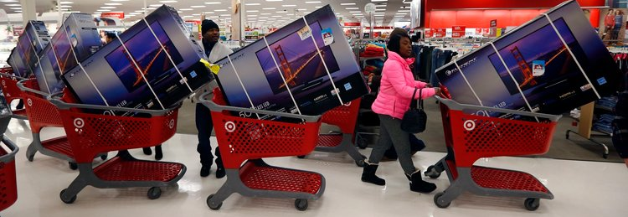
Images, Strings CSE 120 Winter 2019
Instructor: Teaching Assistants:
Justin Hsia Ann Shan, Eunia Lee, Pei Lee Yap, Sam Wolfson, Travis McGaha
There's a simple reason your new smart TV was so affordable: It's collecting and selling your data
“If you want a 65-inch 4K smart TV with HDR capability, one can be purchased for below $500. But that low price comes with a caveat most people probably don't realize: Some manufacturers collect data about users and sell that data to third parties.
“Smart TVs can be sold at or near cost to consumers because Vizio is able to monetize those TVs through data collection, advertising, and selling direct-to-consumer entertainment (movies, etc.).”
https://www.businessinsider.com/ smart-tv-data-collection-advertising- 2019-1

Slide 2
Administrivia
Assignments:
Arrays and Elli [checkoff] due tomorrow (2/14)
Reading Check 5 due @ 3:30 pm tomorrow (2/14)
Color Filters [checkoff] due on Tuesday (2/19)
Controlling Elli [submit] due on Tuesday (2/19)
Living Computers Museum Report due in 2 weeks (2/26)
Guest lecture on Friday: Artificial Intelligence

Slide 3

Report
Field trip out to the Living Computers: Museum + Labs in SoDo
Admission is paid for you!
Transportation: Link + walk, bus, drive
Go when you can: open Wed-Sun each week
Report: PDF including photos and responses due 2/26
Part 1: Favorite Exhibit
Part 2: Computer History
Part 3: Modern Tech Exhibit Reflection

Slide 4
Outline
Images
Compression
Strings

Slide 5

Images
An image is just a 2-dimensional set of pixels
The image has a width and a height
Each pixel has an associated (RGB) color

Slide 6
Images
An image is just a 2-dimensional set of pixels
The image has a width and a height
Each pixel has an associated (RGB) color
In Processing, an image is represented as an array of color data
Can explicitly use color[] myImage
Processing also provides special datatype PImage

Slide 7
Using Images in Processing
Load an image from a file into a Processing variable
Use the loadImage("photo.jpg") function
The image name is a String representing the path to the file, similar to your website
Store the return value from loadImage() into a PImage variable
e.g. PImage myImg = loadImage("img/justin.jpg");
Draw the image on your canvas using the image() function
image(<PImage var>, <x_pos>, <y_pos>)
e.g. image(myImg, 0, 0);

Slide 8
The Canvas as an Image
The drawing canvas is also treated as an image!
Retrieve the current canvas image data (i.e. array of color data) using the loadPixels() function
loadPixels() has no parameters or return value
The canvas image data will be automatically stored into the system variable pixels[]
You can manually manipulate the data in pixels[]
e.g. pixels[0] = color(0); // set to black
Update the drawing canvas with the current/new data in pixels[] using the updatePixels() function
updatePixels() also has no parameters or return value

Slide 9
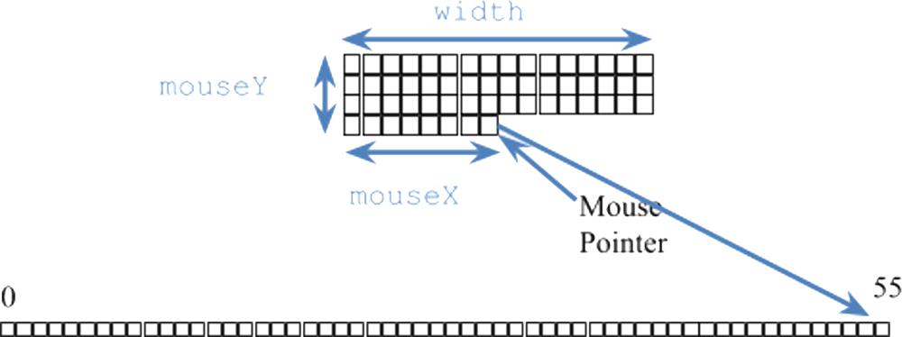
Linearizing an Image
Despite being 2-D in nature (i.e. x- and y- coordinates), we deal with image data in a 1-D array (i.e. pixels[])
As we increment our array index, we move left-to-right horizontally and then top-to-bottom vertically

Slide 10
Color as Data in Processing
Recall: all data on a computer is stored using binary encoding
Including colors, though we won’t cover exactly how
Processing has a special color datatype
We’re used to using the color(R, G, B) function to specify colors
Represents colors but looks nonsensical if you try to print it
Can retrieve the RGB triplet values using the functions red(), green(), and blue()

Slide 11
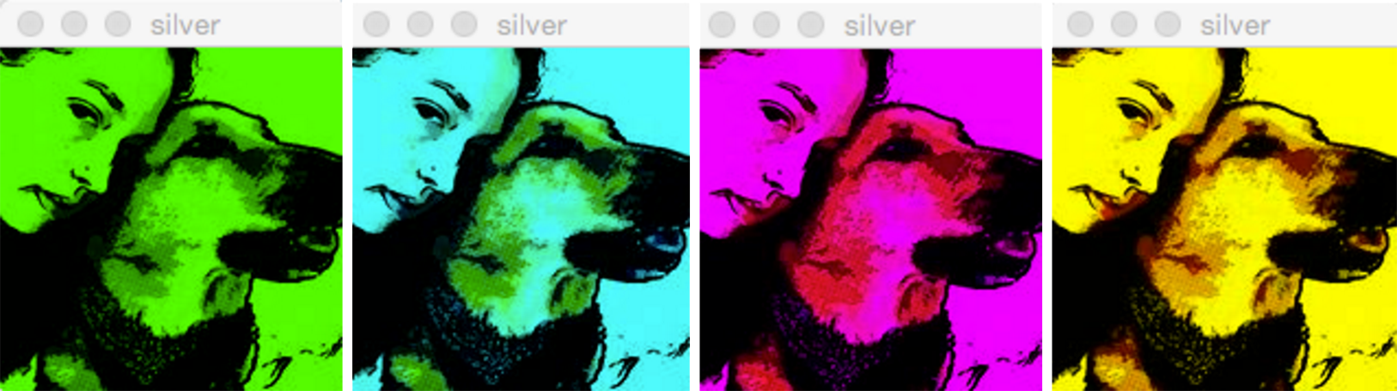
Color Filters
Learn the basics of using and manipulating images in Processing
You choose a photo to display
Display the RGB of the pixel your mouse is hovering over
Key presses will filter the colors of your image appropriately

Slide 12
Outline
Images
Compression
Strings

Slide 13
Compression
Compression is the process of encoding information/data using fewer bits than the original representation
Lossless: original bits can be exactly recovered from transformed bits
Lossy: original bits cannot be exactly recovered from transformed bits (i.e. some data is lost)

Slide 14
Lossless Compression
Eliminates bits that can be recovered again
Consider this 6 x 6 black-and-white image:
Uncompressed:
WWWWWW BBBBBB BWWWWB BWWWWB BBBBBB WWWWWW

Slide 15
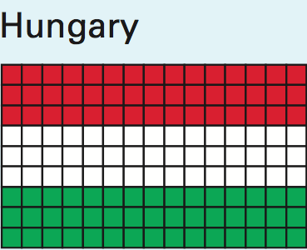
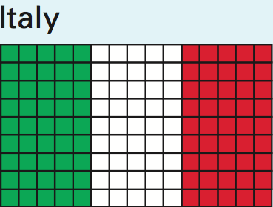
Lossless Image Format: RLE
Run Length Encoding
Not used commonly, but found in formats ( TIFF and Bitmap)
For repeated data/color, encode # of repeats
Many variations on actual encoding exist
Black-and-white example:
6W 7B 4W 2B 4W 7B 6W
Flag example:
HU = 45:R,45:W,45:G
IT = 5:G,5:W,5:R,5:G,5:W,5:R 5:G,5:W,5:R,5:G,5:W,5:R 5:G,5:W,5:R,5:G,5:W,5:R 5:G,5:W,5:R,5:G,5:W,5:R5:G,5:W,5:R
Notes:
PackBits: https://www.print-driver.com/stories/packbits-tiff
Bitmap: https://docs.microsoft.com/en-us/windows/desktop/gdi/bitmap-compression

Slide 16
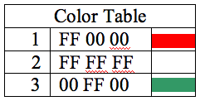
Lossless Image Format: GIF, PNG
Graphics Interchange Format
Uses a 256-color palette (not RGB) encoded in a Color Table
Why GIFs may not seem like “true color”
Uses LZW Encoding (Lempel-Ziv-Welch)
Create encodings based on strings of colors in image
Supplanted RLE for lossless compression
Portable Network Graphics
Improved, non-patented replacement for GIF
Doesn’t support animations

Slide 17
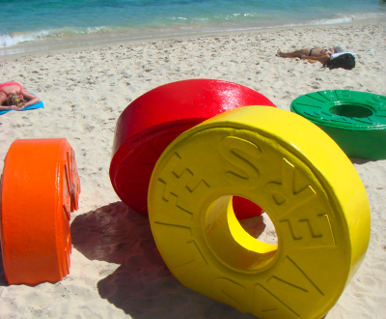

Lossy Image Format: JPEG/JPG
Joint Photographic Experts Group
Tradeoff between amount of compression and image quality
Areas of similar color are represented by a single shade
Based on quantization of discrete cosine transform (DCT) operation

Slide 18
Outline
Images
Compression
Strings

Slide 19
Strings
A string is a string of characters (0 or more)
Strings cannot be modified, but string variables can be reassigned
Individual characters can be accessed (not modified), numbered from left-to-right starting at 0
String literal: an unnamed string specified between double-quotes
e.g. "hello", "!@#$%^&*()_+ ?~", "xoxo <3"
"" is known as the empty string (0 characters in it)

Slide 20
Using Strings
Declaration: String str;
Assignment: str = "hello";
Get character using str.charAt(i)
Get length using str.length()
Concatenation: join strings using ‘+’ operator
e.g. "hi " + "there" gives you "hi there"
Conversion to string usually occurs implicitly
Can also explicitly use str()

Slide 21
Strings vs. Arrays
Strings are sort of like arrays of characters:
 | Array | String
Declare
Initialize
Get element
Get length

Slide 22
Example: Recording User Input
keyPressed() lets you read user input 1 character at a time
Use a String variable to “store”
Add/append new characters using concatenation

Slide 23
Example: Recording User Input
keyPressed() lets you read user input 1 character at a time
Use a String variable to “store”
Add/append new characters using concatenation
String input = "";
void draw() {
}
void keyPressed() {
input = input + str(key);
println("input = " + input);
}

Slide 24
Word Guessing
Learn to use text input & output
Player 1 enters a secret phrase
Player 2 tries to guess the secret phrase
Game tells you how many letters correct & # of attempts

Slide 25
Strings and Arrays Worksheet
Declaration: String str;
Assignment: str = "hello";
Get character using str.charAt(i)
Get length using str.length()
Concatenation: join strings using ‘+’ operator
e.g. "hi " + "there" gives you "hi there"
Conversion to string usually occurs implicitly
Can also explicitly use str()

