Slide 1

Buttons & Boards CSE 120 Winter 2019
Instructor: Teaching Assistants:
Justin Hsia Ann Shan, Eunia Lee, Pei Lee Yap, Sam Wolfson, Travis McGaha
Humans playing VR game Beat Saber move faster than what Steam thought was ‘humanly possible’
“Some people move so fast when they play the VR game Beat Saber, a rhythm game that’s basically Dance Dance Revolution with lightsabers, that Valve developers have had to issue a fix. People were moving so fast that Steam VR couldn’t track their movements.
“[D]evelopers noted that they had to ‘Increase limits of what we thought was humanly possible for controller motion.’ ”
https://www.theverge.com/platform/amp/2019/2/11/ 18220993/vr-valve-steam-beat-saber-fast-speeds

Slide 2
Administrivia
Assignments:
Reading Check 7 due @ 3:30 pm tomorrow (2/21)
Controlling Elli [submit] due tomorrow (2/21)
Word Guessing [checkoff/submit] due Saturday (2/23)
Living Computers Museum Report due Tuesday (2/26)
“Big Ideas” lecture: CS and Ethics

Slide 3
Review: Rectangle Detection
(x,y)
h
w
if( (mouseX >= x) &&
(mouseX <= x + w) && (mouseY >= y) && (mouseY <= y + h) )

Slide 4
Review: Rectangle Detection
if( (mouseX >= x) && (mouseX <= x + w) && (mouseY >= y) && (mouseY <= y + h) ) {
// do something
}
Potential Uses:
To detect on every frame, place in draw() or function called by draw()
e.g. hover detection – change color when mouse is over rectangle
To detect on a mouse click, place in mousePressed()
e.g. a button that the user can click on

Slide 5
Circle Detection
A circle is defined as all points in a 2-D plane that are equidistant from a center point
In mathematical terms, the set of all points (x, y) that satisfy: (x - centerX)² + (y - centerY)² = radius²
To detect the mouse being inside the circle, this becomes an inequality
(mouseX - centerX)² + (mouseY - centerY)² <= radius²
In Processing:
if( (mouseX-x)*(mouseX-x)+(mouseY-y)*(mouseY-y) <= r*r ) {
// do something
}
Notes:
TODO: insert image of triangle inside a circle with Pythagorean Theorem

Slide 6
Creating a Button
The button needs to be visible to the user
Use rect() or ellipse() to draw on your canvas
Generally, the user should know what the button is for
Use text() to either label the button or put directions somewhere else on screen
Often, textAlign(CENTER) makes finding appropriate coordinates easier

Slide 7
Button Demo
Create a “Clear” button for phone or calculator
Use a 500 x 500 canvas
The button should be of size 46 x 46 and white at position (152, 302)
Labeled button with a red “C” text roughly centered
Hints: use textSize(40) and textAlign(CENTER)
When the mouse is hovering over the button, it should turn yellow: color(255, 255, 98)
Requires Active Mode
When the button is clicked, it should print "Cleared!" to the console

Slide 8
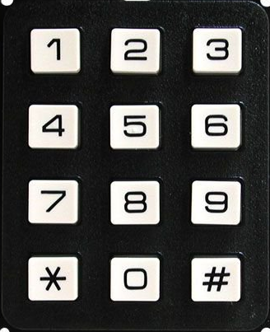
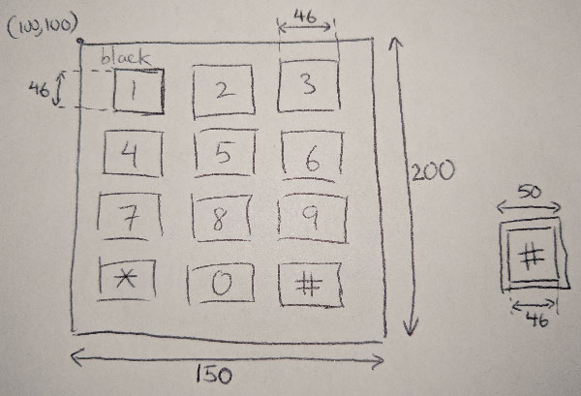
Grids and Boards
Grids can be created using nested for-loops
Example: numeric keypad

Slide 9
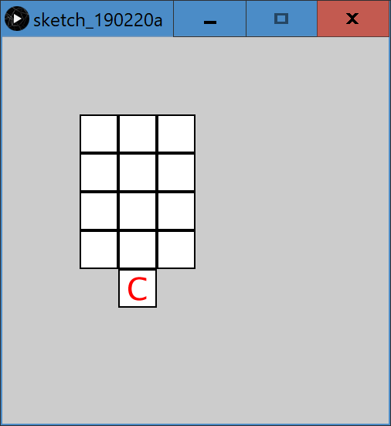
Grid Demo
Grids can be created using nested for-loops

Slide 10
Your Board “State”
The state of your board indicates its current configuration
In some applications, this never changes
e.g. numeric keypad
In other applications, this will change over time
e.g. tic-tac-toe
Board state is typically represented via an array
Naturally ties a numeric location on your grid to the symbol/value currently associated with that cell
Similar to pixels[] holding the color “state” of your drawing canvas

Slide 11
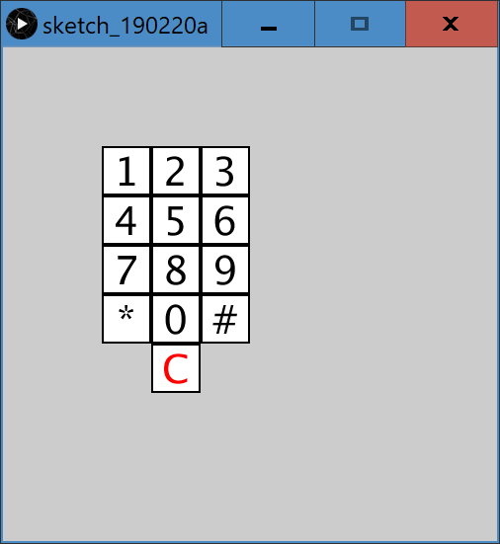
Labeling Our Grid
For the numeric keypad, the board state is the set of (ordered) key labels:
char[] keypad = {'1','2','3',…,'*','0','#'};

Slide 12
Grid Detection
Detection of mouse location within a grid
int x_index, y_index;
if( (mouseX >= x) && (mouseX <= x+w) && (mouseY >= y) && (mouseY <= y + h) ) {
x_index = int( (mouseX-x)/(w/2) );
y_index = int( (mouseY-y)/(h/2) );
}
Notes:
x_index and y_index must be of datatype int!

Slide 13
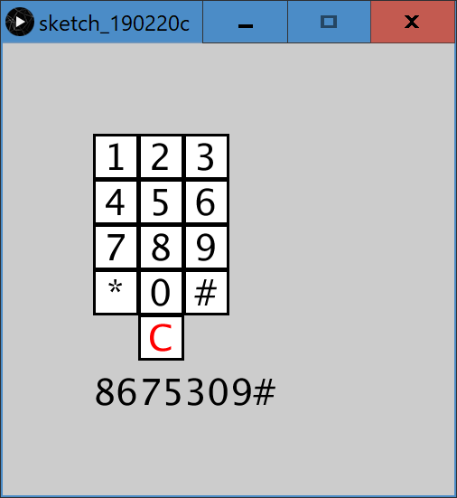
Keypad Grid Click Detection
Clicking on the keypad should add to the phone number you are trying to dial
Use a String to store and display on the canvas

Slide 14
Clear Functionality
Our phone number should “reset” or “clear” when we click the clear button
Currently, it prints "Cleared!" to the console

Slide 15
Summary
Sketched the idea on paper
Planned out coding representations
Built on previous work by adding one function or idea at a time
Ran the program after every improvement to make sure that it worked correctly
Unit and integration testing!!!

