Slide 1
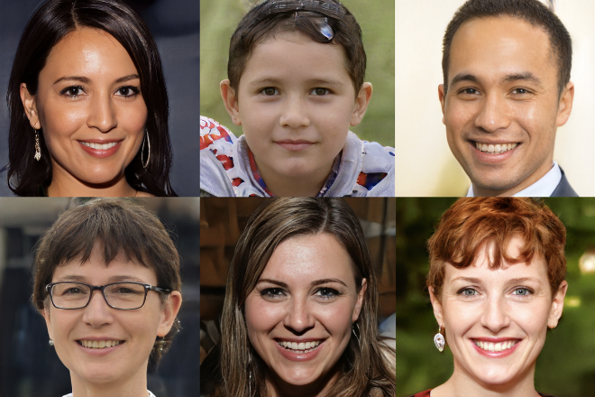
Digital “Reality” CSE 120 Winter 2019
Some Inspiration: INFO 270 Calling Bullshit: Data Reasoning in a Digital World
https://callingbullshit.org
Instructor: Teaching Assistants:
Justin Hsia Ann Shan, Eunia Lee, Pei Lee Yap, Sam Wolfson, Travis McGaha
ThisPersonDoesNotExist.com uses AI to generate endless fake faces
“The ability of AI to generate fake visuals is not yet mainstream knowledge, but a new website — ThisPersonDoesNotExist.com — offers a quick and persuasive education.
“The site is the creation of Philip Wang, a software engineer at Uber, and uses research released last year by chip designer Nvidia to create an endless stream of fake portraits. The algorithm behind it is trained on a huge dataset of real images, then uses a type of neural network known as a generative adversarial network (or GAN) to fabricate new examples.”
https://www.theverge.com/tldr/2019/2/15/18226005/ ai-generated-fake-people-portraits-thispersondoesnotexist- stylegan

Slide 2
Administrivia
Assignments:
Reading Check 9 due Thursday @ 3:30 pm (3/7)
Project Update in section (3/7)
Innovation Exploration Comments due Friday (3/8)
“Big Ideas” lecture: Security

Slide 3
Digital Information
All digital information is stored in binary
Online text is just ASCII or Unicode data
In most cases, it is very easy to manipulate!
Can change data in your RAM or stored on your hard drive
Example: add a new word to the English language
Printed dictionary: Get noticed by publishers, come to agreement over new definition, wait for next edition
Online: Edit your website HTML, share it. Or add to repository like urbandictionary.com or knowyourmeme.com

Slide 4
Digital Information
Anyone can publish anything they want online!
Freedom of speech was a central tenet of the creation of the Internet
The Bullshit Asymmetry Principle: “The amount of energy needed to refute bullshit is an order of magnitude bigger than to produce it.”
– Alberto Brandolini
Ultimately, dealing with online information boils down to a matter of trust

Slide 5
Why This Matters
“[T]he United States government should teach the public to tell when they are being manipulated. Via schools and nongovernmental organizations and public service campaigns, Americans should be taught the basic skills necessary to be savvy media consumers, from how to fact-check news articles to how pictures can lie.”
– Mark Galotti, (Dec. 2016) NY Times.

Slide 6
Outline
Exposure to Information
Spread of Information
Digital Media Manipulation

Slide 7
Audience News Consumption
Where do you get your news (and opinions on the news) from?
Facebook Newsfeed
Twitter
Google News
CNN News (app, TV)
iPhone New app
Daily email digests
Buzzfeed
Printed text (newspaper, magazines)

Slide 8
The Internet Forms Our Opinions
Having an enormous amount of information available to us creates a poverty of attention
Compounded by the massive new problem of fake news
How should we allocate our attention now that we have so many options to choose from?
Not only do we have the ability to choose what to read and pay attention to, but we also have the ability to choose what we believe in
Notes:
Whatever your beliefs, you can find information that confirm these beliefs

Slide 9
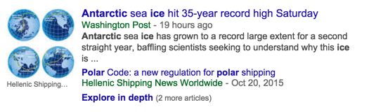
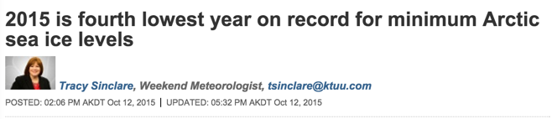
Example: Climate Change

Slide 10
Example: Conspiracy Theories
Unfounded, deeply held alternative explanations for how things are
Not just for the crazies!
Aided by abundance of information and false memories
Now an almost automatic response to current events:
2016 Pizzagate: Hillary Clinton’s leaked emails linked her to an alleged child sex ring at the restaurant Comet Ping Pong
2017 Las Vegas shooting: questioning the shooter’s identity and motive
2018 Stoneman Douglas High School (Parkland, FL) shooting: staged by “crisis actors”
Notes:
https://en.wikipedia.org/wiki/False_memory
https://www.newstatesman.com/science-tech/internet/2016/12/movie-doesn-t-exist-and-redditors-who-think-it-does

Slide 11
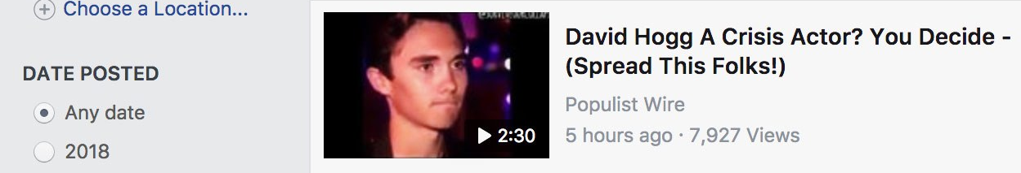
Example: Conspiracy Theories
Easy to find corroborating or persuasive data/information for almost any position
A lot of data is misrepresented
Sometimes misinformation is purposely spread to support an agenda
Sometimes unintentionally spread: “Parkland Conspiracies Overwhelm the Internet’s Broken Trending Tools”
https://www.wired.com/story/youtube-facebook-trending-tools-parkland-conspiracy/
Notes:
Sometimes sloppy analytical work.
Sometimes purposeful selection to get data to “lie”.
Sometimes just a bad game of telephone.

Slide 12
Content Moderation
Content moderators monitor and apply site rules and guidelines (“community standards”)
AI algorithms aren’t good enough yet
These rules and guidelines are often “fuzzy” and nuanced to apply
This exposes people to the worst of the Internet ☹
The Trauma Floor: “The job also changed the way he saw the world. After he saw so many videos saying that 9/11 was not a terrorist attack, he came to believe them. Conspiracy videos about the Las Vegas massacre were also very persuasive, he says, and he now believes that multiple shooters were responsible for the attack.”
https://www.theverge.com/2019/2/25/18229714/cognizant-facebook-content-moderator-interviews-trauma-working-conditions-arizona
Notes:
https://www.theverge.com/2019/2/25/18229714/cognizant-facebook-content-moderator-interviews-trauma-working-conditions-arizona

Slide 13
Filter Bubbles
Eli Pariser warns that technology tends towards exposure to information that confirms preexisting beliefs
https://www.ted.com/talks/eli_pariser_beware_online_filter_bubbles
People (myself included) tend to look to people who they think have the right answers
Often people who act and look like me or share similar opinions
This is a bias (natural filter bubble)

Slide 14
Polarization and Technology
Pablo Barberá argues that technology has the opposite effect
“How Social Media Reduces Mass Political Polarization. Evidence from Germany, Spain, and the U.S.”
http://smapp.nyu.edu/papers/SocialMediaReduces.pdf
“Weak social ties tend to be more ideologically heterogeneous than strong social ties.”
“Citizens are now exposed not only to their close friends’ opinions, but also to political content shared by their co-workers, childhood friends, distant relatives, and other people with whom they form weak ties.”

Slide 15
Polarization and Technology
Diana Mutz: “Cross-cutting Social Networks: Testing Democratic Theory in Practice”
http://repository.upenn.edu/cgi/viewcontent.cgi?article=1124&context=asc_papers
“Exposure to conflicting political viewpoints is widely assumed to benefit the citizens of a democratic polity.”
“... Utilizing a laboratory experiment manipulating exposure to dissonant and consonant political views, I further substantiate the causal role of cross-cutting exposure in fostering political tolerance.”

Slide 16
Facebook Friends
More recently, there’s an interesting fad of unfriending people on social media sites like Facebook
This past presidential election, in particular, has made many people post their personal political beliefs on Facebook, which has ruined many a friendship
This results in a tighter filter bubble

Slide 17
Discussion
Social Media: Humanizing or Polarizing?

Slide 18
Outline
Exposure to Information
Spread of Information
Digital Media Manipulation

Slide 19
Virality
What generates $$ on the Internet?
Advertising, clicks/views, sponsorships
Notes:
Video: - 2:50

Slide 20

Virality
What generates $$ on the Internet?
Advertising, clicks/views, sponsorships
Not the truth:
https://www.youtube.com/watch?v=rE3j_RHkqJc&t=12
Notes:
Video: - 2:50

Slide 21
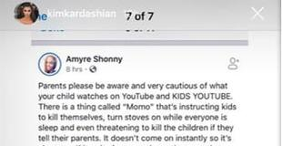
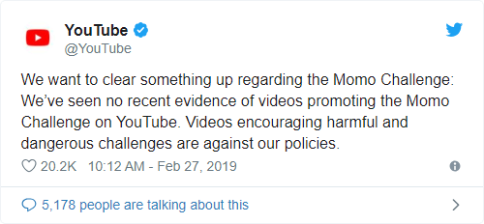
Example: Momo Challenge
Images of a demonic chicken lady spread with a warning of a dangerous “suicide” game that targets children on social media
https://www.vox.com/2019/3/3/18248783/momo-challenge-hoax-explained
Hoax fueled by media reports and parents’ fears about their children’s online activity
Original photo is of a sculpture called “Mother Bird” made by a Japanese artist
Twitter → schools → police → Kim Kardashian → TV reports

Slide 22
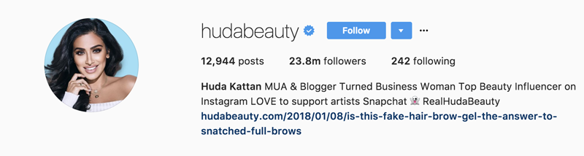
Social Media “Influencers”
Definition?
“A Social Media Influencer is a user on social media who has established credibility in a specific industry. A social media influencer has access to a large audience and can persuade others by virtue of their authenticity and reach.” – https://www.pixlee.com/definitions/definition-social-media-influencer

Slide 23
Social Media “Influencers”
What do they do?
Using https://influencermarketinghub.com/top-25-instagram-influencers/ just as an example

Slide 24
Social Media “Influencers”
Would you rather take advice from…
a beauty blogger OR a make-up artist
a food blogger OR a food critic
a fashionista OR a movie star
a fitness guru OR a professional athlete
Why do we trust influencers?
More relatable, can see whole process
“Children report viewing influencers to be more trustworthy than traditional celebrities, possibly because of increased feelings of familiarity.” https://www.marketwatch.com/story/how-social-media-influencers-are-making-your-kids-fat-2019-03-05

Slide 25
Social Media “Influencers”
… but who is more qualified?
Social media influencers are often just a form of testimonial advertising
Celebrities → “endorsement”, Ordinary citizens → “testimonial”
Anecdotal evidence is not definitive proof
Influencers are often PAID to advertise certain products!

Slide 26
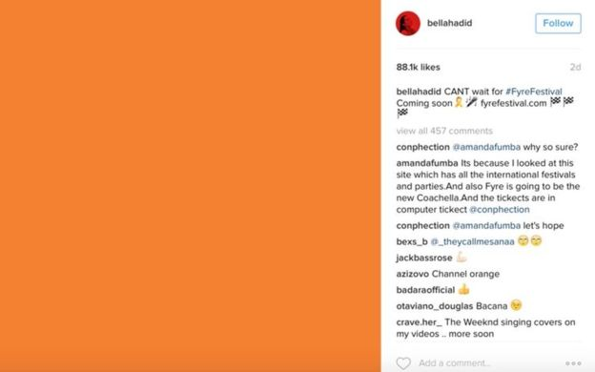


Example: Fyre Festival
Failed “luxury music festival” founded by Billy McFarland and Ja Rule
Gained traction because of influencer sponsored posts:
Expectations Reality
vs
Images from: https://www.bbc.com/news/46945662

Slide 27
Sponsored Content
These are a common source of revenue and platforms are encouraged to get you to click on them
Often look just like other items (e.g. Google search results, Facebook newsfeed)
Targeted advertising!
Open up your favorite social media platform and look at the first 10 items – count how many of them are sponsored content
Look for a little “Sponsored” tag – these were not always required!

Slide 28
Discussion
Social Media Sharing: What content do you share? Where is your line to NOT share?

Slide 29
Outline
Exposure to Information
Spread of Information
Digital Media Manipulation

Slide 30




Image Editing
Photo editing is no longer just for the art professionals!
Built-in editing tools in apps like SnapChat, Instagram, Messenger, FaceTune
The user interfaces encourage image editing
e.g. suggested edits by Google Assistant in Google Photos
Audience photo editing
<audience responses>

Slide 31
Social Media Curation
What are some uses for social media?
Stay connected with those who are physically far
Meet others with shared interests regardless of location
Broadcast notable events and thoughts
Project a certain image or persona

Slide 32
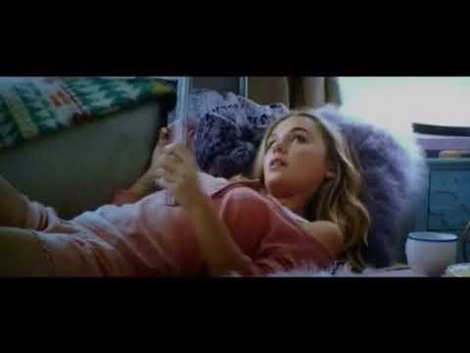
Social Media Curation
What are some uses for social media?
Stay connected with those who are physically far
Meet others with shared interests regardless of location
Broadcast notable events and thoughts
Project a certain image or persona
Selfie scene of the character Bethany in “Jumanji 2.”

Slide 33
Social Media Curation
What are some uses for social media?
Stay connected with those who are physically far
Meet others with shared interests regardless of location
Broadcast notable events and thoughts
Project a certain image or persona
Effects:
No statistically significant link between social media usage and depression
Arms races between online personas
Fear of missing out (FOMO)
Not spending as much time connecting in real life

Slide 34
Image Generation
Billions of images already exist on the internet – we can easily train algorithms to generate more from scratch
Let’s play a game!
http://whichfaceisreal.com/

Slide 35
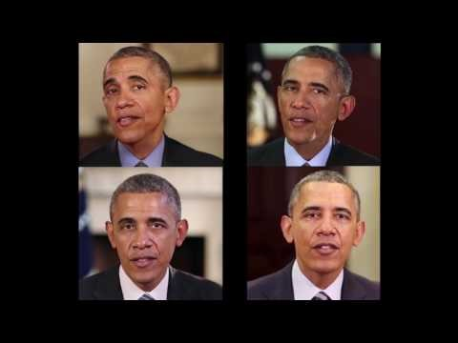
Audio Generation
We can synthesize audio/speech
Siri, Alexa, Cortana, GPS voices
With enough audio training data, can train a neural net to produce new audio that approximates someone’s voice
Learning Lip Sync from Audio (UW!)
Graft synthetic mouth shapes onto existing video to match audio

Slide 36
Video Generation
Videos are collections of sequential images
Faking motion and lighting is a lot harder for videos
DeepFake
An open source machine-learning-powered human image synthesis technique
Most common usage is to superimpose one person’s face onto another person’s body in a video
Still pretty easy to tell apart from authentic video

Slide 37
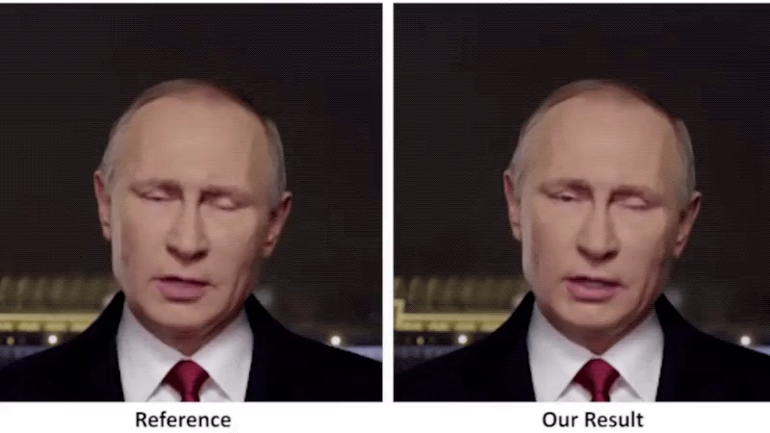
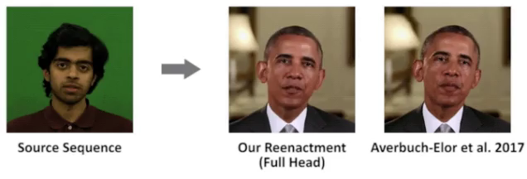
Video Generation
Videos are collections of sequential images
Faking motion and lighting is a lot harder for videos
Deep Video Portraits
Create photorealistic re-animations of portrait videos on top of a source actor

Slide 38
Discussion
What will we use to verify the truth once video can be easily faked?

Slide 39
What Can Be Done?
It’s not all doom and gloom
Synthesized versions can still be detected
Detection tools will continue to improve
Laws and policies will eventually catch up
Be aware of where you are getting your information from and what you choose to share
Fact-checking is exhausting, but important
Make sure your trusted sources are trustworthy

