Slide 1
Graphs
Ruth Anderson
UW CSE 160
Spring 2018

Slide 2
A graph contains nodes and edges
Chicago
Seattle
Salt Lake City
San Francisco
Dallas

Slide 3
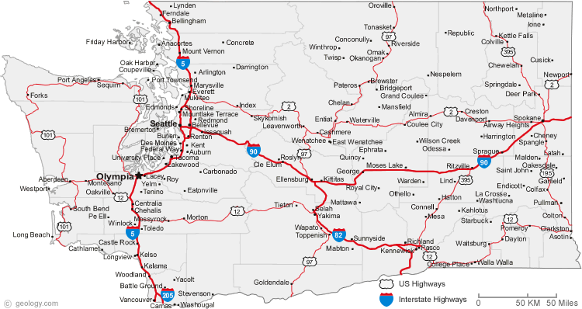

Slide 4
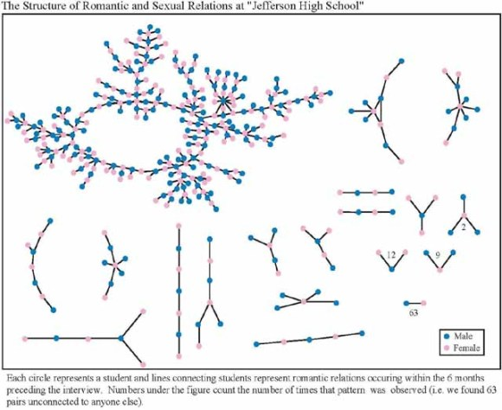
+ 350 students in no romantic and/or sexual relationship
From: “Chains of Affection: The Structure of Adolescent Romantic and Sexual Networks”, American Journal of Sociology, by Peter Bearman of (Columbia), James Moody (Ohio State), and Katherine Stovel (U. of Washngton);

Slide 5
Graphs
A graph can be thought of as either of:
a collection of edges
Each edge represents some relationship
for each node, a collection of neighbors
The neighbors are those connected by an edge

Slide 6
Operations on a graph
Creation:
Create an empty graph
Querying:
Look up a node: Does it exist? What are its neighbors?
Look up an edge (= a pair of nodes): does it exist? (You know the nodes it connects.)
Iterate through the nodes or edges
Modification:
Add/remove a node
Add/remove an edge

Slide 7
networkx Graph Library
Used in Homework 4
https://networkx.github.io/documentation/networkx-1.11/tutorial/index.html
import networkx as nx
g = nx.Graph()
g.add_node(1)
g.add_node(2)
g.add_edge(1, 2)
print g.nodes()
print g.edges()
Note: It is also o.k. to just add an edge before you add the individual nodes; the nodes will be added for you in that case.

Slide 8
Installing networkx Graph Library
Through the GUI:
In Canopy select Tools-> Package Manager
In the left hand panel, click on “Available " and then type "networkx“ in the search box in the upper right
Once found, click the Install button.
To check if you have networkx installed, type:
import networkx
in the python interpreter in Canopy. If it is installed properly nothing should happen, but if it is NOT installed you will get an error message.

Slide 9
import networkx as nx
import matplotlib.pyplot as plt
g = nx.Graph() # Creates a graph
g.add_edge(1, 2) # Adds edge from node 1 to node 2
g.add_edge(1, 3)
g.add_node(4) # Adds node 4
print g.edges()
print g.nodes()
print g.neighbors(1)
assert len(g.nodes()) == 4
assert len(g.edges()) == 2
nx.draw_networkx(g) # Draw the graph
plt.show() # Show the graph in a separate window

