Slide 1
Visualization
UW CSE 160
Spring 2018

Slide 2
matplotlib
Strives to emulate MATLAB
Pro: familiar to MATLAB users
Pro: powerful
Con: not the best design for a plotting library
One important function for HW6:
plot(xvalues, yvalues)

Slide 3
Plot
import matplotlib.pyplot as plt
xs = [1,2,3,4,5]
# ys = [x**2 for x in xs]
ys = []
for x in xs:
ys.append(x**2)
plt.plot(xs, ys)
plt.show()
no return value?
Has a side effect on the figure (like “print” statement)

Slide 4
import matplotlib.pyplot as plt
xs = range(-100,110,10)
x2 = [x**2 for x in xs]
negx2 = [-x**2 for x in xs]
plt.plot(xs, x2)
plt.plot(xs, negx2)
plt.xlabel("x")
plt.ylabel("y")
plt.ylim(-2000, 2000)
plt.axhline(0) # horiz line
plt.axvline(0) # vert line
plt.savefig("quad.png")
plt.show()
Incrementally modify the figure.
Save your figure to a file
Show it on the screen

Slide 5
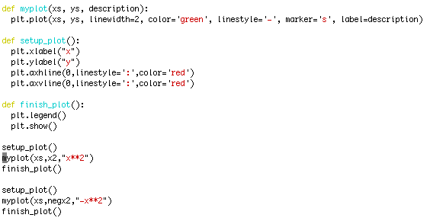
We can group these options into functions as usual, but remember that they are operating on a global, hidden variable (the figure)

Slide 6
Visualization: Pros and Cons
Visualizations can Mislead:
https://venngage.com/blog/misleading-graphs/
Visualizations can be powerful:
John Snow’s Famous Cholera Map

Slide 7
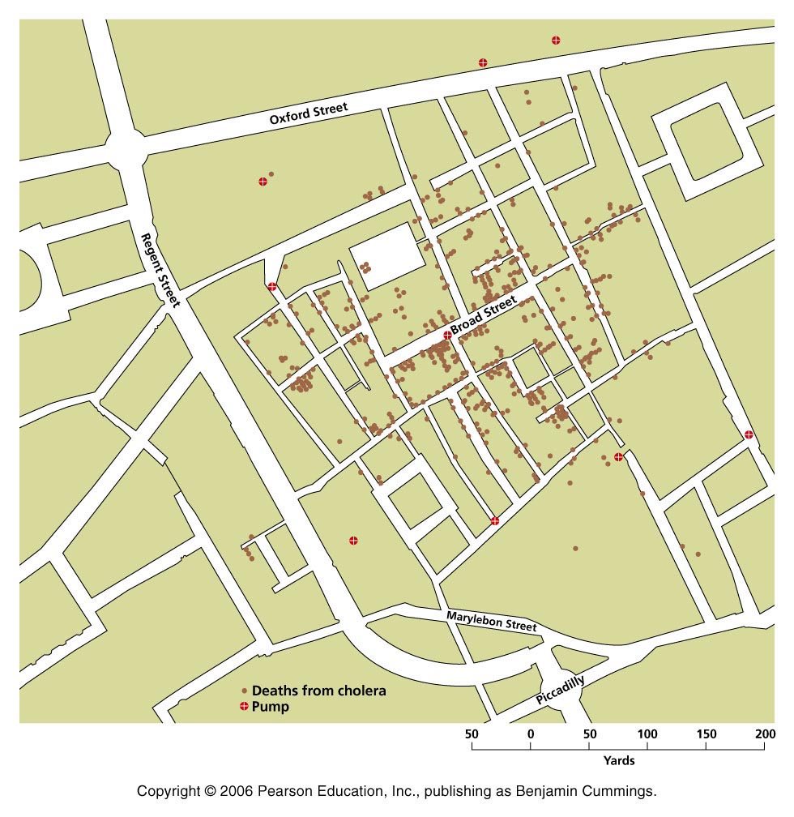
1854 London cholera epidemic
Map by Dr. John Snow

Slide 8
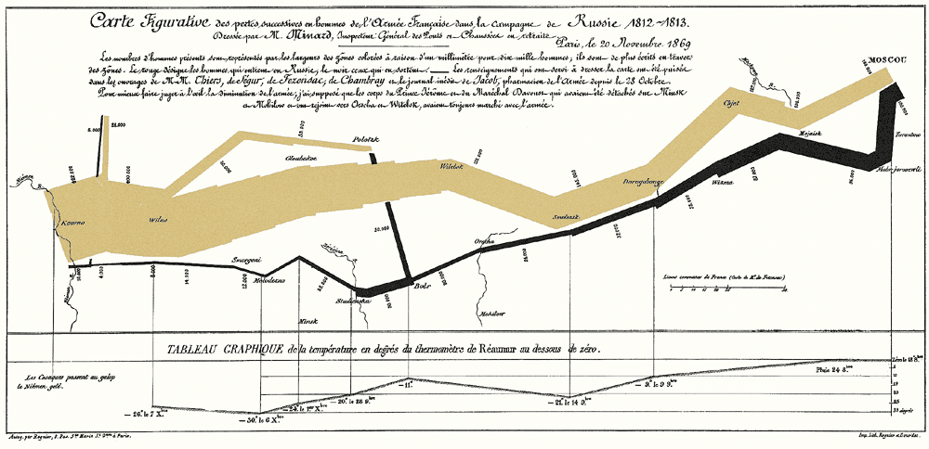
Napoleon’s Russian Campaign of 1812
Graphic by Charles Joseph Minard

