Slide 1
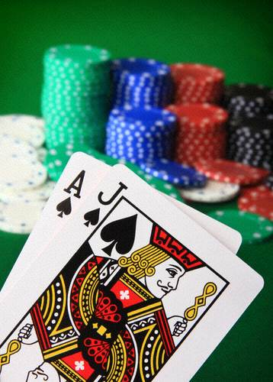
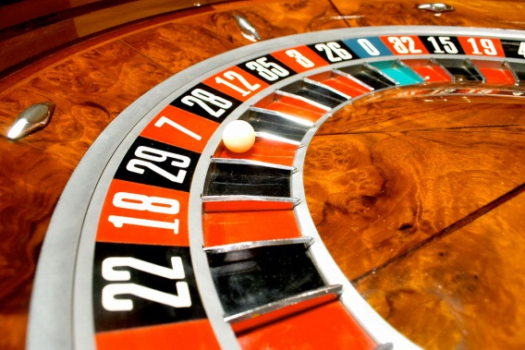
Elementary statistics
UW CSE 160
Spring 2018

Slide 2
A dice-rolling game
Two players each roll a die
The higher roll wins
Goal: roll as high as you can!
Repeat the game 6 times
Notes:
Have one student roll the die, and the other report the outcome

Slide 3
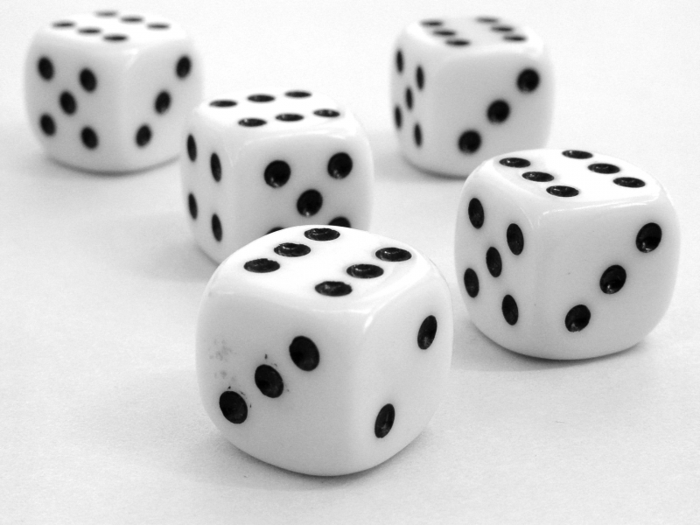
Hypotheses regarding the outcome
Luck
Fraud
loaded die
inaccurate reporting
How likely is luck?
How do we decide?

Slide 4
Questions that statistics can answer
I am flipping a coin. Is it fair? How confident am I in my answer?
I have two bags of beans, each containing some black and some white beans. I have a handful of beans. Which bag did the handful come from?
I have a handful of beans, and a single bag. Did the handful come from that bag?
Does this drug improve patient outcomes?
Which website design yields greater revenue?
Which baseball player should my team draft?
What premium should an insurer charge?
Which chemical process leads to the best-tasting beer?
Notes:
“Student” was William Gosset, a chemist working for the Guinness brewery in Dublin

Slide 5

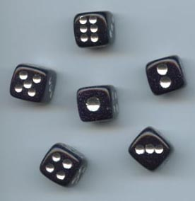
What can happen when you roll a die?
What is the likelihood of each?

Slide 6






What can happen when you roll two dice?
How likely are you to roll 11 or higher?
This probability is known as the “p value”.
2
3
4
5
6
7
8
9
10
11
12

Slide 7
How to compute p values
Via a statistical formula
Requires you to make assumptions and know which formula to use
Computationally (simulation)
Run many experiments
Count the fraction with a better result
Requires a metric/measurement for “better”
Requires you to be able to run the experiments
We will use this approach exclusively

Slide 8
Analogy between hypothesis testing and mathematical proofs
“The underlying logic [of hypothesis testing] is similar to a proof by contradiction. To prove a mathematical statement, A, you assume temporarily that A is false. If that assumption leads to a contradiction, you conclude that A must actually be true.”
From the book Think Statistics by Allen Downey

Slide 9
Summary of statistical methodology
Decide on a metric (bigger value = better)
Observe what you see in the real world
Hypothesize that what you saw is normal/typical
This is the “null hypothesis”
Simulate the real world many times
How different is what you observed from the simulations?
What percent of the simulation values are the real world values bigger than?
If the percentage is 95% or more, reject the null hypothesis

Slide 10
Null Hypothesis
Null Hypothesis: The common wisdom, “nothing unusual is happening here”
Examples:
Ruth was using a fair die
The accused is innocent
This new drug does NOT cure disease
The Iranian election results are accurate

Slide 11
Interpreting p values
p value of 5% or less = statistically significant
This is a convention; there is nothing magical about 5%
Two types of errors may occur in statistical tests:
false positive (or false alarm or Type I error): no real effect, but report an effect (through good/bad luck or coincidence)
If no real effect, a false positive occurs about 1 time in 20
false negative (or miss or Type II error): real effect, but report no effect (through good/bad luck or coincidence)
The larger the sample, the less the likelihood of a false positive or negative

Slide 12
Errors
Type 1: False Positive (false alarm)
Type 2: False negative (miss)
Examples:
Ruth was using a fair die
Type 1: Die is actually fair, accuse me of lying!
Type 2: Die is actually biased, you don’t notice
The accused is innocent
This new drug does NOT cure disease
The Iranian election results are accurate

Slide 13
Error Examples
Type 1: False Positive (false alarm)
Type 2: False negative (miss)
Examples:
Ruth was using a fair die
Type 1: Die is actually fair, accuse me of lying!
Type 2: Die is actually biased, you don’t notice
The accused is innocent
Type 1:
Type 2:
This new drug does NOT cure disease
Type 1:
Type 2:
The Iranian election results are fair/accurate
Type 1:
Type 2:

Slide 14
Answer: Error Examples
Type 1: False Positive (false alarm)
Type 2: False negative (miss)
Examples:
Ruth was using a fair die
Type 1: Die is actually fair, accuse me of lying!
Type 2: Die is actually biased, you don’t notice
The accused is innocent
Type 1: Actually innocent, court finds guilty
Type 2: Actually guilty, court sets them free
This new drug does NOT cure disease
Type 1: Drug actually does nothing, study claims it does
Type 2: Drug actually does help, study claims it does not
The Iranian election results are fair/accurate
Type 1: Results are actually fair, we claim they are fraudulent
Type 2: Results are actually fraudulent, we claim they are fair

Slide 15
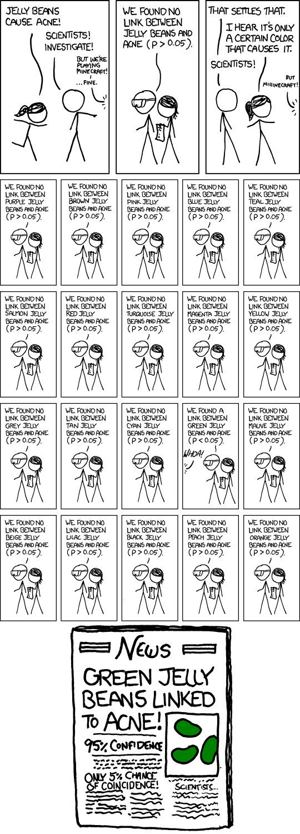
A false positive
http://xkcd.com/882/

Slide 16
http://xkcd.com/882/
http://xkcd.com/882/

Slide 17
A common error
Observe what you see in the real world
Decide on a metric (bigger value = better)
This is backwards
For any observation, there is something unique about it.
Example: Roll dice, then be amazed because what are the odds you would get exactly that combination of rolls?

Slide 18
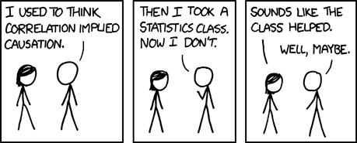
Correlation ≠ causation
Ice cream sales and rate of drowning deaths are correlated
http://xkcd.com/552/

Slide 19
Statistical significance ≠ practical importance

Slide 20
Don’t trust your intuition
People have very bad statistical intuition
It’s much better to follow the methodology and do the experiments

