Slide 1
Algorithmic complexity: Speed of algorithms
UW CSE 160
Spring 2018

Slide 2
How fast does your program run?
Usually, this does not matter
Correctness is more important than speed
Computer time is much cheaper than human time
The cost of your program depends on:
Time to write and verify it
High cost: salaries
Time to run it
Low cost: electricity
An inefficient program may give you results faster

Slide 3
Sometimes, speed does matter
Programs that need to run in real time
e.g. will my car crash into the car in front of me?
Very large datasets
Even inefficient algorithms usually run quickly enough on a small dataset
Example large data set:
Google:
67 billion pages indexed (2014)
5.7 billion searches per day (2014)
Number of pages searched per day??
Notes:
http://www.statisticbrain.com/total-number-of-pages-indexed-by-google/

Slide 4
Program Performance
We’ll discuss two things a programmer can do to improve program performance:
Good Coding Practices
Good Algorithm Choice

Slide 5
Good Coding Practices (1)
Minimize amount of work inside of loops
y = 500
for i in range(n):
z = expensive_function()
x = 5.0 * y / 2.0 + z
lst.append(x + i)
Move computations that WILL NOT CHANGE outside/above the loop whenever possible.
Notes:
Move computations that WILL NOT CHANGE outside/above the loop whenever possible.

Slide 6
Good Coding Practices (2)
Minimize amount of work inside of loops
for i in friends_of_friends(n):
for j in friends_of_friends(n):
# do stuff with i and j
Move computations that WILL NOT CHANGE outside/above the loop whenever possible.
Notes:
Move computations that WILL NOT CHANGE outside/above the loop whenever possible.

Slide 7
Good Coding Practices (3)
Avoid iterating over data multiple times when possible
for base in nucleotides:
if base == 'A':
# code here
for base in nucleotides:
if base == 'C':
# code here
for base in nucleotides:
if base == 'T':
# code here
for base in nucleotides:
if base == 'G':
# code here
for base in nucleotides:
if base == 'A':
# code here
elif base == 'C':
# code here
elif base == 'T':
# code here
elif base == 'G':
# code here
Even without the loop, it is more efficient to use the if elif elif than multiple if statements (Potentially fewer cases will be checked with the elif option vs. the if option where all four options will always be checked.)
Notes:
Even without the loop, it is more efficient to use the if elif elif than multiple if statements (Potentially fewer cases will be checked with the elif option vs. the if option where all four options will always be checked.)

Slide 8
Good Coding Practices (4)
Expensive operations:
Reading files
Writing files
Printing to the screen
Try to open the file once and read in all the data you need into a data structure.
Accessing the data structure will be MUCH faster than reading the file a second time.

Slide 9
Testing and Developing your Program
Test your program on a SMALL input file.
This will allow you to calculate expected results by hand to check for correctness
But it can also make your development process easier if you have to wait a shorter time for your program to run

Slide 10
Good Algorithm Choice
Good choice of algorithm can have a much bigger impact on performance than the good coding practices mentioned.
However good coding practices can be applied fairly easily
Trying to come up with a better algorithm can be a (fun!) challenge
Remember: Correctness is more important than speed!!

Slide 11
How to compare two algorithms?
Implement them both in Python
Run them and time them

Slide 12
A Better Way to Compare Two Algorithms
Hardware?
Count number of “operations” something independent of speed of processor
Properties of data set? (e.g. almost sorted, all one value, reverse sorted order)
Pick the worst possible data set: gives you an upper bound on how long the algorithm will take
Also it can be hard to decide on what is and “average” data set
Size of data set?
Describe running time of algorithm as a function of data set size

Slide 13
Asymptotic Analysis
Comparing “Orders of Growth”
This approach works when problem size is large
When problem size is small, “constant factors” matter
A few common Orders of Growth:
Example:
Constant O(1) integer + integer
Linear O(n) iterating through a list
Quadratic O(n²) iterating through a grid

Slide 14
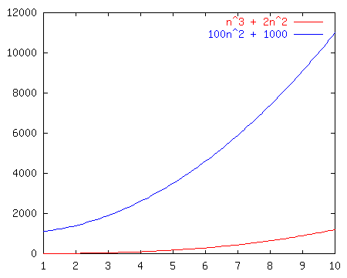
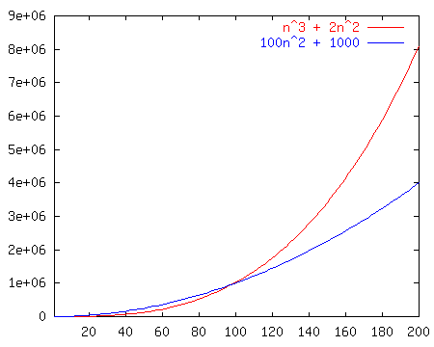
Which Function Grows Faster?
O(n³)
O(n²)
n³ + 2n²
vs.
100n² + 1000
n
n

Slide 15
Running Times of Python Operations
Constant Time operations: O(1)
Basic Math on numbers (+ - * /)
Indexing into a sequence (eg. list, string, tuple) or dictionary
E.g. myList[3] = 25
List operations: append, pop(at end of list)
Sequence operation: len
Dictionary operation: in
Set operations: in, add, remove, len
Linear Time operations: O(n)
for loop traversing an entire sequence or dictionary
Built in functions: sum, min, max, slicing a sequence
Sequence operations: in, index, count
Dictionary operations: keys(), values(), items()
Set operations: &, |, -
String concatenation (linear in length of strings)
Note: These are general guidelines, may vary, or may have a more costly worst case. Built in
functions (e.g. sum, max, min, sort) are often faster than implementing them yourself.

Slide 16
Example: Processing pairs
def make_pairs(list1, list2):
"""Return a list of pairs.
Each pair is made of corresponding elements of list1 and list2.
list1 and list2 must be of the same length."""
…
assert make_pairs([100, 200, 300], [101, 201, 301]) == [[100, 101], [200, 201], [300, 301]]
2 nested loops vs. 1 loop
Quadratic (n²) vs. linear (n) time

Slide 17
Example: Searching
def search(value, lst):
"""Return index of value in list lst.
The value must be in the list."""
…
Any list vs. a sorted list
Linear (n) vs. logarithmic (log n) time

Slide 18
Example: Sorting
def sort(lst):
"""Return a sorted version of the list lst.
The input list is not modified."""
…
assert sort([3, 1, 4, 1, 5, 9, 2, 6, 5]) == [1, 1, 2, 3, 4, 5, 5, 6, 9]
selection sort vs. quicksort
2 nested loops vs. recursive decomposition
time: quadratic (n²) vs. log-linear (n log n) time
Note: Calling built in sorting methods sort or sorted in Python has O(n log n) time

