Slide 1


Minimum Spanning Trees
Data Structures and Algorithms

Slide 2
Announcements
On “optimization experiments” section of P3 writeup, if you find the experiments are taking WAY too long, decrease the depth (and tell us you’ve done that)
I don’t think depth 5 will be a problem for most laptops/the lab machines, but we’d rather you get some numbers than none.
Exercises 12 and 13 out now
No resubmissions allowed for these

Slide 3

Minimum Spanning Trees
It’s the 1920’s. Your friend at the electric company needs to choose where to build wires to connect all these cities to the plant.
B
6
3
E
2
1
C
A
10
9
5
7
4
D
8
She knows how much it would cost to lay electric wires between any pair of locations, and wants the cheapest way to make sure electricity from the plant to every city.

Slide 4
Minimum Spanning Trees
1950’s
boss
phone
It’s the 1920’s. Your friend at the electric company needs to choose where to build wires to connect all these cities to the plant.
phones to each other.
B
6
3
E
2
1
C
A
10
9
5
7
4
D
F
8
phone
She knows how much it would cost to lay electric wires between any pair of locations, and wants the cheapest way to make sure
electricity from the plant to every city.
Everyone can call everyone else.

Slide 5

Minimum Spanning Trees
today
ISP
It’s the 1920’s. Your friend at the electric company needs to choose where to build wires to connect all these cities to the plant.
the Internet.
B
6
3
E
2
1
C
A
10
9
5
7
4
D
8
She knows how much it would cost to lay electric wires between any pair of locations, and wants the cheapest way to make sure
cable
Everyone can reach the server

Slide 6
Minimum Spanning Trees
What do we need? A set of edges such that:
Every vertex touches at least one of the edges. (the edges span the graph)
The graph on just those edges is connected.
i.e. the edges are all in the same connected component.
A connected component is a vertex and everything you can reach from it.
The minimum weight set of edges that meet those conditions
Claim: The set of edges we pick never has a cycle. Why?

Slide 7
Aside: Trees
On graphs our trees:
Don’t need a root (the vertices aren’t ordered, and we can start BFS from anywhere)
Varying numbers of children neighbors
Connected and no cycles
Tree (when talking about undirected graphs)
An undirected, connected, acyclic graph.

Slide 8
MST Problem
What do we need? A set of edges such that:
Every vertex touches at least one of the edges. (the edges span the graph)
The graph on just those edges is connected.
The minimum weight set of edges that meet those conditions.
Our goal is a tree!
We’ll go through two different algorithms for this problem today.
Given: an undirected, weighted graph G
Find: A minimum-weight set of edges such that you can get from any vertex of G to any other on only those edges.
Minimum Spanning Tree Problem

Slide 9
Example
Try to find an MST of this graph:
B
6
3
E
2
1
C
10
A
9
5
7
4
D
F
8

Slide 10
Prim’s Algorithm
Algorithm idea: choose an arbitrary starting point. Add a new edge that:
Will let you reach more vertices.
Is as light as possible
We’d like each not-yet-connected vertex to be able to tell us the lightest edge we could add to connect it.

Slide 11
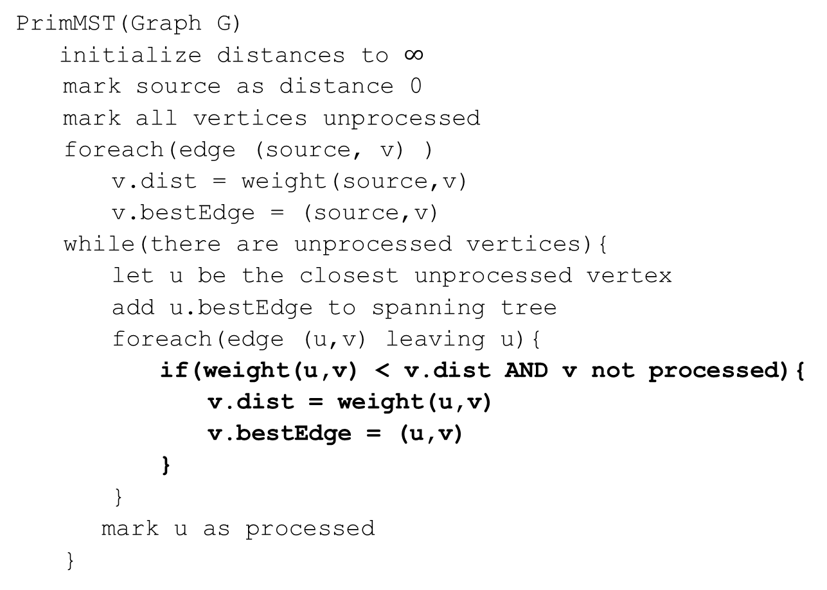
Code
PrimMST(Graph G)
initialize distances to $∞$
mark source as distance 0
mark all vertices unprocessed
foreach(edge (source, v) )
v.dist = weight(source,v)
v.bestEdge = (source,v)
while(there are unprocessed vertices){
let u be the closest unprocessed vertex
add u.bestEdge to spanning tree
foreach(edge (u,v) leaving u){
if(weight(u,v) < v.dist AND v not processed){
v.dist = weight(u,v)
v.bestEdge = (u,v)
}
}
mark u as processed
}

Slide 12
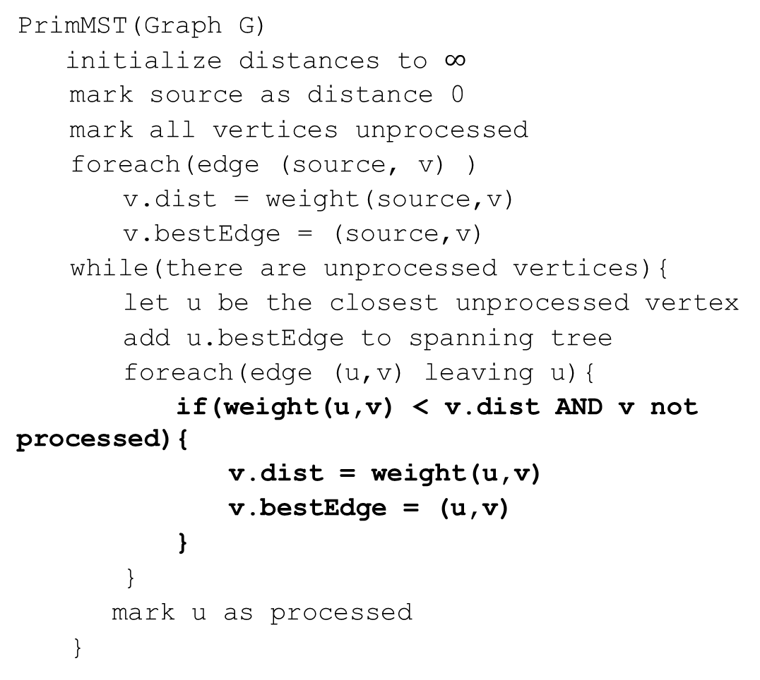
Try it Out
50
G
6
B
2
3
E
PrimMST(Graph G)
initialize distances to $∞$
mark source as distance 0
mark all vertices unprocessed
foreach(edge (source, v) )
v.dist = weight(source,v)
v.bestEdge = (source,v)
while(there are unprocessed vertices){
let u be the closest unprocessed vertex
add u.bestEdge to spanning tree
foreach(edge (u,v) leaving u){
if(weight(u,v) < v.dist AND v not processed){
v.dist = weight(u,v)
v.bestEdge = (u,v)
}
}
mark u as processed
}
4
C
5
A
9
2
7
7
F
D
8
Vertex | Dist. | Best Edge | Processed
A
B
C
D
E
F
G

Slide 13
Try it Out
50
G
6
B
2
3
E
PrimMST(Graph G)
initialize distances to $∞$
mark source as distance 0
mark all vertices unprocessed
foreach(edge (source, v) )
v.dist = weight(source,v)
v.bestEdge = (source,v)
while(there are unprocessed vertices){
let u be the closest unprocessed vertex
add u.bestEdge to spanning tree
foreach(edge (u,v) leaving u){
if(weight(u,v) < v.dist AND v not processed){
v.dist = weight(u,v)
v.bestEdge = (u,v)
}
}
mark u as processed
}
4
C
5
A
9
2
7
7
F
D
8
Vertex | Dist. | Best Edge | Processed
A | -- | -- | Yes
B | 2 | (A,B) | Yes
C | 4 | (A,C) | Yes
D | 7 2 | (A,D)(C,D) | Yes
E | 6 5 | (B,E)(C,E) | Yes
F | 3 | (B,F) | Yes
G | 50 | (B,G) | Yes
Notes:
Run time same as Dijkstra’s

Slide 14
Does This Algorithm Always Work?
Prim’s Algorithm is a greedy algorithm. Once it decides to include an edge in the MST it never reconsiders its decision.
Greedy algorithms rarely work.
There are special properties of MSTs that allow greedy algorithms to find them.
In fact MSTs are so magical that there’s more than one greedy algorithm that works.

Slide 15
Why do all of these MST Algorithms Work?
MSTs satisfy two very useful properties:
Cycle Property: The heaviest edge along a cycle is NEVER part of an MST.
Cut Property: Split the vertices of the graph any way you want into two sets A and B. The lightest edge with one endpoint in A and the other in B is ALWAYS part of an MST.
Whenever you add an edge to a tree you create exactly one cycle, you can then remove any edge from that cycle and get another tree out.
This observation, combined with the cycle and cut properties form the basis of all of the greedy algorithms for MSTs.

Slide 16
A Different Approach
Prim’s Algorithm started from a single vertex and reached more and more other vertices.
Prim’s thinks vertex by vertex (add the closest vertex to the currently reachable set).
What if you think edge by edge instead?
Start from the lightest edge; add it if it connects new things to each other (don’t add it if it would create a cycle)
This is Kruskal’s Algorithm.

Slide 17
Kruskal’s Algorithm
KruskalMST(Graph G)
initialize each vertex to be a connected component
sort the edges by weight
foreach(edge (u, v) in sorted order){
if(u and v are in different components){
add (u,v) to the MST
Update u and v to be in the same component
}
}

Slide 18
Try It Out
B
3
6
E
2
KruskalMST(Graph G)
initialize each vertex to be a connected component
sort the edges by weight
foreach(edge (u, v) in sorted order){
if(u and v are in different components){
add (u,v) to the MST
Update u and v to be in the same component
}
}
1
C
A
10
5
9
7
4
D
F
8
Edge | Include? | Reason
(A,C)
(C,E)
(A,B)
(A,D)
(C,D)
Edge (cont.) | Inc? | Reason
(B,F)
(D,E)
(D,F)
(E,F)
(C,F)

Slide 19
Try It Out
B
3
6
E
2
KruskalMST(Graph G)
initialize each vertex to be a connected component
sort the edges by weight
foreach(edge (u, v) in sorted order){
if(u and v are in different components){
add (u,v) to the MST
Update u and v to be in the same component
}
}
1
C
A
10
5
9
7
4
D
F
8
Edge | Include? | Reason
(A,C) | Yes
(C,E) | Yes
(A,B) | Yes
(A,D) | Yes
(C,D) | No | Cycle A,C,D,A
Edge (cont.) | Inc? | Reason
(B,F) | Yes
(D,E) | No | Cycle A,C,E,D,A
(D,F) | No | Cycle A,D,F,B,A
(E,F) | No | Cycle A,C,E,F,D,A
(C,F) | No | Cycle C,A,B,F,C

Slide 20
Kruskal’s Algorithm: Running Time
KruskalMST(Graph G)
initialize each vertex to be a connected component
sort the edges by weight
foreach(edge (u, v) in sorted order){
if(u and v are in different components){
add (u,v) to the MST
Update u and v to be in the same component
}
}

Slide 21
Kruskal’s Algorithm: Running Time
Running a new BFS in the partial MST, at every step seems inefficient.
Do we have an ADT that will work here?
Not yet…

Slide 22
Union-Find Crash Course
Union-Find ADT
aka Disjoint Sets
Represents…well…disjoint sets.
state
Set of Sets
Disjoint: No element appears in multiple sets
No required order
Each set has representative
behavior
makeSet(x) – creates a new set where the only member (and the representative) is x.
findSet(x) – looks up the set containing element x, returns representative of that set
union(x, y) – combines set containing x and set containing y. Picks new representative.

Slide 23
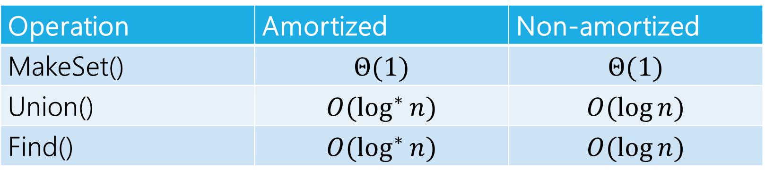
Union-Find Running Time
We don’t have time to talk about an implementation.
Weiss has a whole chapter on it if you want to know more
Here’s the important thing:
Can do these operations in:
Operation | Amortized | Non-amortized
MakeSet() | $$Θ(1)$$ | $$Θ(1)$$
Union() | $$O(\log^{∗}{n})$$ | $$O(\log{n)}$$
Find() | $$O(\log^{∗}{n)}$$ | $$O(\log{n)}$$

Slide 24
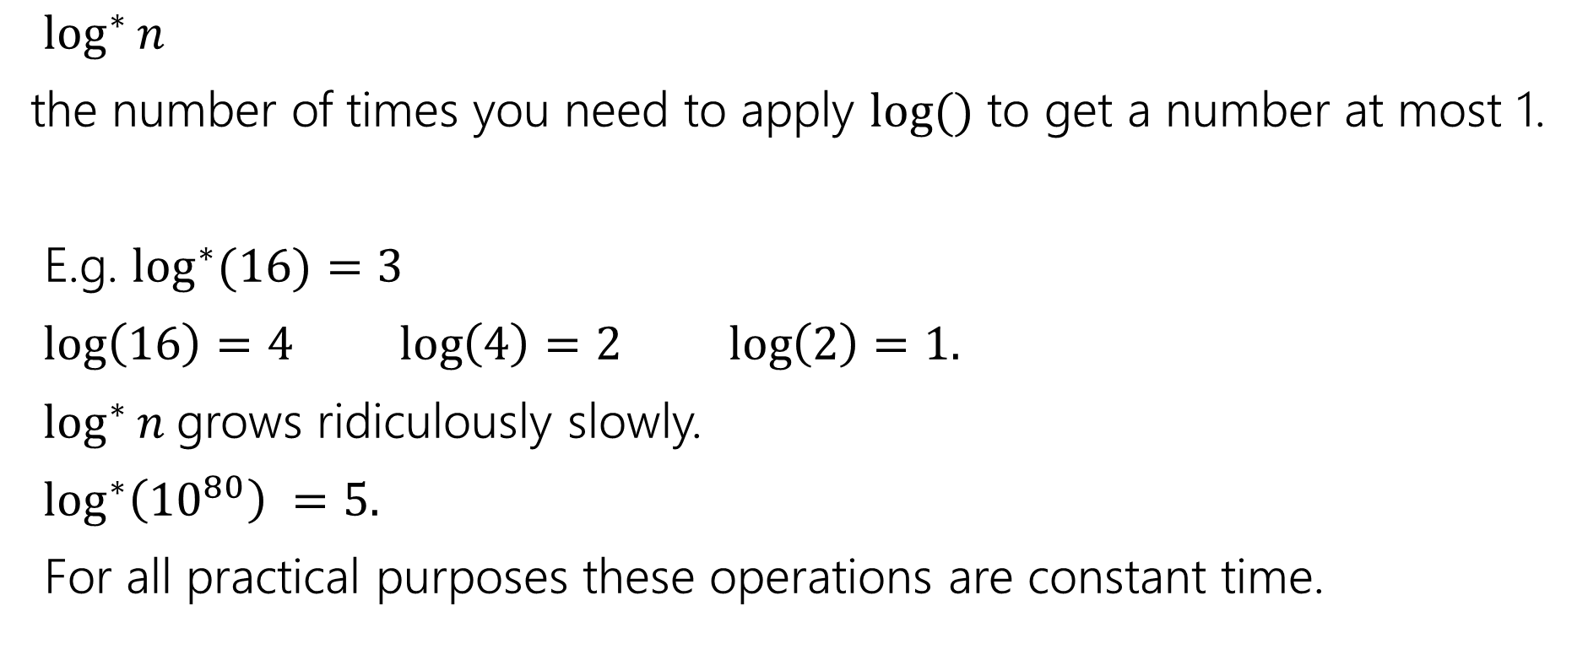
$$\log^{∗}{n}$$
$\log^{∗}{n}$
the number of times you need to apply $log⁡()$ to get a number at most 1.
E.g. $\log^{∗}{(16)}=3$
$\log\left(16\right)=4 \log\left(4\right)=2 \log\left(2\right)=1.$
$\log^{∗}{n}$grows ridiculously slowly.
$\log^{∗}\left({10}^{80}\right) =5.$
For all practical purposes these operations are constant time.

Slide 25
Using Union-Find
Have each disjoint set represent a connected component
A connected component is a “piece” of a (disconnected) undirected graph
i.e. a vertex, and everything you can reach from that vertex.
When you add an edge, you union those connected components.

Slide 26
Try it Out
KruskalMST(Graph G)
initialize each vertex to be a connected component
sort the edges by weight
foreach(edge (u, v) in sorted order){
if(find(u) != find(v)){
add (u,v) to the MST
Union(u,v) }
}
50
G
6
B
2
3
E
4
C
5
A
9
2
7
7
F
D
8

Slide 27
Try it Out
Edge | Include? | Reason
(A,B) | Yes
(C,D) | Yes
(B,F) | Yes
(A,C) | Yes
(C,E) | Yes
(B,E) | No | Cycle A,C,D,B,A
(A,D) | No | Cycle A,D,C
(D,E) | No | Cycle C,D,E
(D,F) | No | Cycle A,B,F,D,C,A
(E,F) | No | Cycle E,F,B,A,C,E
(B,G) | Yes
50
G
6
B
2
3
E
4
C
5
A
9
2
7
7
F
D
8

Slide 28
Some Extra Comments
Prim’s algorithm wasn’t invented by Prim (just discovered)
First algorithm was by Boruvka
He literally used it to figure out efficient electrical grids
Boruvka’s algorithm is trickier to implement, but is useful in some cases.
In particular it’s the basis for fast parallel MST algorithms.
There’s at least a fourth greedy algorithm for MSTs…
If all the edge weights are distinct, then the MST is unique.
If some edge weights are equal, there may be multiple spanning trees. Prim’s/Kruskal’s are only guaranteed to find you one of them.
Notes:
Prims made by Jarnik almost 30 years earlier
Reverse-delete reverse of Kruskal’s algorithm

Slide 29
Aside: A Graph of Trees
A tree is an undirected, connected, and acyclic graph.
How would we describe the graph Kruskal’s builds.
It’s not a tree until the end.
It’s a forest!
Tree: undirected, acyclic, connected graph
Forest: undirected, acyclic, connected graph

Slide 30

EVERY TREE IS A FOREST.

