Slide 1


CSE 341 Section 3
HW1 Debrief, Tail Recursion, More Pattern-Matching
Winter 2019

Slide 2
Learning Objectives
More tail recursion (QC, ~15 min)
What is and isn’t tail recursive?
How can we make functions tail recursive?
When can’t we be tail recursive?
Pattern-matching over expression trees
Function patterns(?)

Slide 3
Key Concepts Review
Custom datatypes
all of (records), one of (variants)
Pattern matching
Powerful way to break apart data
Tail recursion
Space efficiency of loops with recursive functions

Slide 4
Homework 1 Recap
is_older was quite subtle.
(Switch to Emacs)

Slide 5
Homework 1 Recap
Think about what makes a date d1 earlier than another date d2:
If the year of d1 is before the year of d2 (March 1, 1970 is older than Feb 6, 2010)
Or, if the years are equal, then if month of d1 is earlier (March 1, 1970 is older than April 1, 1970)
Or, if both the year and month are equal, then if the day is earlier (March 1, 1970 is older than March 2, 1970)

Slide 6
Homework 1 Recap
Ok, that may seem obvious now. But many solutions did not cover all cases, and many had logical redundancy.
Takeaways:
Easy to miss things when learning a new language
Design your tests carefully
Read the spec before, during, and after each problem. It’s worth the extra time!
Check for correctness and redundancy/style

Slide 7
Homework 1 Recap
Functional programming emphasizes code reuse
Building up functions by using smaller functions
Save work and ease code understanding!
Best to avoid reimplementing functionality where possible:
Switch to emacs
Will become even more important with higher-order functions

Slide 8
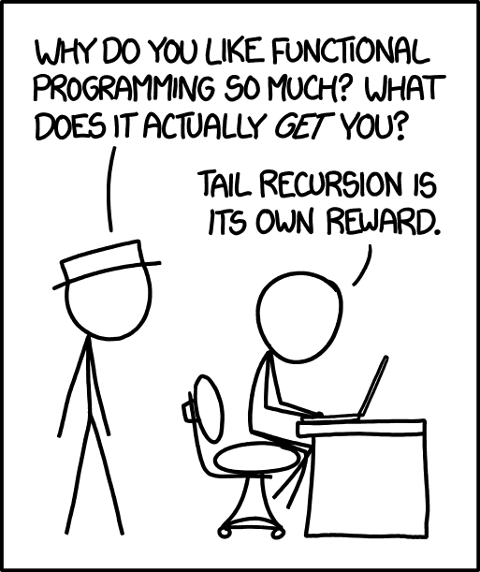
Tail Recursion
What is it?
Briefly: if a function will immediately return after making a call, we can reuse the stack space of the current function.

Slide 9
Tail Recursion
Quickcheck! (6 minutes, ungraded)
Speak with a neighbor if you’d like.

Slide 10
Tail Recursion
Was length tail recursive?
Was all_positive tail recursive?
Why tail recursion?
Let’s look at more examples of tail recursion

Slide 11
Pattern Matching
We can pattern match over datatypes
Beware “non-exhaustive matching”
Pattern matching can avoid “empty list” exceptions!
Most functions pattern match over a single argument
SML has special syntax for this common case!
Use is a matter of taste
Live demo

