Slide 1
Lecture 1: Welcome!
CSE 373: Data Structures and Algorithms

Slide 2
Agenda
Introductions
Syllabus
Dust off cob webs
Meet the ADT

Slide 3

Course Staff
Instructor: Robbie Weber
rtweber2@cs.washington.edu Office: CSE 330 Office Hours: M,W 2:20-3:30 and by appointment
Ph.D. student in CSE
Research in algorithm design
2nd time as instructor
TAed 15 times
(3 times for this course)
Amazing Teaching Assistants:
Brian Chan
Zach Chun
Kevin Son
Oscar Sprumont Matthew Taing
Howard Xiao
Blarry Wang
Xin Yang
Velocity Yu

Slide 4
Class Style
Please come to lecture (yes, there will be panoptos)
Warm Ups -> Extra Credit
Discuss with other students
Ask questions! Point out mistakes!
Sections
TAs = heroes
Practice problems
Different Explanations
Sections start this week

Slide 5
Class Style
Summer Quarter is weird.
We have fewer class meetings
But they’re all 60 minutes, not 50 minutes.
We’ve rearranged (and cut) things to account for the schedule
But things are more cramped.
Please start on assignments early and ask for help early
TAs are amazing – we can help A LOT 3 days before an assignment is due.
There’s only so much we can do 3 hours before it’s due.

Slide 6

Course Administration
Course Page cs.washington.edu/373
Course content posted here
Pay attention for updates!
Canvas
Grades will be posted to Canvas at end of quarter
Office Hours
Will be posted on Course Page
Will start next week (at the latest)
Piazza
If you were signed up for the course before this morning, you were added already.
If not, you can find an add code on Canvas (or ask a member of staff)
Announcements made via Piazza
Great place to discuss questions with other students
Will be monitored by course staff
No posting of project code!
Textbook
Optional
Data Structures and Algorithm Analysis in Java by Mark Allen Weiss

Slide 7
Grade Break Down
Homework (55%)
Programming Projects (35%)
1 Individual Project (review of 14X)
4 Partner Projects
Partners GREATLY encouraged
Graded automatically
Regrades available on some parts
Some projects are two connected one-week assignments; others are just one week.
Written Assignments (20%)
Written assignments graded by TAs
Exams (45%)
Midterm Exam – Friday July 26th in class (15%)
Final Exam (30%)
Two one-hour parts:
In place of final section Thursday August 22
In place of final lecture Friday August 23
If you have a conflict with any of those dates, email Robbie as soon as possible.

Slide 8
Syllabus
Homework Policies
4 late days
Both partners must use one for pair projects
When you run out you will forfeit 20% each 24 hour period an assignment is late
No assignment will be accepted more than 2 days late
Regrades
For assignments with two parts: automatically get back half missed points for part 1 when you turn in part 2
If you think we made a mistake grading (or the autograder did something unreasonable):
Fill out a regrade request on gradescope for written work
Fill out the google form for programming projects
Academic Integrity
Discussing concepts and high-level ideas for problems is strongly encouraged, but submitted work must be your own.
Read policy on the webpage.
No posting code on discussion board or ANYWHERE online
We do run MOSS
No directly sharing code with one another (except for partners)
Extra Credit
Available for attending lecture, by filling out PollEverywhere questions
Based on completion not correctness.
Worth up to 0.05 GPA bump

Slide 9
Questions?
Clarification on syllabus, General complaining/moaning

Slide 10
What is this class about?
Data Structures
Algorithms
How do we organize our data most effectively?
And how do we justify those decisions
Actually implement data structures
Not just use them
Some classic, fundamental algorithms
How they work
How do we get them use them to solve problems
TOOLS to make and analyze DS&Algs
Basic Software Engineering Practices
Debugging
Testing
Version Control
Basic Theoretical Computer Science
Modelling Code/Big-O
Analyzing Recurrences

Slide 11
Data Structures and Algorithms
What are they anyway?

Slide 12
Basic Definitions
Data Structure
A way of organizing, storing, accessing, and updating a set of data
Examples from CSE 14X: arrays, linked lists, binary search trees
Algorithm
A series of precise instructions guaranteed to produce a certain answer
Examples from CSE 14X: binary search, merge sort

Slide 13
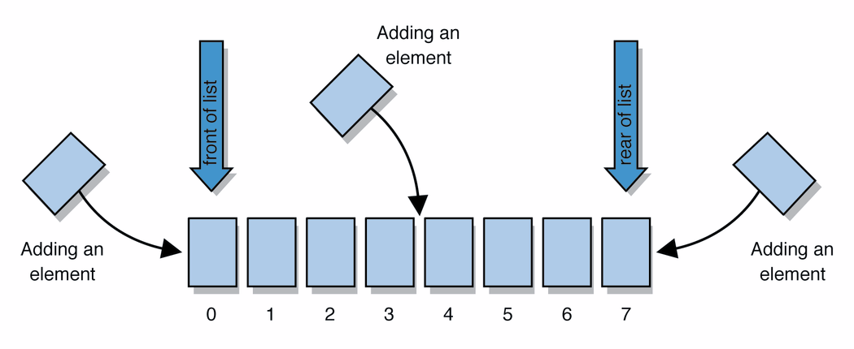
Abstract Data Types (ADT)
Abstract Data Types
A definition for expected operations and behavior
Start with the operations you want to do then define how those operations will play out on whatever data is being stored
Review: List - a collection storing an ordered sequence of elements
each element is accessible by a 0-based index
a list has a size (number of elements that have been added)
elements can be added to the front, back, or elsewhere
in Java, a list can be represented as an ArrayList object
Notes:
A way to communicate with other programmers, a standard that we all can agree on so we can discuss conceptual ways of organizing data

Slide 14
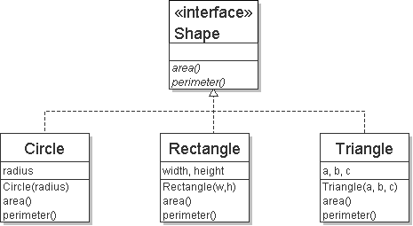
Review: Interfaces
Example
// Describes features common to all // shapes.
public interface Shape {
public double area();
public double perimeter();
}
interface: A list of methods that a class promises to implement.
Interfaces give you an is-a relationship without code sharing.
A Rectangle object can be treated as a Shape but inherits no code.
Analogous to non-programming idea of roles or certifications:
"I'm certified as a CPA accountant. This assures you I know how to do taxes, audits, and consulting."
"I'm 'certified' as a Shape, because I implement the Shape interface. This assures you I know how to compute my area and perimeter."
public interface name {
public type name(type name, ..., type name);
public type name(type name, ..., type name);
...
public type name(type name, ..., type name);
}

Slide 15
Review: Java Collections
Java provides some implementations of ADTs for you!
You used:
Lists List<Integer> a = new ArrayList<Integer>();
Stacks Stack<Character> c = new Stack<Character>();
Queues Queue<String> b = new LinkedList<String>();
Maps Map<String, String> d = new TreeMap<String, String>();

Slide 16
Full Definitions
Abstract Data Type (ADT)
A definition for expected operations and behavior
A mathematical description of a collection with a set of supported operations and how they should behave when called upon
Describes what a collection does, not how it does it
Can be expressed as an interface
Examples: List, Map, Set
Data Structure
A way of organizing and storing related data points
An object that implements the functionality of a specified ADT
Describes exactly how the collection will perform the required operations
Examples: LinkedIntList, ArrayIntList

Slide 17
ADTs we’ll discuss this quarter
List
Set
Map
Stack
Queue
Priority Queue
Graph
Disjoint Set

Slide 18
Case Study: The List ADT
list: stores an ordered sequence of information.
Each item is accessible by an index.
Lists have a variable size as items can be added and removed
List ADT
supported operations:
get(index): returns the item at the given index
set(value, index): sets the item at the given index to the given value
append(value): adds the given item to the end of the list
insert(value, index): insert the given item at the given index maintaining order
delete(index): removes the item at the given index maintaining order
size(): returns the number of elements in the list
state
Set of ordered items
Count of items
behavior
get(index) return item at index
set(item, index) replace item at index
append(item) add item to end of list
insert(item, index) add item at index
delete(index) delete item at index
size() count of items

Slide 19
Case Study: List Implementations
ArrayList
uses an Array as underlying storage
LinkedList
uses nodes as underlying storage
List ADT
ArrayList<E>
LinkedList<E>
state
Set of ordered items
Count of items
state
state
data[]
size
Node front
size
behavior
get(index) return item at index
set(item, index) replace item at index
append(item) add item to end of list
insert(item, index) add item at index
delete(index) delete item at index
size() count of items
behavior
behavior
get return data[index]
set data[index] = value
append data[size] = value, if out of space grow data
insert shift values to make hole at index, data[index] = value, if out of space grow data
delete shift following values forward
size return size
get loop until index, return node’s value
set loop until index, update node’s value
append create new node, update next of last node
insert create new node, loop until index, update next fields
delete loop until index, skip node
size return size
0 | 1 | 2 | 3 | 4
88.6 | 26.1 | 94.4 | 0 | 0
88.6
26.1
94.4
list
free space

Slide 20
Implementing ArrayList
insert(element, index) with shifting
ArrayList<E>
0 | 1 | 2 | 3
state
insert(10, 0)
5
3
4
5
10
3
4
data[]
size
4
behavior
numberOfItems =
3
get return data[index]
set data[index] = value
append data[size] = value, if out of space grow data
insert shift values to make hole at index, data[index] = value, if out of space grow data
delete shift following values forward
size return numberOfItems
delete(index) with shifting
0 | 1 | 2 | 3
10
3
4
5
delete(0)
3
4
5
numberOfItems =
4
3
Take 2 Minutes
Should we overwrite index 3 with null?
Notes:
2 minutes – how does insert work? Delete?
2 minutes – should we overwrite garbage values with null or leave them garbage?

Slide 21
Implementing ArrayList
append(element) with growth
ArrayList<E>
0 | 1 | 2 | 3
state
append(2)
10
3
4
5
data[]
size
behavior
get return data[index]
set data[index] = value
append data[size] = value, if out of space grow data
insert shift values to make hole at index, data[index] = value, if out of space grow data
delete shift following values forward
size return size
numberOfItems =
4
5
0 | 1 | 2 | 3 | 4 | 5 | 6 | 7
2

Slide 22
Design Decisions
For every ADT there are lots of different ways to implement them
Based on your situation you should consider:
Memory vs Speed
Generic/Reusability vs Specific/Specialized
One Function vs Another
Robustness vs Performance
This class is all about implementing ADTs based on making the right design tradeoffs!
> A common topic in interview questions

Slide 23
Case Study: List Implementations
ArrayList
uses an Array as underlying storage
LinkedList
uses nodes as underlying storage
List ADT
ArrayList<E>
LinkedList<E>
state
Set of ordered items
Count of items
state
state
data[]
size
Node front
size
behavior
get(index) return item at index
set(item, index) replace item at index
append(item) add item to end of list
insert(item, index) add item at index
delete(index) delete item at index
size() count of items
behavior
behavior
get return data[index]
set data[index] = value
append data[size] = value, if out of space grow data
insert shift values to make hole at index, data[index] = value, if out of space grow data
delete shift following values forward
size return size
get loop until index, return node’s value
set loop until index, update node’s value
append create new node, update next of last node
insert create new node, loop until index, update next fields
delete loop until index, skip node
size return size
Take 2 Minutes
What method will be much faster for LinkedList than for ArrayList?
0 | 1 | 2 | 3 | 4
88.6 | 26.1 | 94.4 | 0 | 0
88.6
26.1
94.4
list
free space

Slide 24
Design Decisions
Take 2 Minutes
Dub Street Burgers is implementing a new system for ticket (i.e. food order) management.
When a new ticket comes in, it is placed at the end of the set of tickets.
Food is prepared in approximately the same order it was requested, but sometimes tickets are fulfilled out of order.
Let’s represent tickets as a list. Which of our ADT implementations should we use?
Why?

Slide 25
Design Decisions
Let’s represent tickets as a list. Which of our ADT implementations should we use?
Why?
ArrayList
Creating a new ticket is very fast (as long as we don’t resize), and I want the cooks to be able to see all the orders right away.
LinkedList
We’ll mostly be removing from the front of the list, which is much faster for the linkedlist (no shifting), and I want finished orders to be removed fast so they aren’t distracting.

Slide 26
Design Decisions
Both ArrayList and LinkedList implementations have pros and cons.
Neither is strictly better than the other.
Some major objectives of this course:
Evaluating pros and cons
Deciding on a design
Defending that design decision
Especially when there’s more than one possible answer.

