Slide 1
Lecture 2: Stacks and Queues
CSE 373: Data Structures and Algorithms

Slide 2
Administrivia
Course Stuff
Office hours are on class webpage: cs.washington.edu/373
Piazza: https://piazza.com/class/jwcann1clfq7bn
Add code is on Canvas (or ask a staff member)
Project 0 Live!
Individual assignment
14x content review
GitLab/IntelliJ setup
You should have already gotten an automatic email with a link to your gitlab repo.
Check your spam folder
Project 1 out next week, partner project
find your own partner
Lecture, section, piazza, office hours
Last 5-10 minutes of section will be help with gitlab/intelliJ setup (if you’re stuck bring your laptop and get some help.)

Slide 3
Warm Up
Q: Would you use a LinkedList or ArrayList implementation for each of these scenarios?
Situation #1: Write a data structure that implements the List ADT that will be used to store a list of songs in a playlist.
Situation #2: Write a data structure that implements the List ADT that will be used to store the history of a bank customer’s transactions.
Situation #3: Write a data structure that implements the List ADT that will be used to store the order of students waiting to speak to a TA at a tutoring center
ArrayList
uses an Array as underlying storage
LinkedList
uses nodes as underlying storage
Instructions
ArrayList<E>
LinkedList<E>
Take 3 Minutes
state
state
Introduce yourself to your neighbors ☺
Discuss your answers
Log onto Poll Everywhere
Go to PollEv.com/cse373su19
OR Text CSE373Su19 to 22333 to join session, text “1” “2” or “3” to select your answer
Get extra credit!
data[]
size
Node front
size
behavior
behavior
get return data[index]
set data[index] = value
append data[size] = value, if out of space grow data
insert shift values to make hole at index, data[index] = value, if out of space grow data
delete shift following values forward
size return size
get loop until index, return node’s value
set loop until index, update node’s value
append create new node, update next of last node
insert create new node, loop until index, update next fields
delete loop until index, skip node
size return size
0 | 1 | 2 | 3 | 4
88.6 | 26.1 | 94.4 | 0 | 0
88.6
26.1
94.4
list
free space

Slide 4
Design Decisions
Situation #1: Write a data structure that implements the List ADT that will be used to store a list of songs in a playlist.
ArrayList – I want to be able to shuffle play on the playlist
Situation #2: Write a data structure that implements the List ADT that will be used to store the history of a bank customer’s transactions.
ArrayList – optimize for addition to back and accessing of elements
Situation #3: Write a data structure that implements the List ADT that will be used to store the order of students waiting to speak to a TA at a tutoring center
LinkedList - optimize for removal from front
ArrayList – optimize for addition to back

Slide 5
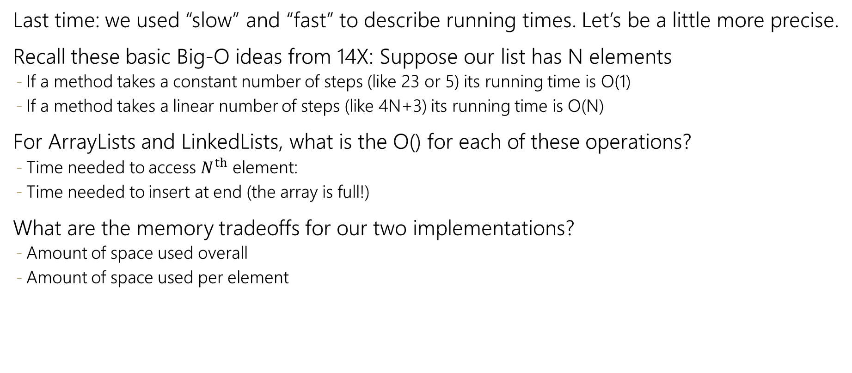
List ADT tradeoffs
Last time: we used “slow” and “fast” to describe running times. Let’s be a little more precise.
Recall these basic Big-O ideas from 14X: Suppose our list has N elements
If a method takes a constant number of steps (like 23 or 5) its running time is O(1)
If a method takes a linear number of steps (like 4N+3) its running time is O(N)
For ArrayLists and LinkedLists, what is the O() for each of these operations?
Time needed to access $N^{th}$ element:
Time needed to insert at end (the array is full!)
What are the memory tradeoffs for our two implementations?
Amount of space used overall
Amount of space used per element
ArrayList<Character> myArr
LinkedList<Character> myLl
0 | 1 | 2 | 3 | 4
‘h’ | ‘e’ | ‘l’ | ‘l’ | ‘o’
front
‘h’
‘e’
‘l’
‘l’
‘o’ | /

Slide 6
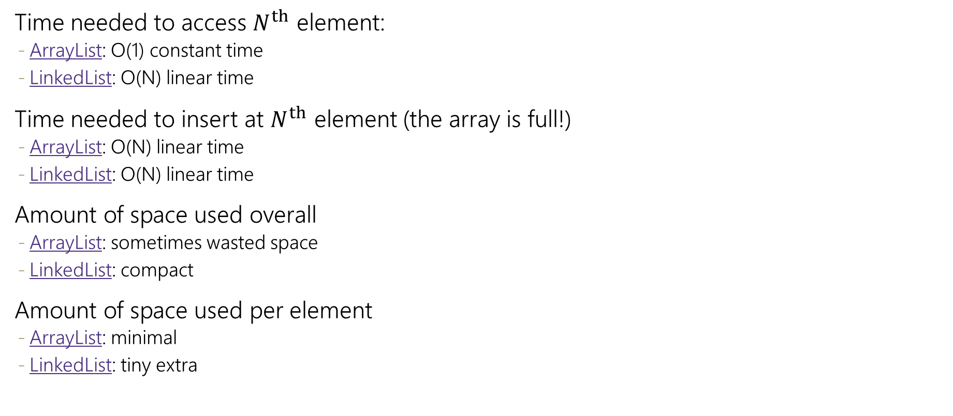
List ADT tradeoffs
Time needed to access $N^{th}$ element:
ArrayList: O(1) constant time
LinkedList: O(N) linear time
Time needed to insert at $N^{th}$ element (the array is full!)
ArrayList: O(N) linear time
LinkedList: O(N) linear time
Amount of space used overall
ArrayList: sometimes wasted space
LinkedList: compact
Amount of space used per element
ArrayList: minimal
LinkedList: tiny extra
ArrayList<Character> myArr
0 | 1 | 2 | 3 | 4
‘h’ | ‘e’ | ‘l’ | ‘l’ | ‘o’
LinkedList<Character> myLl
front
‘h’
‘e’
‘l’
‘l’
‘o’ | /

Slide 7
Goals for Today
Review Stacks, Queues
What are the ADTs
How can you implement both of them with arrays and with nodes?
Basics of Testing your code.
(maybe) Review Dictionaries.
What is the ADT
Can we implement well with arrays and nodes?

Slide 8
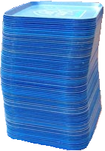
Review: What is a Stack?
stack: A collection based on the principle of adding elements and retrieving them in the opposite order.
Last-In, First-Out ("LIFO")
Elements are stored in order of insertion.
We do not think of them as having indexes.
Client can only add/remove/examine the last element added (the "top").
push
pop, peek
top | 3
 | 2
bottom | 1
Stack ADT
state
Set of ordered items
Number of items
supported operations:
push(item): Add an element to the top of stack
pop(): Remove the top element and returns it
peek(): Examine the top element without removing it
size(): how many items are in the stack?
isEmpty(): false if there are 1 or more items in stack, true otherwise
behavior
push(item) add item to top
pop() return and remove item at top
peek() look at item at top
size() count of items
isEmpty() count of items is 0?
Notes:
We’ll see uses later in this course – canonical one is balancing parentheses.

Slide 9
Implementing a Stack with an Array
Stack ADT
ArrayStack<E>
Big O Analysis
pop()
peek()
size()
isEmpty()
push()
state
state
O(1) Constant
Set of ordered items
Number of items
data[]
size
O(1) Constant
behavior
behavior
push(item) add item to top
pop() return and remove item at top
peek() look at item at top
size() count of items
isEmpty() count of items is 0?
push data[numItems] = value, if out of room grow data, numItems++
pop return data[numItems - 1], numItems-=1
peek return data[numItems - 1]
size return numItems
isEmpty return numItems == 0
O(1) Constant
O(1) Constant
Don’t resize: O(1) Constant
Do resize: O(N) linear
push(3)
push(4)
pop()
push(5)
0 | 1 | 2 | 3
3
4
5
2
0
numItems =
1
Notes:
Key implementation idea: the thing that slowed us down when we were doing the list implementation was shifting. But we’re only inserting at one end, so if we make that not the front of the array, we can eliminate shifting.
Take 2 minutes, think about implementations. Think about O(1) vs. O(N).

Slide 10
Implementing a Stack with Nodes
Stack ADT
LinkedStack<E>
Big O Analysis
pop()
peek()
size()
isEmpty()
push()
state
state
O(1) Constant
Set of ordered items
Number of items
Node top
size
O(1) Constant
behavior
behavior
push(item) add item to top
pop() return and remove item at top
peek() look at item at top
size() count of items
isEmpty() count of items is 0?
push add new node at top numItems++
pop return and remove node at top, numItems-=1
peek return node at top
size return numItems
isEmpty return numItems == 0
O(1) Constant
O(1) Constant
O(1) Constant
4
push(3)
push(4)
pop()
front
3
numItems =
1
0
2
Notes:
Implementations are identical to list, don’t take time study them, just do the big-O

Slide 11
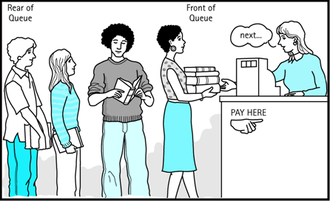
Review: What is a Queue?
queue: Retrieves elements in the order they were added.
First-In, First-Out ("FIFO")
Elements are stored in order of insertion but don't have indexes.
Client can only add to the end of the queue, and can only examine/remove the front of the queue.
front |  | back
1 | 2 | 3
remove, peek
add
Queue ADT
state
supported operations:
add(item): aka “enqueue” add an element to the back.
remove(): aka “dequeue” Remove the front element and return.
peek(): Examine the front element without removing it.
size(): how many items are stored in the queue?
isEmpty(): if 1 or more items in the queue returns true, false otherwise
Set of ordered items
Number of items
behavior
add(item) add item to back
remove() remove and return item at front
peek() return item at front
size() count of items
isEmpty() count of items is 0?

Slide 12
Implementing a Queue with an Array
Queue ADT
ArrayQueue<E>
Big O Analysis
remove()
peek()
size()
isEmpty()
add()
state
state
O(1) Constant
Set of ordered items
Number of items
data[]
numItems
front index
back index
O(1) Constant
behavior
add(item) add item to back
remove() remove and return item at front
peek() return item at front
size() count of items
isEmpty() count of items is 0?
O(1) Constant
behavior
add – data[back] = value, if out of room grow data, back++, numItems++
remove – return data[front], numItems-=1, front++
peek – return data[front]
size – return numItems
isEmpty – return numItems == 0
O(1) Constant
Don’t resize: O(1) Constant
Do resize: O(N) linear
0 | 1 | 2 | 3 | 4
add(5)
add(8)
add(9)
remove()
5
8
9
1
2
numItems =
3
0
1
front = 0
back = 0
2
1
Notes:
Key idea: avoid shifting by remembering the index of the front and back.

Slide 13
Implementing a Queue with an Array
> Wrapping Around
add(7)
add(4)
add(1)
front
back
0 | 1 | 2 | 3 | 4
4
5
9
2
7
front
5
3
back
numItems =
4
0 | 1 | 2 | 3 | 4 | 5 | 6 | 7 | 8 | 9
5 | 9 | 2 | 7 | 4
1
Notes:
Two observations: 1. front can wrap around and be in front of back, have to watch for that.
2. Still might need to resize – if so you have to copy so front is in index 0.

Slide 14
Implementing a Queue with Nodes
Queue ADT
LinkedQueue<E>
Big O Analysis
remove()
peek()
size()
isEmpty()
add()
state
state
O(1) Constant
Set of ordered items
Number of items
Node front
Node back
numItems
O(1) Constant
behavior
add(item) add item to back
remove() remove and return item at front
peek() return item at front
size() count of items
isEmpty() count of items is 0?
O(1) Constant
behavior
add – add node to back, numItems++
remove – return and remove node at front, numItems--
peek – return node at front
size – return numItems
isEmpty – return numItems == 0
O(1) Constant
O(1) Constant
numItems =
0
2
1
add(5)
add(8)
remove()
front
5
8
back
Notes:
Good thing we added a back pointer!

Slide 15
Multiple Levels of Design Decisions
Implementation Details
Do we overwrite old values with null or do we leave the garbage value?
Do we validate input and throw exceptions or just wait for the code to fail?
Data structure choice
Do we use a LinkedList or an ArrayList?
Do we use a Node-based queue implementation or an array-based implementation?
Choice of ADT
Which of the ADTs that we’ve seen is the best fit?
(We’ll see other kinds of design decisions later in the quarter).

Slide 16
Design Decisions
Take 3 Minutes
Discuss with your neighbors: For each scenario select the appropriate ADT and implementation to best optimize for the given scenario.
Situation #1: You are writing a program to manage a todo list with a specific approach to tasks. This program will order tasks for so that the most recent task is addressed first. You don’t want to risk a long delay between submission of an item and its appearance.
Stack – First in Last out
Nodes – make addition and removal of tasks very easy
Situation #2: You are writing a program to schedule jobs sent to a laser printer. The laser printer should process these jobs in the order in which the requests were received. The printer has very limited memory.
Queue – First in First out
Array – want to save the extra pointers to fit in our limited space

Slide 17
Testing Your Code

Slide 18
Testing: Why are we doing this?
The ability to test your own code is integral to an understanding of data structures.
Differentiating between ADT requirements and design decisions you made.
Coming up with test cases is one of the best ways to understand data structures more deeply
What cases will cause certain implementations to slow down?
How long do I expect certain operations to take?
What edge cases are there in the definition?
Where else might I find bugs?
In the real world, coding projects don’t come with their own tests.
You have to write your own.
You might be frustrated with us at some point for not giving you test cases.
I understand. I was frustrated with my data structures professor when she didn’t give us tests.
Learning to test your own code is integral to maturing as a computer scientist.
We’re always tweaking things to make this as painless as we can.

Slide 19
Testing
Today: Strategies for generating tests. Ways to think about testing.
Thursday: Activity to practice our particular testing framework

Slide 20
Testing
Computers don’t make mistakes- people do!
“I’m almost done, I just need to make sure it works”
– Naive 14Xers
Software Test: a separate piece of code that exercises the code you are assessing by providing input to your code and finishes with an assertion of what the result should be.
Isolate - break your code into small modules
Build in increments - Make a plan from simplest to most complex cases
Test as you go - As your code grows, so should your tests

Slide 21
Types of Tests
Black Box
Behavior only – ADT requirements
From an outside point of view
Does your code uphold its contracts with its users?
Performance/efficiency
White Box
Includes an understanding of the implementation
Written by the author as they develop their code
Break apart requirements into smaller steps
“unit tests” break implementation into single assertions

Slide 22
What to test?
Expected behavior
The main use case scenario
Does your code do what it should given friendly conditions?
Forbidden Input
What are all the ways the user can mess up?
Empty/Null
Protect yourself!
How do things get started?
0, -1, null, empty collections
Boundary/Edge Cases
First items
Last item
Full collections (resizing)
Scale
Is there a difference between 10, 100, 1000, 10000 items?

Slide 23
Testing Strategies
You can’t test everything
Break inputs into categories
What are the most important pieces of code?
Test behavior in combination
Call multiple methods one after the other
Call the same method multiple times
Trust no one!
How can the user mess up?
If you messed up, someone else might
Test the complex logic

Slide 24
Thought Experiment
5 Minutes
Discuss with your neighbors: Imagine you are writing an implementation of the List interface that stores integers in an Array. What are some ways you can assess your program’s correctness in the following cases:
Expected Behavior
Create a new list
Add some amount of items to it
Remove a couple of them
Forbidden Input
Add a negative number
Add duplicates
Add extra large numbers
Add something to index 10 of a size 3 list
Empty/Null
Call remove on an empty list
Add to a null list
Call size on an null list
Boundary/Edge Cases
Add 1 item to an empty list
Set an item at the front of the list
Set an item at the back of the list
Scale
Add 1000 items to the list
Remove 100 items in a row
Set the value of the same item 50 times

Slide 25
JUnit
JUnit: a testing framework that works with IDEs to give you a special GUI when testing your code
@Test
public void myTest() {
MyArrayList<String> basicAl = new MyArrayList<String>();
basicAl.append(“373 Rocks”);
assertThat(basicAl.get(0), is(“373 Rocks”));
}
Assertions:
assertThat(thingYoureTesting, is(ExpectedResult)) is most common. Calls .equals() method
May write your own helper methods here to check that internal state is identical.
Other assertions exist; see official documentation, or our documentation on the webpage.
More: https://junit.org/junit5/docs/5.0.1/api/org/junit/jupiter/api/Assertions.html

Slide 26
Review: Generics
public class Box {
private Object object;
public void set(Object object) {
this.object = object;
}
public Object get() {
return object;
}
}
// a parameterized (generic) class
public class name<TypeParameter> {
...
}
Forces any client that constructs your object to supply a type
Don't write an actual type such as String; the client does that
Instead, write a type variable name such as E (for "element") or T (for "type")
You can require multiple type parameters separated by commas
The rest of your class's code can refer to that type by name
public class Box<T> {
private T t;
public void set(T t) {
this.t = t;
}
public T get() {
return t;
}
}
More details: https://docs.oracle.com/javase/tutorial/java/generics/types.html

Slide 27
Dictionaries

Slide 28
Dictionaries (aka Maps)
Every Programmer’s Best Friend
You’ll use one in every single programming project.
Because I don’t think we could really design an interesting project that doesn’t use one.

Slide 29
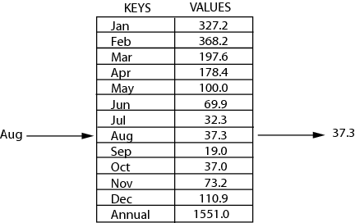
Review: Maps
key | value
“at" | 43
key | value
“in" | 37
key | value
“you" | 22
map: Holds a set of unique keys and a collection of values, where each key is associated with one value.
a.k.a. "dictionary"
key | value
“the" | 56
map.get("the")
56
Dictionary ADT
supported operations:
put(key, value): Adds a given item into collection with associated key, if the map previously had a mapping for the given key, old value is replaced
get(key): Retrieves the value mapped to the key
containsKey(key): returns true if key is already associated with value in map, false otherwise
remove(key): Removes the given key and its mapped value
state
Set of items & keys
Count of items
behavior
put(key, item) add item to collection indexed with key
get(key) return item associated with key
containsKey(key) return if key already in use
remove(key) remove item and associated key
size() return count of items

Slide 30
Implementing a Dictionary with an Array
2 Minutes
Dictionary ADT
ArrayDictionary<K, V>
Big O Analysis
put()
get()
containsKey()
remove()
size()
state
state
O(N) linear
Set of items & keys
Count of items
Pair<K, V>[] data
O(N) linear
behavior
behavior
put(key, item) add item to collection indexed with key
get(key) return item associated with key
containsKey(key) return if key already in use
remove(key) remove item and associated key
size() return count of items
put create new pair, add to next available spot, grow array if necessary
get scan all pairs looking for given key, return associated item if found
containsKey scan all pairs, return if key is found
remove scan all pairs, replace pair to be removed with last pair in collection
size return count of items in dictionary
O(N) linear
O(N) linear
O(1) constant
put(‘a’, 1)
put(‘b’, 2)
put(‘c’, 3)
put(‘d’, 4)
remove(‘b’)
put(‘a’, 97)
0 | 1 | 2 | 3
97)
(‘a’, 1)
(‘b’, 2)
(‘c’, 3)
(‘d’, 4)

Slide 31
Implementing a Dictionary with Nodes
2 Minutes
Dictionary ADT
LinkedDictionary<K, V>
Big O Analysis
put()
get()
containsKey()
remove()
size()
state
state
O(N) linear
Set of items & keys
Count of items
front
size
O(N) linear
behavior
behavior
put(key, item) add item to collection indexed with key
get(key) return item associated with key
containsKey(key) return if key already in use
remove(key) remove item and associated key
size() return count of items
put if key is unused, create new with pair, add to front of list, else replace with new value
get scan all pairs looking for given key, return associated item if found
containsKey scan all pairs, return if key is found
remove scan all pairs, skip pair to be removed
size return count of items in dictionary
O(N) linear
O(N) linear
O(1) constant
put(‘a’, 1)
put(‘b’, 2)
put(‘c’, 3)
put(‘d’, 4)
remove(‘b’)
put(‘a’, 97)
front
‘d’
4
‘c’
3
‘b’
2
‘a’
1
97

