Slide 1
Lecture 8:Tree Method
CSE 373: Data Structures and Algorithms

Slide 2
Administrivia
Project 1 Part 1 due tonight
Fill out the late day form on the project page if you need to use late days.
Project 1 Part 2 out tonight
Fix bugs from part 1 to get half of your missed points back.
Run experiments on your code (connect the programming project to things learned in lecture).
Exercise 1 due Friday

Slide 3
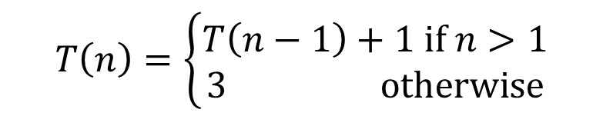
Don’t Panic
We couldn’t apply Master Theorem to this recurrence:
The books don’t have a nice theorem;
They do have methods for figuring out the big-O.
$$T\left(n\right)=\left\{\begin{aligned}T\left(n−1\right)+1 if n>1 \\ 3 otherwise\end{aligned}\right.$$

Slide 4

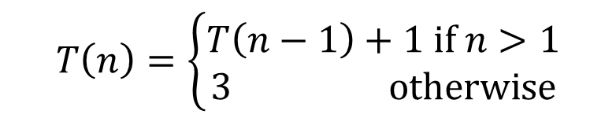
Unrolling
$$T\left(n\right)=\left\{\begin{aligned}T\left(n−1\right)+1 if n>1 \\ 3 otherwise\end{aligned}\right.$$
Idea: keep plugging the definition of $T()$ into itself.
Until you find the pattern and can hit the base case.

Slide 5
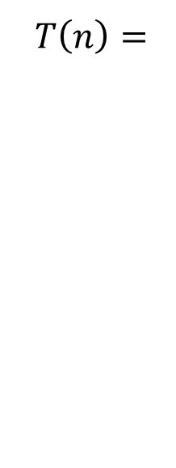

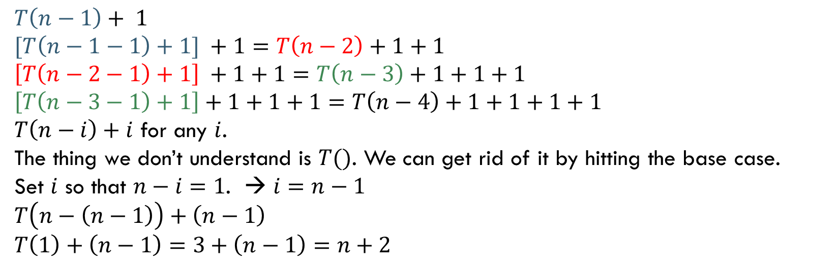
Unrolling
$$T\left(n\right)=\left\{\begin{aligned}T\left(n−1\right)+1 if n>1 \\ 3 otherwise\end{aligned}\right.$$
$T\left(n\right)=$
$$T\left(n−1\right)+ 1$$
$$[T\left(n−1−1\right)+1] +1=T\left(n−2\right)+1+1$$
$$\left[T\left(n−2−1\right)+1\right] +1+1=T\left(n−3\right)+1+1+1$$
$$\left[T\left(n−3−1\right)+1\right]+1+1+1=T\left(n−4\right)+1+1+1+1$$
$T\left(n−i\right)+i$ for any $i$.
The thing we don’t understand is $T()$. We can get rid of it by hitting the base case.
Set $i$ so that $n−i=1$. → $i=n−1$
$$T\left(n−\left(n−1\right)\right)+\left(n−1\right)$$
$$T\left(1\right)+\left(n−1\right)=3+\left(n−1\right)=n+2$$
$$T\left(n\right)=n+2$$

Slide 6
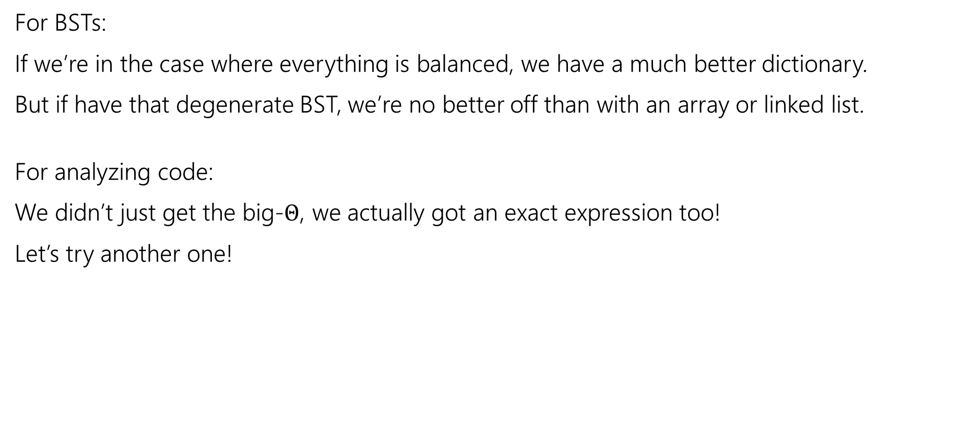
We did it!
For BSTs:
If we’re in the case where everything is balanced, we have a much better dictionary.
But if have that degenerate BST, we’re no better off than with an array or linked list.
For analyzing code:
We didn’t just get the big-$Θ$, we actually got an exact expression too!
Let’s try another one!

Slide 7

More Practice
Write a recurrence to describe the running time of this function, then find the big-$Θ$ for the running time.
public int dumbFindMax(int[] arr, int hi){
if(hi == 0)
return arr[0];
int maxInd = 0;
for(int i=0; i<hi; i++){
if(arr[i] > arr[maxInd])
maxInd=i;
}
return Math.max(arr[maxInd], dumbFindMax(arr, hi-1));
}

Slide 8
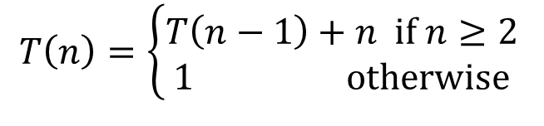
$T\left(n\right)=\left\{\begin{aligned}T\left(n−1\right)+n if n≥2 \\ 1 otherwise\end{aligned}\right.$
You probably had some lower-order terms when you wrote this recurrence. When we’re solving recurrences we usually ignore lower-order terms in non-recursive work. They make the algebra a lot more complicated, and don’t affect the big-O.
We’ll tell you to ignore lower-order terms when we want you to.

Slide 10
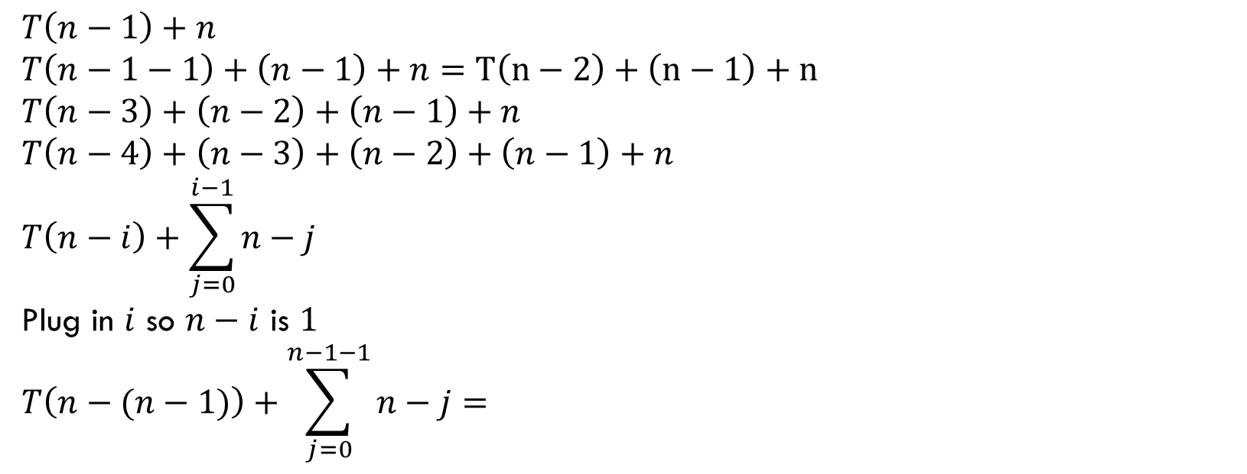
$T\left(n\right)=\left\{\begin{aligned}T\left(n−1\right)+n if n≥2 \\ 1 otherwise\end{aligned}\right.$
$$T\left(n−1\right)+n$$
$$T\left(n−1−1\right)+\left(n−1\right)+n=T\left(n−2\right)+\left(n−1\right)+n$$
$$T\left(n−3\right)+\left(n−2\right)+\left(n−1\right)+n$$
$$T\left(n−4\right)+\left(n−3\right)+\left(n−2\right)+\left(n−1\right)+n$$
$$T\left(n−i\right)+\sum_{j=0}^{i−1}{n−j}$$
Plug in $i$ so $n−i$ is $1$
$$T\left(n−(n−1)\right)+\sum_{j=0}^{n−1−1}{n−j}=$$

Slide 11

$T\left(n\right)=\left\{\begin{aligned}T\left(n−1\right)+n if n≥2 \\ 1 otherwise\end{aligned}\right.$
$$1+\sum_{j=0}^{n−2}{n−j}=1+\sum_{j=0}^{n−2}{n}−\sum_{j=0}^{n−2}{j}$$
$$=1+n\left(n−1\right)−\sum_{j=0}^{n−2}{j}$$
$$=1+n\left(n−1\right)−\frac{\left(n−1\right)\left(n−2\right)}{2}$$
$$=n^{2}−n−\frac{n^{2}}{2}+\frac{3n}{2}−1$$
$$∈Θ(n^{2})$$

Slide 12
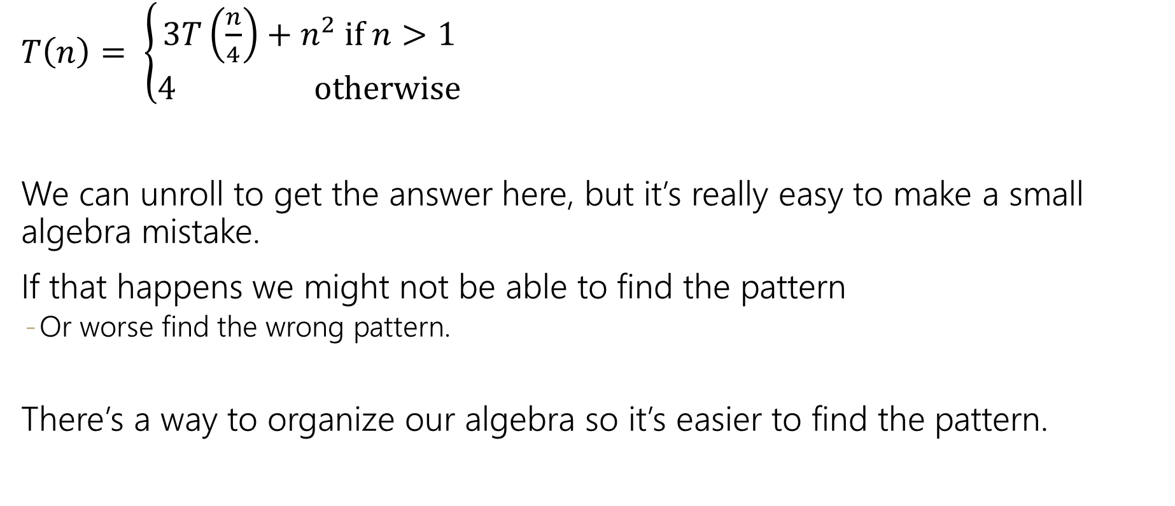
$T\left(n\right)= \left\{\begin{aligned}3T\left(\frac{n}{4}\right)+n^{2} if n>1 \\ 4 otherwise\end{aligned}\right.$
We can unroll to get the answer here, but it’s really easy to make a small algebra mistake.
If that happens we might not be able to find the pattern
Or worse find the wrong pattern.
There’s a way to organize our algebra so it’s easier to find the pattern.

Slide 13
Tree Method
Idea: We’ll do the same algebra, but let’s give ourselves a visual to make the organization easier.
We’ll make a tree.
Each node of the tree represents one recursive call
The children of that node are the new recursive calls made

Slide 14


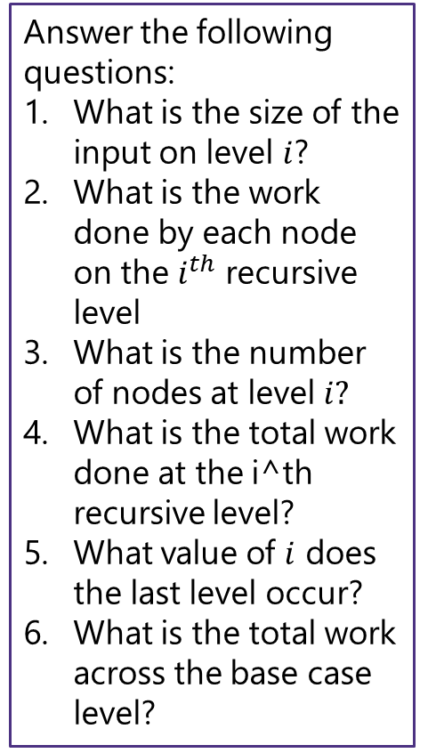





























Tree Method Practice
$$4 when n≤1$$
$$T\left(n\right)=$$
$$3T\left(\frac{n}{4}\right)+n^{2} otherwise$$
$$T\left(\frac{n}{4}\right)+T\left(\frac{n}{4}\right)+T\left(\frac{n}{4}\right)+n^{2}$$
$$T\left(n\right)$$
$$n^{2}$$
Answer the following questions:
What is the size of the input on level $i$?
What is the work done by each node on the $i^{th}$ recursive level
What is the number of nodes at level $i?$
What is the total work done at the i^th recursive level?
What value of $i$ does the last level occur?
What is the total work across the base case level?
$${\left(\frac{n}{4}\right)}^{2}$$
$$T\left(\frac{n}{4}\right)$$
$$T\left(\frac{n}{16}\right)+T\left(\frac{n}{16}\right)+T\left(\frac{n}{16}\right)+{\left(\frac{n}{4}\right)}^{2}$$
$$T\left(\frac{n}{16}\right)+T\left(\frac{n}{16}\right)+T\left(\frac{n}{16}\right)+{\left(\frac{n}{4}\right)}^{2}$$
$$T\left(\frac{n}{16}\right)+T\left(\frac{n}{16}\right)+T\left(\frac{n}{16}\right)+{\left(\frac{n}{4}\right)}^{2}$$
$${\left(\frac{n}{4}\right)}^{2}$$
$${\left(\frac{n}{4}\right)}^{2}$$
$$T\left(\frac{n}{4}\right)$$
$$T\left(\frac{n}{4}\right)$$
$$T\left(\frac{n}{16}\right)$$
$$T\left(\frac{n}{16}\right)$$
$$T\left(\frac{n}{16}\right)$$
$$T\left(\frac{n}{16}\right)$$
$$T\left(\frac{n}{16}\right)$$
$$T\left(\frac{n}{16}\right)$$
$${\left(\frac{n}{16}\right)}^{2}$$
$$T\left(\frac{n}{16}\right)$$
$${\left(\frac{n}{16}\right)}^{2}$$
$${\left(\frac{n}{16}\right)}^{2}$$
$${\left(\frac{n}{16}\right)}^{2}$$
$${\left(\frac{n}{16}\right)}^{2}$$
$$T\left(\frac{n}{16}\right)$$
$$T\left(\frac{n}{16}\right)$$
$${\left(\frac{n}{16}\right)}^{2}$$
$${\left(\frac{n}{16}\right)}^{2}$$
$${\left(\frac{n}{16}\right)}^{2}$$
$${\left(\frac{n}{16}\right)}^{2}$$
…
…
…
…
…
…
…
…
…
…
…
…
…
…
…
…
…
…
…
…
…
…
…
…
…
…
…
4
4
4
4
4
4
4
4
4
4
4
4
4
4
4
4
4
4
4
4
4
4
4
4
4
4
4

Slide 15

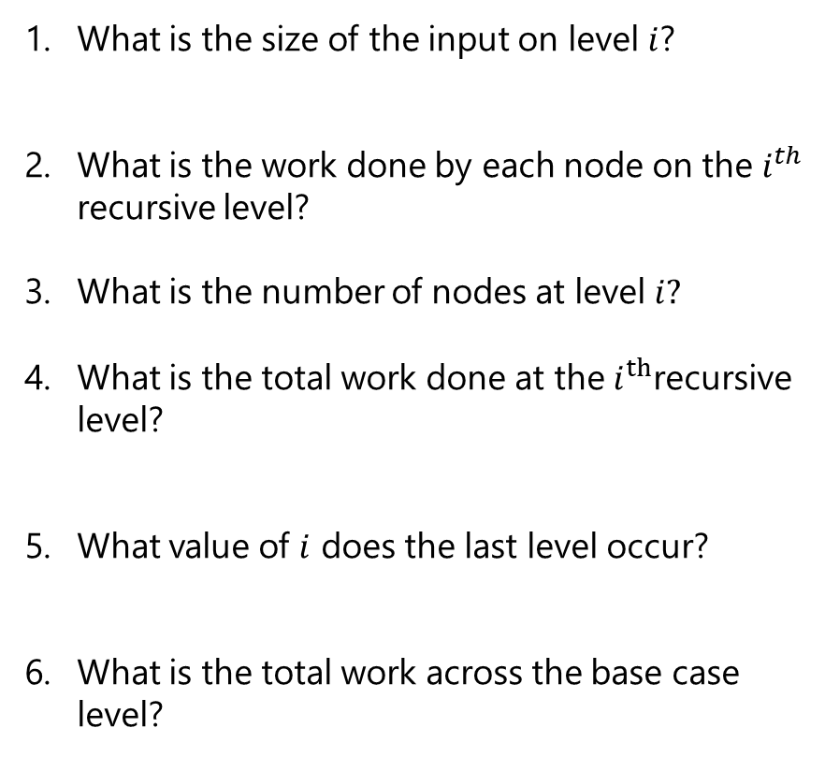
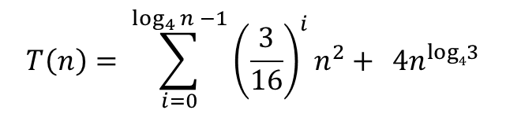
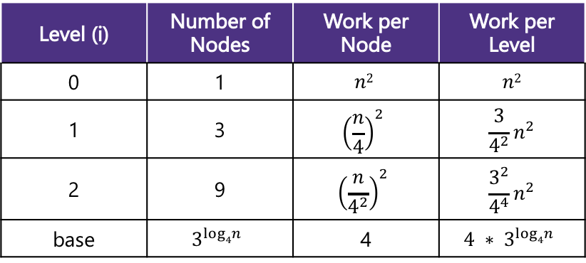

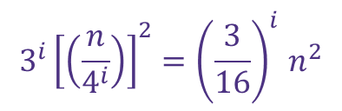
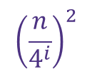





Tree Method Practice
5 Minutes
$$4 when n≤1$$
$$T\left(n\right)=$$
$$3T\left(\frac{n}{4}\right)+n^{2} otherwise$$
Level (i) | Number of Nodes | Work per Node | Work per Level
0 | 1 | $$n2$$ | $$n2$$
1 | 3 | $${\left(\frac{n}{4}\right)}^{2}$$ | $$\frac{3}{4^{2}}n^{2}$$
2 | 9 | $${\left(\frac{n}{4^{2}}\right)}^{2}$$ | $$\frac{3^{2}}{4^{4}}n^{2}$$
base | $$3^{log4n}$$ | 4 | $$4 ∗ 3^{log4n}$$
$$\frac{n}{4^{i}}$$
What is the size of the input on level $i$?
What is the work done by each node on the $i^{th}$ recursive level?
What is the number of nodes at level $i?$
What is the total work done at the $i^{th}$recursive level?
What value of $i$ does the last level occur?
What is the total work across the base case level?
$${\left(\frac{n}{4^{i}}\right)}^{2}$$
$$3^{i}$$
Combining it all together…
$$3^{i}{\left[\left(\frac{n}{4^{i}}\right)\right]}^{2}{=\left(\frac{3}{16}\right)}^{i}n^{2}$$
$$T\left(n\right)= \sum_{i=0}^{\log_{4}{n −1}}{{\left(\frac{3}{16}\right)}^{i}n^{2}+ } 4n^{log43}$$
$\frac{n}{4^{i}}=1$→ $n=4^{i}$→ $i=\log_{4}{n}$
$$3^{\log_{4}{n}}⋅4$$
power of a log
$${4⋅n}^{\log_{4}{3}}$$
$$x^{\log_{b}{y}}=y^{\log_{b}{x}}$$

Slide 16
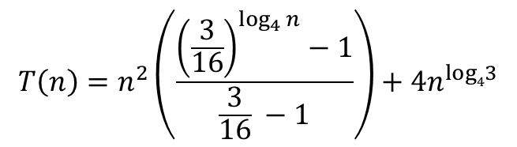
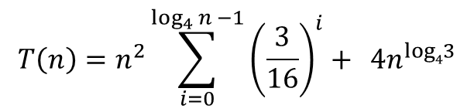
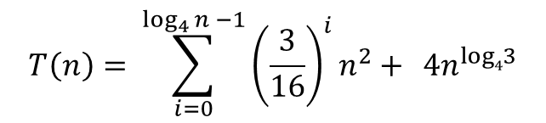
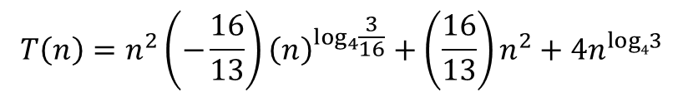
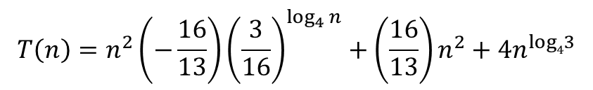


Tree Method Practice
factoring out a constant
$$T\left(n\right)= \sum_{i=0}^{\log_{4}{n −1}}{{\left(\frac{3}{16}\right)}^{i}n^{2}+ } 4n^{log43}$$
$$T\left(n\right)=n^{2}\sum_{i=0}^{\log_{4}{n −1}}{{\left(\frac{3}{16}\right)}^{i}+ } 4n^{log43}$$
$$\sum_{i=a}^{b}{cf(i)=}c\sum_{i=a}^{b}{f(i)}$$
Closed form:
Identities are on the webpage. You don’t need to memorize them.
finite geometric series
$$T\left(n\right)=n^{2}\left(\frac{{\left(\frac{3}{16}\right)}^{\log_{4}{n}}−1}{\frac{3}{16} −1}\right)+4n^{log43}$$
$$\sum_{i=0}^{n−1}{x^{i}=\frac{x^{n}−1}{x−1}}$$
So what’s the big-$Θ$…
$$T\left(n\right)=n^{2}\left(−\frac{16}{13}\right){\left(\frac{3}{16}\right)}^{\log_{4}{n}}+\left(\frac{16}{13}\right)n^{2}+4n^{log43}$$
$$T\left(n\right)=n^{2}\left(−\frac{16}{13}\right){\left(n\right)}^{\log_{4}{\frac{3}{16}}}+\left(\frac{16}{13}\right)n^{2}+4n^{log43}$$
$$T\left(n\right)∈Θ(n^{2})$$

Slide 17
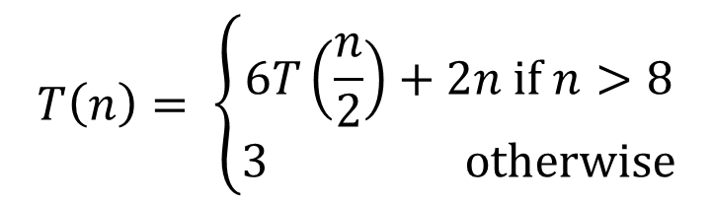
More Tree Method
$$T\left(n\right)= \left\{\begin{aligned}6T\left(\frac{n}{2}\right)+2n if n>8 \\ 3 otherwise\end{aligned}\right.$$

Slide 18

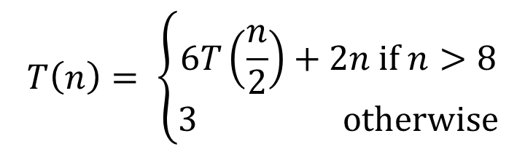
Tree Method Practice
$$T\left(n\right)= \left\{\begin{aligned}6T\left(\frac{n}{2}\right)+2n if n>8 \\ 3 otherwise\end{aligned}\right.$$
Answer the following questions:
What is the size of the input on level $i$?
What is the work done by each node on the $i^{th}$ recursive level
What is the number of nodes at level $i?$
What is the total work done at the i^th recursive level?
What value of $i$ does the last level occur?
What is the total work across the base case level?

Slide 19
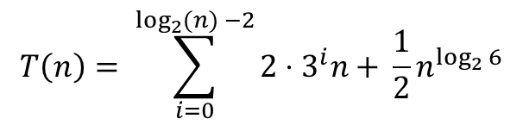

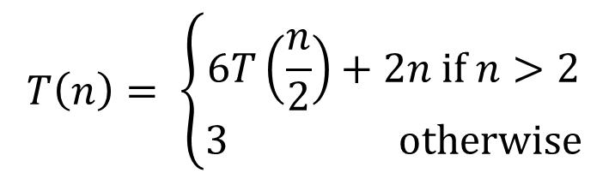
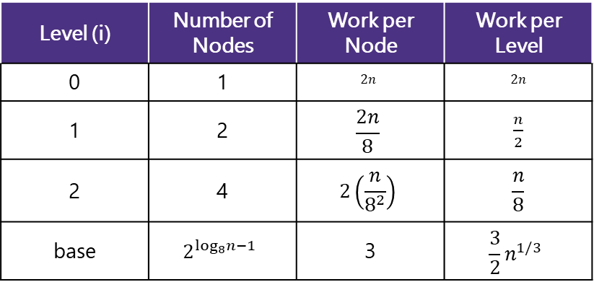


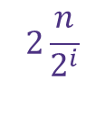
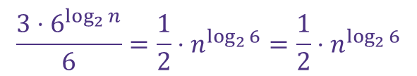


Tree Method Practice
$$T\left(n\right)= \left\{\begin{aligned}6T\left(\frac{n}{2}\right)+2n if n>2 \\ 3 otherwise\end{aligned}\right.$$
5 Minutes
Level (i) | Number of Nodes | Work per Node | Work per Level
0 | 1 | $$2n$$ | $$2n$$
1 | 2 | $$\frac{2n}{8}$$ | $\frac{n}{2}$
2 | 4 | $$2\left(\frac{n}{8^{2}}\right)$$ | $$\frac{n}{8}$$
base | $$2^{\log_{8}n−1}$$ | 3 | $$\frac{3}{2}n^{1/3}$$
$$\frac{n}{2^{i}}$$
What is the size of the input on level $i$?
What is the work done by each node on the $i^{th}$ recursive level?
What is the number of nodes at level $i?$
What is the total work done at the $i^{th}$recursive level?
What value of $i$ does the last level occur?
What is the total work across the base case level?
$$2\frac{n}{2^{i}}$$
$$6^{i}$$
Combining it all together…
$$6^{i}\left[2\frac{n}{2^{i}}\right]=2⋅3^{i}⋅n$$
$$T\left(n\right)= \sum_{i=0}^{\log_{2}{(n) −2}}{2⋅3^{i}n+ }\frac{1}{2}n^{\log_{2}{6}}$$
$\frac{n}{2^{i}}=2$→ $n=2^{i+1}$→ $i=\log_{2}{(n)−1}$
power of a log
$$\frac{{3⋅6}^{\log_{2}{n}}}{6}=\frac{1}{2}⋅n^{\log_{2}{6}}=\frac{1}{2}⋅n^{\log_{2}{6}}$$
$$6^{\log_{2}{(n) −1}}⋅3$$
$$x^{\log_{b}{y}}=y^{\log_{b}{x}}$$

Slide 20




$$T\left(n\right)= \sum_{i=0}^{\log_{2}{(n) −2}}{2⋅3^{i}n+ }\frac{1}{2}n^{\log_{2}{6}}$$
$$=2n\sum_{i=0}^{\log_{2}{(n)}−2}{3^{i}+\frac{1}{2}n^{\log_{2}{6}}}$$
$$=2n\frac{3^{\log_{2}\left(n\right)−1}}{3−1}+\frac{1}{2}n^{\log_{2}{6}}$$
$$=n⋅\frac{n^{\log_{2}\left(3\right)}}{3}+\frac{1}{2}n^{\log_{2}{6}}$$
$$=\frac{n^{\log_{2}\left(3\right)+1}}{3}+\frac{1}{2}n^{\log_{2}{6}}$$
$$=\frac{n^{\log_{2}\left(6\right)}}{3}+\frac{1}{2}n^{\log_{2}{6}}=\frac{5}{6}n^{\log_{2}{6}}$$
finite geometric series
$$\sum_{i=0}^{n−1}{x^{i}=\frac{x^{n}−1}{x−1}}$$
power of a log
$$x^{\log_{b}{y}}=y^{\log_{b}{x}}$$
$$1=\log_{2}{2}$$
$$\log_{a}{b}+\log_{a}{c}=\log_{a}{(bc)}$$

