Slide 1
Lecture 15: Sorting II, Intro Graphs
CSE 373 Data Structures and Algorithms

Slide 2
Administrivia
Project 2 due tonight.
Project 3 out this evening – one week project due Wednesday August 7
P3 is a step up in difficulty compared to P1 and P2.
Exercise 3 due Friday

Slide 3
Administrivia
Midterm scores are on gradescope
Median 71.3% (58.5/82) Mean 70.9% (58.1/82) Standard Deviation 12.03% (9.86 points)
The exam was difficult (and a bit longer than I wanted it to be)
These are good scores – you’ve learned a lot so far.

Slide 4
Administrivia
If you’re concerned about your grade:
Because you need [GPA X] to graduate/for your major
Because you’re trying to transfer into CSE
Because you just want to know how you’re doing
I’ll have office hours 2:30-4 on Friday (CSE 330)
Just for one-on-one discussions of where you stand in the class and what you should expect to need to do in the second half of the course.
TAs will have regular office hours then (at the breakouts) for content questions.
You can also email me for appointments.

Slide 5
Algorithm Design Patterns
Algorithms don’t just come out of thin air.
There are common patterns we use to design new algorithms.
Many of them are applicable to sorting (we’ll see more patterns later in the quarter)
Invariants/Iterative improvement
Step-by-step make one more part of the input your desired output.
Using data structures
Speed up our existing ideas
Divide and conquer
Split your input
Solve each part (recursively)
Combine solved parts into a single

Slide 6
Merge Sort
https://www.youtube.com/watch?v=XaqR3G_NVoo
Divide
0 | 1 | 2 | 3 | 4 | 5 | 6 | 7 | 8 | 9
8 | 2 | 91 | 22 | 57 | 1 | 10 | 6 | 7 | 4
0 | 1 | 2 | 3 | 4
8 | 2 | 91 | 22 | 57
5 | 6 | 7 | 8 | 9
1 | 10 | 6 | 7 | 4
Sort the pieces through the magic of recursion
magic
Combine
0 | 1 | 2 | 3 | 4
2 | 8 | 22 | 57 | 91
5 | 6 | 7 | 8 | 9
1 | 4 | 6 | 7 | 10
0 | 1 | 2 | 3 | 4 | 5 | 6 | 7 | 8 | 9
1 | 2 | 4 | 6 | 7 | 8 | 10 | 22 | 57 | 91

Slide 7

Merge Sort
0 | 1 | 2 | 3 | 4
8 | 2 | 57 | 91 | 22
0 | 1
8 | 2
0 | 1 | 2
57 | 91 | 22
mergeSort(input) {
if (input.length == 1)
return
else
leftHalf = mergeSort(new [0, ..., mid])
rightHalf = mergeSort(new [mid + 1, ...])
return merge(leftHalf, rightHalf)
}
0
8
0
2
0
57
0 | 1
91 | 22
0
91
0
22
1 if n<= 1
2T(n/2) + n otherwise
0 | 1
22 | 91
Worst case runtime?
Best case runtime?
Average runtime?
Stable?
In-place?
T(n) =
= $O(n\log{n})$
Same
0 | 1
2 | 8
0 | 1 | 2
22 | 57 | 91
Same
Yes
0 | 1 | 2 | 3 | 4
2 | 8 | 22 | 57 | 91
No

Slide 8
Divide and Conquer
There’s more than one way to divide!
Mergesort:
Split into two arrays.
Elements that just happened to be on the left and that happened to be on the right.
Quicksort:
Split into two arrays.
Elements that are “small” and elements that are “large”
What do I mean by “small” and “large” ?
Choose a “pivot” value (an element of the array)
One array has elements smaller than pivot, other has elements larger than pivot.

Slide 9
Quick Sort v1
https://www.youtube.com/watch?v=ywWBy6J5gz8
Divide
Combine (no extra work if in-place)
0 | 1 | 2 | 3 | 4 | 5 | 6 | 7 | 8 | 9
8 | 2 | 91 | 22 | 57 | 1 | 10 | 6 | 7 | 4
0 | 1 | 2 | 3 | 4
2 | 1 | 6 | 7 | 4
0
8
0 | 1 | 2 | 3
91 | 22 | 57 | 10
Sort the pieces through the magic of recursion
magic
0 | 1 | 2 | 3 | 4
1 | 2 | 4 | 6 | 7
0
8
0 | 1 | 2 | 3
10 | 22 | 57 | 91
0 | 1 | 2 | 3 | 4 | 5 | 6 | 7 | 8 | 9
1 | 2 | 4 | 6 | 7 | 8 | 10 | 22 | 57 | 91

Slide 10
Quick Sort v1
0 | 1 | 2 | 3 | 4 | 5 | 6
20 | 50 | 70 | 10 | 60 | 40 | 30
0
10
0 | 1 | 2 | 3 | 4
50 | 70 | 60 | 40 | 30
quickSort(input) {
if (input.length == 1)
return
else
pivot = getPivot(input)
smallerHalf = quickSort(getSmaller(pivot, input))
largerHalf = quickSort(getBigger(pivot, input))
return smallerHalf + pivot + largerHalf
}
0 | 1
40 | 30
0 | 1
70 | 60
0
30
0
60
0 | 1
30 | 40
0 | 1
60 | 70
T(n) =
1 if n<= 1
n + T(n - 1) otherwise
= $O\left(n^{2}\right)$
Worst case runtime?
Best case runtime?
In-practice runtime?
Stable?
In-place?
0 | 1 | 2 | 3 | 4
30 | 40 | 50 | 60 | 70
T(n) =
1 if n<= 1
n + 2T(n/2) otherwise
=$O(n\log{n)}$
Just trust me $O(n\log{n)}$
0 | 1 | 2 | 3 | 4 | 5 | 6
10 | 20 | 30 | 40 | 50 | 60 | 70
No
Can be done

Slide 11
Quick Sort v2 (swapping in-place)
0 | 1 | 2 | 3 | 4 | 5 | 6 | 7 | 8 | 9
6 | 1 | 4 | 9 | 0 | 3 | 5 | 2 | 7 | 8
0 | 1 | 2 | 3 | 4 | 5 | 6 | 7 | 8 | 9
6 | 1 | 4 | 9 | 0 | 3 | 5 | 2 | 7 | 8
Low
X < 6
High
X >= 6
0 | 1 | 2 | 3 | 4 | 5 | 6 | 7 | 8 | 9
6 | 1 | 4 | 2 | 0 | 3 | 5 | 9 | 7 | 8
Low
X < 6
High
X >= 6
0 | 1 | 2 | 3 | 4 | 5 | 6 | 7 | 8 | 9
5 | 1 | 4 | 2 | 0 | 3 | 6 | 9 | 7 | 8

Slide 12
Quick Sort v2 (in-place)
0 | 1 | 2 | 3 | 4 | 5 | 6 | 7 | 8 | 9
6 | 1 | 4 | 2 | 0 | 3 | 5 | 9 | 7 | 8
quickSort(input) {
if (input.length == 1)
return
else
pivot = getPivot(input)
smallerHalf = quickSort(getSmaller(pivot, input))
largerHalf = quickSort(getBigger(pivot, input))
return smallerHalf + pivot + largerHalf
}
1 if n<= 1
n + T(n - 1) otherwise
Worst case runtime?
Best case runtime?
In-practice runtime?
Stable?
In-place?
T(n) =
= O(n^2)
T(n) =
1 if n<= 1
n + 2T(n/2) otherwise
= O(nlogn)
Just trust me
= O(nlogn)
No
Yes

Slide 13
Can we do better?
We’d really like to avoid hitting the worst case.
Key to getting a good running time, is always cutting the array (about) in half.
How do we choose a good pivot?
Here are four options for finding a pivot. What are the tradeoffs?
Just take the first element
Take the median of the first, last, and middle element
Take the median of the full array
Pick a random element as a pivot
pollEV.com/cse373su19
Which of these seems like the best option?

Slide 14
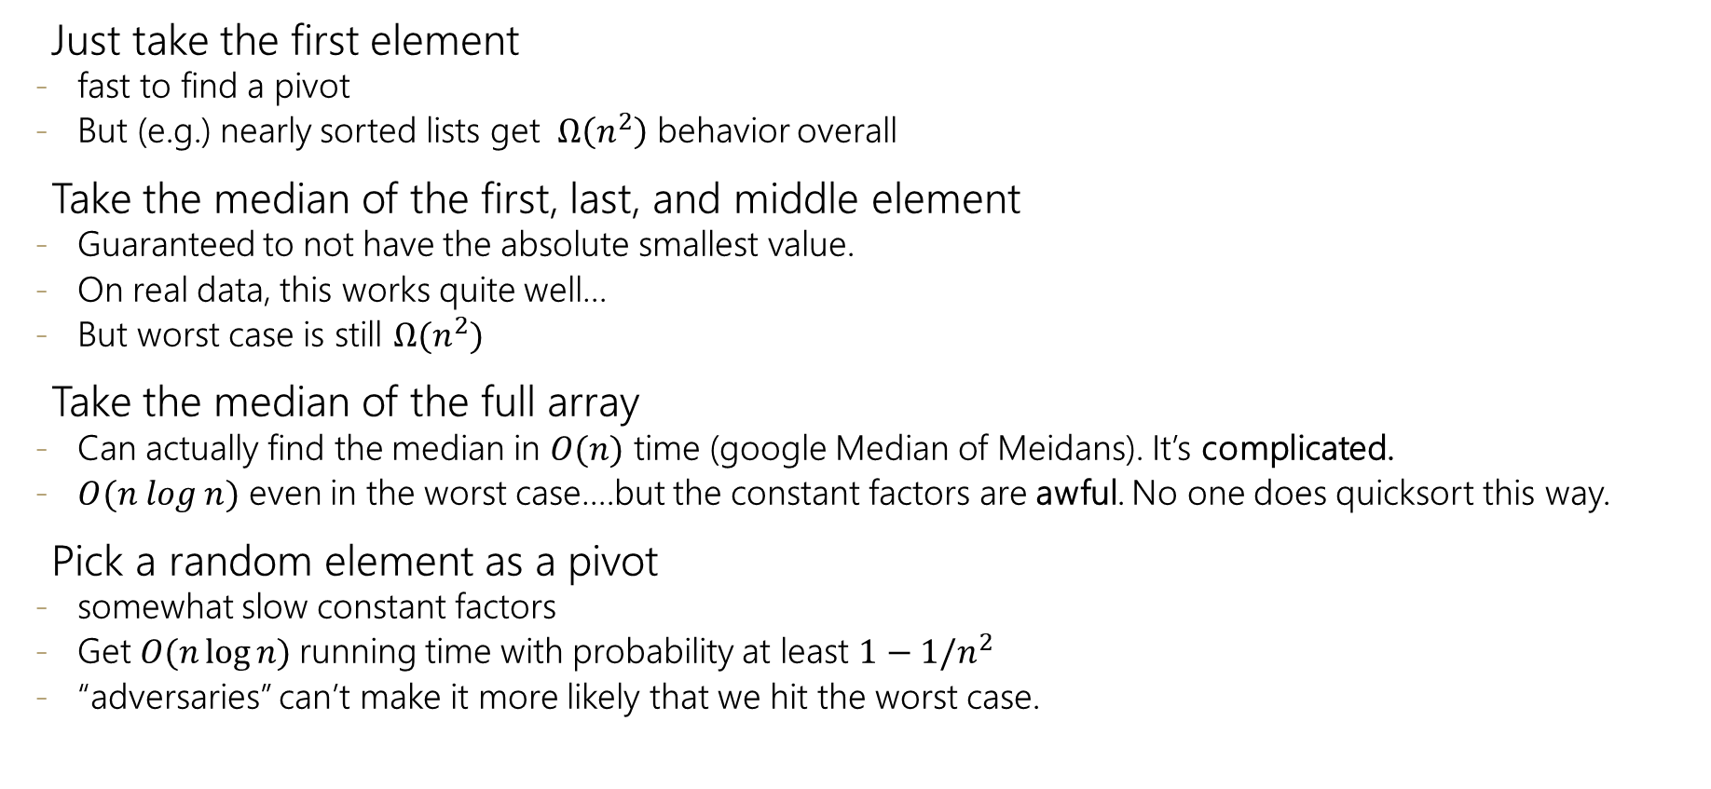
Pivots
Just take the first element
fast to find a pivot
But (e.g.) nearly sorted lists get $Ω\left(n^{2}\right)$ behavior overall
Take the median of the first, last, and middle element
Guaranteed to not have the absolute smallest value.
On real data, this works quite well…
But worst case is still $Ω(n^{2})$
Take the median of the full array
Can actually find the median in $O(n)$ time (google Median of Meidans). It’s complicated.
$O(n log n)$ even in the worst case….but the constant factors are awful. No one does quicksort this way.
Pick a random element as a pivot
somewhat slow constant factors
Get $O(n\log{n)}$running time with probability at least $1−1/n^{2}$
“adversaries” can’t make it more likely that we hit the worst case.
Median of three is a common choice in practice

Slide 15
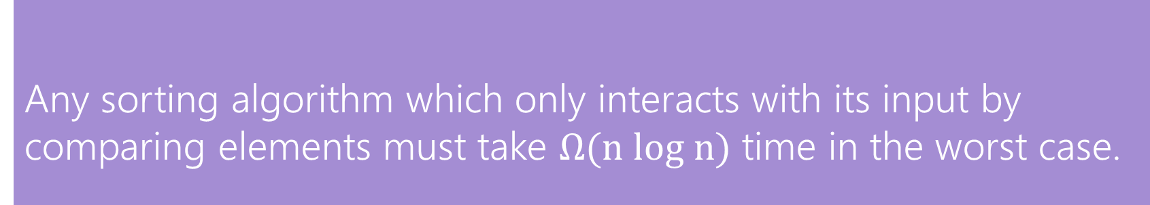
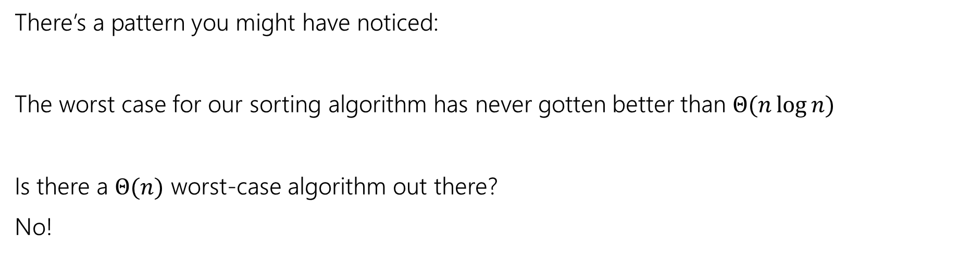
Worst Case
There’s a pattern you might have noticed:
The worst case for our sorting algorithm has never gotten better than $Θ(n\log{n)}$
Is there a $Θ(n)$ worst-case algorithm out there?
No!
Any sorting algorithm which only interacts with its input by comparing elements must take $Ω(n log n)$ time in the worst case.
Comparison Sorting Lower Bound

Slide 16
Radix Sort
For each “digit” (starting at the “ones place”)
Run a “bucket sort” with respect to that digit
I.e. make an array, where each index corresponds to one of the possible values
Place the next element you see at the end of the list of elements in that bucket.
Keep the sort stable!

Slide 17
Radix Sort: Ones Place
012 | 234 | 789 | 555 | 679 | 200 | 777 | 562
0 | 2 | 4 | 5 | 7 | 9
200
012
234
555
777
789
562
678
200 | 012 | 562 | 234 | 555 | 777 | 789 | 678

Slide 18
Radix Sort: Tens Place
200 | 012 | 562 | 234 | 555 | 777 | 789 | 678
0 | 1 | 2 | 3 | 5 | 6 | 7 | 8
200
012
234
555
562
777
789
678
200 | 012 | 234 | 555 | 562 | 777 | 678 | 789

Slide 19
Radix Sort: Hundreds Place
200 | 012 | 234 | 555 | 562 | 777 | 678 | 789
0 | 2 | 5 | 6 | 7
012
200
555
678
777
234
562
789
012 | 200 | 234 | 555 | 562 | 678 | 777 | 789

Slide 20
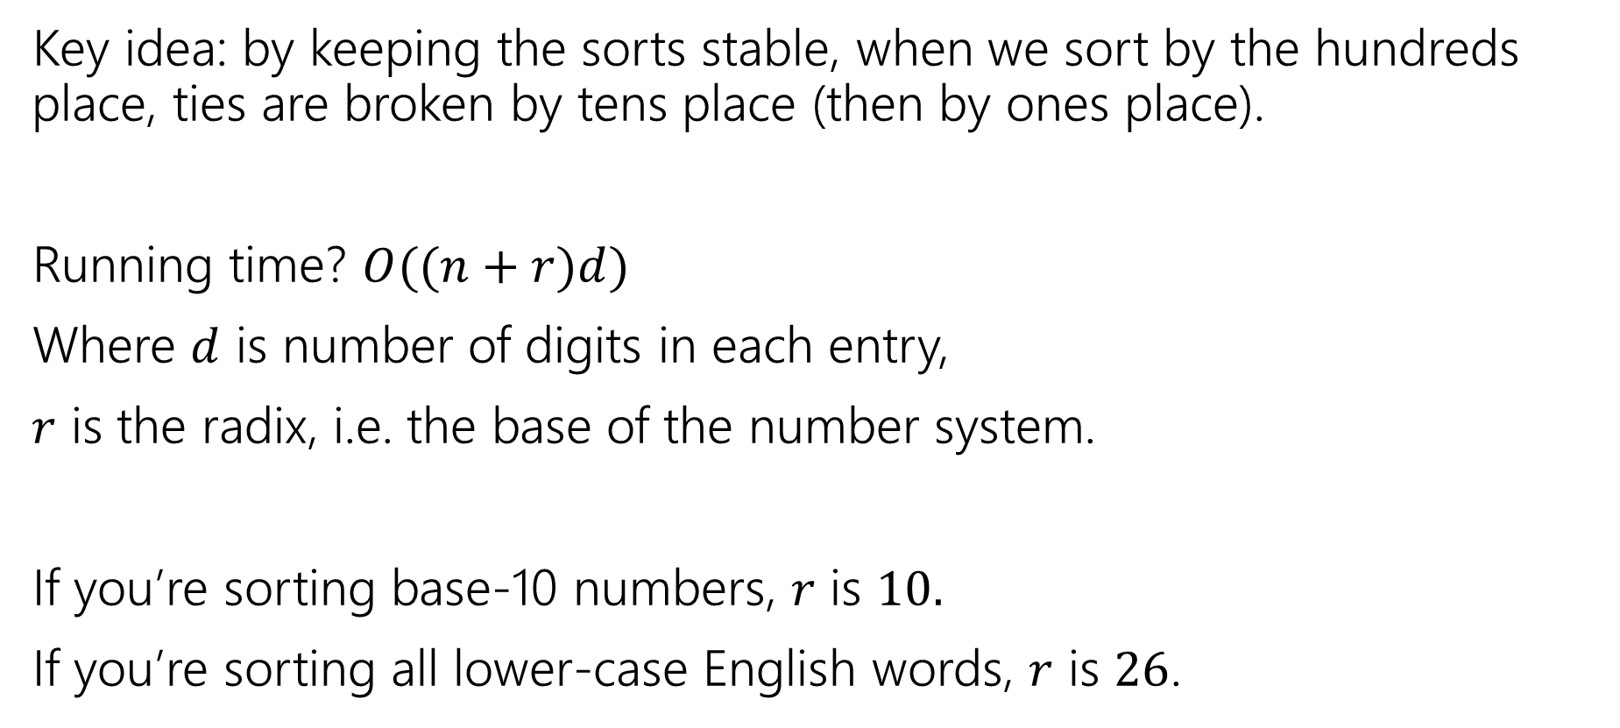
Radix Sort
Key idea: by keeping the sorts stable, when we sort by the hundreds place, ties are broken by tens place (then by ones place).
Running time? $O((n+r)d)$
Where $d$ is number of digits in each entry,
$r$ is the radix, i.e. the base of the number system.
If you’re sorting base-10 numbers, $r$ is $10.$
If you’re sorting all lower-case English words, $r$ is $26$.

Slide 21
Radix Sort
When can you use it?
ints and strings. As long as they aren’t too large.
But you have to know you’re sorting ints and strings.

Slide 22
Summary
You have a bunch of data. How do you sort it?
Honestly…use your language’s default implementation
It’s been carefully optimized.
Unless you really know something about your data, or the situation your in
Not a lot of extra memory? Use an in place sort.
Want to sort repeatedly to break ties? Use a stable sort.
Know your data all falls into a small range? Maybe radix sort.

Slide 23
Graphs

Slide 24
ADTs so far
Queues and Stacks
We want to process our data in some order (based on when they were inserted)
Lists
We want to maintain an order, but add or remove from anywhere
Priority Queues
Our data had some priority we needed to keep track of, and wanted to process in order of importance.
Dictionaries
Our data points came as (key, value) pairs.
Quickly find the value for a key

Slide 25
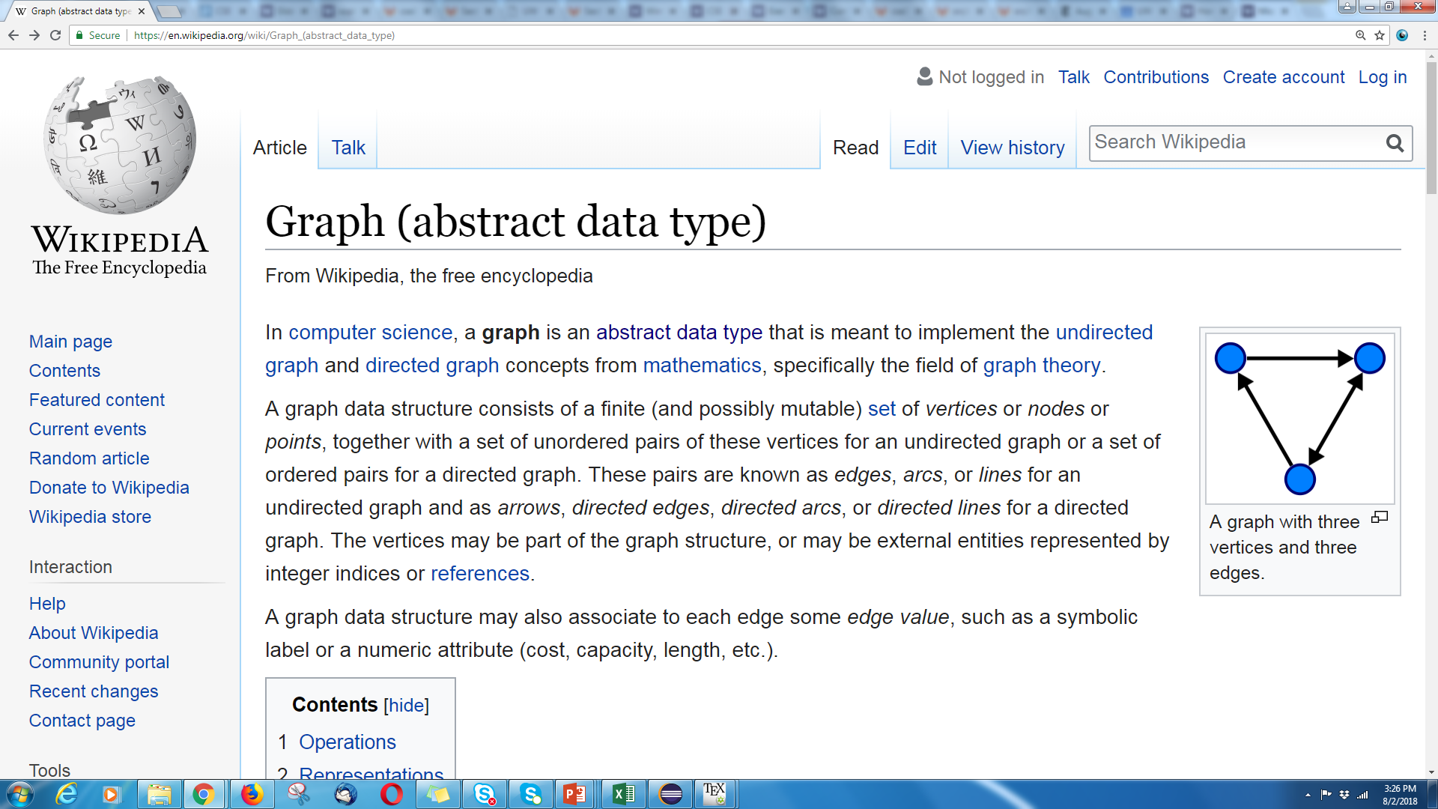
Graphs
We’ll list Graphs as one of our ADTs…
But don’t let that limit your thinking. They are more versatile than any ADT we’ve seen before.

Slide 26


Graphs
Represent data points and the relationships between them.
That’s vague.
Formally:
A graph is a pair: G = (V,E)
V: set of vertices (aka nodes)
E: set of edges
Each edge is a pair of vertices.
B
D
A
C
$$\{A,B,C,D\}$$
$$\{(A,B), (B,C), (B,D), (C,D)\}$$

Slide 27

Graph Terms
This graph is disconnected.
Graphs can be directed or undirected.
Degree: 2
Following on twitter.
Kasey
Kasey
Robbie
Outdegree: 2
Robbie
Zach
Zach
Degree: 0
Indegree: 2
Friendships on Facebook.

Slide 28
Making Graphs
If your problem has data and relationships, you might want to represent it as a graph
How do you choose a representation?
Usually:
Think about what your “fundamental” objects are
Those become your vertices.
Then think about how they’re related
Those become your edges.

Slide 29
Some examples
For each of the following think about what you should choose for vertices and edges.
The internet.
Facebook friendships
Input data for the “6 degrees of Kevin Bacon” game
Course Prerequisites

Slide 30
Some examples
For each of the following think about what you should choose for vertices and edges.
The internet.
Vertices: webpages. Edges from a to b if a has a hyperlink to b.
Facebook friendships
Vertices: people. Edges: if two people are friends
Input data for the “6 Degrees of Kevin Bacon” game
Vertices: actors. Edges: if two people appeared in the same movie
Or: Vertices for actors and movies, edge from actors to movies they appeared in.
Course Prerequisites
Vertices: courses. Edge: from a to b if a is a prereq for b.

