Slide 1

Lecture 23: P vs. NP
Data Structures and Algorithms

Slide 2
Administrivia
Project 4 and Exercise 5 due tonight
Exercise 3 scores out tonight.
Final review session tomorrow Sieg 134 at 1:10

Slide 3
Administrivia
Please fill out official UW course evaluations
I’m trying to make teaching my full-time job soon
Constructive criticism helps me get better.
High response rate will help on the job market
TAs appreciate your feedback on sections as well
We also have a “content survey”
This course was redesigned a few years ago, and we’re still trying to make it better.
It helps a lot to know what you thought helped and where your pain points were
Google form:
https://forms.gle/arVRDPT5nubkbvYc9
We’ll award 2 lecture-attendances worth of extra credit for filling out the survey.

Slide 4
Goals for this lecture
Our topic today is part of CS culture.
I want to give you enough cultural knowledge to “fit in” when people reference it.
And to give you enough practical understanding to have a fighting chance if it comes up in a real way at work.
It’s also REALLY cool
I’m going to try to give you a sense of why it’s the biggest unsolved question in CS.
CSE 417 covers this topic in more detail
take that course (or talk to me some other time) to learn more

Slide 5
Last Lecture…
The Review Making Problem was a type of “Satisfiability” problem.
We had a bunch of variables (include/exclude this question) and needed to satisfy everything in a list of requirements.
The algorithm we just made for Final Creation works for any 2-SAT problem.
Given: A set of Boolean variables, and a list of requirements, each of the form:
variable1==[True/False] || variable2==[True/False]
Find: A setting of variables to “true” and “false” so that all of the requirements evaluate to “true”
2-Satisfiability (“2-SAT”)

Slide 6
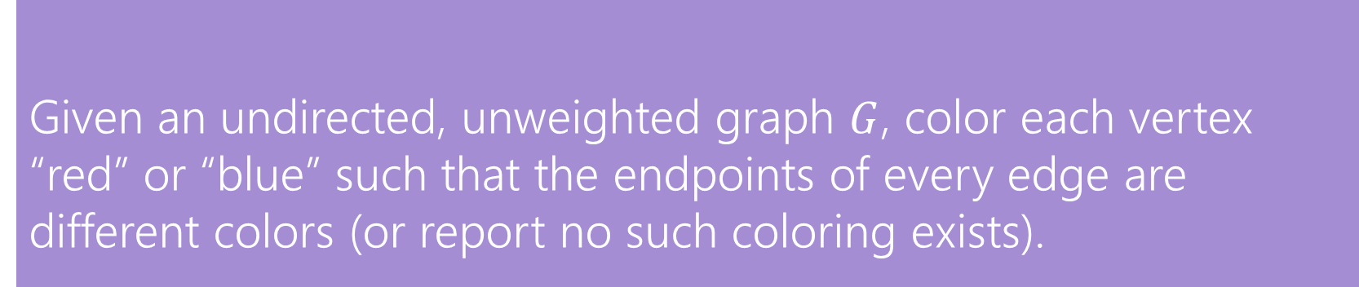
Reductions
It might not be too surprising that we can solve one shortest path problem with the algorithm for another shortest path problem.
The real power of reductions is that you can sometimes reduce a problem to another one that looks very very different.
We’re going to reduce a graph problem to 2-SAT.
Given an undirected, unweighted graph $G$, color each vertex “red” or “blue” such that the endpoints of every edge are different colors (or report no such coloring exists).
2-Coloring

Slide 7
2-Coloring
Can these graphs be 2-colored? If so find a 2-coloring. If not try to explain why one doesn’t exist.
B
C
B
C
E
E
A
A
D
D

Slide 8
2-Coloring
Can these graphs be 2-colored? If so find a 2-coloring. If not try to explain why one doesn’t exist.
B
C
B
C
E
E
A
A
D
D

Slide 9
2-Coloring
Why would we want to 2-color a graph?
We need to divide the vertices into two sets, and edges represent vertices that can’t be together.
You can modify [B/D]FS to come up with a 2-coloring (or determine none exists)
This is a good exercise!
But coming up with a whole new idea sounds like work.
And we already came up with that cool 2-SAT algorithm.
Maybe we can be lazy and just use that!
Let’s reduce 2-Coloring to 2-SAT!
Use our 2-SAT algorithm
to solve 2-Coloring

Slide 10
A Reduction
We need to describe 2 steps
1. How to turn a graph for a 2-color problem into an input to 2-SAT
2. How to turn the ANSWER for that 2-SAT input into the answer for the original 2-coloring problem.
How can I describe a two coloring of my graph?
Have a variable for each vertex – is it red?
How do I make sure every edge has different colors? I need one red endpoint and one blue one, so this better be true to have an edge from v1 to v2:
(v1IsRed || v2isRed) && (!v1IsRed || !v2IsRed)

Slide 11
Transform Input
C
(AisRed||BisRed)&&(!AisRed||!BisRed)
(AisRed||DisRed)&&(!AisRed||!DisRed)
(BisRed||CisRed)&&(!BisRed||!CisRed)
(BisRed||EisRed)&&(!BisRed||!EisRed)
(DisRed||EisRed)&&(!DisRed||!EisRed)
B
E
A
D
2-SAT Algorithm
AisRed = True
BisRed = False
CisRed = True
DisRed = False
EisRed = True
Transform Output
B
C
E
A
D

Slide 12
Efficiency, P vs. NP

Slide 13
Taking a step back
The main theme of this quarter has been doing things faster.
You might get the impression at this point that if you’re clever enough and use (or invent) the right data structures that you can do anything.
And you can do A LOT But you probably can’t do everything.
Our goal for today is to divide problems into those where a computer can find an answer in a reasonable amount of time and those where a computer probably can’t.

Slide 14
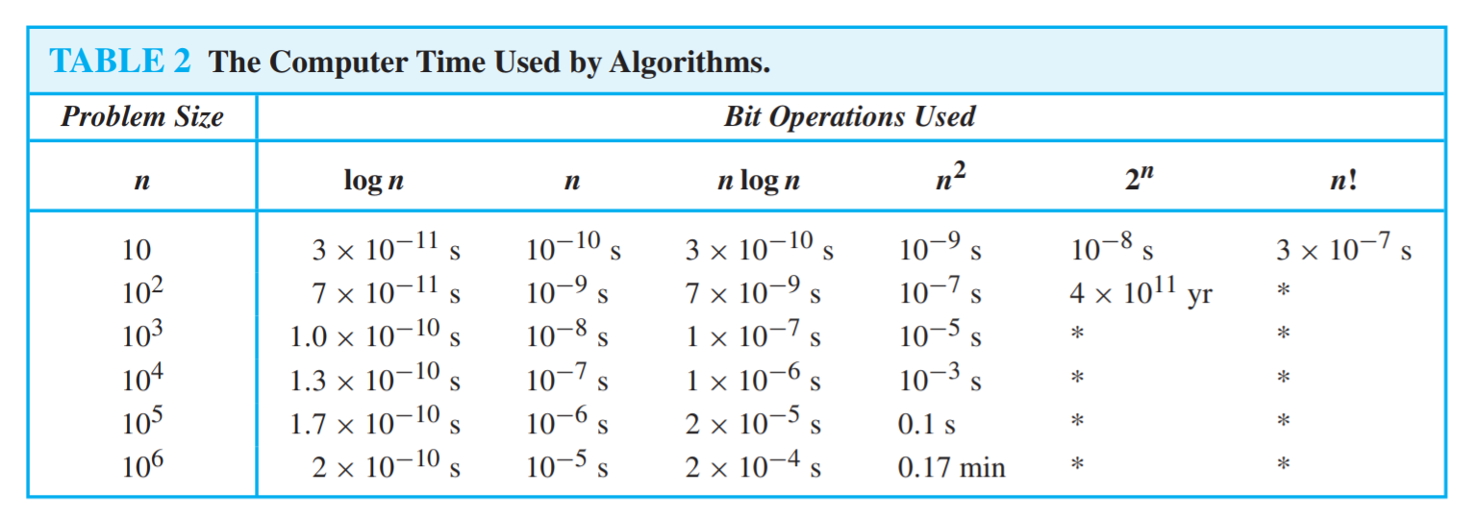
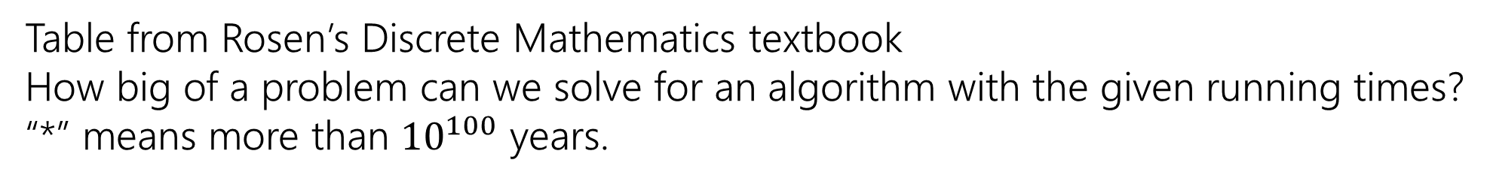
Running Times
Table from Rosen’s Discrete Mathematics textbook How big of a problem can we solve for an algorithm with the given running times?
“*” means more than ${10}^{100}$ years.

Slide 15
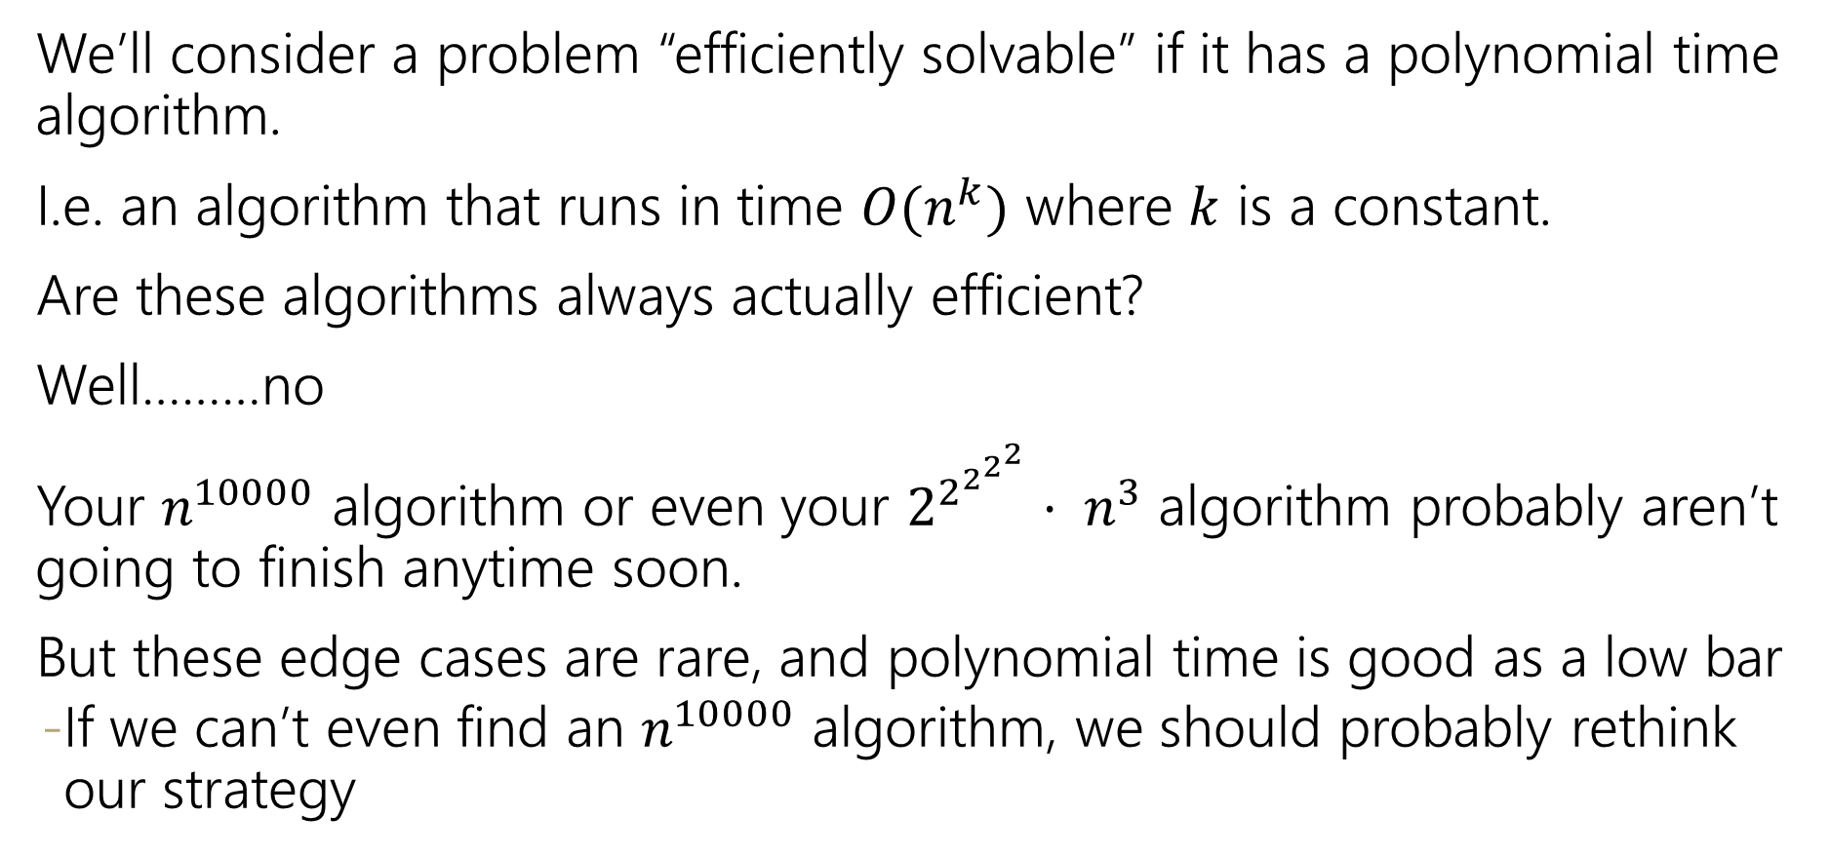
Efficient
We’ll consider a problem “efficiently solvable” if it has a polynomial time algorithm.
I.e. an algorithm that runs in time $O(n^{k})$ where $k$ is a constant.
Are these algorithms always actually efficient?
Well………no
Your $n^{10000}$ algorithm or even your $2^{2^{2^{2^{2}}}}⋅ n^{3}$ algorithm probably aren’t going to finish anytime soon.
But these edge cases are rare, and polynomial time is good as a low bar
If we can’t even find an $n^{10000}$ algorithm, we should probably rethink our strategy

Slide 16
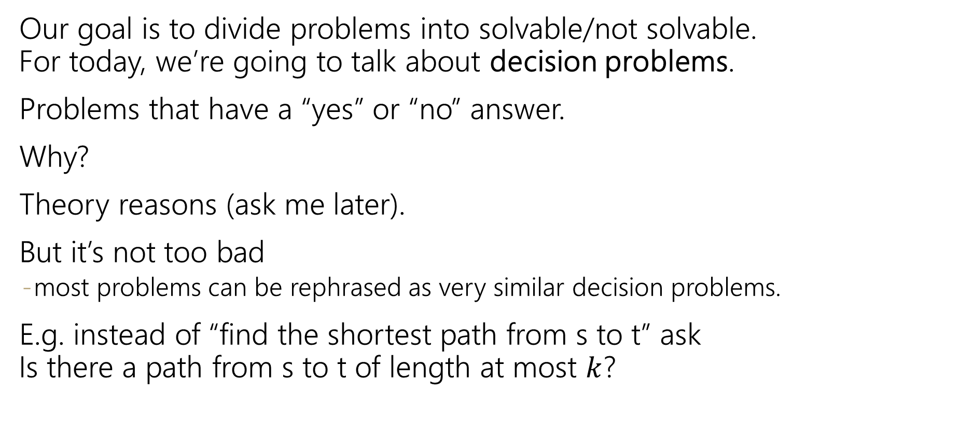
Decision Problems
Our goal is to divide problems into solvable/not solvable. For today, we’re going to talk about decision problems.
Problems that have a “yes” or “no” answer.
Why?
Theory reasons (ask me later).
But it’s not too bad
most problems can be rephrased as very similar decision problems.
E.g. instead of “find the shortest path from s to t” ask Is there a path from s to t of length at most $k$?

Slide 17
P (can be solved efficiently)
The set of all decision problems that have an algorithm that runs in time $O\left(n^{k}\right)$ for some constant $k$.
P (stands for “Polynomial”)
The decision version of all problems we’ve solved in this class are in P.
P is an example of a “complexity class”
A set of problems that can be solved under some limitations (e.g. with some amount of memory or in some amount of time).

Slide 18
NP
Our second set of problems have the property that “I’ll know it when I see it”
We’re looking for something, and if it’s there, we can recognize it quickly (it just might be hard to find)
NP (stands for “nondeterministic polynomial”)
The set of all decision problems such that if the answer is YES, there is a proof of that which can be verified in polynomial time.
It’s a common misconception that NP stands for “not polynomial”
Never, ever, ever, ever say “NP” stands for “not polynomial”
Please
Every time someone says that, a theoretical computer scientist sheds a single tear
(That theoretical computer scientist is me)

Slide 19
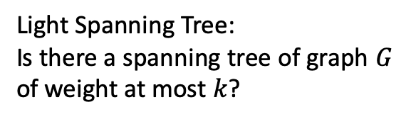
NP
Decision Problems such that:
If the answer is YES, you can prove the answer is yes by
Being given a “proof” or a “certificate”
Verifying that certificate in polynomial time.
What certificate would be convenient for short paths?
The path itself. Easy to check the path is really in the graph and really short.
NP (stands for “nondeterministic polynomial”)
The set of all decision problems such that if the answer is YES, there is a proof of that which can be verified in polynomial time.
Light Spanning Tree:
Is there a spanning tree of graph $G$ of weight at most $k$?
2-Coloring:
Can you color vertices of a graph red and blue so every edge has differently colored endpoints?
2-SAT:
Given a set of variables and a list of requirements:
(variable==[T/F] || variable==[T/F])
Find a setting of the variables to make every requirement true.
The spanning tree itself.
Verify by checking it really connects every vertex and its weight.
The coloring. Verify by checking each edge.
The assignment of variables. Verify by checking each requirement.

Slide 20
P vs. NP
Are P and NP the same complexity class?
That is, can every problem that can be verified in polynomial time also be solved in polynomial time.
P vs. NP
No one knows the answer to this question.
In fact, it’s the biggest unsolved question in Computer Science.

Slide 21
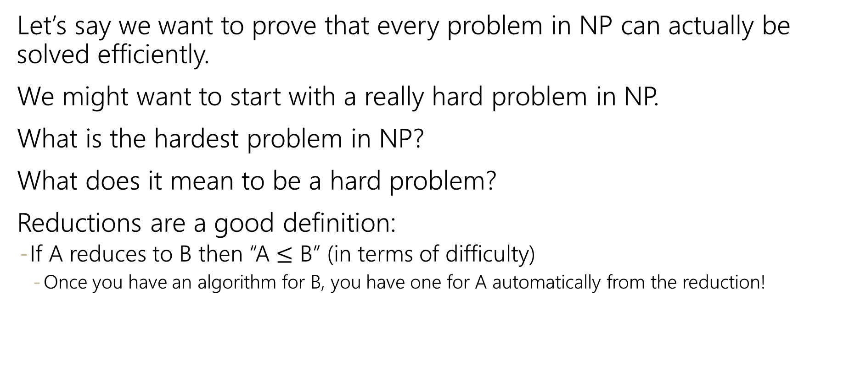
Hard Problems
Let’s say we want to prove that every problem in NP can actually be solved efficiently.
We might want to start with a really hard problem in NP.
What is the hardest problem in NP?
What does it mean to be a hard problem?
Reductions are a good definition:
If A reduces to B then “A $≤$ B” (in terms of difficulty)
Once you have an algorithm for B, you have one for A automatically from the reduction!

Slide 22
NP-Completeness
The problem B is NP-complete if B is in NP and for all problems A in NP, A reduces to B.
NP-complete
An NP-complete problem is a “hardest” problem in NP.
If you have an algorithm to solve an NP-complete problem, you have an algorithm for every problem in NP.
An NP-complete problem is a universal language for encoding “I’ll know it when I see it” problems.
Does one of these exist?

Slide 23
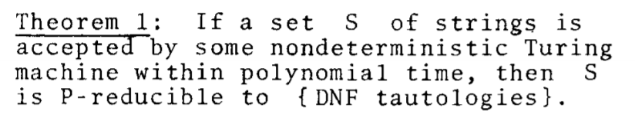
NP-Completeness
An NP-complete problem does exist!
3-SAT is NP-complete
Cook-Levin Theorem (1971)
This sentence (and the proof of it) won Cook the Turing Award.

Slide 24
2-SAT vs. 3-SAT
Given: A set of Boolean variables, and a list of requirements, each of the form:
variable1==[True/False] || variable2==[True/False]
Find: A setting of variables to “true” and “false” so that all of the requirements evaluate to “true”
2-Satisfiability (“2-SAT”)
Given: A set of Boolean variables, and a list of requirements, each of the form:
variable1==[True/False]||variable2==[True/False]||variable3==[True/False]
Find: A setting of variables to “true” and “false” so that all of the requirements evaluate to “true”
3-Satisfiability (“3-SAT”)

Slide 25
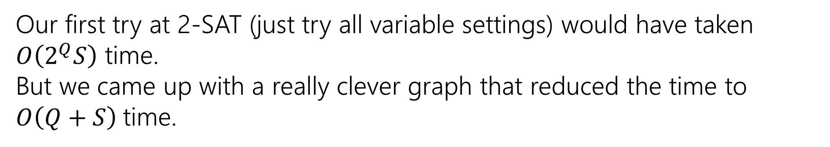
2-SAT vs. 3-SAT
Given: A set of Boolean variables, and a list of requirements, each of the form:
variable1==[True/False] || variable2==[True/False]
Find: A setting of variables to “true” and “false” so that all of the requirements evaluate to “true”
2-Satisfiability (“2-SAT”)
Our first try at 2-SAT (just try all variable settings) would have taken $O\left(2^{Q}S\right)$ time.
But we came up with a really clever graph that reduced the time to $O\left(Q+S\right)$time.

Slide 26
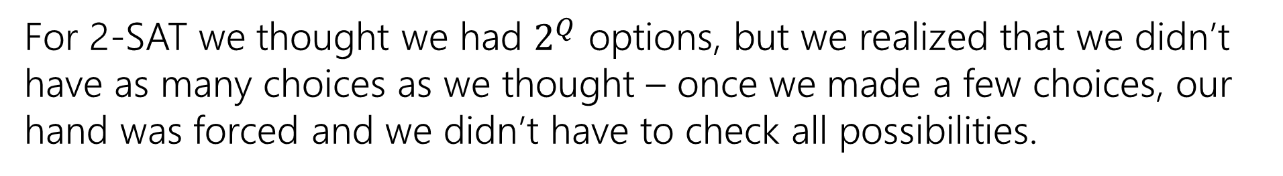
2-SAT vs. 3-SAT
NO Big-O
NO recurrence
Can we do the same for 3-SAT?
For 2-SAT we thought we had $2^{Q}$ options, but we realized that we didn’t have as many choices as we thought – once we made a few choices, our hand was forced and we didn’t have to check all possibilities.
Given: A set of Boolean variables, and a list of requirements, each of the form:
variable1==[True/False]||variable2==[True/False]||variable3==[True/False]
Find: A setting of variables to “true” and “false” so that all of the requirements evaluate to “true”
3-Satisfiability (“3-SAT”)

Slide 27
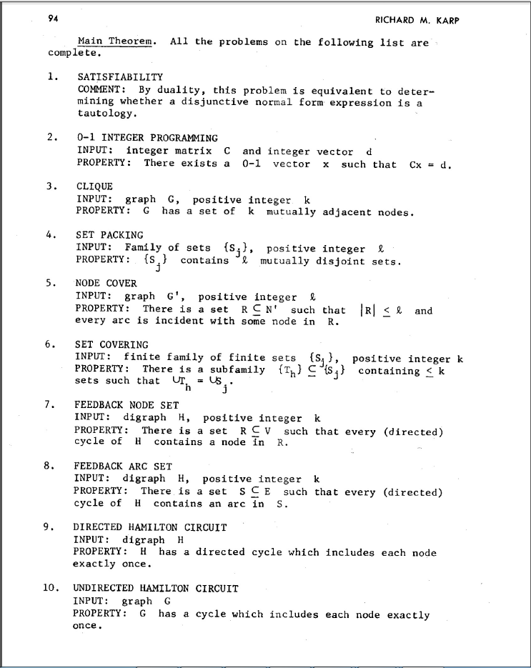
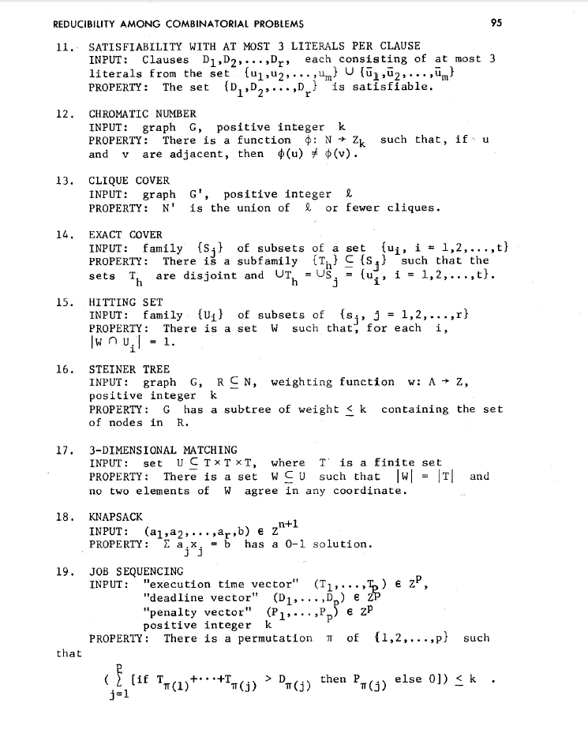
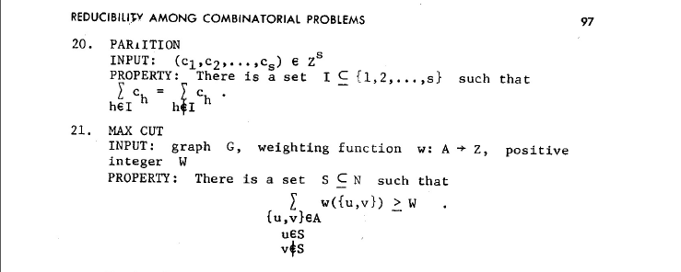
NP-Complete Problems
But Wait! There’s more!
A lot of problems are NP-complete
Karp’s Theorem (1972)

Slide 28
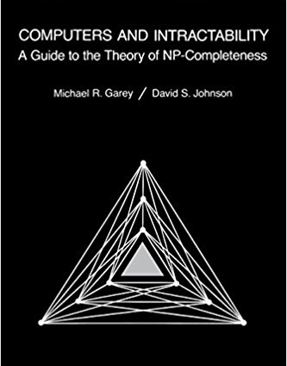
NP-Complete Problems
But Wait! There’s more!
By 1979, at least 300 problems had been proven NP-complete.
Garey and Johnson put a list of all the NP-complete problems they could find in this textbook.
Took almost 100 pages to just list them all.
No one has made a comprehensive list since.

Slide 29
NP-Complete Problems
But Wait! There’s more!
In December 2018, mathematicians and computer scientists put papers on the arXiv claiming to show (at least) 25 more problems are NP-complete.
There are literally thousands of NP-complete problems known.

Slide 30
Examples
There are literally thousands of NP-complete problems.
And some of them look weirdly similar to problems we do know efficient algorithms for.
In P
NP-Complete
Given a directed graph, report if there is a path from s to t of length at most $k$.
Short Path
Given a directed graph, report if there is a path from s to t of length at least$k$.
Long Path

Slide 31
Examples
In P
NP-Complete
Given a weighted graph, find a spanning tree (a set of edges that connect all vertices) of weight at most $k$.
Light Spanning Tree
Given a weighted graph, find a tour (a walk that visits every vertex and returns to its start) of weight at most $k$.
Traveling Salesperson
The electric company just needs a greedy algorithm to lay its wires.
Amazon doesn’t know a way to optimally route its delivery trucks.

Slide 32
Dealing with NP-completeness
Thousands of times someone has wanted to find an efficient algorithm for a problem…
…only to realize that the problem was NP-complete.
Sooner or later it will happen to one of you.
What do you do if you think your problem is NP-complete?

Slide 33

Dealing with NP-completeness
You just started your new job at Amazon. Your boss asks you to look into the following problem
You have a graph, each vertex is where a specific truck has to do a delivery. Starting from the warehouse, how do you make all the deliveries and return to the warehouse using the minimum amount of gas.
This problem is NP-complete. So you tell your boss, and they say…
That’s a cool theorem and all. But really we need to use less gas.
Given a weighted graph, find a tour (a walk that visits every vertex and returns to its start) of weight at most $k$.
Traveling Salesperson

Slide 34
Dealing with NP-Completeness
Option 1: Maybe your problem isn’t really NP-complete; it’s a special case we understand
Maybe you don’t need to solve the general problem, just a special case
Option 2: Maybe your problem isn’t really NP-complete; it’s a special case we don’t understand (yet)
There are algorithms that are known to run quickly on “nice” instances. Maybe your problem has one of those.
One approach: Turn your problem into a SAT instance, find a solver and cross your fingers.
Analogy: Insertion sort (great if your list is almost sorted. Really slow otherwise)

Slide 35
Dealing with NP-Completeness
Option 3: Approximation Algorithms
You might not be able to get an exact answer, but you might be able to get close.
Given a weighted graph, find a tour (a walk that visits every vertex and returns to its start) of minimum weight.
Optimization version of Traveling Salesperson
Algorithm:
Find a minimum spanning tree.
Have the tour follow the visitation order of a DFS of the spanning tree.
Theorem: This tour is at most twice as long as the best one.

Slide 36
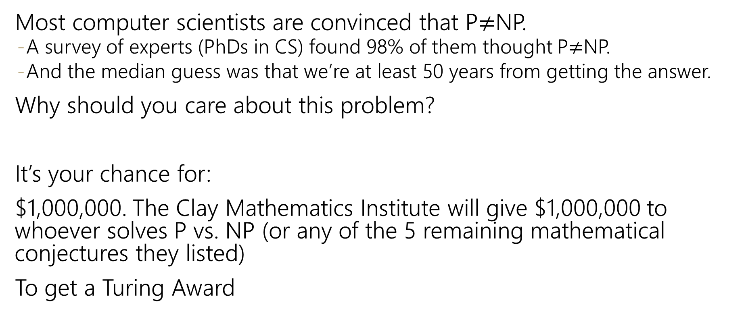
Why should you care about P vs. NP
Most computer scientists are convinced that P$≠$NP.
A survey of experts (PhDs in CS) found 98% of them thought P$≠$NP.
And the median guess was that we’re at least 50 years from getting the answer.
Why should you care about this problem?
It’s your chance for:
$1,000,000. The Clay Mathematics Institute will give $1,000,000 to whoever solves P vs. NP (or any of the 5 remaining mathematical conjectures they listed)
To get a Turing Award

Slide 37
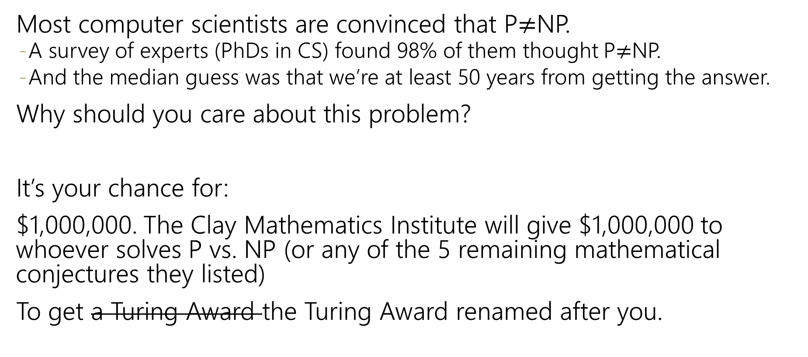
Why should you care about P vs. NP
Most computer scientists are convinced that P$≠$NP.
A survey of experts (PhDs in CS) found 98% of them thought P$≠$NP.
And the median guess was that we’re at least 50 years from getting the answer.
Why should you care about this problem?
It’s your chance for:
$1,000,000. The Clay Mathematics Institute will give $1,000,000 to whoever solves P vs. NP (or any of the 5 remaining mathematical conjectures they listed)
To get a Turing Award the Turing Award renamed after you.

Slide 38
Why Should You Care if P=NP?
Suppose P=NP.
Specifically that we found a genuinely in-practice efficient algorithm for an NP-complete problem. What would you do?
$1,000,000 from the Clay Math Institute obviously, but what’s next?

Slide 39
Why Should You Care if P=NP?
We found a genuinely in-practice efficient algorithm for an NP-complete problem. What would you do?
Another $5,000,000 from the Clay Math Institute
Put mathematicians out of work.
Decrypt (essentially) all current internet communication.
No more secure online shopping or online banking or online messaging…or online anything.
A world where P=NP is a very very different place from the world we live in now.

Slide 40
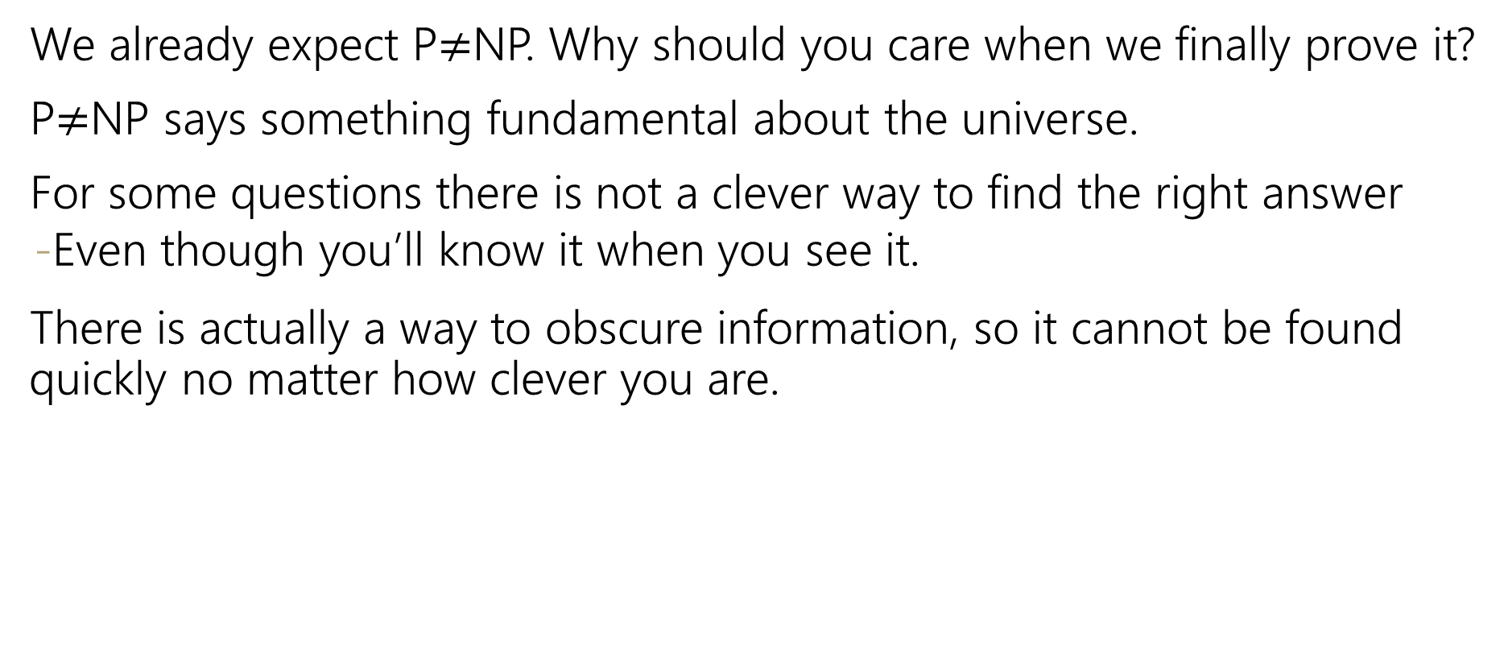
Why Should You Care if P$≠$NP?
We already expect P$≠$NP. Why should you care when we finally prove it?
P$≠$NP says something fundamental about the universe.
For some questions there is not a clever way to find the right answer
Even though you’ll know it when you see it.
There is actually a way to obscure information, so it cannot be found quickly no matter how clever you are.

Slide 41
Why Should You Care if P$≠$NP?
To prove P$≠$NP we need to better understand the differences between problems.
Why do some problems allow easy solutions and others don’t?
What is the structure of these problems?
We don’t care about P vs NP just because it has a huge effect about what the world looks like.
We will learn a lot about computation along the way.

