Slide 1
Company and Product Overview

Slide 3
About Us
Create, consolidate, enrich, certify and govern all your master data across all business domains
Innovative Company
Innovative Products
15+ years of successful track record in Data Integration
From the founders of Sunopsis (ETL) acquired by Oracle in 2006
Regrouping Industry Data Integration and MDM experts
Lessons learned from traditional MDM and decade of pioneering in the domain
Convergence for MDM
Convergence Pulse
Convergence for Data Integration
Convergence for Address Verification and Geocoding
Market Recognition
Innovative leader in the MDM market with introduction of Evolutionary MDM
International customers

Slide 4
Evolutionary MDM

Slide 5
Evolutionary MDM – Domain Agnostic
MDM Styles - As Presented by Gartner and Others...
Registry Hub
Consolidation Hub
Cross-Reference index
Consume source data
No data consolidation
Author
De-dup, Enrich & Merge
Author
Read &
Stewardship
Read
Read-access only
Stewardship Workflows
Federated queries
Index
Publish to consuming Apps
MDM
Non intrusive
Non intrusive
May not scale
Highly scalable
Co-Existence Hub
Transactional Hub (Centralized)
Consume source data
Authoring in MDM (ONLY)
De-dup, Enrich & Merge
Author
Read &
Stewardship
Data Authoring Workflows
Author &
Approve
Read &
Stewardship
Stewardship Workflows
Stewardship Workflows
Publish to consuming Apps
MDM
Publish to ALL Apps
MDM
Closed-loop to source Apps
Single point of « Truth »
More Intrusive
Most Intrusive

Slide 6

Evolutionary MDM – Domain Agnostic
As Proposed by Semarchy
Semarchy Convergence for MDM
Support ALL implementation Styles (simultaneously)
Author
Author
Manage
Read
Read
Consumes source data
Semarchy Convergence
Orchestrates authoring and de-duplication workflows
Profile
Apps
Metrics
Certifies Golden Data
Data Integration
Convergence Hub
Certification Process
Distributes and shares certified data
Enrichment Plug-ins
Share
Evolves at the pace of the business requirements’ maturity

Slide 7
Evolutionary MDM – Platform Agnostic
Cloud Solution = OnPremises Solution
Same Price
Same Skills
Same Features
Ultimate Flexibility

Slide 8
Evolutionary MDM – Metadata Driven
Logical model seemlessly generates Physical model
Eliminates duplicate management efforts
Creates highly agile data management environment

Slide 9
Semarchy Convergence
The Evolutionary MDM Platform

Slide 10
Semarchy Functional Areas
Convergence for MDM | Multi-domain MDM
 | Data Modeling
 | Business Glossary
 | Data Quality
 | Data Enrichment
 | Match/Merge
Convergence Pulse (optional) | Data Profiling
 | Data Quality Dashboards
Convergence Data Integration (optional) | Batch loading
 | Real-time/trickle feed

Slide 11

















Semarchy Convergence™ Architecture
Evolutionary
Governance
Framework
Establish Goals
Engage Stakeholders
Align Activities
Communicate Achievements
Exercise Governance
DISCOVER
INTEGRATE
STANDARDIZE & ENRICH
CONSOLIDATE & AUTHOR
MEASURE & MONITOR
SHARE
Existing Applications
Convergence Pulse Profiling
Convergence for Mdm
Convergence Pulse Metrics
Discover
Design
Author
Dedup
Validate
Approve
Search
Imp/Exp
Monitor
Measure
Profiling Warehouse
Application Server
(Any JEE)
Excel
3rd Party BI
MDM Applications
Convergence for Data Integration
Certification Process
Convergence Hub
(Oracle Database)
Metrics Warehouse
Soap
Publish
Validate
Third Party Middleware (ETL / ESB / SOA)
Java
Consolidate
Get Value!
XRef
Golden
Match
Landing
Convergence for Address Verification and Geocoding
SQL
Enrich
Reject
Master
360° View
Convergence Plug-ins
Consistency
Other sources
(Duns, LexisNexis,Facebook, Linkedin, …)
Plug-in API
Address
Transliterate
Telephone
Completeness
Email
Social
Custom…
Compliance

Slide 12
SUCCESS STORIES

Slide 13




















Semarchy Success Stories
By Domain
 | First Iteration | Second Iteration
Party Customers, Suppliers, Resellers, Partners, etc.
Thing Products, Services, Assets, etc.
Location Geographies, Stores, Addresses, Subsidiaries, etc.
Organization Org Structure, Employees, BUs, Cost Centers, etc.

Slide 14
Proof of Value

Slide 15
Proof Of Value
What is it?
A complete MDM application designed for you with your data in just a few weeks!
Prove the value of your MDM initiative
Minimize your risks with a pragmatic approach
Justify your ROI on a subset of your data
Augment your chances of success through a first iteration

Slide 16

Proof Of Value
How does it work?
1
2
3
You send us a subset of your data
We discover your data with you and define goals and metrics
We work on your data and processes using our software
We show you intermediary results and discuss findings
We refine the final deliverables
We demo the results to you and your team
We give you access to the results and our software for 30 days
6
5
4
7

Slide 17

Proof Of Value
Engagement
YOU & US
1
First contact to understand the scope of your initiative
Domain (products, parties, supplier, organization, etc.)
Strategic Goals and Vision
Agreement on a significant subset of data
Execution of a Mutual Non-Disclosure Agreement
Signature of the SEMARCHY POV Purchase Order
Understand Your Project Goals & Scope

Slide 18

Proof Of Value
Access to your data
YOU
2
You upload a subset of your data to our secured file server
CSV or Excel format
You give us a short description of each of your data files (files and columns descriptions)
You give us a short description of the original source applications from which the files originated
You send us a subset of your data

Slide 19


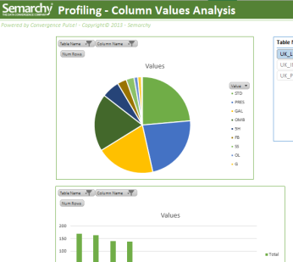
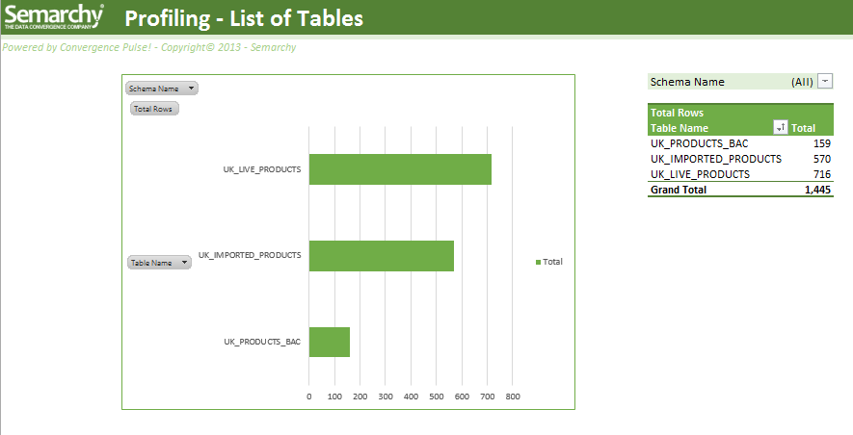
Proof Of Value
Data Discovery
YOU & US
3
We profile your data with Convergence Pulse™ Profiling
We understand your source data
We share information on our initial findings with you
We define the target data model
We understand your business rules
We understand your current processes and workflows
We discover your data with you and define goals and metrics
Convergence Pulse Profiling
Discover
Profiling Warehouse

Slide 20
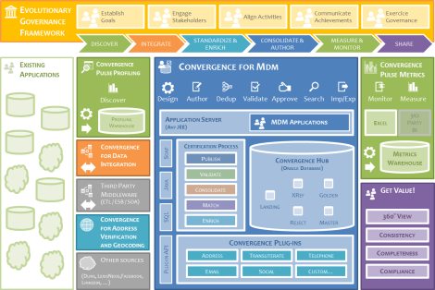
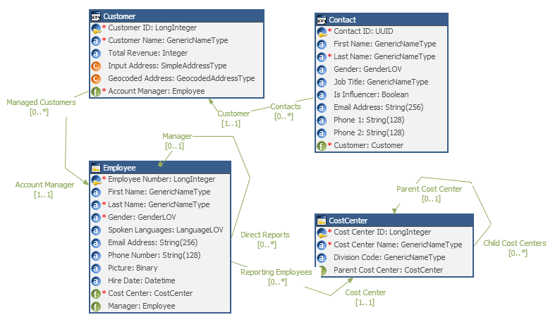
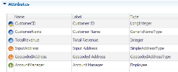
Proof Of Value
1st Iteration – Initial Design
US
4
We model your domain with Convergence for MDM™
Entities, attributes, relationships
Standardization rules
Data quality rules
Matching and consolidation rules
Authoring and Navigation User Interface and hierarchies
Collaborative Human Workflows
We load and certify your data in Convergence for MDM™
We prepare the first reporting dashboards on your metrics using Convergence Pulse™
We work on your data and processes using our software
Nous découvrons vos données avec vous et fixons les objectifs

Slide 21
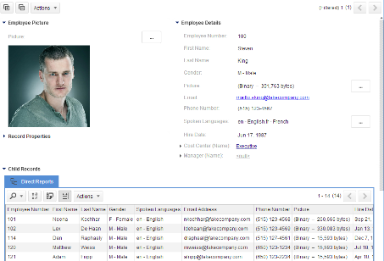
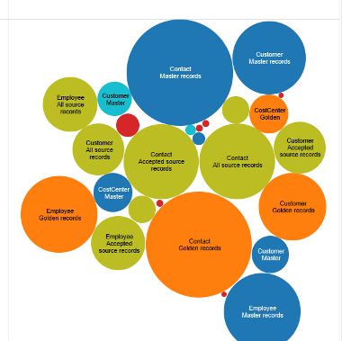
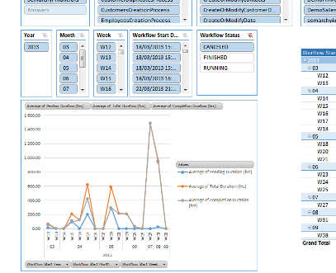
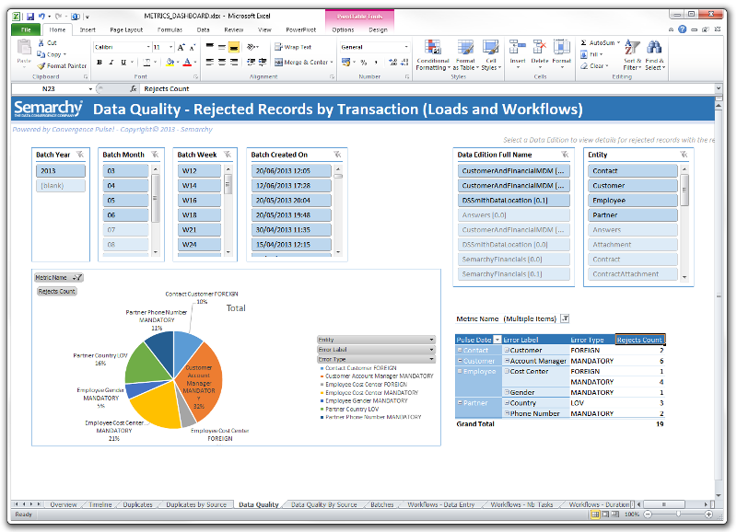
Proof Of Value
Intermediate Milestone
YOU & US
5
We present the intermediate results to you using Convergence for MDM™
De-duplicated records, consolidation results, enriched and standardized data
Search and Navigation
Authoring and validation workflows
We challenge the results with you using Convergence Pulse™
Duplicates analysis
Rejected records analysis
Conformity and Completeness analysis
We show you intermediary results and discuss findings
Nous découvrons vos données avec vous et fixons les objectifs

Slide 22

Proof Of Value
2nd Iteration – Refining the Results
US
6
We apply the changes discussed in the data model
We improve the user experience in the data stewardship and data access applications
We refine the metrics
We rerun a complete integration of your data sets using Convergence for Data Integration™ Convergence for MDM™ and Convergence Pulse™
We refine the final deliverables
Nous découvrons vos données avec vous et fixons les objectifs

Slide 23

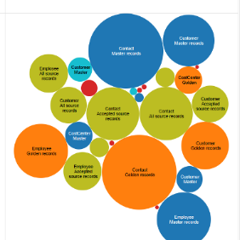
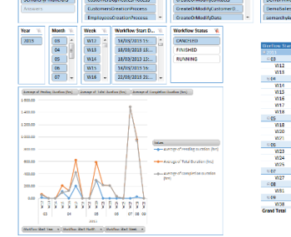
Proof Of Value
On-Site Demo
US
7
On-site demo of the results to you and your team
Methodology
Profiling in Convergence Pulse™
Data Quality Metrics and Duplicates analysis dashboards in Convergence Pulse™
Data transformations and loading in Convergence for Data Integration™
Data model and data certification rules in Convergence for MDM™
Workflows and user interactions with your data
Conclusions and Deliverables
Strategic presentation of your challenges and ROI
Dashboards and metrics reports
We demo the results to you and your team
Nous découvrons vos données avec vous et fixons les objectifs

Slide 24

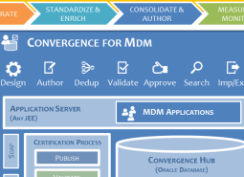
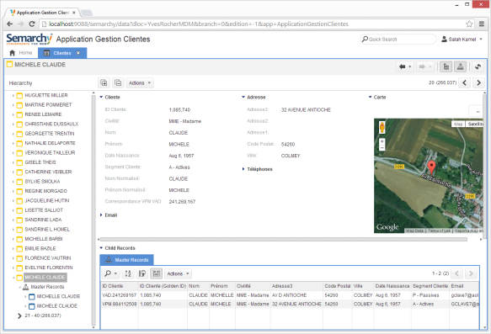
Proof Of Value
30 day Unlimited Access
YOU & US
8
We grant you an unlimited access to Semarchy Convergence™ for 30 days
Installed and configured on your machines OR
Installed and configured on Amazon’s Cloud
Support and assistance
1 Semarchy expert dedicated to your deployment
Unlimited access to Semarchy technical resources and documentation
We give you access to the results and our software for 30 days

Slide 25
Deliverables

Slide 26





Proof Of Value
Deliverables
Strategic PowerPoint presentation with results
HTML Documentation of your data model, rules and processes as generated by Convergence for MDM™
MDM Metrics dashboards from Convergence Pulse™ in MS Excel format
Oracle database export of the development environment and results ready to be imported in your on-site environments
Data Profiling reports from Convergence Pulse™ in MS Excel format
Evolutionary Governance Framework™ design methodology in MS Excel format
Zip export of ETL mappings and processes designed in Convergence for DI™

Slide 27
POV Examples

Slide 28
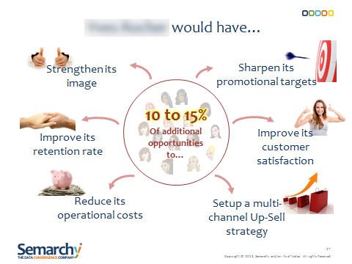
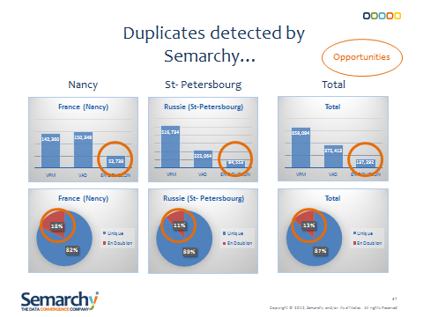
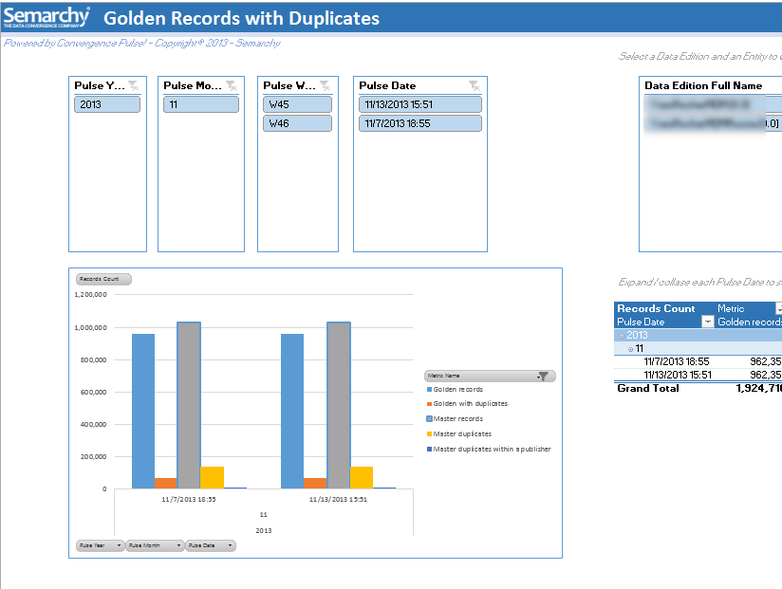
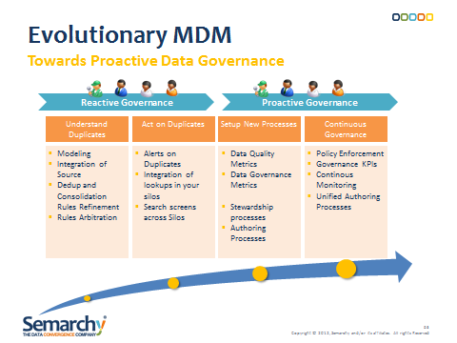

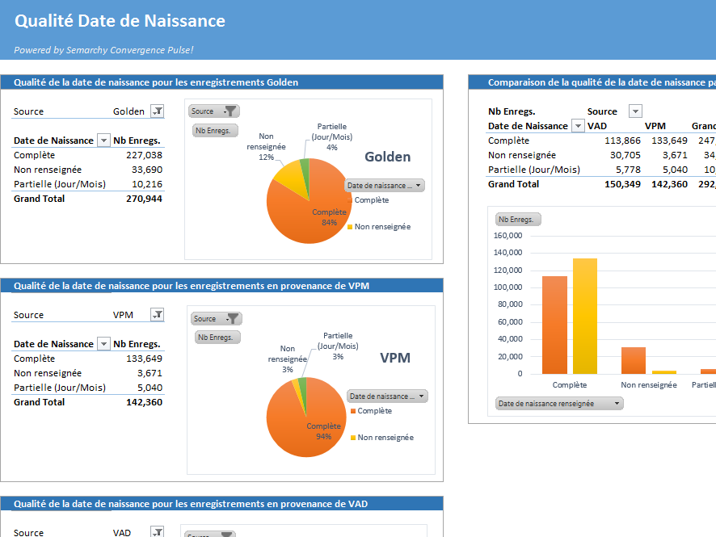
Cosmetics (B2C)
360° Customer View – Target 35M Identities across 8 sources
Strategic Presentation of Goals
Opportunity Analysis
Duplicates Trend over Time
Evolutionary MDM Roadmap
Semarchy MDM Aplication
Data Quality Analysis

Slide 29
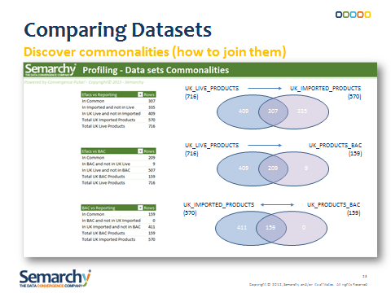
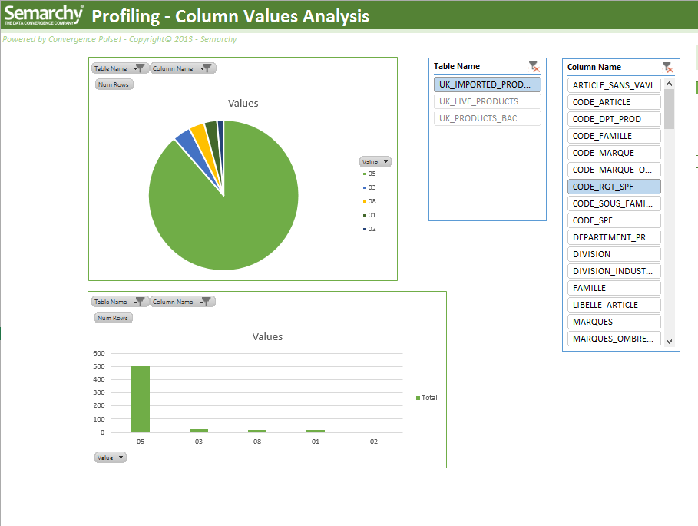
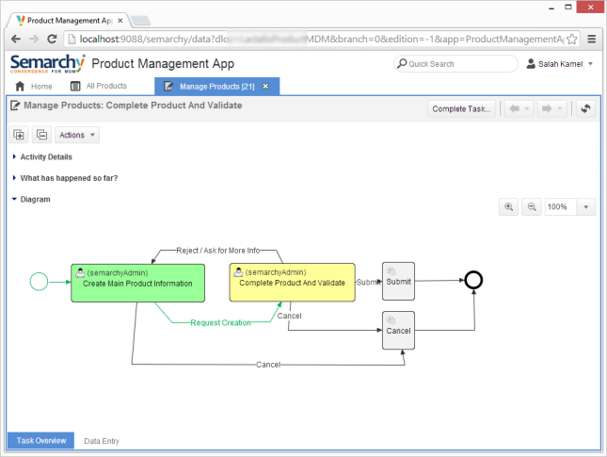
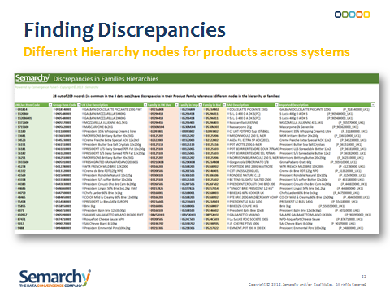
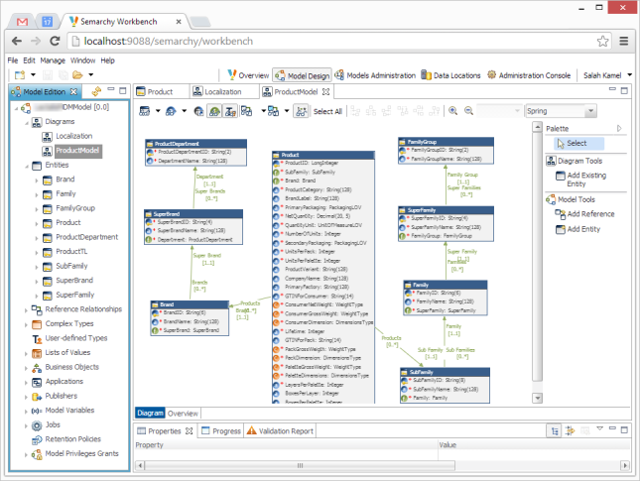
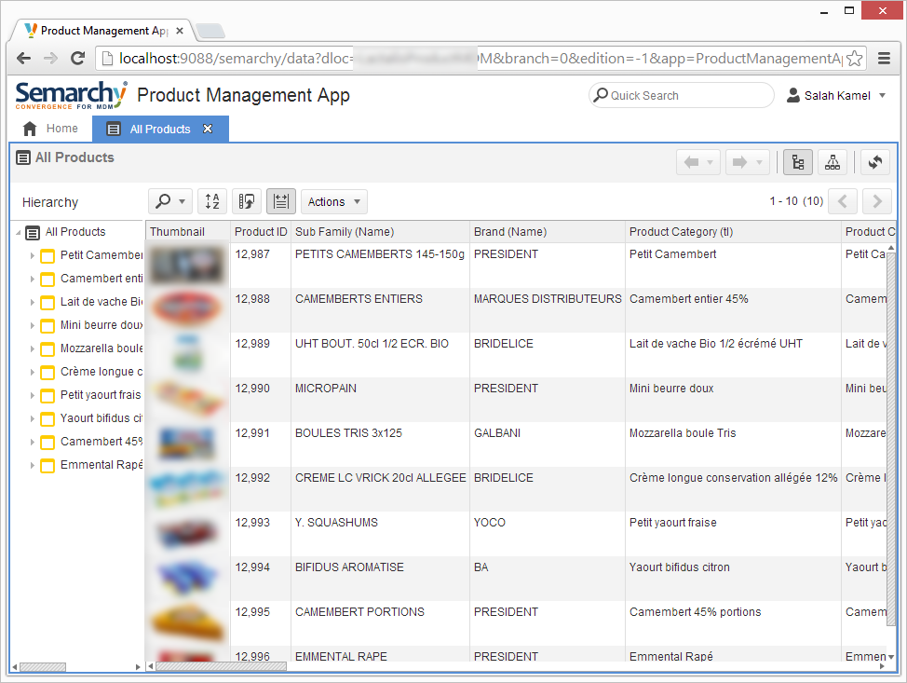
Retail (B2C)
Product Centralization – Target 150K Products, 1.5K Users, 25 Countries
Results Presentation
Sources Data Profiling
Workflows Orchestration
Cross Silos Discrepancies Analysis
Complex Data Modeling
Product Management Application

Slide 30
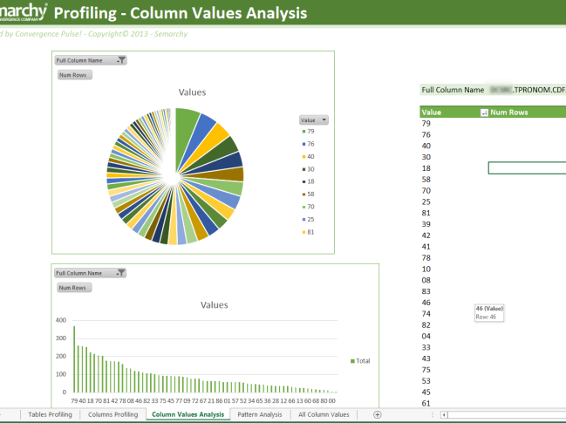
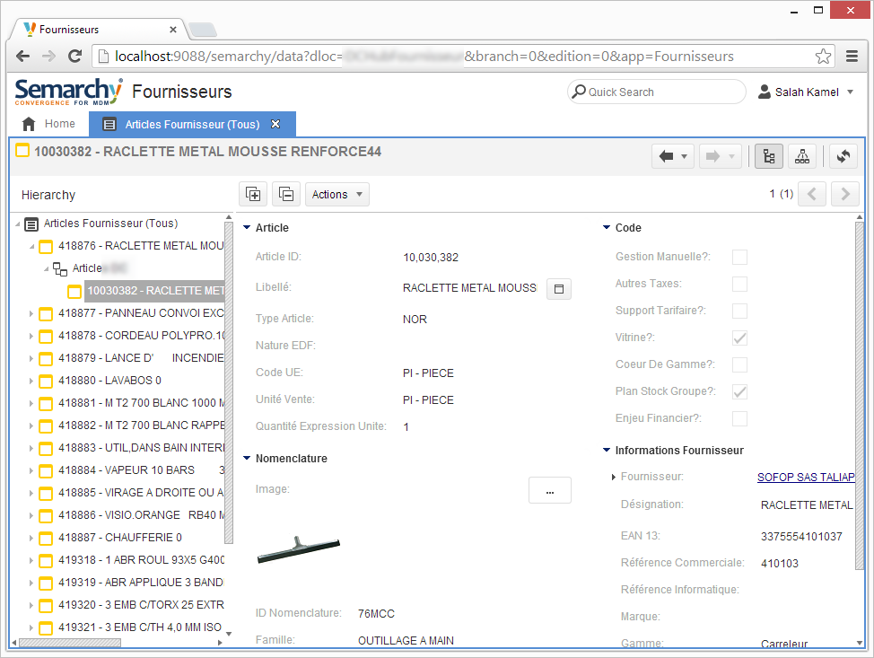
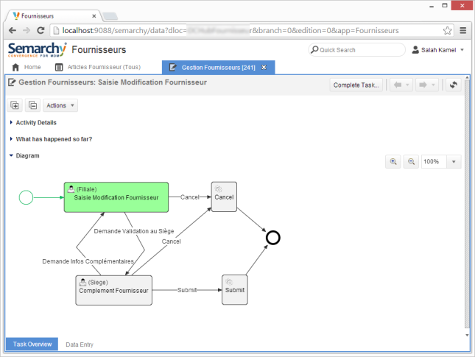
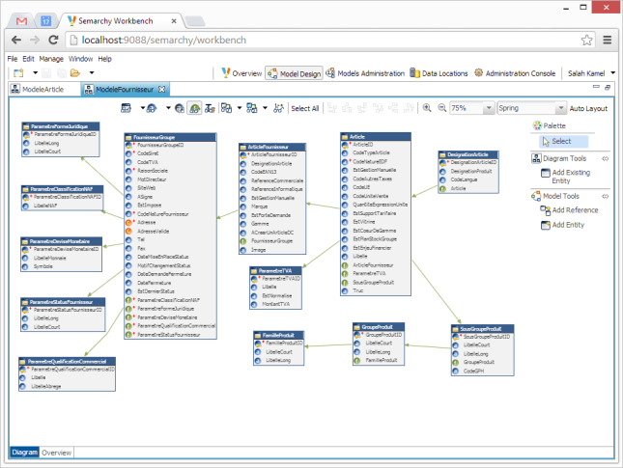
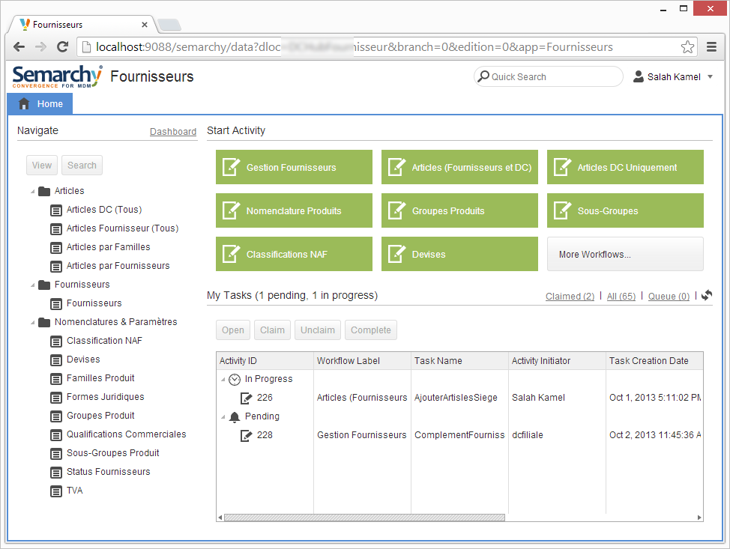
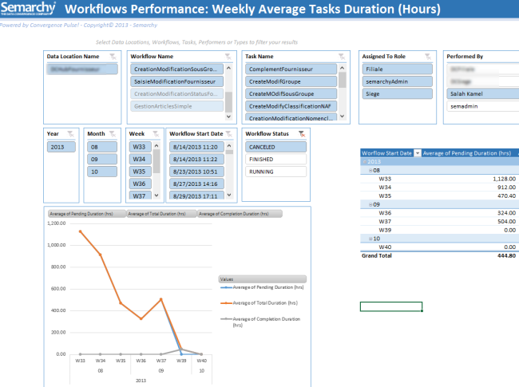
Construction (B2B)
Products and Suppliers MDM – Target 2M Products, 500+ Users
Data Discovery and Profiling
Products Management in MDM
Workflows Orchestration
Complex Data Model
15+ Management Workflows
Workflows Performance Analysis

Slide 31
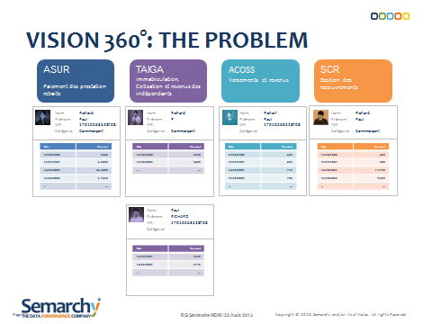
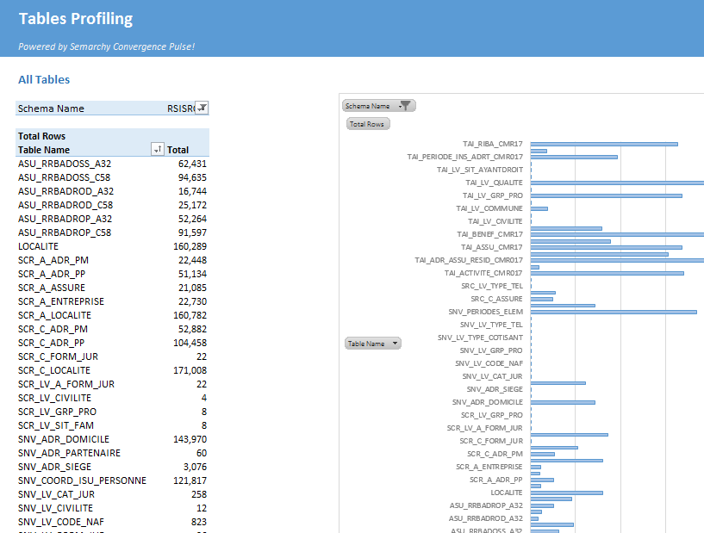
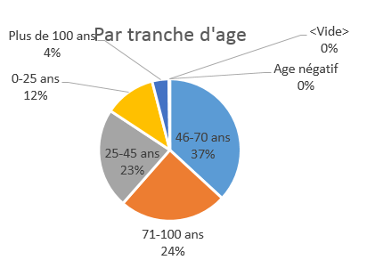
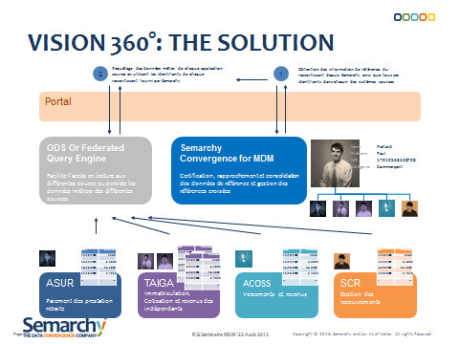
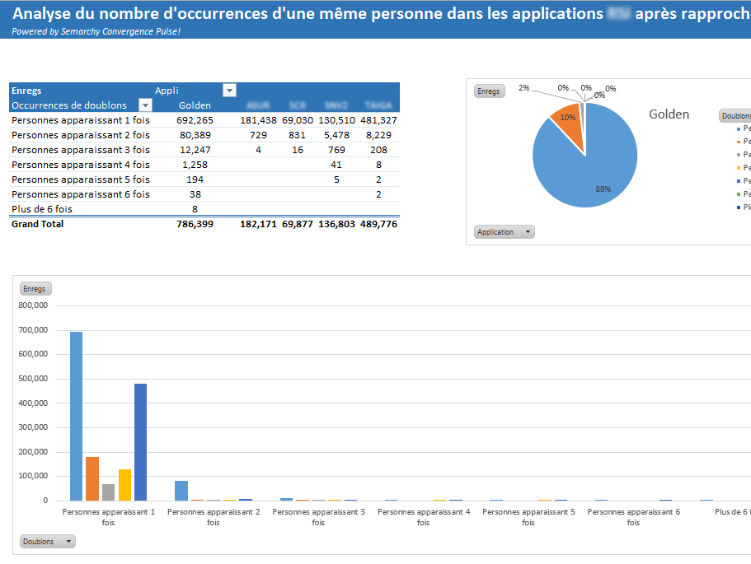
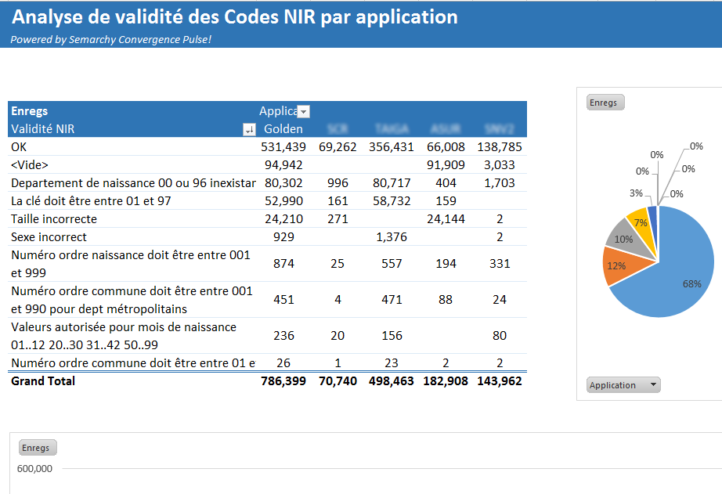
Social Security and Pensions (France)
360° Policy Holders Consolidation – Target 20M Identities
Strategic presentation
Source Data profiling
Age ranges of consolidated IDs
Target architecture
Duplicates by source (4 sources)
SSN data quality issues

Slide 32
Alan Missroon
alan.missroon@semarchy.com
+1 770 329 8749

