Slide 1
Presentation: DW/BI Lifecycle Overview and ETL
Erik Perjons
DSV, Stockholm University

Slide 2
DW/BI Lifecycle Overview

Slide 3
































DW Architecture
Data staging
Monitoring & Administration
Analysis
Analytic applications
 | Productt | Time1 | Value1 | Value11
 | Product2 Product3 | Time2 Time3 | Value2 Value3 | Value21 Value31
 | Product4 | Time4 | Value4 | Value41
OLAP
cubes
Metadata repository
Data warehouse
Operational DBs
Ad hoc Query/Reporting
Extract Transform Load Refresh
Access
External sources
Forecasting, scoring, Data mining
Data marts
Falö aöldf flaöd aklöd falö alksdf
Data sources
Staging Tables & ODS
RDBMS, Rolap, Molap, Holap

Slide 4
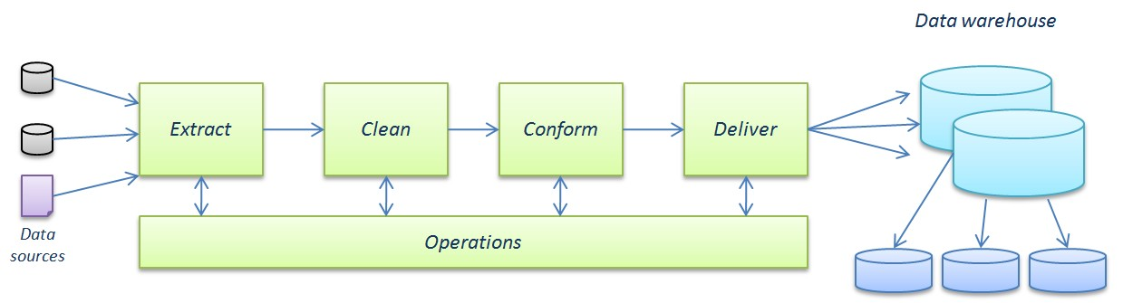





The ETL Process Steps
Transformation step: Clean and Conform
Load
/Data processing
Flat Files
Staging tables
Data staging area

Slide 5
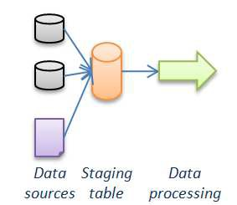
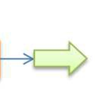

ETL design decision
Use a staging table or not

Slide 6
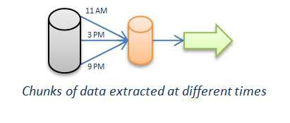

ETL design decision
Use one staging table for several sources or one staging table for one source

Slide 7
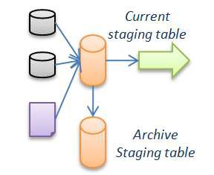

ETL design decision
Archive the data in the staging table in another database or not

Slide 8
ETL design decision
Load the data staging table at one or several occasions

Slide 9
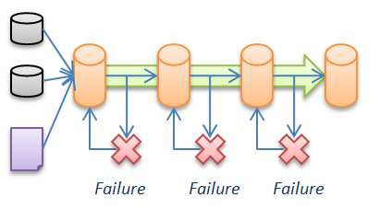
ETL design decision
Use one or several data staging tables during data processing

Slide 10
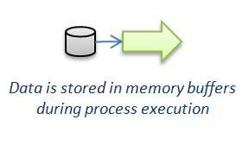
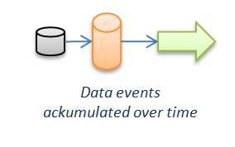
Data staging pattern
The different design decision can result in a number of well-known data staging pattern
Staggered staging
Persistent staging
Pipeline staging
Chuncked ackumulated staging
Ackumulated staging

Slide 11
Staggered staging
Data is stored in staging tables throughout the ETL process, where each staging table contains data with higher value
This pattern can support recovery, that is, the whole ETL process does not need to be processed again when a failure is happening

Slide 12
Persistent staging
A copy of the data in the staging table is stored in another database
This pattern is used for data auditing and other reasons

Slide 13
Pipeline staging
Data are not stored in data staging tables, instead data are stored in memory bufferts during processing
This pattern can be used for higher data throughput, but descrease the ability to handle changes in the data

Slide 14
Chunked Accumulated Staging
Data is extracted from source system in smaller chunks at different times
This pattern is often used in high transaction environments

Slide 15
Accumulated Staging
The staging table is used for detect and accumulate data changes from extracted data
This pattern is often used when the source systems cannot provide info of which data that are new since last extraction

Slide 16
Different aspects of ETL
Design the ETL architecture, staging tables, script and transformation rules – to enable the execution of the ETL process
One time historic load processing – when the DW is loaded for the first time with records from the source systems
Incremental load processing – when the DW is loaded daily with new records daily (or using some other time interval for load)

Slide 17
ETL process issues
Kimball/Ross presents 34 ETL Subsystem and Techniques to be applied in order to manage different kinds of issues related to the ETL process

Slide 18
Source system issues
Issue: How to check data quality in the source system?
Solution: Carry out data profiling activities using a data profiling tool
A data profiling tool can be used to measure the conformance of data to data quality rules, which need to be specified.
However, a data profiling tool can also be used to discover possible data quality rules, for example, the tool can detect that a column in the database always has a unique value, therefore, the tool suggests that that column should have a uniqueness data quality rule

Slide 19
Source system issues
Issue: How to handle low data quality identified in the source systems?
Solutions:
Send the source system owner a request for improvement of data quality in the source system
Specify requirements and implement data quality improvement in the ETL process

Slide 20
Extract issues
Issue: How identify changes in the sources system to be extracted and loaded into the data staging area, that is, how to perform so called change data capture (CDC)
Solution:
source system can include audit files (created by for example triggers when data is inserted or changed) with date and time when a record was added or modified
compare a yesterdays data with the today’s data, record by record – can be carried out in the source system (preferable) or inte data staging area (may require that the whole database to betransferred into the data staging area)
use a checksum algoritm (CRC) to check if a complex record is changed

Slide 21
Extract issues
Issue: Which method to use for transfering data – batch/file or streaming?
Solution: Extracts in form of files has many advantages over streaming:
the extraction is easy to rerun due to failure
the extraction is easy to encrypt and compress,
it is easy to verify that all data have been transfered

Slide 22
Data cleansing issues
Issue: How to identify data quality issues in the data loaded into the data staging area?
Solution: Carry out data profiling analysis in form of quality screens, which are diagnostic filters in the data flow pipelines. Each quality screen is a test and if the test fail, an error event is dropped, such as identified NULL values (column screen, test data in one column), violation of referential integrity (structure screen, i.e., test relationship of data accross columns), or violation of business rules (business rules screen)

Slide 23
Data cleansing issues
Issue: How to handle data quality issues identified in the data loaded into the data staging area?
Solution: If an quality issue occures (that is, an error event is dropped) the following can be done:
Halt the data flow/process
Send the data into suspension
Tag the data (the preferred option, according to Kimball/Ross)

Slide 24
Data cleansing issues
Issue: How to document identified error events?
Solutions:
Create a star join schema to be used in the data staging area with an error event fact table and dimensions such as Batch dimension, Data dimensions, and Scrre dimension?
Add an audit dimensions for each star join schema with info about errors

Slide 25
Dimension building issues
Issue: How to mange attribute values that have changed and thereby differ from the values already stored in the DW?
Solution: Select and apply appropriate Slowly changing dimension (SCD) techniques, or select a Minidimension

Slide 26
Dimension building issues
Issue: How to add a surrogate key to the rows in the dimensions?
Solution:
Introduce a robust mechanism for producing surrogate key, for example a surrogate key generator that independently generate keys for every dimensions.
Make use of a table in the data staging area where the natural keys and surrogate keys are mapped. This can be used to identify new rows to be added in the dimensional table: a new natural key value, means a row that needs to be added to the DW

Slide 27
Dimension building issues
Issue: How to create conformed dimensions from different source systems?
Solution: Data from multiple systems need to be combined and integrated according to some strategy, for example applying attribute mapping model

Slide 28
Attribute mapping model
Attribute Mapping Model - make one attribute mapping model for each dimension
Carry out the following steps:
Step 1: List the attributes for a dimensional table
Step 2: List the relevant attributes in the source databases
Step 3: Map the source attributes to the attributes in the dimensional table.
Step 4: Add transformation rules for the source attributes

Slide 29
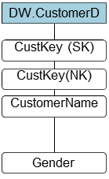
Attribute mapping model
Step 1: List the attributes for a dimensional table

Slide 30
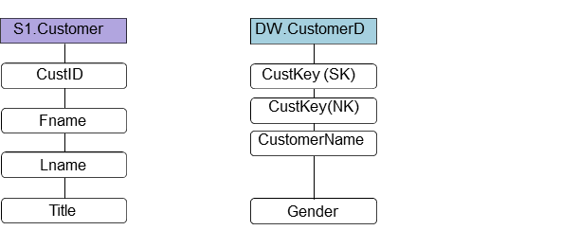
Attribute mapping model
Step 2: List the relevant attributes in the source databases

Slide 31
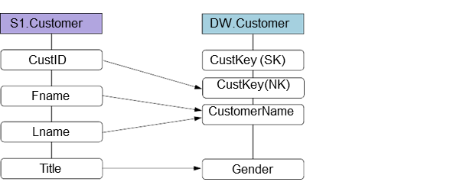
Attribute mapping model
Step 3: Map the source attributes to the attributes in the dimensional table

Slide 32
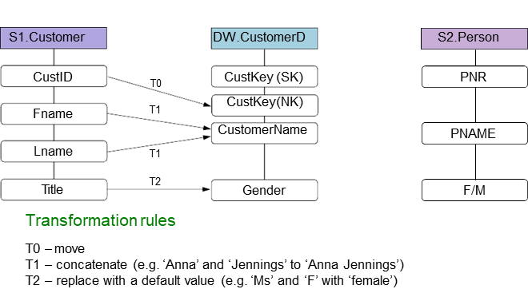
Attribute mapping model
Step 4: Add transformation rules for the source attributes

Slide 33
Attribute mapping model
Step 2: Add additional source: List the relevant attributes in the source databases

Slide 34
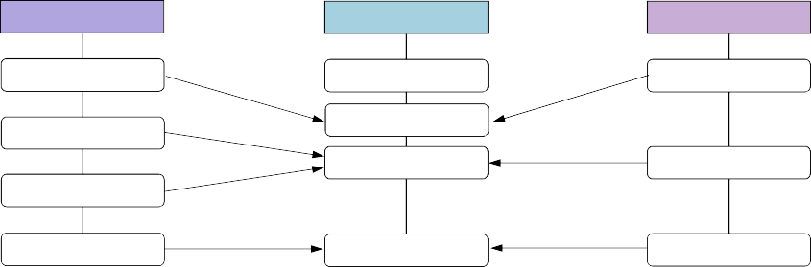
Attribute mapping model
Step 3: Map the source attributes to the attributes in the dimensional table
S1.Customer DW.CustomerD S2.Person
CustID CustKey (SK)
T0
PNR
T0
CustKey(NK) CustomerName
Fname
T1
T3
PNAME
Lname
T1
T2 T2
F/M
Title Gender
Transformation rules
T0 – move
T1 – concatenate (e.g. ‘Anna’ and ‘Jennings’ to ‘Anna Jennings’) T2 – replace with a default value (e.g. ‘Ms’ and ‘F’ with ‘female’)
T3 – parse, clean, change case, concatenate (e.g. ‘JENNINGS, ANNA’ to ‘Anna Jennings’)

Slide 35
Attribute mapping model
Step 4: Add transformation rules for the source attributes
S1.Customer DW.CustomerD S2.Person
CustID CustKey (SK)
T0
PNR
T0
CustKey(NK) CustomerName
Fname
T1
T3
PNAME
Lname
T1
T2 T2
F/M
Title Gender
Transformation rules
T0 – move
T1 – concatenate (e.g. ‘Anna’ and ‘Jennings’ to ‘Anna Jennings’) T2 – replace with a default value (e.g. ‘Ms’ and ‘F’ with ‘female’)
T3 – parse, clean, change case, concatenate (e.g. ‘JENNINGS, ANNA’ to ‘Anna Jennings’)

Slide 36
Fact building issues
Issue: How to add a new facts in the fact tables?
Solution: Bulk loading (batch) new rows in the fact table

Slide 37
Fact building issues
Issue: How to maintain referential integrity with the associated dimensional tables when loading the fact table with facts?
Solution: Replace the natural keys with appropate surrogate key existing in the dimensions

Slide 38
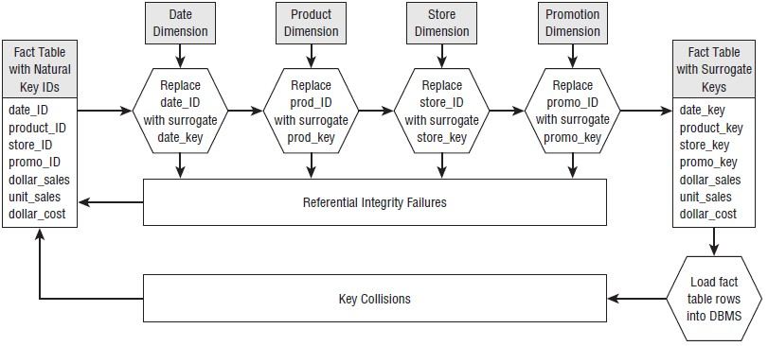
Maintain referential integrity
Important steps:
Assign surrogate key to new rows in the dimensional tables
Populate data in dimensions
Substitute natural key in fact table rows with proper surrogate key

Slide 39
Fact and dimension building issues
Issue: How to handle fact table data arriving much later than dimensional table data?
Solutions:
Search back in history to find the correct dimension keys and, thereby, rows

Slide 40
Fact and dimension building issues
Issue: How to handle dimensional table data arriving later than fact table data?
Solutions:
Wait to load the facts table data if possible
Create a new customer dimension row with a surrogate key with a set of dummy attributes, that later will be changed (type 1 overwrite) when you get complete information of the customer
….

Slide 41
Kimball & Ross: ETL process
Kimball/Ross suggest a ETL process, consisting of three ”subprocesses”, which consist of a number of steps
Subprocess 1: Develop a Plan (Step 1-4)
Subprocess 2: Develop One-Time Historic Load Processing (Step 5-6)
Subprocess 3: Develop Incremental ETL Processing (Step 7-10

Slide 42
Subprocess 1: Develop a Plan (Step 1-4)

Slide 43
Step 1: Draw the High Level Plan
Draw a high-level plan showing sources and targets and imporant info about this transformation
Document the overall ETL strategy
Highlight issues and open problems
Sources
Customer Master (RDBMS)
Slowly changimng on demo-graphics and account status
25M customers in total
10k new/changed customer/day
Target
Customer Dimension

Slide 44
Step 2: Choose an ETL Tool
Tools offers support for advanced and standardized ETL processes
Some commercial tools:
Oracle Warehouse Builder
IBM DB2 Warehouse Manager
Microsoft Integration Services
Some open source tools:
Talend
Enhydra Octopus
Clover.ETL

Slide 45
Step 3: Develop Default Strategies
Decide how extract from each major source system
Decide staging design/patterns
Decide how to handle data profiling
Decide how to manage change in dimension attributes
Decide how to monitoring performance

Slide 46
Step 4: Drill down by Target Tables
Drill down to detailed descriptions of how to transform the data in the source tables to the data in the target table
Design necessary transformations
How to transform source data to target data, including combining separate sources
How to mange hierachies
How to decode production codes with text descriptions
How to assign surrogate keys
How to handle NULL values
How to achieve referential integrity

Slide 47
Subprocess 2: Develop One-Time Historic Load Processing (Step 5-6)

Slide 48
Step 5: Populate Dimension Tables with Historic Data
Carry out extract, transform and load of data for the the dimensional tables

Slide 49
Step 6: Perform the Fact Table Historic Load
Carry out extract, transform and load of data to the fact tables
Create indexes

Slide 50
Subprocess 3: Develop Incremental ETL Processing (Step 7-10)

Slide 51
Step 7: Dimensional Table Incremental Processesing
Carry out extract, transform and load of data of new and changed rows for the dimensional tables
Identify new and changed dimensional rows/column values
Manage changed values of dimensional attributes
Add surrogate key

Slide 52
Step 8: Fact Table Incremental Processing
Carry out extract, transform and load of data in form of new rows for the fact tables
Handling data quality (data profiling)
Manage referential integrity
Create indexes

Slide 53
Step 9: Load Aggregate Table and OLAP load
The aggregate tables and OLAP cubes are loaded with data created by carrying out queries that aggregate data in different dimensions

Slide 54
Step 10: ETL System Operations and Automation
The ETL operations should ideally be run without human intervention – this is hard to attain but not impossible to get close

Slide 55
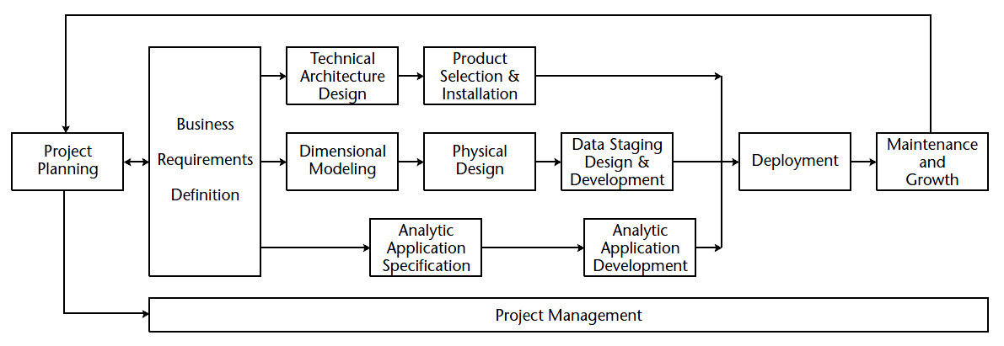
DW/BI Lifecycle Overview
The road map outlines the steps needed to be taken in a DW/BI Project
The diagram shows:
Task sequence
Dependency
Concurrency

Slide 56
Program/Project Planning & Management
Assessing readiness
Sponsorship: ”Business partner-in- crime” or CIO?
Business motivation: Getting the users onboard
Feasability: resonably clean source data at the right granularity
Establish Scope and Justification
Scope of project
Managable for the IT organisation?
Justification: the cost/benefit ratio
Plan and resources
Launch and maintain plan
Obtain resources

Slide 57
Business Requirements Definitions
Requirements Preplanning
Collect Business Requirements
Users need analysis
Interplay between planning and gathering requriment
Conducting Data-centric interviews
What Data is available?
Documenting Requirements
Key business processes
Prioritizing Requirements
88

Slide 58
Technical architecture design
Establish task force and gather requirements
– Interlinked with project planning and Business requirements definition
Create an architecture model
Determine implementation phases
E.g. divided in implementation of different data marts
Interlinked with the lifecycle data track below
Design Subsystems
Layers, processes etc
See LECTURE 1
Tecnical sollutions and hardware architecture
Replication servers techniques, Rolap, Mopal Holap, dealing with Big Data, etc
Define functionality not covered by major vendor soullution
Interlinked with product selection and installation phase next

Slide 59
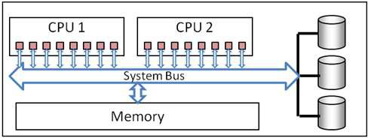
Example of technical architecture concerns: Parallel Processing
SMP or MMP?
The system bus is a
Symmetric Multi Processing (SMP)
Single Server systems with shared resources
Each CPU core can work with any section of memory or disk
E.g. different parts of an sql statement simoulaneously
All memory is available to each core
bottleneck
© Microsoft / Warren Thornthwaite
92

Slide 60

Product Selection & Installation
Understand the purchase process
Can be tricky!
Public Procurement
e.g. LOU Lagen om Offentlig upphandling
Product evaluation matrix
evaluation criteria
Weighting factors to indicate importance for your needs
Conduct market research
The web is great!!!
Request for Proposals (RFP)
kostnadsförslag
Evaluate options
Kimball : Prototyping!!!
Look for alternative solutions
Select product
Install on Trial
Negotiate
94
Be specific! You deal with sellers...

Slide 61



IS5
Data warehousing
Lifecycle Data Track
Dimensional Modelling
The 4 steps for each model
Physical Design
Develop naming and database standards
Develop Physical database Model
Optimization issues
Develop initial Index plan
Design aggregations
ETL design and developement
Draw high-level plan
Choose an ETL tool
Develope default strategies
Drill down by target table
Populate dimension tables
Load the fact table
Incremental processing
Load aggregates
System operation & Automation
96

Slide 62
Lifecycle BI Application Track
BI Application Specification
Grounded upon requirement documentation create 10-15 BI reports and analytic applications
Define and use standardized interface
Usability!
Bi Application Developement
Preconditions:
Database design is complete
BI-tools and meta data installed
(Subset of) Historical data is loaded
But before the ETL process is completed
Important feedback from developement process!
97

Slide 63
Lifecycle BI Application Track
BI Application Specification
Grounded upon requirement documentation create 10-15 BI reports and analytic applications
Define and use standardized interface
Usability!
Bi Application Developement
Preconditions:
Database design is complete
BI-tools and meta data installed
(Subset of) Historical data is loaded
But before the ETL process is completed
Important feedback from developement process!
97

Slide 64
ETL

Slide 65
























What goes on in the Backroom?
The back room
The front room
OLAP
Cubes
BI Tools
Data warehouse
Analysis
Operational DBs
Productt | Time1 | Value1 | Value11
Product2 Product3 | Time2 Time3 | Value2 Value3 | Value21 Value31
Product4 | Time4 | Value4 | Value41
ETL
External sources
Serve
Query/Reporting
Data sources
Data marts
Data mining
Falö aöldf flaöd aklöd falö alksdf

Slide 66

IS5
Data warehousing
The ETL
Extraction
reading and understanding the source data
copying the data into the staging area
Transformation
cleansing the data (correcting misspellings, resolving domain conflicts, dealing with missing elements, parsing into standard formats)
combining data from multiple sources
de-duplicating data
assigning warehouse keys
Loading
loading the data into the data marts
indexing the newly loaded data
publishing and notifying the users

Slide 67

ETL Definition
ETL processes are responsible for
Set of processes by which
– the operational source data is prepared for the data warehouse.
The primary processes of the backroom data staging area of the data warehouse, prior to any presentation or querying. Consists of
the extraction of data from heterogeneous operational data sources,
their transformation (conversion, cleaning, normalization, etc.) and
their loading into the DW.
[Luján-Mora Vassiliadis & Trujillo 2004]
extracting operational data from a source application,
transforming it,
loading and indexing it,
quality-assuring it, and
publishing it
[Kimball & Ross 2002]
6

Slide 68

IS5
Data warehousing
© Heidelberg University
ETL Overview
THE 4 ETL PROCESS STEPS

Slide 69

Data Extraction
Raw data is retrieved from sources
often a complex diversity of sources
E.g. relational databases
flat files
legacy systems.
include activities such as
reading source-data models
connecting to and accessing data
scheduling the source system and intercepting notifications and daemons
capturing changed data
staging the extracted data to disk
10

Slide 70
Data Cleansing
Dirty data
Activities
Data of low quality
Due to user entry errors
data that has been corrupted in transmission or storage
data that has been duplicated while merging data from different sources.
Enforce column properties
Enforce structure
Enforce data and value rules
Enforce complex business rules
build a metadata foundation describing data quality
stage the cleaned data to disk
document commenced changes to the data
Data profiling
establish baseline indicators
assesses data quality on data sets
(not focus on errors on specific records)
3 things to do
fix the data
Discard the data
stop processing
Three phases in Data Cleansing [Maletic]
Define and Determine Error Types
the error types that are present in the data needs to be defined and determined.
Search and Identify Error Instances
the data set needs to be searched to identify the error instances
Correct the Uncovered Errors
the uncovered errors need to be corrected
or rejected
Data Cleansing
– applies data profiling on dirty data
11

Slide 72
Data Conformation
The activity of integrating data (usually) from different sources
Activities such as
conforming business labels in dimensions
conforming business metrics and performance indicators in fact tables
Deduplicating
commence householding
internationalizing and staging the conformed data to disk
Data needs to be made identical in structures
Codes, etc., needs to be standardized
Invalid records need to be filtered out
Duplicate records need to be lifted out
Enterprise wide agreements
Data conformation is achieved in a three phase process:
Adherence to organizational business rules,
agreeing on standards and common terminology, measures, labels,
conformity concerns
format issues,
writing notation
et cetera.
standardizing data
matching and deduplicating data
surviving, i.e. to distilling a set of matched records into a unified set of data to build dimension table records.

Slide 73

IS5
Data warehousing
Data Delivery
All previous steps lead up to this…
Consist of the following activities:
loading flat and snowflake dimensions,
generating time dimensions,
loading degenerate dimensions,
loading sub dimensions, loading type 1, 2, and 3 slowly changing dimensions,
conforming dimensions and conforming facts,
handling late-arriving dimensions and late- arriving facts,
loading multi-valued dimensions,
loading ragged hierarchy dimensions,
loading text facts in dimensions,
running the surrogate key pipeline for fact tables,
loading different fact tables, loading and updating aggregations and…
staging the delivered data to disk into a
13
data warehouse or to data marts

Slide 74
34 components of an ETL system
The components of an ETL system
a best-practice initiative
To design effective and efficient Data Integration environments
for Data Warehousing using the Dimensional Model.
represent a relatively complete picture of what is needed for ETL Integration.
The subsystems are grouped in:
Data Extraction subsystems
Cleansing and Conforming
Data subsystems
Data Delivery subsystems
And…
Management subsystems
Management is an often forgotten aspect of ETL systems

Slide 75
IS5
Data warehousing
ETL Design Process
Develop the ETL Plan
Develop One-Time Historic Load Processing
Develop Incremental Processing

Slide 76
Design the ETL Plan
High-Level Plan
Document the whole ETL strategy
Highlight issues and open problems
Choose ETL tool
Tools offers support for advanced and standardized ETL processes
Some commercial tools:
Oracle Warehouse Builder
IBM DB2 Warehouse Manager
Microsoft Integration Services
Some open source tools:
Talend
Enhydra Octopus
Clover.ETL
Develop Strategies
Extract from each major source system
Use of triggers, logs
Staging techniques
High level Data profiling
Manage change
Monitoring Performance
Develop Specialized Strategies by Destination tables
Detailed analysis of what transformation techniques should be used
Ensure clean hierarchies
E.g. analyzing Foreign Key constraints
Detailed load schematics
E.g. Attribute mapping model
18

Slide 77
IS5
Data warehousing
Historical loading of D & F
Populate dimensions with historic data
Data type conversion and other simple transformations
Combine data from separate sources
Decode and extract production codes
Validate normalized data constraints (for hierarchies)
Many to one couplings
One to one couplings
Surrogate Key assignment
Create pre-populated dimensions
Load Fact Tables with historic data
First time load. Usually in huge volumes
Capture useable data
Not data that solely is used for operational reasons
Audit data quality
Dealing with nulls
Ok in facts
Not ok in Foreign Keys
Ensure granularity consistence
Referential integrity
Between fact table and dimensions

Slide 78

IS5
Data warehousing
Historical loading of Fact Tables
Loading steps:
Disable referential integrity
i.e. Foreign keys
Drop (or disable) indexes
Load the data
Create (or enable) fact table indexes
Adress partition issues
Ensure all dimensions has an unique surrogate key column
Enable referential integrity between Fact table and dimensions

Slide 79
IS5
Data warehousing
Incremental loading of D & F
For Dimensions
Identifying new and changed rows
See exampe next slide
Aggregate tables and Olap Loads
Recalculating facts
Recalculating keys
E.g. from date to month
For Fact Tables
Usually incrementally processed
Managing surrogate keys
System operation and automation
Monitoring & Administration
Performance issues

Slide 80















IS5 Data warehousing
Incremental loading of Dimensions
Input Yes
New row?
Add new row to dimension
No
Changed row?
Yes
SCD1?
Yes
Update row
No
No
End processing row
SCD2?
Yes
Add new row with new key and date
No
Adapted from Kimball & Ross 2013
One time design change or Customized solution
22

Slide 81

The Data Staging Area (DSA)
Only data management concerning the ETL Process
Do not let business users access data in the DSA
The raw data is loaded to staging tables from the data sources.
The data is then loaded from the staging tables into the transformation process
Finally, the data is delivered to the enterprise data warehouse
or to several data marts
Staging tables
– Tables that temporally store the data used in the ETL process
39

Slide 82
IS5 Data warehousing
Staging Data from Multiple Sources
Staging Data from Multiple Sources
used with multiple sources where data can’t be accessed at the same time.
Data is gathered in a staging table before it is processed.
Enable backup
staging tables can be compressed and stored elsewhere
40

Slide 83
IS5
Data warehousing
Persisted Staging
keeps a copy of the staging table
Enables data auditing
can be used in troubleshooting
Enables comparing data within process
Not only input/output

Slide 84
Staggered Staging
Staggered Staging
stores data from (single or multiple) sources before it is processed,
keeps storing data in staging tables throughout the process
Can act as recovery points
the whole process does not have to be processed again.
faster recovery times
greater storage capacity needs.

Slide 85
IS5
Data warehousing
Accumulated Staging
Accumulated Staging
uses a staging table to detect and accumulate data changes
when the source systems do not provide a built-in mechanism to achieve this.
whether new rows are inserts, updates, or deletes

Slide 86
Chunked Accumulated Staging
Chunked Accumulated Staging
spreads out the data source extraction load in smaller chunks
Process the data when all is gathered
This pattern is often used in high-transaction environments

Slide 87
Pipeline Staging
Pipeline Staging with no staging tables
Do not uses staging tables
streams transformation tasks into a single flow stored in memory buffers.
Enables the data throughput of the process to be enhanced.
A requisite is that data can be extracted and processed at the same time
Decreases ability to improve process recoverability, handle changes in data, et cetera.
45

Slide 88
IS5
Data warehousing
Increasing ETL Throughput
Reduce I/O
Pipeline the ETL process
Only use staging tables when needed
Eliminate Reads/Writes
Use flat files when staging tables are needed
Flat files has more efficient Read/Write access
Filter as soon as possible
Filter before any calculations are made
Less rows needs to be processed
Partitioning & Parallelizing
Use multiple processes in parallel on separate partitions
Parallel Source extraction
Parallel transformations
Partition and load destinations in parallel
Update Aggregates Incrementally
Calculating records on most recent data
Do before loading
Modifying existing aggregate records (tweaking)
Run quality assurance check
Recalculating entirely from atomic data
Very performance heavy
47

Slide 89
Increasing ETL Throughput
Taking only what you need
Avoid loading the same data over and over again
Use triggers and logs
Bulk loading/Eliminating Logging
Loading in bulk is generally faster than inserting rows one by one
It also enables turning of the log (which also consumes resources)
Dropping constraints and indexes
Referential integrity and indexes requires each row loaded to be checked against the constraints
Eliminating Network Traffic
Network traffic is a bottleneck
Consider where to run the ETL process
Consider storage on internal disks
(risking effecting server performance )
Letting the ETL Engine do the work
Avoid
stored procedures,
functions,
database key generators,
triggers
etc.
48

Slide 91
OLAP

Slide 95




IS5
Data wareho
MOLAP
OLAP server
End-user access tools
MDX
request
server5
response
Multi-dimensional Storage
OLAP Server

Slide 96
IS5
Data wareho
MOLAP
OLAP server
End-user access tools
MDX
request
server5
response
Multi-dimensional Storage
OLAP Server

Slide 97
MOLAP
Aggregations of the partition and a copy of its source data is stored in a n-dimensional structure
during partition processing
highly optimized
to maximize query performance.
Storage location
on the computer where the partition is defined
(or) on another computer running Analysis Services.
The data in the partition's MOLAP structure is only as current as the most recent processing of the partition.
Advantages:
fast data retrieval,
optimal for slicing and dicing operations.
Can perform complex calculations:
All calculations have been
pre-generated when the cube is created.
Supports advanced indexing
Disadvantages:
Limited amount of data
Because pre-calculations
only summary-level information will be included if large data amount
Additional investments in human and capital resources are needed.
12

Slide 98



ROLAP
Relational Database server
OLAP server
End-user access tools
server5
request
request
server5
response
response
SQL
OLAP Server
Database

Slide 99
ROLAP
The ROLAP storage mode stores
aggregations of the partition in indexed views in the relational database that was specified in the partition's data source.
does not cause a copy of the source data to be stored.
when results cannot be derived from the query cache, the indexed views in the data source is accessed to answer queries.
Advantages:
Can handle large amounts of data
Can leverage functionalities inherent in the relational database
can save storage space ROLAP enables users to view data in real time
Disadvantages:
Query response is slower
Processing time is slower
Limited by SQL functionalities
for example, it is difficult to perform complex calculations using SQL

Slide 100



IS5
Data wareho
using
HOLAP
Relational Database server
OLAP server
End-user access tools
server5
request
request
server5
response
response
SQL
OLAP Server
MDX
Database
Multi-dimensional Storage

Slide 101
IS5
Data warehousing
HOLAP
The HOLAP storage mode combines attributes of both MOLAP and ROLAP.
Like MOLAP, HOLAP causes the aggregations of the partition to be stored in a multidimensional structure in an SQL Server Analysis Services instance.
HOLAP does not cause a copy of the source data to be stored.
For summary type queries the aggregations of a partition, HOLAP is the equivalent of MOLAP.
Queries that access source data must retrieve data from the relational database and will not be as fast as they would be if the source data were stored in the MOLAP structure.
16

Slide 102
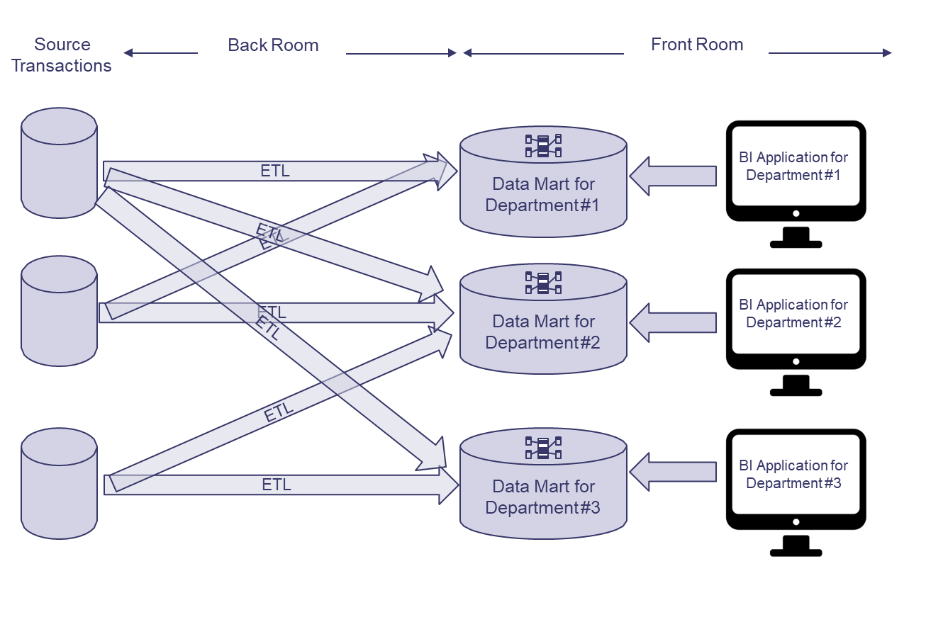
Independent Data Mart Architecture
(Kimball & Ross, 2013)

Slide 103
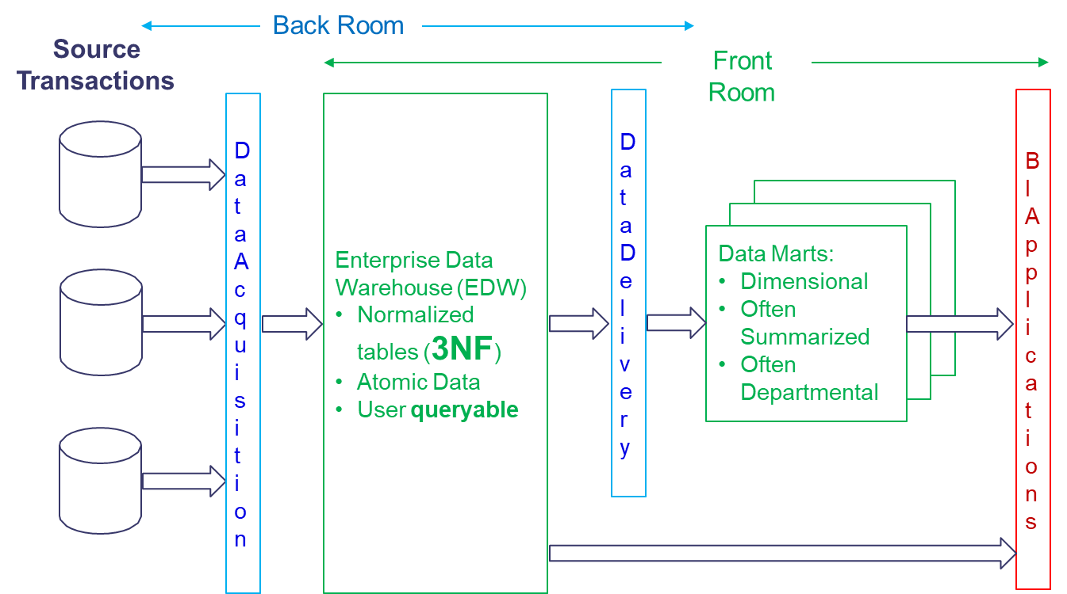
Hub-and-Spoke Corporate Information Factury Archiecture (Inmon)
(Kimball & Ross, 2013)

Slide 104
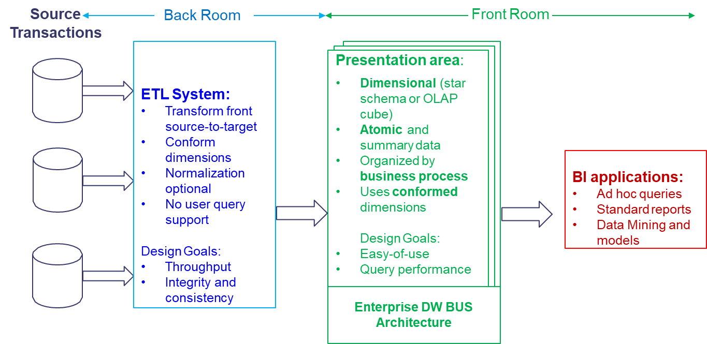
Kimball/Ross DW/BI Architecture
(Kimball & Ross, 2013)

Slide 105
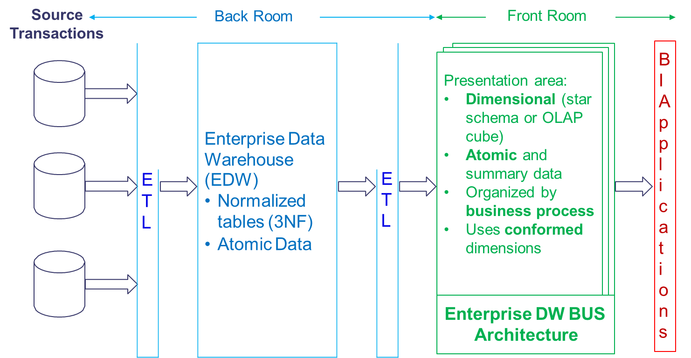
Hybrid Architecture
(Kimball & Ross, 2013)

Slide 106
Two additional types of Data Warehouse architectures

Slide 107
Centralized Architecture
Centralized (Enterprise) Data Warehouse
Normalized (3NF)
Atomic data
Some summerized data
E
T
L
BI
apps

Slide 108
Federated Architecture
E
T
L
Data Warehouse
Logisk eller
fysisk integration of common data
E
T
L
BI
apps
Data Mart
E
T
L
Data Mart

Slide 109
Which factor impact the selection of data warehouse architechture?

Slide 110
Which factors affect architecture selection?
Which of these factors affect?
High interdependence between departments, units, employees?
High urgency for a DW solution?
Tasks in the organization are relatively less routine?
DW as a short-term point solution or strategic infrastructure project?
Low resource availability?
IT staff with low perceived ability?
Upper management sponsorship?
(Ariyachandra, T., & Watson, H. (2010). Key organizational factors in data warehouse architecture selection. Decision support systems, 49(2), 200-212.)

Slide 111
Data Lake and Data Warehouse

Slide 112
What is a Data Lake?
“A data lake is a storage repository that holds a vast amount of raw data in its native format, including structured, semi-structured, and unstructured data.”
(https://www.kdnuggets.com/2015/09/data-lake-vs-data-warehouse-key-differences.html)

Slide 113
What is a Data Lake”
A data lake is “a methodology enabled by a massive data repository based on low cost technologies that improves the capture, refinement, archival, and exploration of raw data within an enterprise.”
"Yesterday's unified storage is today's enterprise data lake"
(Huang Fang, Managing Data Lakes in Big Data Era: What’s a data lake and why has it became popular in data management ecosystem, The 5th Annual IEEE International Conference on Cyber Technology in Automation, Control and Intelligent Systems, June 8-12, 2015, Shenyang, China.)

Slide 114
What is a Data Lake?
“The basic idea of Data Lake is simple, all data emitted by the organization will be stored in a single data structure called Data Lake.”
“Data will be stored in the lake in their original format.”
“Once data are placed in the lake, it’s available for analysis by everyone in the organization.“
(Khine, P. P., & Wang, Z. S. (2018). Data lake: a new ideology in big data era. In ITM Web of Conferences (Vol. 17, p. 03025). EDP Sciences.)

Slide 115
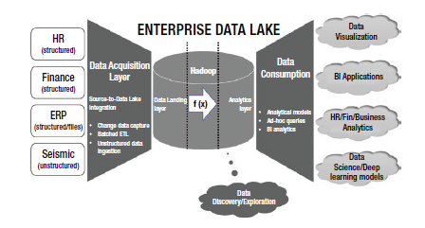
An example of a Data Lake Architecture
Gupta, S., & Giri, V. (2018). Introduction to Enterprise Data Lakes. In Practical Enterprise Data Lake Insights (pp. 1-31). Apress, Berkeley, CA.

Slide 116
Data Lake vs Data Warehouse
Comparison | Data Warehouse | Data Lake
Data | Structured, processed data | Structured, semistructured and unstructured data, raw data, unprocessed data
Processing | Schema-on-write | Schema-on-read
Storage | Expensive, reliable | Low cost storage
Agility | Less agile, fixed configuration | High agility, flexible configuration
Security | Matured | Maturing
Users | Business professional | Data scientists

Slide 117
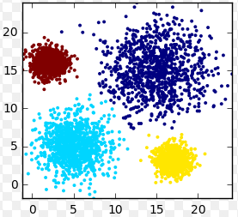

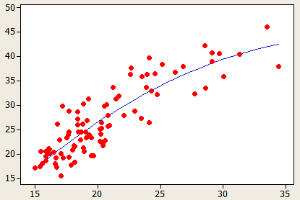
Data Lake
Data are
fed into a Hadoop
Data Lake
Data Lake
Analytic Sandbox
(Bill Schmarzo, Big Data MBA, Wiley, 2016)

Slide 118
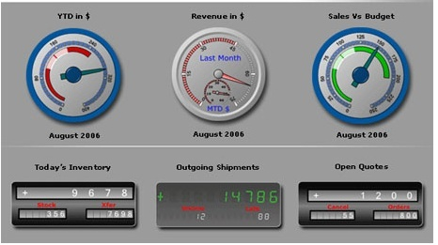
The analytics dilemma
How does an organization supports both the data warehouse/BI and an analytics environment?
DW/BI environment
Static and pre-planned process – a production process
Pre-planned use of data (via ETL)
DW
Analytic environment
Exploratory, experimental process
On the fly use of large amount of data
Loosely governed
Analytic Sandbox
(Bill Schmarzo, Big Data MBA, Wiley, 2016)

Slide 119
Data Lake can support both environments
DW/BI environment
DW
Data are
fed into a Hadoop
Data Lake
Data Lake
Analytic environment
Analytic Sandbox
(Bill Schmarzo, Big Data MBA, Wiley, 2016)

Slide 120
Off-load ETL processes from DW
DW/BI environment
DW
ETL
Data are
fed into a Hadoop
Data Lake
Data Lake
Analytic environment
Perform the ETL work in the data lake using Hadoop
Analytic Sandbox
(Bill Schmarzo, Big Data MBA, Wiley, 2016)

Slide 121
Actions to exploit the value of Data Lake
Action 1: Create a Hadoop-Based Data Lake
Action 2: Introduce the Analytics Sandbox
Action 3: Off-load ETL Processes from Data Warehouses
(Bill Schmarzo, Big Data MBA, Wiley, 2016)

Slide 122
Lessons learned
There shall be one Data Lake, not several – facititating sharing of the corporate data assets across the organization
Data governance is a life cycle, not a project
Data Lake sits before your data warehouse, not after it
(Bill Schmarzo, Big Data MBA, Wiley, 2016)

Slide 123
Benefits of using a Data Lake
Eliminate data silos – consolidating the data in one repository result in increased data use and sharing
Reduce cost for IT infrastructure – according to Schmarzo, it is 20 to 50 times cheaper to store, manage and analyze a hugh amount of data in a big data/analytics environment, compared to store, manage and analyze data in a traditional data warehouse environments
(Bill Schmarzo, Big Data MBA, Wiley, 2016)

Slide 124
Benefits of using a Data Lake
Provide a scalable, flexible and shared storage platform - that support both BI, analytic and next generation environments
Store all data - Store data even if the organization has not decided if it is going to use the data and how to use the data
(Bill Schmarzo, Big Data MBA, Wiley, 2016)

Slide 125
Business Intelligence vs Big Data/Data science

Slide 126
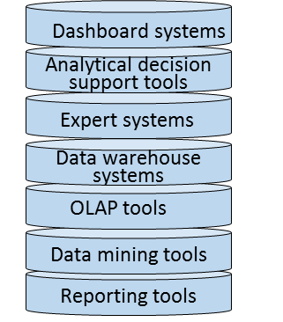

Business intelligence – an overview
Goals
(vision, enterprise goals, objectives)
BI systems/tools
BI related methods
Other areas related
Performance management
Business processes
Means
(mission, strategies, tactics, business processes)
Six sigma
Business rules
Balanced scorecard
Models for decision
Lean
Data governance
Decisions on strategic level
Activity based costing
Master data management
Decision models
Decisions on tactical level
Data and process mining
Meta data management
Decision and risk analysis
Org structures
System integration tools
Decisions on operational level
IT architecture
Visualization
Visualization techniques
Data repository
Cloud computing
Systems supporting decision making and data sources
Security
Operational systems: System that support the daily business, such as business systems (ERPs), BPM system, CRM system, etc
Business case/ROI

Slide 127
Business Intelligence – a definition
Business intelligence (BI) is an umbrella term that is commonly used to describe the technologies, applications, and processes for gathering, storing, accessing, and analyzing data to help users make better decisions.
Wixom and Watson, 2010

Slide 128

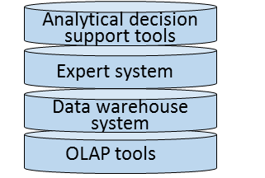
Two different approaches within BI
BI system
BI related methods
Steering /governing methods, models
and systems
Performance management
Six sigma
Balanced scorecard
Decision methods, models and systems
Decision and risk analysis

Slide 129

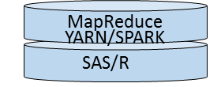
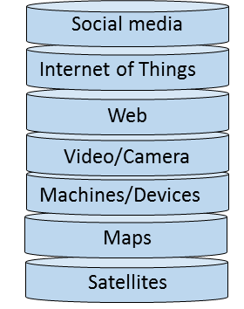
Big data/Data science – an overview
Big data related systems/techniques
Big Data related methods for data analysis
Other areas related
Goals
(vision, enterprise goals, objectives)
Data mining
Business processes
Means
(mission, strategies, tactics, business processes)
Machine learning
Business rules
Language technology
Models for decision
Additional data sources
Process mining
Data governance
Decisions on strategic level
Web mining
Master data management
Decision models
Meta data management
Decisions on tactical level
Processes for data analysis
CRISP-DM
Org structures
IT architecture
Decisions on operational level
Knowledge Discovery in Databases (KDD)
Data repository
Visualization
Cloud computing
Systems supporting decision making and data sources
Visualization techniques
Security
Operational systems: System that support the daily business, such as business systems (ERPs), BPM system, CRM system, etc
Business case/ROI

Slide 130
Data Science – a definition
Data science is about finding new variables and metrics that are better predictors of performance
Lewis (2004) Moneyball: The Art of Winning an Unfair Game

Slide 131
Big Data – a definition
Big data is a key enabler of a new discipline called data science that seeks to leverage new sources of structured and unstructured data, coupled with predictive and prescriptive analytics, to uncover new variables and metrics that are better predictors of performance
Bill Schmarzo, 2016, based on Lewis (2004) Moneyball: The Art of Winning an Unfair Game

Slide 132
Business intelligence vs. Data science
Predictive analytics
Prescriptive analytics
On the fly use of large amount of data
Exploratory, experimental process
Focus on pattern, correlations
Data model – schema on query/read
Data quality – good enough, propabilities
High
Data science
Value for the business
Business intelligence
Desciptive analytics
Pre-planned use of data (via ETL)
Static and pre-planned process
Focus on trends, use of KPIs
Data model – schema on load
Data quality – high quality, single source of truth
Low
Past
Current
Future
Time
(Bill Schmarzo, Big Data MBA, Wiley, 2016)

Slide 133
Business intelligence vs. Data science
The differences between BI and Data science
The questions are different
The analyst characteristics are different
The analytic approaches are different
The data models are different
The views on business are different
(Bill Schmarzo, Big Data MBA, Wiley, 2016)

Slide 134
BI vs. Data science: The questions are different
Business Intelligence
Focus on descriptive analytics: ”What happend?” type of questions: How many units of products X did we sell in Jan 2017
Data Science
Focus on predictive analytics: ”What is likely to happend? type of questions: How many units of products X will we sell in Jan 2018?
Focus on prescriptive analytics: ”What should we do?” type of question: How many components A, B, C should I order to support the sales of product X?
(Bill Schmarzo, Big Data MBA, Wiley, 2016)
To answer the predictive and prescriptive questions, the data scientist build analytic models in order to quantify cause and effect relationships

Slide 135
BI vs. Data science: The analysts’ characteristics are different The attitude and work approach among BI analysts and data scientists differs:
AREA | BI ANALYST | DATA SCIENTIST
Focus | Trends, KPIs | Pattern, Correlations, Models
Process | Static | Exploratory, experimentation, visual, agile
Data sources | Pre-planned, added slowly | On the fly, as needed
Transform data | Carefully planned | On demand, enrichment
Data quality | Single version of truth | ”Good enough”, probabilities
Data model | Schema on load | Schema on query
Analysis | Descriptive | Predictive, prescriptive
(Bill Schmarzo, Big Data MBA, Wiley, 2016, based on EMC )

Slide 136
BI vs. Data science: The analytic approaches are different 1(2)
BI analytic approach
Data science analytic approach
Step 1: Pre-build a data model (Schema on load)
Step 1: Define hypothesis (test/prediction)
Step 2: Make use of (visualisation) tools that automatically generated SQL commands from drag and drop using attributes/dimensions/facts
Step 2: Gather data (Data Lake)
Step 3: Build data model (Schema on query)
Step 3: Make use of the generated SQL commands to generate reports automatically
Step 4: Build analytic models (SAS, R)
Step 5: Evaluate model goodness of fit
What would happend if you want to add new data into the data warehouse/BI environment? What is the benefit with schema on the load?
(Bill Schmarzo, Big Data MBA, Wiley, 2016)

Slide 137
BI vs. Data science: The analytic approaches are different 2(2)
Schema on load
– a schema must be built prior to loading data into the data warehouse
Schema on query/read
– a schema is defined as needed based on data being used, and the data scientist will go through different versions of the schema until finding a schema that support the analytical model
(Bill Schmarzo, Big Data MBA, Wiley, 2016)

Slide 138
BI vs. Data science: The data models are different
Business Intelligence
Schema on load
Often star join schemas – multiples tables, many (comparable slow) joins
Data Science
Schema on query/read
Often flattened tables – few (flattened) tables with a lot of data, few joins
(Bill Schmarzo, Big Data MBA, Wiley, 2016)

Slide 139
BI vs. Data science: The views on business are different
Business Intelligence
Aggregated data on business entities, such as customers, products
Data Science
Build analytic profiles on each business entity. Example of business entities are customers, partners/suppliers, devices, machines
For exampel, analytic profiles for customers could be used for managing customer rentension/attrite rate
(Bill Schmarzo, Big Data MBA, Wiley, 2016)

Slide 140
Master Data

Slide 141
What is master data?
Domain data
Transactional data
Master data
Domain data – is data about the business and the area of the business, and it can be devided in:
Transactional data – is data about transactions, such as order request, ATM machine transcations, mobile calls. Transaction data represent different kinds of business events in the organization. Transactional data must be related to master data to receive a meaning
Master data – is data about central business entities that are be used in several processes and systems, such as customers, suppliers, products, assets, locations

Slide 142
What is master data?
Master data has the following characteristics:
Master data are not transactional – but master data are linked to transactions to give the transaction meaning
Master data have meaning independent of transactional data –master data are linked to transactional data but they have meaning also without the transactional data
Master data have known provenance/place of origin – that is, you know where the data come from
[Graham A. (2015) Mastering You Data, Koios Associated Ltd]

Slide 143
Master Data Management System

Slide 144



Why a master data management system (MDM-system)?
Problems addressed by a MDM-system: When you have several IT systems, there may exist incorrect and/or inconsistent data about customers, suppliers, and products in the systems. For example, a name of a customer or a product can be incorrectly spelled in some systems, a customer can have two different delivery addresses in two different systems
Manufacturing department
Shipping department
Order management
Produkt ID 202233. Samsung, SMART-TV
Produkt ID 202233
Produkt Samsung 202233
IT
IT
IT

Slide 145
Why a master data management system (MDM-system)?
Business consequenses of incorrect data in different IT system
Customers may not receive in time what has been ordered
If the same product has different spellings or there are incorrect info about the customer – the trust of the company can get damaged
Reports to governmental organizations may be harder to perform
Incorrect data about a customer’s delivery address
cause
The customer does not receive the ordered product in time

Slide 146
What is a MDM system?
A MDM-system – is a system that contain correct info about customers, suppliers and products, etc
In the MDM system, you can find the correct spelling, abbrevations, descriptions of customers, suppliers and products
In the MDM system, you can also find allowed categorizations, and hierarchies of categorizations (for example the hierarchy: food - fruit – berry - strawberry eller the hierarchy: food – perishable - strawberry)
”One version of the truth”
MDM
system

Slide 147
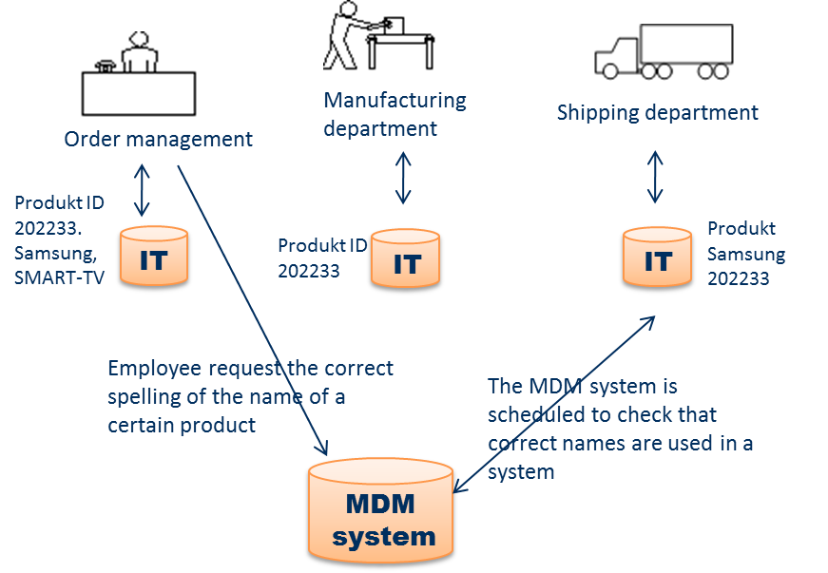
Hur to use a MDM system?
Employees can request correct spelling and attributes of data element

Slide 148
Hur to use a MDM system?
The MDM system could be used for automatically correct info in the operational systems

Slide 149
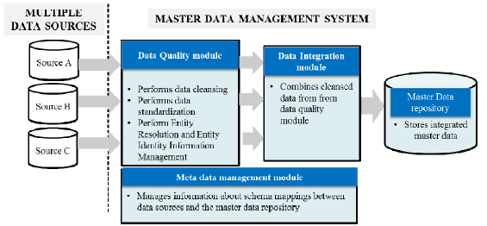
Architecture of a MDM system
Haneem, F., Ali, R., Kama, N., & Basri, S. (2017, July). Resolving data duplication, inaccuracy and inconsistency issues using Master Data Management. In Research and Innovation in Information Systems (ICRIIS), 2017 International Conference on (pp. 1-6). IEEE.

Slide 150
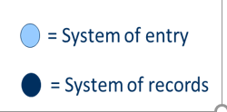
Define where your single source of truth for data elements are?
= place where the master is created and maybe also maintained
= master data = golden copy = single place where master data i garanteed to be accurate and up to date
[White C. (2007) Using master data i business intelligence, BI research]

Slide 151
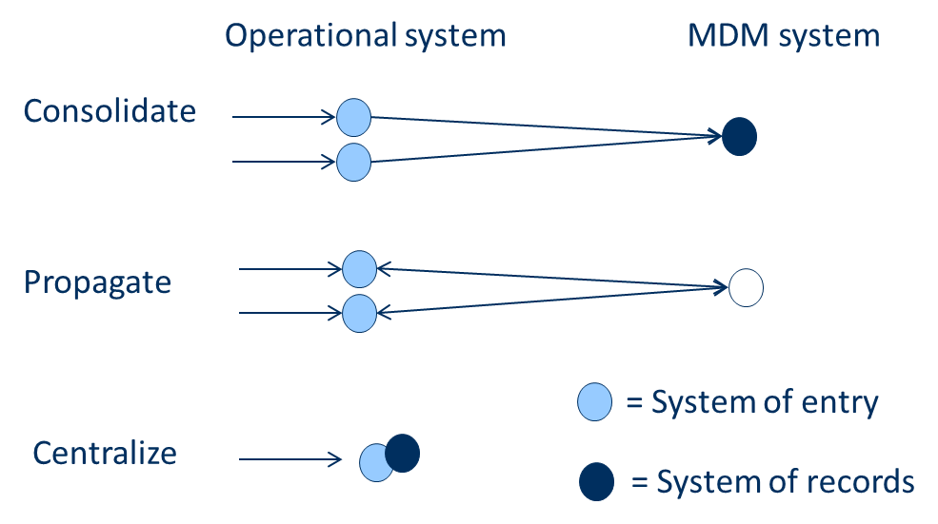
Define where your single source of truth for data elements are?
Approaches for managing master data
Master Data Management system
Syncronize master data changes between systems so master data in all systems are kept consistens
= place where the master is created and maybe also maintained
= master data = golden copy = single place where master data i garanteed to be accurate and up to date
[White C. (2007) Using master data i business intelligence, BI research]

Slide 152
Define where your single source of truth for data elements are?
Approaches for managing master data
Master Data Management system
Another approach could also be to use both approaches = consolidate and propagate
Syncronize master data changes between systems so master data in all systems are kept consistens
= place where the master is created and maybe also maintained
= master data = golden copy = single place where master data i garanteed to be accurate and up to date
Often the long term goal
[White C. (2007) Using master data i business intelligence, BI research]

Slide 153
Hur to use a MDM system?
MDM
system
Data warehouse
How could the MDM system support a Data Warehouse?
ETL

Slide 154
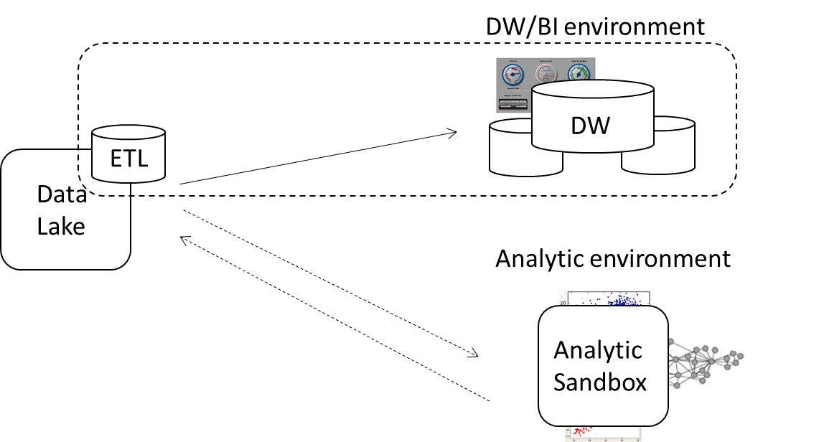
Hur to use a MDM system?
MDM
system
How could the MDM system support a Data Lake?

