Slide 1
Reltio Data Model

Slide 2
Agenda
Reltio Data Model vs Legacy data model
Reltio multi layer architecture
Reltio Accelerators
Guidelines & Best practices
Use Case

Slide 3
Legacy Data model
Identify
Entities
Attributes
Relationships (1:1, 1:M, M:M)
Create Logical model
Convert Logical model to physical model
Normalization/Denormalization
Bridge tables due to M:M relationships
Multi value attributes
etc.

Slide 4
Reltio Data Model
Dynamic Model:
The Reltio model is metadata driven and can help avoid many of these issues.
Traditional database modeling iteratively can become tedious. Even small changes in a data model - such as making an organization name a multi-valued attribute - can result in costly data migration projects, or rely on temporary workarounds just to make things work, until the next change is made in the model.
The Reltio model can be changed dynamically without making changes to the underlying physical storage. The Reltio UI reflects these model changes automatically and instantly.

Slide 5
Key differences between Reltio and relational models are
Every attribute in Reltio is multi-valued. This eliminates the need to model additional tables to support this functionality.
Reltio supports nested attributes to remove the need for 1->M dependent entities. Attributes can be deeply nested, which eliminates the need for cascading joins. This eliminates the need for frequent foreign key resolution.
Reltio allows addresses to be modeled as nested attributes and the built-in address cleanse engine handles this model seamlessly.
Reltio RDM can be used to model reference data without the need for a large number of reference data tables. This can greatly simplify the model.

Slide 6
Introducing Reltio n-layer Configuration Architecture
Any part of Meta Object Model can be defined in any Layer
Customer Layer can…
Accept
Override
Extend
Ignore
Reltio controls Layers 1, 2
created industry models
learns from customer feedback
leverages these layers for accelerated pre-integration
speeds up time to deployment
Reltio Entity Types:
Party
Individual
Organization
Location
Product
…
Objects are available to a Customer tenant
Objects are available to vertical tenants
Objects are available to ALL tenants
Layer 3 – Customer extensions
(extended by customer)
Layer 2 – Reltio Verticals
(maintained by Reltio)
Layer 1 – Reltio Core
(maintained by Reltio)
Notes:
The model itself is what we call an n-layer configuration architecture. Reltio has developed and delivered a layer 1 and a layer 2 set of entities, relationships, and behaviors. So you're not starting from scratch when you are configuring Reltio, and it can work right out of the box.
The Reltio Core, also referred to as Layer 1 configuration, contains base objects such as predefined entityTypes, relationTypes, roles, etc. The Reltio Core/L1 is controlled by Reltio.
The Reltio Verticals, otherwise referred to as Layer 2 configuration, contains more industry specific object extensions. For example the Life Science Vertical contains entityTypes such as HCP and HCO’s to represent the Health Care Organization and Providers. Reltio Verticals/L2 is also controlled by Reltio.
Reltio Customer Extensions, commonly referred to as the L3 Configuration, is where business specific customizations reside. Within the L3 the customer can extend existing L1 and L2 objects as well as create business specific objects. The L3 is controlled and maintained by the customer and gives you the ability to modify and configure the application to behave to your specific business rules.
By using inheritance from L1 (the Reltio Core) or L2 (the Reltio Verticals), you have a base foundation of objects and are not starting from scratch when customizing your Reltio tenant.
In addition to the 3 mentioned layers, the platform can be further extended to include additional configuration layers. For example Layer 4 is an additional customer extension for multiple customer regions. Layer 4 configurations are commonly used in global implementations.
Additionally the model can be extended into further layers if needed.
Reltio configurations (or layers) are defined as JSON files. A configuration can be deployed to any tenant, and changes to the Layer 3 Customer Extensions are done with zero downtime. Noting that a Layer 3 Customer Extension can be versioned to prevent collisions with disparate configurations.
Now that we understand the architecture of the configuration, let’s take a look into how interactions are made within Reltio.

Slide 7

Introducing Reltio n-layer Configuration Architecture
Objects for other Customer Regions
Objects for Customer Global
Objects for vertical tenants
Layer 4 – Local Regions
(extended by customer)
Objects for ALL tenants
Layer 3 – Amgen Global
(extended by customer)
Layer 2 – Reltio Verticals
(maintained by Reltio)
Layer 1 – Reltio Core
(maintained by Reltio)

Slide 8
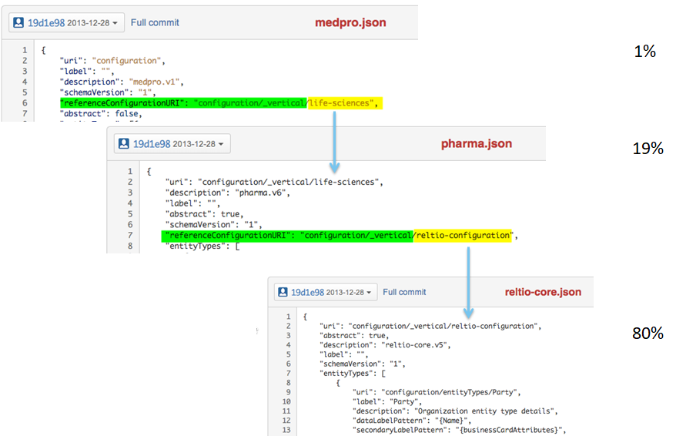
3-layer referencing and inheritance
Notes:
Now that we understand the L3 Customer Extension, let’s dig deeper into the details of the configuration.
The JSON configuration is comprised of a set of collections and properties that work collaboratively to drive the behavior of your tenant.
The “referenceConfigurationURI” property indicates that we are inheriting from the Life Sciences, L2 vertical.
As you can see here, each object type is grouped into it’s own collection - sources, entityTypes, relationTypes, and so on.
In addition to being able to extend from predefined verticals, such as the Life Sciences Vertical, also have the ability to extend from the different objects located within L1 and L2.
For example the “extendsTypeURI” on the Organization entityType dictates that this entityType is inheriting the properties and attributes of the Layer 1 Party entityType.
Within the L3 we can inherit from any of the layers or we have the ability to create custom objects and inherit from them as well to create further customized objects.

Slide 9
Radically Simplified Approach to Data Model
Entities
Attributes
Relationship Types
Attributes
GraphType
Interactions
Transactions
Hierarchies
(GraphType)
Entities
Entities
Entities
Entities
Entities
Entities
Entities
Entities
The Reltio meta model supports additional concepts:
Unlimited attribution - objects (entities, relationships) can have unlimited attributes
Matching and merging – exact and fuzzy matching with survivorship rules and multiple best versions of the truth
Crosswalks maintenance – to support unlimited number of contributing and non-contributing source records
Change History – complete support for bi-temporal history and point in time views
Audit and Lineage – always know who, when and what the change was at the attribute level
Relationships
Transactions
Transactions
Transactions
Transactions
A true multi-domain environment
Notes:
The metadata model defines the Reltio Tenant objects with the JSON Configuration file.
This means that the source of the data, entities, relationships, interactions, graphs… all of the different objects are defined through the metadata model layered configuration.
Not only does the metadata model define the objects, but it also drives the behavior of the tenant. This means that the cleansing, matching and merging, and survivorship is all controlled by the metadata model as well.
The definition and behavior of the Reltio tenant are controlled by the inherited objects of the layer 1, 2, and 3 JSON configuration files.

Slide 10
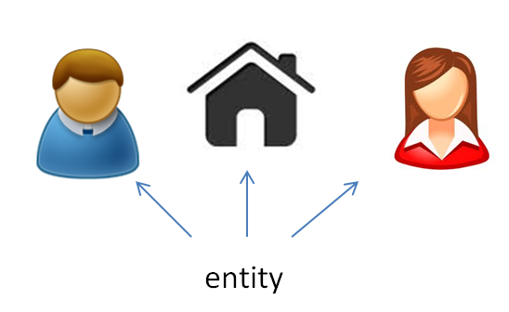
Entity Types
An entity can be a thing, person, place, or object. Data is stored for an entity in Reltio.
Entity Type identifies the various kinds of nodes that will be used in graphs (e.g., “Person”, “Organization”)
An Entity Type corresponds to the generic concept of a category or a class
Entity Type defines a set of entities that have same set of properties (and attributes)
Entity Types can have taxonomies

Slide 11
Attribute Types Examples
Simple attributes
Based on primitive data types, such as:
String
Int
Float
Date
Blob
Based on smart data types, such as:
Image - can be marked to use for custom entity logo
URL – text from the URL can be indexed for full text search
SSN# - predefined rules for validation and formatting
Id – such as passport, license, etc
Email – validation and formatting rules
email-domains - Company email domains
ticker-symbol - Company ticker identification for the stock exchange
Enums
Simple enums – such as list of stock exchanges
Hierarchical enums – taxonomy/hierarchy of enum values. Example – Tokyo is Japan, Japan is Asia, etc. – so if somebody searches by Asia it will return records with values for Tokyo
Lookups – dynamic enums
Nested attributes
To support complex attributes for a Business Object. For example, University, year of graduation and degree is a combination of attributes that would be tracked together
Reference attributes
Provide support for complex structures in a Business Object. For example, if you have Entity types of Person, Address and Company, you can create a Business Object for Person with multiple addresses, companies, etc. In such a case the multiple addresses for this person are maintained as references (relationships) to various address entities
Reference attributes contain relationship attributes that include both system and user defined attributes
Reference attributes allow you to use any combination of entity types within a Business Object

Slide 12
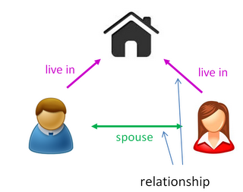
Relationship Types
Define links between objects:
Entity-Entity
Entity-Relationship (T-relations)
Support Taxonomies
Have directional context based on rules

Slide 13
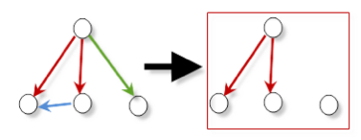
Graph types
Logical containers for a set of Entities, Groups and Relationships
Graph types are defined and controlled by:
graph type objects rule - a rule that defines what entities can be a part of group
a set of possible relationship types
Graph types are convenience functions that allow:
Retrieval of entities, groups and relationships
Maintenance of entities, groups and relationships
Graph type is like a pattern - it filters out relationships and leaves only relationships of certain types that are defined for it
Graph types can have attributes:
System attributes
Tags
Simple attributes
Complex attributes
Graph type properties include:
Visualization layout
Style settings
Validation settings
All Relationships
Graph Type container

Slide 14
Guidelines / Best practices

Slide 15
Reltio Accelerators
Reltio provides default out of the box multi layer configuration. Please use following approach for defining new entities.
If customer vertical has defined Reltio L2, please use the L2 entities already defined. Following are the existing L2 configuration available today:
Repository: https://bitbucket.org/reltio-ondemand/workspace/projects/ROCS
Life-Sciences
Consumer360
Account360
LSProduct360
Identify the existing (L1/L2/L3) entity and relationships types
Use L2 entities for defined verticals and extend them in L3 for customization. Define new attributes only if they do not exist in L1 or L2
Identify new entity types
Identify new relationship types
Identify new interaction types
Identify the Reference data (RDM)

Slide 16
Entities/Model For New Verticals
If the vertical is not defined in Reltio L2 or the information being stored cannot use one of the existing entities, we follow the below approach to define it as either an entity, RDM or a lookup.
Below are some of the additional considerations when defining new entities:
If not done correctly, entity modeling can adversely affect UI, data load, and matching performance. Please collect enough data points during initial phases to drive the modeling decisions.
When modeling high cardinality relations, nested attributes are preferable over the reference attributes. Nested attributes perform better in terms of storage, and maintenance of data (create, update, delete etc.).
When moving a MDM system originally defined in Relational databases, do not map entities directly to Reltio. Relito is non-relational and converting relational system to non-relational does not work. Instead, use the best practice guidelines (link given above) to convert relational entities to either Reltio entities, Reltio nested attributes, Reltio RDM objects or lookup as it fits based on the requirements.

Slide 17
Use Case

Slide 18
Customer Data Model
Legacy system modelled for relational databases
Problem: Customer has large number of entities for their Organization and Site entities. The total volume was expected to be 250 million Organization and 380 million OPSI, and 380 million location entities. This creates challenges for data loads, UI and matching performance.
The highly normalized data model also has many entities/tables defied for reference data, or to manage many to many relationships.
Solution:
We merged location entity with Site, which reduced the 380 million relationship objects and 380 million location object. Also, it was determined that Site has only one address associated with it, which can easily be supported with this approach.
Following are the gains received because of this change:
- Dataload speed was 3.5 times higher,
- Reindexing speed was 2 times higher for Site entity type with nested Address.
- C* tables took 2.5 less space (less entities, no relationships, less activity and history data)
Modelled many legacy entities/tables which are truly a reference data as RDM objects. This reduced the overall complexity. This was slow moving data used mainly as qualifiers or list of values. If the source item is small collection of attributes (Code, Value, Description etc) and total number of records < 10K, it is recommended to be modelled as RDM object. This will reduce the number of relationships, references to other entities, resulting in a better performance.
Finally, the resulting model reflects the actual business entities and relationships much more clearly, without adding the technical complexities.

