Slide 1
Async JavaScript with Reactive Extensions
Untangle Your Asynchronous JavaScript Code

Slide 2
This is the story how Netflix solved
BIG async problem
by thinking different about
EVENT

Slide 3
Async is Hard
Events and AJAX requests are sequences of values that are pushed from the producer to the consumer asynchronously.
The consumer reacts to the data as it comes in, which is why asynchronous programming is also called Reactive Programming.
Logical units of code have to be split across many different callbacks so that they can be resumed after async operations complete.
Asynchronous errors aren’t thrown on the stack, which means that try/catch blocks are useless.

Slide 4
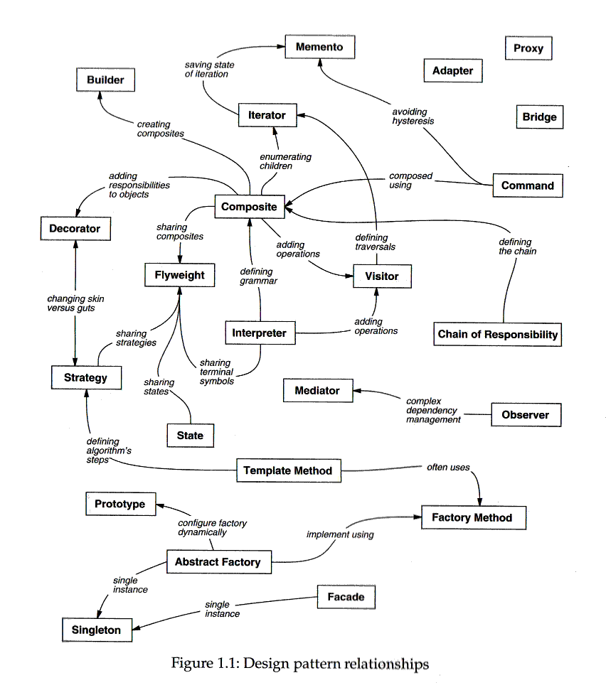
Design pattern

Slide 5
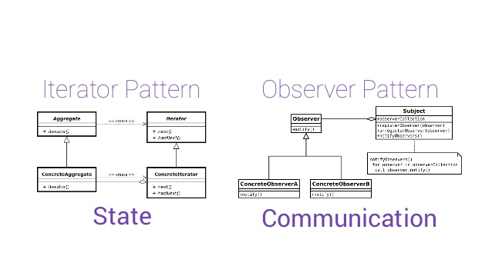
Iterator vs Observer

Slide 6
Pull vs Push
Pull | Push
Arrays Generators Iterables | DOM Events Promises Observables
synchronous | asynchronous

Slide 7
What’s different between…
Arrays
[{x: 23, y: 44}, {x: 27, y: 55}, …, {x: 27, y: 55}, …]
Events
[{x: 23, y: 44}, {x: 27, y: 55}, …, {x: 27, y: 55}, …]

Slide 8
What’s different between…
Arrays
[{x: 23, y: 44}, {x: 27, y: 55}, …, {x: 27, y: 55}, …]
Events
[{x: 23, y: 44}, {x: 27, y: 55}, …, {x: 27, y: 55}, …]
Arrays and Events are both collections

Slide 9
Top-rated Movie Collection
const getTopRatedFilms = user => user.videoLists
.map(videoList => videoList.videos
.filter(video => video.rating === 5.0))
.concatAll();
getTopRatedFilms(user).forEach(film => console.log(film));
What if I told you that you could create a drag event with nearly the same code?

Slide 10
Mouse Drags Collection
const getElementDrags = el => el.mouseDowns
.map(mouseDown => document.mouseMoves
.takeUntil(mouseUps))
.concatAll();
getElementDrags(image).forEach(pos => image.position = pos);
const getTopRatedFilms = user => user.videoLists
.map(videoList => videoList.videos
.filter(video => video.rating === 5.0))
.concatAll();
getTopRatedFilms(user).forEach(film => console.log(film));

Slide 11
Introducing Observable
interface Iterable {
Generator iterator(void);
}
interface OBservable {
void observer(Generator);
}
Observable === Collection + Time

Slide 12
Reactive Extensions
Reactive Extensions (Rx) is a library for composing asynchronous and event-based programs using observable sequences and LINQ-style query operators.

Slide 13
The essential concepts
Observable: represents the idea of an invokable collection of future values or events.
Observer: is a collection of callbacks that knows how to listen to values delivered by the Observable.
Subscription: represents the execution of an Observable, is primarily useful for cancelling the execution.
Operators: are pure functions that enable a functional programming style of dealing with collections with operations like map, filter, concat, reduce, etc.
Subject: is the equivalent to an EventEmitter, and the only way of multicasting a value or event to multiple Observers.
Schedulers: are centralized dispatchers to control concurrency, allowing us to coordinate when computation happens on e.g. setTimeout or requestAnimationFrame or others.

Slide 14
Creating Observables
of('hello')
from([1,2,3,4])
interval(1000)
ajax('http://example.com')
webSocket('ws://echo.websocket.com')
fromEvent(button, 'click')
…

Slide 15
Subscribing
myObservable.subscribe(
value => console.log('next', value),
err => console.error('error', err),
() => console.info('complete')
);

Slide 16
Observable Composition
function drag(element) {
const downs = Observable.fromEvent(element, 'mousedown’);
const ups = Observable.fromEvent(element, 'mouseup’);
const moves = Observable.fromEvent(element, 'mousemoves');
const drags = downs
.map(down => moves.takeUtil(ups))
.flatten();
drags.forEach(drag => {
element.style.top = drag.offsetY;
element.style.left = drag.offsetX;
});
}

Slide 17
Netflix Search
const searchResultSets = keyPresses
.throttle(250)
.map(key => getJSON(`/searchResults?q=${input.value}`)
.retry(3)
.takeUntil(keyPresses))
.concatAll();
searchResultSets.forEach(
resultSet => updateSearchResults(resultSet),
error => showMessage('Something went wrong!!!')
);

Slide 18
From Promiseland
/* create a new promise. */
const p = new Promise(resolve => {
setTimeout(() => {
resolve('Hello from Promiseland!');
}, 1000)
});
/* log single value that is emitted. */
p.then(value => console.log(value));

Slide 19
To Observableland
const observable = new Observable(observer => {
const interval = setInterval(() => {
observer.next('Hello from Observableland!');
}, 1000);
return () => {
clearInterval(interval);
}
});
const subscription = observable.subscribe(value =>
console.log(value));
/* Unsubscribe after 5 seconds. */
setTimeout(() => subscription.unsubscribe(), 5000);

Slide 20
Working with Socket
const messages = Observable.create((observer: Observer<any>) => {
console.log("%cNew subscription created");
const url = "localhost:3000";
const socket: SocketIOClient.Socket = io(url);
socket.on("message", (data: any) => {
observer.next(data);
});
return () => {
socket.disconnect();
};
});
messages.subscribe((message: any) => console.log(message));

Slide 21
Async JavaScript with Reactive Extesions
http://academy.telerik.com

