Slide 1
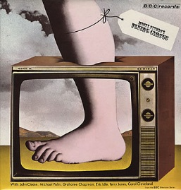
Introduction to Python and programming
UW CSE 160

Slide 2
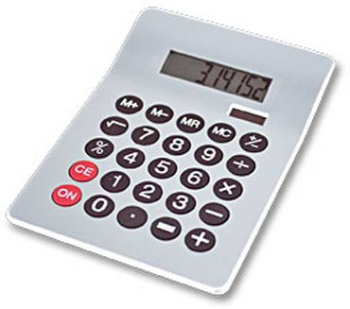
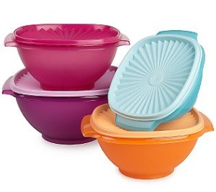
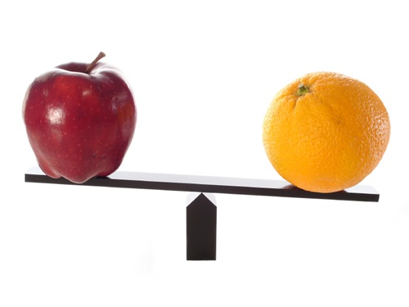
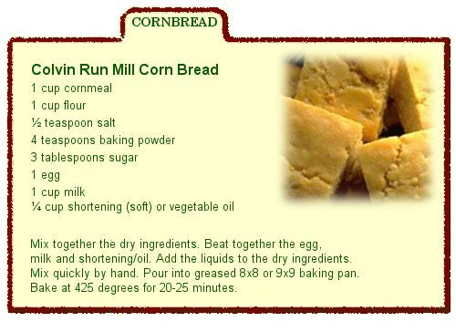
1. Python is a calculator
2. A variable is a container
3. Different types cannot be compared
4. A program is a recipe

Slide 3

0. Don’t panic!
CSE 160 is for beginners to programming
(If you know how to program, you don’t belong)
You can learn to program in 10 weeks
You will work hard
We will work hard to help you
Ask questions!
This is the best way to learn
Notes:
“Ask questions”: also, we will be grading on participation.
Introduce myself here. Also Dun-Yu.

Slide 4
1. Python is a calculator

Slide 5
You type expressions. Python computes their values.
5
3 + 4
44 / 2
2 ** 3
3 * 4 + 5 * 6
If precedence is unclear, use parentheses
(72 – 32) / 9 * 5

Slide 6
An expression is evaluated from the inside out
How many expressions are in this Python code?
an expression
values
(72 – 32) / 9.0 * 5
(72 – 32) / 9.0 * 5
(40) / 9.0 * 5
40 / 9.0 * 5
4.44 * 5
22.2
Notes:
Note: using 9.0 instead of 9 as on previous slide.

Slide 7
Another evaluation example
(72 – 32) / (9.0 * 5)
(40) / (9.0 * 5)
40 / (9.0 * 5)
40 / (45.0)
40 / 45.0
.888
Notes:
Note: Still using 9.0 instead of 9 as on previous slide.

Slide 8
2. A variable is a container

Slide 9
Variables hold values
Recall variables from algebra:
Let x = 2 …
Let y = x …
In Python assign a variable: “varname = expression”
pi = 3.14
pi
avogadro = 6 * 10 ** 23
avogadro
22 = x # Error!
Not all variable names are permitted
No output from an assignment statement
Notes:
Draw out the current values

Slide 10
Changing existing variables (“re-binding” or “re-assigning”)
x = 2
x
y =
y
x = 5
x
y
“=” in an assignment is not a promise of eternal equality
This is different than the mathematical meaning of “=”
Evaluating an expression gives a new (copy of a) number, rather than changing an existing one
2
x

Slide 11
How an assignment is executed
Evaluate the right-hand side to a value
Store that value in the variable
x = 2
print (x)
y = x
print (y)
z = x + 1
print (z)
x = 5
print (x)
print (y)
print (z)
State of the computer:
Printed output:
To visualize a program’s execution: http://pythontutor.com Link to this code here

Slide 12
How an assignment is executed
Evaluate the right-hand side to a value
Store that value in the variable
x = 2
print (x)
y = x
print (y)
z = x + 1
print (z)
x = 5
print (x)
print (y)
print (z)
State of the computer:
Printed output:
2
2
3
5
2
3
x: 2
x: 5
y: 2
z: 3
To visualize a program’s execution: http://pythontutor.com Link to this code here

Slide 13
More expressions: Conditionals (value is True or False)
22 > 4
22 < 4
22 == 4
x = 100 # Assignment, not conditional!
22 = 4 # Error!
x >= 5
x >= 100
x >= 200
not True
not (x >= 200)
3<4 and 5<6
4<3 or 5<6
temp = 72
water_is_liquid = temp > 32 and temp < 212
See in python tutor
Numeric operators: +, *, **
Mixed operators: <, >=, ==
Boolean operators: not, and, or

Slide 14
More expressions: strings
A string represents text
'Python'
this_class = "CSE 160"
""
Empty string is not the same as an unbound variable
Operations on strings:
Length:
len(this_class)
Concatenation:
"Ruth" + 'Anderson'
Containment/searching:
'0' in this_class
"O" in this_class
Notes:
Empty string is like the 0 value in arithmetic – Arabic numerals are a great advance over Roman numerals

Slide 15
3. Different types cannot be compared

Slide 16
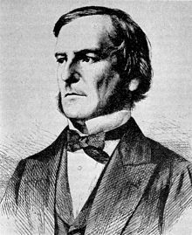
Types of values
Integers (int): -22, 0, 44
Arithmetic is exact
Some funny representations: 12345678901L
Real numbers (float, for “floating point”): 2.718, 3.1415
Arithmetic is approximate, e.g., 6.022*10**23
Some funny representations: 6.022e+23
Strings (str): "I love Python", ""
Truth values (bool, for “Boolean”): True, False
George Boole
Notes:
Photo is of George Boole, an English mathematician and logician

Slide 17
Operations behave differently on different types
See in python tutor
3.0 + 4.0
3 + 4
3 + 4.0
"3" + "4"
3 + "4" # Error
3 + True # Insanity! (Don’t do this.)
Moral: Python sometimes tells you when you do something that does not make sense.

Slide 18
Operations behave differently on different types
See in python tutor
15.0 / 4.0
15 / 4 # Would have been truncated in Python 2.
15.0 / 4
15 / 4.0
Type conversion:
float(15)
int(15.0)
int(15.5)
int("15")
str(15.5)

Slide 19
4. A program is a recipe

Slide 20
What is a program?
See in python tutor
A program is a sequence of instructions
The computer executes one after the other, as if they had been typed to the interpreter
Saving your work as a program is better than re-typing from scratch
x = 1
y = 2
x + y
print (x + y)
print ("The sum of", x, "and", y, "is", x+y)

Slide 21
Interlude: The print statement
See in python tutor
The print statement always prints one line
The next print statement prints below that one
For Python 3 , print is followed by parentheses
Write 0 or more expressions after print, separated by commas
In the output, the values are separated by spaces
Examples:
print (3.1415)
print (2.718, 1.618)
print ()
print (20 + 2, 7 * 3, 4 * 5)
print ("The sum of", x, "and", y, "is", x+y)

Slide 22
Exercise: Convert temperatures
Make a temperature conversion chart: Fahrenheit to Centrigrade, for -40, 0, 32, 68, 98.6, 212, 293, 451 Output:
-40 -40.0
0 -17.7778
32 0.0
68 20.0
98.6 37.0
212 100.0
293 145.0
451 232.778
You have created a Python program!
(It doesn’t have to be this tedious, and it won’t be.)
Notes:
See lecture 3 for what the final program should look like

Slide 23
Expressions, statements, and programs
An expression evaluates to a value
3 + 4
pi * r**2
A statement causes an effect
pi = 3.14159
print (pi)
Expressions appear within other expressions and within statements
(fahr – 32) * (5.0 / 9)
print (pi * r**2)
A statement may not appear within an expression
3 + print (pi) # Error!
A program is made up of statements
A program should do something or communicate information
Just evaluating an expression does not accomplish either goal

Slide 24
1. Python is a calculator
2. A variable is a container
3. Different types cannot be compared
4. A program is a recipe

