Slide 1
Applications of
Markov Logic

Slide 2
Overview
Basics
Logistic regression
Hypertext classification
Information retrieval
Entity resolution
Hidden Markov models
Information extraction
Statistical parsing
Semantic processing
Bayesian networks
Relational models
Practical tips

Slide 3
Running Alchemy
Programs
  Infer
  Learnwts
  Learnstruct
Options
MLN file
  Types (optional)
  Predicates
  Formulas
Database files

Slide 4
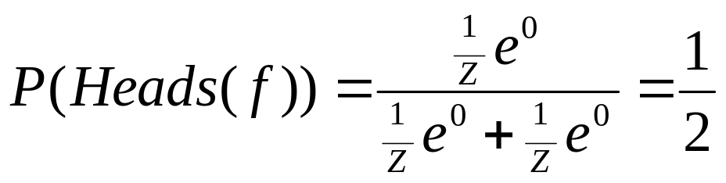
Uniform Distribn.: Empty MLN
Example: Unbiased coin flips
Type: flip = { 1, … , 20 }
Predicate: Heads(flip)

Slide 5
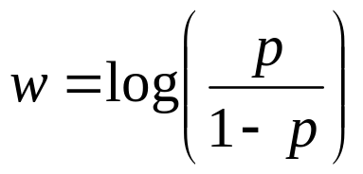
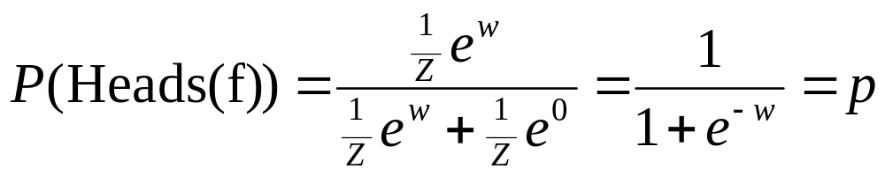
Binomial Distribn.: Unit Clause
Example: Biased coin flips
Type: flip = { 1, … , 20 }
Predicate: Heads(flip)
Formula: Heads(f)
Weight: Log odds of heads:
By default, MLN includes unit clauses for all predicates
(captures marginal distributions, etc.)

Slide 6
Multinomial Distribution
Example: Throwing die
Types: throw = { 1, … , 20 }
face = { 1, … , 6 }
Predicate: Outcome(throw,face)
Formulas: Outcome(t,f) ^ f != f’ => !Outcome(t,f’).
Exist f Outcome(t,f).
Too cumbersome!

Slide 7
Multinomial Distrib.: ! Notation
Example: Throwing die
Types: throw = { 1, … , 20 }
face = { 1, … , 6 }
Predicate: Outcome(throw,face!)
Formulas:
Semantics: Arguments without “!” determine arguments with “!”.
Also makes inference more efficient (triggers blocking).

Slide 8
Multinomial Distrib.: + Notation
Example: Throwing biased die
Types: throw = { 1, … , 20 }
face = { 1, … , 6 }
Predicate: Outcome(throw,face!)
Formulas: Outcome(t,+f)
Semantics: Learn weight for each grounding of args with “+”.

Slide 9
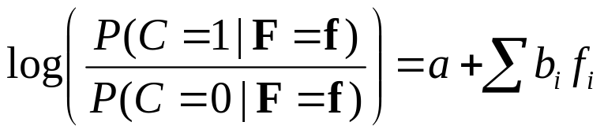
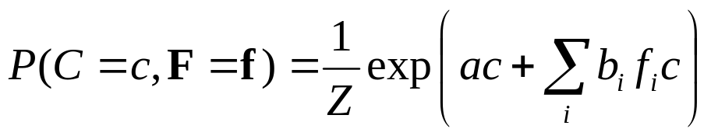
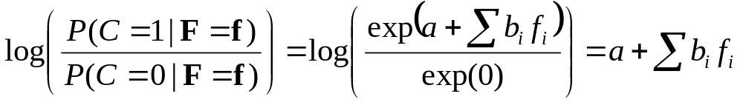
Logistic Regression
Logistic regression:
Type: obj = { 1, ... , n }
Query predicate: C(obj)
Evidence predicates: F_{i}(obj)
Formulas: a C(x)
b_{i} F_{i}(x) ^ C(x)
Resulting distribution:
Therefore:
Alternative form: F_{i}(x) => C(x)

Slide 10
Text Classification
page = { 1, … , n }
word = { … }
topic = { … }
Topic(page,topic!)
HasWord(page,word)
!Topic(p,t)
HasWord(p,+w) => Topic(p,+t)

Slide 11
Text Classification
Topic(page,topic!)
HasWord(page,word)
HasWord(p,+w) => Topic(p,+t)

Slide 12
Hypertext Classification
Topic(page,topic!)
HasWord(page,word)
Links(page,page)
HasWord(p,+w) => Topic(p,+t)
Topic(p,t) ^ Links(p,p') => Topic(p',t)
Cf. S. Chakrabarti, B. Dom & P. Indyk, “Hypertext Classification
Using Hyperlinks,” in Proc. SIGMOD-1998.

Slide 13
Information Retrieval
InQuery(word)
HasWord(page,word)
Relevant(page)
InQuery(+w) ^ HasWord(p,+w) => Relevant(p)
Relevant(p) ^ Links(p,p’) => Relevant(p’)
Cf. L. Page, S. Brin, R. Motwani & T. Winograd, “The PageRank Citation
Ranking: Bringing Order to the Web,” Tech. Rept., Stanford University, 1998.

Slide 14
Entity Resolution
Problem: Given database, find duplicate records
HasToken(token,field,record)
SameField(field,record,record)
SameRecord(record,record)
HasToken(+t,+f,r) ^ HasToken(+t,+f,r’)
=> SameField(f,r,r’)
SameField(+f,r,r’) => SameRecord(r,r’)
SameRecord(r,r’) ^ SameRecord(r’,r”)
=> SameRecord(r,r”)
Cf. A. McCallum & B. Wellner, “Conditional Models of Identity Uncertainty
with Application to Noun Coreference,” in Adv. NIPS 17, 2005.

Slide 15
Entity Resolution
Can also resolve fields:
HasToken(token,field,record)
SameField(field,record,record)
SameRecord(record,record)
HasToken(+t,+f,r) ^ HasToken(+t,+f,r’)
=> SameField(f,r,r’)
SameField(+f,r,r’) <=> SameRecord(r,r’)
SameRecord(r,r’) ^ SameRecord(r’,r”)
=> SameRecord(r,r”)
SameField(f,r,r’) ^ SameField(f,r’,r”)
=> SameField(f,r,r”)
More: P. Singla & P. Domingos, “Entity Resolution with
Markov Logic”, in Proc. ICDM-2006.

Slide 16
Hidden Markov Models
obs = { Obs1, … , ObsN }
state = { St1, … , StM }
time = { 0, … , T }
State(state!,time)
Obs(obs!,time)
State(+s,0)
State(+s,t) => State(+s',t+1)
Obs(+o,t) => State(+s,t)

Slide 17
Information Extraction
Problem: Extract database from text or
semi-structured sources
Example: Extract database of publications from citation list(s) (the “CiteSeer problem”)
Two steps:
  Segmentation:
  Use HMM to assign tokens to fields
  Entity resolution:
  Use logistic regression and transitivity

Slide 18
Information Extraction
Token(token, position, citation)
InField(position, field, citation)
SameField(field, citation, citation)
SameCit(citation, citation)
Token(+t,i,c) => InField(i,+f,c)
InField(i,+f,c) <=> InField(i+1,+f,c)
f != f’ => (!InField(i,+f,c) v !InField(i,+f’,c))
Token(+t,i,c) ^ InField(i,+f,c) ^ Token(+t,i’,c’)
^ InField(i’,+f,c’) => SameField(+f,c,c’)
SameField(+f,c,c’) <=> SameCit(c,c’)
SameField(f,c,c’) ^ SameField(f,c’,c”) => SameField(f,c,c”)
SameCit(c,c’) ^ SameCit(c’,c”) => SameCit(c,c”)

Slide 19
Information Extraction
Token(token, position, citation)
InField(position, field, citation)
SameField(field, citation, citation)
SameCit(citation, citation)
Token(+t,i,c) => InField(i,+f,c)
InField(i,+f,c) ^ !Token(“.”,i,c) <=> InField(i+1,+f,c)
f != f’ => (!InField(i,+f,c) v !InField(i,+f’,c))
Token(+t,i,c) ^ InField(i,+f,c) ^ Token(+t,i’,c’)
^ InField(i’,+f,c’) => SameField(+f,c,c’)
SameField(+f,c,c’) <=> SameCit(c,c’)
SameField(f,c,c’) ^ SameField(f,c’,c”) => SameField(f,c,c”)
SameCit(c,c’) ^ SameCit(c’,c”) => SameCit(c,c”)
More: H. Poon & P. Domingos, “Joint Inference in Information
Extraction”, in Proc. AAAI-2007.

Slide 20
Statistical Parsing
Input: Sentence
Output: Most probable parse
PCFG: Production rules
with probabilities
  E.g.: 0.7 NP → N
  0.3 NP → Det N
WCFG: Production rules
with weights (equivalent)
Chomsky normal form:
A → B C or A → a
S
VP
NP
NP
V
N
Det
N
John ate the pizza

Slide 21
Statistical Parsing
Evidence predicate: Token(token,position)
  E.g.: Token(“pizza”, 3)
Query predicates: Constituent(position,position)
  E.g.: NP(2,4)
For each rule of the form A → B C:
Clause of the form B(i,j) ^ C(j,k) => A(i,k)
  E.g.: NP(i,j) ^ VP(j,k) => S(i,k)
For each rule of the form A → a:
Clause of the form Token(a,i) => A(i,i+1)
  E.g.: Token(“pizza”, i) => N(i,i+1)
For each nonterminal:
Hard formula stating that exactly one production holds
MAP inference yields most probable parse

Slide 22
Semantic Processing
Weighted definite clause grammars:
Straightforward extension
Combine with entity resolution:
NP(i,j) => Entity(+e,i,j)
Word sense disambiguation:
Use logistic regression
Semantic role labeling:
Use rules involving phrase predicates
Building meaning representation:
Via weighted DCG with lambda calculus
(cf. Zettlemoyer & Collins, UAI-2005)
Another option:
Rules of the form Token(a,i) => Meaning
and MeaningB ^ MeaningC ^ … => MeaningA
Facilitates injecting world knowledge into parsing

Slide 23
Semantic Processing
Example: John ate pizza.
Grammar: S → NP VP VP → V NP V → ate
NP → John NP → pizza
Token(“John”,0) => Participant(John,E,0,1)
Token(“ate”,1) => Event(Eating,E,1,2)
Token(“pizza”,2) => Participant(pizza,E,2,3)
Event(Eating,e,i,j) ^ Participant(p,e,j,k)
^ VP(i,k) ^ V(i,j) ^ NP(j,k) => Eaten(p,e)
Event(Eating,e,j,k) ^ Participant(p,e,i,j)
^ S(i,k) ^ NP(i,j) ^ VP(j,k) => Eater(p,e)
Event(t,e,i,k) => Isa(e,t)
Result: Isa(E,Eating), Eater(John,E), Eaten(pizza,E)

Slide 24
Bayesian Networks
Use all binary predicates with same first argument (the object x).
One predicate for each variable A: A(x,v!)
One clause for each line in the CPT and
value of the variable (weight = ?)
Context-specific independence:
One clause for each path in the decision tree
Logistic regression: As before
Noisy OR: Deterministic OR + Pairwise clauses

Slide 25
Relational Models
Knowledge-based model construction
  Allow only Horn clauses
  Same as Bayes nets, except arbitrary relations
  Combin. function: Logistic regression, noisy-OR or external
Stochastic logic programs
  Allow only Horn clauses
  Weight of clause = log(p)
  Add formulas: Head holds => Exactly one body holds
Probabilistic relational models
  Allow only binary relations
  Same as Bayes nets, except first argument can vary

Slide 26
Relational Models
Relational Markov networks
  SQL → Datalog → First-order logic
  One clause for each state of a clique
  * syntax in Alchemy facilitates this
Bayesian logic
  Object = Cluster of similar/related observations
  Observation constants + Object constants
  Predicate InstanceOf(Obs,Obj) and clauses using it
Unknown relations: Second-order Markov logic

Slide 27
Practical Tips
Add all unit clauses (the default)
Implications vs. conjunctions
Open/closed world assumptions
How to handle uncertain data:
R(x,y) => R’(x,y) (the “HMM trick”)
Controlling complexity
  Low clause arities
  Low numbers of constants
  Short inference chains
Use the simplest MLN that works
Cycle: Add/delete formulas, learn and test

