Slide 1
Markov Logic
And other SRL Approaches

Slide 2
Overview
Statistical relational learning
Markov logic
Basic inference
Basic learning

Slide 3
Statistical Relational Learning
Goals:
Combine (subsets of) logic and probability into a single language
Develop efficient inference algorithms
Develop efficient learning algorithms
Apply to real-world problems
L. Getoor & B. Taskar (eds.), Introduction to Statistical
Relational Learning, MIT Press, 2007.

Slide 4
Plethora of Approaches
Knowledge-based model construction
[Wellman et al., 1992]
Stochastic logic programs [Muggleton, 1996]
Probabilistic relational models
[Friedman et al., 1999]
Relational Markov networks [Taskar et al., 2002]
Bayesian logic [Milch et al., 2005]
Markov logic [Richardson & Domingos, 2006]
And many others!

Slide 5
Key Dimensions
Logical language
First-order logic, Horn clauses, frame systems
Probabilistic language
Bayes nets, Markov nets, PCFGs
Type of learning
  Generative / Discriminative
  Structure / Parameters
  Knowledge-rich / Knowledge-poor
Type of inference
  MAP / Marginal
  Full grounding / Partial grounding / Lifted

Slide 6
Knowledge-Based
Model Construction
Logical language: Horn clauses
Probabilistic language: Bayes nets
  Ground atom → Node
  Head of clause → Child node
  Body of clause → Parent nodes
  >1 clause w/ same head → Combining function
Learning: ILP + EM
Inference: Partial grounding + Belief prop.

Slide 7
Stochastic Logic Programs
Logical language: Horn clauses
Probabilistic language:
Probabilistic context-free grammars
  Attach probabilities to clauses
  Σ Probs. of clauses w/ same head = 1
Learning: ILP + “Failure-adjusted” EM
Inference: Do all proofs, add probs.

Slide 8
Probabilistic Relational Models
Logical language: Frame systems
Probabilistic language: Bayes nets
  Bayes net template for each class of objects
  Object’s attrs. can depend on attrs. of related objs.
  Only binary relations
  No dependencies of relations on relations
Learning:
  Parameters: Closed form (EM if missing data)
  Structure: “Tiered” Bayes net structure search
Inference: Full grounding + Belief propagation

Slide 9
Relational Markov Networks
Logical language: SQL queries
Probabilistic language: Markov nets
  SQL queries define cliques
  Potential function for each query
  No uncertainty over relations
Learning:
  Discriminative weight learning
  No structure learning
Inference: Full grounding + Belief prop.

Slide 10
Bayesian Logic
Logical language: First-order semantics
Probabilistic language: Bayes nets
  BLOG program specifies how to generate relational world
  Parameters defined separately in Java functions
  Allows unknown objects
  May create Bayes nets with directed cycles
Learning: None to date
Inference:
  MCMC with user-supplied proposal distribution
  Partial grounding

Slide 11
Markov Logic
Logical language: First-order logic
Probabilistic language: Markov networks
  Syntax: First-order formulas with weights
  Semantics: Templates for Markov net features
Learning:
  Parameters: Generative or discriminative
  Structure: ILP with arbitrary clauses and MAP score
Inference:
  MAP: Weighted satisfiability
  Marginal: MCMC with moves proposed by SAT solver
  Partial grounding + Lazy inference / Lifted inference

Slide 12
Markov Logic
Most developed approach to date
Many other approaches can be viewed as special cases
Main focus of rest of this class

Slide 13
Markov Logic: Intuition
A logical KB is a set of hard constraints
on the set of possible worlds
Let’s make them soft constraints:
When a world violates a formula,
It becomes less probable, not impossible
Give each formula a weight
(Higher weight ⇒ Stronger constraint)

Slide 14
Markov Logic: Definition
A Markov Logic Network (MLN) is a set of pairs (F, w) where
  F is a formula in first-order logic
  w is a real number
Together with a set of constants,
it defines a Markov network with
  One node for each grounding of each predicate in the MLN
  One feature for each grounding of each formula F in the MLN, with the corresponding weight w

Slide 15
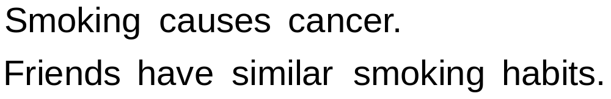
Example: Friends & Smokers

Slide 16
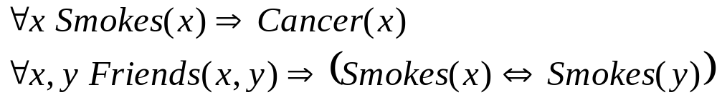
Example: Friends & Smokers

Slide 17

Example: Friends & Smokers

Slide 18
Example: Friends & Smokers
Two constants: Anna (A) and Bob (B)

Slide 19
Example: Friends & Smokers
Two constants: Anna (A) and Bob (B)
Smokes(A)
Smokes(B)
Cancer(A)
Cancer(B)

Slide 20
Example: Friends & Smokers
Two constants: Anna (A) and Bob (B)
Friends(A,B)
Friends(A,A)
Smokes(A)
Smokes(B)
Friends(B,B)
Cancer(A)
Cancer(B)
Friends(B,A)

Slide 21
Example: Friends & Smokers
Two constants: Anna (A) and Bob (B)
Friends(A,B)
Friends(A,A)
Smokes(A)
Smokes(B)
Friends(B,B)
Cancer(A)
Cancer(B)
Friends(B,A)

Slide 22
Example: Friends & Smokers
Two constants: Anna (A) and Bob (B)
Friends(A,B)
Friends(A,A)
Smokes(A)
Smokes(B)
Friends(B,B)
Cancer(A)
Cancer(B)
Friends(B,A)

Slide 23
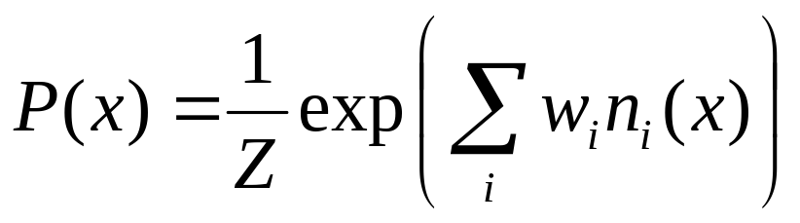
Markov Logic Networks
MLN is template for ground Markov nets
Probability of a world x:
Typed variables and constants greatly reduce size of ground Markov net
Functions, existential quantifiers, etc.
Infinite and continuous domains
Weight of formula i
No. of true groundings of formula i in x

Slide 24
Relation to Statistical Models
Special cases:
  Markov networks
  Markov random fields
  Bayesian networks
  Log-linear models
  Exponential models
  Max. entropy models
  Gibbs distributions
  Boltzmann machines
  Logistic regression
  Hidden Markov models
  Conditional random fields
Obtained by making all predicates zero-arity
Markov logic allows objects to be interdependent
(non-i.i.d.)

Slide 25
Relation to First-Order Logic
Infinite weights ⇒ First-order logic
Satisfiable KB, positive weights ⇒
Satisfying assignments = Modes of distribution
Markov logic allows contradictions between formulas

Slide 26
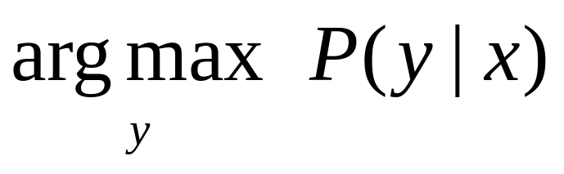
MAP Inference
Problem: Find most likely state of world given evidence
Query
Evidence

Slide 27
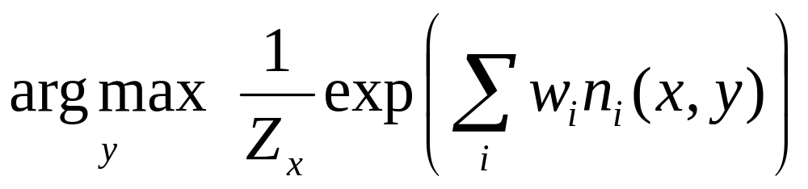
MAP Inference
Problem: Find most likely state of world given evidence

Slide 28
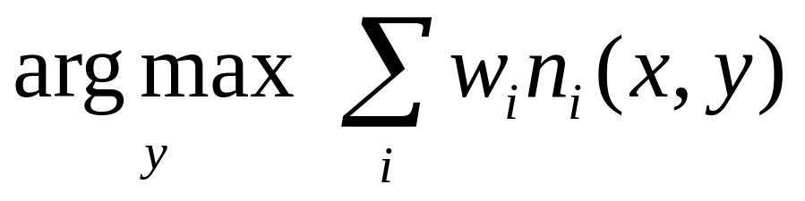
MAP Inference
Problem: Find most likely state of world given evidence

Slide 29
MAP Inference
Problem: Find most likely state of world given evidence
This is just the weighted MaxSAT problem
Use weighted SAT solver
(e.g., MaxWalkSAT [Kautz et al., 1997]

Slide 30
The MaxWalkSAT Algorithm
for i ← 1 to max-tries do
solution = random truth assignment
for j ← 1 to max-flips do
if ∑ weights(sat. clauses) > threshold then
return solution
c ← random unsatisfied clause
with probability p
flip a random variable in c
else
flip variable in c that maximizes
∑ weights(sat. clauses)
return failure, best solution found

Slide 31
Computing Probabilities
P(Formula|MLN,C) = ?
Brute force: Sum probs. of worlds where formula holds
MCMC: Sample worlds, check formula holds
P(Formula1|Formula2,MLN,C) = ?
Discard worlds where Formula 2 does not hold
In practice: More efficient alternatives

Slide 32
Learning
Data is a relational database
For now: Closed world assumption (if not: EM)
Learning parameters (weights)
  Similar to learning weights for Markov networks
Learning structure (formulas)
  A form of inductive logic programming
  Also related to learning features for Markov nets

Slide 33
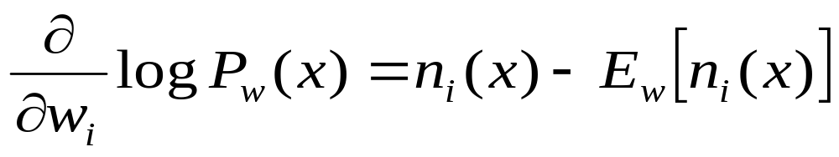
Weight Learning
Parameter tying: Groundings of same clause
Generative learning: Pseudo-likelihood
Discriminative learning: Cond. likelihood,
use MaxWalkSAT for inference
No. of times clause i is true in data
Expected no. times clause i is true according to MLN

Slide 34
Alchemy
Open-source software including:
Full first-order logic syntax
Inference (MAP and conditional probabilities)
Weight learning (generative and discriminative)
Structure learning
Programming language features
alchemy.cs.washington.edu

Slide 35
 | Alchemy | Prolog | BUGS
Represent-ation | F.O. Logic + Markov nets | Horn clauses | Bayes nets
Inference | Satisfiability, MCMC, BP | Theorem proving | Gibbs sampling
Learning | Parameters & structure | No | Params.
Uncertainty | Yes | No | Yes
Relational | Yes | Yes | No

