Slide 1
Markov Networks

Slide 2
Overview
Markov networks
Inference in Markov networks
  Computing probabilities
    Markov chain Monte Carlo
    Belief propagation
  MAP inference
Learning Markov networks
  Weight learning
    Generative
    Discriminative (a.k.a. conditional random fields)
  Structure learning

Slide 3
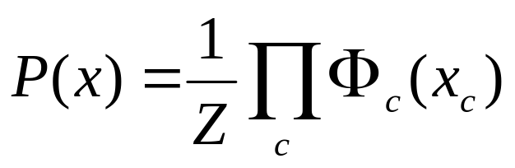
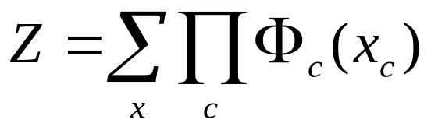
Markov Networks
Undirected graphical models
Smoking
Cancer
Asthma
Cough
Potential functions defined over cliques
Smoking | Cancer | Ф(S,C)
False | False | 4.5
False | True | 4.5
True | False | 2.7
True | True | 4.5

Slide 4
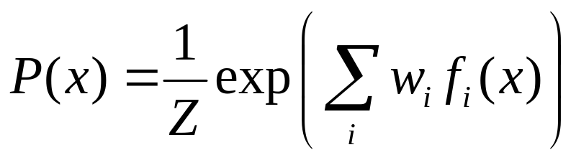
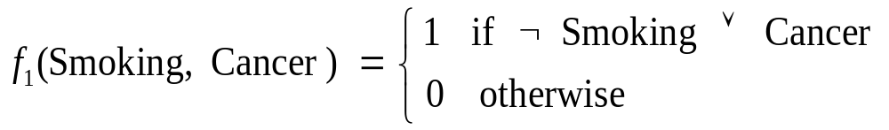

Markov Networks
Undirected graphical models
Smoking
Cancer
Asthma
Cough
Log-linear model:
Weight of Feature i
Feature i

Slide 5
Hammersley-Clifford Theorem
If Distribution is strictly positive (P(x) > 0)
And Graph encodes conditional independences
Then Distribution is product of potentials over cliques of graph
Inverse is also true.
(“Markov network = Gibbs distribution”)

Slide 6
Markov Nets vs. Bayes Nets
Property | Markov Nets | Bayes Nets
Form | Prod. potentials | Prod. potentials
Potentials | Arbitrary | Cond. probabilities
Cycles | Allowed | Forbidden
Partition func. | Z = ? | Z = 1
Indep. check | Graph separation | D-separation
Indep. props. | Some | Some
Inference | MCMC, BP, etc. | Convert to Markov

Slide 7
Inference in Markov Networks
Computing probabilities
  Markov chain Monte Carlo
  Belief propagation
MAP inference

Slide 8
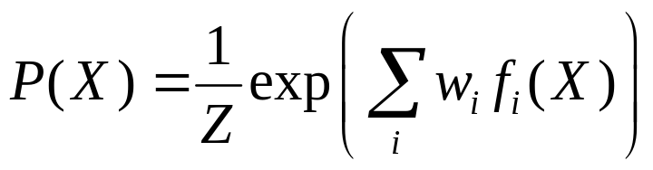
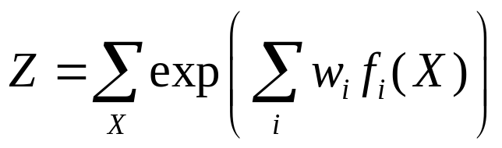
Computing Probabilities
Goal: Compute marginals & conditionals of
Exact inference is #P-complete
Approximate inference
  Monte Carlo methods
  Belief propagation
  Variational approximations

Slide 9
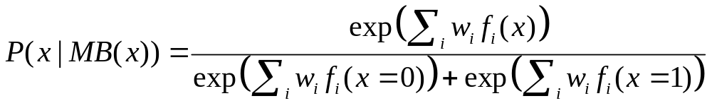
Markov Chain Monte Carlo
General algorithm: Metropolis-Hastings
  Sample next state given current one according
  to transition probability
  Reject new state with some probability to
  maintain detailed balance
Simplest (and most popular) algorithm:
Gibbs sampling
  Sample one variable at a time given the rest

Slide 10
Gibbs Sampling
state ← random truth assignment
for i ← 1 to num-samples do
for each variable x
sample x according to P(x|neighbors(x))
state ← state with new value of x
P(F) ← fraction of states in which F is true

Slide 11
Belief Propagation
Form factor graph: Bipartite network of variables and features
Repeat until convergence:
  Nodes send messages to their features
  Features send messages to their variables
Messages
  Current approximation to node marginals
  Initialize to 1

Slide 12
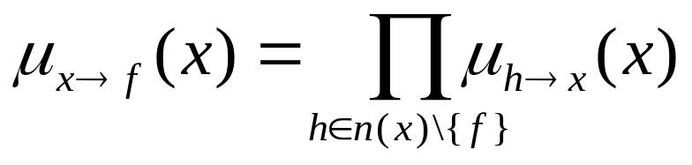
Belief Propagation
Nodes (x)
Features (f)

Slide 13
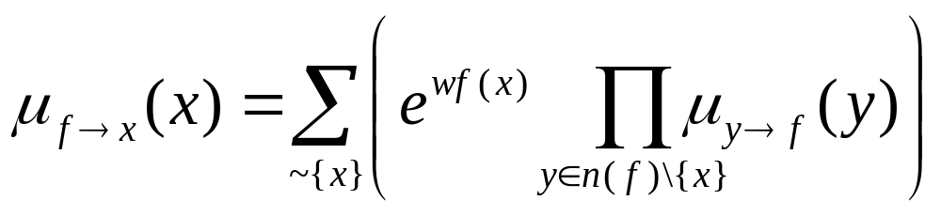
Belief Propagation
Nodes (x)
Features (f)

Slide 14
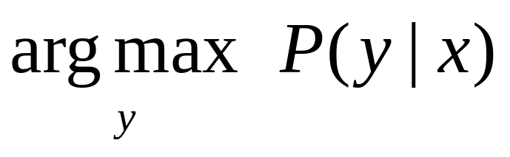
MAP/MPE Inference
Goal: Find most likely state of world given evidence
Query
Evidence

Slide 15
MAP Inference Algorithms
Iterated conditional modes
Simulated annealing
Belief propagation (max-product)
Graph cuts
Linear programming relaxations

Slide 16
Learning Markov Networks
Learning parameters (weights)
  Generatively
  Discriminatively
Learning structure (features)
In this lecture: Assume complete data
(If not: EM versions of algorithms)

Slide 17
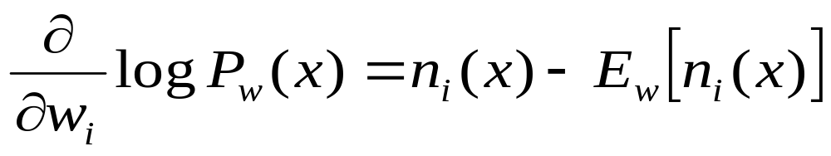
Generative Weight Learning
Maximize likelihood or posterior probability
Numerical optimization (gradient or 2nd order)
No local maxima
Requires inference at each step (slow!)
No. of times feature i is true in data
Expected no. times feature i is true according to model

Slide 18
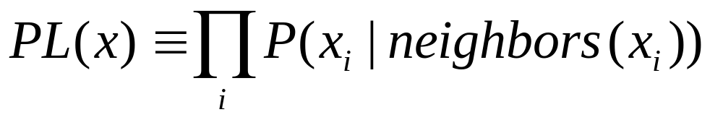
Pseudo-Likelihood
Likelihood of each variable given its neighbors in the data
Does not require inference at each step
Consistent estimator
Widely used in vision, spatial statistics, etc.
But PL parameters may not work well for
long inference chains

Slide 19
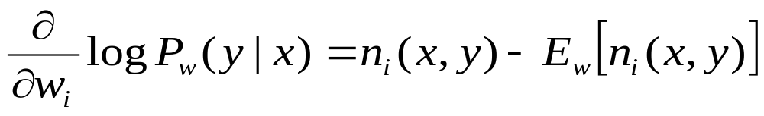
Discriminative Weight Learning
(a.k.a. Conditional Random Fields)
Maximize conditional likelihood of query (y) given evidence (x)
Voted perceptron: Approximate expected counts by counts in MAP state of y given x
No. of true groundings of clause i in data
Expected no. true groundings according to model

Slide 20
Other Weight Learning Approaches
Generative: Iterative scaling
Discriminative: Max margin

Slide 21
Structure Learning
Start with atomic features
Greedily conjoin features to improve score
Problem: Need to reestimate weights for each new candidate
Approximation: Keep weights of previous features constant

