Slide 1
Structure Learning

Slide 2
Overview
Structure learning
Predicate invention
Transfer learning

Slide 3
Structure Learning
Can learn MLN structure in two separate steps:
  Learn first-order clauses with an off-the-shelf
  ILP system (e.g., CLAUDIEN)
  Learn clause weights by optimizing
  (pseudo) likelihood
Unlikely to give best results because ILP optimizes accuracy/frequency, not likelihood
Better: Optimize likelihood during search

Slide 4
Structure Learning Algorithm
High-level algorithm
REPEAT
MLN Ã MLN [ FindBestClauses(MLN)
UNTIL FindBestClauses(MLN) returns NULL
FindBestClauses(MLN)
Create candidate clauses
FOR EACH candidate clause c
Compute increase in evaluation measure
of adding c to MLN
RETURN k clauses with greatest increase

Slide 5
Structure Learning
Evaluation measure
Clause construction operators
Search strategies
Speedup techniques

Slide 6
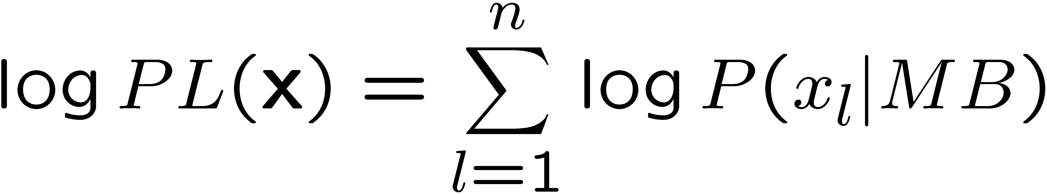
Evaluation Measure
Fastest: Pseudo-log-likelihood
This gives undue weight to predicates with large # of groundings

Slide 7
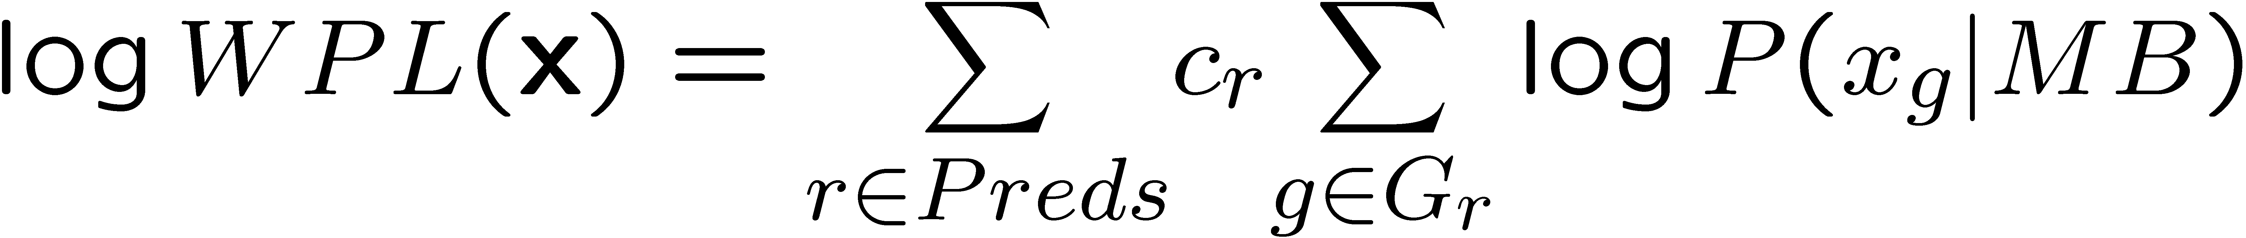
Evaluation Measure
Weighted pseudo-log-likelihood (WPLL)
Gaussian weight prior
Structure prior

Slide 8
Evaluation Measure
Weighted pseudo-log-likelihood (WPLL)
Gaussian weight prior
Structure prior
weight given to predicate r

Slide 9
Evaluation Measure
Weighted pseudo-log-likelihood (WPLL)
Gaussian weight prior
Structure prior
weight given to predicate r
sums over groundings of predicate r

Slide 10
Evaluation Measure
Weighted pseudo-log-likelihood (WPLL)
Gaussian weight prior
Structure prior
weight given to predicate r
CLL: conditional
log-likelihood
sums over groundings of predicate r

Slide 11
Clause Construction Operators
Add a literal (negative or positive)
Remove a literal
Flip sign of literal
Limit number of distinct variables
to restrict search space

Slide 12
Beam Search
Same as that used in ILP & rule induction
Repeatedly find the single best clause

Slide 13
Shortest-First Search (SFS)
Start from empty or hand-coded MLN
FOR L Ã 1 TO MAX_LENGTH
Apply each literal addition & deletion to
each clause to create clauses of length L
Repeatedly add K best clauses of length L
to the MLN until no clause of length L
improves WPLL
Similar to Della Pietra et al. (1997),
McCallum (2003)

Slide 14
Speedup Techniques
FindBestClauses(MLN)
Creates candidate clauses
FOR EACH candidate clause c
Compute increase in WPLL (using L-BFGS)
of adding c to MLN
RETURN k clauses with greatest increase

Slide 15
Speedup Techniques
FindBestClauses(MLN)
Creates candidate clauses
FOR EACH candidate clause c
Compute increase in WPLL (using L-BFGS)
of adding c to MLN
RETURN k clauses with greatest increase
SLOW
Many candidates

Slide 16
Speedup Techniques
FindBestClauses(MLN)
Creates candidate clauses
FOR EACH candidate clause c
Compute increase in WPLL (using L-BFGS)
of adding c to MLN
RETURN k clauses with greatest increase
SLOW
Many candidates
SLOW
Many CLLs
SLOW
Each CLL involves a
#P-complete problem

Slide 17
Speedup Techniques
FindBestClauses(MLN)
Creates candidate clauses
FOR EACH candidate clause c
Compute increase in WPLL (using L-BFGS)
of adding c to MLN
RETURN k clauses with greatest increase
SLOW
Many candidates
NOT THAT FAST
SLOW
Many CLLs
SLOW
Each CLL involves a
#P-complete problem

Slide 18
Speedup Techniques
Clause sampling
Predicate sampling
Avoid redundant computations
Loose convergence thresholds
Weight thresholding

Slide 19
Overview
Structure learning
Predicate invention
Transfer learning

Slide 20
Motivation
Statistical Relational Learning
Statistical Learning
able to handle noisy data
Relational Learning (ILP)
able to handle non-i.i.d. data

Slide 21
Motivation
Statistical Predicate Invention
Discovery of new concepts, properties, and relations
from data
Statistical Relational Learning
Latent Variable Discovery
[Elidan & Friedman, 2005; Elidan et al.,2001; etc.]
Statistical Learning
able to handle noisy data
Predicate Invention
[Wogulis & Langley, 1989; Muggleton
& Buntine, 1988; etc.]
Relational Learning (ILP)
able to handle non-i.i.d. data

Slide 22
Benefits of Predicate Invention
More compact and comprehensible models
Improve accuracy by representing unobserved aspects of domain
Model more complex phenomena

Slide 23
Multiple Relational Clusterings
Clusters objects and relations simultaneously
Multiple types of objects
Relations can be of any arity
#Clusters need not be specified in advance
Learns multiple cross-cutting clusterings
Finite second-order Markov logic
First step towards general framework for SPI

Slide 24
Multiple Relational Clusterings
Invent unary predicate = Cluster
Multiple cross-cutting clusterings
Cluster relations by objects they relate and vice versa
Cluster objects of same type
Cluster relations with same arity and argument types

Slide 25
Example of Multiple Clusterings
Predictive of skills
Some are friends
Some are co-workers
Co-workers
Co-workers
Co-workers
Friends
Alice
Anna
Bob
Bill
Carol
Cathy
Predictive
of hobbies
David
Darren
Eddie
Elise
Felix
Faye
Friends
Gerald
Gigi
Hal
Hebe
Ida
Iris
Friends

Slide 26
Second-Order Markov Logic
Finite, function-free
Variables range over relations (predicates) and objects (constants)
Ground atoms with all possible predicate symbols and constant symbols
Represent some models more compactly than first-order Markov logic
Specify how predicate symbols are clustered

Slide 27
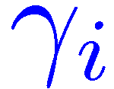

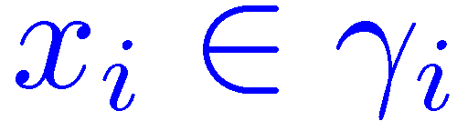
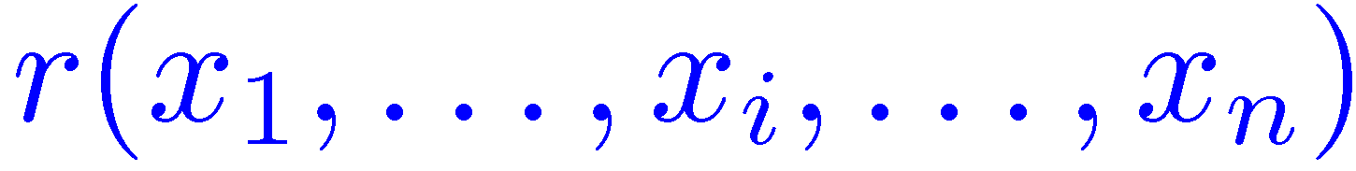
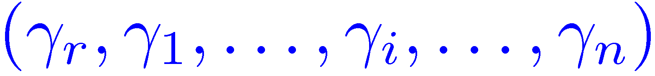
Symbols
Cluster:
Clustering:
Atom: ,
Cluster combination:

Slide 28
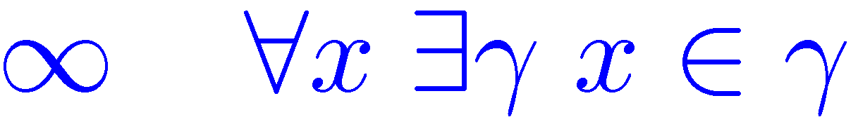
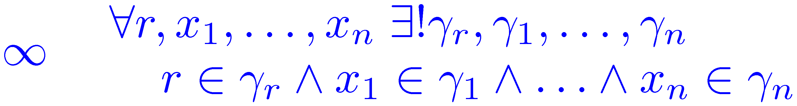
MRC Rules
Each symbol belongs to at least one cluster
Symbol cannot belong to >1 cluster in same clustering
Each atom appears in exactly one combination of clusters

Slide 29
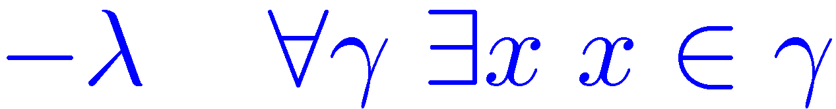
MRC Rules
Atom prediction rule: Truth value of atom is determined by cluster combination it belongs to
Exponential prior on number of clusters

Slide 30
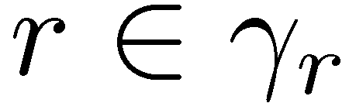
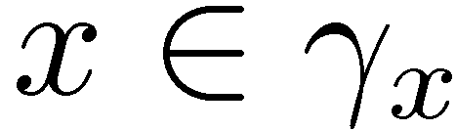
Learning MRC Model
Learning consists of finding
  Cluster assignment {Γ}: assignment of truth values to all and atoms
  Weights of atom prediction rules
that maximize log-posterior probability
Vector of truth assignments to
all observed ground atoms

Slide 31
Learning MRC Model
Three hard rules + Exponential prior rule

Slide 32
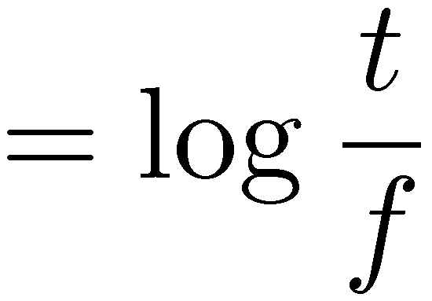
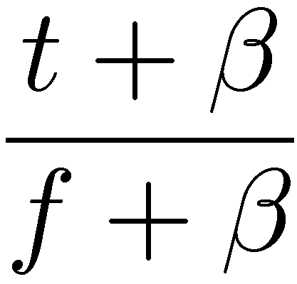
Learning MRC Model
Atom prediction rules
Can be computed in
closed form
Wt of rule is log-odds of atom
in its cluster combination being true
Smoothing
parameter
#true & #false atoms
in cluster combination

Slide 33
Search Algorithm
Approximation: Hard assignment of symbols to clusters
Greedy with restarts
Top-down divisive refinement algorithm
Two levels
  Top-level finds clusterings
  Bottom-level finds clusters

Slide 34
Search Algorithm
predicate symbols
constantsymbols
Inputs: sets of
Greedy search with restarts
P
P
T
T
Q
a
Q
U
h
Outputs: Clustering of each
set of symbols
R
V
b
g
R
S
c
d
e
f
S
W
W

Slide 35
Search Algorithm
predicate symbols
constantsymbols
Inputs: sets of
Greedy search with restarts
P
P
T
T
Q
a
Q
U
h
Outputs: Clustering of each
set of symbols
R
V
b
g
R
Recurse for every
cluster combination
S
c
d
e
f
S
W
W
P
P
T
T
Q
a
Q
h
U
a
U
h
R
b
R
g
V
b
V
g
S
c
d
S
e
f
W
c
d
W
e
f

Slide 36
Search Algorithm
predicate symbols
constantsymbols
Inputs: sets of
P
P
P
P
T
T
T
T
a
Q
a
Q
Q
Q
U
U
h
h
V
V
b
b
g
R
g
R
R
R
c
c
d
d
e
e
f
Recurse for every
cluster combination
S
f
S
S
S
W
W
W
W
P
P
P
P
P
T
T
T
P
T
a
a
a
a
h
a
h
h
h
Q
h
Q
Q
Q
Q
U
U
U
Q
U
b
b
g
g
g
b
b
g
b
V
g
V
V
R
V
R
R
R
R
R
c
c
c
d
d
d
e
e
e
f
f
f
c
c
d
d
e
e
f
S
f
S
S
S
S
W
W
W
S
W
P
P
P
b
R
b
R
Q
h
h
Q
a
Q
c
d
S
a
g
S
c
d
R
g
e
f
S
e
f
Terminate when no refinement improves MAP score

Slide 37
Search Algorithm
P
P
P
P
T
T
T
T
a
Q
a
Q
Q
Q
U
U
h
h
V
V
b
b
g
R
g
R
R
R
c
c
d
d
e
e
f
S
f
S
S
S
W
W
W
W
P
P
P
P
P
T
T
T
P
T
a
a
a
a
h
a
h
h
h
Q
h
Q
Q
Q
Q
U
U
U
Q
U
b
b
g
g
g
b
b
g
b
V
g
V
V
R
V
R
R
R
R
R
c
c
c
d
d
d
e
e
e
f
f
f
c
c
d
d
e
e
f
S
f
S
S
S
S
W
W
W
S
W
P
P
P
b
R
b
R
Q
h
h
Q
a
Q
c
d
S
a
g
S
c
d
R
g
e
f
S
e
f
Leaf ≡ atom prediction rule
Return leaves
8r, x r 2 γ_{r} Æ x 2 γ_{x} ) r(x)

Slide 38
Search Algorithm
P
P
P
P
T
T
T
T
Limitation: High-level clusters constrain lower ones
Search enforces hard rules
a
Q
a
Q
Q
Q
U
U
h
h
V
V
b
b
g
R
g
R
R
R
c
c
d
d
e
e
f
S
f
S
S
S
W
W
W
W
P
P
P
P
P
T
T
T
P
T
a
a
a
a
h
a
h
h
h
Q
h
Q
Q
Q
Q
U
U
U
Q
U
b
b
g
g
g
b
b
g
b
V
g
V
V
R
V
R
R
R
R
R
c
c
c
d
d
d
e
e
e
f
f
f
c
c
d
d
e
e
f
S
f
S
S
S
S
W
W
W
S
W
P
P
P
b
R
b
R
Q
h
h
Q
a
Q
c
d
S
a
g
S
c
d
R
g
e
f
S
e
f
: Multiple clusterings

Slide 39
Overview
Structure learning
Predicate invention
Transfer learning

Slide 40
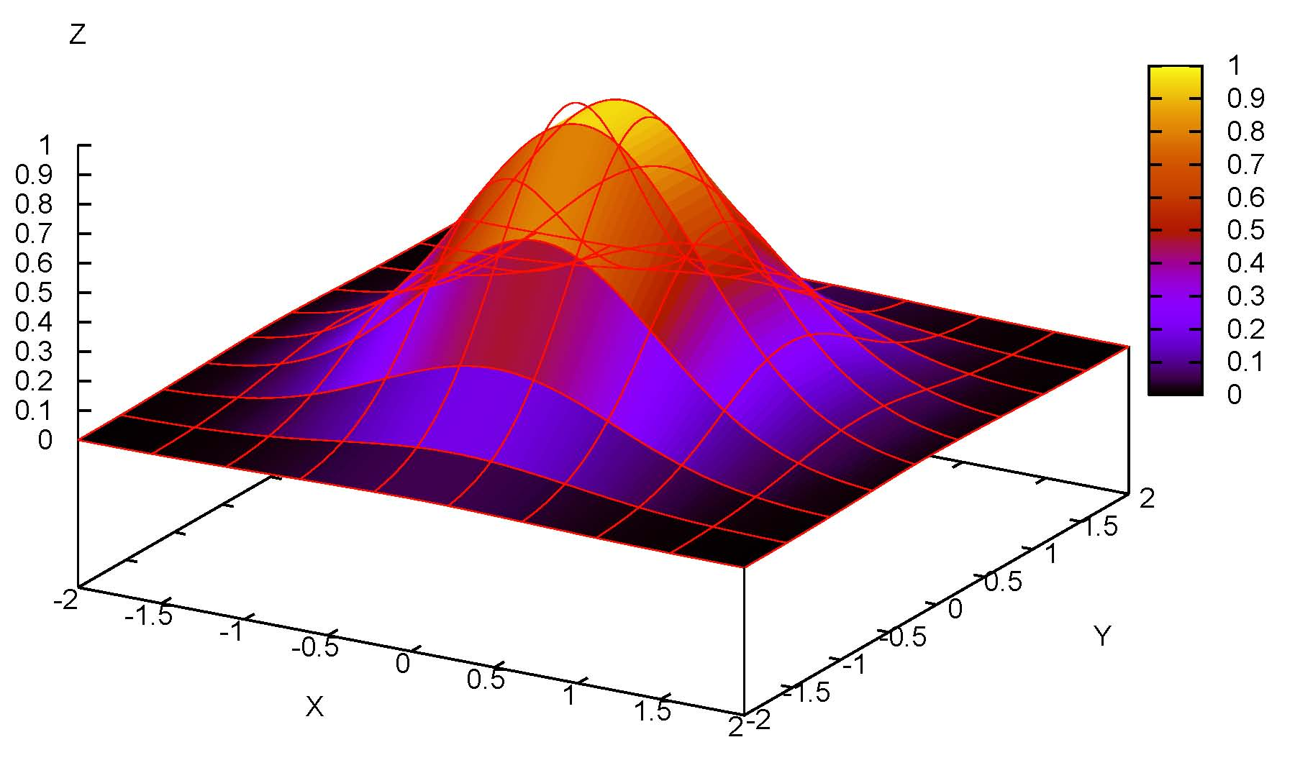
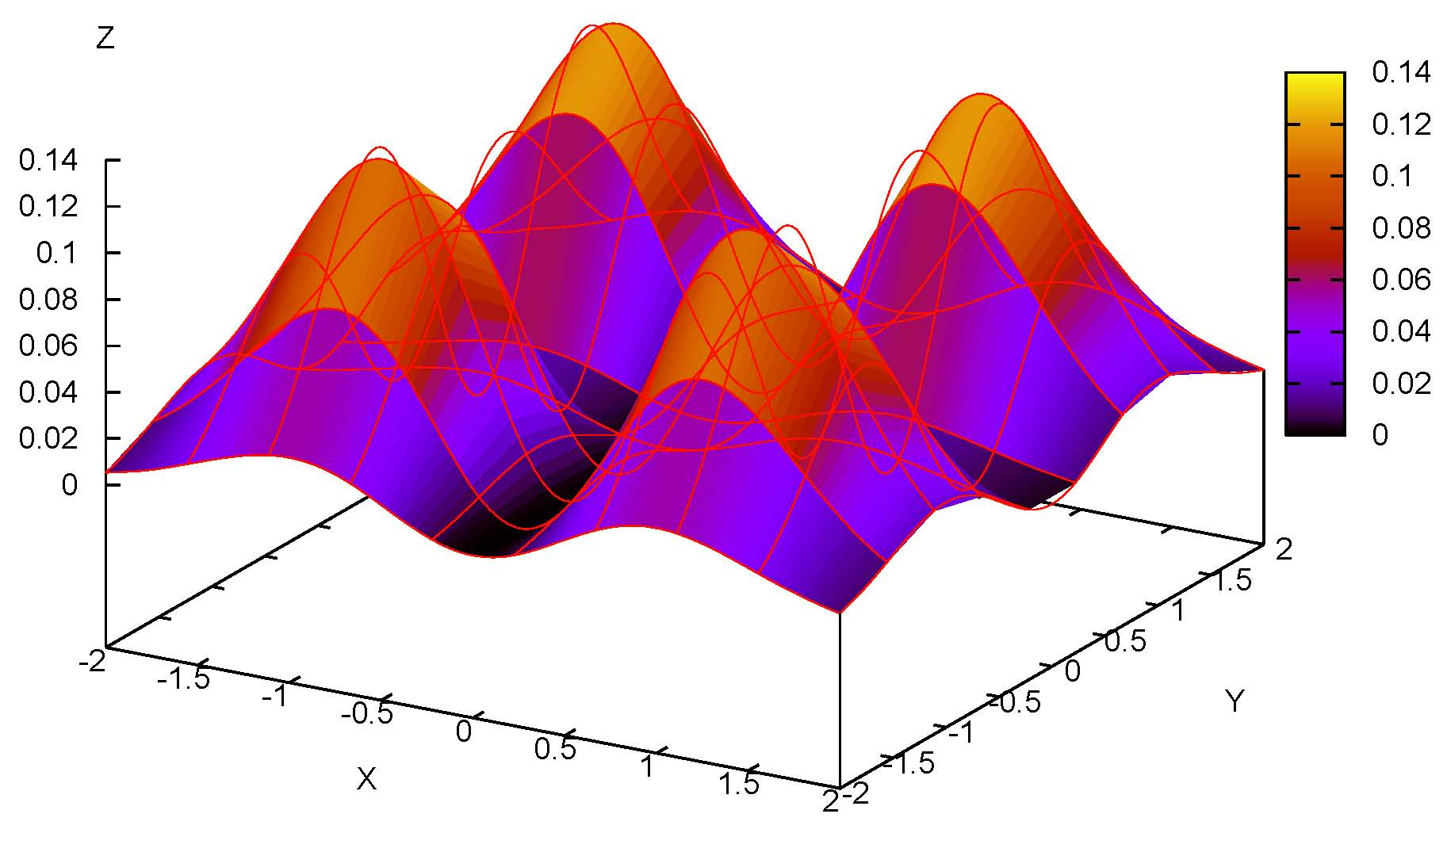
Shallow Transfer
Source Domain
Target Domain
Generalize to different distributions over same variables

Slide 41
Deep Transfer
Source Domain
Target Domain
Prof. Domingos
Students: Parag,…
Projects: SRL,
Data mining
Class: CSE 546
Grad Student
Parag
Advisor:
Domingos
Research: SRL
cytoplasm
cytoplasm
YOR167c
YBL026w
ribosomal
proteins
rNA processing
CSE 546:
Data Mining
Topics:…
Homework: …
SRL Research
At UW
Publications:…
Splicing
Generalize to different vocabularies

Slide 42
Deep Transfer via
Markov Logic (DTM)
Clique templates
  Abstract away predicate names
  Discern high-level structural regularities
Check if each template captures a regularity beyond sub-clique templates
Transferred knowledge provides declarative bias in target domain

Slide 43
Transfer as Declarative Bias
Large search space of first-order clauses
→ Declarative bias is crucial
Limit search space
  Maximum clause length
  Type constraints
Background knowledge
DTM discovers declarative bias in one domain and applies it in another

Slide 44
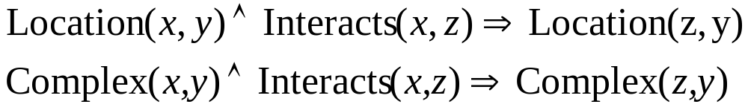
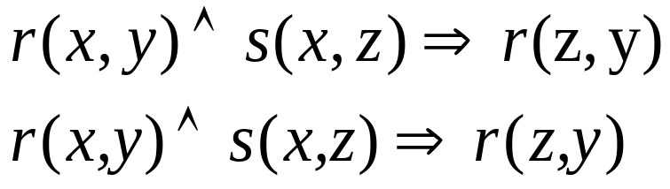
Intuition Behind DTM
Have the same second order structure:
1) Map Location and Complex to r
2) Map Interacts to s

Slide 45
Clique Templates
Groups together features with similar effects
r(x,y),r(z,y),s(x,z)
Groundings do not overlap
r(x,y) Λ r(z,y) Λ s(x,z)
r(x,y) Λ r(z,y) Λ ¬s(x,z)
r(x,y) Λ ¬r(z,y) Λ s(x,z)
r(x,y) Λ ¬r(z,y) Λ ¬s(x,z)
¬r(x,y) Λ r(z,y) Λ s(x,z)
¬r(x,y) Λ r(z,y) Λ ¬s(x,z)
¬r(x,y) Λ ¬r(z,y) Λ s(x,z)
¬r(x,y) Λ ¬r(z,y) Λ ¬s(x,z)
Feature template

Slide 46
Clique Templates
r(x,y),r(z,y),s(x,z)
Unique modulo variable renaming
r(x,y),r(z,y),s(x,z)
r(z,y),r(x,y),s(z,x)
Two distinct variables cannot unify
e.g., r≠s and x≠z
Templates of length two and three
r(x,y) Λ r(z,y) Λ s(x,z)
r(x,y) Λ r(z,y) Λ ¬s(x,z)
r(x,y) Λ ¬r(z,y) Λ s(x,z)
r(x,y) Λ ¬r(z,y) Λ ¬s(x,z)
¬r(x,y) Λ r(z,y) Λ s(x,z)
¬r(x,y) Λ r(z,y) Λ ¬s(x,z)
¬r(x,y) Λ ¬r(z,y) Λ s(x,z)
¬r(x,y) Λ ¬r(z,y) Λ ¬s(x,z)
Feature template

Slide 47
Evaluation Overview
r(x,y),r(z,y),s(x,z)
Clique Template
Clique
Location(x,y),Location(z,y),Interacts(x,z)
…
Decomposition
Location(x,y),Location(z,y)
Location(z,y),Interacts(x,z)
Interacts(x,z)
Location(x,y)

Slide 48
Clique Evaluation
Location(x,y),Location(z,y),Interacts(x,z)
Q: Does the clique capture a regularity beyond its sub-cliques?
Prob(Location(x,y),Location(z,y),Interacts(x,z)) ≠
Prob(Location(x,y),Location(z,y)) x Prob(Interacts(x,z))
…
Prob(Location(x,y),Location(z,y),Interacts(x,z)) ≠
Prob(Location(x,y),Location(z,y)) x Prob(Interacts(x,z))
…
Location(x,y),Location(z,y)
Location(z,y),Interacts(x,z)
Interacts(x,z)
Location(x,y)

Slide 49
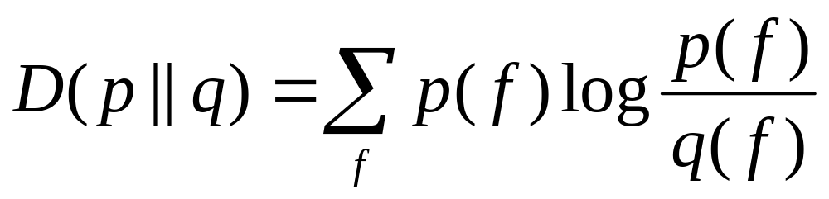
Scoring a Decomposition
KL divergence
p is clique´s probability distribution
q is distribution predicted by decomposition

Slide 50
Clique Score
Location(x,y),Location(z,y),Interacts(x,z)
Score: 0.02
Min over scores
Score: 0.04
Score: 0.02
Location(x,y),Location(z,y)
Location(z,y),Interacts(x,z)
Interacts(x,z)
Location(x,y)
Score: 0.02
Location(x,y),Interacts(x,z)
Location(z,y)

Slide 51
Scoring Clique Templates
r(x,y),r(z,y),s(x,z)
Score: 0.015
…
Average over
top K cliques
Score: 0.02
Location(x,y),Location(z,y),Interacts(x,z)
Score: 0.01
Complex(x,y),Complex(z,y),Interacts(x,z)

Slide 52
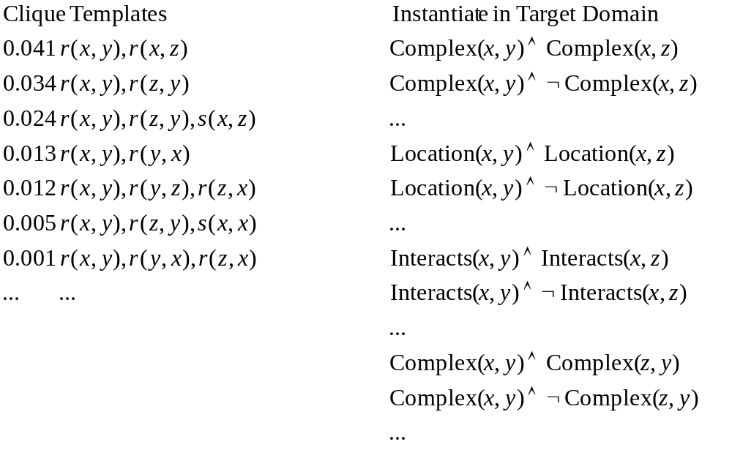
Transferring Knowledge

Slide 53
Using Transferred Knowledge
Influence structure learning in target domain
Markov logic structure learning (MSL)
[Kok & Domingos, 2005]
  Start with unit clauses
  Modify clauses by adding, deleting, negating literals in clause
  Score by weighted-pseudo log likelihood
  Beam search

Slide 54
Transfer Learning vs.
Structure Learning
Initial
MLN
Initial
Beam
Transferred
Clauses
SL
Seed
Greedy
Refine
Empty
C₁
C₂
C₃
…
C_{n}
None
Empty
C₁
C₂
C₃
…
C_{n}
…
T_{m}
T₁
…
T₁
T_{m}
T₁
T₂
T_{m}
Empty
None
T₁
T₂
…
T_{m}
T₂
T₁₇
T₂₅
C₁
C₂
C₃
…
C_{n}
T₂
T₁₇
T₂₅

Slide 55
Extensions of Markov Logic
Continuous domains
Infinite domains
Recursive Markov logic
Relational decision theory

