Slide 1
Weight Learning
(Slides by Daniel Lowd)

Slide 2
Overview
Generative
Discriminative
  Gradient descent
  Diagonal Newton
  Conjugate gradient
Missing data
Empirical comparison

Slide 3
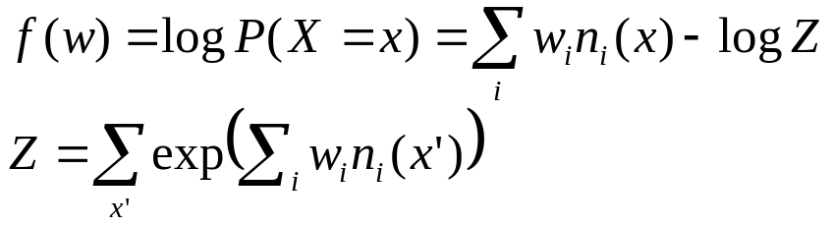
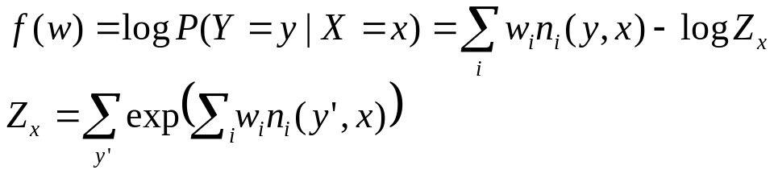
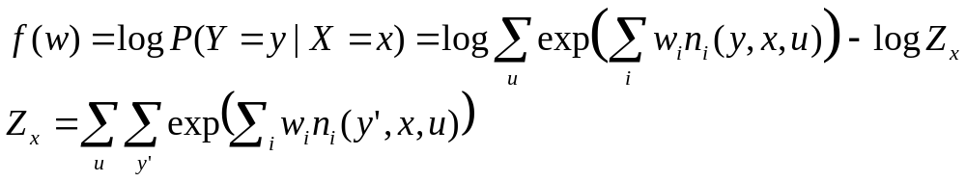
Weight Learning Overview
Weight learning is function optimization.
Generative learning:
Discriminative learning:
Learning with missing data:
Typically too hard!
Use pseudo-likelihood instead
Used in structure learning
Most common scenario.
Main focus of class today.
Modification of
discriminative case.

Slide 4

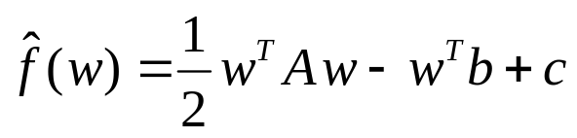
Optimization Methods
First-order methods
  Approximate f(x) as a plane:
  Gradient descent (+ various tweaks)
Second-order methods
  Approximate f(x) as quadratic form:
  Conjugate gradient – “correct” the gradient to avoid undoing work
  Newton’s method – use second derivatives to move directly towards optimum
  Quasi-Newton methods – approximate Newton’s method using successive gradients to estimate curvature

Slide 5
Convexity (and Concavity)
Formally:
1D:
f(w)
w
2D:
w₂
w₁

Slide 6
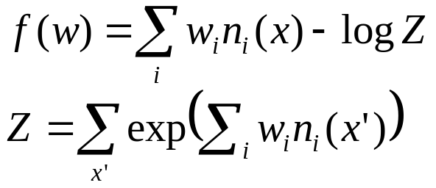
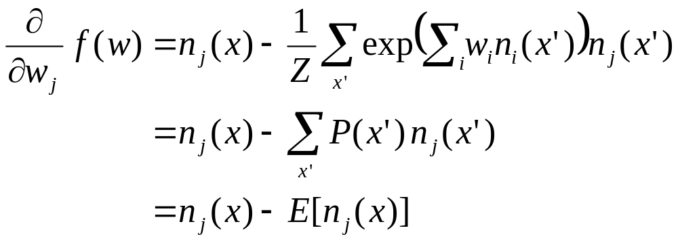
Generative Learning
Function to optimize:
Gradient:
Counts in training data
Weighted sum over all possible worlds
No evidence, just sets of constants
Very hard to approximate

Slide 7
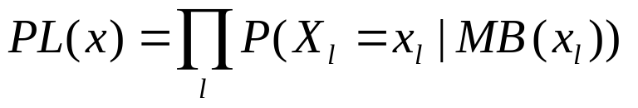
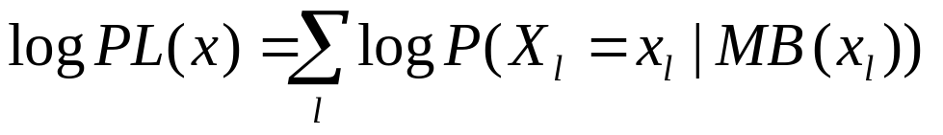
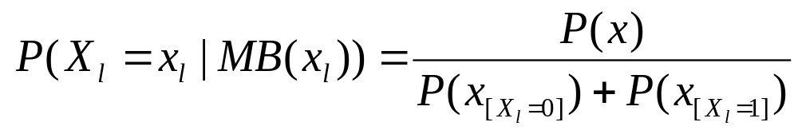
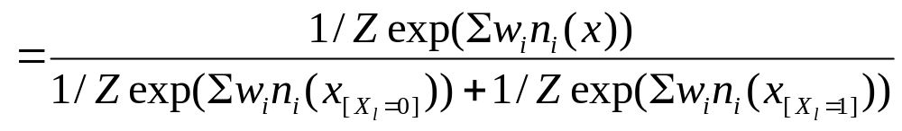
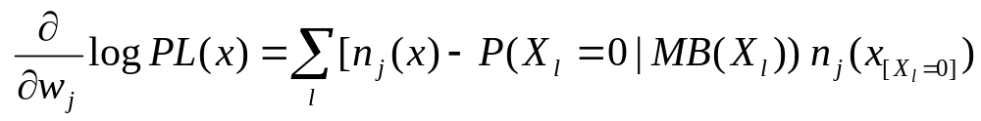

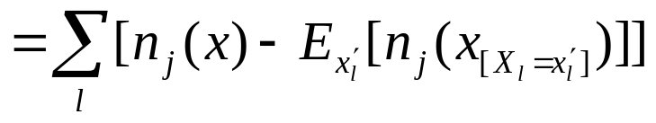
Pseudo-likelihood

Slide 8
Pseudo-likelihood
Efficiency tricks:
  Compute each n_{j}(x) only once
  Skip formulas in which x_{l} does not appear
  Skip groundings of clauses with > 1 true literal
  e.g., (A v ¬B v C) when A=1, B=0
Optimizing pseudo-likelihood
  Pseudo-log likelihood is convex
  Standard convex optimization algorithms
  work great (e.g., L-BFGS quasi-Newton method)

Slide 9
Pseudo-likelihood
Pros
  Efficient to compute
  Consistent estimator
Cons
  Works poorly with long-range dependencies

Slide 10
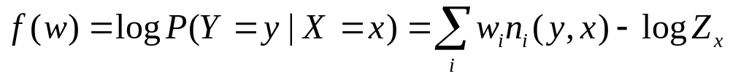
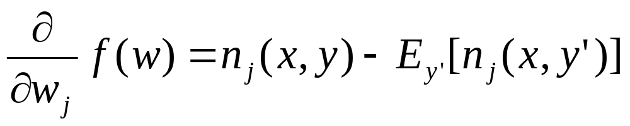
Discriminative Learning
Function to optimize:
Gradient:
Counts in training data
Weighted sum over possible
worlds consistent with x.

Slide 11
Approximating E[n(x,y)]
Use the counts of the most likely (MAP) state
  Approximate with MaxWalkSAT -- very efficient
  Does not represent multi-modal distributions well
Average over states sampled with MCMC
  MC-SAT produces weakly correlated samples
  Just a few samples (5) often suffices!
  (Contrastive divergence)
Note that a single complete state may have millions of groundings of a clause! Tied weights allow us to get away with fewer samples.

Slide 12
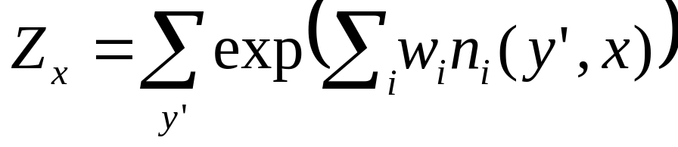
Approximating Z_{x}
This is much harder to approximate than the gradient!
So instead of computing it, we avoid it
  No function evaluations
  No line search
What’s left?

Slide 13
Gradient Descent
Move in direction of steepest descent,
scaled by learning rate:
w_{t+1} = w_{t} + η g_{t}

Slide 14
Gradient Descent in MLNs
Voted perceptron [Collins, 2002; Singla & Domingos, 2005]
  Approximate counts use MAP state
  MAP state approximated using MaxWalkSAT
  Average weights across all learning steps for additional smoothing
Contrastive divergence [Hinton, 2002; Lowd & Domingos, 2007]
  Approximate counts from a few MCMC samples
  MC-SAT gives less correlated samples
  [Poon & Domingos, 2006]

Slide 15
Per-weight Learning Rates
Some clauses have vastly more groundings than others
  Smokes(x) ⇒ Cancer(x)
  Friends(a,b) ∧ Friends(b,c) ⇒ Friends(a,c)
Need different learning rate in each dimension
Impractical to tune rate to each weight by hand
Learning rate in each dimension is:
η /(# true clause groundings)

Slide 16
Problem: Ill-Conditioning
Skewed surface → Slow convergence
Condition number: (λ_{max}/λ_{min}) of Hessian

Slide 17
The Hessian Matrix
Hessian matrix: all second derivatives
In an MLN, the Hessian is the negative covariance matrix of clause counts
  Diagonal entries are clause variances
  Off-diagonal entries show correlations
Shows local curvature of the error function

Slide 18
Newton’s Method
Weight update: w = w + H⁻¹ g
We can converge in one step if error surface is quadratic
Requires inverting the Hessian matrix

Slide 19
Diagonalized Newton’s method
Weight update: w = w + D⁻¹ g
We can converge in one step if error surface is quadratic AND the features are uncorrelated
(May need to determine step length…)

Slide 20
Problem: Ill-Conditioning
Skewed surface → slow convergence
Condition number: (λ_{max}/λ_{min}) of Hessian

Slide 21
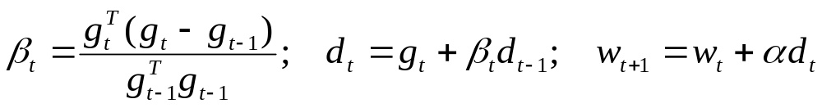
Conjugate Gradient
Gradient along all previous directions remains zero
  Avoids “undoing” any work
  If quadratic, finds n optimal weights in n steps
Depends heavily on line searches
Finds optimum along search direction by function evals.

Slide 22
Scaled Conjugate Gradient
[Møller, 1993]
Gradient along all previous directions remains zero
  Avoids “undoing” any work
  If quadratic, finds n optimal weights in n steps
Uses Hessian matrix in place of line search
Still cannot store full Hessian in memory

Slide 23
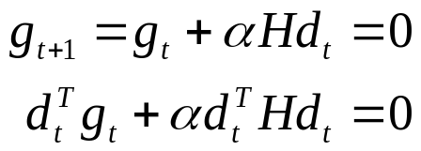
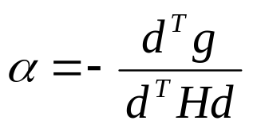
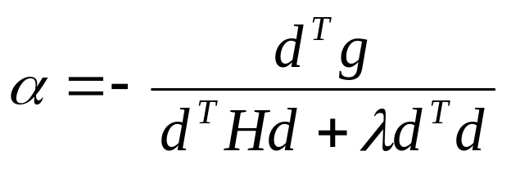
Choosing a Step Size
[Møller, 1993; Nocedal & Wright, 2007]
Given a direction d, how do we choose a good step size α?
Want to make gradient zero. Suppose f is quadratic:
But f isn’t quadratic!
  In a small enough region it’s approximately quadratic
  One approach: Set maximum step size
  Alternately, add a normalization term to denominator
Notes:
NOTE: When lambda = 0, this is our previous expression; when H=0 and d=g, this is gradient descent.

Slide 24
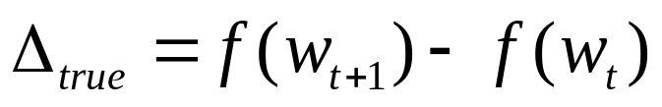
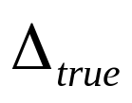
How Do We Pick Lambda?
We don’t. We adjust it automatically.
According to the quadratic approximation,
Compare to the actual difference,
  If ratio is near one, decrease λ
  If ratio is far from one, increase λ
  If ratio is negative, backtrack!
We can’t actually compute , but we can exploit convexity to bound it.

Slide 25

How Convexity Helps
f(w)
w_{t-1}
w_{t}
w_{t} – w_{t-1}

Slide 26


How Convexity Helps
Slope Step t
f(w)
w_{t-1}
w_{t}
w_{t-1} - w_{t}

Slide 27

How Convexity Helps
Slope Step t
f(w)
w_{t-1}
w_{t}
w_{t-1} - w_{t}

Slide 28
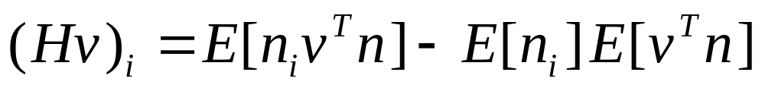
Step Sizes and Trust Regions
By using the lower bound in place of the actual function difference, we ensure that f(x) never decreases.
We don’t need the full Hessian, just dot products Hv. We can compute this directly from samples:
Other tricks
  When backtracking, take new samples at the old weight vector and add them to the old samples
  When the upper bound on improvement falls below a threshold, stop.
[Perlmutter, 1994]

Slide 29
Preconditioning
Initial direction of SCG is the gradient
  Very bad for ill-conditioned problems
Well-known fix: preconditioning
  Multiply by matrix to lower condition number
  Ideally, approximate inverse Hessian
Standard preconditioner: D⁻¹
[Sha & Pereira, 2003]

Slide 30
Overview of Discriminative Learning Methods
Gradient descent
  Direction: Steepest descent
  Step size: Simple ratio
Diagonal Newton
  Direction: Shortest path towards global optimum, assuming
  f(x) is quadratic and clauses are uncorrelated
  Step size: Trust region
  Much more effective than gradient descent
Scaled conjugate gradient
  Direction: Correction of gradient to avoid “undoing” work
  Step size: Trust region
  A little better than gradient descent without preconditioner;
  a little better than diagonal Newton with preconditioner

Slide 31
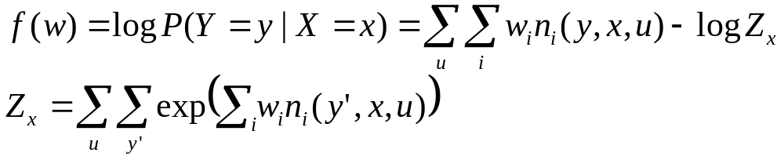
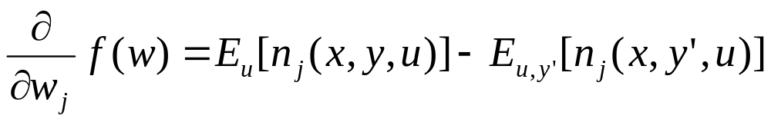
Learning with Missing Data
Gradient:
We can use inference to compute each expectation.
However, the objective function is no longer convex.
Therefore, extra caution is required when applying PSCG or DN – you may need to adjust λ more conservatively.

Slide 32
Practical Tips
There are several reasons why discriminative weight learning can fail miserably…
Overfitting
  How to detect: Evaluate model on training data
  How to fix: Use narrower prior (-priorStdDev) or change the set of formulas
Inference variance
  How to detect: Lambda grows really large
  How to fix: Increase MC-SAT samples (-minSteps)
Inference bias
  How to detect: Evaluate model on training data.
  Clause counts should be similar to during training.
  How to fix: Re-initialize MC-SAT periodically during learning or change set of formulas.

Slide 33
Experiments: Algorithms
Voted perceptron (VP,VP-PW)
Contrastive divergence (CD,CD-PW)
Diagonal Newton (DN)
Scaled conjugate gradient (SCG, PSCG)

Slide 34
Experiments: Cora
[Singla & Domingos, 2006]
Task: Deduplicate 1295 citations to 132 papers
MLN (approximate):
HasToken(+t,+f,r) ^ HasToken(+t,+f,r’)=> SameField(f,r,r’)
SameField(+f,r,r’) <=> SameRecord(r,r’)
SameRecord(r,r’) ^ SameRecord(r’,r”)=> SameRecord(r,r”)
SameField(f,r,r’) ^ SameField(f,r’,r”)=> SameField(f,r,r”)
Weights: 6141
Ground clauses: > 3 million
Condition number: > 600,000

Slide 35
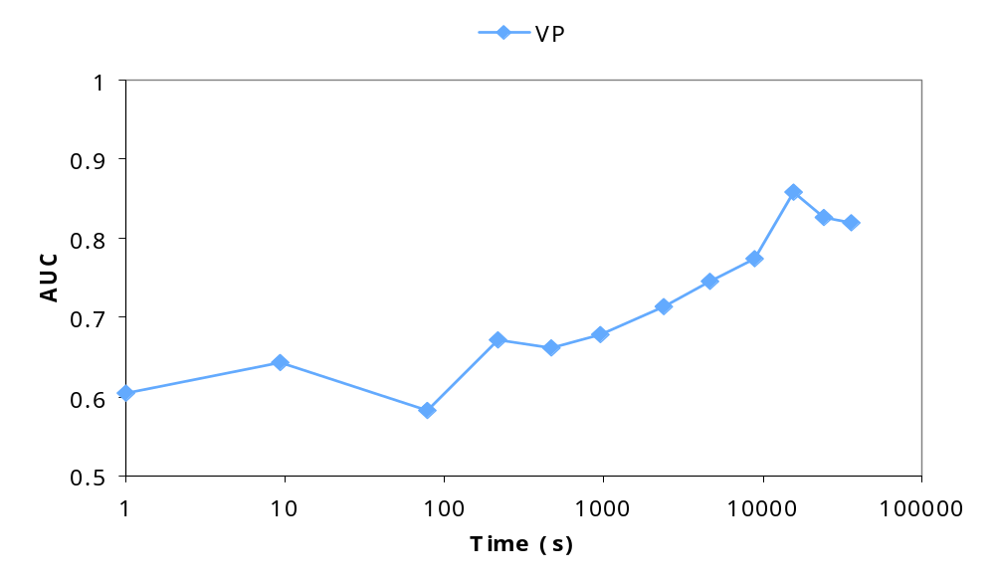
Results: Cora AUC

Slide 36
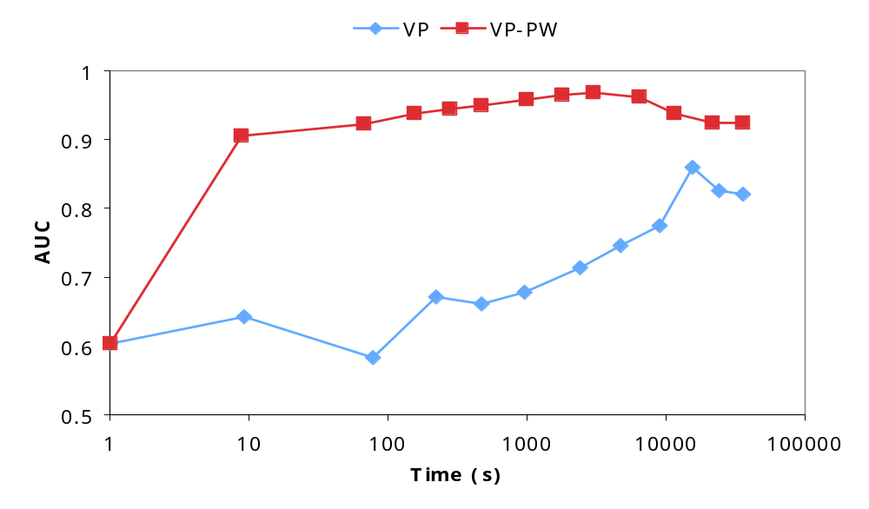
Results: Cora AUC

Slide 37
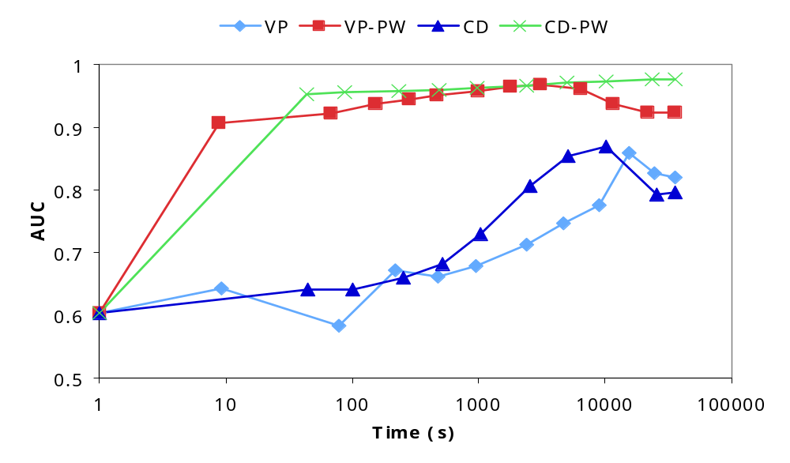
Results: Cora AUC

Slide 38
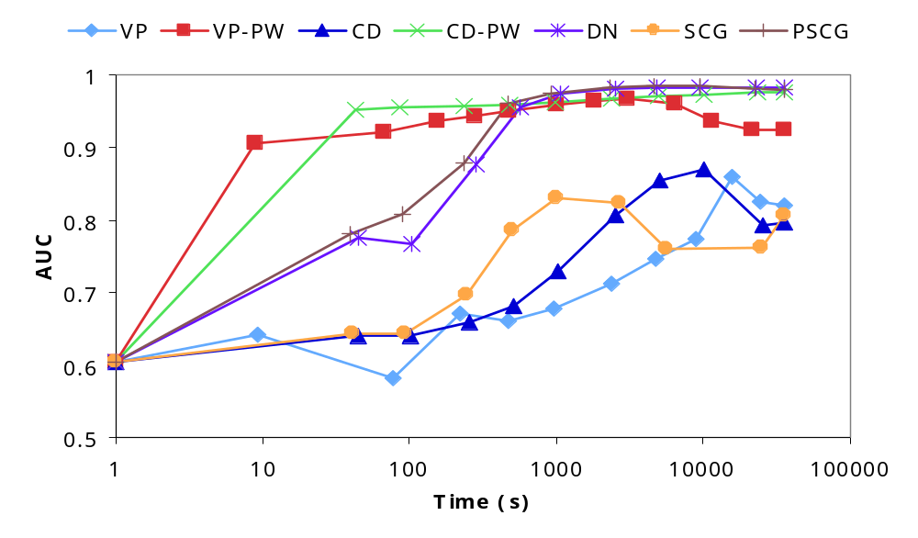
Results: Cora AUC

Slide 39
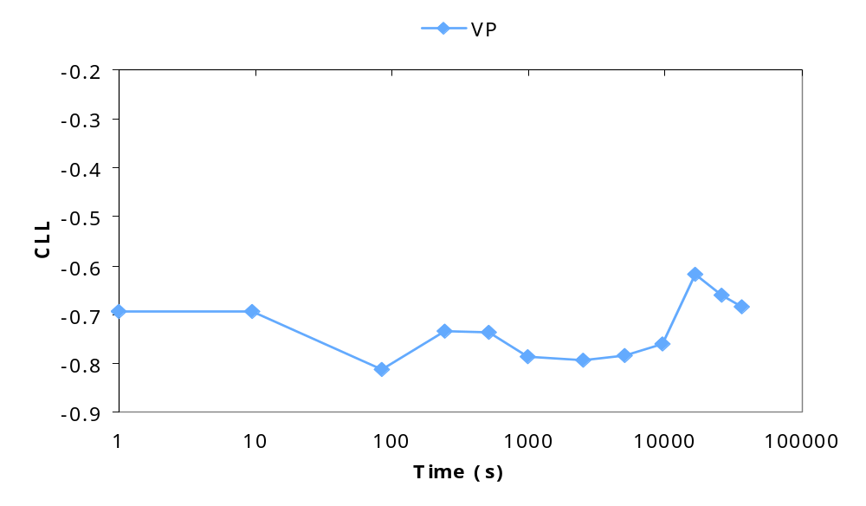
Results: Cora CLL

Slide 40
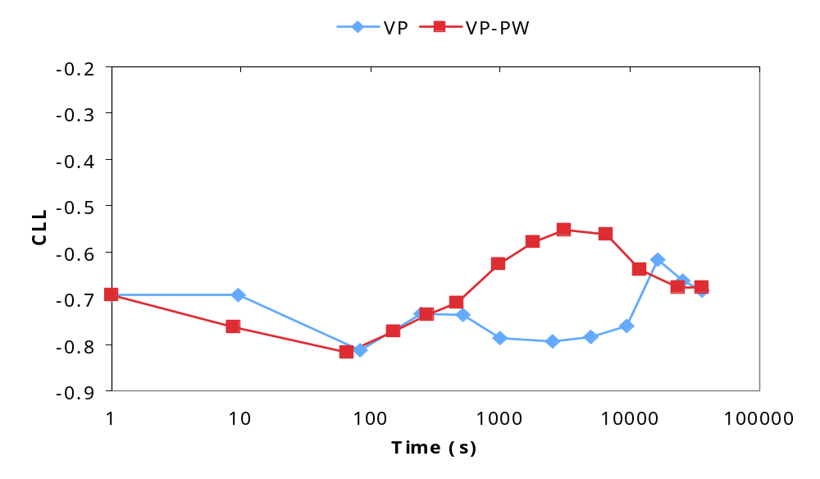
Results: Cora CLL

Slide 41
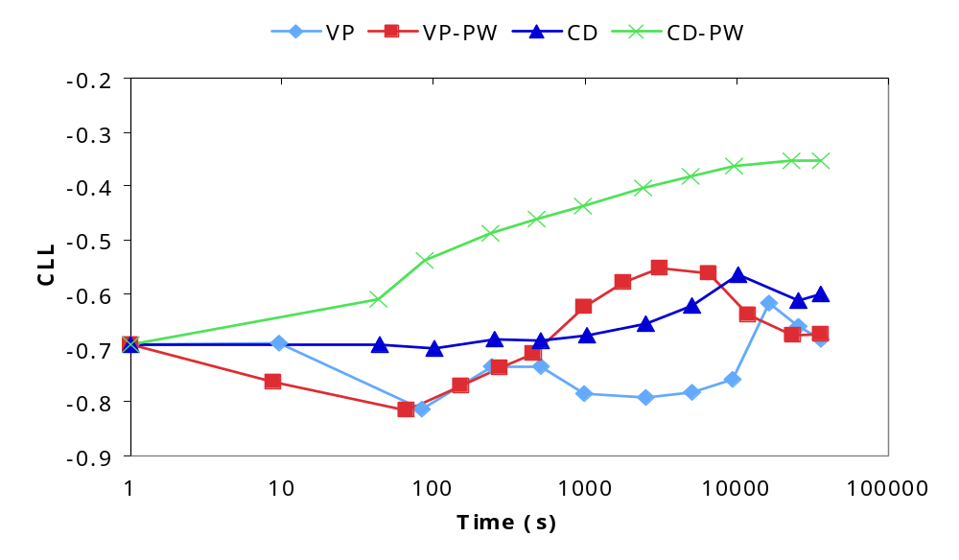
Results: Cora CLL

Slide 42
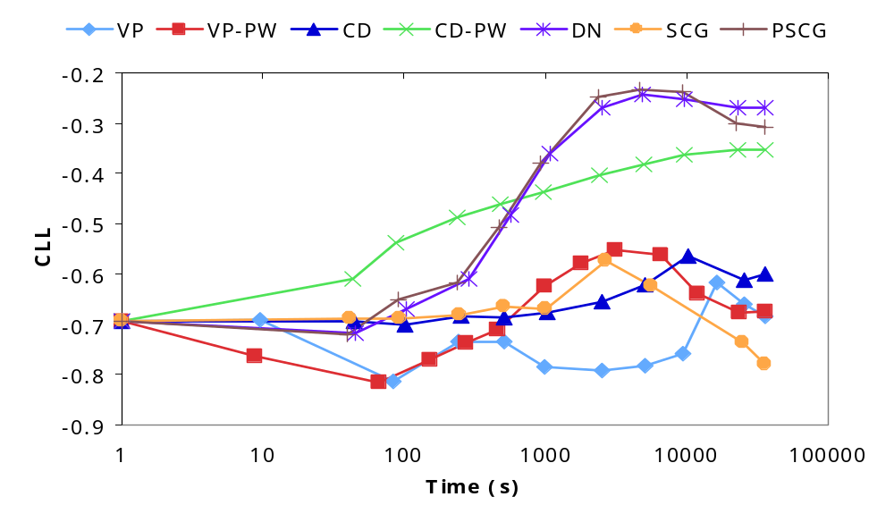
Results: Cora CLL

Slide 43
Experiments: WebKB
[Craven & Slattery, 2001]
Task: Predict categories of 4165 web pages
MLN:
PageClass(page,class)
HasWord(page,word)
Links(page,page)
HasWord(p,+w) => PageClass(p,+c)
!HasWord(p,+w) => PageClass(p,+c)
PageClass(p,+c) ^ Links(p,p') => PageClass(p',+c')
Weights: 10,891
Ground clauses: > 300,000
Condition number: ~7000

Slide 44
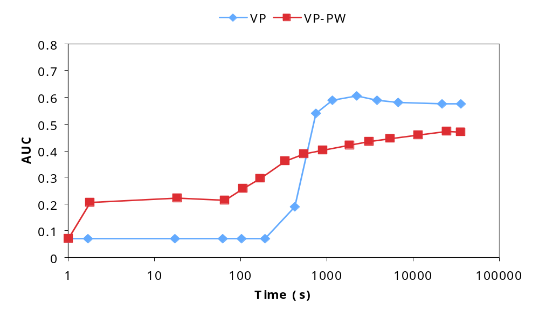
Results: WebKB AUC

Slide 45
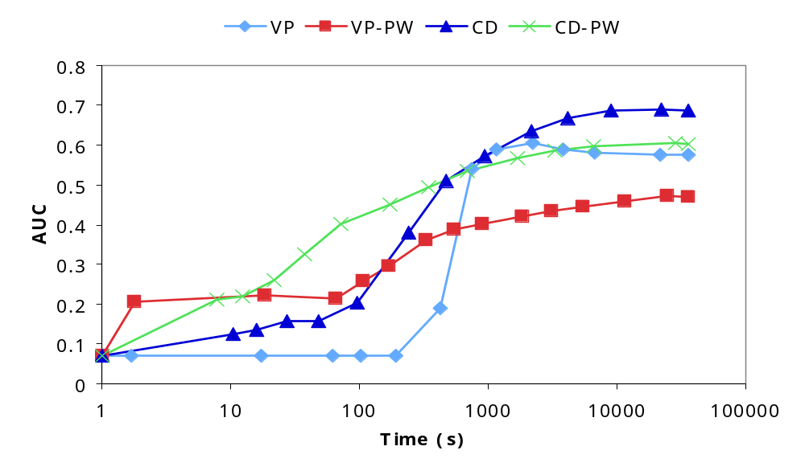
Results: WebKB AUC

Slide 46
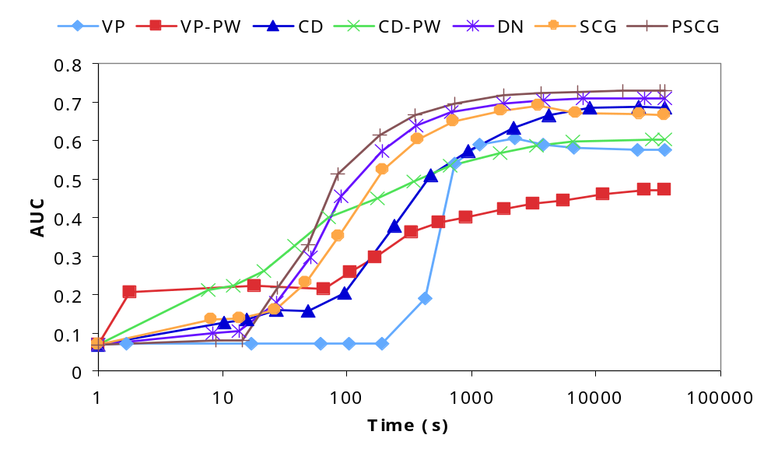
Results: WebKB AUC

Slide 47
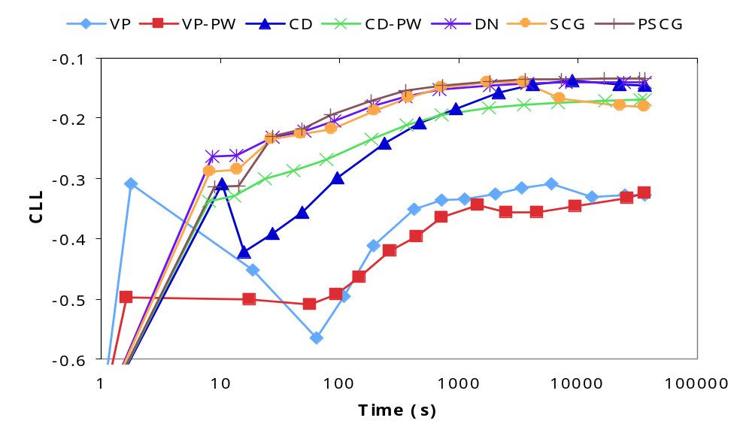
Results: WebKB CLL

