Slide 1
Lecture 5: Big-O and Cases
CSE 373 – Data Structures and Algorithms

Slide 2
Administrivia
No section tomorrow (Independence Day)
Friday’s lecture will be primarily lead by TAs as a replacement section.
Will still be recorded.
Practicing Big-O stuff!
Project 0 due tonight at 11:59 PM.
If you want to use a late day, fill out the form (linked on projects section of webpage).
Project 1 out very soon!
Check you email (and spam folder) for a link to your gitlab repo.
Make sure you know who your partner is (go to repo, settings [in left sidebar], members. Will see course staff as “owners” and you/your partner as “maintainers”
Forget to fill out partner form/something went wrong? Make a private post on piazza.

Slide 3
Project notes
How to effectively work on partner projects:
Pair program! See the document on the webpage.
Two brains is better than one when debugging
We expect you to understand the full projects, not just half of the projects.
Meet in-person with your partner.
Please don’t:
Come to office hours and say “my partner wrote this code, I don’t understand it. Please help me debug it.”
Just split the project in-half and each do half (or alternate projects)
Be mean to your partner.
Double check runners! (sometimes the checkmark appears when it shouldn’t)
Passing the runners does not guarantee full credit.

Slide 4
Project Notes
Start early!

Slide 5

Where Are We?
We’re using big-O to analyze code.
So far:
Going from a set of code, to a code model $f(n)$.
From $f\left(n\right)$, find the big-O,
Formally prove big-O
Today
More big-O-like tools: what are $Ω$, $Θ$?
How do we model code with complicated if/else branches?
Next week
Recursive code

Slide 6
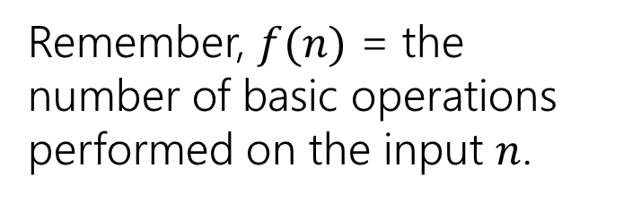
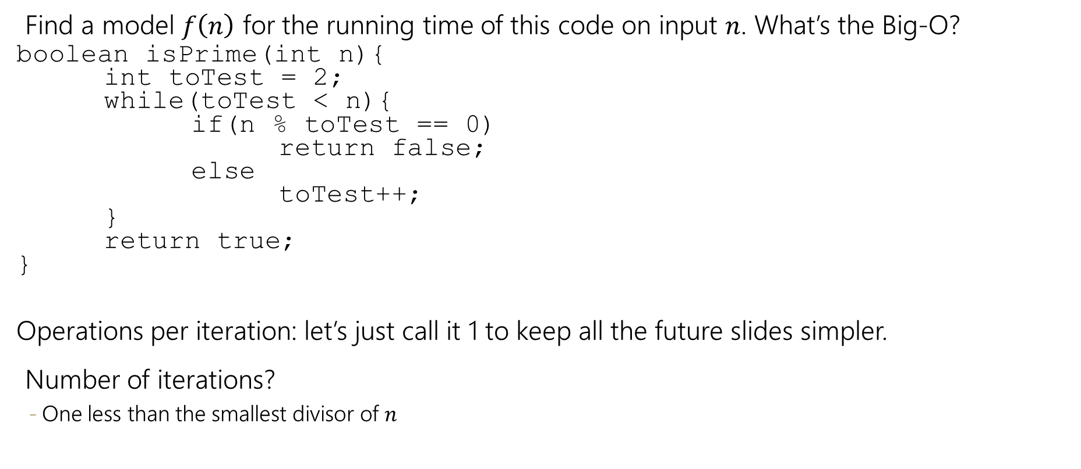
Uncharted Waters
Find a model $f\left(n\right)$ for the running time of this code on input $n$. What’s the Big-O?
boolean isPrime(int n){
int toTest = 2;
while(toTest < n){
if(n % toTest == 0)
return false;
else
toTest++;
}
return true;
}
Operations per iteration: let’s just call it 1 to keep all the future slides simpler.
Number of iterations?
One less than the smallest divisor of $n$
Remember, $f(n)$ = the number of basic operations performed on the input $n$.

Slide 7
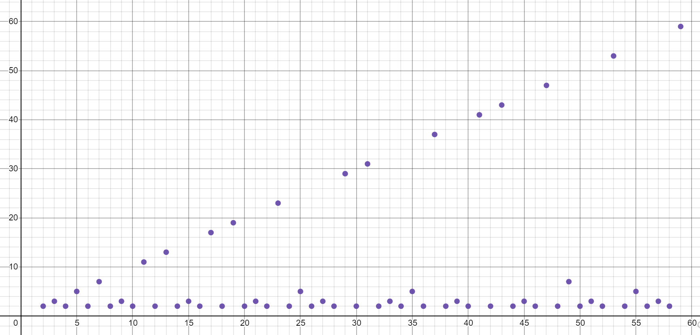
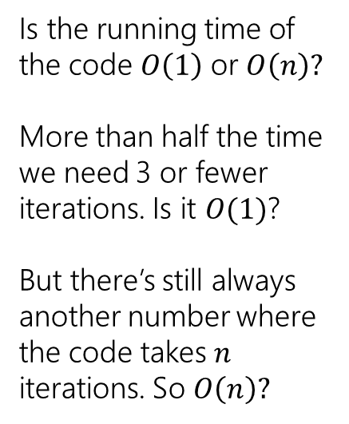
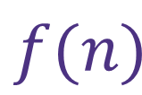
Prime Checking Runtime
$$f(n)$$
Is the running time of the code $O\left(1\right)$ or $O\left(n\right)?$
More than half the time we need 3 or fewer iterations. Is it $O(1)$?
But there’s still always another number where the code takes $n$ iterations. So $O\left(n\right)?$
This is why we have definitions!

Slide 8
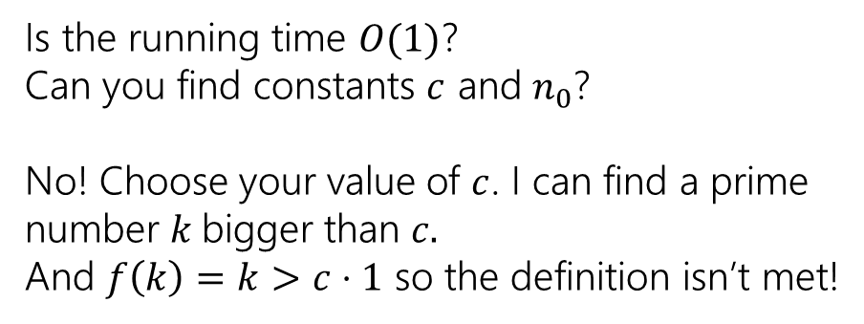
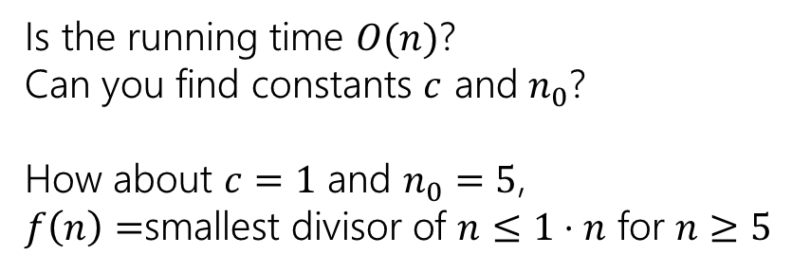
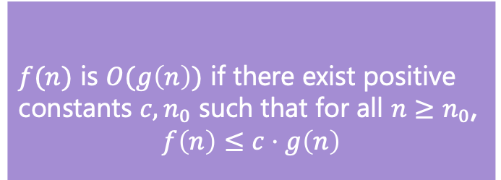

$f(n)$ is $O(g\left(n\right))$ if there exist positive constants $c, n_{0}$ such that for all $n≥n_{0}$,
$$f\left(n\right)≤c⋅g\left(n\right)$$
$$f(n)$$
Big-O
Is the running time $O(n)$?
Can you find constants $c$ and $n_{0}$?
How about $c=1$ and $n_{0}=5$,
$f\left(n\right)=$smallest divisor of $n≤1⋅n$ for $n≥5$
Is the running time $O(1)$?
Can you find constants $c$ and $n_{0}$?
No! Choose your value of $c$. I can find a prime number $k$bigger than $c.$
And $f\left(k\right)=k>c⋅1$ so the definition isn’t met!
It’s $O(n)$ but not $O\left(1\right)$

Slide 9
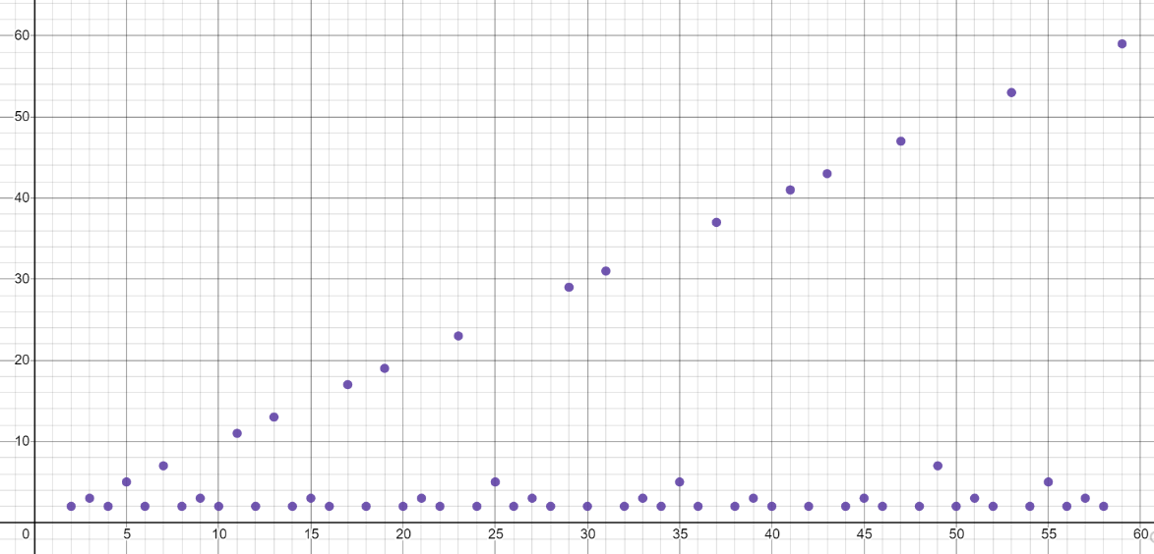
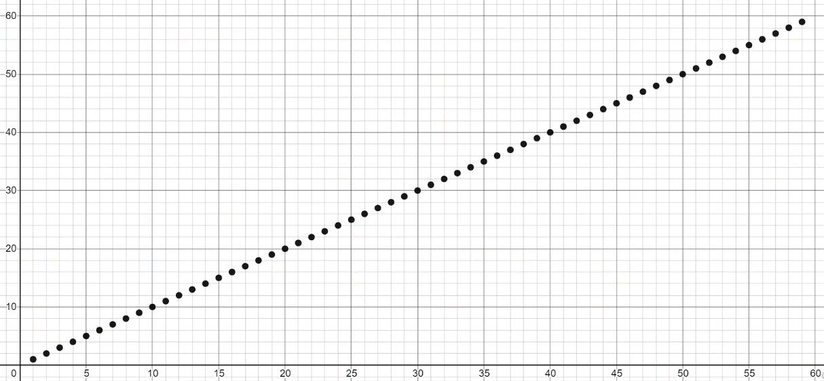

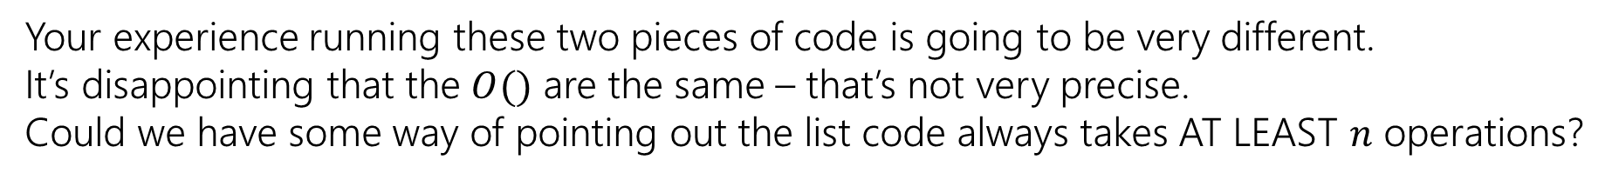
Big-O isn’t everything
Our prime finding code is $O(n)$. But so is, for example, printing all the elements of a list.
Your experience running these two pieces of code is going to be very different.
It’s disappointing that the $O()$ are the same – that’s not very precise.
Could we have some way of pointing out the list code always takes AT LEAST $n$ operations?

Slide 10

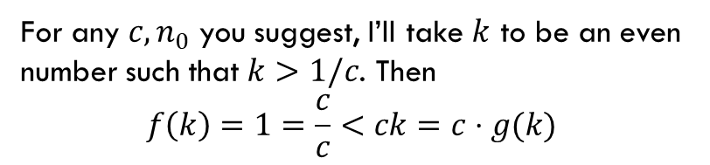

Big-$Ω$ [Omega]
$f(n)$ is $Ω(g\left(n\right))$ if there exist positive constants $c, n_{0}$ such that for all $n≥n_{0}$,
$$f\left(n\right)≥c⋅g\left(n\right)$$
Big-Omega
$f_{1}\left(n\right)$ is not $Ω(n)$ $f_{2}\left(n\right)$ is $Ω(n)$
For any $c, n_{0}$ you suggest, I’ll take $k$ to be an even number such that $k>1/c$. Then
$$f\left(k\right)=1=\frac{c}{c}<ck=c⋅g(k)$$

Slide 11
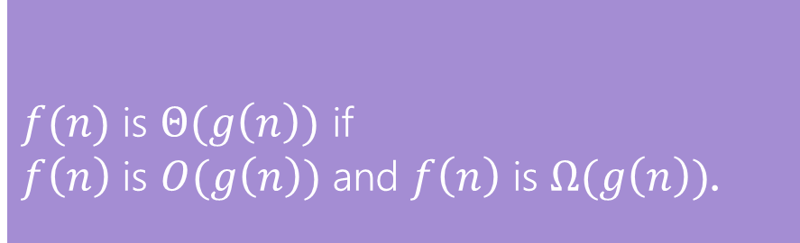
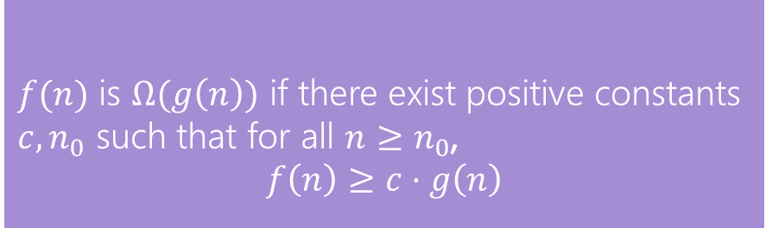
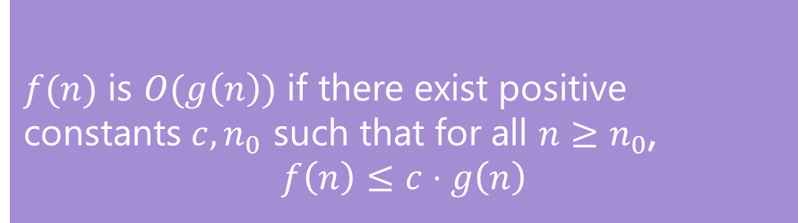
O, and Omega, and Theta [oh my?]
$f(n)$ is $O(g\left(n\right))$ if there exist positive constants $c, n_{0}$ such that for all $n≥n_{0}$,
$$f\left(n\right)≤c⋅g\left(n\right)$$
Big-O
Big-O is an upper bound
My code takes at most this long to run
Big-Omega is a lower bound
My code takes at least this long to run
Big Theta is “equal to”
My code takes “exactly”* this long to run
*Except for constant factors and lower order terms
$f(n)$ is $Ω(g\left(n\right))$ if there exist positive constants $c, n_{0}$ such that for all $n≥n_{0}$,
$$f\left(n\right)≥c⋅g\left(n\right)$$
Big-Omega
$f(n)$ is $Θ(g\left(n\right))$ if
$f\left(n\right)$ is $O(g\left(n\right))$ and $f\left(n\right)$ is $Ω(g\left(n\right))$.
Big-Theta

Slide 12
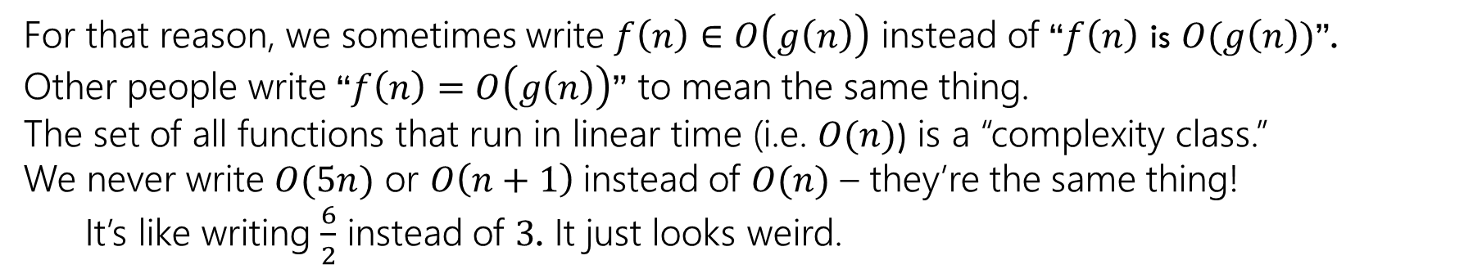
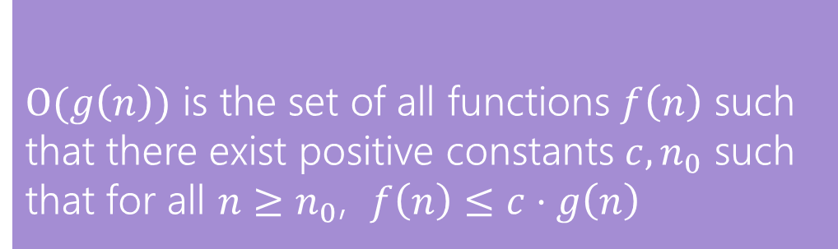
Viewing O as a class
Sometimes you’ll see big-O defined as a family or set of functions.
$O(g\left(n\right))$ is the set of all functions $f\left(n\right)$ such that there exist positive constants $c, n_{0}$ such that for all $n≥n_{0}$, $f\left(n\right)≤c⋅g\left(n\right)$
Big-O (alternative definition)
For that reason, we sometimes write $f\left(n\right)∈O\left(g\left(n\right)\right)$ instead of “$f\left(n\right)$ is $O(g\left(n\right))$”.
Other people write “$f\left(n\right)=O\left(g\left(n\right)\right)$” to mean the same thing.
The set of all functions that run in linear time (i.e. $O(n)$) is a “complexity class.”
We never write $O(5n)$ or $O\left(n+1\right)$instead of $O(n)$ – they’re the same thing!
It’s like writing $\frac{6}{2}$ instead of $3$. It just looks weird.

Slide 13



Examples
$f(n)$ $∈$ $O(g\left(n\right))$ if there exist positive constants $c, n_{0}$ such that for all $n≥n_{0}$,
$$f\left(n\right)≤c⋅g\left(n\right)$$
Big-O
4n² ∈ Ω(1)
true
4n² ∈ Ω(n)
true
4n² ∈ Ω(n²)
true
4n² ∈ Ω(n³)
false
4n² ∈ Ω(n⁴)
false
4n² ∈ O(1)
false
4n² ∈ O(n)
false
4n² ∈ O(n²)
true
4n² ∈ O(n³)
true
4n² ∈ O(n⁴)
true
$f(n)$ $∈ Ω(g\left(n\right))$ if there exist positive constants $c, n_{0}$ such that for all $n≥n_{0}$,
$$f\left(n\right)≥c⋅g\left(n\right)$$
Big-Omega
$f(n)$ $∈$ $Θ(g\left(n\right))$ if
$f\left(n\right)$ is $O(g\left(n\right))$ and $f\left(n\right)$ is $Ω(g\left(n\right))$.
Big-Theta

Slide 14
Practice
3 Minutes
$f(n)$ $∈$ $O(g\left(n\right))$ if there exist positive constants $c, n_{0}$ such that for all $n≥n_{0}$,
$$f\left(n\right)≤c⋅g\left(n\right)$$
Big-O
5n + 3 is O(n)
n is O(5n + 3)
5n + 3 = O(n)
n² ∈ O(1)
n² ∈ O(n)
n² ∈ O(n²)
n² ∈ O(n³)
n² ∈ O(n¹⁰⁰)
True
pollEV.com/cse373su19
What are the answers to the first two questions?
True
True
$f(n)$ $∈ Ω(g\left(n\right))$ if there exist positive constants $c, n_{0}$ such that for all $n≥n_{0}$,
$$f\left(n\right)≥c⋅g\left(n\right)$$
Big-Omega
False
False
True
True
$f(n)$ $∈$ $Θ(g\left(n\right))$ if
$f\left(n\right)$ is $O(g\left(n\right))$ and $f\left(n\right)$ is $Ω(g\left(n\right))$.
Big-Theta
True

Slide 15

Simplified, tight big-O
Why not always just say $f\left(n\right)$ is $O\left(f\left(n\right)\right)$.
It’s always true! (Take $c=1, n_{0}=1$).
The goal of big-O/$Ω$/$Θ$ is to group similar functions together.
We want a simple description of $f$, if we wanted the full description of $f$ we wouldn’t use $O$

Slide 16
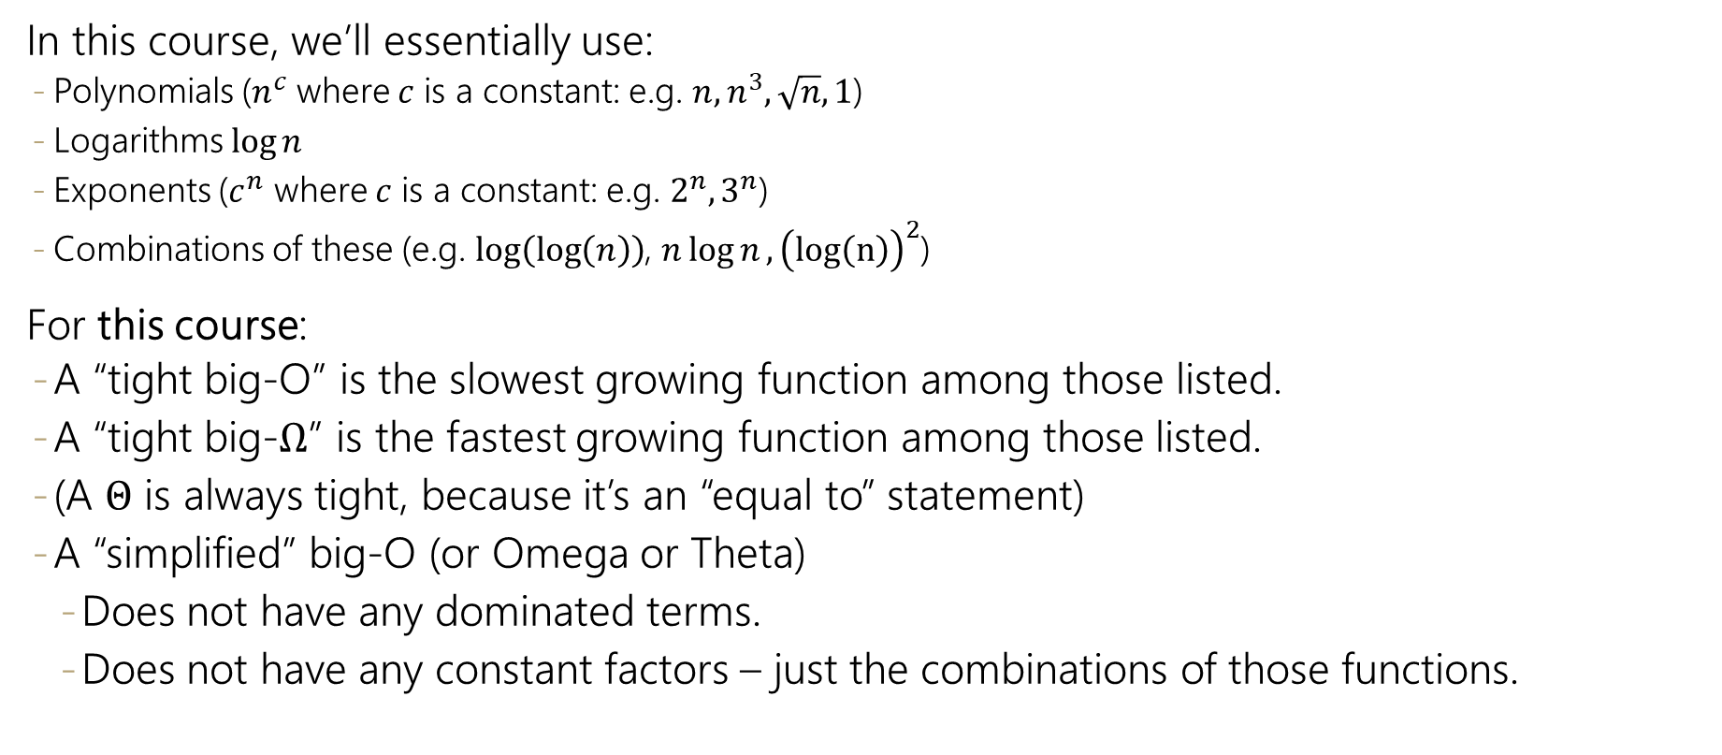
Simplified, tight big-O
In this course, we’ll essentially use:
Polynomials ($n^{c}$ where $c$ is a constant: e.g. $n, n^{3}, \sqrt{n}, 1$)
Logarithms $\log{n}$
Exponents ($c^{n}$ where $c$ is a constant: e.g. $2^{n}, 3^{n}$)
Combinations of these (e.g. $\log\left(\log\left(n\right)\right)$, $n\log{n}, {\left(log\left(n\right)\right)}^{2}$)
For this course:
A “tight big-O” is the slowest growing function among those listed.
A “tight big-$Ω$” is the fastest growing function among those listed.
(A $Θ$ is always tight, because it’s an “equal to” statement)
A “simplified” big-O (or Omega or Theta)
Does not have any dominated terms.
Does not have any constant factors – just the combinations of those functions.

Slide 17

Cases
We defined $f(n)$ to be (our model for) the number of operations the code does on an input of size $n$.
$f(n)$ doesn’t always have a nice formula, but so far if I tell you $n$, you can tell me $f(n)$.
Knowing $n$ isn’t always enough to know how long our code will take to run.

Slide 18
Linear Search
/* given an array and int toFind, return index where toFind is located, or -1 if not in array.*/
int linearSearch(int[] arr, int toFind){
for(int i=0; i < arr.length; i++){
if(arr[i] == toFind)
return i;
}
return -1;
}

Slide 19
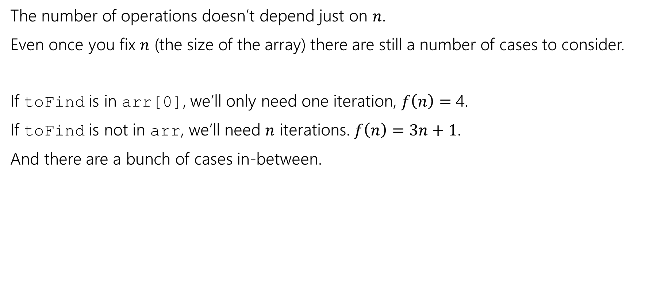
Cases
The number of operations doesn’t depend just on $n$.
Even once you fix $n$ (the size of the array) there are still a number of cases to consider.
If toFind is in arr[0], we’ll only need one iteration, $f\left(n\right)=$4.
If toFind is not in arr, we’ll need $n$ iterations. $f\left(n\right)=3n+1$.
And there are a bunch of cases in-between.

Slide 20
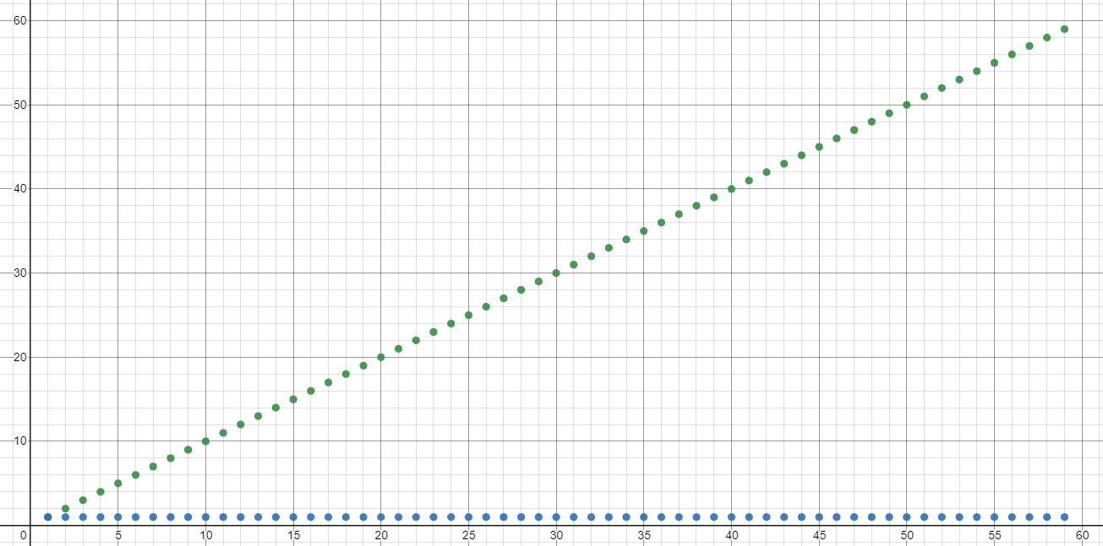
Linear Search Models

Slide 21
Prime Checker
Linear Search
For a given$n,$ prime checker had only one model. For a given $n$, Lienar Search has multiple possible models.

Slide 22
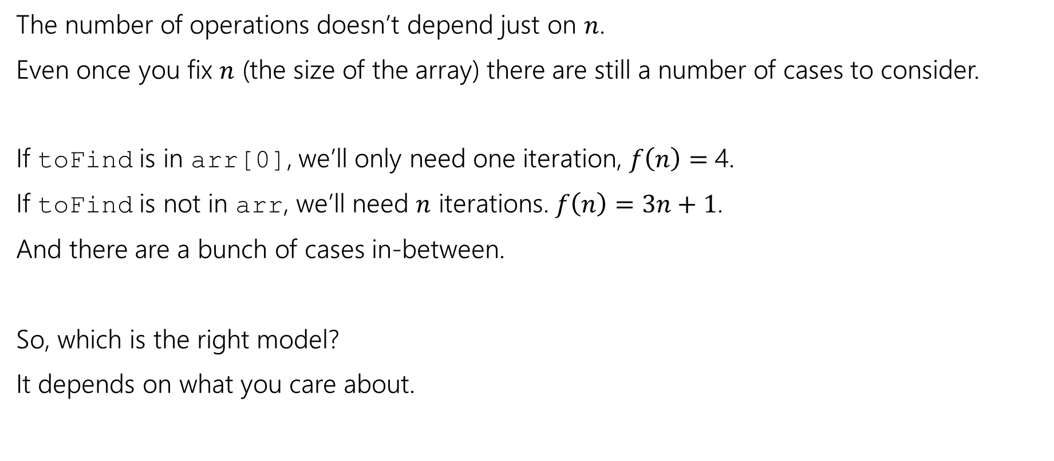
Cases
The number of operations doesn’t depend just on $n$.
Even once you fix $n$ (the size of the array) there are still a number of cases to consider.
If toFind is in arr[0], we’ll only need one iteration, $f\left(n\right)=$4.
If toFind is not in arr, we’ll need $n$ iterations. $f\left(n\right)=3n+1$.
And there are a bunch of cases in-between.
So, which is the right model?
It depends on what you care about.

Slide 23
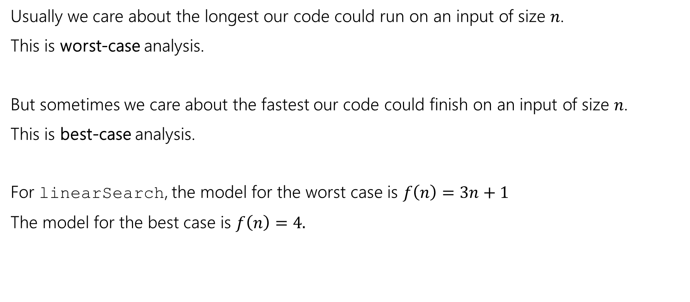
Cases
Usually we care about the longest our code could run on an input of size $n$.
This is worst-case analysis.
But sometimes we care about the fastest our code could finish on an input of size $n$.
This is best-case analysis.
For linearSearch, the model for the worst case is $f\left(n\right)=3n+1$
The model for the best case is $f\left(n\right)=4.$

Slide 24
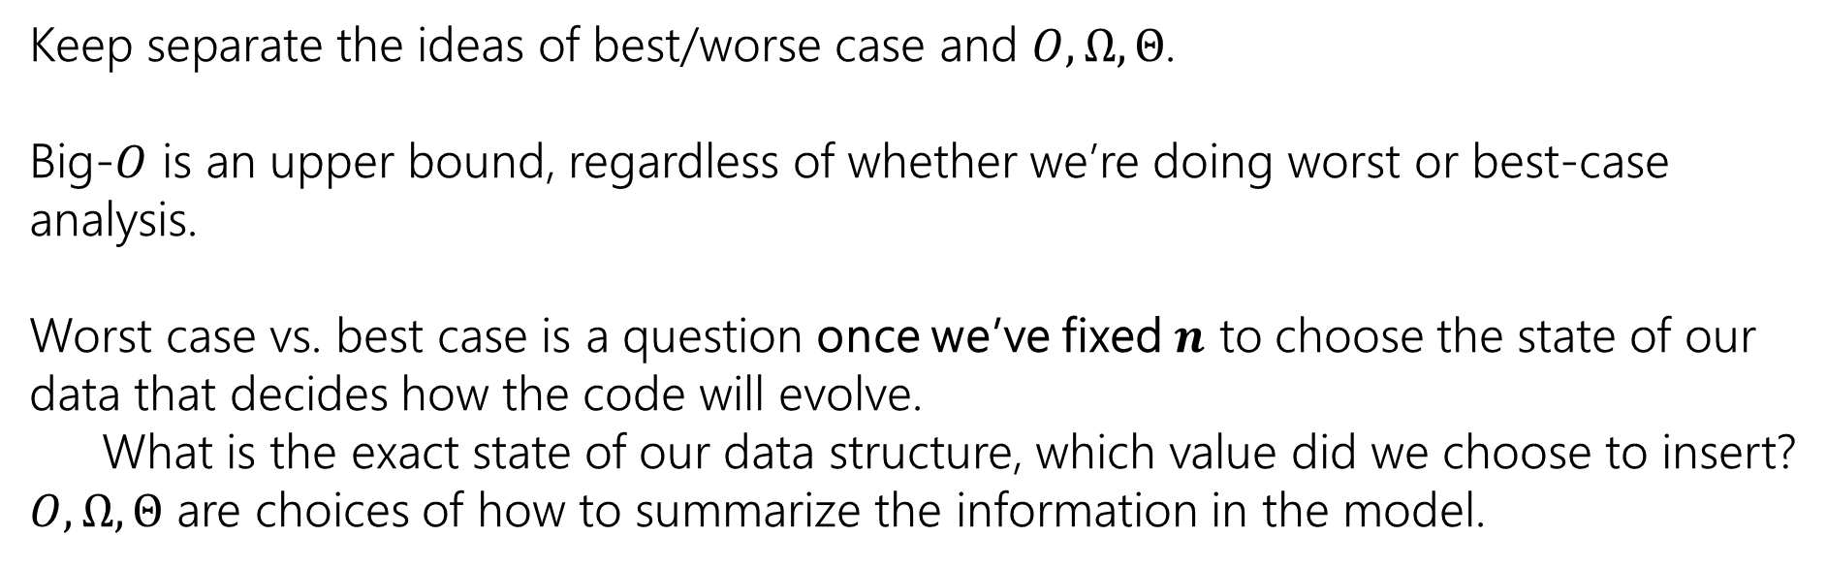
!
Caution
!
Keep separate the ideas of best/worse case and $O,Ω,Θ$.
Big-$O$ is an upper bound, regardless of whether we’re doing worst or best-case analysis.
Worst case vs. best case is a question once we’ve fixed $n$ to choose the state of our data that decides how the code will evolve.
What is the exact state of our data structure, which value did we choose to insert?
$O,Ω,Θ$ are choices of how to summarize the information in the model.

Slide 25
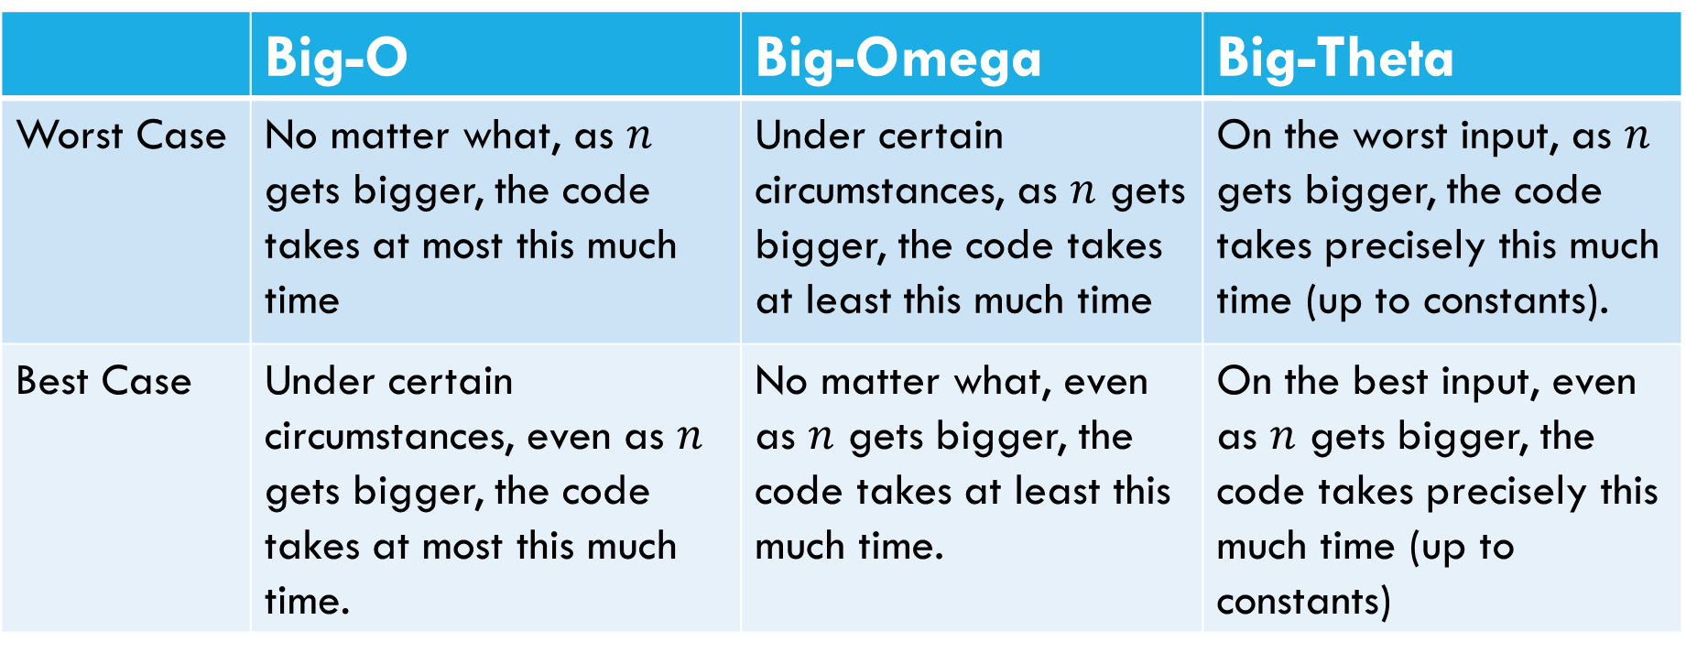
 | Big-O | Big-Omega | Big-Theta
Worst Case | No matter what, as $n$ gets bigger, the code takes at most this much time | Under certain circumstances, as $n$ gets bigger, the code takes at least this much time | On the worst input, as $n$ gets bigger, the code takes precisely this much time (up to constants).
Best Case | Under certain circumstances, even as $n$ gets bigger, the code takes at most this much time. | No matter what, even as $n$ gets bigger, the code takes at least this much time. | On the best input, even as $n$ gets bigger, the code takes precisely this much time (up to constants)
“worst input”: input that causes the code to run slowest.

Slide 26
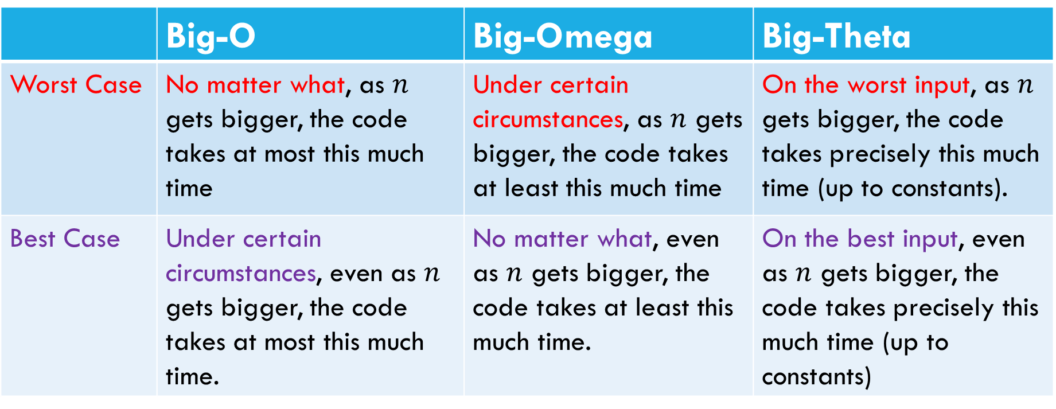
 | Big-O | Big-Omega | Big-Theta
Worst Case | No matter what, as $n$ gets bigger, the code takes at most this much time | Under certain circumstances, as $n$ gets bigger, the code takes at least this much time | On the worst input, as $n$ gets bigger, the code takes precisely this much time (up to constants).
Best Case | Under certain circumstances, even as $n$ gets bigger, the code takes at most this much time. | No matter what, even as $n$ gets bigger, the code takes at least this much time. | On the best input, even as $n$ gets bigger, the code takes precisely this much time (up to constants)
“worst input”: input that causes the code to run slowest.

Slide 27
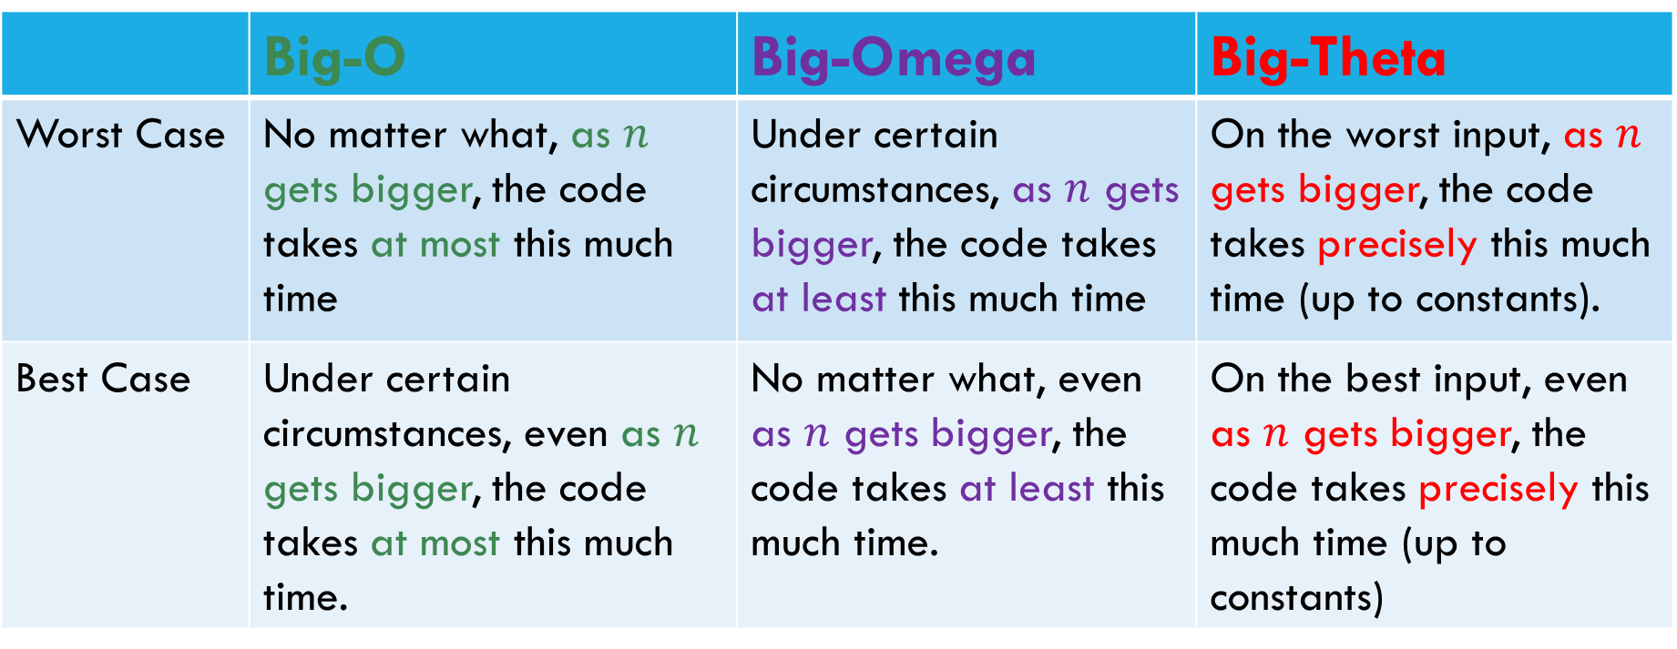
 | Big-O | Big-Omega | Big-Theta
Worst Case | No matter what, as $n$ gets bigger, the code takes at most this much time | Under certain circumstances, as $n$ gets bigger, the code takes at least this much time | On the worst input, as $n$ gets bigger, the code takes precisely this much time (up to constants).
Best Case | Under certain circumstances, even as $n$ gets bigger, the code takes at most this much time. | No matter what, even as $n$ gets bigger, the code takes at least this much time. | On the best input, even as $n$ gets bigger, the code takes precisely this much time (up to constants)
“worst input”: input that causes the code to run slowest.

Slide 28
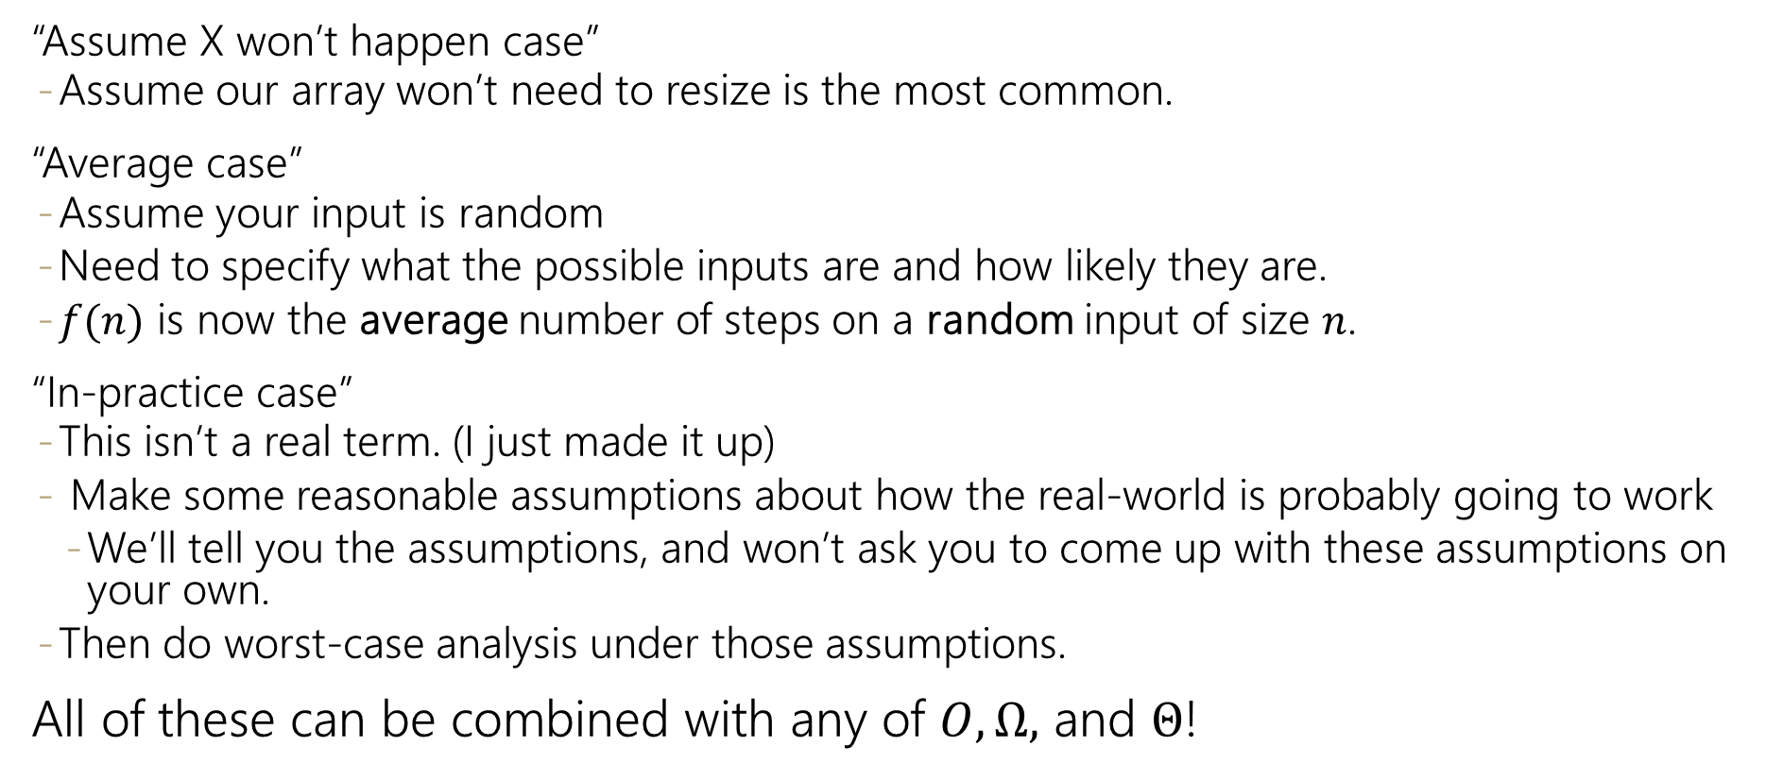
Other cases
“Assume X won’t happen case”
Assume our array won’t need to resize is the most common.
“Average case”
Assume your input is random
Need to specify what the possible inputs are and how likely they are.
$f(n)$ is now the average number of steps on a random input of size $n$.
“In-practice case”
This isn’t a real term. (I just made it up)
Make some reasonable assumptions about how the real-world is probably going to work
We’ll tell you the assumptions, and won’t ask you to come up with these assumptions on your own.
Then do worst-case analysis under those assumptions.
All of these can be combined with any of $O,Ω,$ and $Θ$!

Slide 29
How to do case analysis
1. Look at the code, understand how thing could change depending on the input.
How can you exit loops early?
Can you return (exit the method) early?
Are some if/else branches much slower than others?
2. Figure out what inputs can cause you to hit the (best/worst) parts of the code.
3. Now do the analysis like normal!

Slide 30
/* given an array of integers, count the number of positive
integers that appear only once */
//There are more efficient versions of this.
int countUniquePositives(int[] arr){
int count = 0;
for(int i=0; i<arr.length; i++){
if(arr[i] <= 0)
break;
else{
boolean repeat = false;
for(int j=0; j < arr.length; j++){
if(i!=j && arr[i] == arr[j])
repeat = true;
}
if(!repeat)
count++;
}
}
return count;
}

Slide 31
Dictionaries and best/worst case analysis

Slide 32
Dictionaries (aka Maps)
Every Programmer’s Best Friend
You’ll probably use one in almost every programming project.
Because it’s hard to make a big project without needing one sooner or later.

Slide 33
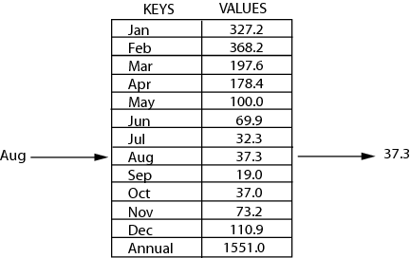
Review: Maps
key | value
“at" | 43
key | value
“in" | 37
key | value
“you" | 22
map: Holds a set of distinct keys and a collection of values, where each key is associated with one value.
a.k.a. "dictionary"
key | value
“the" | 56
map.get("the")
56
Dictionary ADT
supported operations:
put(key, value): Adds a given item into collection with associated key,
if the map previously had a mapping for the given key, old value is replaced
get(key): Retrieves the value mapped to the key
containsKey(key): returns true if key is already associated with value in map, false otherwise
remove(key): Removes the given key and its mapped value
state
Set of items & keys
Count of items
behavior
put(key, item) add item to collection indexed with key
get(key) return item associated with key
containsKey(key) return if key already in use
remove(key) remove item and associated key
size() return count of items

Slide 34
Implementing a Dictionary with an Array
2 Minutes
Big O Analysis – Worst case
put()
get()
containsKey()
remove()
size()
Dictionary ADT
ArrayDictionary<K, V>
O(N) linear
state
state
O(N) linear
Set of items & keys
Count of items
Pair<K, V>[] data
O(N) linear
behavior
behavior
put find key, overwrite value if there. Otherwise create new pair, add to next available spot, grow array if necessary
get scan all pairs looking for given key, return associated item if found
containsKey scan all pairs, return if key is found
remove scan all pairs, replace pair to be removed with last pair in collection
size return count of items in dictionary
O(N) linear
put(key, item) add item to collection indexed with key
get(key) return item associated with key
containsKey(key) return if key already in use
remove(key) remove item and associated key
size() return count of items
O(1) constant
Big O Analysis – Best case
put()
get()
containsKey()
remove()
size()
O(1) constant
O(1) constant
put(‘a’, 1)
put(‘b’, 2)
put(‘c’, 3)
put(‘d’, 4)
remove(‘b’)
put(‘a’, 97)
O(1) constant
0 | 1 | 2 | 3
O(1) constant
97)
O(1) constant
(‘a’, 1)
(‘b’, 2)
(‘c’, 3)
(‘d’, 4)

Slide 35
Implementing a Dictionary with Nodes
2 Minutes
Big O Analysis – Worst Case
put()
get()
containsKey()
remove()
size()
Dictionary ADT
LinkedDictionary<K, V>
O(N) linear
state
state
O(N) linear
Set of items & keys
Count of items
front
size
behavior
O(N) linear
behavior
put(key, item) add item to collection indexed with key
get(key) return item associated with key
containsKey(key) return if key already in use
remove(key) remove item and associated key
size() return count of items
put if key is unused, create new with pair, add to front of list, else replace with new value
get scan all pairs looking for given key, return associated item if found
containsKey scan all pairs, return if key is found
remove scan all pairs, skip pair to be removed
size return count of items in dictionary
O(N) linear
O(1) constant
Big O Analysis – Best Case
put()
get()
containsKey()
remove()
size()
O(1) constant
O(1) constant
put(‘a’, 1)
put(‘b’, 2)
put(‘c’, 3)
put(‘d’, 4)
remove(‘b’)
put(‘a’, 97)
O(1) constant
front
O(1) constant
O(1) constant
‘d’
4
‘c’
3
‘b’
2
‘a’
1
97

Slide 36
Dictionaries
Running times summary:
Worst case is slow for EVERY interesting operation.
For lists, we had usually one slow operation.
Dictionaries are really useful.
We’ll spend a week-and-a-half designing faster versions.
But first, more big-O.

