Slide 1
Lecture 7: Analyzing Recursive Code
CSE 373: Data Structures and Algorithms

Slide 2
Administrivia
Project 1 Part 1 due Wednesday
Exercise 1 due Friday.
Review Session tomorrow (Sieg 134, 1-3PM)
Panopto might not work yet…

Slide 3

Where Are We?
Analyzing Code:
So far:
Writing a Code Model
Simplifying to $O,Ω,Θ$
Formally proving $O,Ω,Θ$
Worst case vs. Best case
This week
Recursive Code
Dictionaries!

Slide 4
Binary Search
int binarySearch(int[] arr, int toFind, int lo, int hi){
if( hi < lo )
return -1;
if(hi == lo)
if(arr[hi] == toFind)
return hi;
return -1;
int mid = (lo+hi) / 2;
if(arr[mid] == toFind)
return mid;
else if(arr[mid] < toFind)
return binarySearch(arr, toFind, mid+1, hi);
else
return binarySearch(arr, toFind, lo, mid-1);
}

Slide 5
Binary search runtime
For an array of size N, it eliminates ½ until 1 element remains.
N, N/2, N/4, N/8, ..., 4, 2, 1
How many divisions does it take?
Think of it from the other direction:
How many times do I have to multiply by 2 to reach N?
1, 2, 4, 8, ..., N/4, N/2, N
Call this number of multiplications "x".
2^{x} = N
x = log₂ N
Binary search is in the logarithmic complexity class.

Slide 6
Moving Forward
The analysis is correct! But it’s a little ad hoc.
It works great for binary search, but we’re going to deal with more complicated recursive code in this course.
We need more powerful tools.

Slide 7

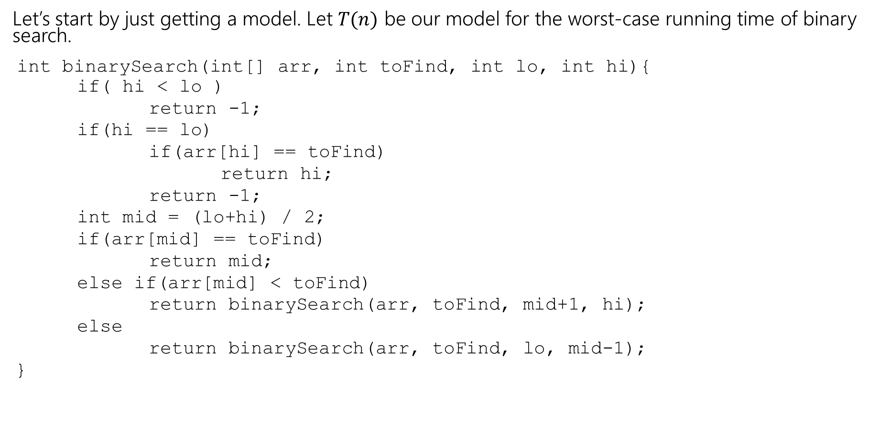
Model
Let’s start by just getting a model. Let $T(n)$ be our model for the worst-case running time of binary search.
int binarySearch(int[] arr, int toFind, int lo, int hi){
if( hi < lo )
return -1;
if(hi == lo)
if(arr[hi] == toFind)
return hi;
return -1;
int mid = (lo+hi) / 2;
if(arr[mid] == toFind)
return mid;
else if(arr[mid] < toFind)
return binarySearch(arr, toFind, mid+1, hi);
else
return binarySearch(arr, toFind, lo, mid-1);
}
$$T\left(n\right)=\left\{\begin{aligned}2 if n=0 \\ 4 if n=1 \\ 5+T\left(\frac{n}{2}\right) othwerwise\end{aligned}\right.$$

Slide 8
Recurrence
Our code is recursive.
It makes sense that our model will be recursive too!
A recursive definition of a function is called a recurrence.
It’s a lot like recursive code:
At least one base case and at least one recursive case.
The cases of your recurrence usually correspond exactly to the cases of the code.
Input size should be getting smaller.

Slide 9
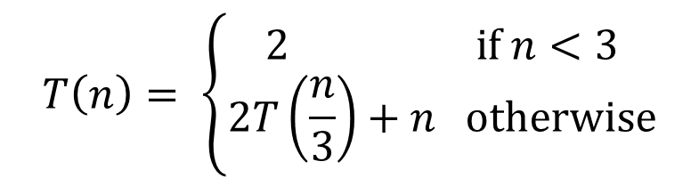
Write a recurrence
pollEV.com/cse373su19
Write a recurrence for the running time of recursiveFunction
int recursiveFunction(int n){
if(n < 3)
return 3;
for(int int i=0; i < n; i++)
System.out.println(i);
int val1 = recursiveFunction(n/3);
int val2 = recursvieFunction(n/3);
return val1 * val2;
}
$$T\left(n\right)= \left\{\begin{aligned}2 if n<3 \\ 2T\left(\frac{n}{3}\right)+n otherwise\end{aligned}\right.$$

Slide 10
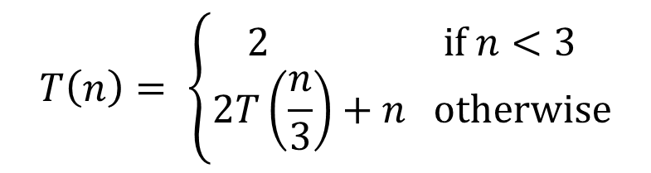
Recurrence to Big-O
Alright what’s the big-O?
There’s another similarity between recursive functions and recursive code.
It’s still really hard to tell what the big-O is just by looking at it.
$$T\left(n\right)= \left\{\begin{aligned}2 if n<3 \\ 2T\left(\frac{n}{3}\right)+n otherwise\end{aligned}\right.$$

Slide 11
I can’t tell what the big-O is. What do we do?
It’s ok.
Mathematicians and computer scientists have been hard at work.
And they’ve written books.
And the answer to our problem is in one of them.

Slide 12

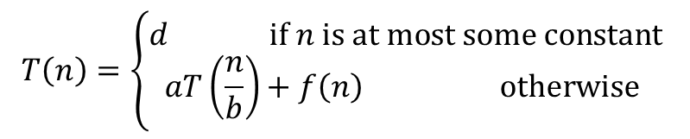

Master Theorem
Given a recurrence of the following form, where $a,b,c,$ and $d$ are constants:
$$T\left(n\right)=\left\{\begin{aligned}d if n is at most some constant \\ aT\left(\frac{n}{b}\right)+f\left(n\right) otherwise \end{aligned}\right.$$
Where $f\left(n\right)$ is $Θ\left(n^{c}\right)$
If
$$\log_{b}{a}<c$$
then
$$T\left(n\right)∈Θ\left(n^{c}\right)$$
If
$$\log_{b}{a}=c$$
then
$$T\left(n\right)∈Θ\left(n^{c}\log{n}\right)$$
If
$$\log_{b}{a}>c$$
then
$$T\left(n\right)∈Θ\left(n^{\log_{b}{a}}\right)$$

Slide 13

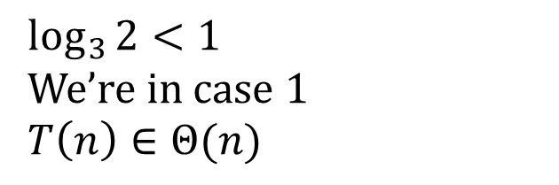

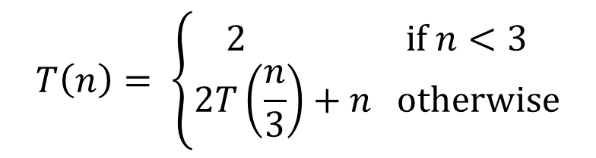



Master Theorem
Given a recurrence of the following form, where $a,b,c,$ and $d$ are constants:
$$T\left(n\right)= \left\{\begin{aligned}2 if n<3 \\ 2T\left(\frac{n}{3}\right)+n otherwise\end{aligned}\right.$$
$$T\left(n\right)=\left\{\begin{aligned}d if n is at most some constant \\ aT\left(\frac{n}{b}\right)+f\left(n\right) otherwise \end{aligned}\right.$$
Where $f\left(n\right)$ is $Θ\left(n^{c}\right)$
$$\log_{3}{2}<1$$
We’re in case 1
$$T\left(n\right)∈Θ(n)$$
If
$$\log_{b}{a}<c$$
then
$$T\left(n\right)∈Θ\left(n^{c}\right)$$
If
$$\log_{b}{a}=c$$
then
$$T\left(n\right)∈Θ\left(n^{c}\log{n}\right)$$
If
$$\log_{b}{a}>c$$
then
$$T\left(n\right)∈Θ\left(n^{\log_{b}{a}}\right)$$

Slide 14
Binary Search Trees

Slide 15
Binary Search Trees
We have one more algorithm analysis topic…
But first a little bit about binary search trees.

Slide 16
Review: Trees!
A tree is a collection of nodes
Each node has at most 1 parent and 0 or more children
Root node: the only node with no parent, “top” of the tree
Leaf node: a node with no children
Edge: a pointer from one node to another
Subtree: a node and all it descendants
Height: the number of edges contained in the longest path from root node to some leaf node
1
2
5
3
6
7
4
8

Slide 17
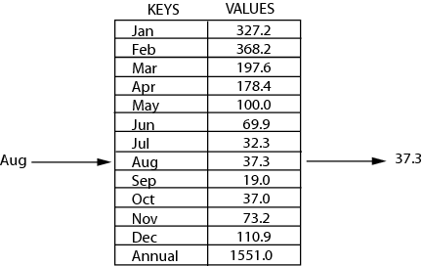
Review: Maps
key | value
“at" | 43
key | value
“in" | 37
key | value
“you" | 22
map: Holds a set of distinct keys and a collection of values, where each key is associated with one value.
a.k.a. "dictionary"
key | value
“the" | 56
map.get("the")
56
Dictionary ADT
supported operations:
put(key, value): Adds a given item into collection with associated key,
if the map previously had a mapping for the given key, old value is replaced
get(key): Retrieves the value mapped to the key
containsKey(key): returns true if key is already associated with value in map, false otherwise
remove(key): Removes the given key and its mapped value
state
Set of items & keys
Count of items
behavior
put(key, item) add item to collection indexed with key
get(key) return item associated with key
containsKey(key) return if key already in use
remove(key) remove item and associated key
size() return count of items

Slide 18
Implement a Dictionary
10
“foo”
Binary Search Trees allow us to:
quickly find what we’re looking for
add and remove values easily
Let’s use them to implement dictionaries!
7
12
“bar”
“baz”
5
9
15
“fo”
“sho”
“sup”
1
8
13
“hi”
“bye”
“boo”

Slide 19

Binary Search Tree
10
“foo”
Invariants
Things that are always true.
The way you make sure your data structure works and is efficient.
Binary Search Tree invariants:
For every node with key $k$:
The left subtree has only keys smaller than $k$.
The right subtree has only keys greater than $k$.
7
12
“bar”
“baz”
5
9
15
“fo”
“sho”
“sup”
1
8
13
“hi”
“bye”
“boo”

Slide 20
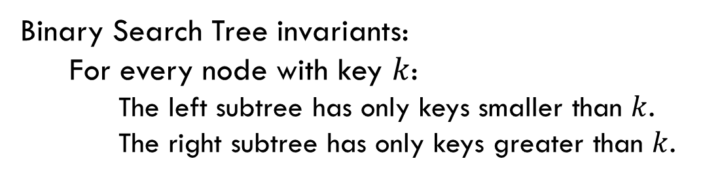
BST Invariants
Binary Search Tree invariants:
For every node with key $k$:
The left subtree has only keys smaller than $k$.
The right subtree has only keys greater than $k$.
Why write down invariants?
They help us write methods?
How does get(key) work?
Is the current node the one we’re looking for?
Return it’s value
Is the current node null?
It’s not in there
Is the current node’s key too small?
Recurse on the right subtree
Is the current node’s key too big?
Recurse on the left subtree
How does put(key, value) work?
Let’s just put it anywhere?
No! Remember the invariants!
Also remember key might already be in the dictionary.
find first
If key is in there, overwrite the value
Otherwise, wherever we ended up is where the new node should go.

Slide 21
Are These Binary Search Trees?
1
4
2
3
7
3
6
2
9
6
5
8
8
10
9

Slide 22
BSTs as dictionaries
Let’s figure out the worst case of get() for two different states our BST could be in.
Perfectly balanced – for every node, its descendants are split evenly between left and right subtrees.
Degenerate – for every node, all of its descendants are in the right subtree.
1
8
2
4
12
3
2
6
10
14
4
1
3
5
7
…
9
11
13
15
15

Slide 23

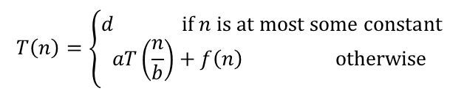

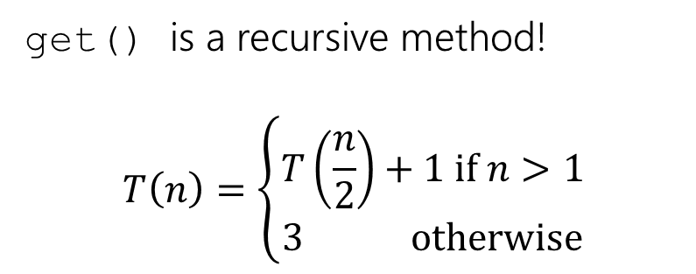

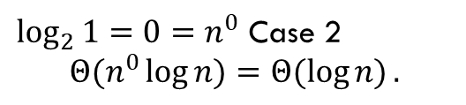




BSTs as dictionaries
Let’s figure out the worst case of get() for two different states our BST could be in.
get() is a recursive method!
$$T\left(n\right)=\left\{\begin{aligned}T\left(\frac{n}{2}\right)+1 if n>1 \\ 3 otherwise\end{aligned}\right.$$
Perfectly balanced – for every node, its descendants are split evenly between left and right subtrees.
8
$$T\left(n\right)=\left\{\begin{aligned}d if n is at most some constant \\ aT\left(\frac{n}{b}\right)+f\left(n\right) otherwise \end{aligned}\right.$$
4
12
Where $f\left(n\right)$ is $Θ\left(n^{c}\right)$
2
6
10
If
$$\log_{b}{a}<c$$
then
$$T\left(n\right)∈Θ\left(n^{c}\right)$$
14
If
$$\log_{b}{a}=c$$
then
$$T\left(n\right)∈Θ\left(n^{c}\log{n}\right)$$
1
3
5
7
9
11
If
$$\log_{b}{a}>c$$
then
$$T\left(n\right)∈Θ\left(n^{\log_{b}{a}}\right)$$
13
15
$\log_{2}{1}=0=n^{0}$ Case 2
$$Θ(n^{0}\log{n)}=Θ(\log{n)}.$$

Slide 24




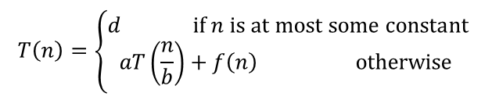


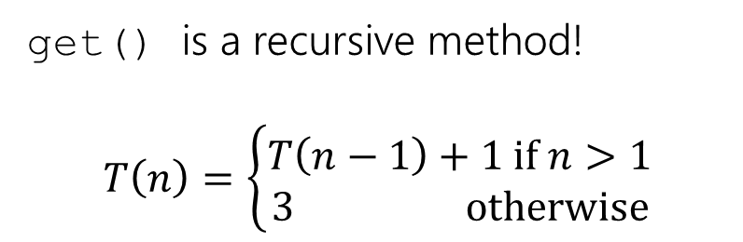


BSTs as dictionaries
Let’s figure out the worst case of get() for two different states our BST could be in.
get() is a recursive method!
$$T\left(n\right)=\left\{\begin{aligned}T\left(n−1\right)+1 if n>1 \\ 3 otherwise\end{aligned}\right.$$
Degenerate – for every node, all of its descendants are in the right subtree.
1
$$T\left(n\right)=\left\{\begin{aligned}d if n is at most some constant \\ aT\left(\frac{n}{b}\right)+f\left(n\right) otherwise \end{aligned}\right.$$
2
Where $f\left(n\right)$ is $Θ\left(n^{c}\right)$
3
If
$$\log_{b}{a}<c$$
then
$$T\left(n\right)∈Θ\left(n^{c}\right)$$
If
$$\log_{b}{a}=c$$
then
$$T\left(n\right)∈Θ\left(n^{c}\log{n}\right)$$
4
If
$$\log_{b}{a}>c$$
then
$$T\left(n\right)∈Θ\left(n^{\log_{b}{a}}\right)$$
…
Master Theorem doesn’t apply!
15

Slide 25
I can’t tell what the big-O is. What do we do?
It’s ok.
Mathematicians and computer scientists have been hard at work.
And they’ve written books.
And I’ve checked them all

Slide 26

This meme is outdated/unfunny.
This meme is funny.

Slide 27


Slide 28


Slide 29
Don’t Panic
The books don’t have a nice theorem;
They do have methods for figuring out the big-O.

Slide 30
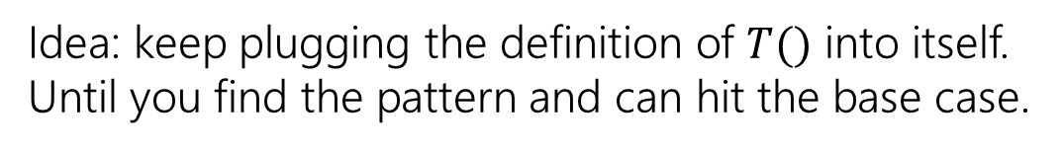
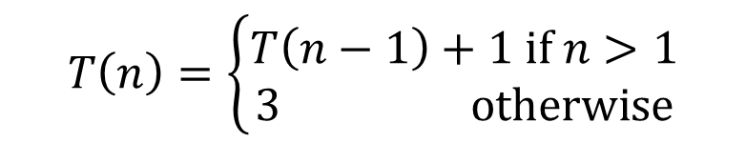
Unrolling
$$T\left(n\right)=\left\{\begin{aligned}T\left(n−1\right)+1 if n>1 \\ 3 otherwise\end{aligned}\right.$$
Idea: keep plugging the definition of $T()$ into itself.
Until you find the pattern and can hit the base case.

Slide 31
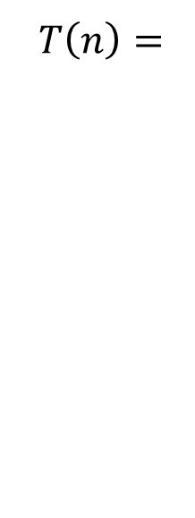

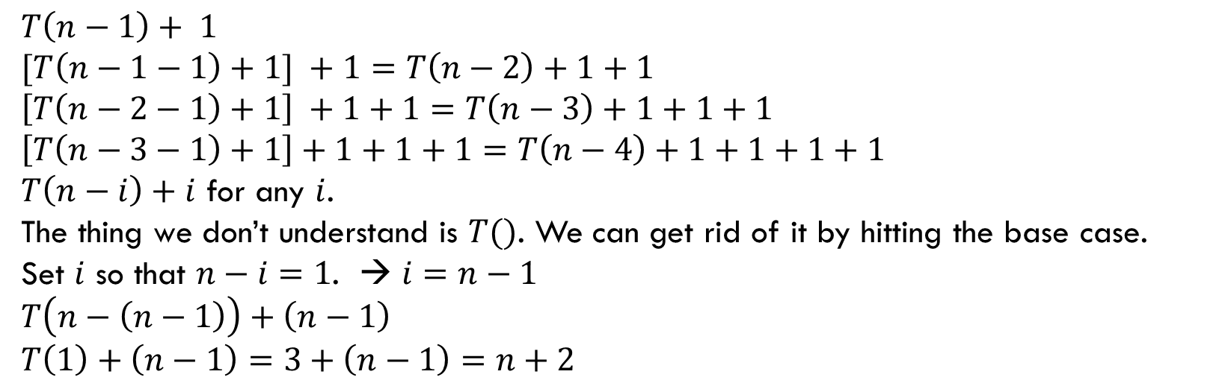
Unrolling
$$T\left(n\right)=\left\{\begin{aligned}T\left(n−1\right)+1 if n>1 \\ 3 otherwise\end{aligned}\right.$$
$T\left(n\right)=$
$$T\left(n−1\right)+ 1$$
$$[T\left(n−1−1\right)+1] +1=T\left(n−2\right)+1+1$$
$$\left[T\left(n−2−1\right)+1\right] +1+1=T\left(n−3\right)+1+1+1$$
$$\left[T\left(n−3−1\right)+1\right]+1+1+1=T\left(n−4\right)+1+1+1+1$$
$T\left(n−i\right)+i$ for any $i$.
The thing we don’t understand is $T()$. We can get rid of it by hitting the base case.
Set $i$ so that $n−i=1$. → $i=n−1$
$$T\left(n−\left(n−1\right)\right)+\left(n−1\right)$$
$$T\left(1\right)+\left(n−1\right)=3+\left(n−1\right)=n+2$$
$$T\left(n\right)=n+2$$

Slide 32
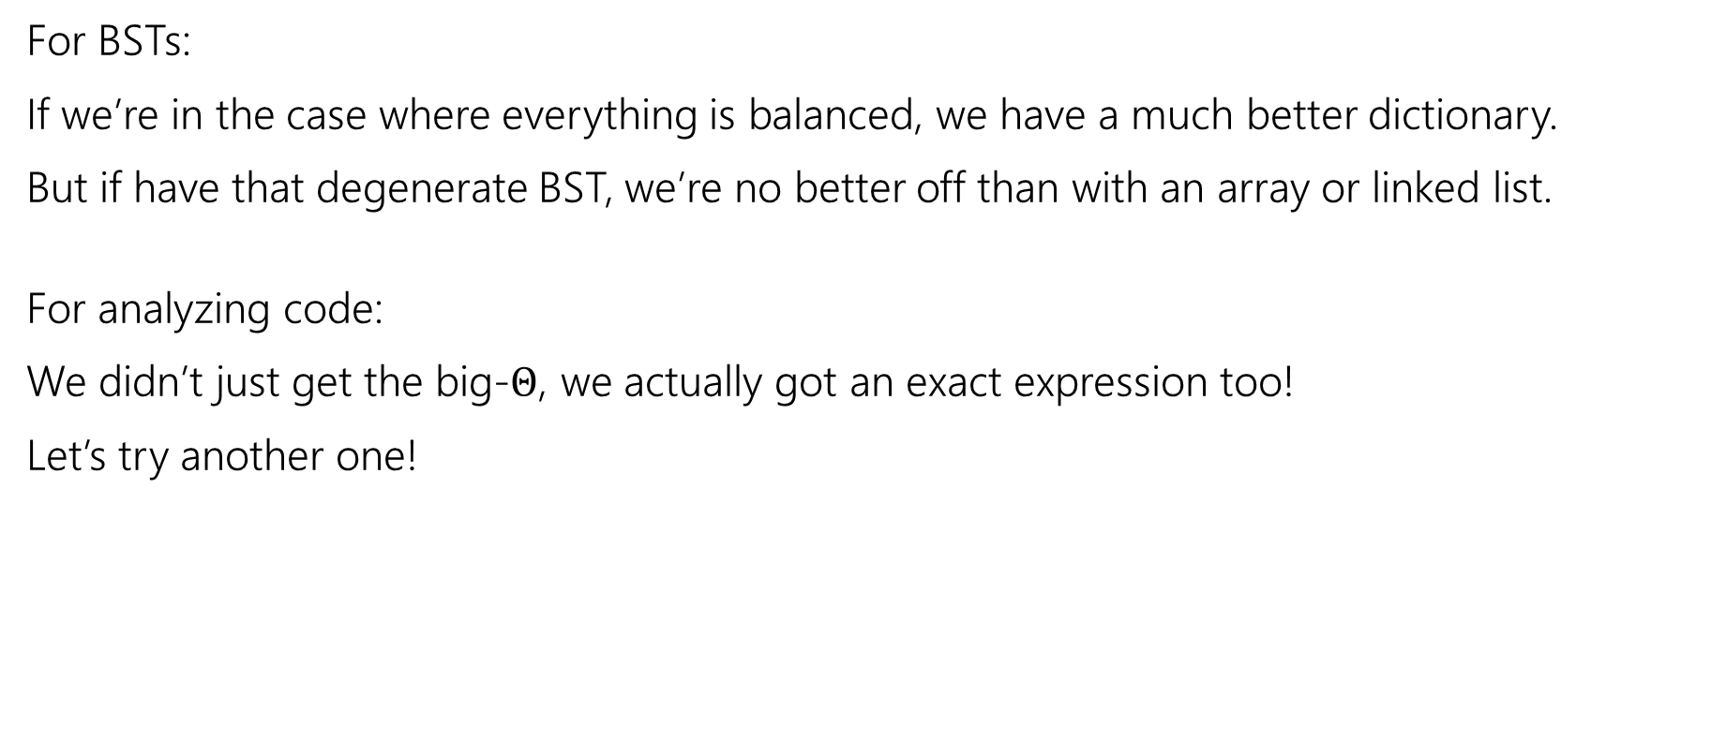
We did it!
For BSTs:
If we’re in the case where everything is balanced, we have a much better dictionary.
But if have that degenerate BST, we’re no better off than with an array or linked list.
For analyzing code:
We didn’t just get the big-$Θ$, we actually got an exact expression too!
Let’s try another one!

Slide 33
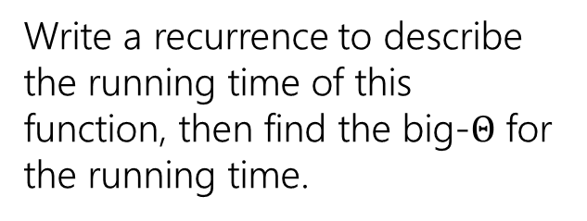
More Practice
Write a recurrence to describe the running time of this function, then find the big-$Θ$ for the running time.
public int dumbFindMax(int[] arr, int hi){
if(hi == 0)
return arr[0];
int maxInd = 0;
for(int i=0; i<hi; i++){
if(arr[i] > arr[maxInd])
maxInd=i;
}
return Math.max(arr[maxInd], dumbFindMax(arr, hi-1));
}

Slide 34
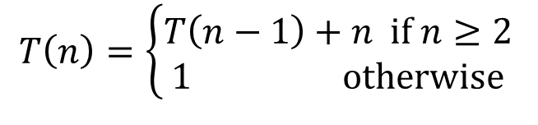
$T\left(n\right)=\left\{\begin{aligned}T\left(n−1\right)+n if n≥2 \\ 1 otherwise\end{aligned}\right.$

Slide 36
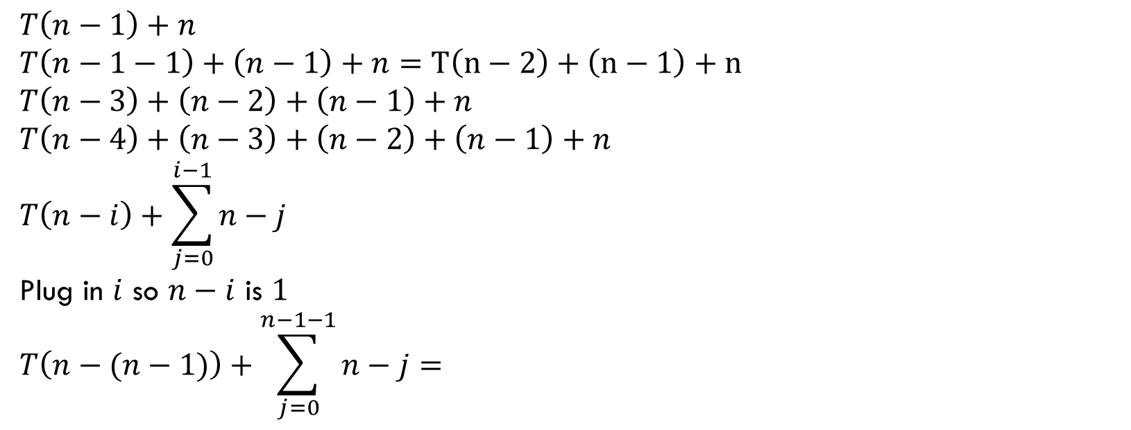
$T\left(n\right)=\left\{\begin{aligned}T\left(n−1\right)+n if n≥2 \\ 1 otherwise\end{aligned}\right.$
$$T\left(n−1\right)+n$$
$$T\left(n−1−1\right)+\left(n−1\right)+n=T\left(n−2\right)+\left(n−1\right)+n$$
$$T\left(n−3\right)+\left(n−2\right)+\left(n−1\right)+n$$
$$T\left(n−4\right)+\left(n−3\right)+\left(n−2\right)+\left(n−1\right)+n$$
$$T\left(n−i\right)+\sum_{j=0}^{i−1}{n−j}$$
Plug in $i$ so $n−i$ is $1$
$$T\left(n−(n−1)\right)+\sum_{j=0}^{n−1−1}{n−j}=$$

Slide 37

$T\left(n\right)=\left\{\begin{aligned}T\left(n−1\right)+n if n≥2 \\ 1 otherwise\end{aligned}\right.$
$$1+\sum_{j=0}^{n−2}{n−j}=1+\sum_{j=0}^{n−2}{n}−\sum_{j=0}^{n−2}{j}$$
$$=1+n\left(n−1\right)−\sum_{j=0}^{n−2}{j}$$
$$=1+n\left(n−1\right)−\frac{\left(n−1\right)\left(n−2\right)}{2}$$
$$=n^{2}−n−\frac{n^{2}}{2}+\frac{3n}{2}−1$$
$$∈Θ(n^{2})$$

Slide 38
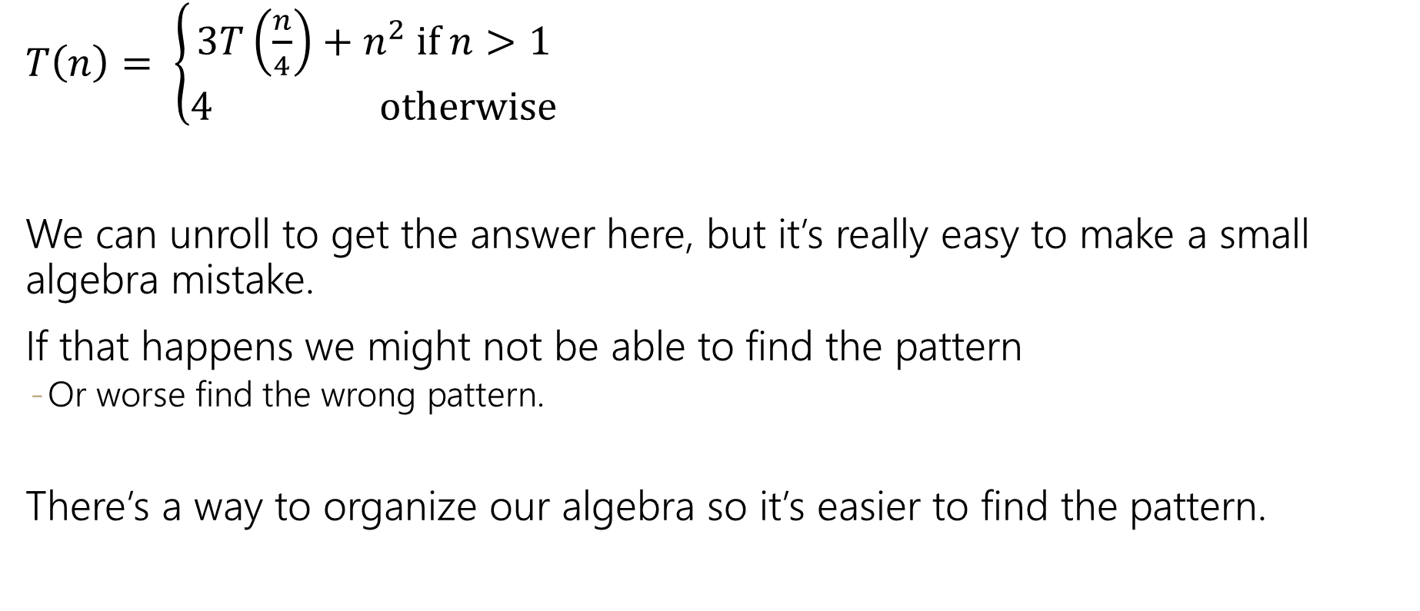
$T\left(n\right)= \left\{\begin{aligned}3T\left(\frac{n}{4}\right)+n^{2} if n>1 \\ 4 otherwise\end{aligned}\right.$
We can unroll to get the answer here, but it’s really easy to make a small algebra mistake.
If that happens we might not be able to find the pattern
Or worse find the wrong pattern.
There’s a way to organize our algebra so it’s easier to find the pattern.

Slide 39



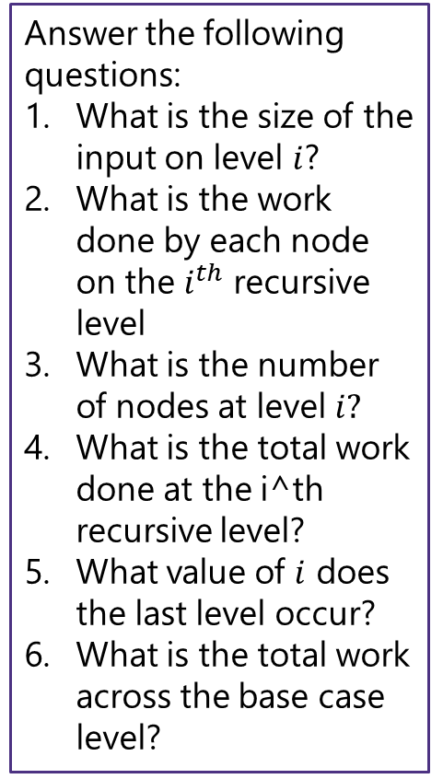




























Tree Method Practice
$$4 when n≤1$$
$$T\left(n\right)=$$
$$3T\left(\frac{n}{4}\right)+n^{2} otherwise$$
$$T\left(\frac{n}{4}\right)+T\left(\frac{n}{4}\right)+T\left(\frac{n}{4}\right)+n^{2}$$
$$T\left(n\right)$$
$$n^{2}$$
Answer the following questions:
What is the size of the input on level $i$?
What is the work done by each node on the $i^{th}$ recursive level
What is the number of nodes at level $i?$
What is the total work done at the i^th recursive level?
What value of $i$ does the last level occur?
What is the total work across the base case level?
$${\left(\frac{n}{4}\right)}^{2}$$
$$T\left(\frac{n}{4}\right)$$
$$T\left(\frac{n}{16}\right)+T\left(\frac{n}{16}\right)+T\left(\frac{n}{16}\right)+{\left(\frac{n}{4}\right)}^{2}$$
$$T\left(\frac{n}{16}\right)+T\left(\frac{n}{16}\right)+T\left(\frac{n}{16}\right)+{\left(\frac{n}{4}\right)}^{2}$$
$$T\left(\frac{n}{16}\right)+T\left(\frac{n}{16}\right)+T\left(\frac{n}{16}\right)+{\left(\frac{n}{4}\right)}^{2}$$
$${\left(\frac{n}{4}\right)}^{2}$$
$${\left(\frac{n}{4}\right)}^{2}$$
$$T\left(\frac{n}{4}\right)$$
$$T\left(\frac{n}{4}\right)$$
$$T\left(\frac{n}{16}\right)$$
$$T\left(\frac{n}{16}\right)$$
$$T\left(\frac{n}{16}\right)$$
$$T\left(\frac{n}{16}\right)$$
$$T\left(\frac{n}{16}\right)$$
$$T\left(\frac{n}{16}\right)$$
$${\left(\frac{n}{16}\right)}^{2}$$
$$T\left(\frac{n}{16}\right)$$
$${\left(\frac{n}{16}\right)}^{2}$$
$${\left(\frac{n}{16}\right)}^{2}$$
$${\left(\frac{n}{16}\right)}^{2}$$
$${\left(\frac{n}{16}\right)}^{2}$$
$$T\left(\frac{n}{16}\right)$$
$$T\left(\frac{n}{16}\right)$$
$${\left(\frac{n}{16}\right)}^{2}$$
$${\left(\frac{n}{16}\right)}^{2}$$
$${\left(\frac{n}{16}\right)}^{2}$$
$${\left(\frac{n}{16}\right)}^{2}$$
…
…
…
…
…
…
…
…
…
…
…
…
…
…
…
…
…
…
…
…
…
…
…
…
…
…
…
4
4
4
4
4
4
4
4
4
4
4
4
4
4
4
4
4
4
4
4
4
4
4
4
4
4
4

Slide 40

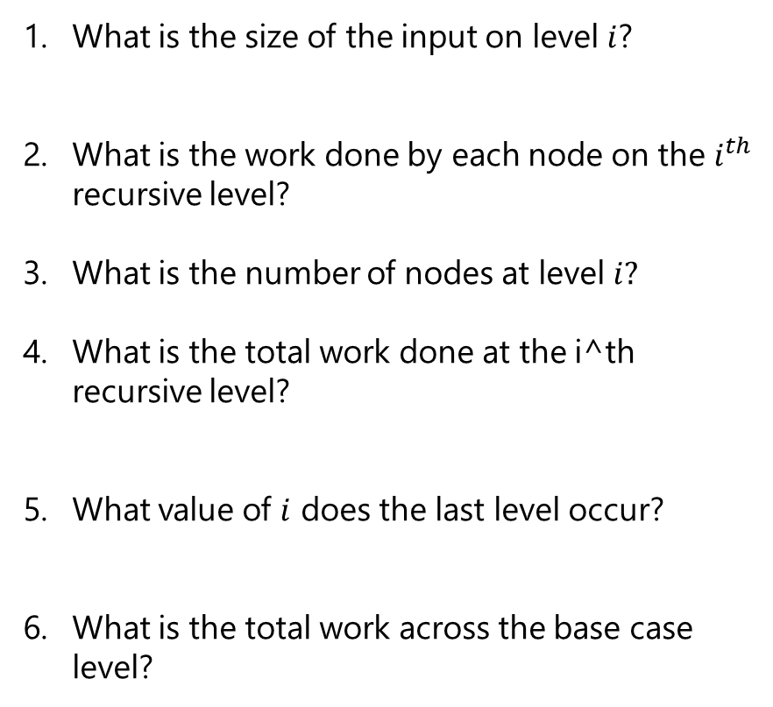
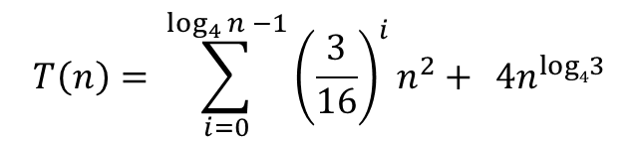
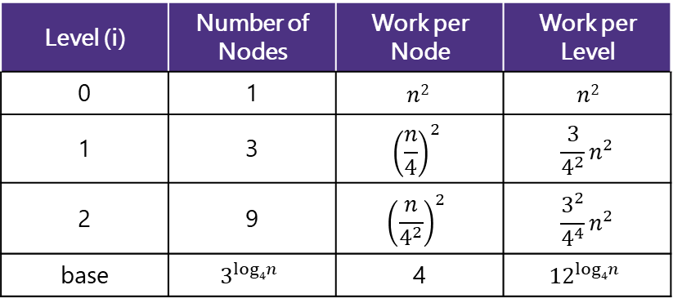

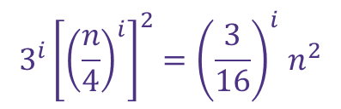
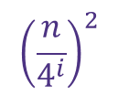




Tree Method Practice
5 Minutes
$$4 when n≤1$$
$$T\left(n\right)=$$
$$3T\left(\frac{n}{4}\right)+cn^{2} otherwise$$
Level (i) | Number of Nodes | Work per Node | Work per Level
0 | 1 | $$n2$$ | $$n2$$
1 | 3 | $${\left(\frac{n}{4}\right)}^{2}$$ | $$\frac{3}{4^{2}}n^{2}$$
2 | 9 | $${\left(\frac{n}{4^{2}}\right)}^{2}$$ | $$\frac{3^{2}}{4^{4}}n^{2}$$
base | $$3^{log4n}$$ | 4 | $${12}^{log4n}$$
$${\left(\frac{n}{4}\right)}^{i}$$
What is the size of the input on level $i$?
What is the work done by each node on the $i^{th}$ recursive level?
What is the number of nodes at level $i?$
What is the total work done at the i^th recursive level?
What value of $i$ does the last level occur?
What is the total work across the base case level?
$${\left(\frac{n}{4^{i}}\right)}^{2}$$
$$3^{i}$$
Combining it all together…
$$3^{i}{\left[{\left(\frac{n}{4}\right)}^{i}\right]}^{2}{=\left(\frac{3}{16}\right)}^{i}n^{2}$$
$$T\left(n\right)= \sum_{i=0}^{\log_{4}{n −1}}{{\left(\frac{3}{16}\right)}^{i}n^{2}+ } 4n^{log43}$$
$\frac{n}{4^{i}}=1$→ $n=4^{i}$→ $i=\log_{4}{n}$
$$3^{\log_{4}{n}}⋅4$$
power of a log
$${4⋅n}^{\log_{4}{3}}$$
$$x^{\log_{b}{y}}=y^{\log_{b}{x}}$$

Slide 41
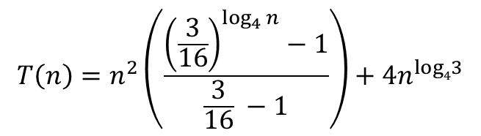
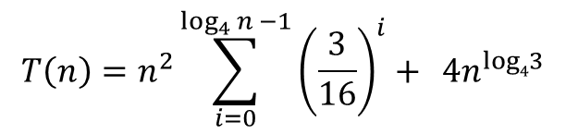
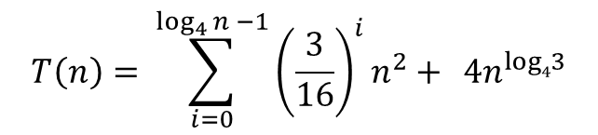
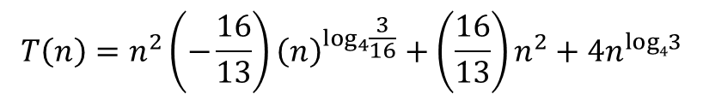
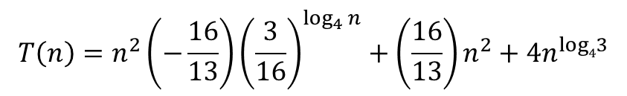

Tree Method Practice
factoring out a constant
$$T\left(n\right)= \sum_{i=0}^{\log_{4}{n −1}}{{\left(\frac{3}{16}\right)}^{i}n^{2}+ } 4n^{log43}$$
$$T\left(n\right)=n^{2}\sum_{i=0}^{\log_{4}{n −1}}{{\left(\frac{3}{16}\right)}^{i}+ } 4n^{log43}$$
$$\sum_{i=a}^{b}{cf(i)=}c\sum_{i=a}^{b}{f(i)}$$
Closed form:
finite geometric series
$$T\left(n\right)=n^{2}\left(\frac{{\left(\frac{3}{16}\right)}^{\log_{4}{n}}−1}{\frac{3}{16} −1}\right)+4n^{log43}$$
$$\sum_{i=0}^{n−1}{x^{i}=\frac{x^{n}−1}{x−1}}$$
So what’s the big-$Θ$…
$$T\left(n\right)=n^{2}\left(−\frac{16}{13}\right){\left(\frac{3}{16}\right)}^{\log_{4}{n}}+\left(\frac{16}{13}\right)n^{2}+4n^{log43}$$
$$T\left(n\right)=n^{2}\left(−\frac{16}{13}\right){\left(n\right)}^{\log_{4}{\frac{3}{16}}}+\left(\frac{16}{13}\right)n^{2}+4n^{log43}$$
$$T\left(n\right)∈O(n^{2})$$

