Slide 1
Lecture 10: AVL Trees
CSE 373 Data Structures and Algorithms

Slide 2
Warm-Up
An AVL tree is a binary search tree that also meets the following rule
AVL condition: For every node, the height of its left subtree and right subtree differ by at most 1.
4
Is this a valid AVL tree?
pollEV.com/cse373su19
Is this a valid AVL tree?
Height of a tree:
Maximum number of edges on a path from the root to a leaf.
3
7
A tree with one node has height 0
A null tree (no nodes) has height -1
5
9
2
6
8
10

Slide 3
Are These AVL Trees?
6
4
3
7
3
7
2
9
2
9
4
6
5
8
10
8
10
5

Slide 4
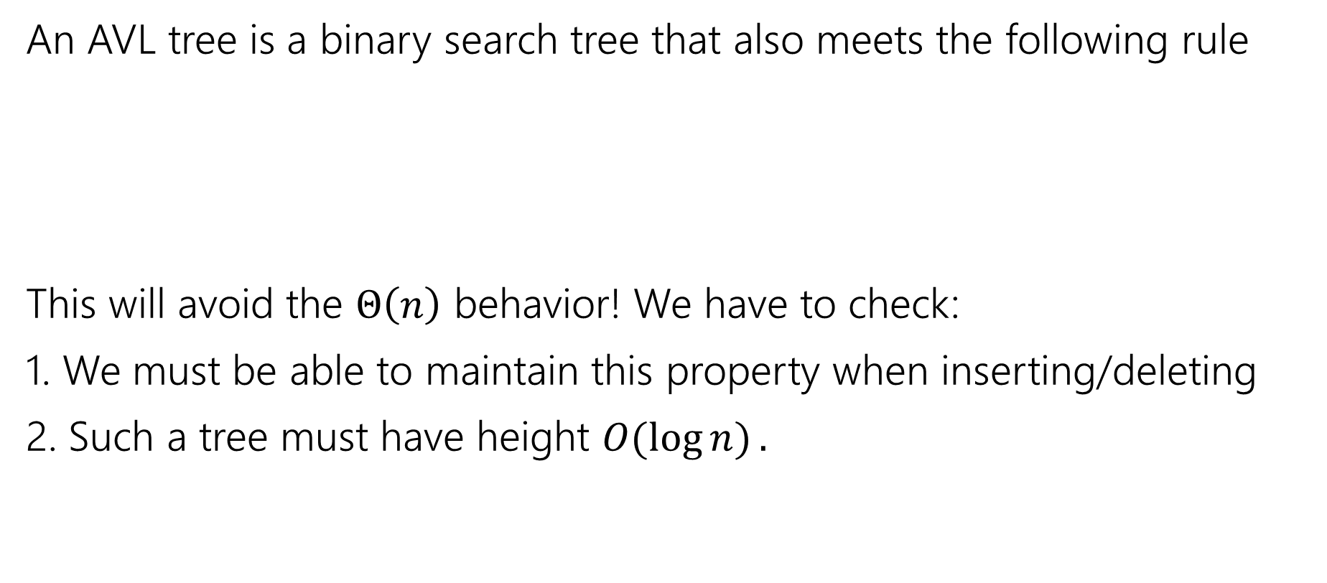
Avoiding the Degenerate Tree
An AVL tree is a binary search tree that also meets the following rule
This will avoid the $Θ\left(n\right)$ behavior! We have to check:
1. We must be able to maintain this property when inserting/deleting
2. Such a tree must have height $O(\log{n)}.$
AVL condition: For every node, the height of its left subtree and right subtree differ by at most 1.

Slide 5
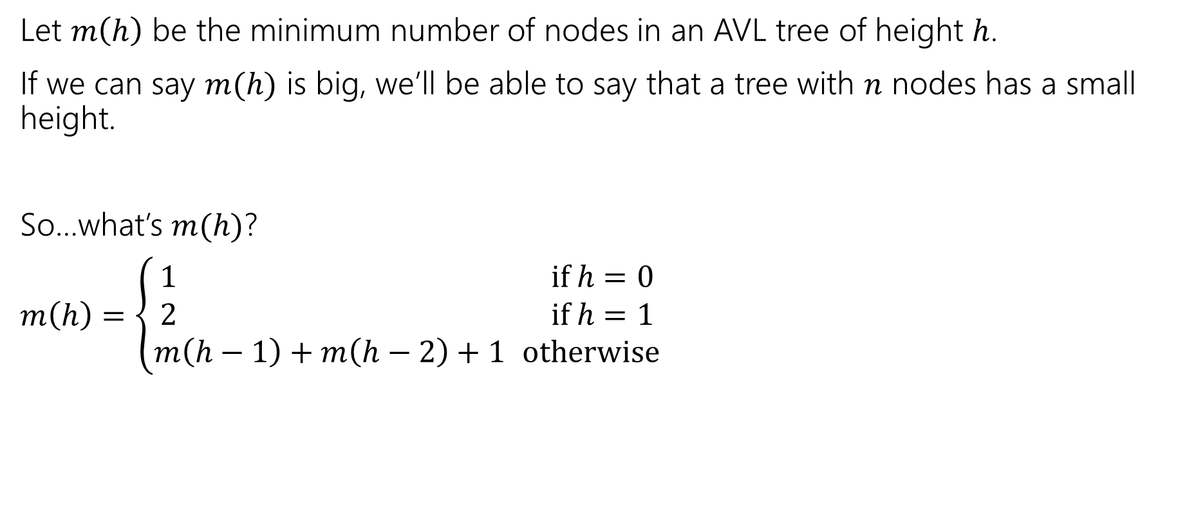
Bounding the Height
Let $m\left(h\right)$ be the minimum number of nodes in an AVL tree of height $h$.
If we can say $m(h)$ is big, we’ll be able to say that a tree with $n$ nodes has a small height.
So…what’s $m(h)$?
$m\left(h\right)=\left\{\begin{aligned}1 if h=0 \\ 2 if h=1 \\ m\left(h−1\right)+m\left(h−2\right)+1 otherwise\end{aligned}\right.$

Slide 6
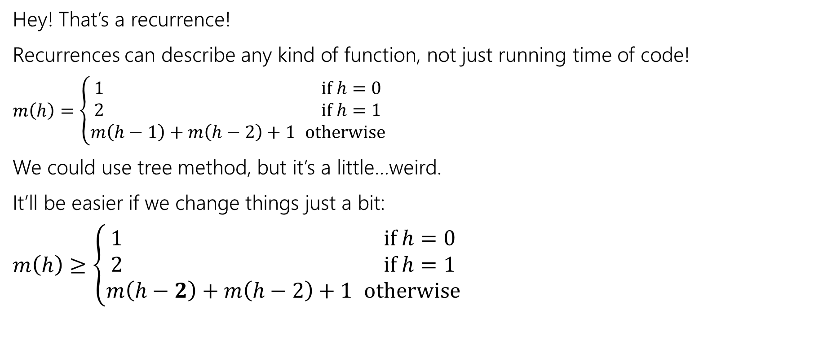
A simpler recurrence
Hey! That’s a recurrence!
Recurrences can describe any kind of function, not just running time of code!
$m\left(h\right)=\left\{\begin{aligned}1 if h=0 \\ 2 if h=1 \\ m\left(h−1\right)+m\left(h−2\right)+1 otherwise\end{aligned}\right.$
We could use tree method, but it’s a little…weird.
It’ll be easier if we change things just a bit:
$m\left(h\right)≥\left\{\begin{aligned}1 if h=0 \\ 2 if h=1 \\ m\left(h−2\right)+m\left(h−2\right)+1 otherwise\end{aligned}\right.$

Slide 7
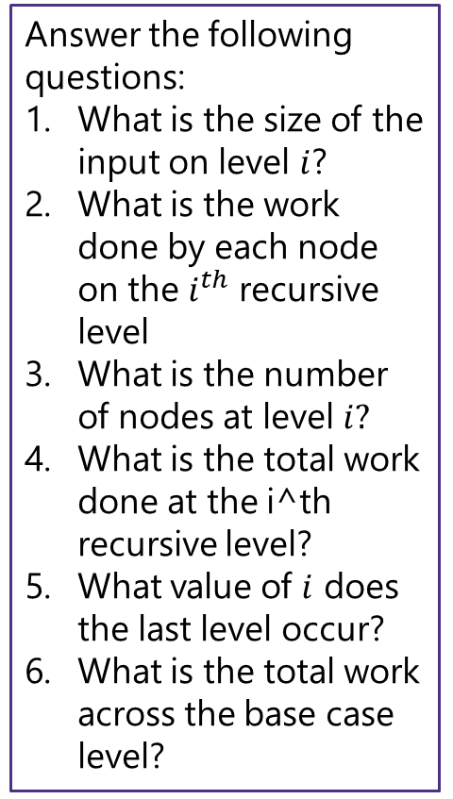
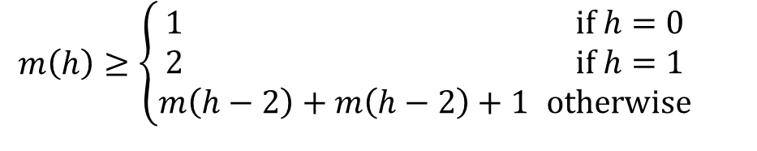
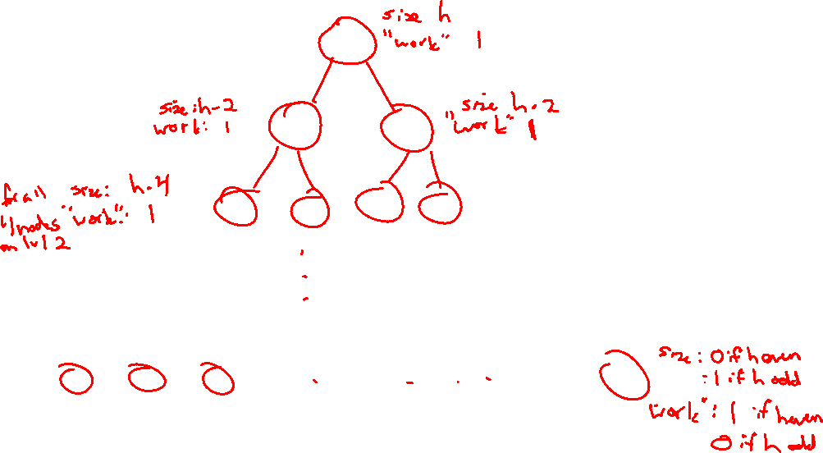
$m\left(h\right)≥\left\{\begin{aligned}1 if h=0 \\ 2 if h=1 \\ m\left(h−2\right)+m\left(h−2\right)+1 otherwise\end{aligned}\right.$
Answer the following questions:
What is the size of the input on level $i$?
What is the work done by each node on the $i^{th}$ recursive level
What is the number of nodes at level $i?$
What is the total work done at the i^th recursive level?
What value of $i$ does the last level occur?
What is the total work across the base case level?

Slide 8

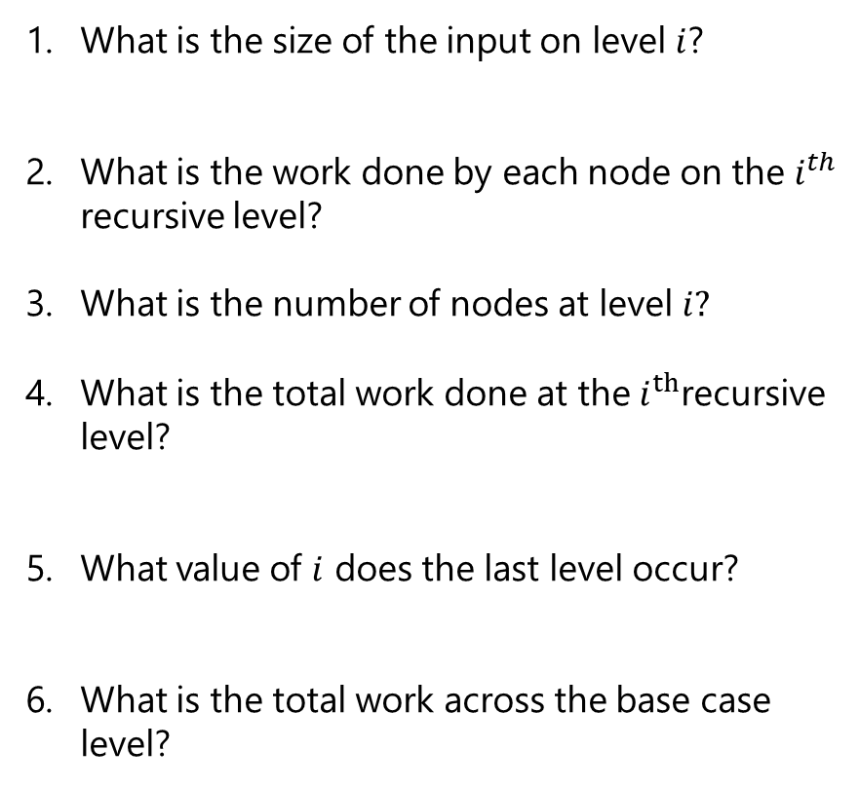




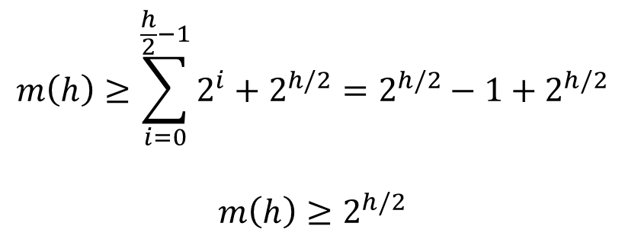


Tree Method Practice
5 Minutes
h$−2i$
What is the size of the input on level $i$?
What is the work done by each node on the $i^{th}$ recursive level?
What is the number of nodes at level $i?$
What is the total work done at the $i^{th}$recursive level?
What value of $i$ does the last level occur?
What is the total work across the base case level?
$$m\left(h\right)≥\sum_{i=0}^{\frac{h}{2}−1}{2^{i}}+2^{h/2}=2^{h/2}−1+2^{h/2}$$
$$m\left(h\right)≥2^{h/2}$$
$$1$$
$$2^{i}$$
$$2^{i}⋅1$$
h$−2i=0$→ $i=\frac{h}{2}$
$$2^{h/2}$$

Slide 9
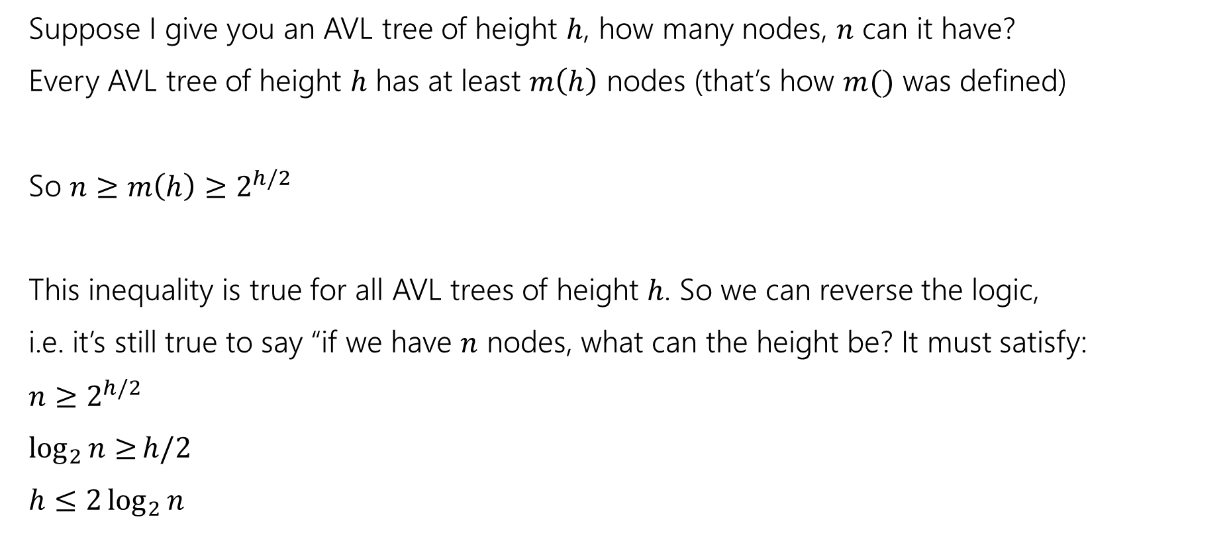
Finishing the Argument
Suppose I give you an AVL tree of height $h$, how many nodes, $n$ can it have?
Every AVL tree of height $h$ has at least $m\left(h\right)$ nodes (that’s how $m()$ was defined)
So $n≥m\left(h\right)≥2^{h/2}$
This inequality is true for all AVL trees of height $h$. So we can reverse the logic,
i.e. it’s still true to say “if we have $n$ nodes, what can the height be? It must satisfy:
$n≥2^{h/2}$
$\log_{2}{n≥}h/2$
$h≤2\log_{2}{n}$
AVL trees are always short, just like we wanted!

Slide 10

Avoiding the Degenerate Tree
An AVL tree is a binary search tree that also meets the following rule
This will avoid the $Θ\left(n\right)$ behavior! We have to check:
1. We must be able to maintain this property when inserting/deleting
2. Such a tree must have height $O(\log{n)}.$
AVL condition: For every node, the height of its left subtree and right subtree differ by at most 1.

Slide 11
Insertion
What happens if when we do an insertion, we break the AVL condition?
1
2
2
1
3
3

Slide 12
Left Rotation
Rest of the tree
Rest of the tree
BALANCED
Right subtree is 1 longer
UNBALANCED
Right subtree is 2 longer
y
x
x
y
z
A
A
B
z
B
C
D
C
D

Slide 13
4
2
7
1
3
6
9
5
8
10
11

Slide 14
4
2
7
1
3
6
9
5
8
10
11

Slide 15
4
2
7
1
3
6
9
5
8
10
11

Slide 16


Slide 17
Right rotation
3
2
2
1
3
1
Just like a left roation, just reflected.

Slide 18
It Gets More Complicated
There’s a “kink” in the tree where the insertion happened.
1
1
2
3
2
1
3
2
3
Now do a left rotation.
Can’t do a left rotation
Do a “right” rotation around 3 first.

Slide 19
Right Left Rotation
Rest of the tree
Rest of the tree
BALANCED
Right subtree is 1 longer
UNBALANCED
Right subtree is 2 longer
y
x
Left subtree is
1 longer
x
z
z
A
A
B
y
D
C
D
B
C

Slide 20
Four Types of Rotations
y
Insert location | Solution
Left subtree of left child (A) | Single right rotation
Right subtree of left child (B) | Double (left-right) rotation
Left subtree of right child (C) | Double (right-left) rotation
Right subtree of right child(D) | Single left rotation
x
z
A
B
C
D

Slide 21
AVL Example: 8,9,10,12,11
8
9
10
Notes:
This is the line case.

Slide 22
AVL Example: 8,9,10,12,11
8
9
10
Notes:
Do a left rotation to correct

Slide 23
AVL Example: 8,9,10,12,11
9
8
10
12
11
Notes:
This is the kink case

Slide 24
AVL Example: 8,9,10,12,11
9
8
10
12
11
Notes:
Do a right rotation to get into a line case

Slide 25
AVL Example: 8,9,10,12,11
9
8
10
11
12
Notes:
Now do a left rotation to re-balance the line!

Slide 26
How Long Does Rebalancing Take?
Assume we store in each node the height of its subtree.
How do we find an unbalanced node?
How many rotations might we have to do?

Slide 27
How Long Does Rebalancing Take?
Assume we store in each node the height of its subtree.
How do we find an unbalanced node?
Just go back up the tree from where we inserted.
How many rotations might we have to do?
Just a single or double rotation on the lowest unbalanced node.
A rotation will cause the subtree rooted where the rotation happens to have the same height it had before insertion.

Slide 28
4
2
7
1
3
6
9
5
8
10
11

Slide 29
4
2
7
1
3
6
9
5
8
10
11

Slide 30
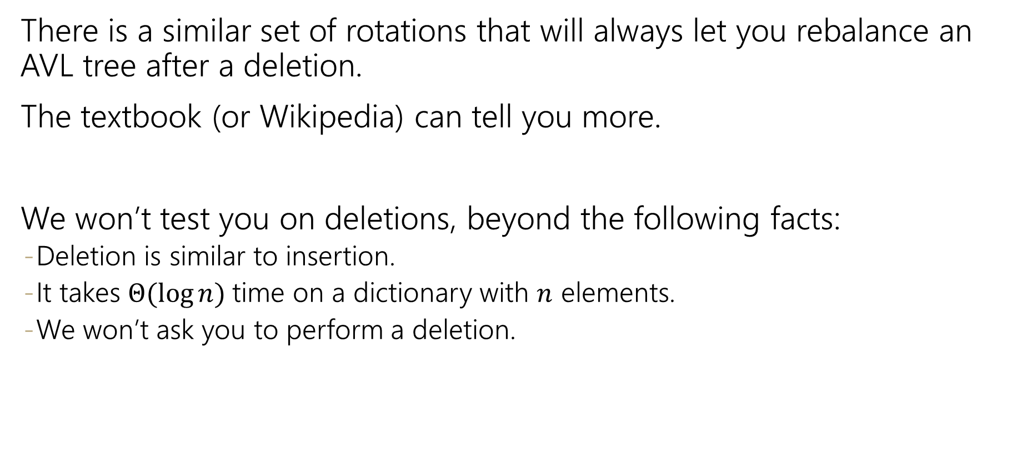
Deletion
There is a similar set of rotations that will always let you rebalance an AVL tree after a deletion.
The textbook (or Wikipedia) can tell you more.
We won’t test you on deletions, beyond the following facts:
Deletion is similar to insertion.
It takes $Θ(\log{n)}$time on a dictionary with $n$ elements.
We won’t ask you to perform a deletion.

Slide 31
Avoiding the Degenerate Tree
An AVL tree is a binary search tree that also meets the following rule
This will avoid the $Θ\left(n\right)$ behavior! We have to check:
1. We must be able to maintain this property when inserting/deleting
2. Such a tree must have height $O(\log{n)}.$
AVL condition: For every node, the height of its left subtree and right subtree differ by at most 1.

Slide 32

Three Asides
Three related topics, we’ll cover what we can:
Lazy deletion
How fast is $Θ(\log{n)}$
Traversals

Slide 33
Aside: Lazy Deletion
Deleting things is hard. Let’s be lazy.
Instead of actually removing elements from a data structure add a flag for whether the element is “really there.”
Then when you call delete, just find the item you’re looking for, and set the flag.
Should you “really delete” or just lazy delete?
This sounds like a design decision! What are the tradeoffs?

Slide 34
Aside: Lazy Deletion
Pros:
Much easier to write delete function.
Delete takes the same time as find (much faster for our data structures that shift everything!)
Cons:
All code now has to check that entries are really there
Running time of all operations is now in terms of elements ever inserted, not number of elements currently in the data structure.
Takeaways:
General technique (not just for dictionaries).
But only use it if you have a good reason.

Slide 35

Aside: How Fast is $Θ(\log{n)}$?
If you just looked at a list of common running times
You might think this was a small improvement.
It was a HUGE improvement!
Class | Big O | If you double N… | Example algorithm
constant | O(1) | unchanged | Add to front of linked list
logarithmic | O(log n) | Increases slightly | Binary search
linear | O(n) | doubles | Sequential search
“n log n” | O(nlog n) | Slightly more than doubles | Merge sort
quadratic | O(n²) | quadruples | Nested loops traversing a 2D array

Slide 36
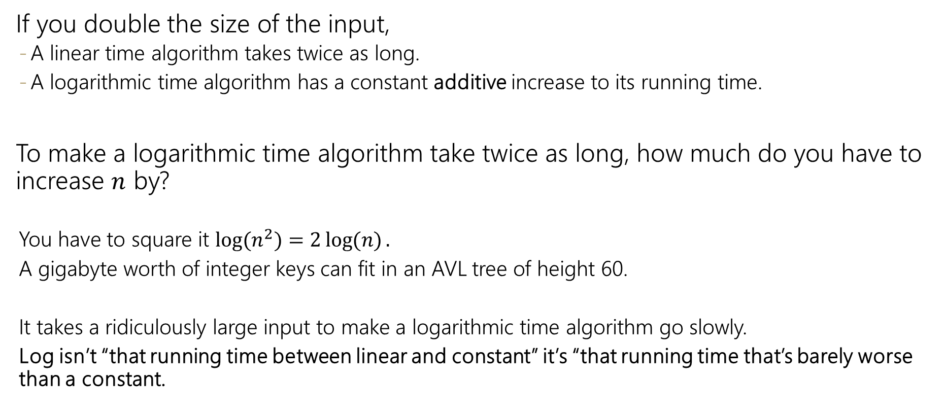
Logarithmic vs. Linear
If you double the size of the input,
A linear time algorithm takes twice as long.
A logarithmic time algorithm has a constant additive increase to its running time.
To make a logarithmic time algorithm take twice as long, how much do you have to increase $n$ by?
You have to square it $\log{(n^{2})}=2\log{(n)}.$
A gigabyte worth of integer keys can fit in an AVL tree of height 60.
It takes a ridiculously large input to make a logarithmic time algorithm go slowly.
Log isn’t “that running time between linear and constant” it’s “that running time that’s barely worse than a constant.

Slide 37
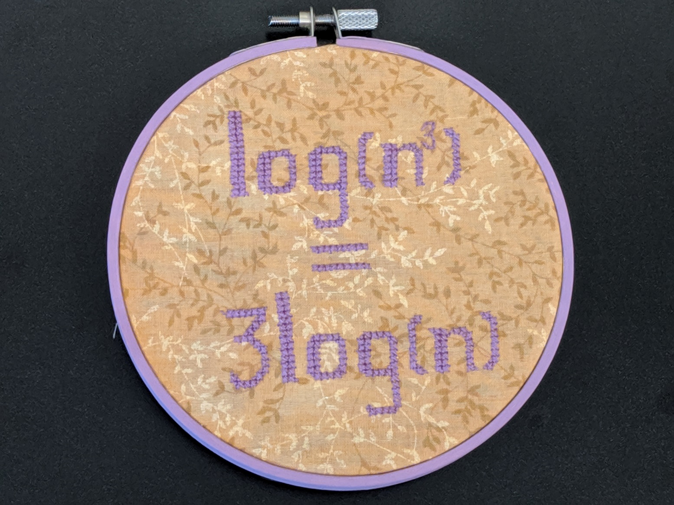
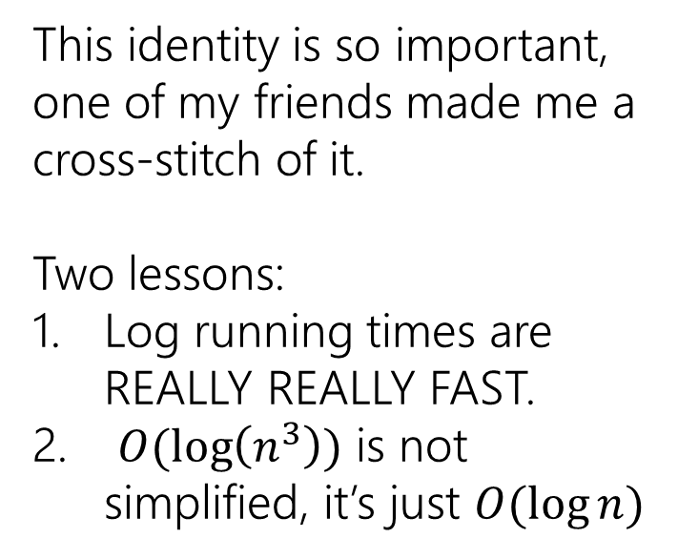
Logarithmic Running Times
This identity is so important, one of my friends made me a cross-stitch of it.
Two lessons:
Log running times are REALLY REALLY FAST.
$O(\log\left(n^{3}\right))$ is not simplified, it’s just $O(\log{n)}$

Slide 38
Aside: Traversals
What if the heights of subtrees were corrupted.
How could we calculate from scratch?
We could use a “traversal”
A process that visits every piece of data in a data structure.
int height(Node curr){
if(curr==null) return -1;
int h = Math.max(height(curr.left),height(curr.right));
return h+1;
}

Slide 39
Three Kinds of Traversals
InOrder(Node curr){
InOrder(curr.left);
doSomething(curr);
InOrder(curr.right);
}
PreOrder(Node curr){
doSomething(curr);
PreOrder(curr.left);
PreOrder(curr.right);
}
PostOrder(Node curr){ PostOrder(curr.left);
PostOrder(curr.right);
doSomething(curr);
}

Slide 40
Traversal Practice
For each of the following scenarios, choose an appropriate traversal:
1. Print out all the keys in an AVL-Dictionary in sorted order.
2. Make a copy of an AVL tree
3. Determine if an AVL tree is balanced (assume height values are not stored)

Slide 41
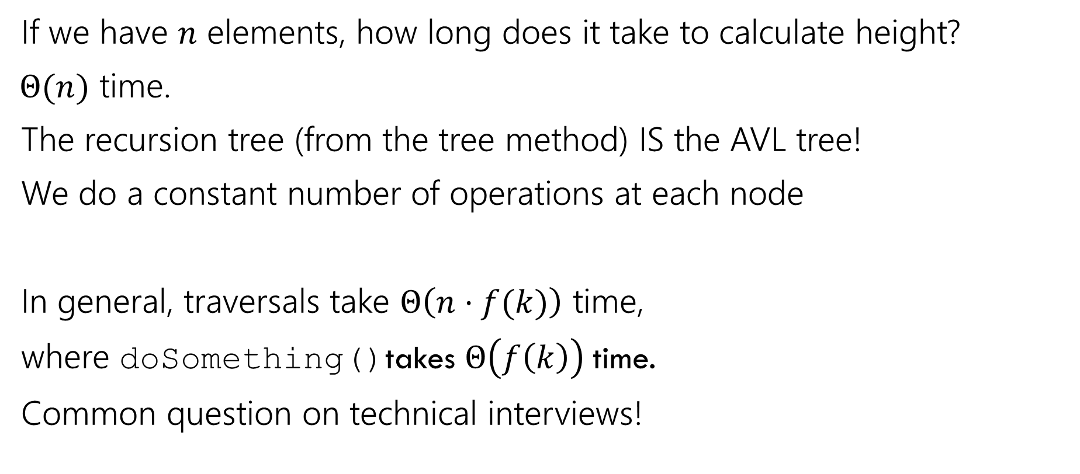
Traversals
If we have $n$ elements, how long does it take to calculate height?
$Θ(n)$ time.
The recursion tree (from the tree method) IS the AVL tree!
We do a constant number of operations at each node
In general, traversals take $Θ\left(n⋅f(k)\right)$ time,
where doSomething()takes $Θ\left(f\left(k\right)\right)$time.
Common question on technical interviews!

Slide 42
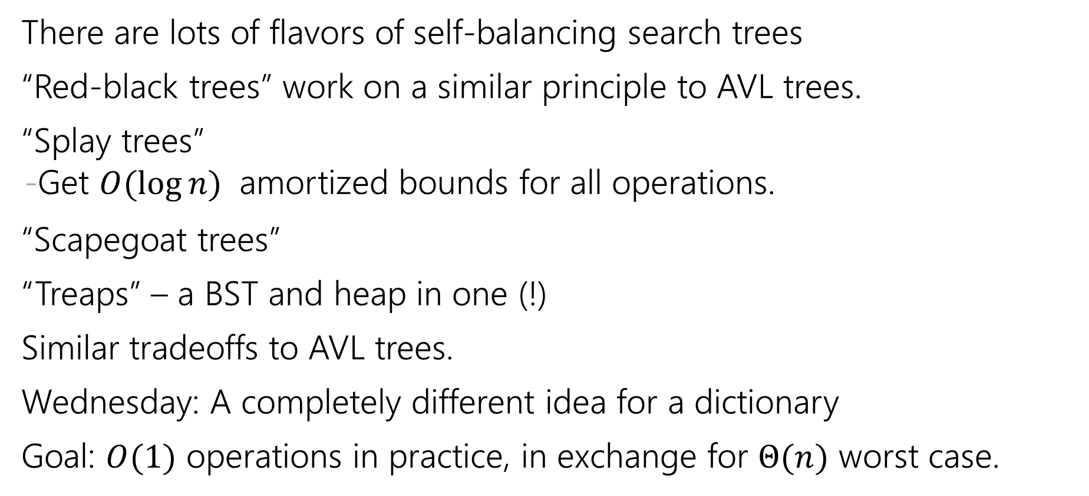
Aside: Other Self-Balancing Trees
There are lots of flavors of self-balancing search trees
“Red-black trees” work on a similar principle to AVL trees.
“Splay trees”
Get $O(\log{n)}$ amortized bounds for all operations.
“Scapegoat trees”
“Treaps” – a BST and heap in one (!)
Similar tradeoffs to AVL trees.
Wednesday: A completely different idea for a dictionary
Goal: $O(1)$ operations in practice, in exchange for $Θ(n)$ worst case.

