Slide 1
Lecture 11: Introduction to Hash Tables
CSE 373: Data Structures and Algorithms

Slide 2
Administrivia
When you’re submitting your group writeup to gradescope, be sure to use the group submission option if you have a partner.
Project 1 part 2 due Thursday night.
Exercise 2 due Friday night.
Project 2 will come out tonight, and Exercise 3 will come out Friday.
Due in two weeks (Wednesday the 31st for Project 2, and Friday the 2nd for Exercise 3)
They “should” be one week assignments… but next Friday is the midterm!
We’re leaving it to you to decide how/when to study for the midterm vs. doing homework.

Slide 3

Aside: How Fast is $Θ(\log{n)}$?
If you just looked at a list of common running times
You might think this was a small improvement.
It was a HUGE improvement!
Class | Big O | If you double N… | Example algorithm
constant | O(1) | unchanged | Add to front of linked list
logarithmic | O(log n) | Increases slightly | Binary search
linear | O(n) | doubles | Sequential search
“n log n” | O(nlog n) | Slightly more than doubles | Merge sort
quadratic | O(n²) | quadruples | Nested loops traversing a 2D array

Slide 4
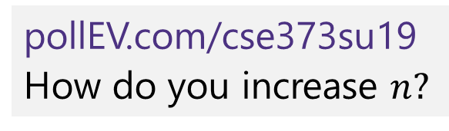
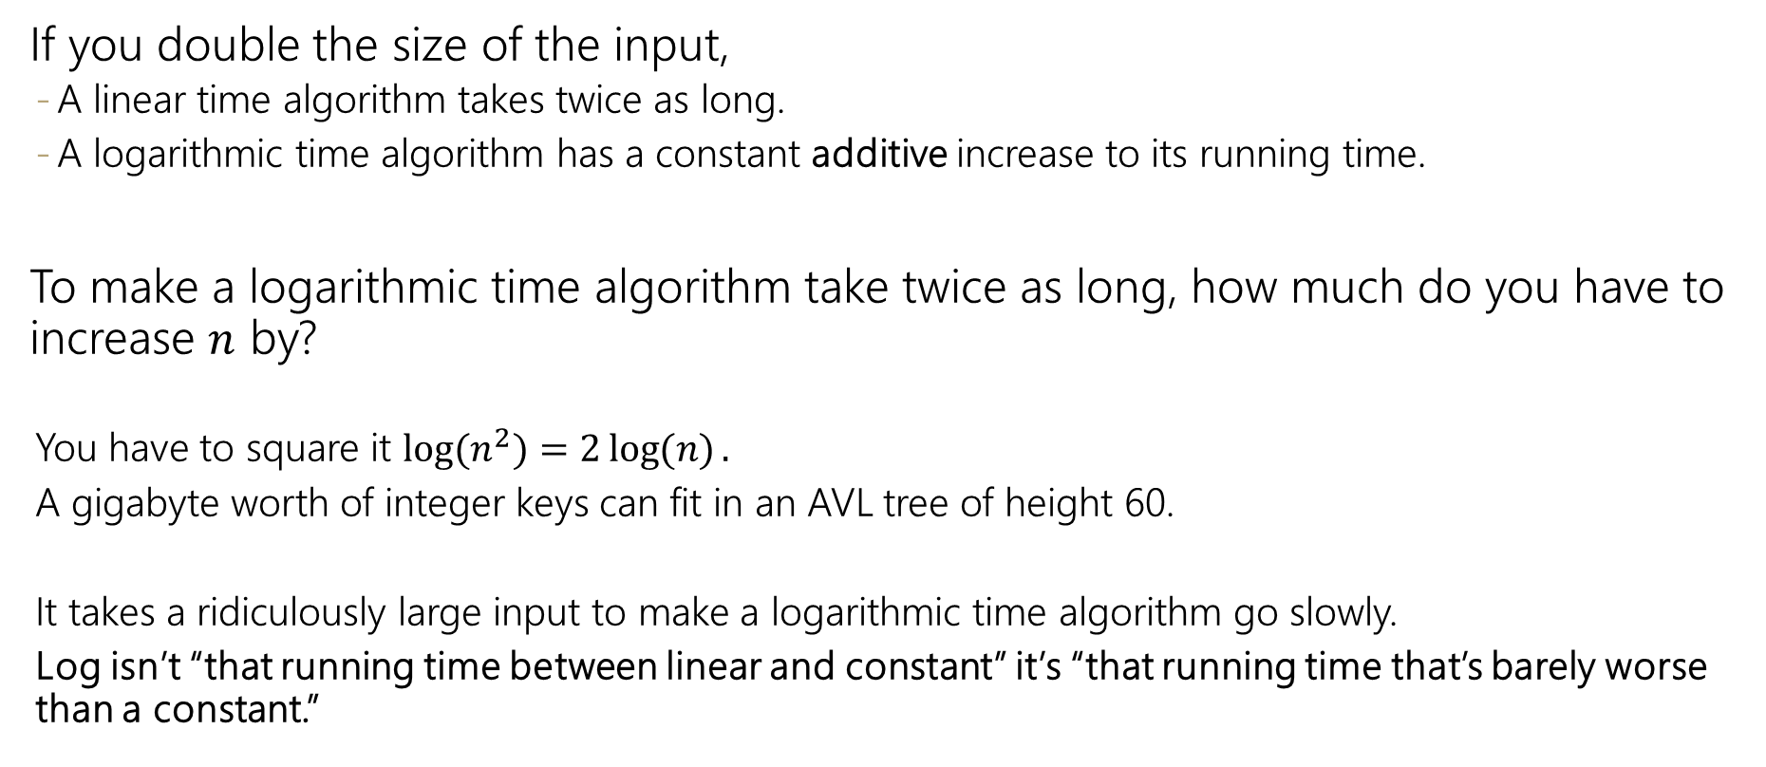
Logarithmic vs. Linear
If you double the size of the input,
A linear time algorithm takes twice as long.
A logarithmic time algorithm has a constant additive increase to its running time.
To make a logarithmic time algorithm take twice as long, how much do you have to increase $n$ by?
You have to square it $\log{(n^{2})}=2\log{(n)}.$
A gigabyte worth of integer keys can fit in an AVL tree of height 60.
It takes a ridiculously large input to make a logarithmic time algorithm go slowly.
Log isn’t “that running time between linear and constant” it’s “that running time that’s barely worse than a constant.”
pollEV.com/cse373su19
How do you increase $n?$

Slide 5
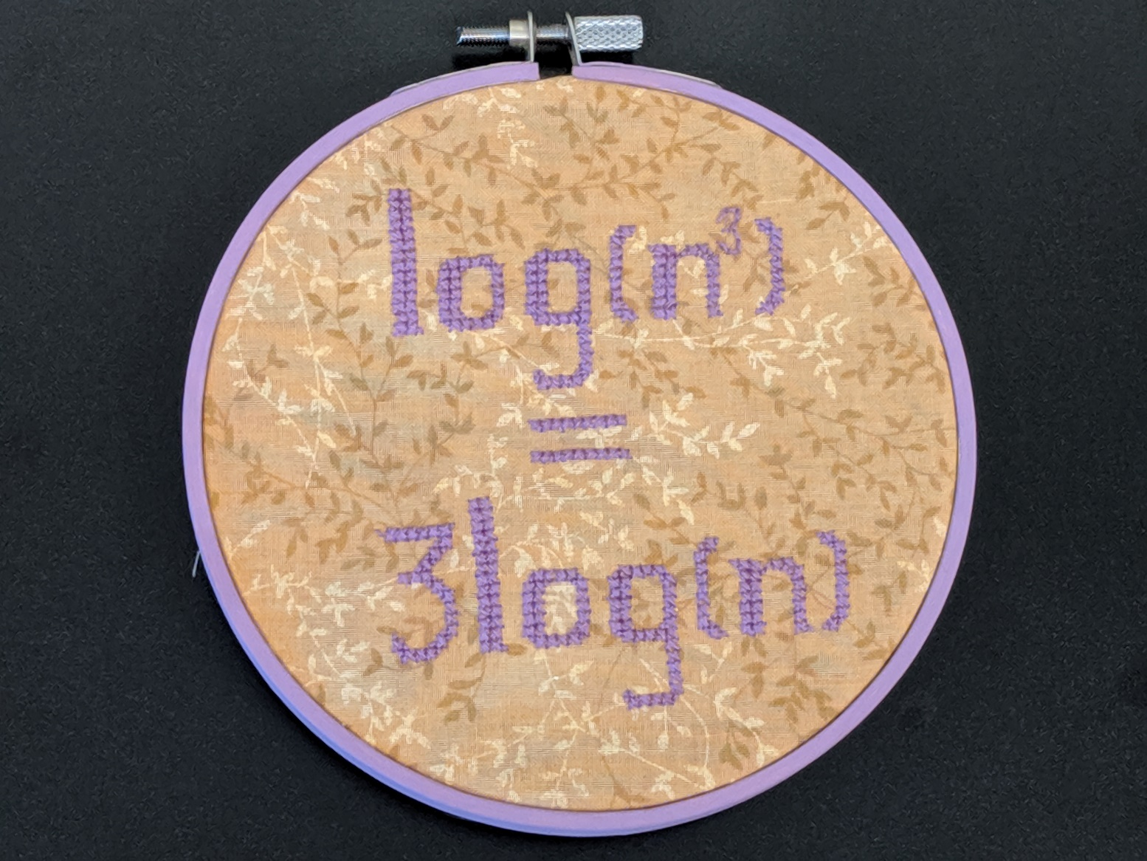
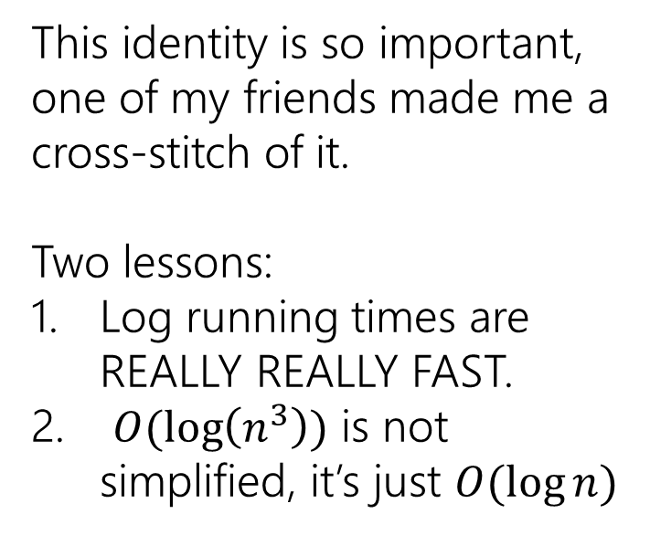
Logarithmic Running Times
This identity is so important, one of my friends made me a cross-stitch of it.
Two lessons:
Log running times are REALLY REALLY FAST.
$O(\log\left(n^{3}\right))$ is not simplified, it’s just $O(\log{n)}$

Slide 6
Aside: Traversals
What if the heights of subtrees were corrupted.
How could we calculate from scratch?
We could use a “traversal”
A process that visits every piece of data in a data structure.
int height(Node curr){
if(curr==null) return -1;
int h = Math.max(height(curr.left),height(curr.right));
return h+1;
}

Slide 7
Three Kinds of Traversals
InOrder(Node curr){
InOrder(curr.left);
doSomething(curr);
InOrder(curr.right);
}
PreOrder(Node curr){
doSomething(curr);
PreOrder(curr.left);
PreOrder(curr.right);
}
PostOrder(Node curr){ PostOrder(curr.left);
PostOrder(curr.right);
doSomething(curr);
}

Slide 8
Traversal Practice
For each of the following scenarios, choose an appropriate traversal:
1. Print out all the keys in an AVL-Dictionary in sorted order.
2. Make a copy of an AVL tree
3. Determine if an AVL tree is balanced (assume height values are not stored)

Slide 9
Traversal Practice
For each of the following scenarios, choose an appropriate traversal:
1. Print out all the keys in an AVL-Dictionary in sorted order.
2. Make a copy of an AVL tree
3. Determine if an AVL tree is balanced (assume height values are not stored)
In order
Pre-order
Post-order

Slide 10
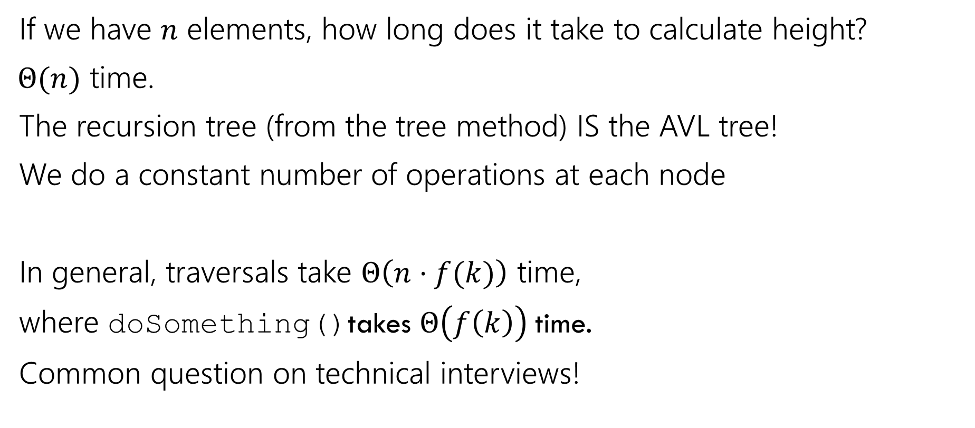
Traversals
If we have $n$ elements, how long does it take to calculate height?
$Θ(n)$ time.
The recursion tree (from the tree method) IS the AVL tree!
We do a constant number of operations at each node
In general, traversals take $Θ\left(n⋅f(k)\right)$ time,
where doSomething()takes $Θ\left(f\left(k\right)\right)$time.
Common question on technical interviews!

Slide 11
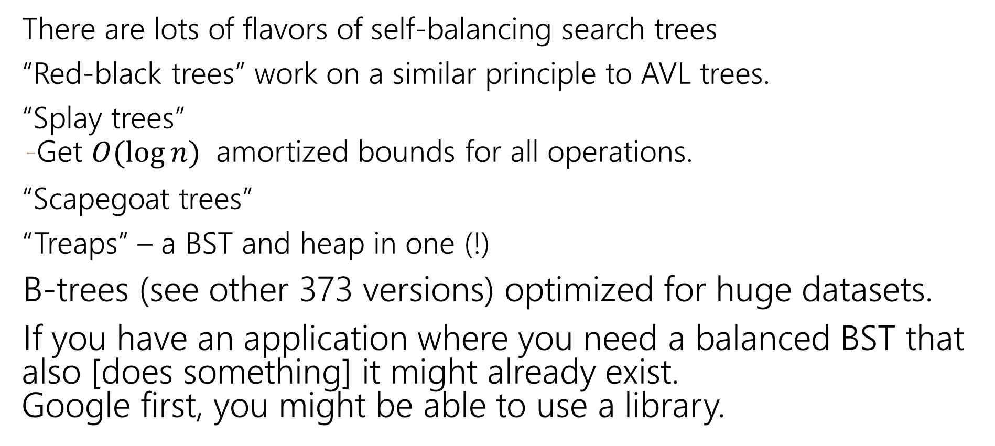
Aside: Other Self-Balancing Trees
There are lots of flavors of self-balancing search trees
“Red-black trees” work on a similar principle to AVL trees.
“Splay trees”
Get $O(\log{n)}$ amortized bounds for all operations.
“Scapegoat trees”
“Treaps” – a BST and heap in one (!)
B-trees (see other 373 versions) optimized for huge datasets.
If you have an application where you need a balanced BST that also [does something] it might already exist. Google first, you might be able to use a library.

Slide 12
Hashing

Slide 13
Review: Dictionaries
Dictionary ADT
ArrayDictionary<K, V>
LinkedDictionary<K, V>
AVLDictionary<K, V>
state
state
state
state
Set of items & keys
Count of items
Pair<K, V>[] data
front
size
overallRoot
size
behavior
behavior
behavior
behavior
put(key, item) add item to collection indexed with key
get(key) return item associated with key
containsKey(key) return if key already in use
remove(key) remove item and associated key
size() return count of items
put create new pair, add to next available spot, grow array if necessary
get scan all pairs looking for given key, return associated item if found
containsKey scan all pairs, return if key is found
remove scan all pairs, replace pair to be removed with last pair in collection
size return count of items in dictionary
put if key is unused, create new pair, add to front of list, else replace with new value
get scan all pairs looking for given key, return associated item if found
containsKey scan all pairs, return if key is found
remove scan all pairs, skip pair to be removed
size return count of items in dictionary
put if key is unused, create new pair, place in BST order, rotate to maintain balance
get traverse through tree using BST property, return item if found
containsKey traverse through tree using BST property, return if key is found
remove traverse through tree using BST property, replace or nullify as appropriate
size return count of items in dictionary

Slide 14
Review: Dictionaries
3 Minutes
Dictionary ADT
It’s all about data baby!
Why are we so obsessed with Dictionaries?
When dealing with data:
Adding data to your collection
Getting data out of your collection
Rearranging data in your collection
state
SUPER common in comp sci
- Databases
- Network router tables
- Compilers and Interpreters
Set of items & keys
Count of items
behavior
put(key, item) add item to collection indexed with key
get(key) return item associated with key
containsKey(key) return if key already in use
remove(key) remove item and associated key
size() return count of items
Operation |  | ArrayList | LinkedList | BST | AVLTree
put(key,value) | best
 | worst
get(key) | best
 | worst
remove(key) | best
 | worst

Slide 15
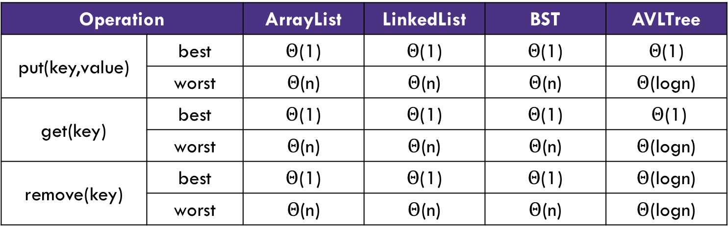
Review: Dictionaries
3 Minutes
Dictionary ADT
It’s all about data baby!
Why are we so obsessed with Dictionaries?
When dealing with data:
Adding data to your collection
Getting data out of your collection
Rearranging data in your collection
state
SUPER common in comp sci
- Databases
- Network router tables
- Compilers and Interpreters
Set of items & keys
Count of items
behavior
put(key, item) add item to collection indexed with key
get(key) return item associated with key
containsKey(key) return if key already in use
remove(key) remove item and associated key
size() return count of items
Operation |  | ArrayList | LinkedList | BST | AVLTree
put(key,value) | best | $Θ$(1) | $Θ$(1) | $Θ$(1) | $Θ$(1)
 | worst | $Θ$(n) | $Θ$(n) | $Θ$(n) | $Θ$(logn)
get(key) | best | $Θ$(1) | $Θ$(1) | $Θ$(1) | $Θ$(1)
 | worst | $Θ$(n) | $Θ$(n) | $Θ$(n) | $Θ$(logn)
remove(key) | best | $Θ$(1) | $Θ$(1) | $Θ$(1) | $Θ$(logn)
 | worst | $Θ$(n) | $Θ$(n) | $Θ$(n) | $Θ$(logn)

Slide 16
“In-Practice” Case
For Hash Tables, we’re going to talk about what you can expect “in-practice”
Instead of just what the best and worst scenarios are.
Other resources (and previous versions of 373) use “average case”
There’s a lot of math (beyond the scope of the course) needed to make “average” statements precise.
So we’re not going to do it that way.
For this class, we’ll just tell you what assumptions we’re making about how the “real world” usually works.
And then do worst-case analysis under those assumptions.

Slide 17
Can we do better?
What if we knew exactly where to find our data?
Implement a dictionary that accepts only integer keys between 0 and some value k
-> Leverage Array Indices!
DirectAccessMap<Integer, V>
state
Data[]
size
behavior
“Direct address map”
put put item at given index
get get item at given index
containsKey if data[] null at index, return false, return true otherwise
remove nullify element at index
size return count of items in dictionary
Operation |  | Array w/ indices as keys
put(key,value) | best | O(1)
 | worst | O(1)
get(key) | best | O(1)
 | worst | O(1)
remove(key) | best | O(1)
 | worst | O(1)

Slide 18
Implement Direct Access Map
public V get(int key) {
this.ensureIndexNotNull(key);
return this.array[key];
}
public void put(int key, V value) {
this.array[key] = value;
}
public void remove(int key) {
this.entureIndexNotNull(key);
this.array[key] = null;
}
DirectAccessMap<Integer, V>
state
Data[]
size
behavior
put put item at given index
get get item at given index
containsKey if data[] null at index, return false, return true otherwise
remove nullify element at index
size return count of items in dictionary

Slide 19
Can we do this for any integer?
Idea 1:
Create a GIANT array with every possible integer as an index
Problems:
Can we allocate an array big enough?
Super wasteful
Idea 2:
Create a smaller array, but create a way to translate given integer keys into available indices
Problem:
How can we pick a good translation?

Slide 20
Review: Integer remainder with % “mod”
The % operator computes the remainder from integer division.
14 % 4 is 2 3 43 4 ) 14 5 ) 218 12 20 2 18 15 3
Applications of % operator:
Obtain last digit of a number: 230857 % 10 is 7
See whether a number is odd: 7 % 2 is 1, 42 % 2 is 0
Limit integers to specific range: 8 % 12 is 8, 18 % 12 is 6
218 % 5 is 3
Equivalently, to find a % b (for a,b > 0):
while(a > b-1)
a -= b;
return a;
Limit keys to indices within array
For more review/practice, check out https://www.khanacademy.org/computing/computer-science/cryptography/modarithmetic/a/what-is-modular-arithmetic

Slide 21
First Hash Function: % table size
indices | 0 | 1 | 2 | 3 | 4 | 5 | 6 | 7 | 8 | 9
elements
“foo”
“biz”
“bar”
“bop”
put(0, “foo”);
put(5, “bar”);
put(11, “biz”)
put(18, “bop”);
0 % 10 = 0
5 % 10 = 5
11 % 10 = 1
18 % 10 = 8

Slide 22
Implement First Hash Function
public V get(int key) {
int newKey = getKey(key);
this.ensureIndexNotNull(newKey);
return this.data[newKey;
}
public void put(int key, int value) {
this.array[getKey(key)] = value;
}
public void remove(int key) {
int newKey = getKey(key);
this.entureIndexNotNull(newKey);
this.data[newKey] = null;
}
public int getKey(int k) {
return k % this.data.length;
}
SimpleHashMap<Integer>
state
Data[]
size
behavior
put mod key by table size, put item at result
get mod key by table size, get item at result
containsKey mod key by table size, return data[result] == null remove mod key by table size, nullify element at result
size return count of items in dictionary

Slide 23
First Hash Function: % table size
indices | 0 | 1 | 2 | 3 | 4 | 5 | 6 | 7 | 8 | 9
elements
“foo”
“biz”
“bar”
“bop”
“:(”
put(0, “foo”);
put(5, “bar”);
put(11, “biz”)
put(18, “bop”);
put(20, “:(”);
0 % 10 = 0
5 % 10 = 5
11 % 10 = 1
18 % 10 = 8
20 % 10 = 0
Collision!

Slide 24
Hash Obsession: Collisions
Collision: multiple keys translate to the same location of the array
The fewer the collisions, the better the runtime!
Two questions:
1. When we have a collision, how do we resolve it?
2. How do we minimize the number of collisions?

Slide 25
Strategies to handle hash collisions

Slide 26
Strategies to handle hash collision
There are multiple strategies. In this class, we’ll cover the following ones:
1. Separate chaining
2. Open addressing
Linear probing
Quadratic probing
Double hashing

Slide 27
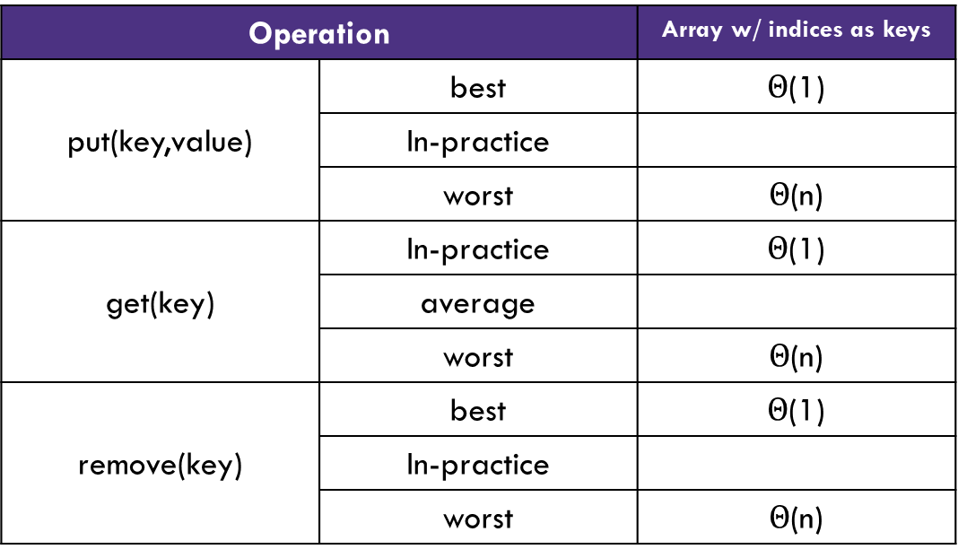

Handling Collisions
Solution 1: Chaining
Each space holds a “bucket” that can store multiple values. Bucket is often implemented with a LinkedList
Operation |  | Array w/ indices as keys
put(key,value) | best | $Θ$(1)
 | In-practice
 | worst | $Θ$(n)
get(key) | In-practice | $Θ$(1)
 | average
 | worst | $Θ$(n)
remove(key) | best | $Θ$(1)
 | In-practice
 | worst | $Θ$(n)
“In-Practice” Case:
Depends on average number of elements per chain
Load Factor λ
If n is the total number of key-value pairs
Let c be the capacity of array
Load Factor λ = $\frac{n}{c}$

Slide 28
In-Practice
We’re going to make an assumption about how often collisions happen.
It’s not actually true, but it’s “close enough” to true that our big-O analyses will be pretty consistent with what you usually see in-practice.
Our Hashing Assumption
The hash function will distribute the input keys as evenly as possible across the buckets.
This is not true in the real-world.
But what is usually true in the real-world is pretty close is close enough that the big-O analyses are the same.

Slide 29
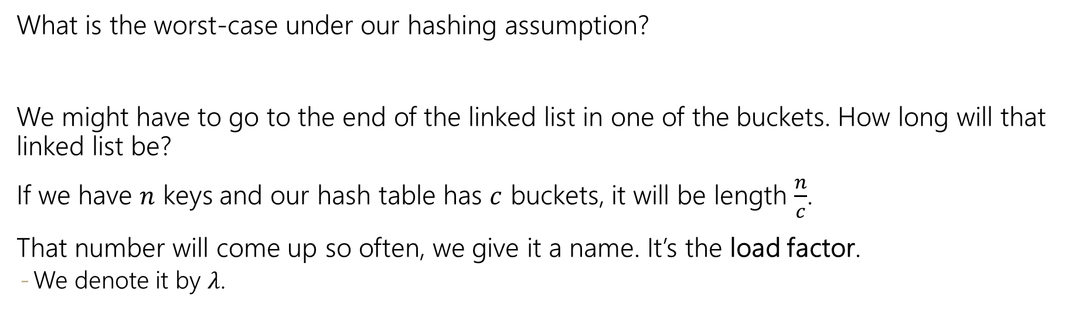
In-Practice
Our Hashing Assumption
The hash function will distribute the input keys as evenly as possible across the buckets.
What is the worst-case under our hashing assumption?
We might have to go to the end of the linked list in one of the buckets. How long will that linked list be?
If we have $n$ keys and our hash table has $c$ buckets, it will be length $\frac{n}{c}$.
That number will come up so often, we give it a name. It’s the load factor.
We denote it by $λ$.

Slide 30
Handling Collisions
Solution 1: Chaining
Each space holds a “bucket” that can store multiple values. Bucket is often implemented with a LinkedList
Operation |  | Array w/ indices as keys
put(key,value) | best | O(1)
 | In-practice | O(1 + λ)
 | worst | O(n)
get(key) | In-practice | O(1)
 | average | O(1 + λ)
 | worst | O(n)
remove(key) | best | O(1)
 | In-practice | O(1 + λ)
 | worst | O(n)
“In-Practice” Case:
Depends on average number of elements per chain
Load Factor λ
If n is the total number of key-value pairs
Let c be the capacity of array
Load Factor λ = $\frac{n}{c}$

Slide 31
Practice
3 Minutes
Consider an IntegerDictionary using separate chaining with an internal capacity of 10. Assume our buckets are implemented using a LinkedList where we append new key-value pairs to the end.
Now, suppose we insert the following key-value pairs. What does the dictionary internally look like?
(1, a) (5,b) (11,a) (7,d) (12,e) (17,f) (1,g) (25,h)
0 | 1 | 2 | 3 | 4 | 5 | 6 | 7 | 8 | 9
(1, a)
(12, e)
(5, b)
(7, d)
(1, g)
(11, a)
(25, h)
(17, f)

Slide 32
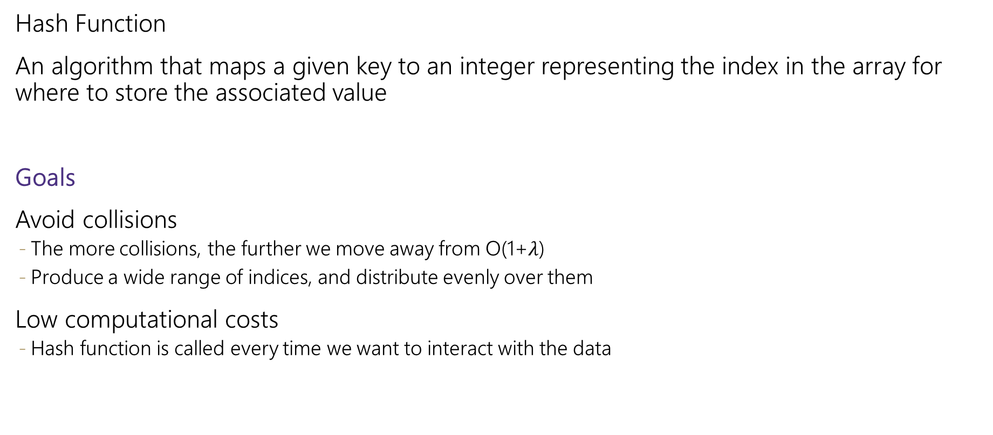
What about non integer keys?
Hash Function
An algorithm that maps a given key to an integer representing the index in the array for where to store the associated value
Goals
Avoid collisions
The more collisions, the further we move away from O(1+$λ$)
Produce a wide range of indices, and distribute evenly over them
Low computational costs
Hash function is called every time we want to interact with the data

Slide 33
How to Hash non Integer Keys
Implementation 1: Simple aspect of values
public int hashCode(String input) {
return input.length();
}
Implementation 2: More aspects of value
public int hashCode(String input) {
int output = 0;
for(char c : input) {
out += (int)c;
}
return output;
}
Implementation 3: Multiple aspects of value + math!
public int hashCode(String input) {
int output = 1;
for (char c : input) {
int nextPrime = getNextPrime();
out *= Math.pow(nextPrime, (int)c);
}
return Math.pow(nextPrime, input.length());
}
Pro: super fast
Con: lots of collisions!
Pro: still really fast
Con: some collisions
Pro: few collisions
Con: slow, gigantic integers

Slide 34
Practice
3 Minutes
Consider a StringDictionary using separate chaining with an internal capacity of 10. Assume our buckets are implemented using a LinkedList. Use the following hash function:
public int hashCode(String input) {
return input.length() % arr.length;
}
Now, insert the following key-value pairs. What does the dictionary internally look like?
(“a”, 1) (“ab”, 2) (“c”, 3) (“abc”, 4) (“abcd”, 5) (“abcdabcd”, 6) (“five”, 7) (“hello world”, 8)
0 | 1 | 2 | 3 | 4 | 5 | 6 | 7 | 8 | 9
(“a”, 1)
(“ab”, 2)
(“abc”, 4)
(“abcd”, 5)
(“c”, 3)
(“abcdabcd”, 6)
(“hello world”, 8)
(“five”, 7)

Slide 35
Java and Hash Functions
Object class includes default functionality:
equals
hashCode
If you want to implement your own hashCode you should:
Override BOTH hashCode() and equals()
If a.equals(b) is true then a.hashCode() == b.hashCode() MUST also be true
That requirement is part of the Object interface. Other people’s code will assume you’ve followed this rule.
Java’s HashMap (and HashSet) will assume you follow these rules and conventions for your custom objects if you want to use your custom objects as keys.

Slide 36
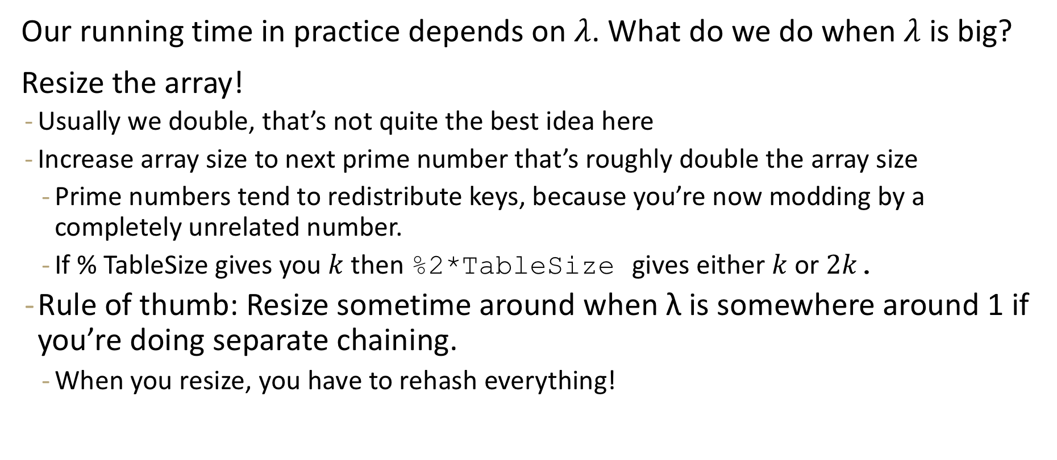
Resizing
Our running time in practice depends on $λ$. What do we do when $λ$ is big?
Resize the array!
Usually we double, that’s not quite the best idea here
Increase array size to next prime number that’s roughly double the array size
Prime numbers tend to redistribute keys, because you’re now modding by a completely unrelated number.
If % TableSize gives you $k$ then %2*TableSize gives either $k$ or $2k$.
Rule of thumb: Resize sometime around when λ is somewhere around 1 if you’re doing separate chaining.
When you resize, you have to rehash everything!

