Slide 1
Lecture 13: Heaps
CSE 373 Data Structures and Algorithms
CSE 373 19 SP - Kasey Champion

Slide 2
Administrivia
We’ll post midterm review material tonight.
In the meantime, go to the bottom of spring’s exam page.
https://courses.cs.washington.edu/courses/cse373/19sp/exams/

Slide 3
Heaps

Slide 4
Priority Queue ADT
Imagine you’re writing a patient management system for an ER.
You need to make sure when a doctor becomes available the person who most urgently needs help is seen first. Other uses:
Operating System
Well-designed printers
Huffman Codes (in 143)
Sorting (in Project 2)
Graph algorithms
Min Priority Queue ADT
state
Set of comparable values
- Ordered based on “priority”
behavior
insert(value) – add a new element to the collection
removeMin() – returns the element with the smallest priority, removes it from the collection
peekMin() – find, but do not remove the element with the smallest priority

Slide 5
Priority Queue ADT
If a Queue is “First-In-First-Out” (FIFO) Priority Queues are “Most-Important-Out-First”
Items in Priority Queue must be comparable, The data structure will maintain some amount of internal sorting
Min Priority Queue ADT
Max Priority Queue ADT
state
state
Set of comparable values
- Ordered based on “priority”
Set of comparable values
- Ordered based on “priority”
behavior
behavior
removeMin() – returns the element with the smallest priority, removes it from the collection
removeMax() – returns the element with the largest priority, removes it from the collection
peekMin() – find, but do not remove the element with the smallest priority
peekMax() – find, but do not remove the element with the largest priority
insert(value) – add a new element to the collection
insert(value) – add a new element to the collection

Slide 6
Implementing Priority Queues: Take I
Maybe we already know how to implement a priority queue.
How long would insert and removeMin take with these data structures?
Implementation | Insert | removeMin | Peek
Unsorted Array
Sorted Array (use “circular array”)
Linked List (sorted)
AVL Tree
For Array implementations, assume you do not need to resize.
Other than this assumption, do worst case analysis.

Slide 7
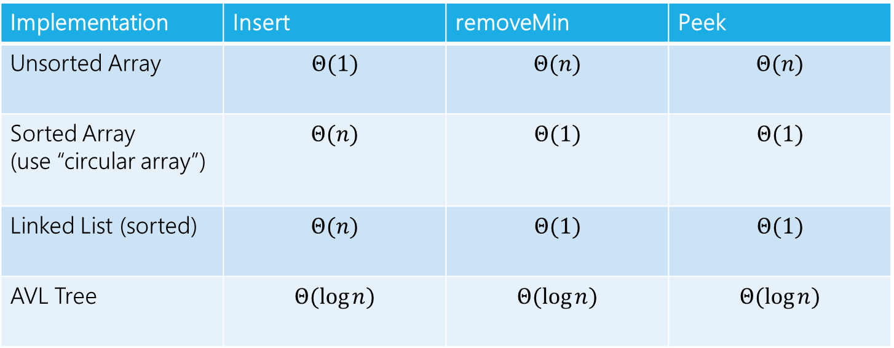
Implementing Priority Queues: Take I
Maybe we already know how to implement a priority queue.
How long would insert and removeMin take with these data structures?
Implementation | Insert | removeMin | Peek
Unsorted Array | $$Θ(1)$$ | $$Θ(n)$$ | $$Θ(n)$$
Sorted Array (use “circular array”) | $$Θ(n)$$ | $$Θ(1)$$ | $$Θ(1)$$
Linked List (sorted) | $$Θ(n)$$ | $$Θ(1)$$ | $$Θ(1)$$
AVL Tree | $$Θ(\log{n)}$$ | $$Θ(\log{n)}$$ | $$Θ(\log{n)}$$
For Array implementations, assume you do not need to resize.
Other than this assumption, do worst case analysis.

Slide 8
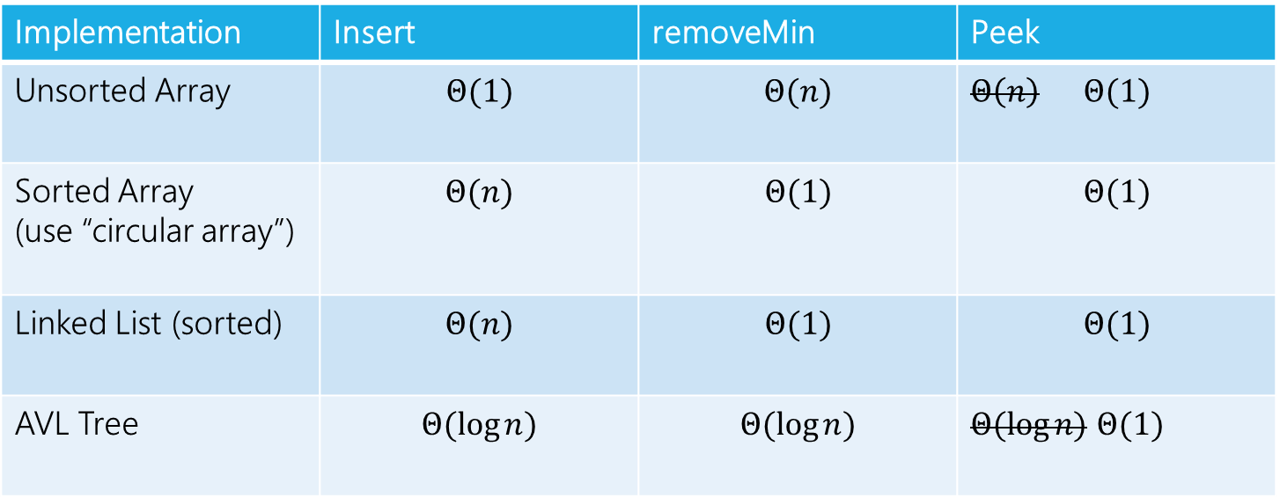
Implementing Priority Queues: Take I
Maybe we already know how to implement a priority queue.
How long would insert and removeMin take with these data structures?
Implementation | Insert | removeMin | Peek
Unsorted Array | $$Θ(1)$$ | $$Θ(n)$$ | $Θ\left(n\right) Θ(1)$
Sorted Array (use “circular array”) | $$Θ(n)$$ | $$Θ(1)$$ | $$Θ(1)$$
Linked List (sorted) | $$Θ(n)$$ | $$Θ(1)$$ | $$Θ(1)$$
AVL Tree | $$Θ(\log{n)}$$ | $$Θ(\log{n)}$$ | $Θ(\log{n)}$ $Θ(1)$
Add a class variable to keep track of the min. Update on every insert or remove.

Slide 9
Let’s start with an AVL tree
AVLPriorityQueue<E>
There’s a technical issue:
Priority Queues allow for repeated priorities, AVL trees don’t
“easy” to fix
Can add a custom compareTo that arbitrarily breaks ties.
Or just weaken the BST invariant to allow for ties.
Implementing heaps with AVL trees isn’t a crazy idea.
We’re going to introduce another one, but keep this baseline in your mind.
Whatever we come up with, it has to be better than this.
state
overallRoot
behavior
removeMin() – traverse through tree all the way to the left, remove node, rebalance if necessary
peekMin() – traverse through tree all the way to the left
insert() – traverse through tree, insert node in open space, rebalance as necessary

Slide 10
Heaps
Idea:
In a BST, we organized the data to find anything quickly.
Now we just want to find the smallest things fast, so let’s write a different invariant:
In particular, the smallest node is at the root!
Super easy to peek now!
Do we need more invariants?
Heap invariant Every node is less than or equal to both of its children.

Slide 11
Heaps
With the current definition we could still have degenerate trees.
The AVL condition was a bit complicated to maintain.
Because we had to make sure when we inserted we could maintain the exact BST structure
The heap invariant is looser than the BST invariant.
Which means we can make our structure invariant stricter.
A tree is complete if:
Every row, except possibly the last, is completely full.
The last row is filled from left to right (no “gap”)
Heap structure invariant: A heap is always a complete tree.

Slide 12
Tree Words
Complete – every row is completely filled, except possibly the last row, which is filled from left to right.
Perfect – every row is completely filled
4
4
4
2
2
2
6
4
6
4
6
4
5
5
5
8
9
5
8
5
8
9
5
2
Complete, but not perfect Neither Both Perfect and Complete

Slide 13
Binary Heap
One flavor of heap is a binary heap.
1. Binary Tree: every node has at most 2 children
2. Heap: every node is smaller than its child
3. Structure: Each level is “complete” meaning it has no “gaps”
- Heaps are filled up left to right
1
8
1
2
3
9
10
2
3
22
4
5
4
5
6
7
36
9
10
47
8

Slide 14
Self Check - Are these valid heaps?
3 Minutes
Binary Heap Invariants:
Binary Tree
Heap
Complete
INVALID
1
3
VALID
INVALID
4
4
7
7
5
2
5
6
9
8
6
3
7
8
9
11
10

Slide 15

Implementing peekMin()
Runtime: $Θ$(1)
2
4
7
5
8
10
9
11
13

Slide 16
Implementing removeMin()
1.) Return min
2.) replace with last added
2
13
4
7
4
7
5
8
10
9
5
8
10
9
11
13
11
Structure invariant restored, heap invariant broken
Runtime:
Locating min = O(1)
Fixing heap = ?
Removing overallRoot creates a gap
Replacing with one of its children causes lots of gaps
What node can we replace with overallRoot that wont cause any gaps?

Slide 17
Implementing removeMin() - percolateDown
3.) percolateDown()
What’s the running time?
Have to:
Find last element
Move it to top spot
Swap until invariant restored
Recursively swap parent with smallest child
until parent is smaller than both children
(or we’re at a leaf).
13
4
4
7
5
13
5
10
9
13
11
8
11
13
Structure invariant restored, heap invariant restored
Runtime:
Locating min = O(1)
Fixing heap = ?
Removing overallRoot creates a gap
Replacing with one of its children causes lots of gaps
What node can we replace with overallRoot that wont cause any gaps?

Slide 18
Practice: removeMin()
3 Minutes
5
18
9
9
18
10
11
17
14
11
13
18
20
19
16
15
24
22
18

Slide 19
Why does percolateDown swap with the smallest child instead of just any child?
If we swap 13 and 7, the heap invariant isn’t restored!
7 is greater than 4 (it’s not the smallest child!) so it will violate the invariant.
13
4
7
5
8
10
9
11

Slide 20
Implementing insert()
Algorithm:
Insert a node to ensure no gaps
Fix heap invariant
percolate UP
i.e. swap with parent,
until your parent is
smaller than you
(or you’re the root).
2
4
7
3
5
8
10
9
4
3
11
13
3
8

Slide 21
Practice: Building a minHeap
3 Minutes
Construct a Min Binary Heap by inserting the following values in this order:
5, 10, 15, 20, 7, 2
Min Priority Queue ADT
Min Binary Heap Invariants
Binary Tree – each node has at most 2 children
Min Heap – each node’s children are larger than itself
Level Complete - new nodes are added from left to right completely filling each level before creating a new one
state
Set of comparable values
- Ordered based on “priority”
5
2
behavior
removeMin() – returns the element with the smallest priority, removes it from the collection
10
15
7
5
2
peekMin() – find, but do not remove the element with the smallest priority
percolateUp!
insert(value) – add a new element to the collection
20
7
2
10
15
percolateUp!
percolateUp!

Slide 22

minHeap runtimes
removeMin():
remove root node
Find last node in tree and swap to top level
Percolate down to fix heap invariant
insert():
Insert new node into next available spot
Percolate up to fix heap invariant
Finding the last node/next available spot is the hard part.
You can do it in $Θ(\log{n)}$time on complete trees, with some extra class variables…
But it’s NOT fun
And there’s a much better way!

Slide 23






Implementing Heaps
How do we find the minimum node?
How do we find the last node?
How do we find the next open space?
How do we find a node’s left child?
How do we find a node’s right child?
How do we find a node’s parent?
$$peekMin()=arr[0]$$
A
$$lastNode()=arr[size −1]$$
B
C
$$openSpace()=arr[size]$$
D
E
F
G
$$leftChild\left(i\right)=2i+1$$
H
I
J
K
L
$$rightChild\left(i\right)=2i+2$$
Fill array in level-order from left to right
$$parent\left(i\right)=\frac{\left(i−1\right)}{2}$$
0 | 1 | 2 | 3 | 4 | 5 | 6 | 7 | 8 | 9 | 10 | 11 | 12 | 13
A | B | C | D | E | F | G | H | I | J | K | L
Notes:
Gives us fast insertions and removals
Completeness forces height to be log(n)
Gives us contiguious memory

Slide 24
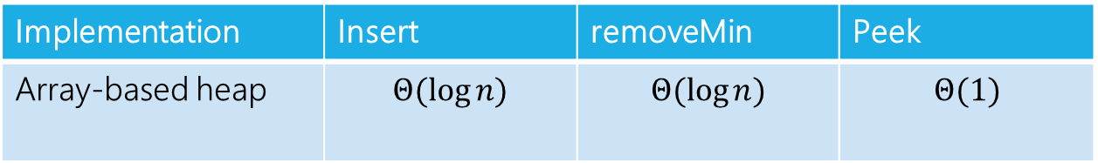
Heap Implementation Worst-Case Runtimes
A
Implementation | Insert | removeMin | Peek
Array-based heap | $$Θ(\log{n)}$$ | $$Θ(\log{n)}$$ | $$Θ(1)$$
B
C
We’ve matched the asymptotic behavior of AVL trees.
But we’re actually doing better!
The constant factors for array accesses are better.
The tree can be a constant factor shorter.
A heap is MUCH simpler to implement.
D
E
F
0 | 1 | 2 | 3 | 4 | 5 | 6 | 7
A | B | C | D | E | F

Slide 25
More Priority Queue Operations

Slide 26
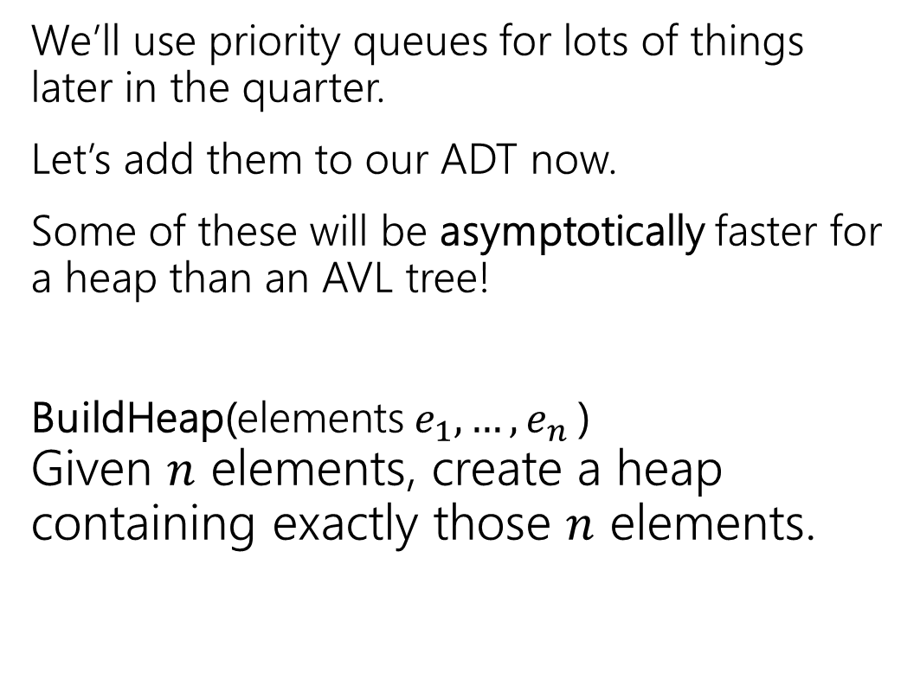
More Operations
Min Priority Queue ADT
We’ll use priority queues for lots of things later in the quarter.
Let’s add them to our ADT now.
Some of these will be asymptotically faster for a heap than an AVL tree!
BuildHeap(elements $e_{1},…,e_{n}$) Given $n$ elements, create a heap containing exactly those $n$ elements.
state
Set of comparable values
- Ordered based on “priority”
behavior
insert(value) – add a new element to the collection
removeMin() – returns the element with the smallest priority, removes it from the collection
peekMin() – find, but do not remove the element with the smallest priority

Slide 27
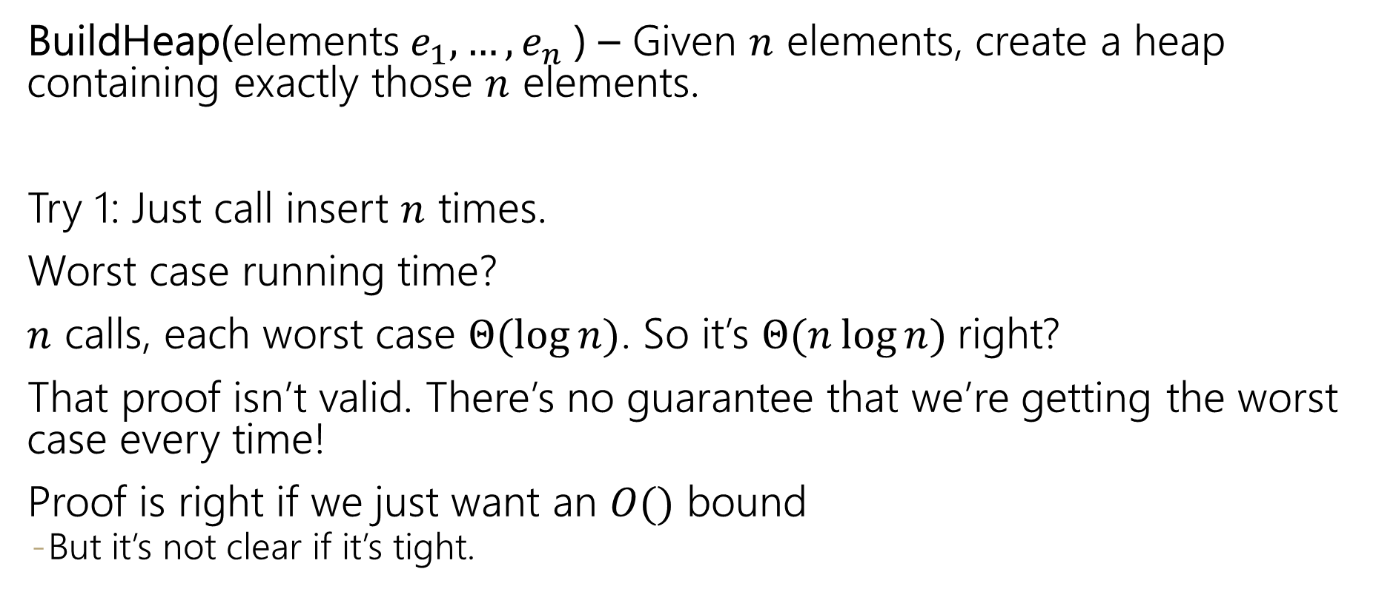
Even More Operations
BuildHeap(elements $e_{1},…,e_{n}$) – Given $n$ elements, create a heap containing exactly those $n$ elements.
Try 1: Just call insert $n$ times.
Worst case running time?
$n$ calls, each worst case $Θ(\log{n})$. So it’s $Θ(n\log{n)}$right?
That proof isn’t valid. There’s no guarantee that we’re getting the worst case every time!
Proof is right if we just want an $O()$ bound
But it’s not clear if it’s tight.

Slide 28
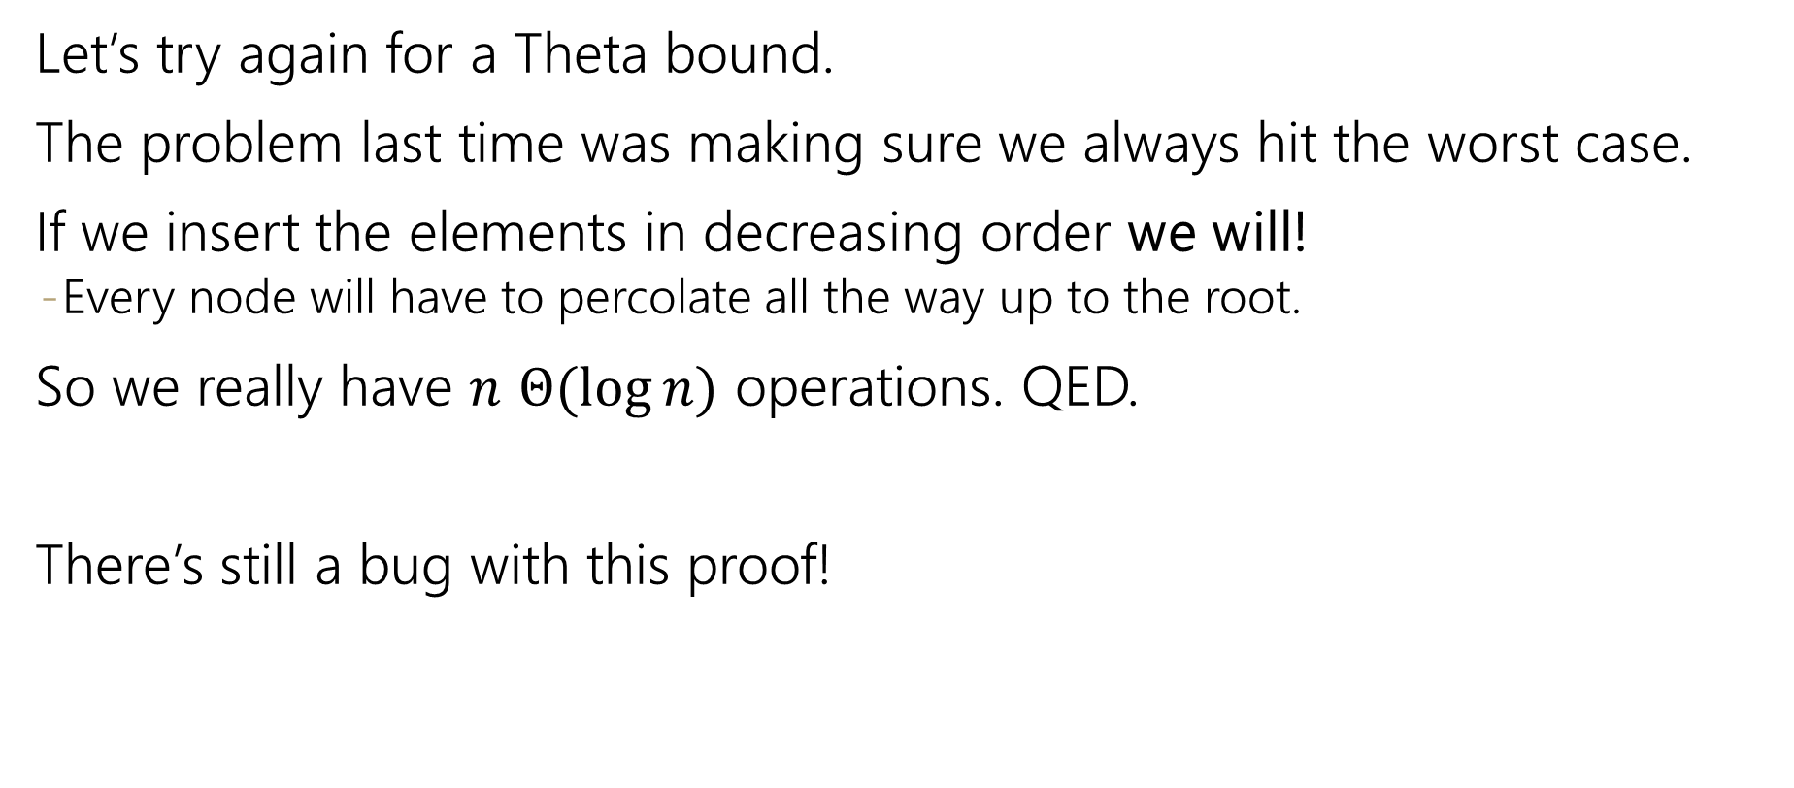
BuildHeap Running Time
Let’s try again for a Theta bound.
The problem last time was making sure we always hit the worst case.
If we insert the elements in decreasing order we will!
Every node will have to percolate all the way up to the root.
So we really have $n$ $Θ(\log{n})$ operations. QED.
There’s still a bug with this proof!

Slide 29
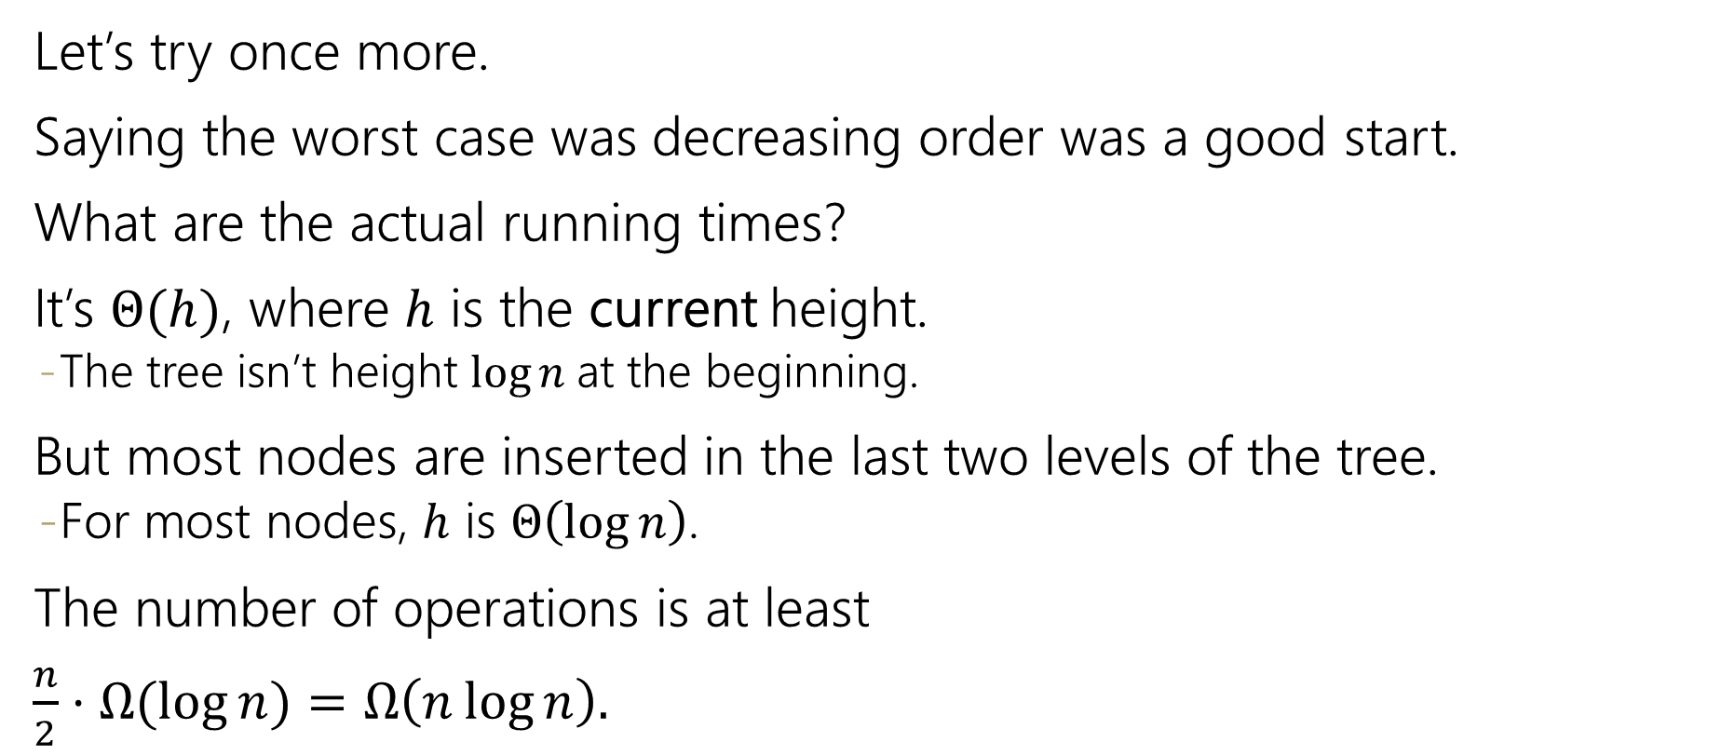
BuildHeap Running Time (again)
Let’s try once more.
Saying the worst case was decreasing order was a good start.
What are the actual running times?
It’s $Θ(h)$, where $h$ is the current height.
The tree isn’t height $\log{n}$at the beginning.
But most nodes are inserted in the last two levels of the tree.
For most nodes, $h$ is $Θ\left(\log{n}\right)$.
The number of operations is at least
$\frac{n}{2}⋅Ω(\log{n)}=Ω\left(n\log{n}\right).$

Slide 30
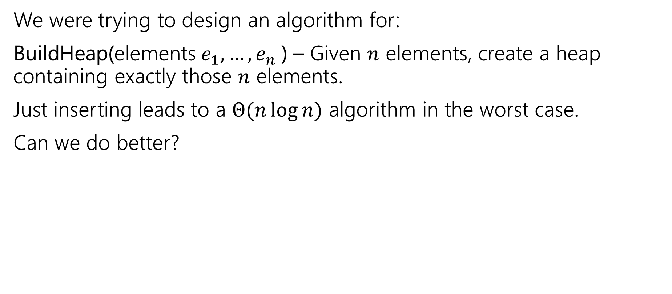
Where Were We?
We were trying to design an algorithm for:
BuildHeap(elements $e_{1},…,e_{n}$) – Given $n$ elements, create a heap containing exactly those $n$ elements.
Just inserting leads to a $Θ(n\log{n)}$ algorithm in the worst case.
Can we do better?

Slide 31
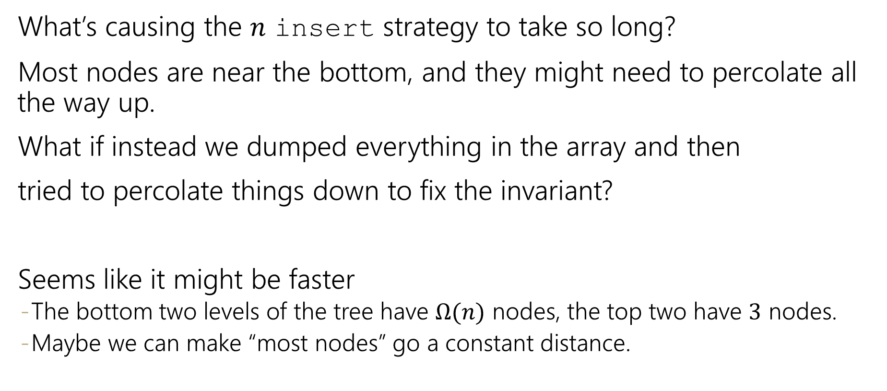
Can We Do Better?
What’s causing the $n$ insert strategy to take so long?
Most nodes are near the bottom, and they might need to percolate all the way up.
What if instead we dumped everything in the array and then
tried to percolate things down to fix the invariant?
Seems like it might be faster
The bottom two levels of the tree have $Ω(n)$ nodes, the top two have $3$ nodes.
Maybe we can make “most nodes” go a constant distance.

Slide 32
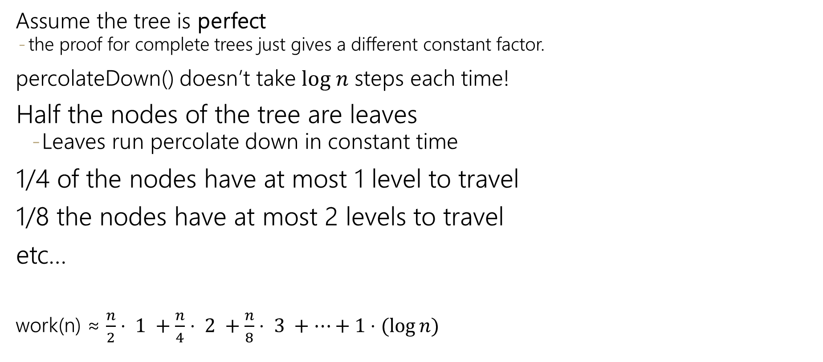
Is It Really Faster?
Assume the tree is perfect
the proof for complete trees just gives a different constant factor.
percolateDown() doesn’t take $log n$ steps each time!
Half the nodes of the tree are leaves
Leaves run percolate down in constant time
1/4 of the nodes have at most 1 level to travel
1/8 the nodes have at most 2 levels to travel
etc…
work(n) ≈ $\frac{n}{2}⋅ 1 +\frac{n}{4}⋅ 2 +\frac{n}{8}⋅ 3 +⋯+1⋅(\log{n})$

Slide 33


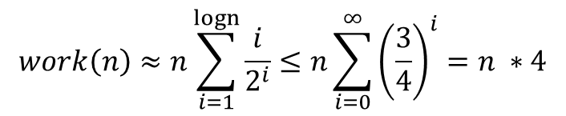
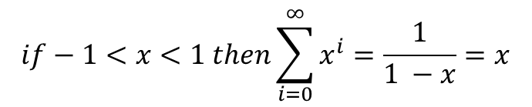


Closed form Floyd’s buildHeap
$\text{n}\text{/2⋅ 1 +}\text{n}\text{/4⋅ 2 +}\text{n}\text{/8⋅ 3 +⋯+1⋅(}\text{log} \text{n}\text{)}$ factor out n
work(n) ≈$n\left(\frac{1}{2}+\frac{2}{4}+\frac{3}{8}+⋯+\frac{\log{n}}{n}\right)$
find a pattern -> powers of 2
work(n) ≈ $n\left(\frac{1}{2^{1}}+\frac{2}{2^{2}}+\frac{3}{2^{3}}+⋯+\frac{\log{n}}{2^{\log{n}}}\right)$
Summation!
$$work\left(n\right)≈n\sum_{i=1}^{?}{\frac{i}{2^{i}}}$$
? = upper limit should give last term
We don’t have a summation for this! Let’s make it look more like a summation we do know.
Infinite geometric series
$$if−1<x<1 then\sum_{i=0}^{∞}{x^{i}}=\frac{1}{1 −x}=x$$
$$work\left(n\right)≈n\sum_{i=1}^{logn}{\frac{i}{2^{i}}≤n\sum_{i=0}^{∞}{{\left(\frac{3}{4}\right)}^{i}=n ∗4}}$$
$$work\left(n\right)≤n\sum_{i=1}^{logn}{\frac{{\left(\frac{3}{2}\right)}^{i}}{2^{i}}}$$
Floyd’s buildHeap runs in O(n) time!
Notes:
Because $\frac{1}{2}$ the nodes are leaves, design algorithms that do less work closer to the bottom!
More careful analysis can reveal tighter bounds
Math strategy: rather than show a <= b directly, it can be simpler to show a <= t then t<= b (a la finding c and n₀)

Slide 34
Floyd’s BuildHeap
Ok, it’s really faster. But can we make it work?
It’s not clear what order to call the percolateDown’s in.
Should we start at the top or bottom? Will one percolateDown on each element be enough?

Slide 35
Floyd’s buildHeap algorithm
Build a tree with the values:
12, 5, 11, 3, 10, 2, 9, 4, 8, 15, 7, 6
12
Add all values to back of array
percolateDown(parent) starting at last index
5
11
3
10
2
9
4
8
15
7
6
0 | 1 | 2 | 3 | 4 | 5 | 6 | 7 | 8 | 9 | 10 | 11 | 12 | 13
12
5
11
3
10
2
9
4
8
15
7
6

Slide 36
Floyd’s buildHeap algorithm
Build a tree with the values:
12, 5, 11, 3, 10, 2, 9, 4, 8, 15, 7, 6
12
Add all values to back of array
percolateDown(parent) starting at last index
percolateDown level 4
percolateDown level 3
5
11
7
9
3
10
2
4
8
15
7
6
10
0 | 1 | 2 | 3 | 4 | 5 | 6 | 7 | 8 | 9 | 10 | 11 | 12 | 13
12
5
11
3
10
2
9
4
8
15
7
6

Slide 37
Floyd’s buildHeap algorithm
Build a tree with the values:
12, 5, 11, 3, 10, 2, 9, 4, 8, 15, 7, 6
12
Add all values to back of array
percolateDown(parent) starting at last index
percolateDown level 4
percolateDown level 3
percolateDown level 2
3
5
11
2
7
6
9
5
10
2
3
11
keep percolating down
like normal here and swap 5 and 4
15
7
11
4
8
10
6
0 | 1 | 2 | 3 | 4 | 5 | 6 | 7 | 8 | 9 | 10 | 11 | 12 | 13
12
5
11
3
7
2
9
4
8
15
10
6

Slide 38
Floyd’s buildHeap algorithm
Build a tree with the values:
12, 5, 11, 3, 10, 2, 9, 4, 8, 15, 7, 6
2
12
Add all values to back of array
percolateDown(parent) starting at last index
percolateDown level 4
percolateDown level 3
percolateDown level 2
percolateDown level 1
3
5
11
2
12
7
9
4
10
2
3
6
5
8
15
7
6
10
11
0 | 1 | 2 | 3 | 4 | 5 | 6 | 7 | 8 | 9 | 10 | 11 | 12 | 13
12
3
2
4
7
6
9
5
8
15
10
11

Slide 39
Floyd’s buildHeap algorithm
Build a tree with the values:
12, 5, 11, 3, 10, 2, 9, 4, 8, 15, 7, 6
2
12
Add all values to back of array
percolateDown(parent) starting at last index
percolateDown level 4
percolateDown level 3
percolateDown level 2
percolateDown level 1
3
5
2
11
6
7
9
4
10
2
3
6
11
5
8
15
7
6
10
11
12
0 | 1 | 2 | 3 | 4 | 5 | 6 | 7 | 8 | 9 | 10 | 11 | 12 | 13
2
3
6
4
7
11
9
5
8
15
10
12

Slide 40
Even More Operations
These operations will be useful in a few weeks…
IncreaseKey(element,priority) Given an element of the heap and a new, larger priority, update that object’s priority.
DecreaseKey(element,priority) Given an element of the heap and a new, smaller priority, update that object’s priority.
Delete(element) Given an element of the heap, remove that element.
Should just be going to the right spot and percolating…
Going to the right spot is the tricky part.
In the programming projects, you’ll use a dictionary to find an element quickly.

