Slide 1
Lecture 14: Sorting Algorithms
CSE 373: Data Structures and Algorithms

Slide 2
Administrivia
Robbie’s office hours today are cancelled (we have to grade your midterms)
Project 3 Partner form is due tomorrow (P3 will be released Wednesday)
Project 2 due Wednesday
Exercise 3 due Friday

Slide 3
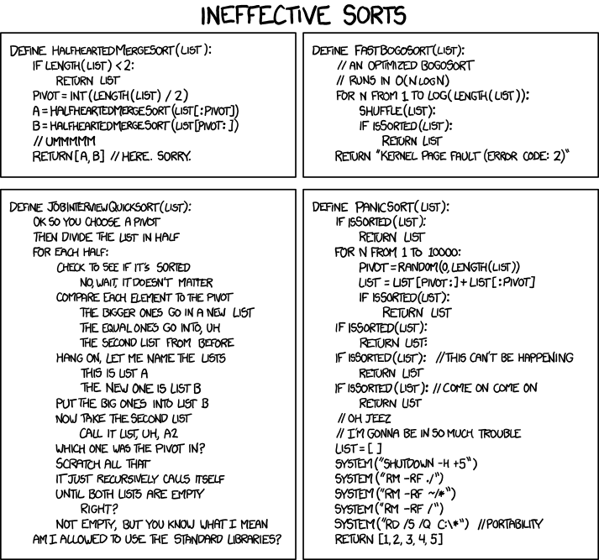
Sorting

Slide 4
Where are we?
This course is “data structures and algorithms”
Data structures
Organize our data so we can process it effectively
Algorithms
Actually process our data!
We’re going to start focusing on algorithms
We’ll start with sorting
A very common, generally-useful preprocessing step
And a convenient way to discuss a few different ideas for designing algorithms.

Slide 5
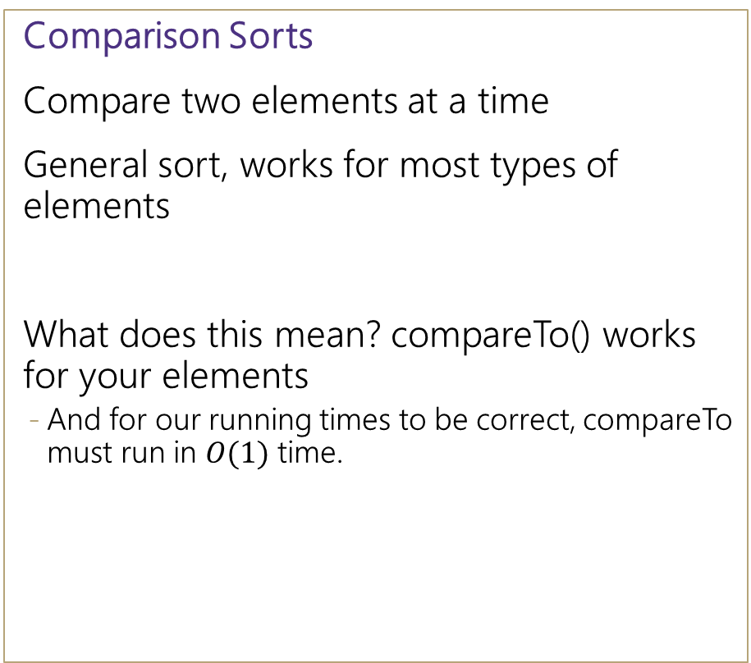
Types of Sorts
Comparison Sorts
Compare two elements at a time
General sort, works for most types of elements
What does this mean? compareTo() works for your elements
And for our running times to be correct, compareTo must run in $O(1)$ time.
Niche Sorts aka “linear sorts”
Leverages specific properties about the items in the list to achieve faster runtimes
niche sorts typically run O(n) time
For example, we’re sorting small integers, or short strings.
In this class we’ll focus on comparison sorts

Slide 6
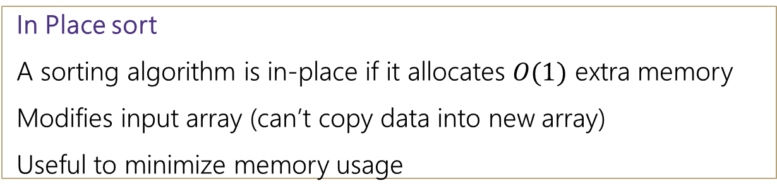
Sorting Goals
In Place sort
A sorting algorithm is in-place if it allocates $O(1)$ extra memory
Modifies input array (can’t copy data into new array)
Useful to minimize memory usage
Speed
Of course, we want our algorithms to be fast.
Sorting is so common, that we often start caring about constant factors.
Stable sort
A sorting algorithm is stable if any equal items remain in the same relative order before and after the sort
Why do we care?
“data exploration” Client code will want to sort by multiple features and “break ties” with secondary features
[(8, “fox”), (9, “dog”), (4, “wolf”), (8, “cow”)]
[(4, “wolf”), (8, “fox”), (8, “cow”), (9, “dog”)]
Stable
[(4, “wolf”), (8, “cow”), (8, “fox”), (9, “dog”)]
Unstable

Slide 7
SO MANY SORTS
Quicksort, Merge sort, in-place merge sort, heap sort, insertion sort, intro sort, selection sort, timsort, cubesort, shell sort, bubble sort, binary tree sort, cycle sort, library sort, patience sorting, smoothsort, strand sort, tournament sort, cocktail sort, comb sort, gnome sort, block sort, stackoverflow sort, odd-even sort, pigeonhole sort, bucket sort, counting sort, radix sort, spreadsort, burstsort, flashsort, postman sort, bead sort, simple pancake sort, spaghetti sort, sorting network, bitonic sort, bogosort, stooge sort, insertion sort, slow sort, rainbow sort…

Slide 8
Goals
Algorithm Design (like writing invariants) is more art than science.
We’ll do a little bit of designing our own algorithms
Take CSE 417 (usually runs in Winter) for more
Mostly we’ll understand how existing algorithms work
Understand their pros and cons
Design decisions!
Practice how to apply those algorithms to solve problems

Slide 9
Algorithm Design Patterns
Algorithms don’t just come out of thin air.
There are common patterns we use to design new algorithms.
Many of them are applicable to sorting (we’ll see more patterns later in the quarter)
Invariants/Iterative improvement
Step-by-step make one more part of the input your desired output.
Using data structures
Speed up our existing ideas
Divide and conquer
Split your input
Solve each part (recursively)
Combine solved parts into a single

Slide 10

Principle 1
Invariants/Iterative improvement
Step-by-step make one more part of the input your desired output.
We’ll write iterative algorithms to satisfy the following invariant:
After $k$ iterations of the loop, the first $k$ elements of the array will be sorted.

Slide 11
Insertion Sort
https://www.youtube.com/watch?v=ROalU379l3U
0 | 1 | 2 | 3 | 4 | 5 | 6 | 7 | 8 | 9
2 | 3 | 6 | 7 | 5 | 1 | 4 | 10 | 2 | 8
Sorted Items
Current Item
Unsorted Items
0 | 1 | 2 | 3 | 4 | 5 | 6 | 7 | 8 | 9
2 | 3 | 5 | 6 | 7 | 8 | 4 | 10 | 2 | 8
Sorted Items
Unsorted Items
Current Item
0 | 1 | 2 | 3 | 4 | 5 | 6 | 7 | 8 | 9
2 | 3 | 5 | 6 | 7 | 8 | 4 | 10 | 2 | 8
Sorted Items
Unsorted Items
Current Item

Slide 12



Insertion Sort
0 | 1 | 2 | 3 | 4 | 5 | 6 | 7 | 8 | 9
2 | 3 | 5 | 6 | 7 | 8 | 4 | 10 | 2 | 8
Sorted Items
Unsorted Items
Current Item
public void insertionSort(collection) {
for (entire list)
if(currentItem is smaller than largestSorted)
int newIndex = findSpot(currentItem);
shift(newIndex, currentItem);
}
public int findSpot(currentItem) {
for (sorted list going backwards)
if (spot found) return
}
public void shift(newIndex, currentItem) {
for (i = currentItem > newIndex)
item[i+1] = item[i]
item[newIndex] = currentItem
}
pollEV.com/cse373su19
What are the best case and worst case times?
Worst case runtime?
Best case runtime?
In-practice runtime?
Stable?
In-place?
$$O(n2)$$
$$O(n)$$
$$O(n2)$$
Yes
Yes

Slide 13
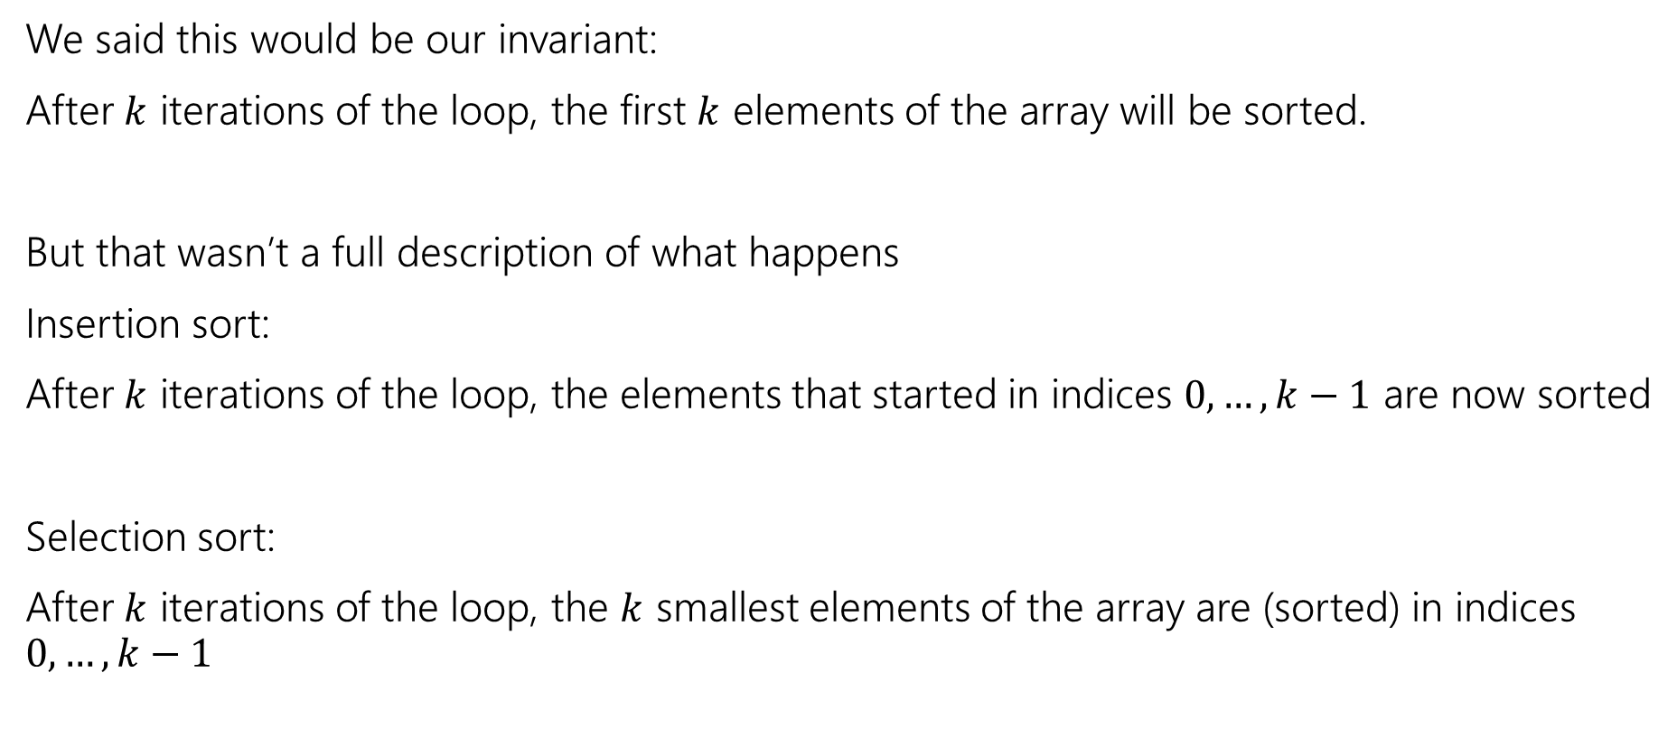
Satisfying the invariant
We said this would be our invariant:
After $k$ iterations of the loop, the first $k$ elements of the array will be sorted.
But that wasn’t a full description of what happens
Insertion sort:
After $k$ iterations of the loop, the elements that started in indices $0,…,k−1$ are now sorted
Selection sort:
After $k$ iterations of the loop, the $k$ smallest elements of the array are (sorted) in indices $0,…,k−1$

Slide 14
Selection Sort
https://www.youtube.com/watch?v=Ns4TPTC8whw
0 | 1 | 2 | 3 | 4 | 5 | 6 | 7 | 8 | 9
2 | 3 | 6 | 7 | 18 | 10 | 14 | 9 | 11 | 15
Sorted Items
Current Item
Unsorted Items
0 | 1 | 2 | 3 | 4 | 5 | 6 | 7 | 8 | 9
2 | 3 | 6 | 7 | 9 | 10 | 14 | 18 | 11 | 15
Sorted Items
Current Item
Unsorted Items
0 | 1 | 2 | 3 | 4 | 5 | 6 | 7 | 8 | 9
2 | 3 | 6 | 7 | 9 | 10 | 18 | 14 | 11 | 15
Sorted Items
Unsorted Items
Current Item

Slide 15

Selection Sort
0 | 1 | 2 | 3 | 4 | 5 | 6 | 7 | 8 | 9
2 | 3 | 6 | 7 | 18 | 10 | 14 | 9 | 11 | 15
Sorted Items
Current Item
Unsorted Items
public void selectionSort(collection) {
for (entire list)
int newIndex = findNextMin(currentItem);
swap(newIndex, currentItem);
}
public int findNextMin(currentItem) {
min = currentItem
for (unsorted list)
if (item < min)
min = currentItem
return min
}
public int swap(newIndex, currentItem) {
temp = currentItem
currentItem = newIndex
newIndex = currentItem
}
Worst case runtime?
Best case runtime?
In-practice runtime?
Stable?
In-place?
$$O(n2)$$
$$O(n2)$$
$$O(n2)$$
No
Yes

Slide 16
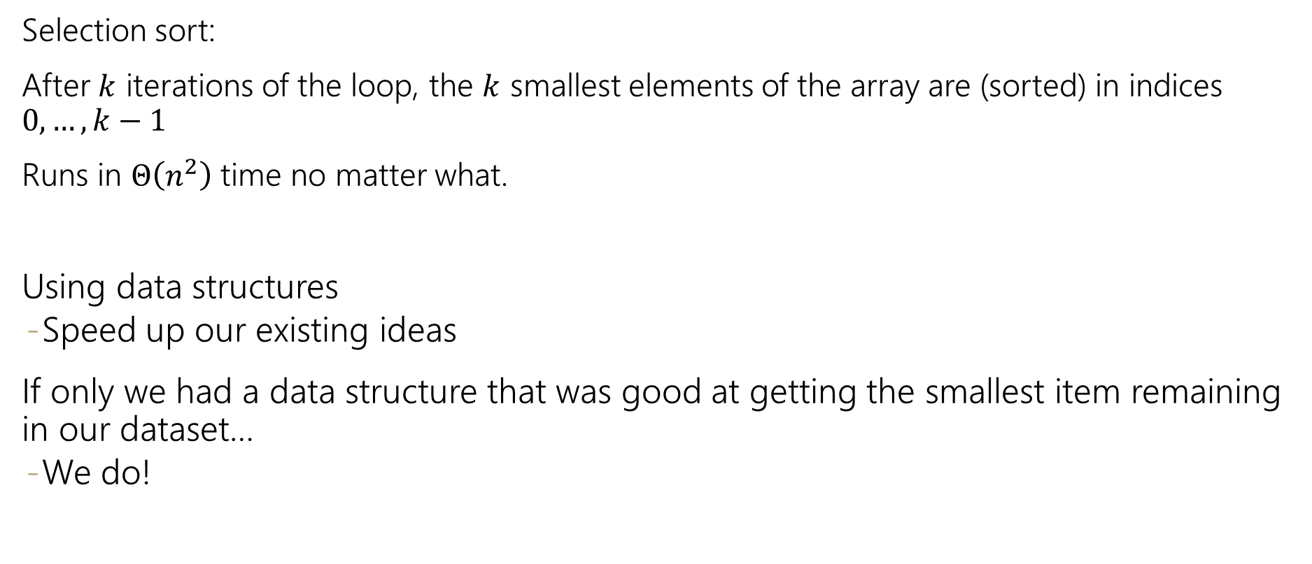
Principle 2
Selection sort:
After $k$ iterations of the loop, the $k$ smallest elements of the array are (sorted) in indices $0,…,k−1$
Runs in $Θ\left(n^{2}\right)$ time no matter what.
Using data structures
Speed up our existing ideas
If only we had a data structure that was good at getting the smallest item remaining in our dataset…
We do!

Slide 17



Heap Sort
https://www.youtube.com/watch?v=Xw2D9aJRBY4
1. run Floyd’s buildHeap on your data
2. call removeMin n times
public void heapSort(collection) {
E[] heap = buildHeap(collection)
E[] output = new E[n]
for (n)
output[i] = removeMin(heap)
}
Worst case runtime?
Best case runtime?
In-practice runtime?
Stable?
In-place?
$$O(n\log{n})$$
$$O(n\log{n})$$
$$O(n\log{n})$$
No

Slide 18
In Place Heap Sort
0 | 1 | 2 | 3 | 4 | 5 | 6 | 7 | 8 | 9
1 | 4 | 2 | 14 | 15 | 18 | 16 | 17 | 20 | 22
Heap
Sorted Items
Current Item
0 | 1 | 2 | 3 | 4 | 5 | 6 | 7 | 8 | 9
22 | 4 | 2 | 14 | 15 | 18 | 16 | 17 | 20 | 1
percolateDown(22)
Heap
Sorted Items
Current Item
0 | 1 | 2 | 3 | 4 | 5 | 6 | 7 | 8 | 9
2 | 4 | 16 | 14 | 15 | 18 | 22 | 17 | 20 | 1
Heap
Sorted Items
Current Item

Slide 19


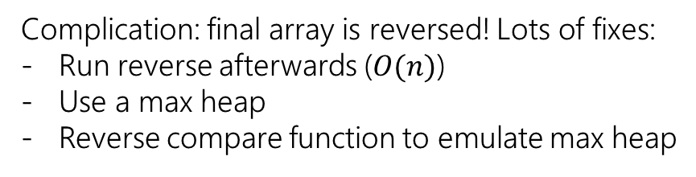

In Place Heap Sort
0 | 1 | 2 | 3 | 4 | 5 | 6 | 7 | 8 | 9
15 | 17 | 16 | 18 | 20 | 22 | 14 | 4 | 2 | 1
Heap
Sorted Items
Current Item
public void inPlaceHeapSort(collection) {
E[] heap = buildHeap(collection)
for (n)
output[n – i - 1] = removeMin(heap)
}
Worst case runtime?
Best case runtime?
In-practice runtime?
Stable?
In-place?
$$O(n\log{n})$$
$$O(n\log{n})$$
$$O(n\log{n})$$
Complication: final array is reversed! Lots of fixes:
Run reverse afterwards ($O(n)$)
Use a max heap
Reverse compare function to emulate max heap
No
Yes

Slide 20
Principle 3: Divide and Conquer
1. Divide your work into smaller pieces recursively
Pieces should be smaller versions of the larger problem
2. Conquer the individual pieces
Recursion!
Until you hit the base case
3. Combine the results of your recursive calls
divideAndConquer(input) {
if (small enough to solve)
conquer, solve, return results
else
divide input into a smaller pieces
recurse on smaller piece
combine results and return
}

Slide 21
Merge Sort
https://www.youtube.com/watch?v=XaqR3G_NVoo
Divide
0 | 1 | 2 | 3 | 4 | 5 | 6 | 7 | 8 | 9
8 | 2 | 91 | 22 | 57 | 1 | 10 | 6 | 7 | 4
0 | 1 | 2 | 3 | 4
8 | 2 | 91 | 22 | 57
5 | 6 | 7 | 8 | 9
1 | 10 | 6 | 7 | 4
Sort the pieces through the magic of recursion
magic
Combine
0 | 1 | 2 | 3 | 4
2 | 8 | 22 | 57 | 91
5 | 6 | 7 | 8 | 9
1 | 4 | 6 | 7 | 10
0 | 1 | 2 | 3 | 4 | 5 | 6 | 7 | 8 | 9
1 | 2 | 4 | 6 | 7 | 8 | 10 | 22 | 57 | 91

Slide 22

Merge Sort
0 | 1 | 2 | 3 | 4
8 | 2 | 57 | 91 | 22
0 | 1
8 | 2
0 | 1 | 2
57 | 91 | 22
mergeSort(input) {
if (input.length == 1)
return
else
smallerHalf = mergeSort(new [0, ..., mid])
largerHalf = mergeSort(new [mid + 1, ...])
return merge(smallerHalf, largerHalf)
}
0
8
0
2
0
57
0 | 1
91 | 22
0
91
0
22
1 if n<= 1
2T(n/2) + n otherwise
0 | 1
22 | 91
Worst case runtime?
Best case runtime?
Average runtime?
Stable?
In-place?
T(n) =
= $O(n\log{n})$
Same
0 | 1
2 | 8
0 | 1 | 2
22 | 57 | 91
Same
Yes
0 | 1 | 2 | 3 | 4
2 | 8 | 22 | 57 | 91
No

Slide 23
Divide and Conquer
There’s more than one way to divide!
Mergesort:
Split into two arrays.
Elements that just happened to be on the left and that happened to be on the right.
Quicksort:
Split into two arrays.
Elements that are “small” and elements that are “large”
What do I mean by “small” and “large” ?
Choose a “pivot” value (an element of the array)
One array has elements smaller than pivot, other has elements larger than pivot.

Slide 24
Quick Sort v1
https://www.youtube.com/watch?v=ywWBy6J5gz8
Divide
Combine (no extra work if in-place)
0 | 1 | 2 | 3 | 4 | 5 | 6 | 7 | 8 | 9
8 | 2 | 91 | 22 | 57 | 1 | 10 | 6 | 7 | 4
0 | 1 | 2 | 3 | 4
2 | 1 | 6 | 7 | 4
0
8
0 | 1 | 2 | 3
91 | 22 | 57 | 10
Sort the pieces through the magic of recursion
magic
0 | 1 | 2 | 3 | 4
1 | 2 | 4 | 6 | 7
0
8
0 | 1 | 2 | 3
10 | 22 | 57 | 91
0 | 1 | 2 | 3 | 4 | 5 | 6 | 7 | 8 | 9
1 | 2 | 4 | 6 | 7 | 8 | 10 | 22 | 57 | 91

Slide 25



Quick Sort v1
0 | 1 | 2 | 3 | 4 | 5 | 6
20 | 50 | 70 | 10 | 60 | 40 | 30
0
10
0 | 1 | 2 | 3 | 4
50 | 70 | 60 | 40 | 30
quickSort(input) {
if (input.length == 1)
return
else
pivot = getPivot(input)
smallerHalf = quickSort(getSmaller(pivot, input))
largerHalf = quickSort(getBigger(pivot, input))
return smallerHalf + pivot + largerHalf
}
0 | 1
40 | 30
0 | 1
70 | 60
0
30
0
60
0 | 1
30 | 40
0 | 1
60 | 70
T(n) =
1 if n<= 1
n + T(n - 1) otherwise
= $O\left(n^{2}\right)$
Worst case runtime?
Best case runtime?
In-practice runtime?
Stable?
In-place?
0 | 1 | 2 | 3 | 4
30 | 40 | 50 | 60 | 70
T(n) =
1 if n<= 1
n + 2T(n/2) otherwise
=$O(n\log{n)}$
Just trust me $O(n\log{n)}$
0 | 1 | 2 | 3 | 4 | 5 | 6
10 | 20 | 30 | 40 | 50 | 60 | 70
No
Can be done

Slide 26
Quick Sort v2 (in-place)
0 | 1 | 2 | 3 | 4 | 5 | 6 | 7 | 8 | 9
8 | 1 | 4 | 9 | 0 | 3 | 5 | 2 | 7 | 6
0 | 1 | 2 | 3 | 4 | 5 | 6 | 7 | 8 | 9
6 | 1 | 4 | 9 | 0 | 3 | 5 | 2 | 7 | 8
Low
X < 6
High
X >= 6
0 | 1 | 2 | 3 | 4 | 5 | 6 | 7 | 8 | 9
6 | 1 | 4 | 2 | 0 | 3 | 5 | 9 | 7 | 8
Low
X < 6
High
X >= 6
0 | 1 | 2 | 3 | 4 | 5 | 6 | 7 | 8 | 9
5 | 1 | 4 | 2 | 0 | 3 | 6 | 9 | 7 | 8

Slide 27
Quick Sort v2 (in-place)
0 | 1 | 2 | 3 | 4 | 5 | 6 | 7 | 8 | 9
6 | 1 | 4 | 2 | 0 | 3 | 5 | 9 | 7 | 8
quickSort(input) {
if (input.length == 1)
return
else
pivot = getPivot(input)
smallerHalf = quickSort(getSmaller(pivot, input))
largerHalf = quickSort(getBigger(pivot, input))
return smallerHalf + pivot + largerHalf
}
1 if n<= 1
n + T(n - 1) otherwise
Worst case runtime?
Best case runtime?
In-practice runtime?
Stable?
In-place?
T(n) =
= O(n^2)
T(n) =
1 if n<= 1
n + 2T(n/2) otherwise
= O(nlogn)
Just trust me
= O(nlogn)
No
Yes

Slide 28
Can we do better?
We’d really like to avoid hitting the worst case.
Key to getting a good running time, is always cutting the array (about) in half.
How do we choose a good pivot?
Here are four options for finding a pivot. What are the tradeoffs?
Just take the first element
Take the median of the first, last, and middle element
Take the median of the full array
Pick a random element as a pivot

Slide 29
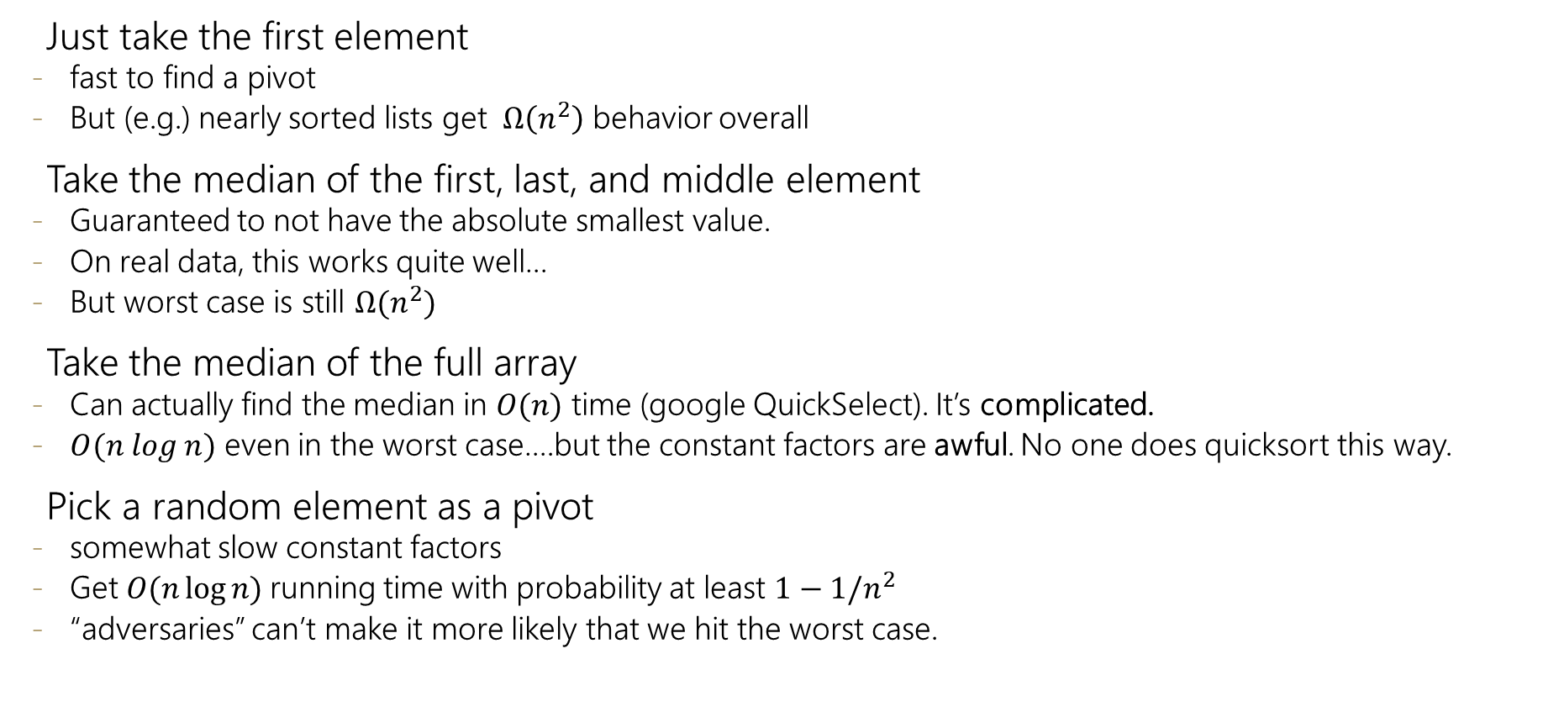
Pivots
Just take the first element
fast to find a pivot
But (e.g.) nearly sorted lists get $Ω\left(n^{2}\right)$ behavior overall
Take the median of the first, last, and middle element
Guaranteed to not have the absolute smallest value.
On real data, this works quite well…
But worst case is still $Ω(n^{2})$
Take the median of the full array
Can actually find the median in $O(n)$ time (google QuickSelect). It’s complicated.
$O(n log n)$ even in the worst case….but the constant factors are awful. No one does quicksort this way.
Pick a random element as a pivot
somewhat slow constant factors
Get $O(n\log{n)}$running time with probability at least $1−1/n^{2}$
“adversaries” can’t make it more likely that we hit the worst case.
Median of three is a common choice in practice

