Slide 1
CSE 403
Lecture 2
Software Lifecycle Models
Reading:
Rapid Development Ch. 7, 25
(further reading: Ch. 21, 35, 36, 20)
slides created by Marty Stepp
http://www.cs.washington.edu/403/

Slide 2
Lecture outline
The software lifecycle
  evaluating models
Lifecycle models
  code-and-fix
  waterfall
  spiral
  evolutionary prototyping
  staged delivery
  design-to-schedule

Slide 3
Big questions
What is a software lifecycle model? When and why should we use such models?
How do we decide which model is the best one to use?
Briefly describe each of these models:
  code-and-fix, waterfall, spiral, evolutionary prototyping, staged delivery, design-to-schedule
What are some benefits and drawbacks of each model?

Slide 4
How complex is software?
Measures of complexity:
  lines of code
    Windows Server 2003: 50 MSLoC
    Debian 5.0: 324 MSLoC (61 years to type at 50wpm!)
  number of classes
  number of modules
  module interconnections and dependencies
  time to understand
  # of authors
  … many more

Slide 5
Ad-hoc development
ad-hoc development: no formal process (aka "code and fix")
  Sounds great! No learning required.
drawbacks?
  some important actions (design, testing) may go ignored
  not clear when to start or stop doing each task
  does not scale well to multiple people
  not easy to review or evaluate one's work
  code didn't match user's needs (no requirements!)
  code was not planned for modification, not flexible
Key observation: The later a problem is found, the more expensive it is to fix.

Slide 6
The "Software Lifecycle"
software lifecycle: The entire process of creating a software product from an initial concept until the last user stops using it.
  often divided into "phases":
    Requirements Analysis & Specification
    High-level (Architectural) Design
    Detailed (Object-oriented) Design
    Implementation, Integration, Debugging
    Testing, Profiling, Quality Assurance
    Operation and Maintenance
    other possibilities: Risk Assessment, Prototyping
  goals of each phase:
    mark out a clear set of steps to perform
    produce a tangible document or item
    allow for review of work
    specify actions to perform in the next phase

Slide 7
Some lifecycle models
code-and-fix: write some code, debug it, repeat (i.e., ad-hoc)
waterfall: standard phases (req., design, code, test) in order
spiral: assess risks at each step; do most critical action first
evolutionary prototyping: build an initial small requirement spec, code it, then "evolve" the spec and code as needed
staged delivery: build initial requirement specs for several releases, then design-and-code each in sequence
agile development: iterative, adaptive, incremental improvement done by self-organizing cross-functional teams

Slide 8
Benefit/cost of models
benefits of models
  decomposing workflow, understanding/managing process
limitations of models
  can lead to compromises and artificial constraints
  risk of overemphasizing process (not the end in itself)
ways of evaluating models
  risk management, quality/cost control, predictability, visibility of progress, customer involvement/feedback

Slide 9
Waterfall
req. change
benefits?
  formal, standard; specific phases with clear goals
  clear divisions between phases
  good feedback loops between adjacent phases
requirements
verify
design
verify
implement
test
operations
retirement

Slide 10
Drawbacks of waterfall
req. change
drawbacks?
  assumes requirements will be clear and well-understood
  requires a lot of planning up front (not always easy)
  rigid, linear; not adaptable to change in the product
  costly to "swim upstream" back to a previous phase
  nothing to show until almost done ("we're 90% done, I swear!")
requirements
verify
design
verify
implement
test
operations
retirement

Slide 11
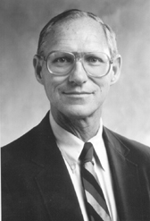
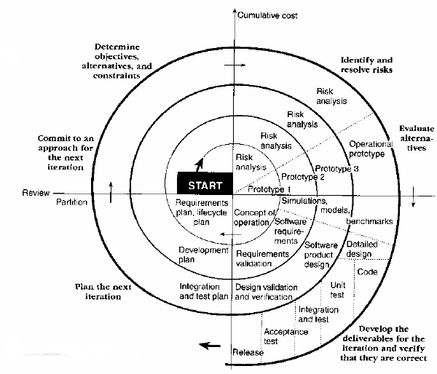
Spiral
Barry Boehm, USC
steps taken at each loop:
  determine objectives
  and constraints
  identify risks
  evaluate options to
  resolve risks
  develop and verify deliverables
benefits?
  provides early indication of unforeseen problems
  always addresses the biggest risk first
  accommodates changes, growth
  eliminates errors and unattractive choices early

Slide 12
Drawbacks of spiral
Barry Boehm, USC
steps taken at each loop:
  determine objectives
  and constraints
  identify risks
  evaluate options to
  resolve risks
  develop and verify deliverables
drawbacks?
  relies on developers to have risk-assessment expertise
  perhaps over-focuses on risk and "putting out fires"; other features may go ignored because they are not "risky" enough
  complex; how do you actually follow this?
  works poorly when bound to an inflexible contract

Slide 13
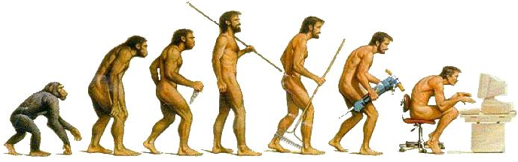
Evolutionary prototyping
build initial requirements, design/code it, "evolve" as needed
benefits?
  produces steady signs of progress, builds customer confidence
  useful when requirements are not well known or change rapidly
  customer involvement ("What do you think of this version?")
requirements
arch. design
for each build:
detailed design,
implement,
test, deliver
operations
verify
verify
retirement

Slide 14
Drawbacks of evolutionary
drawbacks?
  assumes user's initial spec will be flexible
  unclear how much iteration/time will be needed to finish
  fails for separate pieces that must then be integrated
  temporary fixes become permanent constraints
  bridging; new software trying to gradually replace old
requirements
arch. design
for each build:
detailed design,
implement,
test, deliver
operations
verify
verify
retirement

Slide 15
Staged delivery
staged delivery
  waterfall-like beginnings, then develop in short stages
  tight coordination with docs, management, marketing
  can ship at any time during implementation
  from the outside (to customers) it looks like a successful delivery even if it is not the final goal the team aimed for
How does staged delivery differ from evolutionary prototyping?
  In staged delivery, requirements are better known ahead of time rather than discovered by customer feedback on each release.

Slide 16
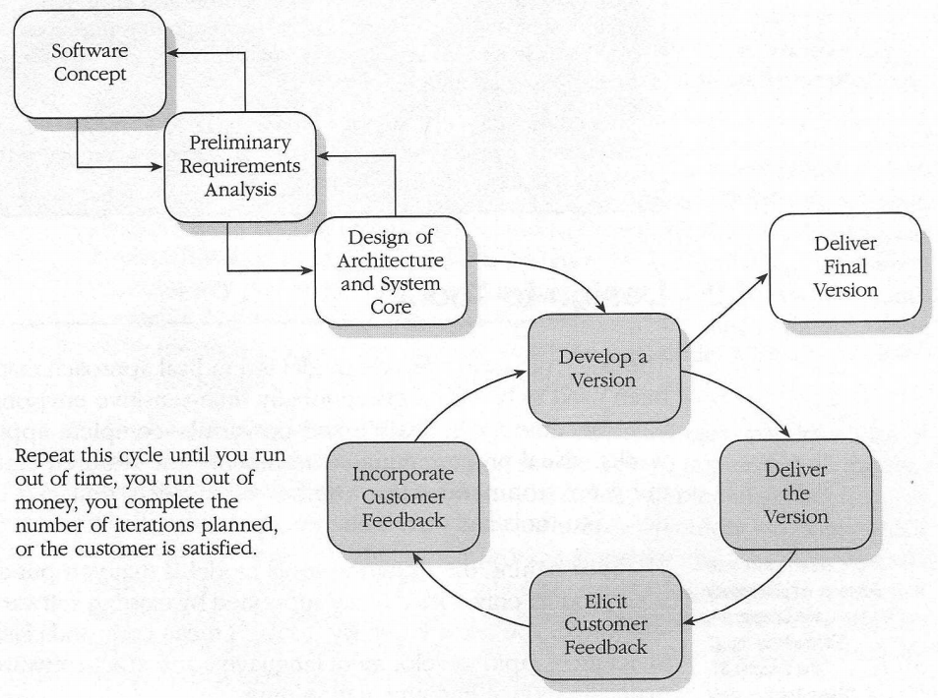
Evolutionary delivery
evolutionary delivery
  a hybrid between evolutionary
  prototyping and staged delivery
difference from evo. prototyping
  focuses on low-level systems first
  evo. prototyping focuses on visible aspects (front-end)

Slide 17
Design-to-*
design-to-schedule
  useful when you absolutely need to ship by a certain date
  similar to the staged delivery model
    but less flexible because of the fixed shipping date
  requires careful prioritization of features and risks to address
  not recommended
design-to-tools
  a model where the project only incorporates features that are easy to implement by using or combining existing components
  reduces development time at cost of losing control of project
  not recommended
off-the-shelf software: don't build it, just purchase it (...)

Slide 18
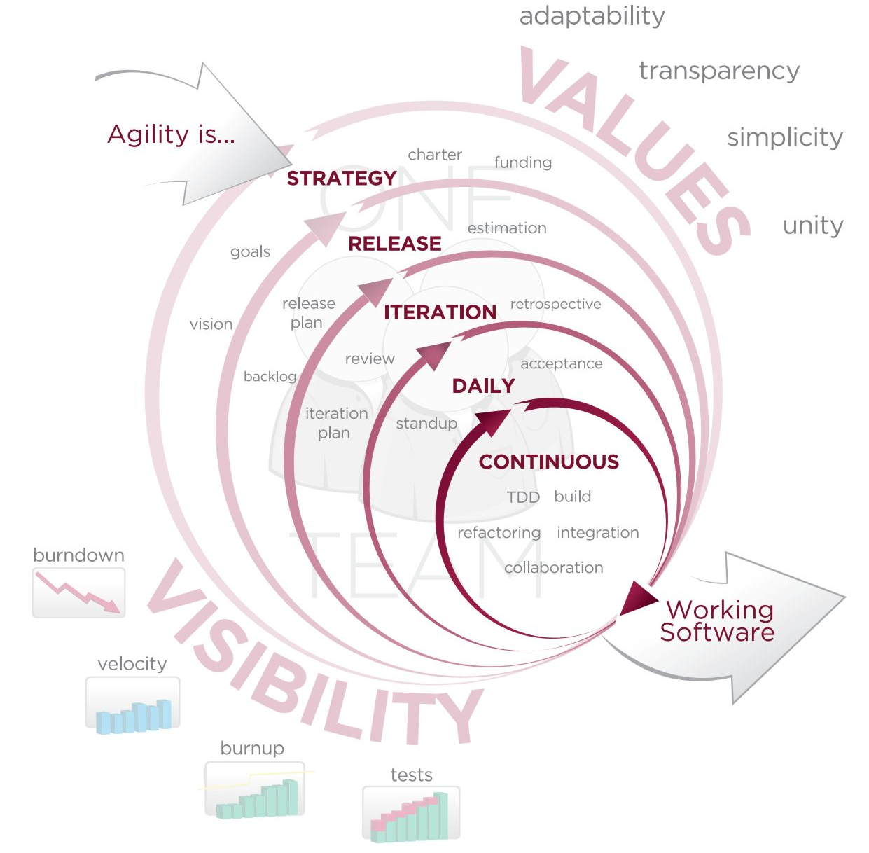
Agile development
agile software development: An adaptive, iterative process where teams self-organize and build features dynamically.
  Extreme Programming
  Scrum
values:
  Individuals and interactions
  over processes and tools
  Working software
  over documentation
  Customer collaboration
  over contract negotiation
  Responding to change
  over following a plan

Slide 19
Agile Manifesto
The 12-point Agile Manifesto:
  customer satisfaction by rapid delivery of useful software
  welcome changing requirements, even late in development
  working software is delivered frequently (weeks rather than months)
  working software is the principal measure of progress
  sustainable development, able to maintain a constant pace
  close, daily co-operation between business people and developers
  face-to-face conversation is the best form of communication
  projects are built around motivated individuals, who are trusted
  continuous attention to technical excellence and good design
  simplicity
  self-organizing teams
  regular adaptation to changing circumstance
Works well when used with small teams of experts who can handle a bit of uncertainty, chaos, change

Slide 20
Model category matrix
Rate each model 1-5 in each of the categories shown:
 | Risk mgmt. | Quality/ cost ctrl. | Predict- ability | Visibility of progress | Customer involvement
code-and-fix
waterfall
spiral
evolutionary prototyping
staged delivery
design-to-schedule
 | Risk mgmt. | Quality/ cost ctrl. | Predict- ability | Visibility of progress | Customer involvement
code-and-fix | 1 | 1 | 1 | 3 | 1
waterfall | 3 | 4 | 4 | 1 | 2
spiral | 5 | 5 | 3 | 3 | 3
evolutionary prototyping | 3 | 3 | 2 | 5 | 5
staged delivery | 4 | 5 | 4 | 4 | 4
design-to-schedule | 4 | 3 | 5 | 3 | 2

Slide 21
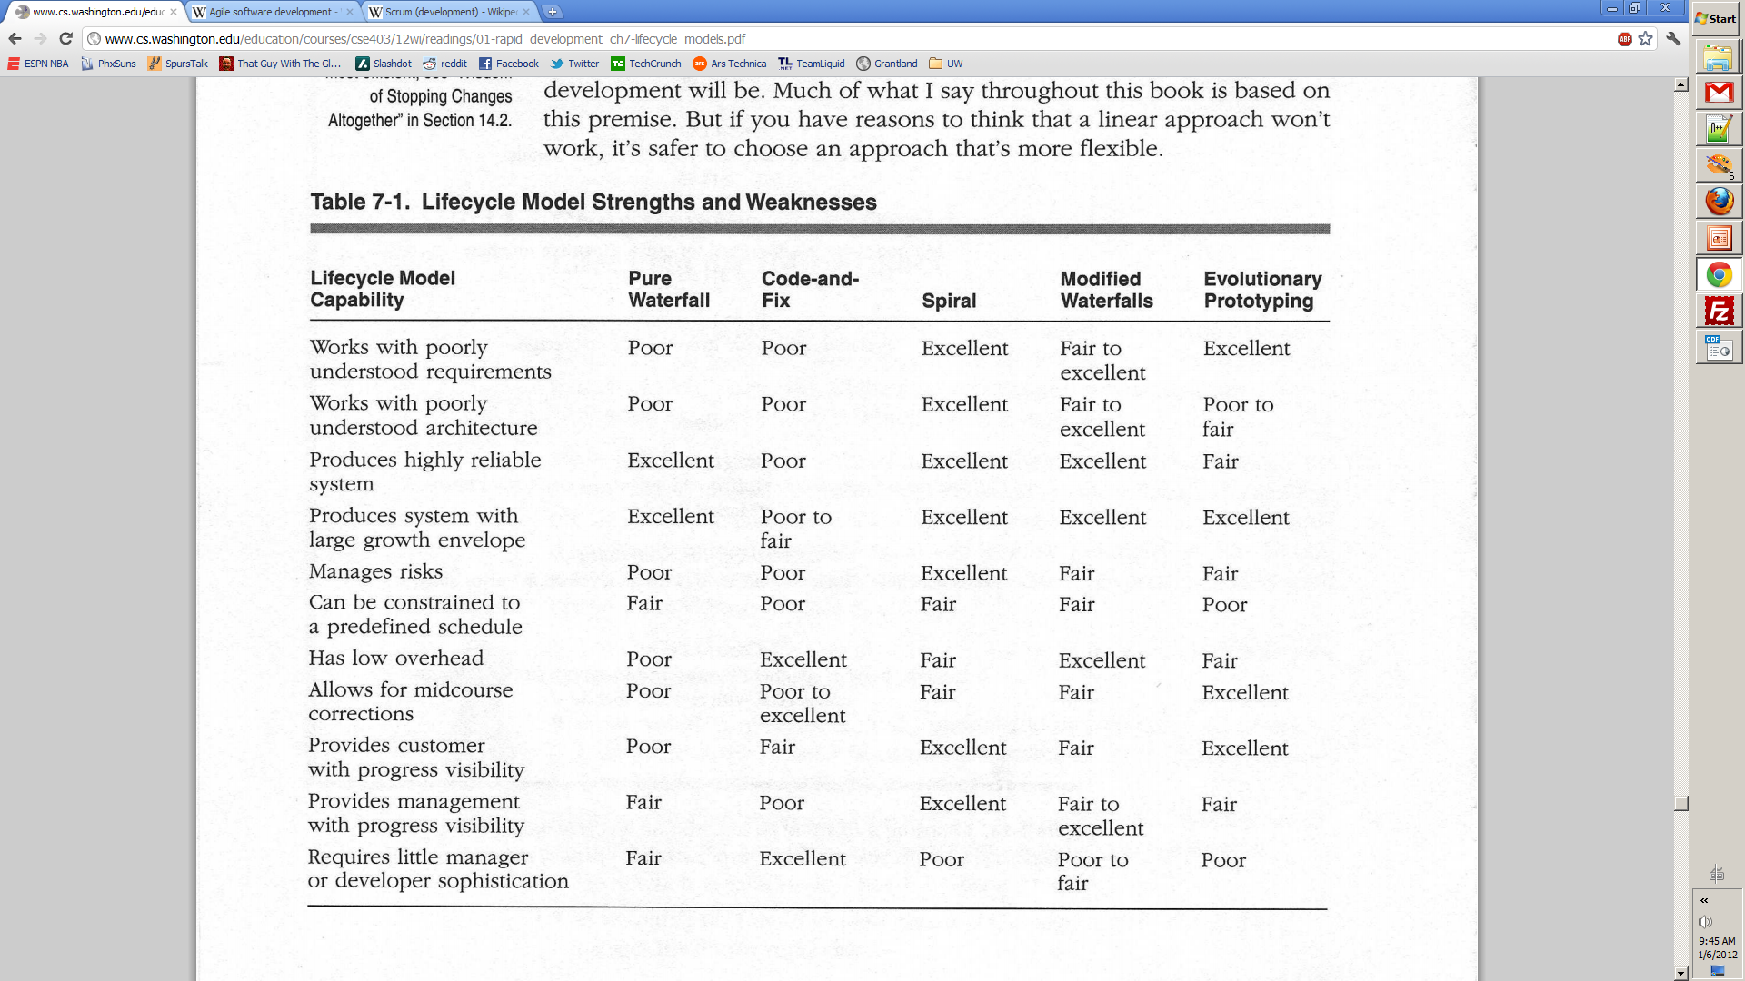
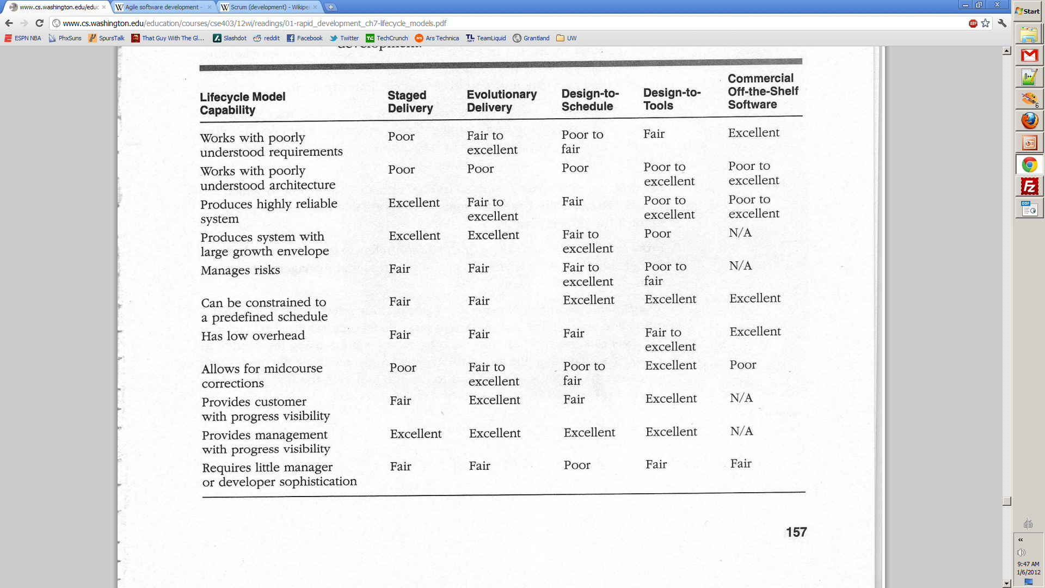
Model pros/cons

