Slide 1
CSE 403
Lecture 3
Software Requirements
Reading:
Pragmatic Programmer Ch. 7: Before the Project
slides created by Marty Stepp
http://www.cs.washington.edu/403/

Slide 2
Big questions
What are requirements?
How do we gather or find out requirements?
Once we know some of the requirements, how do we write them down and document them?
  What should and shouldn't be included?
  How much detail should we use?

Slide 3
Are requirements important?
"The hardest single part of building a software system is deciding precisely what to build. No other part of the conceptual work is so difficult as establishing the detailed technical requirements, including all the interfaces to people, to machines, and to other software systems. No other part of the work so cripples the resulting system if done wrong. No other part is more difficult to rectify later.
Therefore the most important function that software builders do for their clients is the iterative extraction and refinement of the product requirements."
-- Fred Brooks, The Mythical Man-Month

Slide 4
Software requirements
requirements: goals that the software needs to accomplish
  "what" and not "how"
  the system design, not the software design
  describes the problem, not the (detailed) solution
roles of requirements
  customers: show what should be delivered; contractual base
  managers: a scheduling / progress indicator
  designers: provide a spec to design
  coders: list a range of acceptable implementations / output
  QA / testers: a basis for testing, validation, verification

Slide 5
Policy vs. mechanism
policy: A set of ideas or rules; a plan of what to do.
mechanism: A process, system, or technique to get a result.
  It's important to decouple policy (what) from mechanism (how).
  Mechanisms should not dictate or overly constrain your policies.
Q: How much policy information should be in requirements?
A: Some, but not much detail. Don't include business policy.
  Good: "Our product will have an access system to protect private features such as employee records."
  Bad: "Only the administrator may view employee records."

Slide 6
"Digging" for requirements
How does one find out the requirements for a project?
Do:
  Talk to the users, or work with them, to learn how they work.
  Ask questions throughout the process to "dig" for requirements.
  Think about why users do something in your app, not just what.
  Allow (and expect) requirements to change later.
Don't:
  Describe complex business logic or rules of the system.
  Be too specific or detailed.
  Describe the exact user interface used to implement a feature.
  Try to think of everything ahead of time. (You will fail.)
  Add unnecessary features not wanted by the customers.

Slide 7
Feature creep/bloat
feature creep: Gradual accumulation of features over time.
  Often has a negative overall effect on a large software project.
Why does feature creep happen? Why is it bad?
Can you think of any products that have had feature creep?
  Because features are "fun"
    developers like to code them
    marketers like to brag about them
    users want them
    ... but too many means more bugs, more delays, less testing, ...
"stone soup" and "boiled frog" analogies
Notes:
"stone soup" analogy : hungry soldiers add ingredients to "stone" soup until it is essentially real soup, then eat it
"boiled frog" analogy : a frog placed into water that gradually increases in temperature will not notice the change and die

Slide 8
DRY and abstractions
Y2K was (in a sense) a requirements problem.
  coders didn't consolidate date logic in one place for easy change
  should have had a requirement such as:
    "The system will be designed for expandability such that it can be easily modified later to work in years 2000 and beyond."
DRY principle: Don't Repeat Yourself.
  Abstractions live longer than details.
  A good abstraction allows you to change/fix details later.
"Premature optimization is the root of all evil." -- Donald Knuth
Notes:
The developers of that old code didn't want to handle dates the "right" way because of wasted time and efficiency. But they didn't have to handle them the right way; they just had to have a layer of abstraction that (currently) did it the wrong way, but allowed them to later swap in a new version that did it the right way, that all the other code would now use.

Slide 9
Good or bad?
Which of the following are good requirements? Why/why not?
  The system will enforce 6.5% sales tax on Washington purchases.
  The system shall display the elapsed time for the car to make one circuit around the track within 5 seconds, in hh:mm:ss format.
  The product will never crash. It will also be secure against hacks.
  The server backend will be written using PHP or Ruby on Rails.
  The system will support a large number of connections at once, and each user will not experience slowness or lag.
  The user can choose a document type from the drop-down list.
Notes:
Answer: They are all bad!
- Shouldn't embed exact sales tax in the req.
- Compound sentence; really 3 reqs in one.
- Too vague and impossible to verify. Be quantitative. How many crashes per year? Etc.
- Vague. Pick just one.
- Vague. How many connections? How much lag (seconds)?
- Over-specified. Don't describe the UI in English.

Slide 10
Classifying requirements
The classic way to classify requirements:
  functional: map inputs to outputs
    "The user can search either all databases or a subset."
    "Every order gets an ID the user can save to account storage."
  nonfunctional: other constraints
    performance, dependability, reusability, safety
    "Our deliverable documents shall conform to the XYZ standard."
    "The system shall not disclose any personal user information."

Slide 11
Faulk's requirement model
Another way to classify requirements (S. Faulk, U. of Oregon):
  behavioral: about implementation; can be measured
    features
    performance
    security
  development quality attributes: part of internal construction
    flexibility
    maintainability
    reusability
    (these are more subjective)

Slide 12
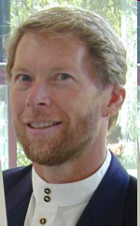
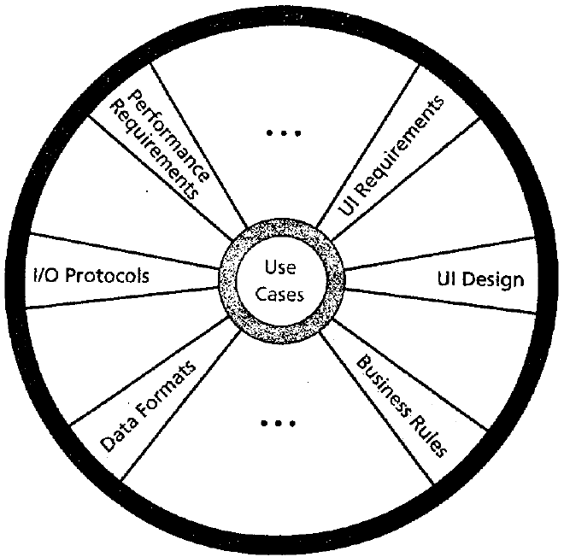
Cockburn's template
Alistair Cockburn's suggested outline for functional requirements:
purpose and scope
terms / glossary
use cases
technology used
other
  development process:
  participants, values (fast, good, cheap?),
  visibility, competition, dependencies
  business rules / constraints
  performance demands
  security (now a hot topic), documentation
  usability
  portability
  unresolved / deferred
human issues: legal, political, organizational, training
Cockburn says the central artifact of requirements is the use case.

Slide 13
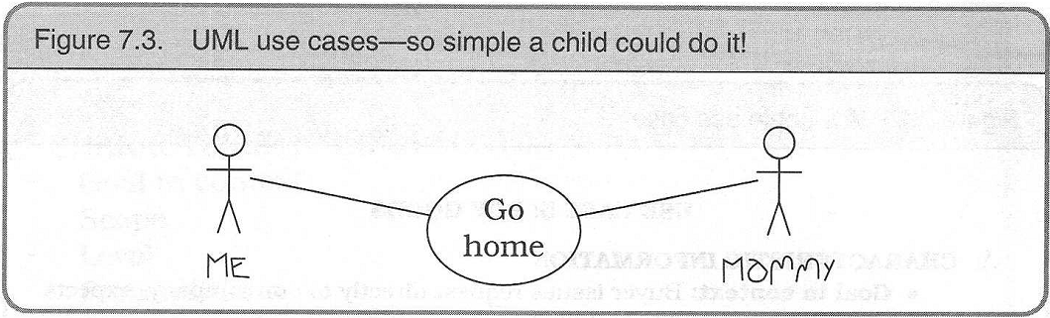
Is formal notation good?
There are standard templates for requirements documents, diagrams, etc. with specific rules. Is this a good thing? Should we use these standards or make up our own?
  Good; standards are helpful as a template or starting point
  But don't be a slave to formal rules or use a model/scheme that doesn't fit your project's needs.

Slide 14
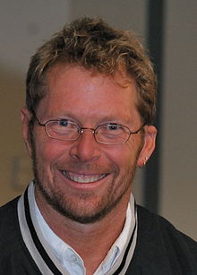
More about Cockburn
pronounced "Ko'-burn" (!)
One of the fathers of the Agile movement.
  championed the idea of use cases
  also influential in user stories in agile methodology
  has his own dev model called Crystal Clear development
Cockburn Scale of Criticality (how important is a feature?):
  Loss of Life (L)
  Loss of Essential Money (E)
  Loss of Discretionary Money (D)
  Loss of Comfort (C)
wrote a "Oath of Non-Allegiance" about accepting new ideas

